Slide 1

An experiment on hierarchical Text Embedding using Stack-Layered Autoencoder
Sarthak Bhatnagar (x21185352)
MSc. in Data Analytics.
School of Computing
National College of Ireland

Slide 2
What is the need for Hierarchical structure in Autoencoders?
Features | Single-Layer | Multi-Layer
Number of layers | 1 | >1
Representation learning | Linear | Non-Linear
Hierarchical representation learning | No | Yes
Complex representation learning | Limited | More Capable
Natural language processing tasks | Text Classification and Summarization | Text Classification, Summarization, and Q/A System, etc.

Slide 3
Research Question
What effect do Bi-LSTM and Bi-GRU layers have on the autoencoders for Text Embedding?
What effect does stacking layers have on the accuracy of autoencoders for Text Embedding?

Slide 4

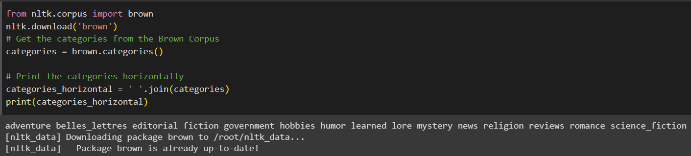
Dataset Information
The Brown Corpus is one of the first million-word corpora of the English language. The text contains 500 sources and is categorized based on genre.

Slide 5

Visualizations

Slide 6
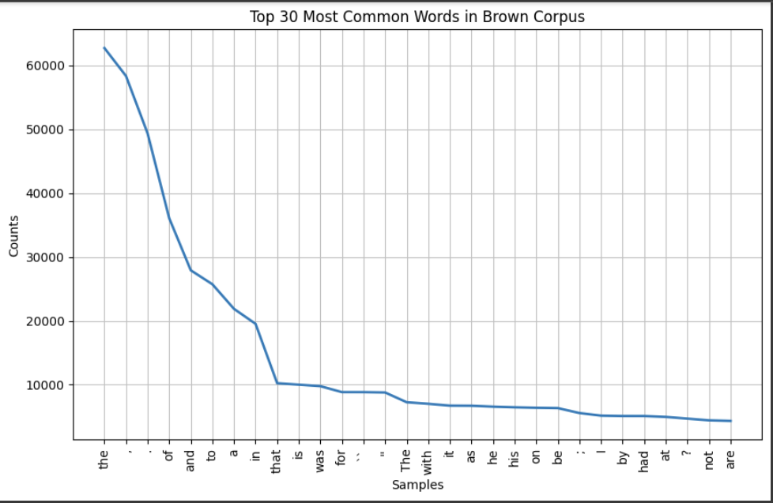
Top 30 Most common words and their distribution.

Slide 7
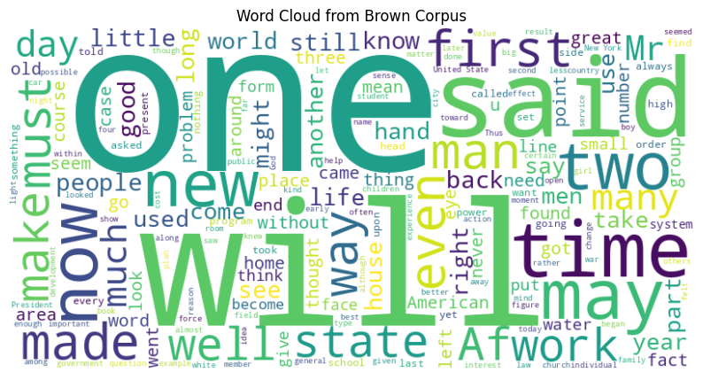
Wordcloud of the corpus.
Wordclouds are eye-catchy and engaging visualizations that are used to identify the most common words and the size of the word is proportional to the frequency of the word used in the corpora.

Slide 8
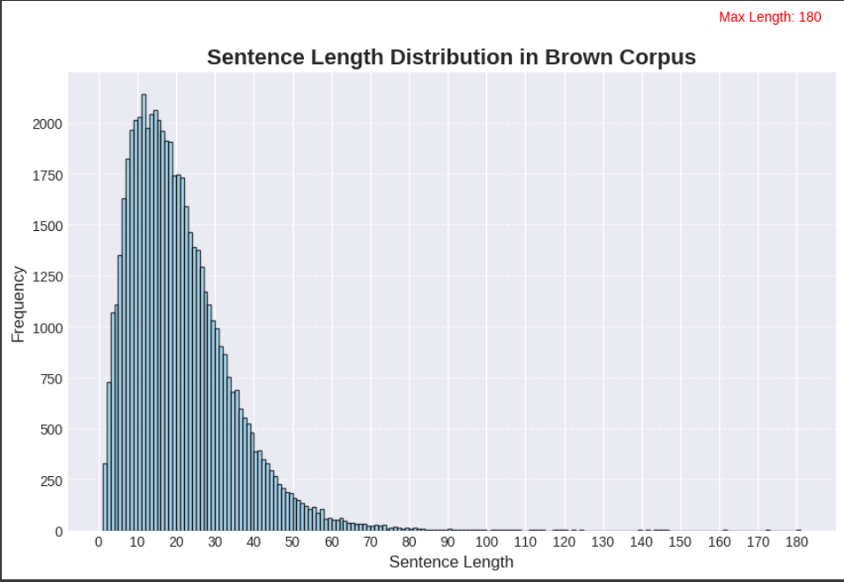
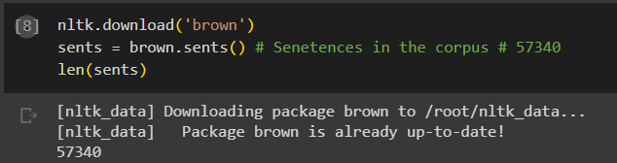
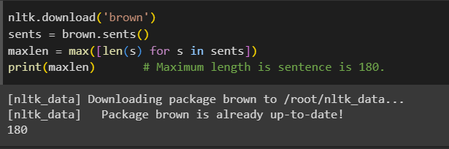
Distribution for Sentences
Number of Sentences = 57340
Maximum Length of Sentences = 180

Slide 9
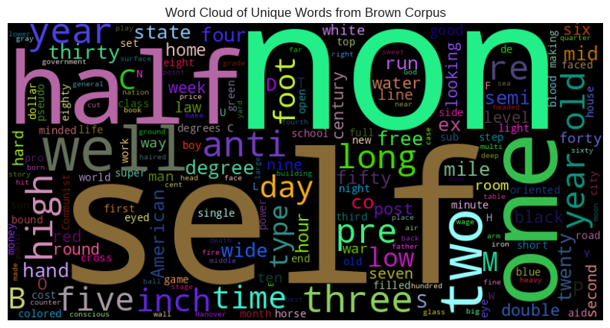
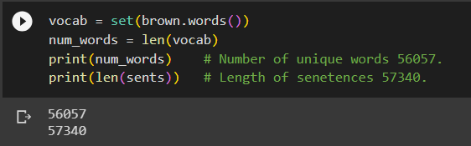
Count of unique words and its wordcloud.
Number of Unique words = 56057
Length of Sentences = 57340

Slide 10
Hyperparameters used.
Hyperparameters | Description | Values
Number of Words | maximum number of words in the vocabulary | 10000
Embedding Dimensions | The embedding in encoders and decoders | 256
Batch size | Data samples will be processed in each iteration | 512
Max Length | The maximum length of input sequences. | 60
Epochs | Number of times the entire training dataset will be used to train the model. | 10
Workers | To speeds up data processing by performing tasks concurrently. | 16

Slide 11

Model Implementation Phase

Slide 12
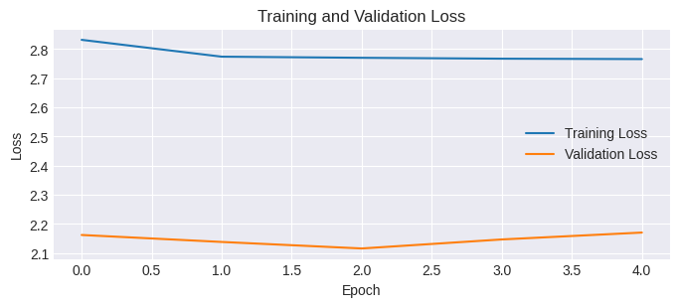
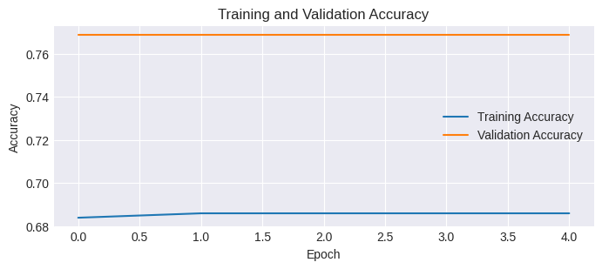
One-Bidirectional LSTM for Stack-Layered Autoencoder.
Layers | Loss | Accuracy | Training Time
Bi-LSTM | 2.6530 | 70.25 | 3hrs 7mins

Slide 13
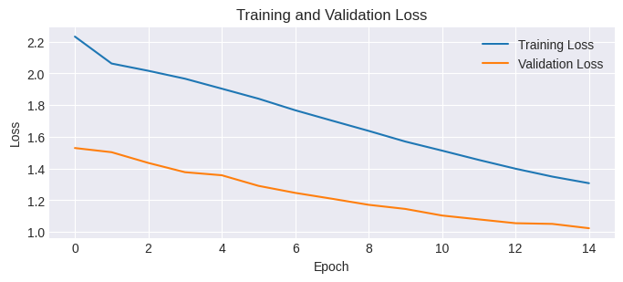
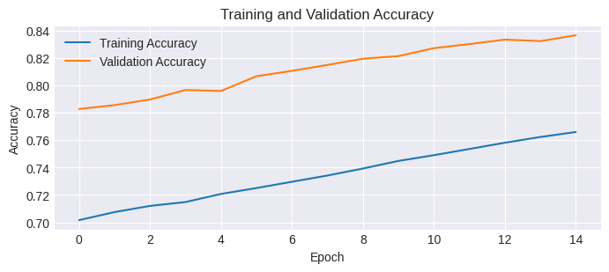
TWO-Bidirectional LSTM for Stack-Layered Autoencoder.
Layers | Loss | Accuracy | Training Time
Two Bi-LSTM | 1.2044 | 78.33 | 6hrs 1min

Slide 14
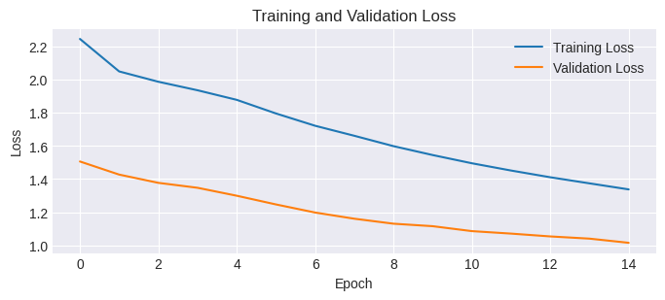

Three-Bidirectional LSTM for Stack-Layered Autoencoder.
Layers | Loss | Accuracy | Training Time
Three Bi-LSTM | 1.2277 | 78.18 | 7hrs 11mins

Slide 15

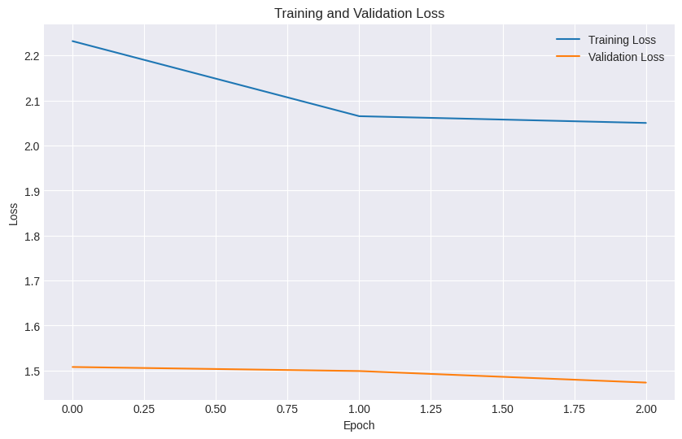

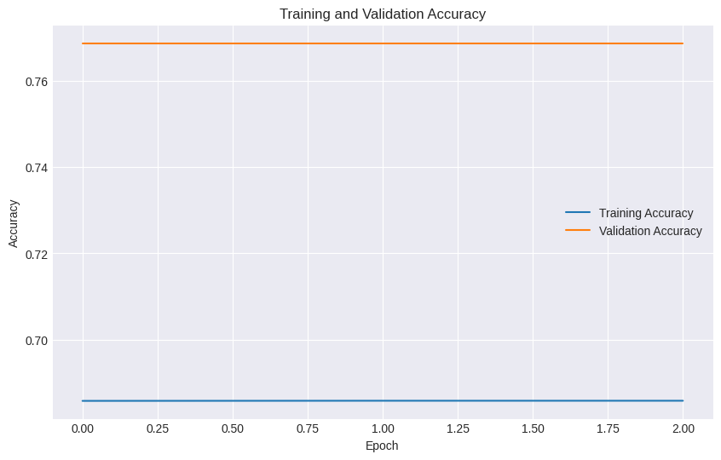

Four-Bidirectional LSTM for Stack-Layered Autoencoder.
Layers | Loss | Accuracy | Training Time
Four-Bi-LSTM | nan | 68.81 | 2hrs 36mins

Slide 16
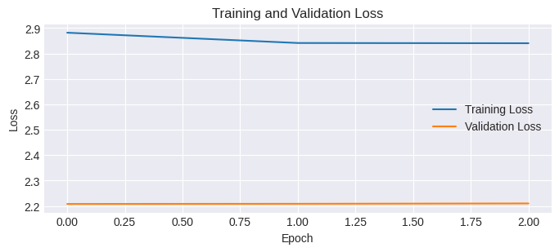

One-Bidirectional GRU for Stack-Layered Autoencoder.
Layers | Loss | Accuracy | Training Time
Bi-GRU | 2.7098 | 68.81 | 1hr 56mins

Slide 17
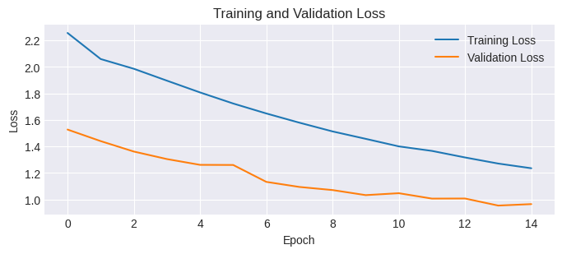
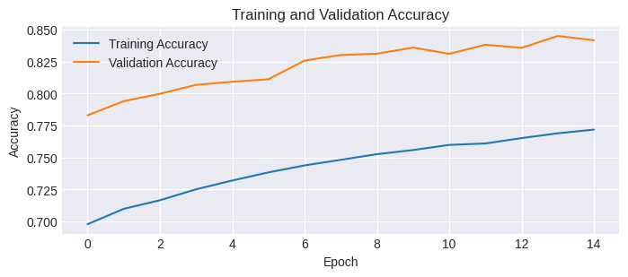

Two-Bidirectional GRU for Stack-Layered Autoencoder.
Layers | Loss | Accuracy | Training Time
Two Bi-GRU | 1.1583 | 78.58 | 6hr 20mins

Slide 18
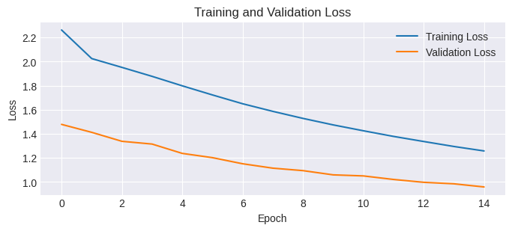

Three-Bidirectional GRU for Stack-Layered Autoencoder.
Layers | Loss | Accuracy | Training Time
Two Bi-GRU | 1.1466 | 79.74 | 7hr 17mins

Slide 19
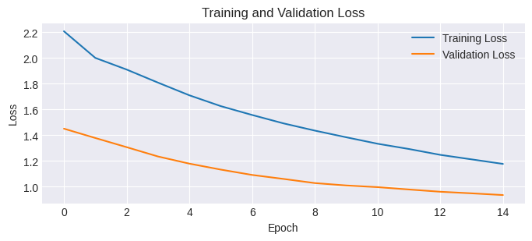
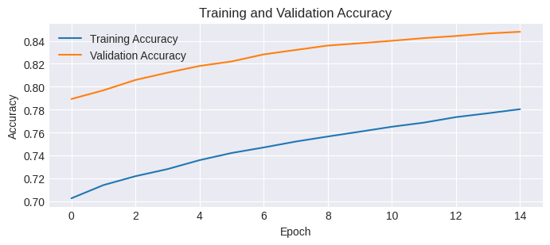
Four-Bidirectional GRU for Stack-Layered Autoencoder.
Layers | Loss | Accuracy | Training Time
Two Bi-GRU | 1.0873 | 79.75 | 6hr 29mins

Slide 20
RESULTS
Layers | Loss | Accuracy | Training Time
Bi-LSTM | 2.6530 | 70.25 | 3hrs 7mins
Two_Bi-LSTM | 1.2044 | 78.33 | 6hrs 1mins
Three_Bi-LSTM | 1.2277 | 78.18 | 7hrs 11mins
Four_Bi-LSTM | nan | 68.81 | 2hrs 36mins
Layers | Loss | Accuracy | Training Time
Bi-GRU | 2.7098 | 68.81 | 1hr 56mins
Two_Bi-GRU | 1.1583 | 78.58 | 6hrs 20mins
Three_Bi-GRU | 1.1466 | 79.74 | 7hrs 17mins
Four_Bi-GRU | 1.0873 | 79.75 | 6hrs 29mins

Slide 21

Thank you

