Slide 1

SMART INDIA HACKATHON 2026
SOFTWARE BASED MODEL DEVELOPMENT FOR DESIGN OF AREA SPECIFIC SHELTER FOR THERMAL COMFORT MAINTENANCE
Problem Statement ID- SIH26051
Problem Statement Title- Software Based Model Development for Design of Area Specific shelter for Thermal Comfort.
Theme- Miscellaneous
PS Category- Software
Team ID- SIH26-A0H-T097
TEAM ZENITH

Slide 2
CREATING A WEBSITE FOR “THERMAL SHELTER”
TEAM ZENITH
SOFTWARE-BASED SHELTER DESIGN:
STHIRA – AN INNOVATIVE SOLUTION
Software-based shelter design uses climate data and simulation tools to develop structures that provide better thermal comfort for users and stored crops. It analyzes important environmental factors such as temperature, humidity, wind speed, solar radiation, and rainfall to understand the conditions of a particular location. The design process considers local climatic conditions, available construction materials, and site characteristics to create shelters that are suitable for their surroundings. Different passive design strategies, such as natural ventilation, shading, insulation, and proper building orientation, are incorporated to control heat naturally. Computer simulations help evaluate the performance of a proposed shelter and identify the most effective design solutions before actual construction.
STHIRA is a web-based platform developed to provide customized, low-cost, and climate-responsive shelter designs based on the specific requirements of users. The website uses relevant climate conditions and user inputs to suggest shelter solutions that are better suited to the selected location. STHIRA is mainly focused on crop storage, where proper temperature control and ventilation are important for maintaining crop quality. The platform considers factors such as local climate, shelter requirements, materials, and passive cooling techniques while developing suitable design solutions. It aims to provide farmers and users with affordable shelter options that can be implemented using locally available and practical materials. The system helps users understand how different design choices can affect thermal comfort, energy consumption, and overall shelter performance. By combining technology, climate analysis, and sustainable design principles, STHIRA provides a practical solution for developing efficient crop-storage shelters. The ultimate goal of STHIRA is to make climate-responsive shelter design easier, more accessible, economical, and sustainable for different users and locations.
CLIMATE-RESPONSIVE APPROACH:
The main idea is to use local climate data to design shelters that can maintain suitable indoor conditions without relying heavily on artificial cooling systems. The system studies how the surrounding climate affects the shelter and uses this information to develop a design that provides natural cooling and improved thermal comfort. Features such as ventilation openings, shading elements, suitable materials, and roof design can be optimized according to the climatic conditions. By responding to the local environment, the shelter can help reduce the heat entering the structure and maintain a more suitable temperature inside. This approach is especially useful for crop storage because maintaining appropriate conditions can help protect crops from excessive heat and environmental damage.

Slide 3
TECHNICAL APPROACH
TEAM ZENITH
TECHNICAL COMPONENTS AND IMPLEMENTATION OF STHIRA
Simulation and Design Optimization – The proposed shelter designs can be evaluated using software-based simulations to understand their thermal performance. This helps identify better combinations of materials, ventilation, shading, and orientation before the shelter is constructed. User-Centered Design – The platform is designed around the specific needs and limitations of the user, allowing recommendations to be adapted according to location, budget, crop requirements, and locally available resources.
Climate Data API – Collects local climate information such as temperature, humidity, wind speed, and solar radiation to understand the environmental conditions of the selected location. Recommendation Algorithm – Analyzes the collected climate data along with user requirements and recommends suitable shelter designs, materials, and passive cooling strategies. Language Support – Provides the website in multiple languages so that users from different regions can easily understand the design recommendations and use the platform effectively. Optional Hardware Integration – Can be connected with sensors or other hardware devices to collect real-time information such as temperature and humidity for more accurate shelter recommendations. Working Prototype – STHIRA – A functional website that brings all these components together and provides users with customized, low-cost, and climate-responsive shelter designs for crop storage.

Slide 4
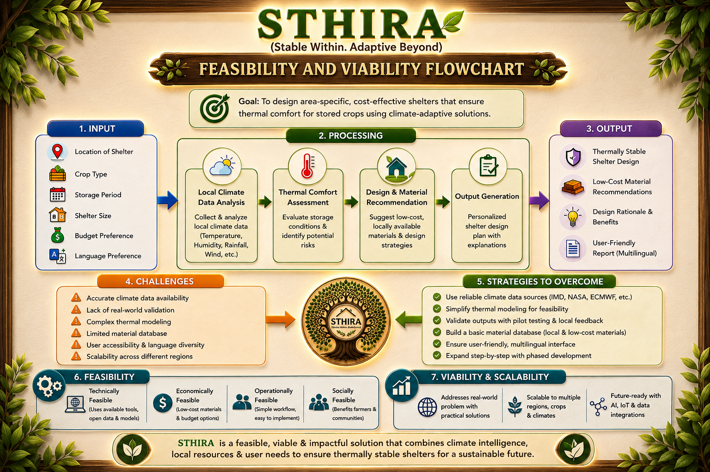
FEASIBILITY AND VIABILITY
TEAM ZENITH

Slide 5
IMPACT AND BENEFITS
TEAM ZENITH
Environmental Sustainability: Promotes eco-friendly materials and reduces energy consumption.
Community Resilience: Supports climate-adaptive shelters that can better respond to changing local climatic conditions.
Improved Comfort & Health: Maintains better thermal conditions, improving comfort and well-being for users.
Lower Construction Costs: Recommends affordable, locally available, and cost-effective materials.
IMPACT AND BENEFITS
Affordable Shelter Solutions: Makes thermally stable shelter design more accessible to communities with different budgets.
Reduced Carbon Footprint: Helps lower carbon emissions by decreasing dependence on energy-intensive systems.
Reduced Energy Costs: Minimizes dependence on active heating and cooling systems through passive design strategies.

Slide 6
RESEARCH AND REFERENCES
TEAM ZENITH
sciencedirect.com in Bing
Read on Springer
ASHRAE Standard 55 (2023) – Thermal Environmental Conditions for Human Occupancy.
ISO 52016-1:2017 – Energy Performance of Buildings: Energy Needs for Heating and Cooling and Internal Temperatures.
NASA POWER – Solar and meteorological climate datasets for energy, agriculture, and infrastructure applications.
India Meteorological Department / Climate Data Service Portal – Indian weather and climate data services.
EnergyPlus, U.S. Department of Energy – Whole-building energy and thermal performance simulation.

