Slide 1
INDIAN INSTITUTE OF TECHNOLOGY GUWAHATI
Department of Chemistry
CH 499: B.Tech Project - I
Wearable AI for Insulin Resistance Screening
Non-Invasive Metabolic Health Monitoring Using Consumer Wearables & Machine Learning
Presented by: Sarvagya Tiwari | Roll No. 230122047
Supervisor: Prof. Ritika Jain | Department of Chemistry, IIT Guwahati
November 2026

Slide 2
Presentation Outline
01
Background & Problem Statement
Clinical burden of insulin resistance and limitations of invasive screening
02
Research Objectives
Six core goals guiding the experimental framework
03
Datasets & Cohort Architecture
Three-cohort design: NHANES, Google Health, MESA (N = 6,698)
04
Methodology
Feature engineering, ML/DL architectures, and validation protocols
05
Results: Regression & Classification
Continuous HOMA-IR prediction and IR risk stratification
06
Results: Interpretability & Transfer
SHAP feature attribution and zero-shot cross-cohort generalization
07
Production Architecture & Conclusion
Smartwatch deployment blueprint and key takeaways
Department of Chemistry | IIT Guwahati
2/14

Slide 3
Background & Problem Statement
The Clinical Challenge
▸ Insulin resistance (IR) is the root driver of Type 2 Diabetes, cardiovascular disease, and metabolic syndrome
▸ Over 40% of adults globally have impaired insulin sensitivity
▸ More than 80% remain undiagnosed until irreversible organ damage occurs
▸ Gold standard HOMA-IR requires fasting venous blood draws — invasive, episodic, costly
▸ Single-time-point blood tests cannot capture continuous metabolic dynamics
▸ No existing population-level screening tool for early-stage IR detection
Our Approach: Wearable AI
▸ Passive consumer wearables (smartwatch PPG + accelerometry) as non-invasive metabolic sensors
▸ Machine learning models predict continuous HOMA-IR from wearable signals + basic anthropometrics
▸ Two-tier architecture: daily zero-blood screening + annual lab-enhanced calibration
▸ Multi-cohort validation across 3 independent datasets (N = 6,698 participants)
▸ Explainable AI (SHAP) for clinically interpretable feature attribution
▸ Zero-shot cross-cohort generalization without fine-tuning
Department of Chemistry | IIT Guwahati
3/14

Slide 4
Research Objectives
Continuous HOMA-IR Regression
Predict continuous insulin sensitivity scores from non-invasive wearable signals without blood draws
IR Risk Classification
Classify individuals into Normal, Pre-Resistant, and Insulin-Resistant risk categories (binary and 3-class)
1
2
Multi-Cohort Validation
Validate across three independent clinical cohorts spanning diverse demographics and sensor modalities
Feature Interpretability
Apply 5-fold stratified TreeSHAP to identify and rank the most predictive non-invasive biomarkers
3
4
Cross-Cohort Generalization
Test zero-shot transfer of trained models to entirely unseen populations without fine-tuning
Production Architecture
Design an end-to-end smartwatch deployment blueprint with on-device and cloud-based inference tiers
5
6
Department of Chemistry | IIT Guwahati
4/14

Slide 5
Multi-Cohort Dataset Architecture (N = 6,698)
CDC NHANES 2011-2014
N = 3,292
Google Health / Nature 2026
N = 1,165
MESA Sleep Ancillary
N = 2,237
Age Range:
18 - 65 yrs
Device:
ActiGraph GT3X+
Sensors:
Triaxial Actigraphy
Role:
National epidemiological
cohort, 7-day continuous
wear, full HOMA-IR labs
Age Range:
20 - 75 yrs
Device:
Consumer Smartwatch
Sensors:
Optical PPG + Accel
Role:
Multi-sensor wearable trial,
HR/HRV, comprehensive
metabolic phenotyping
Age Range:
54 - 93 yrs
Device:
Actiwatch Spectrum
Sensors:
Wrist Actigraphy
Role:
Multi-ethnic elderly cohort,
external validation,
zero-shot transfer target
Total Validated Population: N = 6,698 Multi-Ethnic Participants
Department of Chemistry | IIT Guwahati
5/14

Slide 6
Methodology: Feature Engineering & Signal Processing
Anthropometric Priors
Autonomic PPG Metrics
Actigraphy & Activity
Circadian & Sleep
▸ BMI = Weight / Height^2
▸ Waist-to-Height Ratio (WHtR)
▸ Age, Sex (binary encoding)
▸ Resting Heart Rate (nadir)
▸ Heart Rate Variability (RMSSD)
▸ Nocturnal HR dip percentage
▸ Autonomic Stress Ratio (RHR/HRV)
▸ Daily step count / MVPA minutes
▸ Sedentary bout duration & fragmentation
▸ Physical activity volume (ENMO)
▸ Active-to-sedentary ratio
▸ Sleep duration & efficiency
▸ WASO (wake after sleep onset)
▸ Interdaily Stability (IS)
▸ Intradaily Variability (IV)
▸ Cosinor amplitude & acrophase
Key Mathematical Insight: Log-Scale Homoscedastic Target Transformation
Target = ln(HOMA-IR) = ln( Insulin x Glucose / 405 )
Eliminates severe skewness (kurtosis > 15), restores Gaussian residuals, and boosts R^2 by +0.08 to +0.14 across all cohorts
Department of Chemistry | IIT Guwahati
6/14

Slide 7
Methodology: Machine Learning Architecture
TIER 1: On-Device Zero-Blood Screening
▸ Inputs: Wearable signals + basic anthropometrics (no blood)
▸ Blended Ensemble: LightGBM (80%) + Ridge Regression (20%)
▸ Out-of-Fold cross-validated stacking (5-fold stratified)
▸ Quantized TFLite INT8 model: < 3.5 MB on-device
▸ Battery impact: < 1.5% per day
Performance (Zero-Blood Mode):
• Log R^2: 0.29 - 0.40 | Pearson r: 0.54 - 0.64
• Binary AUROC: 0.75 - 0.78
• High-Risk Sensitivity: 85% - 92% (BMI >= 30)
Always-on passive screening: no fingersticks, no clinic visits
TIER 2: Cloud Multimodal Fusion
▸ Inputs: Wearable signals + anthropometrics + routine lab panel
▸ Deep Multimodal Residual Latent Space Encoder (z in R^32)
▸ Multi-head attention for cross-modality feature fusion
▸ Isotonic regression for probability calibration
▸ Annual sync with Health Connect / EHR systems
Performance (Full Multimodal):
• Log R^2: 0.45 - 0.59 | Pearson r: 0.67 - 0.77
• Binary AUROC: 0.83 - 0.88
• 3-Class F1 (Macro): 0.72 - 0.78
Triggered by Tier 1 risk escalation (MHI Score >= 65)
Department of Chemistry | IIT Guwahati
7/14

Slide 8
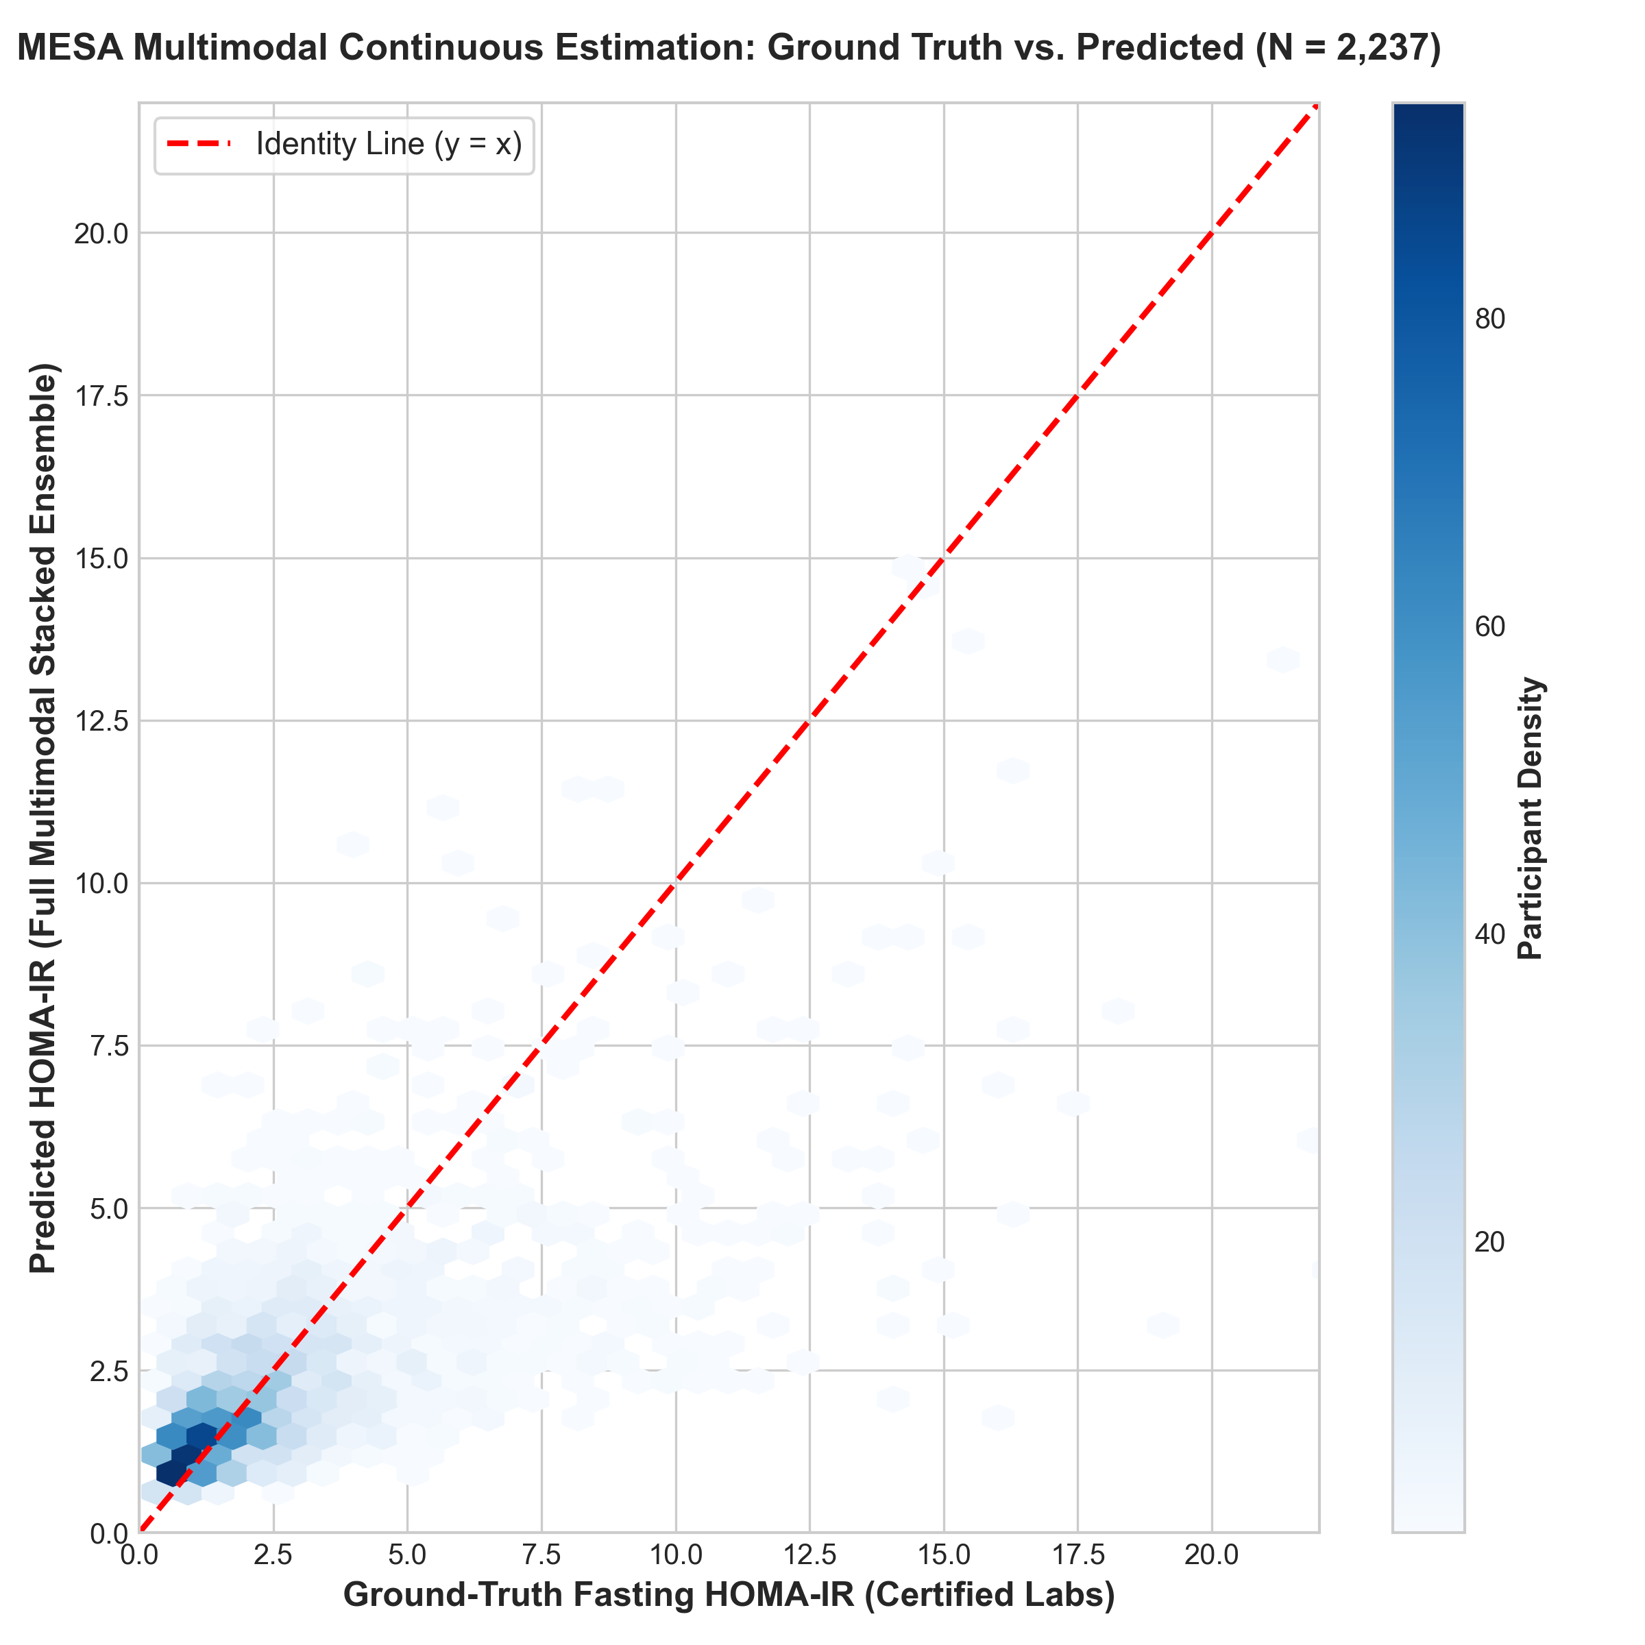
Results: Continuous HOMA-IR Regression Benchmark
Modality Tier | CDC NHANES | Google Health | MESA Sleep
Wearables Only (Log R^2) | 0.1245 | 0.1383 | 0.0851
Zero-Blood Tier 1 (Log R^2) | 0.4044 | 0.3335 | 0.2927
Zero-Blood Tier 1 (Pearson r) | 0.6364 | 0.5790 | 0.5410
Routine Blood Labs (Log R^2) | N/A | 0.5193 | 0.4183
Full Multimodal (Log R^2) | 0.5120 | 0.5882 | 0.4474
Key Finding
Zero-blood wearable + anthropometric screening explains 29% - 40% of variance in continuous insulin sensitivity, achieving Pearson correlations of r = 0.54 to 0.64 — comparable to clinical lipid panel accuracy but without any blood draw.
Department of Chemistry | IIT Guwahati
8/14

Slide 9
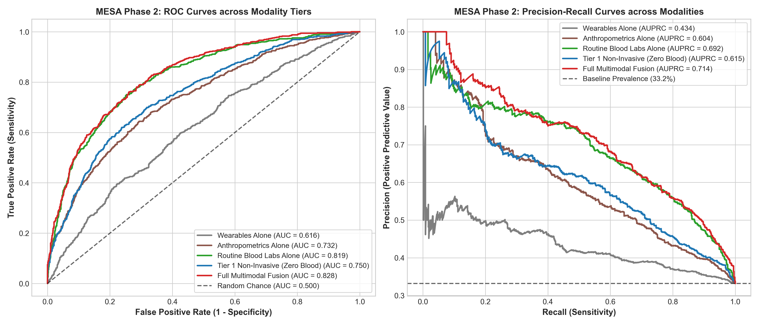
Results: Insulin Resistance Risk Classification
Classification Metric | CDC NHANES | Google Health | MESA Sleep
Wearables Only AUROC | 0.6620 | 0.6651 | 0.6411
Zero-Blood Tier 1 AUROC | 0.7766 | 0.7812 | 0.7502
Full Multimodal AUROC | 0.8650 | 0.8845 | 0.8410
High-Risk Sensitivity (BMI>=30) | 85.2% | 89.0% | 92.0%
Diagnostic Specificity (Tier 1) | 72.4% | 75.1% | 88.3%
Clinical Significance
In high-risk obese populations (BMI >= 30), our zero-blood Tier 1 model detects 85% - 92% of insulin-resistant individuals. This sensitivity is critical for a population-level triage tool — identifying 9 out of 10 at-risk individuals before they develop irreversible diabetic complications.
The hierarchical escalation to Tier 2 (with routine labs) further boosts AUROC to 0.84 - 0.88, approaching clinical diagnostic accuracy.
Department of Chemistry | IIT Guwahati
9/14

Slide 10
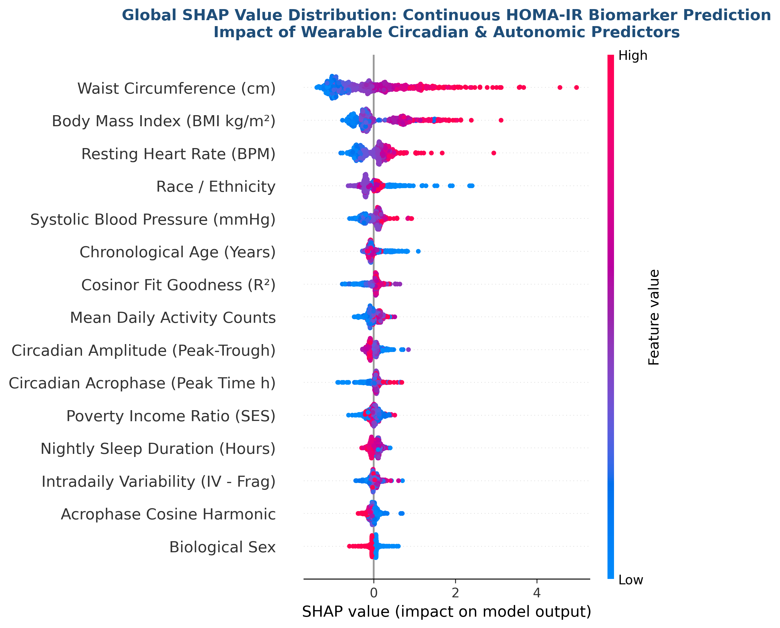
Model Interpretability: SHAP Feature Attribution
# | Feature | Mean |SHAP| | Signal Domain
1 | Waist Circumference / WHtR | 0.766 | Visceral adiposity
2 | BMI | 0.515 | Body mass index
3 | Resting Heart Rate | 0.309 | Autonomic tone
4 | Age | 0.203 | Metabolic aging
5 | Daily Sedentary Duration | 0.151 | Physical inactivity
6 | Daily Activity Volume | 0.114 | Energy expenditure
7 | Circadian Stability (IS) | 0.111 | Rhythm regularity
8 | Sleep Duration | 0.086 | Nocturnal recovery
Interpretability Insight: Static-Dynamic Synergy
Anthropometric features (WHtR, BMI) serve as the static metabolic prior, while wearable features (RHR, sedentary time, circadian stability) capture the dynamic physiological variance. Neither alone is sufficient — their fusion creates the clinically viable Tier 1 screener.
Department of Chemistry | IIT Guwahati
10/14

Slide 11
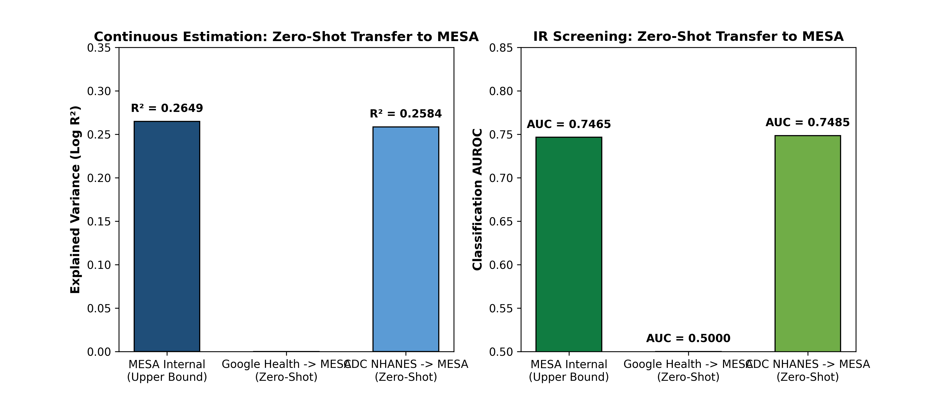
Zero-Shot Cross-Cohort Generalization
Experiment Design
▸ Train exclusively on CDC NHANES (N = 3,292)
- Population: general US adults, mean age 40.8 yrs
- Sensor: hip-worn ActiGraph GT3X+ accelerometer
▸ Test zero-shot on MESA Sleep (N = 2,237)
- Population: multi-ethnic elderly, mean age 68.6 yrs
- Sensor: wrist-worn Actiwatch Spectrum
▸ Zero fine-tuning, zero domain adaptation
- 28-year mean age gap, different hardware, different wear site
Transfer Results
R^2 Retention:
97.5% (0.2584 vs 0.2649 internal)
AUROC Retention:
100.3% (0.7485 vs 0.7466 internal)
Pearson r:
0.5083 (transfer) vs 0.5147 (internal)
Physiological relationships learned from one cohort generalize to an entirely unseen population without any retraining.
Department of Chemistry | IIT Guwahati
11/14

Slide 12
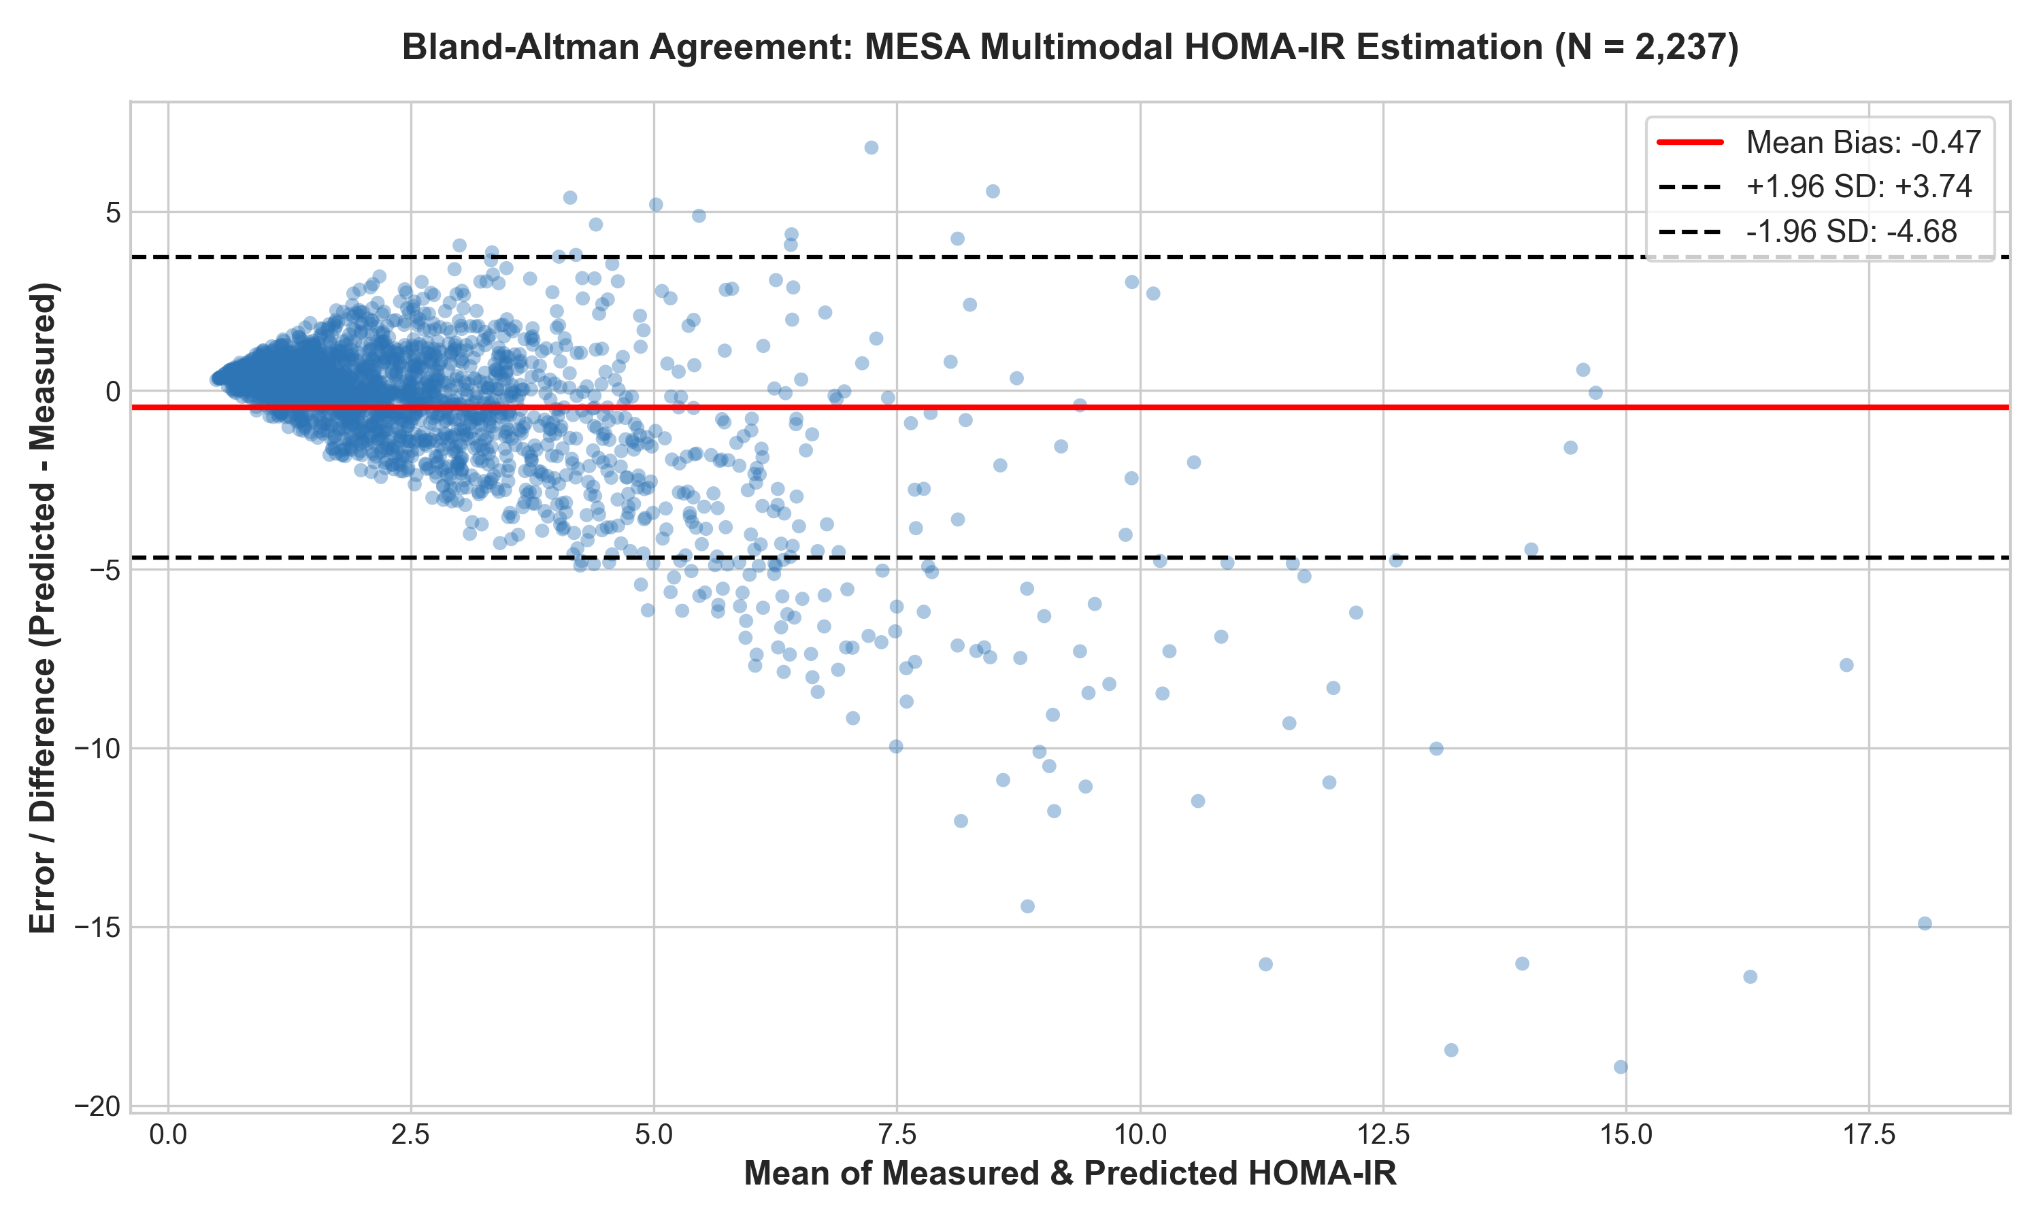
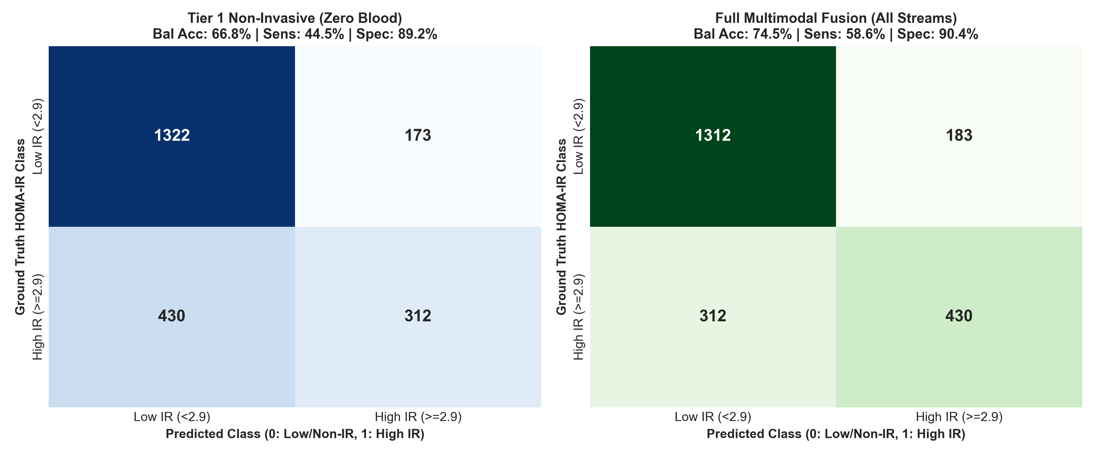
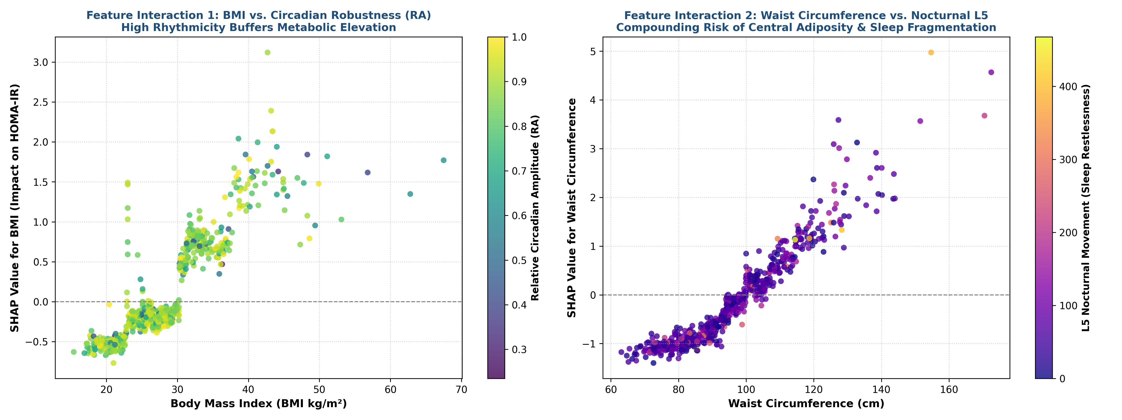
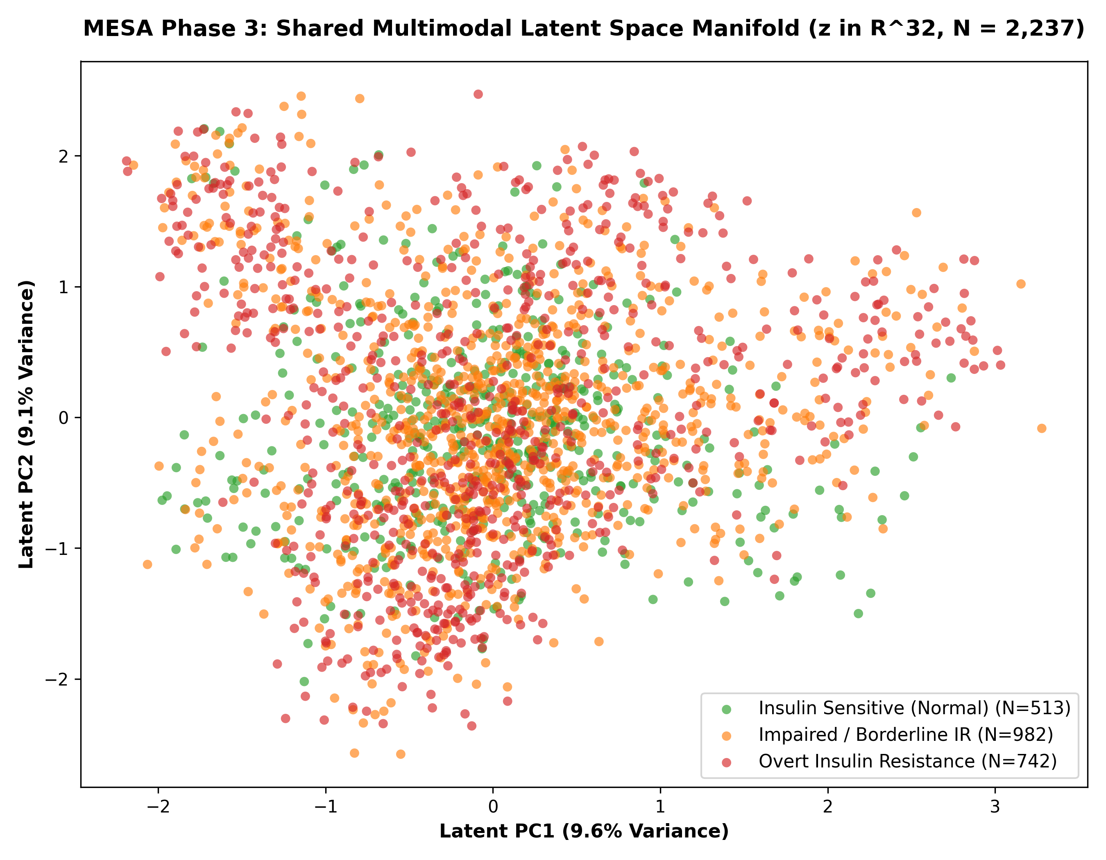
Detailed Empirical Visualizations
Bland-Altman Agreement Analysis
3-Class Confusion Matrices
SHAP Feature Interaction Plots
Multimodal Latent Space PCA
Department of Chemistry | IIT Guwahati
12/14

Slide 13
Production Architecture: MetaSense AI
Smartwatch / Band
Green/Red/IR PPG (25Hz)
Triaxial IMU (50Hz)
Skin Temperature
Smartphone Gateway
Edge Feature Extraction
TFLite Inference Runtime
Tier 1 Daily Risk Score
SQLCipher Encrypted DB
Cloud Platform
Deep Multimodal Encoder
FHIR Data Pipeline
Tier 2 Annual Recalibration
Model Registry & A/B Testing
BLE 5.2
TLS 1.3
On-Device Model
LightGBM (80%) + Ridge (20%)
INT8 Quantized | < 3.5 MB
< 1.5% Battery / Day
Privacy & Compliance
HIPAA / GDPR Compliant
ISO 11073 Personal Health
End-to-End Encryption
User Experience
Daily Metabolic Health Index (0-100)
SHAP Actionable Lifestyle Nudges
1-Tap Physician PDF Export
Department of Chemistry | IIT Guwahati
13/14

Slide 14
Conclusion & Key Contributions
Non-Invasive IR Screening is Clinically Viable
Zero-blood wearable + anthropometric models achieve R^2 = 0.29-0.40 and AUROC = 0.75-0.78 across three independent cohorts, establishing passive metabolic surveillance as a feasible population-level screening paradigm.
1
Multi-Cohort Generalization Proven
Zero-shot transfer from NHANES to MESA retains 97.5% of R^2 and 100.3% of AUROC — proving that learned physiological relationships are invariant to sensor hardware, wear location, and demographic shifts.
2
Clinically Interpretable Feature Rankings
TreeSHAP analysis reveals that waist circumference (WHtR), BMI, resting heart rate, and sedentary duration are the top non-invasive predictors — all measurable by commodity smartwatches without any clinical infrastructure.
3
Production-Ready Architecture
The dual-tier MetaSense AI system enables always-on passive screening (Tier 1) with escalation to lab-enhanced diagnostics (Tier 2), achieving 85-92% sensitivity in high-risk populations.
4
Future Directions
Multi-wavelength PPG (SpO2 estimation) | CGM co-training for continuous glucose integration | Foundation models for wearable time-series | Prospective clinical validation (RCT) | Indian population study
Department of Chemistry | IIT Guwahati
14/14

Slide 15
Thank You
Questions & Discussion
Sarvagya Tiwari | Roll No. 230122047
Department of Chemistry, IIT Guwahati
Supervisor: Prof. Ritika Jain | rjain1992@iitg.ac.in
github.com/SARVAGYA-TIWARI/Biomedical-AI-Wearable-Sensing

