Slide 1

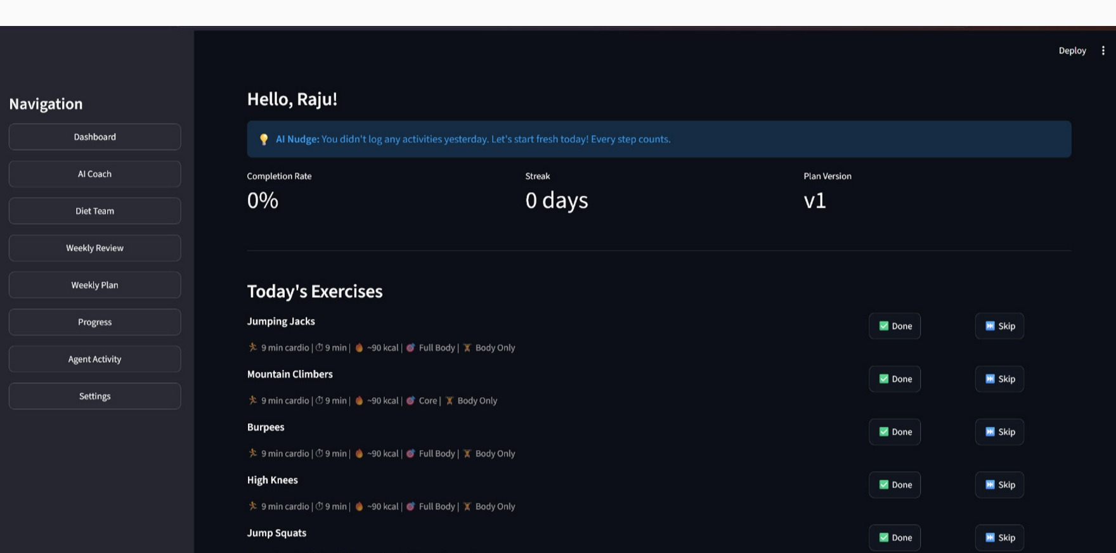
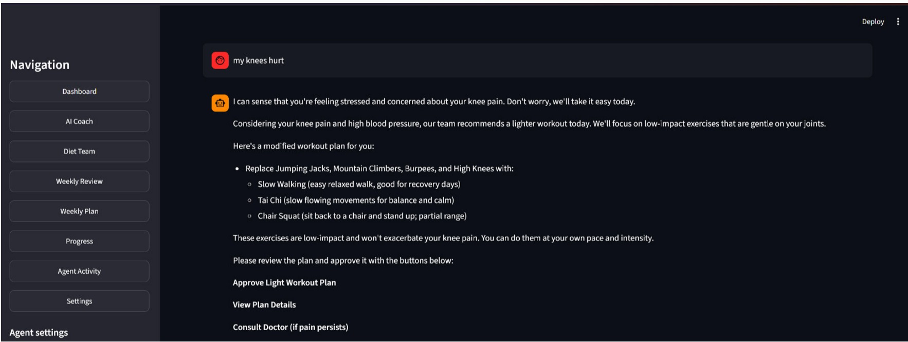
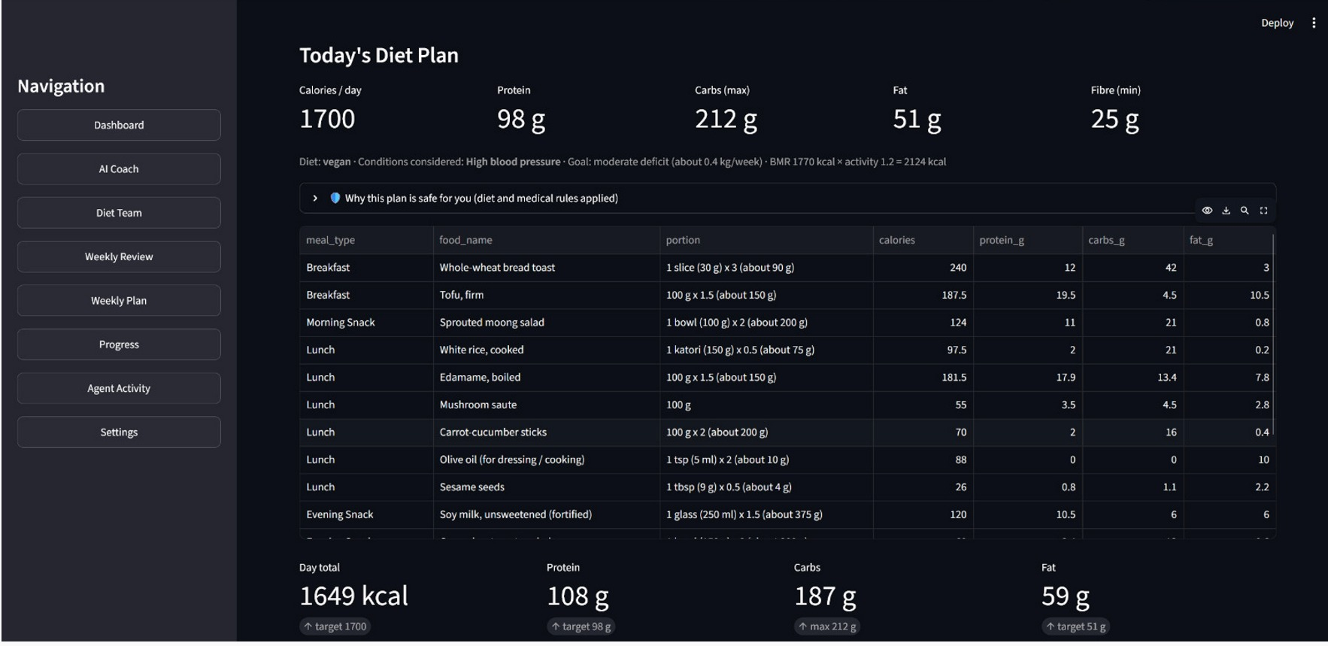
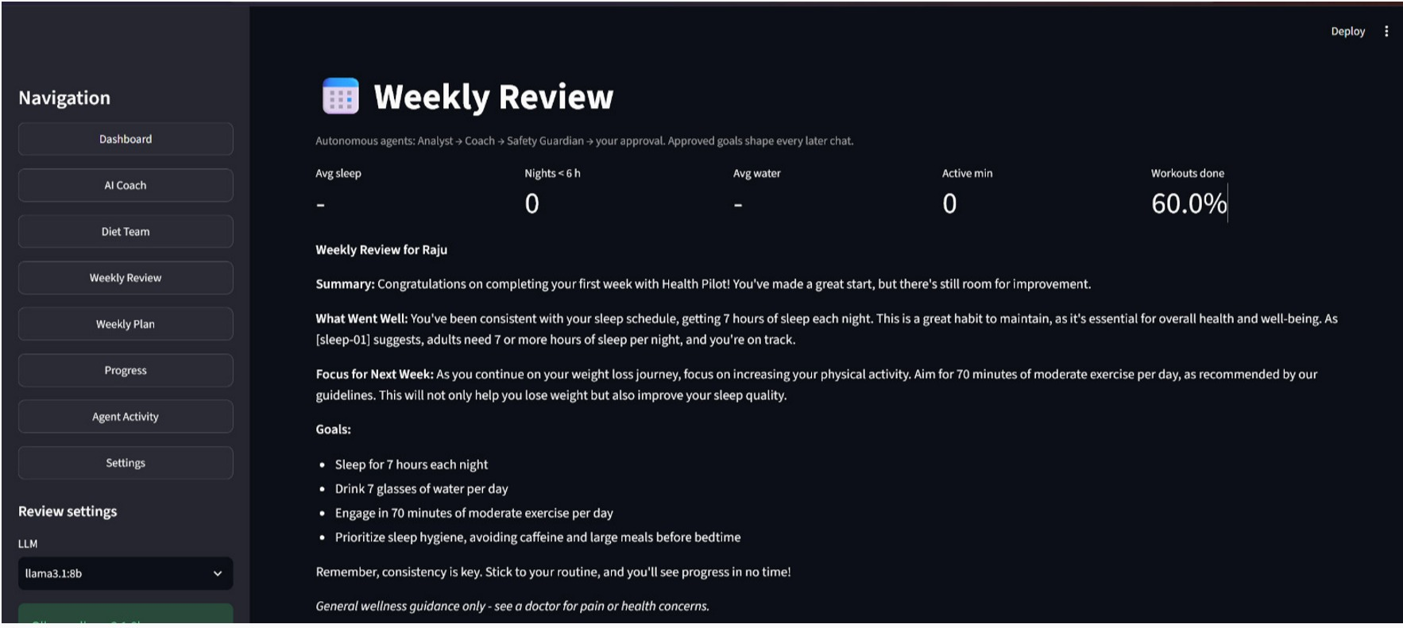
DEPARTMENT OF ARTIFICIAL INTELLIGENCE AND MACHINE LEARNING
HEALTH PILOT: Agentic AI Health Coach
A LangGraph multi-agent system for personalised, safe and adaptive wellness coaching
Team Members
RUBARAJAN R (231501138)
SARVEESH B (231501148)
TRISHANTH D P J (231501175)
Submitted to: Dr. M. Soundarya, Professor, Department of AI&ML, Rajalakshmi Engineering College
Notes:
Introduce the team and the project. Health Pilot is an agentic AI health coach: a team of LangGraph agents that gives personalised, guideline-backed and safety-checked advice, runs fully on a local GPU, and always asks the user before changing a plan. The screenshots are from the working prototype.

Slide 2
Problem Statement
1
Problem Definition
Business / Real-World Context
Wellness spans sleep, diet, exercise and mental health, but apps treat them as separate silos.
Advice is generic: it ignores diet type, medical conditions, mood and recent habits.
Plans stay fixed when life changes — exams, short nights, pain or stress.
Stand-alone chatbots can invent facts, contradict themselves or sound like a diagnosis.
Plans are changed without any safety check or the user's approval.
Individuals – one coach for sleep, food, fitness and stress
Students – exam stress, irregular sleep and meals
Fitness centres and coaches – personalised plans at scale
Corporate and college wellness programmes – private, scalable support
Digital-health providers – safe, explainable AI guidance
Notes:
The problem is fragmentation plus unsafe generic AI advice. Our users range from individuals and students to coaches and wellness programmes.

Slide 3
User and Stakeholder Analysis
2
Target Users
Stakeholder Identification
Stakeholder | Main Need
Wellness user | Personal, safe daily guidance on sleep, food, fitness and stress
Users with medical conditions | Condition-aware diet and joint-safe exercise
Fitness / nutrition coaches | Plans that adapt to real behaviour and check-ins
Colleges and companies | Scalable, private wellness support for many users
Project team / administrators | Maintainable, traceable and testable agent workflow
General wellness users
Students under exam stress
Fitness-focused users
Vegetarian / vegan users and food allergies
Users with diabetes, BP, heart, asthma, knee or back problems
The user as human reviewer of every plan change
Notes:
Six user groups; the user is also the human reviewer, because nothing changes without their approval.

Slide 4
Proposed System: Agent Pipeline
3
Turns a user's message, or a week of logged data, into safe, personalised and approved advice through a multi-agent workflow.
1
Message + Memory
2
NLP Perception
3
Supervisor + Researcher
Reads the message with the profile, 7-day habits, chat history and approved weekly goals.
Our NLP-subject models detect mood, intent, habit numbers (e.g. 5 h sleep) and red flags.
Picks 1–3 specialists; agentic RAG finds cited guideline evidence for each of them.
4
Specialist Agents
5
Mediator + Safety
6
Approval + Memory
Sleep, Fitness, Nutrition and Mind work in parallel, each with its own tools and topics.
Mediator resolves disagreements; Guardian can veto; a second LLM critiques; revise loop.
User approves workout or diet changes; results are saved to memory and the agent timeline.
Notes:
Six stages. The key idea: perception from our NLP models, specialist agents in parallel, deterministic safety, and human approval before anything is stored.

Slide 5





Proposed System: Data Sources
4
Curated, citable knowledge plus structured datasets and the user's own memory. Every source is checked by check_setup.py at start-up.
Guideline Knowledge Base
Diet Food Table
Exercise Dataset
User Memory (SQLite)
Evaluation Test Set
49 passages in 7 topics from WHO, ICMR-NIN, NHS, CDC, EFSA, NICE and Tele-MANAS; each has an ID for citation.
87 foods with calories, macros, fibre, sodium, saturated fat, glycaemic index and allergy flags.
55 exercises with type, intensity, MET value and knee-safe / back-safe flags.
Profile, habits, chat, plans, meal check-ins, weigh-ins, food dislikes and weekly goals.
20 questions with gold passages and expected facts, plus safety, routing and diet test sets.
Data-integrity fix from the NLP version: removed a corpus of 150 copies of one sentence and a mislabelled “mental health” file that was really house-price data.
Notes:
Knowledge base for RAG; two curated datasets for tools; SQLite as memory. Mention the data-integrity fixes, since the rubric marks data integrity.

Slide 6










TOOLS AND TECHNOLOGIES USED
5
Layer
Technologies / Tools
1
User Layer
Streamlit web app (8 pages)
Chat · Diet Team · Weekly Review
2
Orchestration Layer
LangGraph (3 agent graphs)
Python 3.11
3
Agent Layer
Llama 3.1 8B + Qwen 2.5 7B
NLTK · VADER · intent/entity NLP
4
Knowledge Layer
nomic-embed + TF-IDF hybrid search
49-passage guideline KB
5
Data Layer
SQLite (12 tables)
pandas · CSV datasets
6
Infrastructure Layer
Ollama on RTX 3070 Ti (8 GB)
Fully local · Groq optional backup
Notes:
Everything runs locally: Streamlit front end, LangGraph orchestration, two 8B-class LLMs through Ollama on an RTX 3070 Ti, hybrid retrieval and SQLite. Our NLP-subject models sit in the agent layer as the perception step.

Slide 7










AGENTS ARCHITECTURE
6
SUPERVISOR
(Router & Planner) · Researcher: Agentic RAG · Shared State
SLEEP
(Sleep agent)
log habits, sleep trend
FITNESS
(Fitness agent)
safe exercises, today's plan
NUTRITION
(Nutrition agent)
diet engine, BMI, swaps
MIND
(Mind agent)
stress, mood, exams
MEDIATOR
(Conflict resolution)
rest / light / normal
SYNTHESIZER
(Answer writer)
one cited answer
GUARDIAN
(Safety (rules))
veto + auto-fix
CRITIC
(Second LLM)
reviews the answer
HITL
(Human approval)
approve / edit / reject
Reflection & Self-Correction (max 2)
Shared State & Persistent Memory
LangGraph AgentState + SQLite: profile, habits, chat, plans, diet, weekly goals
Notes:
The supervisor routes to four specialists that run in parallel. Their views go to the mediator, then the synthesizer writes one answer, the rule-based guardian checks it, and a critic on the other LLM reviews it. If the critic or guardian finds issues, the answer is revised, up to twice. The human approves any plan change. Everything shares one LangGraph state backed by SQLite.

Slide 8
AGENTS RESPONSIBILITIES
7
Specialised agents coordinated by LangGraph; numbers and safety rules are deterministic code, the LLM adds reasoning and language.
Supervisor — Router
Researcher — Agentic RAG
Sleep Agent
Fitness Agent
Routes each message
Finds the evidence
Rest and recovery
Safe movement
reads mood, intent, entities
picks 1–3 specialists
LLM + keyword fallback
spots diet-change requests
rewrites query + topic
hybrid search (top-4)
grades relevance
retries up to 2 times
logs sleep / water
7-day sleep trend
sleep guidelines
gives workout stance
today's plan + progress
joint-safe exercise search
low intensity when strained
gives workout stance
Nutrition Agent
Mind Agent
Mediator + Synthesizer
Guardian + Critic
Food and hydration
Stress and mood
One decision, one answer
Independent checks
diet-engine food ideas
BMI (Asian cut-offs)
meal swaps, dislikes
hydration guidance
uses NLP mood
exam / stress guidance
mental-health passages
crisis → helplines
resolves rest / light / normal
safety cap: pain or <5 h sleep
merges advice
cites passages
removes fake citations
blocks medication / diagnosis
vetoes unsafe exercises
other LLM reviews answer
Notes:
Two more teams reuse this pattern: the Diet Team (clinical, nutritionist, guardian, critic, explainer) and the Weekly Review team (analyst, coach, diet adaptation, guardian).

Slide 9




AGENT WORKFLOW AND ORCHESTRATION
8
Emergency
112 / Tele-MANAS 14416
specialists and plan changes skipped
Knowledge Sources
49 guideline passages
yes
Red flag?
Pass?
Yes
User
message
Memory + NLP
mood · intent
Supervisor
routing
Researcher
agentic RAG
Specialists ×4
in parallel
Mediator + Synth
one answer
Guardian
rules + veto
Critic
other LLM
Human Approval
approve / edit
Save
plan + memory
No → Revise & re-check (max 2)
Persistent Data Layer
SQLite: profile · habits · chat · plans · goals
Notes:
Demo example: 'I slept only 5 hours and I'm stressed about exams. Should I still do today's workout?' Sleep says rest, Fitness says train normally, Mind says train light; the Mediator picks light training, the Guardian checks the exercises are knee-safe, the Critic (Qwen) reviews the Llama answer, and the user approves the lighter workout.

Slide 10
ORCHESTRATION: THREE AGENT TEAMS
9
1
AI Coach Team (chat)
2
Diet Team (builds the plan)
3
Weekly Review Team
User message
load_memory
nlp_analysis
emergency_guardian (red flag)
supervisor
researcher (agentic RAG)
4 specialists — parallel Send
mediate → diet_edit
synthesizer
guardian → critic → revise
human_review → diet_review
save_memory
clinical → nutritionist → guardian (repair / veto) → critic (other LLM) → explainer → review (approve / regenerate / reject) → save
gather → analyst → coach → diet_adapt → guardian → human_review → save
Runs without a question; approved goals feed every later chat.
A plan the guardian vetoes is never saved.
“LangGraph is the orchestration backbone: agents share one state, run in parallel, branch on conditions, loop to correct themselves and pause for human approval.”
Persistent Data Layer — SQLite
users, plans, logs, agent_logs
chat_memory, habit_logs
diet_chart, diet_meta, diet_prefs
diet_log (meal check-ins), weight_logs
weekly_goals
LangGraph features used: StateGraph · Send fan-out · conditional edges · interrupt() / Command(resume) · MemorySaver
Notes:
Three graphs share the same memory and safety rules: the chat coach, the diet team that creates the meal plan, and the weekly review team that acts autonomously.

Slide 11



System Architecture: Tiered View
10
1
2
3
4
5
6
User Layer
Orchestration
Agent Layer
Knowledge Layer
Data Layer
Infrastructure
User
LangGraph
Supervisor
Researcher
Sleep
Fitness
Nutrition
49 passages
SQLite
Ollama
Streamlit app
3 graphs
Mind
Mediator
Synthesizer
Guardian
Critic
hybrid index
12 tables
Llama 3.1 · Qwen 2.5
8 pages
shared state
Diet Team: clinical · nutritionist · guardian · critic · explainer
datasets
memory
RTX 3070 Ti
Weekly Review: analyst · coach · diet adapt · guardian
Notes:
Six tiers from the user to the GPU. The agent layer holds the chat team plus the diet and weekly teams; all of them use the same knowledge, data and model tiers.

Slide 12
AGENTIC RAG IMPLEMENTATION
11
1
Knowledge Sources
2
Why Hybrid + Agentic Retrieval?
3
Retrieval Quality Evaluation
Guideline Knowledge Base
49 passages · 7 topics (sleep, exercise, nutrition, hydration, stress, mental, safety)
Curated sources
WHO 2020 activity · ICMR-NIN 2024 · NHS · CDC · EFSA · NICE · Tele-MANAS
Citable
Every passage has an ID (e.g. [sleep-05]) and a source line
Dense — nomic-embed-text (0.7)
Same meaning, different words
Sparse — TF-IDF 1-2 grams (0.3)
Exact terms such as “HIIT” or “BMI”
Agentic loop
LLM plans query + topic → top-4 → LLM grades relevance → rewrite, widen and retry (max 2)
Baseline 1 — No RAG
LLM answers from its own knowledge
Baseline 2 — Basic RAG
Raw question, top-3, no grading
Proposed — Agentic RAG
+ query planning, grading, retry, per-specialist evidence
Notes:
Measured offline: Basic RAG retrieves the gold passage in its top-3 for 17/20 questions (85%). The agentic version and the LLM answer quality are measured with run_eval.py on the GPU laptop. The Guardian also deletes any citation that was not actually retrieved.

Slide 13

SAFETY AND HUMAN-IN-THE-LOOP
12
Emergency Path
Safety Guardian (rules)
Human-in-the-Loop
Red flags detected by the NLP step: chest pain, fainting, self-harm
All specialists and plan changes are skipped
Instant answer with 112 and Tele-MANAS 14416
Removes citations that were not retrieved
Flags medication, dosage or diagnosis wording
Pain → must advise a doctor
Vetoes exercises unsafe for knee / back
Pain or <5 h sleep can never mean a normal workout
Diet: diet type, 6 conditions, carbs, sodium, allergies
LangGraph interrupt() pauses the graph
Workout change: Approve / Edit / Reject
Diet change: old vs new meals, Approve / Keep
Diet plan: Approve / Regenerate with feedback / Reject
Weekly goals, lighter workout and diet adaptation approved separately
Notes:
Safety is layered: a deterministic emergency path, a rule-based Guardian the LLM cannot override, a cross-model critic, and the user's approval before any stored plan changes.

Slide 14




SYSTEM IMPLEMENTATION
13
Main Technologies
Streamlit
8-page web app
LangGraph
agent orchestration
Ollama LLMs
Llama 3.1 · Qwen 2.5
Hybrid RAG
embeddings + TF-IDF
SQLite
memory + plans
Implementation Flow
User
asks in chat
Perception
mood, intent, red flags
Supervisor
routes agents
Research
cited evidence
Specialists
parallel advice
Safety
guardian + critic
Approval
plan updated
Functional Prototype
1
2
3
4
5
Login, profile and dashboard with daily plan
AI Coach chat with team activity and approval cards
Diet Team builds a condition-aware 7-day plan
Weekly Review sets goals and adapts the diet
Agent Activity timeline for traceability
Notes:
The prototype is a working Streamlit app. One-click install (install_requirements.bat), run.bat starts Ollama and the app; check_setup.py verifies everything.

Slide 15
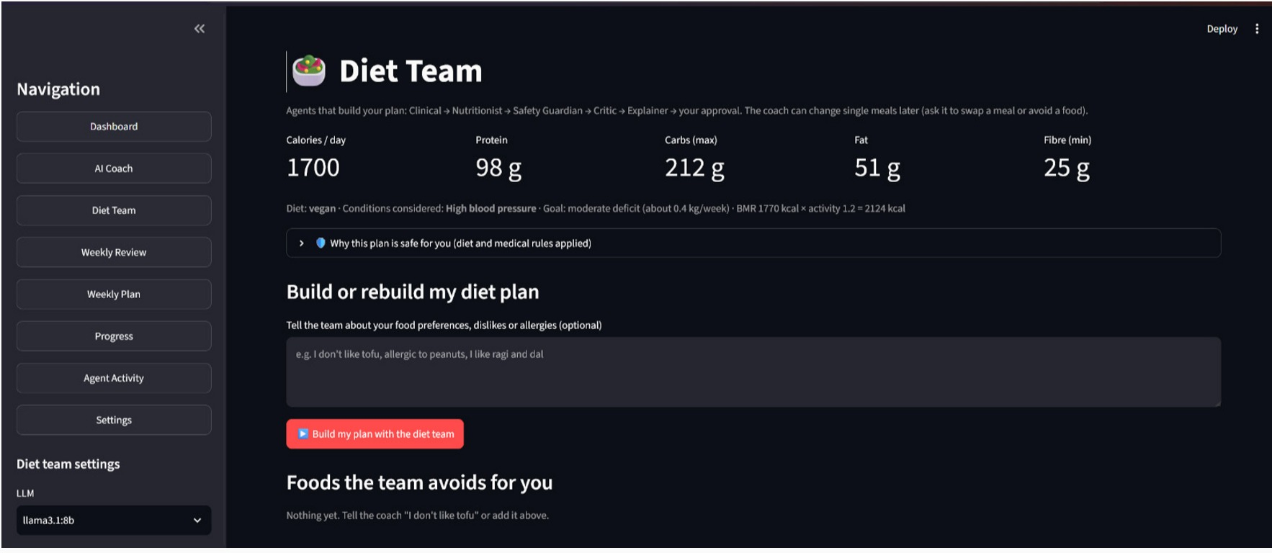
FUNCTIONAL PROTOTYPE: SCREENSHOTS
14
AI Coach: “my knees hurt” → team proposes a lighter, joint-safe workout for approval
Today's Diet Plan: vegan + high-BP targets, 5 meals, daily totals vs targets
Diet Team: build or rebuild the plan with preferences, allergies and approval
Weekly Review: analyst + coach + guardian write the report and next week's goals
Notes:
Real screenshots from the running prototype on the RTX 3070 Ti laptop.

Slide 16

Experimental Evaluation
15
We evaluate each stage of the workflow, comparing against a baseline wherever one exists.
Evaluation Areas
Testing Methodology
Key Goal
Area | What we check
Retrieval | Is the gold passage retrieved?
Diet safety | Does every day meet all rules?
Safety detection | Are red-flag messages caught?
Routing | Are the right specialists chosen?
Diet tools | Is the diet request understood?
LLM answers | Accuracy, reasoning, consistency
Build test sets: 20 questions, 24 diet profiles, 24 safety and 20 routing messages
Run deterministic parts offline
Compare with a rule-free baseline
run_eval.py on GPU: 4 systems × 2 LLMs
LLM-judge, consistency, latency
“To verify that the system does not just answer, but gives grounded, safe advice and never changes a plan without approval.”
Results and Analysis (measured)
Notes:
Diet: 24 random profiles x 7 days = 168 days. Diet team: 92.9% of days pass every rule, 0% critical violations; a rule-free random baseline from the same food table: 0% pass, 14.9% critical. Red flags: 10/12 crisis messages caught, 0 false alarms. Routing uses only the keyword fallback (the LLM supervisor adds to it). LLM answer quality, Llama vs Qwen, comes from run_eval.py on the GPU laptop.

Slide 17
Performance & Success Metrics
16
Important Metrics
Success Condition (end-to-end run)
29 / 29
92.9%
85%
100%
100%
Memory + NLP
Routing + research
setup checks passed
diet days meet every rule
Basic RAG hit@3
red-flag precision
diet requests understood
Specialists + mediator
graphs, emergency path, diet profiles, allergies, adaptation limits
0% critical violations (baseline: 14.9%)
gold passage in top-3 (20 questions)
recall 83.3% — 2 phrasings missed
swap · dislike · allergy · regenerate
Guardian + critic
Human approval
Plan and memory saved
Main Result
Success means a complete, safe and approved change — not just an AI reply. All three agent teams completed end-to-end runs with the approval step in testing. LLM answer quality (Llama 3.1 vs Qwen 2.5 across 4 systems) is measured with run_eval.py on the GPU laptop.
Notes:
Be honest in the viva: the two missed self-harm phrasings show why we keep the emergency rules and the human in the loop, and they are the first item in future work.

Slide 18
Comparison & Innovation
17
Feature | LLM only | Basic RAG | Single agent (v1) | Health Pilot
Uses profile, mood and habits | Limited | Limited | ✓ | ✓
Grounded, cited answers | ✗ | ✓ | ✓ | ✓
Self-correcting retrieval | ✗ | ✗ | ✓ | ✓
Multiple specialist agents | ✗ | ✗ | ✗ | ✓
Conflict resolution (Mediator) | ✗ | ✗ | ✗ | ✓
Rule-based safety veto | ✗ | ✗ | Partial | ✓
Cross-model critic | ✗ | ✗ | ✗ | ✓
Human approval of plan changes | ✗ | ✗ | ✓ | ✓
Builds and adapts the diet plan | ✗ | ✗ | ✗ | ✓
Autonomous weekly review | ✗ | ✗ | ✗ | ✓
Our Innovation
Health Pilot connects Perception → Specialists → Mediation → Safety → Human approval → Adaptation in one continuous workflow.
Deterministic safety rules the LLM cannot override, our own NLP models as perception, and everything running on a local GPU so health data stays private.
Notes:
Single agent (v1) is our own baseline: planner, agentic RAG, reflection and HITL, but no specialists, mediator, cross-model critic, diet team or weekly review.

Slide 19
Scalability & Real-World
18
Real-World Applicability
Health Pilot can support:
Scalability
HEALTH PILOT
Individuals and families
College student-wellness cells
Fitness centres and coaches
Corporate wellness programmes
Dietitian support tools
Digital-health apps
New Agents
add a LangGraph node
More Knowledge
drop in guideline files
Bigger Models
swap Ollama / Groq model
More users: SQLite → PostgreSQL · wearables · cloud model serving
Notes:
Each agent is a node, knowledge is a folder of files and the model is a setting, so the system grows without redesign.

Slide 20
FUTURE WORK
19
1. Wearable integration
2. Stronger safety coverage
3. Larger evaluation
steps, sleep and heart rate
replace self-reported habits
broader crisis-phrase detection
clinician-reviewed rules
doctors and dietitians as raters
repeated runs, bigger test sets
4. Voice and languages
5. Production deployment
6. Observability
Tamil and Hindi voice chat
wider reach
authentication, PostgreSQL
scalable model serving
agent tracing
latency and safety dashboards
Notes:
Item 2 comes straight from our evaluation: two self-harm phrasings were missed by the keyword detector.

Slide 21
CONCLUSION
20
Health Pilot shows how agentic AI can move beyond a chatbot to a safe, personalised wellness coach that acts — with the user in control.
The system:
understands mood, intent and habits with our NLP models
routes each message to Sleep, Fitness, Nutrition and Mind specialists
retrieves cited guideline evidence with agentic RAG
resolves disagreements through a mediator
enforces safety with a rule-based guardian and a cross-model critic
builds condition-aware diet plans with a diet team
reviews the week and adapts goals autonomously
asks the user before changing any plan
runs fully locally, keeping health data private
Notes:
Close by summarising the three teams and the safety design, then offer the live demo.

Slide 22

Thank You
Department of Artificial Intelligence and Machine Learning
Questions & live demo
Notes:
Thank the panel and invite questions.

