Slide 1
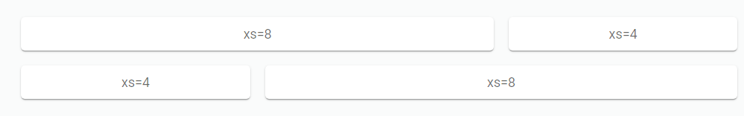
1. Task: Implementing a Custom Grid System with React and CSS
Objective: Develop a responsive grid system using React components and CSS.
Approach:
Created a custom grid component in React to handle layout structures.
Implemented a flexible grid layout with column widths configurable for different screen sizes.
Utilized React Context to manage grid settings globally within the application.
Ensured responsiveness by adapting grid layouts to various breakpoints.
Fig: Implementing a custom grid
SARVESH2120/ASTask (github.com)

Slide 2
Key Achievements:
Context Management: Utilized React Context to manage grid settings globally within the application.
Dynamic Column Widths: Implemented a flexible grid layout where column widths are specified with integer values (1-12) for adaptability across breakpoints.
Component Composition: Created a modular Grid component allowing nested child elements to define their column sizes.
CSS Flexbox: CSS Flexbox for layout flexibility, enabling items to wrap and adjust based on available space.

Slide 3
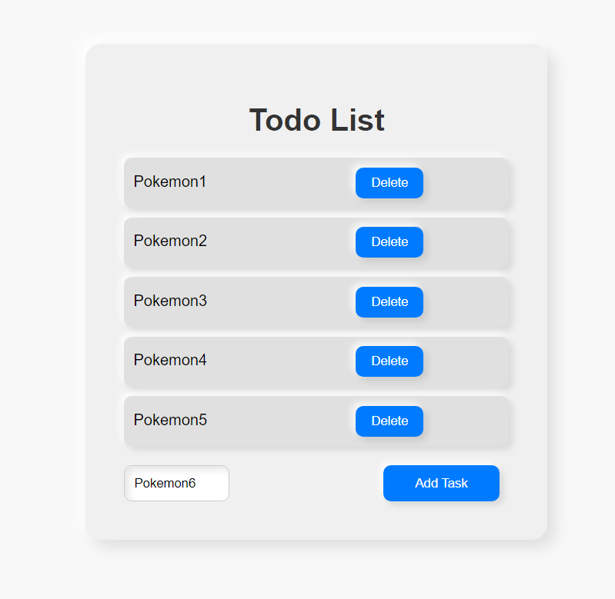
2. Task: Developing a To-Do List App with RTK Query
Objective: Build a to-do list application integrated with Redux Toolkit Query.
Approach :
Utilized Redux Toolkit for state management, leveraging RTK Query for data fetching.
Implemented CRUD (Create, Read, Update, Delete) functionality for tasks.
Integrated asynchronous actions with Redux Toolkit Query to manage API interactions seamlessly.
SARVESH2120/AST-TodoTask (github.com)
Fig: Implementing a To-Do List

Slide 4
Key Achievements:
Redux Toolkit Integration:
Integrated Redux Toolkit, leveraging the createSlice and createAsyncThunk utilities for state management and asynchronous data fetching.
Created a centralized store with a tasks reducer using configureStore for state initialization.
Asynchronous Data Fetching:
Implemented asynchronous data fetching using createAsyncThunk to retrieve tasks from a RESTful API endpoint (http://localhost:4000/tasks).
Utilized fetchTasks thunk action to populate tasks in the Redux store upon component mount using useEffect.
CRUD Operations:
Enabled task creation (handleAddTask) by sending POST requests to the API and updating the Redux store with the new task using the addTask reducer.
Supported task deletion (handleDeleteTask) by sending DELETE requests to the API and removing the task from the Redux store using the deleteTask reducer.

Slide 5
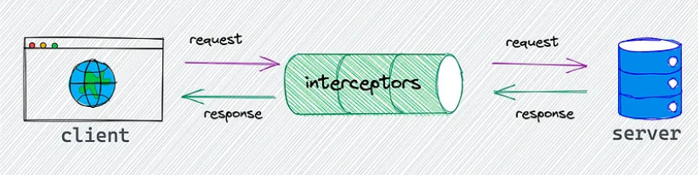
3. Task: Building a React Vite Application with TypeScript
Objective: Create a modern React application using Vite and TypeScript, integrating Axios with RTK Query.
Approach :
Set up a project scaffold using Vite for rapid development.
Implemented TypeScript for type-safe development, enhancing code quality and developer productivity.
Integrated Axios with Redux Toolkit Query for efficient data fetching and caching.
Developed an Axios interceptor to handle global request and response logic, adding custom headers.
SARVESH2120/AxiosInterceptor (github.com)

Slide 6
Key Achievements:
Project Setup and Configuration:
Utilized Vite for a fast and optimized development environment.
Configured Axios as the HTTP client for making API requests with customizable interceptors.
Redux Toolkit Query Integration:
Implemented Redux Toolkit Query (createApi) to manage API endpoints and data fetching logic.
Created a baseQuery function (axiosBaseQuery) to handle HTTP requests using Axios with error handling and response interception.
Component Composition:
Developed functional components (App and PostList) using React functional components
Used hooks (useGetPostsQuery) from Redux Toolkit Query for fetching and managing post data.
API Interceptors:
Implemented Axios interceptors to modify outgoing requests and incoming responses globally.
Added a custom header (Channel: SarveshGupta) to all outgoing requests for identification and logging purposes.

Slide 7
Application Flow:
1.Component Rendering:
Rendered the App component as the main entry point, which then renders the PostList component for displaying fetched post data.
2.Data Fetching:
Utilized useGetPostsQuery hook within the PostList component to fetch posts asynchronously from the API endpoint.
3.Error Handling:
Managed loading states (isLoading), error handling (error), and data display (data) within the PostList component based on API request status.

Slide 8
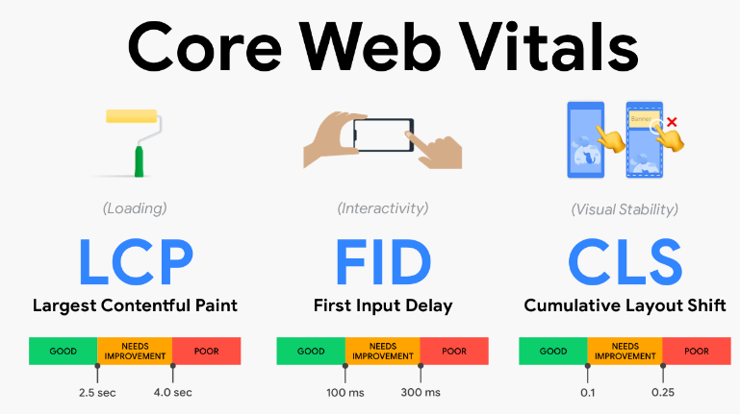
4. Task: Web Vitals Presentation
Objective: Prepare an informative presentation on Web Vitals.
Approach :
Defined Core Web Vitals (CLS, FID, LCP) and their impact on user experience and SEO.
Discussed strategies to measure and improve Web Vitals scores using tools like Lighthouse.
Explored optimization techniques such as lazy loading, image optimization, and resource prefetching to enhance performance.
ASTppt/AstWebVitals.pdf at main · SARVESH2120/ASTppt (github.com)

Slide 9
Introduction to Web Vitals:
Explain what Web Vitals are and why they are important for measuring user-centric performance on the web.
Highlight the three core Web Vitals metrics: Largest Contentful Paint (LCP), First Input Delay (FID), and Cumulative Layout Shift (CLS).
Understanding Each Web Vital:
Largest Contentful Paint (LCP):
Define LCP as the metric that measures the render time of the largest content element visible within the viewport.
Discuss how LCP impacts perceived loading speed and user experience, emphasizing the importance of optimizing critical rendering paths.
First Input Delay (FID):
Explain FID as the delay between a user's first interaction (e.g., clicking a button) and the browser's response.
Explore factors affecting FID, such as JavaScript execution time, and strategies for reducing FID to improve interactivity.
Cumulative Layout Shift (CLS):
Describe CLS as a metric that quantifies the amount of unexpected layout shifts during page load.
Highlight how CLS affects visual stability and user frustration, and methods to minimize CLS by ensuring stable element positioning.

Slide 10
3. Optimization Techniques:
Performance Budgeting:
Discuss the concept of performance budgeting and setting thresholds for Web Vitals to maintain optimal performance levels.
Critical Rendering Path Optimization:
Address techniques like lazy loading, code splitting, and resource prioritization to enhance LCP and reduce time to interactive (TTI).
Minimizing JavaScript Execution:
Explore strategies for reducing FID by optimizing JavaScript code, such as deferring non-critical scripts and using efficient event handling.
Layout Stability Techniques:
Provide tips for preventing CLS, such as reserving space for dynamic content, specifying image dimensions, and avoiding intrusive elements.
4. Tools for Web Vitals Monitoring:
Introduce tools like Lighthouse, and Chrome DevTools for assessing and monitoring Web Vitals metrics.
Demonstrate how to interpret Web Vitals data and use insights to prioritize performance optimizations.

Slide 11
5. Task: Creating a Next.js Project with Specific Features
Objective: Set up a Next.js project with various functionalities.
Approach :
Implemented user authentication with a login page using Next.js API routes.
Integrated Open Weather API to display real-time weather information based on user location.
Utilized props and state management to enable pop-up features for notifications.
Configured dynamic routing with catch-all routes and route groups for improved navigation and SEO.
SARVESH2120/my-app (github.com)

Slide 12
Key Features Implemented:
1. Login Page:
Created a login page using Next.js for user authentication.
Utilized form components and client-side routing for seamless user interaction.
2. Weather App Integration:
Integrated OpenWeather API to fetch real-time weather data based on user-provided city names.
Implemented a search feature (SearchBar) to query weather information and display results dynamically.
3. Pop-Up Feature:
Implemented a custom Button component with onClick functionality to trigger pop-up alerts or dialogs.
Utilized useState and onClick event handling to manage dynamic behavior based on user interactions.
4. Catch-All Routes:
Configured catch-all routes to handle dynamic and nested routing within the Next.js application.
Implemented routing logic for error handling and redirection based on specific route conditions.
5. Route Groups and Nested Routing:
Explored nested routing and route groups within Next.js for organizing and managing complex application structures.
Leveraged route parameters and nested components (CityWeather, HomeDynamic) to display dynamic content based on URL parameters.

Slide 13
Code Highlights:
Login Page (/login):
Developed a user authentication flow using Next.js routing and form components.
Weather App (/city/cityName):
Implemented dynamic routing to display weather information for specific cities using the OpenWeather API.
Utilized state management (useState) and API integration (fetchWeather) to fetch and render weather data dynamically.
Custom Components:
Created reusable components (Button, Sheet, Typography) using JoyUI (Material-UI) for consistent UI design and interaction.
Dynamic Pop-Up Feature:
Implemented a custom Button component with click event handling to trigger dynamic pop-up alerts or dialogs.

Slide 14
