Slide 1
Build SAS® Studio Flows
Hands-on Workshop
Mary Kathryn Queen, SAS EDU Content Development Group
Notes:
SAS® Studio Flows provide a visual, drag-and-drop interface within SAS® Studio that allows users to build, manage, and execute complex analytics workflows without writing code. In this hands-on workshop you'll learn to build a flow using steps to access, prepare, and analyze your data.

Slide 2
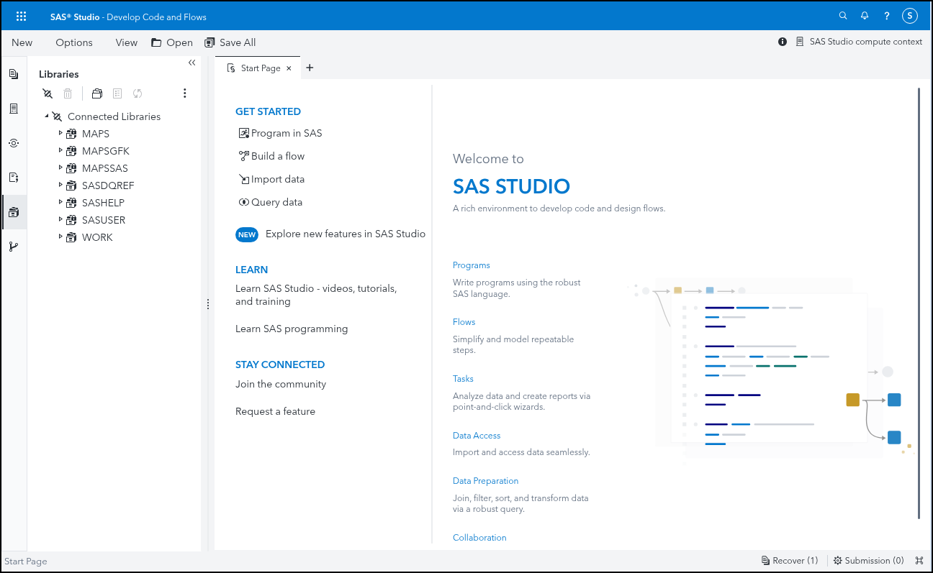
SAS Studio Interface
Open Files
Explorer for navigating to saved files
Close an open file
Libraries
SAS Studio Flow Steps
Git Repositories
Notes:
SAS Studio is used to write your own programs or flows. You can also use the pre-defined tasks or code snippets. When you first open SAS Studio, the Start Page is available, allowing you to quickly get started writing a new SAS program, building a flow, importing data, or creating a query. Use the icons on the left-hand side to access the different sections of the navigation pane.
The first icon on the navigation pane is used to Open saved files.
Next is the Explorer icon for navigating to saved files.
Then there is the SAS Studio Flow Steps.
Then libraries for viewing saved libraries and their contents.
The last one is for working with Git repository connections.
Finally, you can click the x on an open tab to close it.

Slide 3
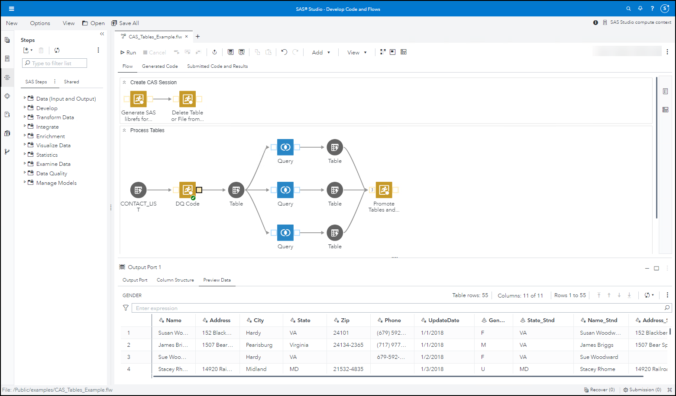
SAS Studio Flows
Flow steps
Flow tab section
Flow file name
Flow properties
Preview tab (Node properties) section
Submission order
Notes:
At the top of the tab is the name of the SAS Studio Flow file.
On the left-hand side, the Steps pane is displayed. You can add these steps to your flow canvas.
The upper part of the main section is the Flow tab section.
On the right-hand side of the flow tab section is the Flow properties and submission order buttons.
On the bottom-half of the screen is the Preview tab section also known as the node properties section.

Slide 4
SAS Studio Flows
Toolbar
Add a step or note
Save flow
Arrange nodes
Run entire flow

Slide 5
Hands-on Exercise
Build a SAS Studio Flow
Notes:
Steps in Build_SAS_Studio_Flow.pdf located here: https://github.com/SAS-Innovate-2025/Build-SAS-Studio-Flows/tree/main

Slide 6

SAS Studio Flows
Resources
Training Courses:
Building SAS® Studio Flows in SAS® Viya®
Using SAS Studio Flows and Custom Steps in SAS® Viya® Fast Track
Transitioning SAS® Enterprise Guide® Projects to SAS® Studio Flows
Managing and Querying Data Using Flows in SAS Studio
Using SAS® Studio Engineer Steps in SAS® Studio Flows
Scheduling and Orchestrating SAS® Programs and Flows with Apache Airflow
Documentation:
SAS Help Center: SAS Studio: Working with Flows
SAS Community Articles:
Search - SAS Support Communities for SAS Studio Flows
Notes:
Training Courses:
Building SAS® Studio Flows in SAS® Viya®: https://learn.sas.com/course/view.php?id=217
Using SAS Studio Flows and Custom Steps in SAS® Viya® Fast Track: https://learn.sas.com/course/view.php?id=6593
Transitioning SAS® Enterprise Guide® Projects to SAS® Studio Flows: https://learn.sas.com/course/view.php?id=475
Managing and Querying Data Using Flows in SAS Studio: https://learn.sas.com/course/view.php?id=7084
Using SAS® Studio Engineer Steps in SAS® Studio Flows: https://learn.sas.com/course/view.php?id=6437
Scheduling and Orchestrating SAS® Programs and Flows with Apache Airflow: https://learn.sas.com/course/view.php?id=7298
Documentation:
SAS Help Center: SAS Studio: Working with Flows: https://go.documentation.sas.com/doc/en/sasstudiocdc/default/webeditorcdc/webeditorflows/titlepage.htm
SAS Community Articles:
Search - SAS Support Communities for SAS Studio Flows: https://communities.sas.com/t5/forums/searchpage/tab/message?advanced=false&allow_punctuation=false&q=SAS%20Studio%20Flows

Slide 7
Thanks for attending this hands-on session!
Mary Kathryn Queen, SAS EDU Content Development Group

