Slide 1

What is it? Why should I care? How do I join?
SAS Data Analytic Day | 22 November 2019
Tan Wei Chyin, NTUC Income
Notes:
Stories of my first exposure – greatest investment in time

Slide 2
The largest Data Science Competition platform
Public vs In-class competition
Machine-Learning vs Deep-Learning use cases
Category: Featured vs Research vs Getting Started
Leaderboard and evaluation metrics
Notes:
Predict next transaction, detect fraud, predict claims, predict stock performance,
detect objects, categorize image, read handwriting, generate dog image, label
sounds,

Slide 3

What is it in for me?
Learning?
Moolah?
Fame?
All of the above?
Notes:
Use Cases
Learn from Experts
Learn from Practice

Slide 4
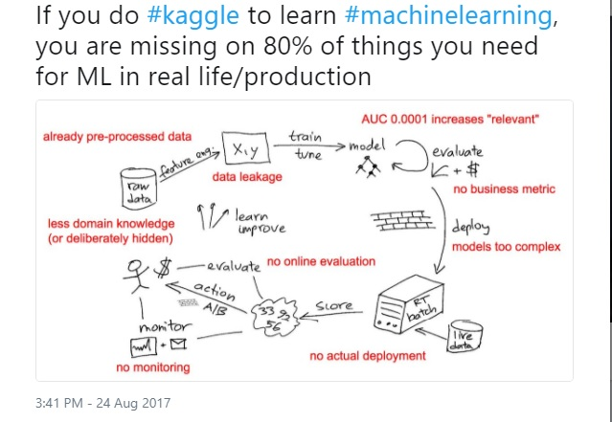
Kaggle vs Reality
Notes:
Higher difficulty
Cleaner data
Every decimal counts

Slide 5

How do I join?
Getting started:
Predict Titanic survival:
https://www.kaggle.com/c/titanic
Predict house prices: https://www.kaggle.com/c/house-prices-advanced-regression-techniques
Walkthrough of a competition: https://www.kaggle.com/c/ndsc-beginner/notebooks
Interested to form a team? Let us know!

