Slide 1

Projectwork1(19AI702) – Review 2
Scholara: A System for the Asynchronous Management of Academic Artifacts Featuring Federated Authentication with a RESTful Endpoint Architecture
Submitted by:
JEGADEESH S (212222230055)
2022-2026 Batch
TEAM NO:253
Under the guidance of:
JABA JASPHIN E T
Assistant Professor (SG),Department of AIDS
DEPARTMENT OF ARTIFICIAL INTELLIGENCE AND DATA SCIENCE
SAVEETHA ENGINEERING COLLEGE
(Autonomous Institution – UGC, Govt. of India)
(Affiliated to Anna University, Approved by AICTE - Accredited by NBA & NAAC – ‘A’ Grade - ISO 9001:2015 Certified)
Saveetha Nagar, Thandalam, Chennai-602 105, TamilNadu, INDIA.

Slide 2
Agenda
Introduction
Statement of the Problem
Purpose of the Project
Proposed Methodology
Test Case
Literature Review
Output and Results
Conclusion
References

Slide 3
Introduction
Academic collaboration and visibility between students and faculty remain challenging due to fragmented systems.
Scholara is a web-based academic networking platform designed to bridge this gap, enabling seamless interaction, project management, publication tracking, and mentorship through unified dashboards for students and faculty.
The system integrates AI-driven analytics, leaderboard ranking, and appointment scheduling, promoting academic visibility and data-driven growth.

Slide 4
Statement of the Problem
Educational institutions often face:
Fragmented tools for academic communication and project management.
Lack of unified systems for showcasing achievements and coordinating collaborations.
Difficulty in tracking academic performance and engagement.
Hence, there is a need for an integrated, role-based, AI-supported platform to improve connectivity, recognition, and efficiency in academic networks.

Slide 5
Purpose of the project
The purpose of Scholara is to:
Centralize academic activities like projects, publications, and achievements.
Simplify student–faculty collaboration and mentorship.
Enhance academic visibility through dashboards and leaderboards.
Use AI analytics for performance tracking and automated resume generation.
Create a scalable and user-friendly digital academic ecosystem.

Slide 6
Proposed Methodology
Methodology Steps:
Frontend: Role-specific dashboards using React/Next.js.
Backend: Node.js with Express RESTful API.
Database: MongoDB for user and activity data.
Authentication: Firebase-based secure login and token validation.
AI Analytics: Heuristic scoring (Phase 1) → ML-driven analytics (Phase 2).
Deployment: Containerized APIs with scalability and load balancing.

Slide 7
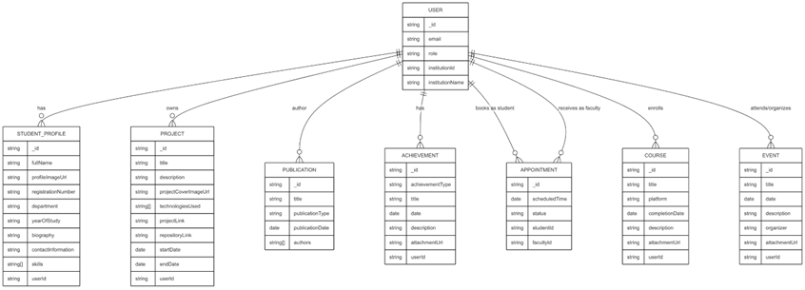
Test Case
Logical Data Model Diagram for Scholara

Slide 8
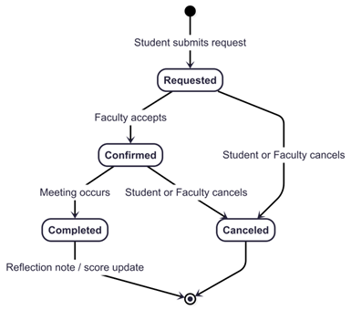
Test Case
Appointment Lifecycle State Diagram in Scholara

Slide 9
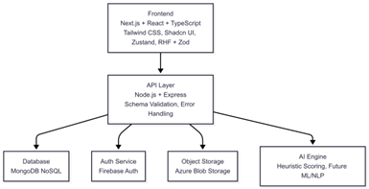
Test Case
Technology Stack Overview for Scholara

Slide 10
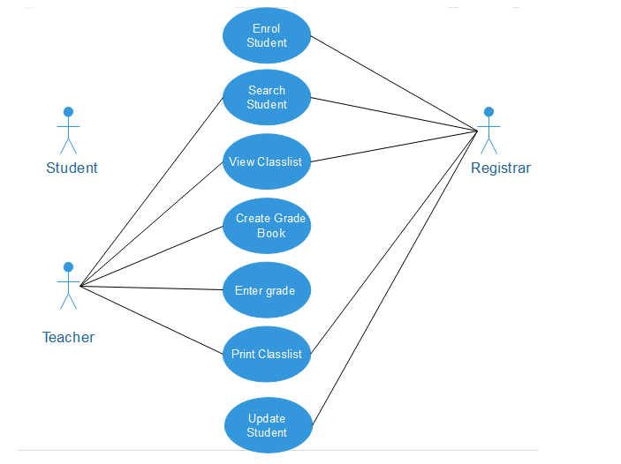
UML DIAGRAMS

Slide 11
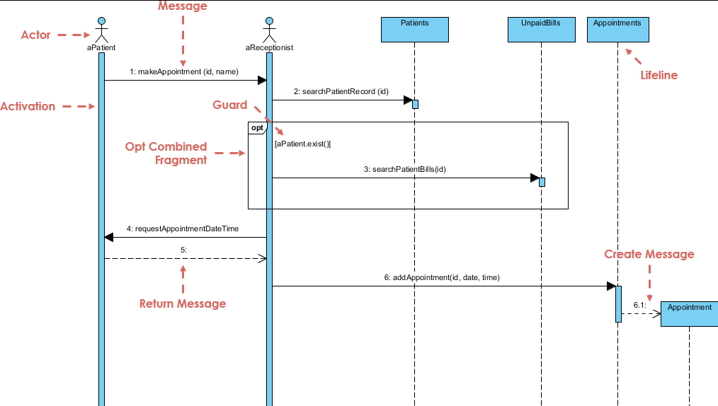
UML DIAGRAMS

Slide 12
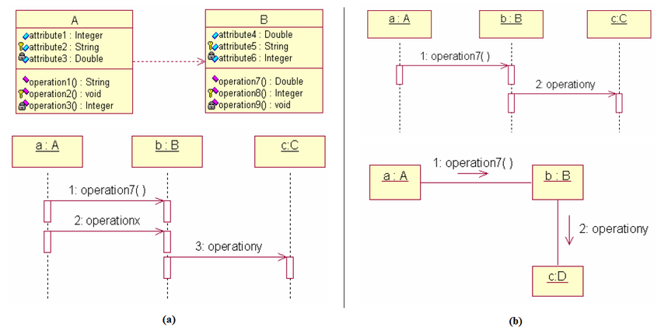
UML DIAGRAMS

Slide 13
HARDWARE SELECTION
Component | Specification
Processor | Dual-core processor or higher
RAM | Minimum 4 GB
Storage | 20 GB free disk space
Display | 1366 × 768 resolution or higher
Network | Stable broadband internet connection
Devices | Desktop, Laptop, Tablet, or Smartphone

Slide 14
Software Selection
Layer | Software
Server OS | Linux (Ubuntu Server)
Client OS | Windows, macOS, Linux, Android, iOS
Technology | Purpose
HTML5 | Page structure
CSS3 | Responsive design
JavaScript | Dynamic interactions
React.js | Component-based UI development
Bootstrap / Tailwind | UI consistency and responsiveness

Slide 15
Literature Review-Reference Paper 1
Paper Title:
ResearchGate and Academia.edu: Academic Social Networks
Problem Statement:
Existing academic networking platforms enable visibility but lack integration with institutional workflows and role-specific collaboration features.
Problem Approach:
The study evaluates how researchers use academic networking platforms for visibility, identifying missing links between faculty–student collaboration and institutional engagement.
Advantages:
Promotes networking and knowledge sharing among academics.
Drawbacks:
Limited support for institution-based collaboration, no project or achievement tracking.
Future Scope:
Development of role-based academic platforms integrating collaboration, mentoring, and analytics.

Slide 16
Literature Review-Reference Paper 2
Paper Title:
Systematic Comparative Review of Three LMS Platforms: Moodle, Blackboard, and Canvas
Problem Statement:
Learning management systems assist course management but do not facilitate comprehensive academic networking or achievement visibility.
Problem Approach:
The paper compares major LMS tools in terms of features, usability, and institutional adaptability.
Advantages:
Strong in course tracking, assessment management, and communication.
Drawbacks:
Lack features for publication showcase, cross-department collaboration, and analytics-driven engagement.
Future Scope:
Integration of LMS features with academic collaboration platforms to unify project, publication, and student–faculty interaction data

Slide 17
Literature Review-Reference Paper 3
Paper Title:
AI-Driven Learning Analytics Applications and Tools in Computer-Supported Collaborative Learning: A Systematic Review
Problem Statement:
AI-driven analytics are underused in academic collaboration platforms and rarely integrated with academic performance or project tracking.
Problem Approach:
The paper analyzes AI techniques used to evaluate academic progress and engagement.
Advantages:
Highlights the potential of AI in personalizing learning experiences and performance tracking.
Drawbacks:
Limited institutional deployment and absence of unified dashboards for collaboration.
Future Scope:
Integration of AI analytics into academic collaboration systems to deliver performance insights and automated career tools.

Slide 18
Functional Requirements
ID | Functional Requirement Description
F001 | The system shall allow users to register and log in with role-based access (student/faculty).
F002 | The system shall enable users to create and edit academic profiles containing skills, interests, and achievements.
F003 | The system shall allow students and faculty to upload and manage publications with metadata and attachments.
F004 | The system shall provide appointment scheduling between students and faculty with real-time status tracking.
F005 | The system shall allow project creation, team collaboration, and progress tracking for academic projects.
F006 | The system shall display a leaderboard ranking users based on AI-computed performance scores.
F007 | The system shall provide dashboards tailored separately for students and faculty.
F008 | The system shall allow users to upload achievements, certifications, and course completions.

Slide 19
Non-Functional Requirements
Requirement Type | Description
Performance | System should respond within 2 seconds for standard operations (login, dashboard load).
Scalability | The platform should support up to 150 concurrent users per instance.
Reliability | The system must ensure 99% uptime and prevent data loss during updates.
Security | All user data must be encrypted and accessible only through authenticated sessions.
Usability | The interface should be intuitive, accessible, and follow consistent UI patterns.
Portability | The system should be deployable across Windows and Linux servers.
Maintainability | Modular code structure with clear documentation for easy future upgrades.
Data Integrity | Database transactions should ensure atomicity and prevent duplicate or corrupted entries.

Slide 20
OUTPUT AND RESULTS
Metric | Expected Value | Notes
Dashboard Load (Median) | 600–800 ms | 95th percentile < 1.2 s
Project Creation | 700–900 ms | Standard operation
Publication Entry | 800–1000 ms | With metadata validation
Leaderboard Query | 500–700 ms | With filtering
File Upload | 1.5–3 s | Depends on file size
Concurrent Users Supported | 100–150 | Per API instance
API Throughput | 120–150 req/sec | Under normal usage

Slide 21
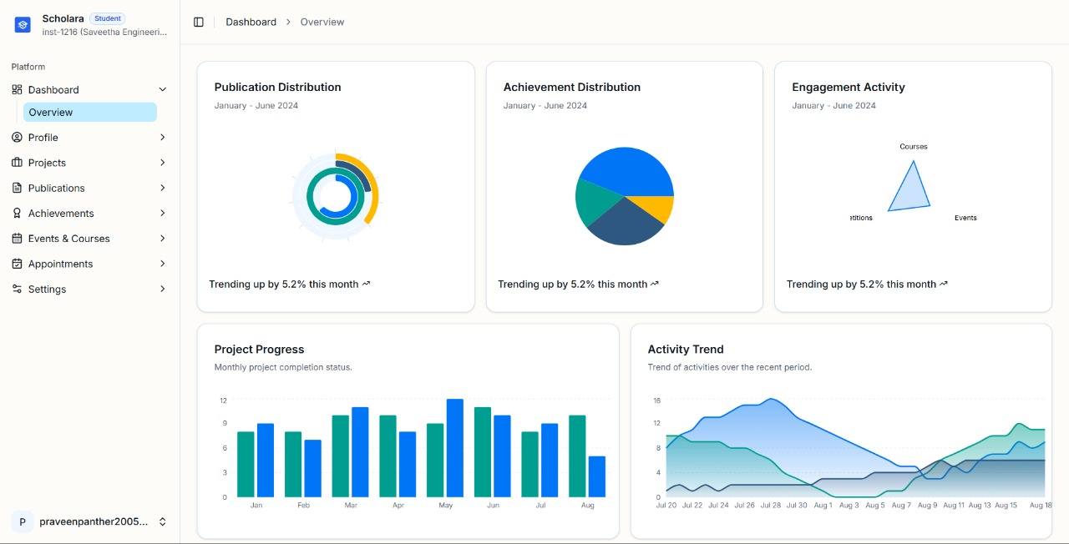
OUTPUT AND RESULTS

Slide 22
Conclusion
The project Scholara successfully implements a role-based academic collaboration system that simplifies and enhances communication between students and faculty.
It integrates AI-driven analytics, publication visibility, and achievement dashboards, establishing an ecosystem that promotes transparency, performance, and academic excellence.
The system lays the foundation for future research in scalable, data-driven educational platforms supporting institution-wide collaboration.

Slide 23
References
Meishar-Tal, H. & Pieterse, E. (2017). Why Do Academics Use Academic Social Networking Sites? Int. Rev. Res. Open Distributed Learning.
Ovadia, S. (2014). ResearchGate and Academia.edu: Academic Social Networks. Behavioral & Social Sciences Librarian.
Fagborun, J. (2024). A Systematic Comparative Review of LMS Platforms. International Journal of Advanced Computing Studies.
Ouyang, F. & Zhang, L. (2024). AI-Driven Learning Analytics in Education. Educational Research Review.
Jivet, I. et al. (2024). Gamification in Learning Environments and Its Impact on Engagement. Computers and Applications in Learning.
F. Ouyang and L. Zhang, "AI-driven learning analytics applications and tools in computer-supported collaborative learning: A systematic review," Educ. Res. Rev., vol. 43, Art. no. 100616, Nov. 2024, doi: 10.1016/j.edurev.2024.100616.
B. Oyarzun and F. Martin, "A Systematic Review of Research on Online Learner Collaboration from 2012-21: Collaboration Technologies, Design, Facilitation, and Outcomes," Online Learn., vol. 27, no. 1, pp. 71-106, Mar. 2023, doi: 10.24059/olj.v27i1.3407.
I. Bouchrika, "20 Best Academic Scheduling Software for 2025," Research.com, Aug. 6, 2025.
I. Jivet, M. Scheffel, M. Specht, and H. Drachsler, "The use of leaderboards in education: A systematic review of the literature," Comput. Appl. Learn., Oct. 2024, doi: 10.1111/jcal.13077.
O. Almousa, "Users' classification and usage-pattern identification in academic social networks," in Proc. IEEE Jordan Conf. Appl. Elect. Eng. Comput. Technol. (AEECT), Amman, Jordan, 2011, pp. 1-6, doi: 10.1109/AEECT.2011.6132492.

