Slide 1
Do area-level covariates sharpen small-area estimates of Penta3 coverage?
Shiny app reports (without and with covariates) combined with a SUMMER reproduction: direct, Fay-Herriot and unit-level estimates, counties and sub-counties, DHS 2022
CEMA SAE short course | Hands-on project | SUMMER / surveyPrev

Slide 2
Context and method
Context: 89% receive Penta3 nationally, but local gaps are hidden
89.2%
Item | Value
Clusters | 1,448
Children 12–23 months | 3,679
Vaccinated (events) | 3,148
Counties (admin 1) | 47
Sub-counties (admin 2) | 300
Areas with no sample | 0 counties; 8 sub-counties (2.67%)
of children aged 12–23 months had received DPT3 / Penta3 (DHS final report 89.2%; DHS app 89.18%)
■ Question set. How large is the geographic variation, why do areas differ, and do covariates add information beyond the survey?
■ Approach. Three estimators at two levels, each fitted without and with four area-level covariates, all in SUMMER / surveyPrev.
Penta3 coverage, Kenya DHS 2022 | CEMA SAE short course
2

Slide 3
Context and method
Two routes to the same estimates: the Shiny app and SUMMER
Source | What it gives | Used for
Shiny app report, no covariates | Direct, area-level and unit-level maps and scatters (county; unit-level also sub-county) | Baseline; national consistency check (89.18% vs 89.20%)
Shiny app report, with covariates | The same report after uploading county and sub-county covariate templates | Visual effect of covariates as a user of the app sees it
SUMMER / surveyPrev refit | Every model, with and without covariates, plus WAIC, coefficients, shrinkage and rankings | Answering the questions the app does not report
■ Estimators. Direct (directEST), Fay-Herriot (fhModel, BYM2) and unit-level (clusterModel, beta-binomial BYM2); nested unit-level variant at sub-county level.
■ Covariates. Mean years of education, 4+ ANC visits, difficulty accessing a facility and facility delivery, standardised (effects per 1 SD).
■ Agreement. The app's no-covariate results were reproduced exactly (direct identical; model-based correlation 1.000), and the with-covariate app results match the SUMMER fit with all four covariates (agreement slide under Q3).
■ Why both. The app gives the maps users see; SUMMER adds the model-comparison numbers the app does not show.
Penta3 coverage, Kenya DHS 2022 | CEMA SAE short course
3

Slide 4
Overview
The nine questions and their short answers
Each section that follows is tagged with its question number
Question | Short answer
Q1 Geographic variation? | Counties 45%–95%; sub-counties 31%–96%. Lowest in the north-east and east.
Q2 Reasons for differences? | Education tracks coverage (county r = 0.62, sub-county r = 0.21); facility delivery at county level; access difficulty is negative.
Q3 Covariates change estimates / precision? | Education: clear effect, but small precision gain (county SD 3.44 to 3.34 pp, sub-county 5.15 to 4.78 pp) and no WAIC gain.
Q4 Unsampled sub-counties plausible? | Mostly: all 8 are close to county averages with wide intervals; the nested model gives an implausible 41% for Garissa / Lagdera.
Q5 How strong is shrinkage? | County slope 0.81 (Fay-Herriot) / 0.76 (unit-level); sub-county 0.54 / 0.46. Covariates change little.
Q6 Nested models useful? | No: WAIC 1784 to 1813, wider intervals, one implausible estimate.
Q7 Direct vs area vs unit differences? | Same ranking and pattern; model intervals narrower than direct; direct 100% values shrink most.
Q8 Very high or low areas? | 8 counties and 26 sub-counties have intervals entirely below the national level; 2 and 4 above.
Q9 Suggestions and bugs? | Report covariate effects and WAIC; fix Fay-Herriot admin-2 failure and prevMap argument; flag missing covariates.
Penta3 coverage, Kenya DHS 2022 | CEMA SAE short course
4

Slide 5
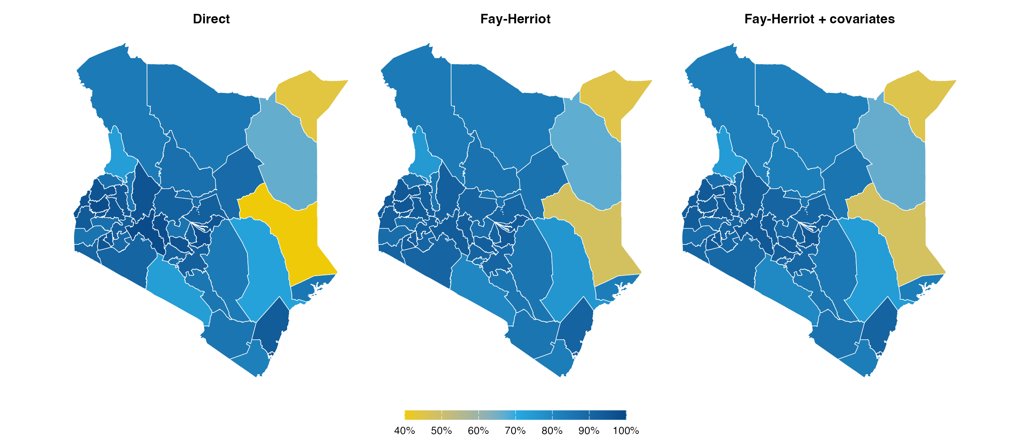
Q1 · Geographic variation
County level: coverage ranges from 45% to 95%
Direct, Fay-Herriot, and Fay-Herriot with covariates (same colour scale)
■ Lowest: Mandera, Garissa, Wajir, Tana River
■ Highest: Nakuru, Embu, Mombasa, Bungoma
■ 12 of 47 counties have a smoothed estimate below 85%.
■ Pattern: low coverage is concentrated in the north-east and east; the highest estimates are in Nakuru, Embu, Mombasa, Bungoma.
Penta3 coverage, Kenya DHS 2022 | CEMA SAE short course
5

Slide 6
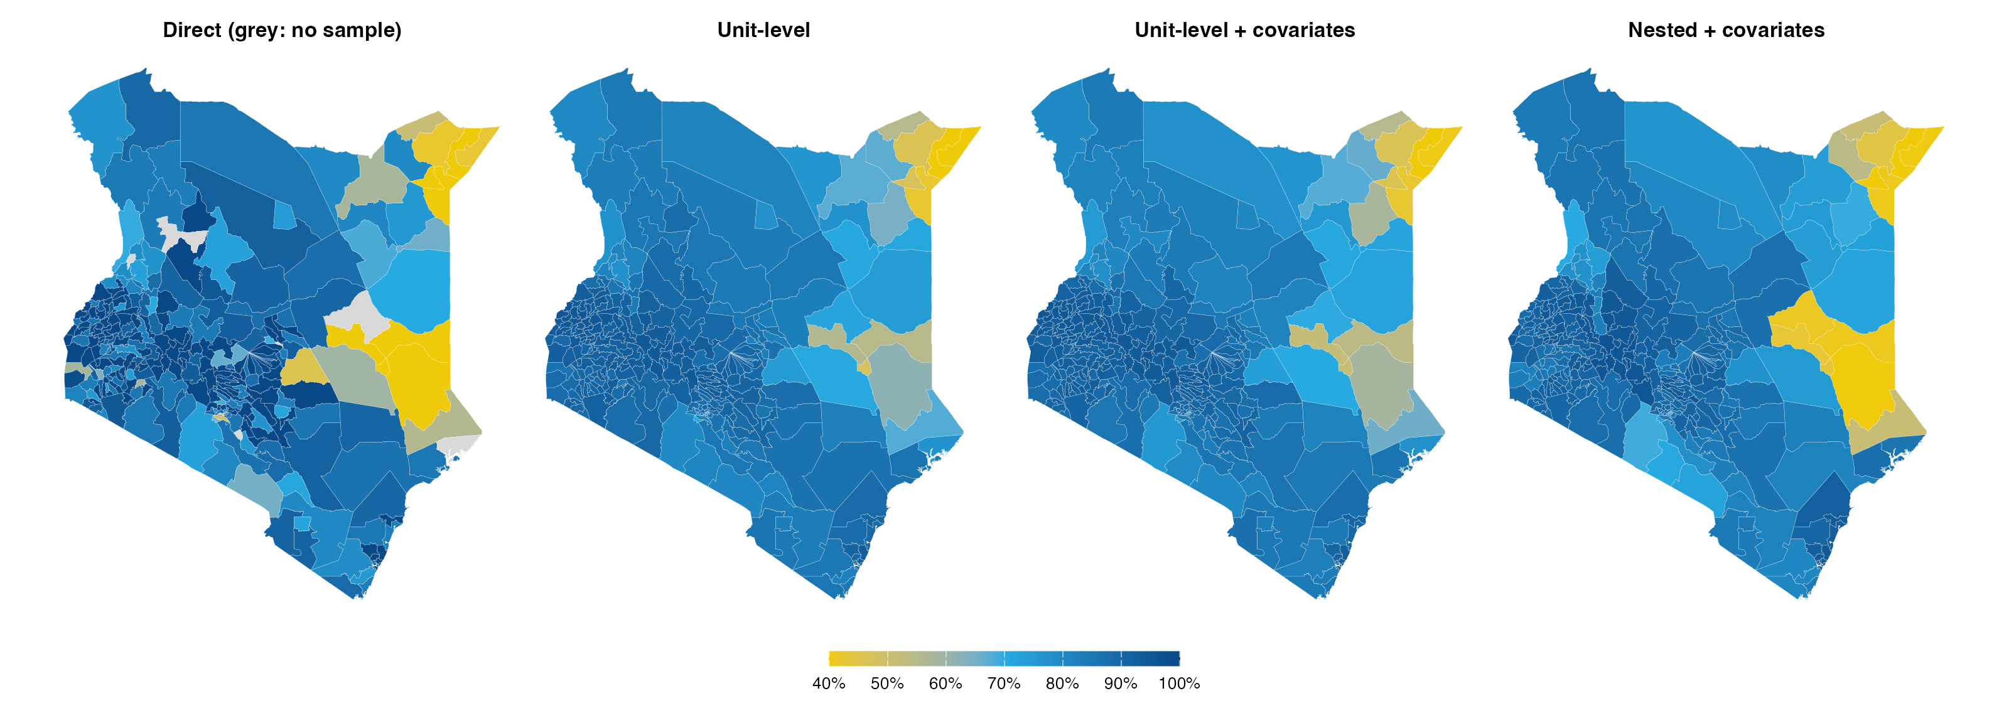
Q1 · Geographic variation
Sub-county level: the range widens to 31%–96%
Direct (design-based), unit-level, unit-level with covariates, and nested with covariates
■ 30 sub-counties fall below 80% and 7 are at or above 95% (unit-level, no covariates).
■ Lowest: Mandera / Lafey; Mandera / Mandera East; Mandera / Mandera South; Mandera / Mandera North
■ Direct map has gaps: 8 sub-counties are unsampled and 99 more have 100% or zero-variance direct estimates.
Penta3 coverage, Kenya DHS 2022 | CEMA SAE short course
6

Slide 7
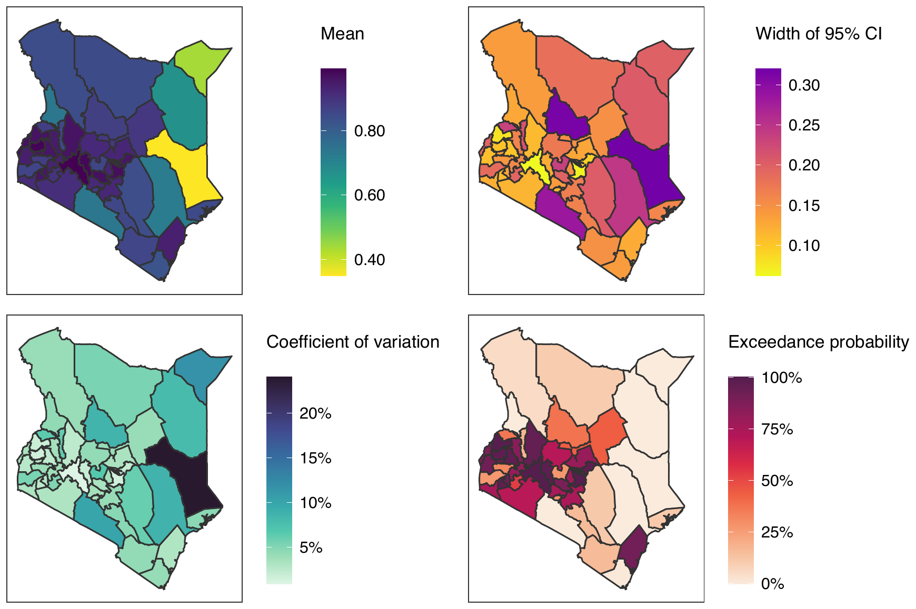
Q1 · Geographic variation
Shiny app, county level: direct estimates are the same with and without covariates
Direct estimates cannot use covariates; the app repeats this panel in both reports
■ Map: low estimates in the north-east and east; the widest intervals (yellow to purple in the width map) are in the same areas.
■ Widest direct intervals: Garissa (0.32), Samburu (0.32), Kajiado (0.28), Tana River (0.24)
■ Implication: these are the counties where borrowing strength, and covariates, can matter most.
Penta3 coverage, Kenya DHS 2022 | CEMA SAE short course
7

Slide 8
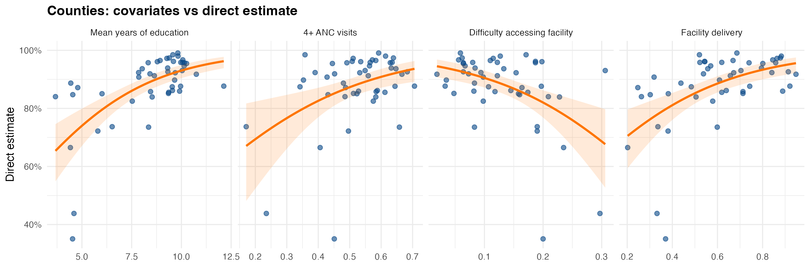
Q2 · Reasons for differences
Why counties differ: education is the covariate most aligned with coverage
County direct estimates against each covariate (z-scores)
■ Strongest: Mean years of education (r = 0.62, R² = 0.38). Weakest: 4+ ANC visits (r = 0.35).
■ Plausible mechanism: caregiver education and facility use raise the chance a child completes the three-dose schedule; poor facility access lowers it.
■ Caution: county covariates are area averages and the association is ecological; it does not show that education causes higher coverage.
Penta3 coverage, Kenya DHS 2022 | CEMA SAE short course
8

Slide 9
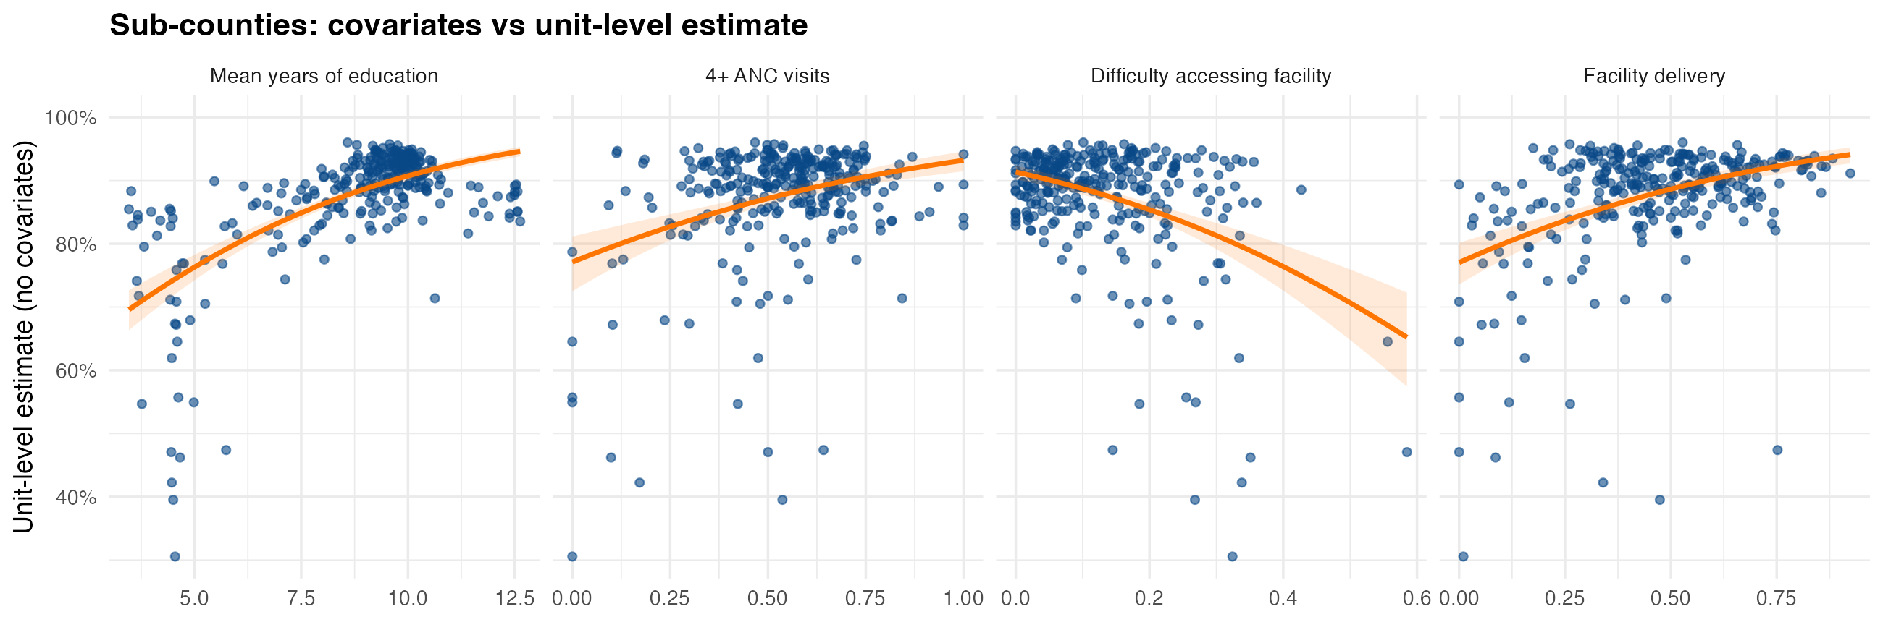
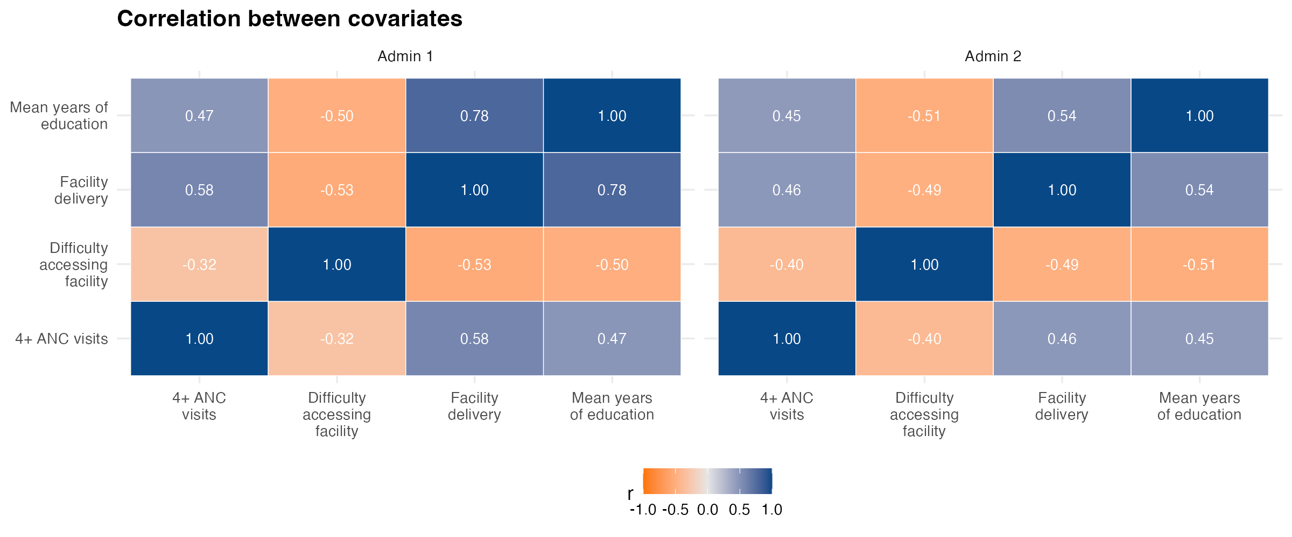
Q2 · Reasons for differences
Sub-counties: same direction, much weaker association than counties
Unit-level estimates against each covariate; correlations among covariates
■ Weaker at sub-county level: education r = 0.21 (193 sub-counties with a usable direct estimate) versus r = 0.62 for counties.
■ Overlap: covariate pairs correlate up to r = 0.78 at county level (education and facility delivery), so effects are partly shared when entered together.
■ Missing values: 4 sub-counties lacked covariate values (Machakos / unknown 7; Nairobi / Dagoretti South; Nairobi / Embakasi Central; Turkana / unknown 2); county means of the remaining sub-counties were used.
Penta3 coverage, Kenya DHS 2022 | CEMA SAE short course
9

Slide 10
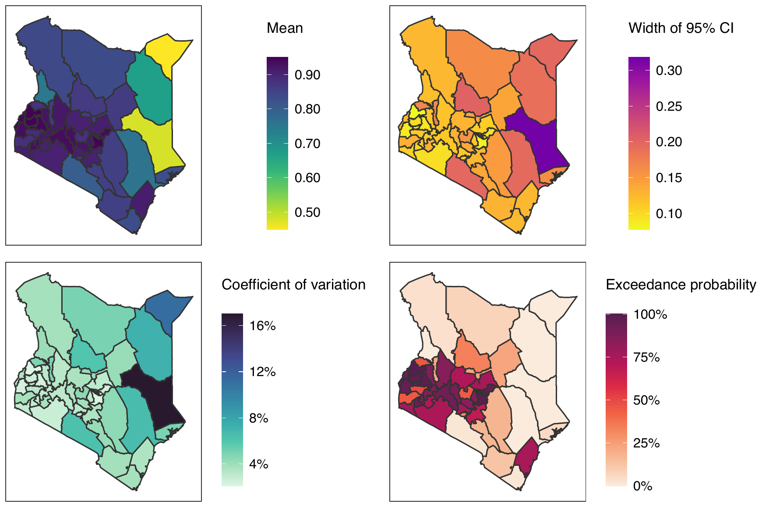
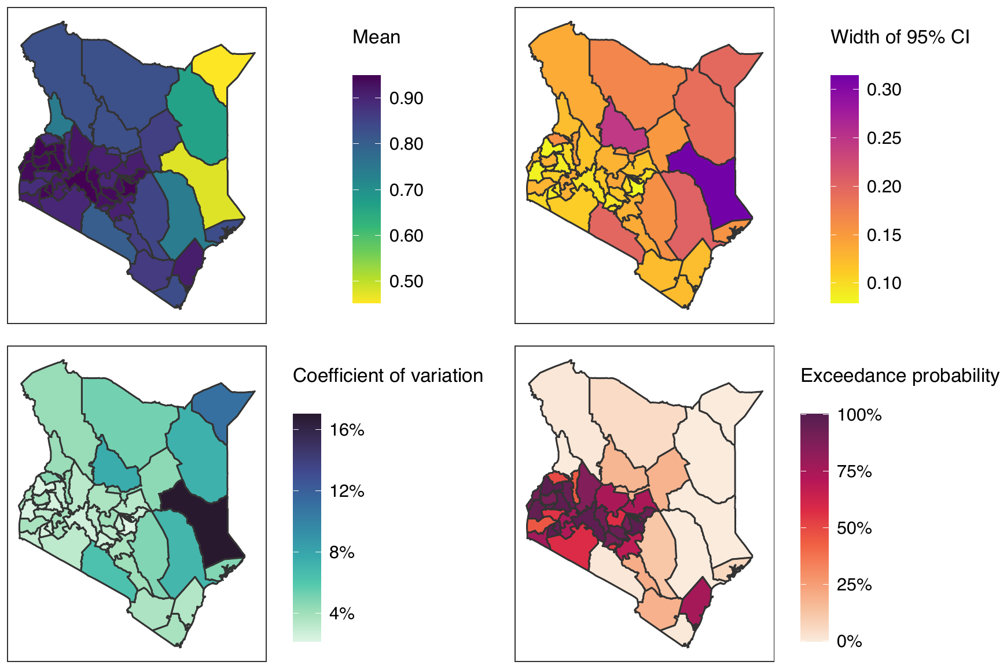
Q3 · Covariates, estimates and precision
County, app Fay-Herriot: covariates change estimates only locally
Legend ranges are identical: mean 0.50–0.90, CI width 0.10–0.30, CV 4–16%
Shiny app: without covariates
Shiny app: with covariates
■ Overall picture unchanged; changes are local (SUMMER values). Samburu: 86.5% to 82.8%, CI width 0.20 to 0.25. Nyeri: CI width 0.15 to 0.14. Elgeyo-Marakwet: 0.17 to 0.14.
■ Average effect is small: mean CI width 0.133 without covariates, 0.133 with all four, 0.130 with education only.
Penta3 coverage, Kenya DHS 2022 | CEMA SAE short course
10

Slide 11
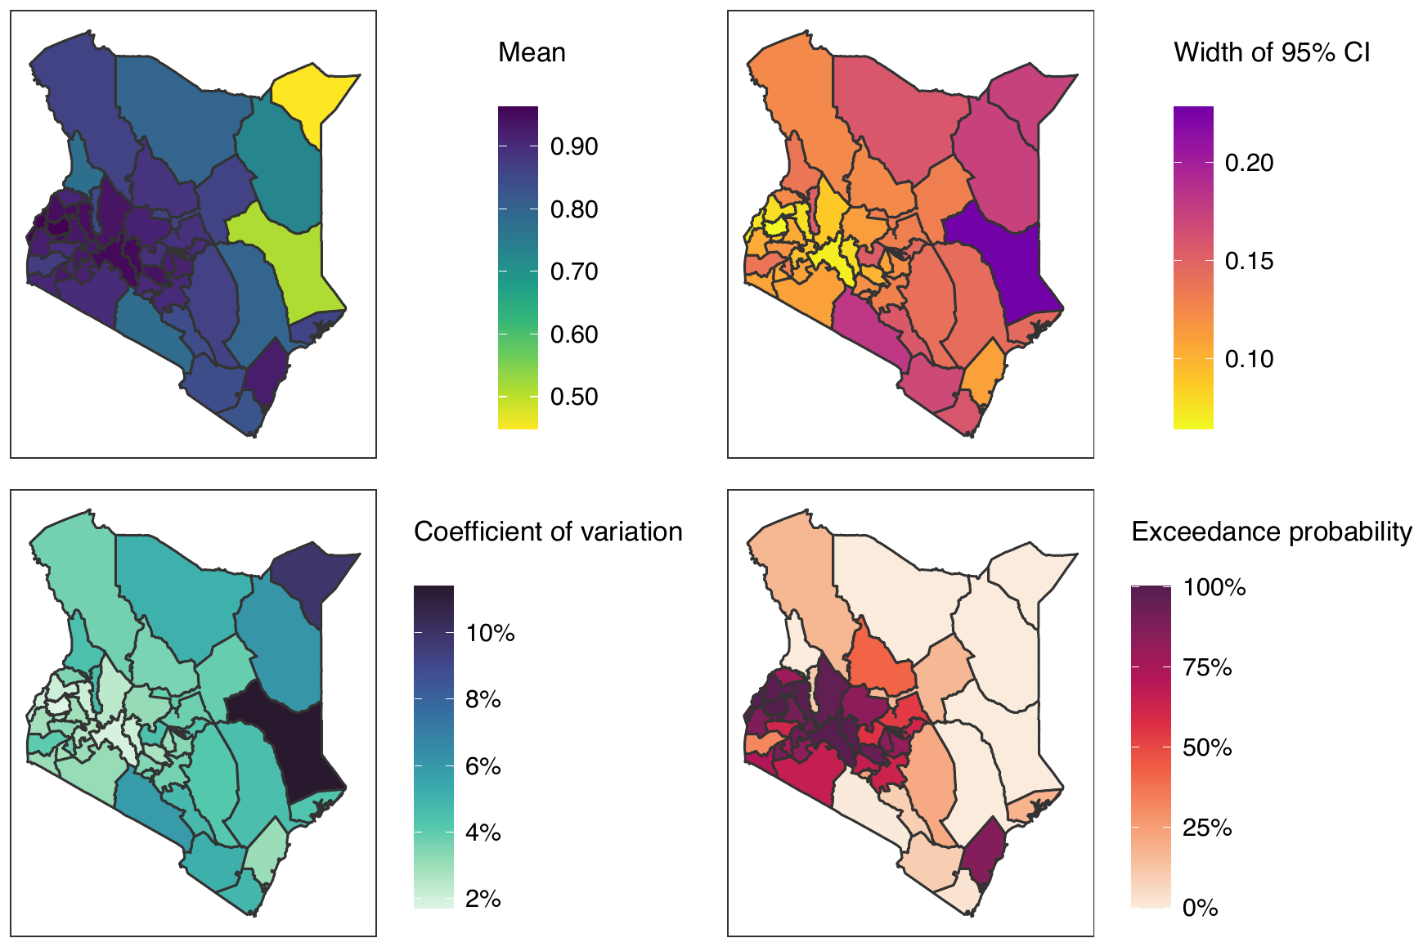
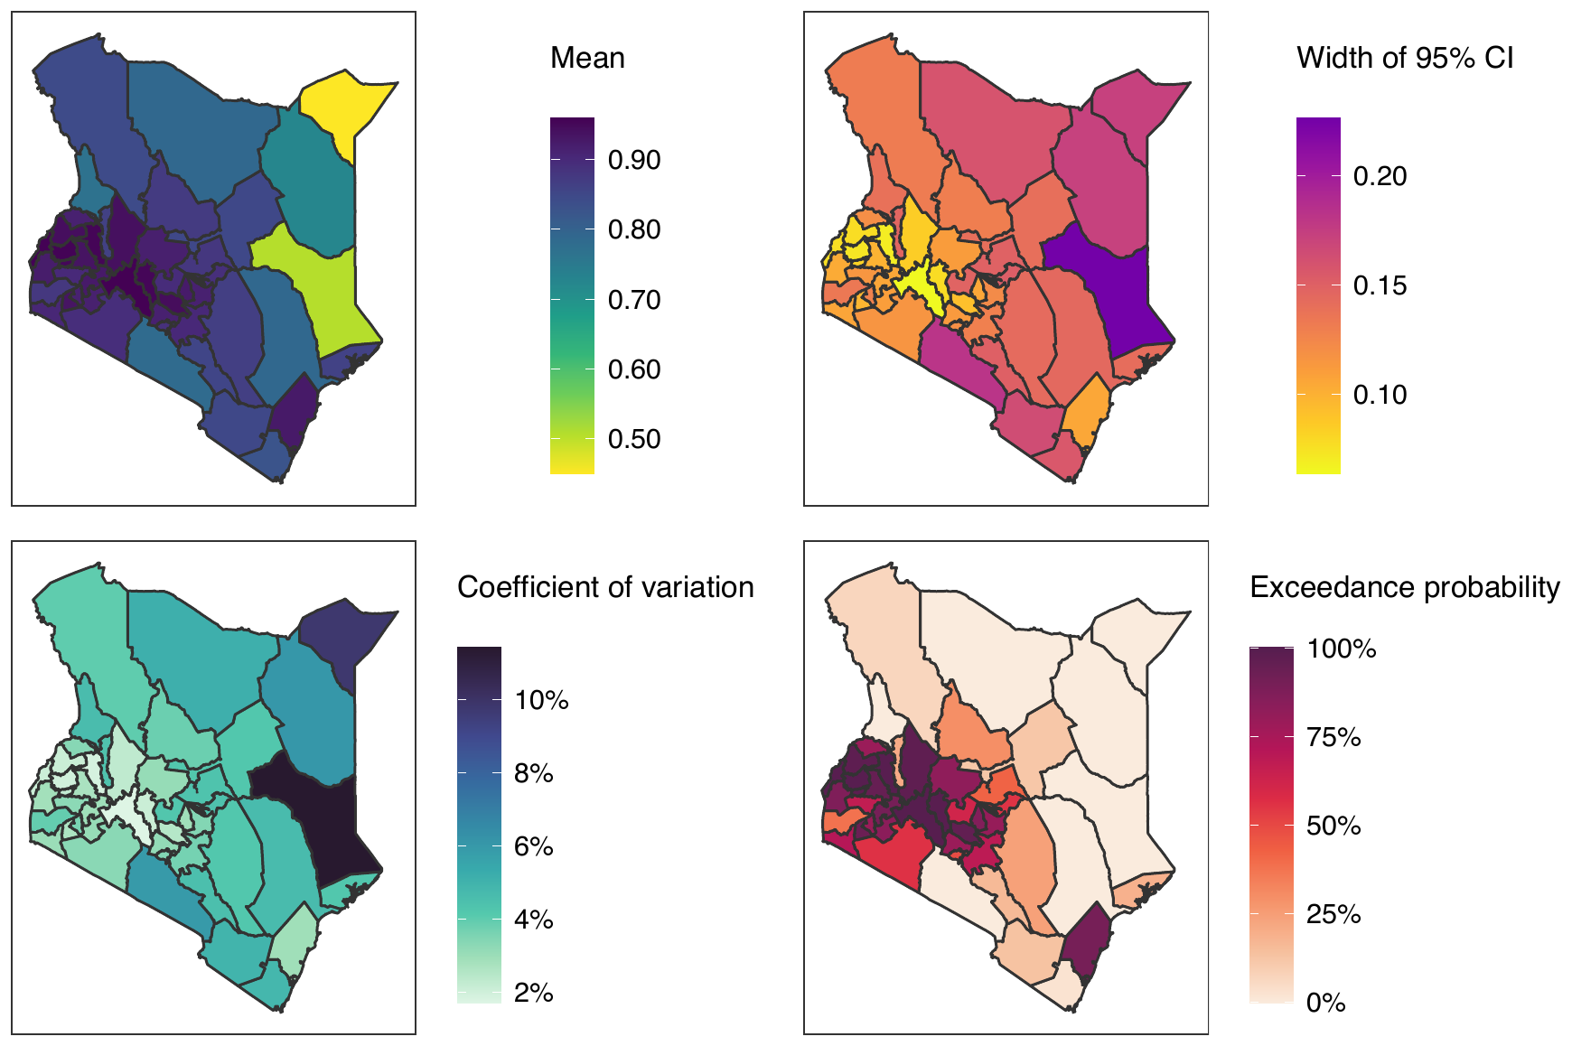
Q3 · Covariates, estimates and precision
County, app unit-level: virtually no visible change
Legend ranges identical: mean 0.50–0.90, CI width 0.10–0.20, CV 2–10%
Shiny app: without covariates
Shiny app: with covariates
■ The cluster-level model already uses all 3,679 children, so covariates add little: mean CI width 0.124 without covariates, 0.123 with all four, 0.120 with education only (SUMMER).
■ Unit-level intervals are narrower than Fay-Herriot (0.124 vs 0.133), because the model uses cluster counts rather than the 47 direct estimates.
Penta3 coverage, Kenya DHS 2022 | CEMA SAE short course
11

Slide 12
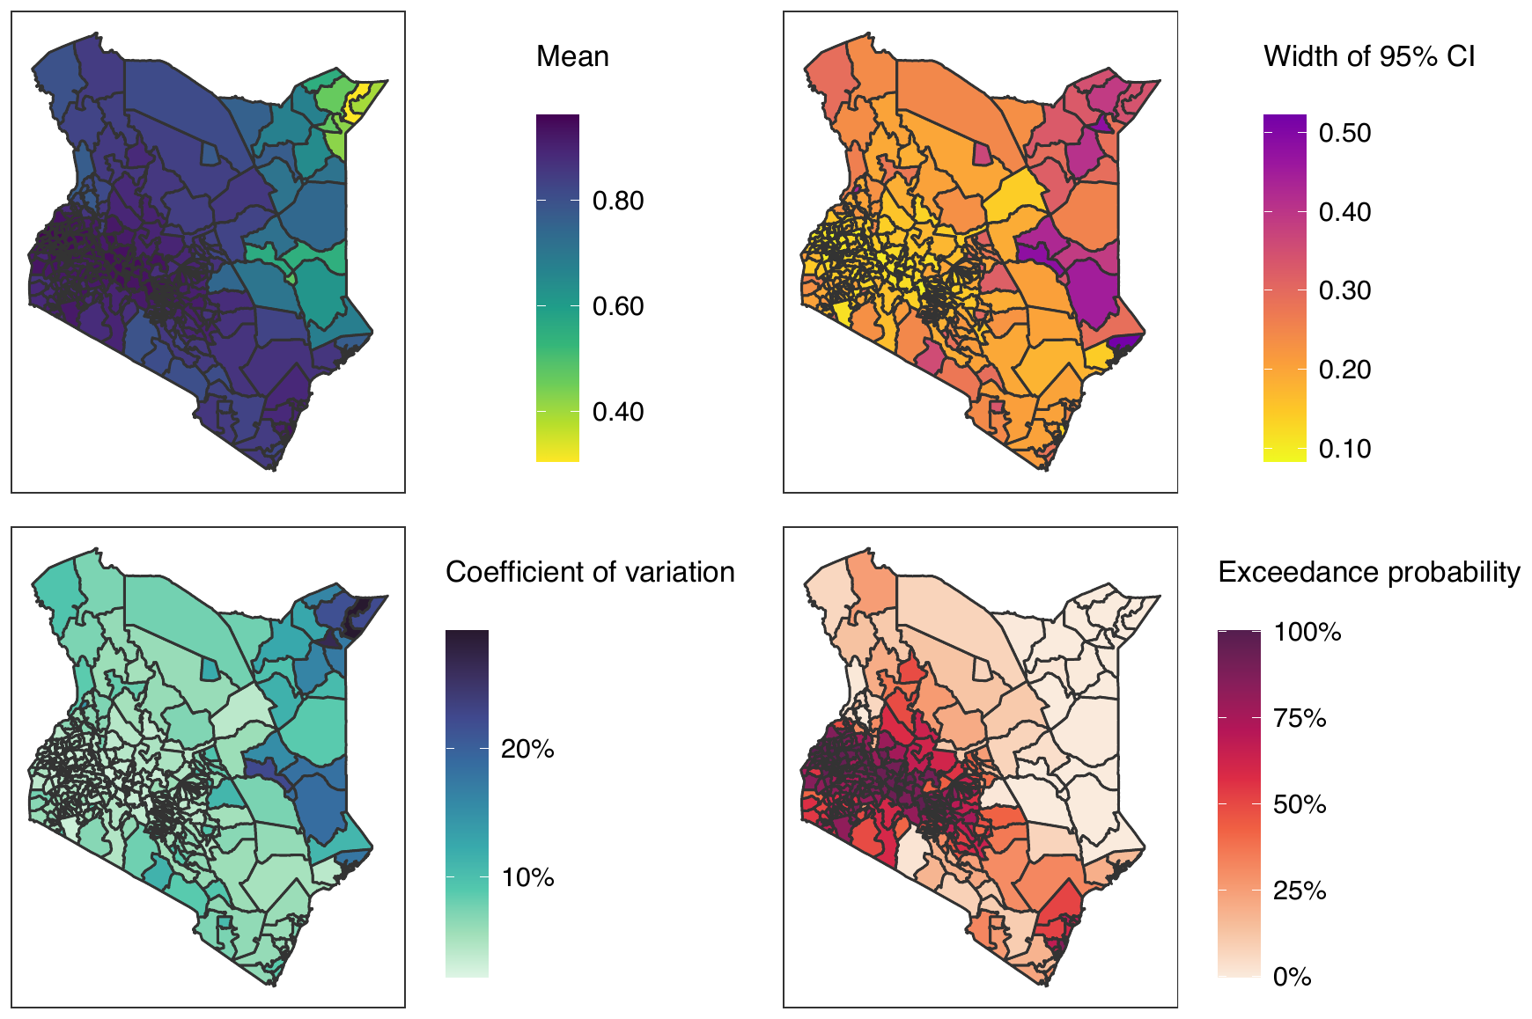
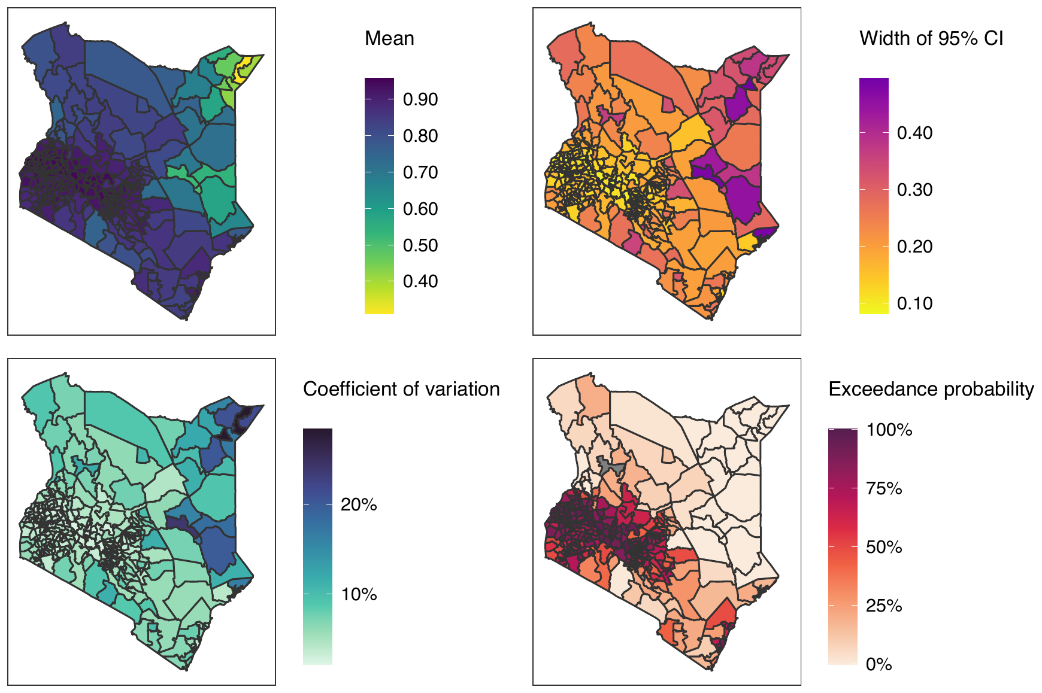
Q3 · Covariates, estimates and precision
Sub-county, app unit-level: tighter intervals, similar pattern
Mean legend 0.40–0.80 becomes 0.40–0.90; the CI-width legend tops out lower (about 0.5 to 0.4–0.5)
Shiny app: without covariates
Shiny app: with covariates
■ Visible change is in precision, not in the pattern: median CI width 0.19 without covariates, 0.17 with all four (SUMMER, 300 sub-counties); the highest widths fall from 0.52 to 0.50.
■ To check: one north-central polygon is grey in the with-covariates exceedance map; it should be confirmed whether it is an area with no estimate.
Penta3 coverage, Kenya DHS 2022 | CEMA SAE short course
12

Slide 13
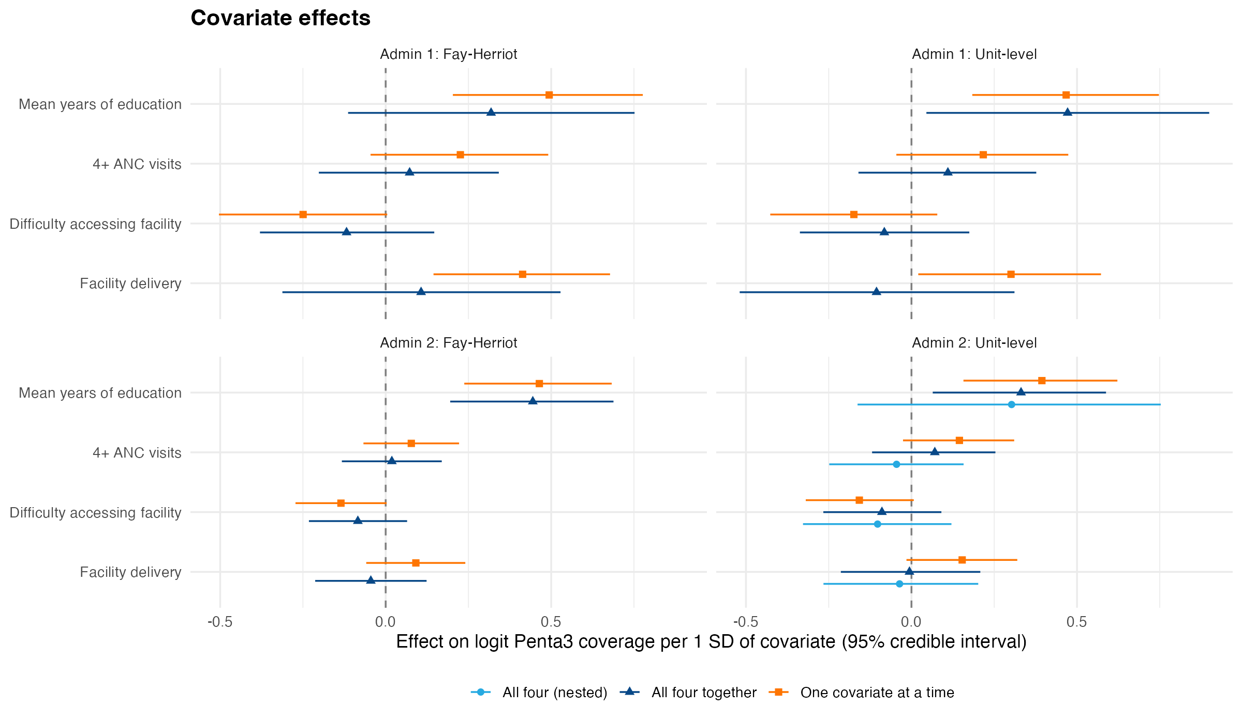
Q3 · Covariates, estimates and precision
Education is the one consistently clear covariate
Posterior mean and 95% credible interval, effect on logit coverage per 1 SD
■ One at a time: education is clear in all four models (+0.39 to +0.49 logits per SD, intervals above zero). Facility delivery is clear only at county level (+0.41 Fay-Herriot, +0.30 unit-level). 4+ ANC and access difficulty are not clear in any model; access difficulty is negative and borderline.
■ All four together: education stays clear in 3 of 4 models (+0.33 to +0.47) but not in county Fay-Herriot (+0.32, -0.11 to 0.75); the other three covariates are not clear anywhere.
■ Why: the covariates overlap (education and facility delivery r = 0.78 across counties), so their effects are shared when entered together.
Penta3 coverage, Kenya DHS 2022 | CEMA SAE short course
13

Slide 14
Q3 · Covariates, estimates and precision
Covariates add little: slightly tighter estimates, no WAIC gain
Lower WAIC is better; ΔWAIC is relative to the model without covariates
Model | ΔWAIC | Mean SD (pp) | Mean CV
Fay-Herriot, county: none | +0.0 | 3.44 | 0.35
+ education | -0.3 | 3.34 | 0.34
+ all four | +2.1 | 3.42 | 0.35
Unit-level, county: none | +0.0 | 3.19 | 0.33
+ education | -0.2 | 3.09 | 0.32
+ all four | +2.1 | 3.17 | 0.33
Fay-Herriot, sub-county: none | +0.0 | 4.54 | 0.51
+ all four | +4.4 | 4.49 | 0.51
Unit-level, sub-county: none | +0.0 | 5.15 | 0.52
+ education | +3.8 | 4.78 | 0.50
+ all four | +6.6 | 4.88 | 0.51
■ Precision: education trims the mean county SD from 3.44 to 3.34 pp (Fay-Herriot) and the sub-county SD from 5.15 to 4.78 pp (unit-level).
■ Information: the county spatial variance falls from 0.45 to 0.33 once all four covariates are included, so they explain part of the between-county differences.
■ Model fit: county WAIC changes are small (-0.3 for education, +2.1 for all four, Fay-Herriot) and sub-county WAIC is worse (+3.8 and +6.6, unit-level), so the evidence for adding covariates is weak.
■ Recommendation: keep education as a single covariate where a modest precision gain is wanted; do not add all four.
Penta3 coverage, Kenya DHS 2022 | CEMA SAE short course
14

Slide 15
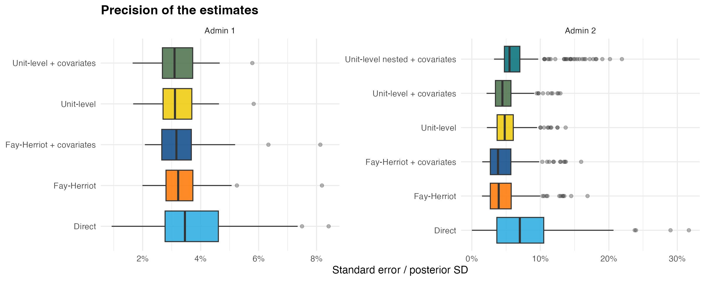
Q3 · Covariates, estimates and precision
Precision: model-based beats direct; covariates add a small gain
■ Median county SD: direct 3.46 pp, Fay-Herriot 3.22 pp, with covariates 3.16 pp.
■ Median sub-county SD: direct 7.01 pp (usable areas only), unit-level 4.80 pp, with covariates 4.46 pp.
Penta3 coverage, Kenya DHS 2022 | CEMA SAE short course
15

Slide 16
Q3 · Covariates, estimates and precision
The app and SUMMER agree, so the SUMMER numbers can explain the app maps
Values read from the app's with-covariate scatter plots against the SUMMER refit (all four covariates)
Quantity | App (read from plot) | SUMMER
Garissa, direct estimate | 0.35 | 0.351
Garissa, Fay-Herriot + cov. | ≈0.48 | 0.478
Kajiado, Fay-Herriot + cov. | ≈0.80 | 0.800
Tana River, Fay-Herriot (none → cov.) | ≈0.76 → 0.74 | 0.758 → 0.740
Samburu, CI width (none → cov.) | ≈0.20 → 0.245 | 0.204 → 0.247
■ Conclusion: the app with covariates behaves as a Fay-Herriot / unit-level model with all four covariates, which is what SUMMER fitted.
■ Limit: the app PDF contains pictures, not numbers; exact values come from the SUMMER refit.
Penta3 coverage, Kenya DHS 2022 | CEMA SAE short course
16

Slide 17
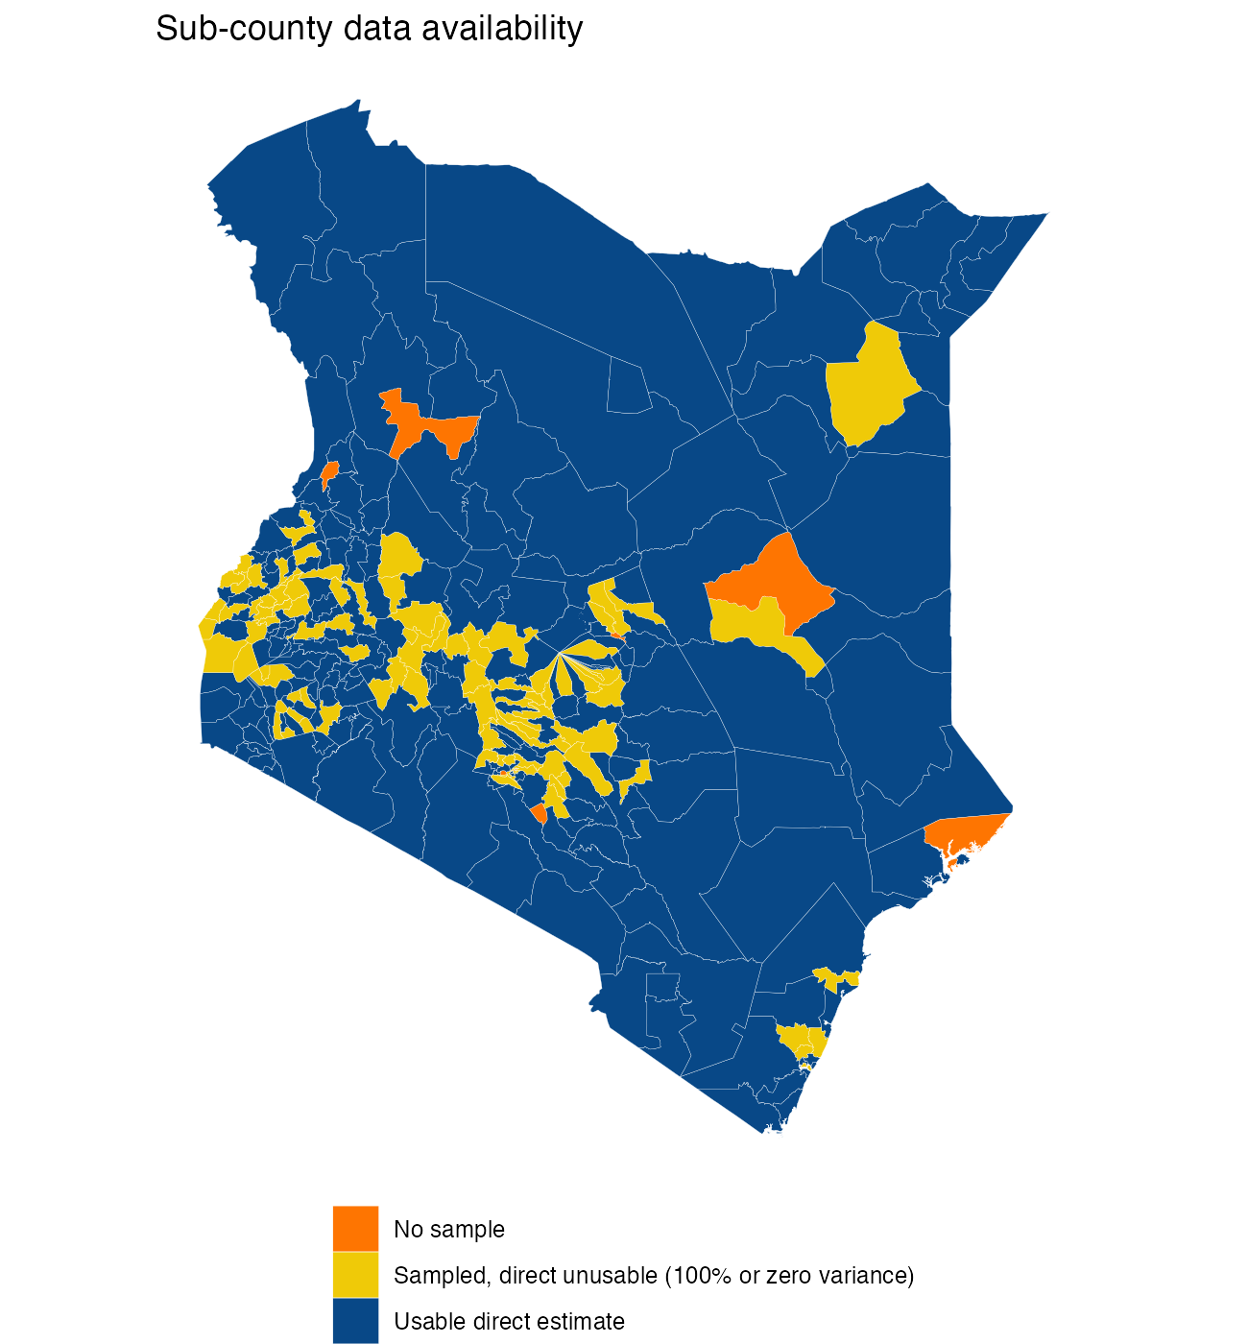
Q4 · Unsampled sub-counties
Unsampled sub-counties: plausible estimates that rest on neighbours
8 of 300 sub-counties had no sampled cluster
Sub-county | Fay-Herriot | Unit-level | Unit-level + cov. | 95% interval (unit + cov.) | County mean (sampled areas)
Garissa / Lagdera | 74% | 72% | 70% | 45%–88% | 58%
Lamu / Lamu East | 73% | 77% | 77% | 46%–95% | 86%
Machakos / unknown 7 | 86% | 85% | 83% | 63%–95% | 89%
Meru / unknown 5 | 89% | 86% | 85% | 67%–95% | 86%
Nairobi / Dagoretti North | 86% | 85% | 89% | 72%–97% | 86%
Nairobi / Embakasi North | 91% | 88% | 91% | 77%–97% | 86%
Turkana / unknown 2 | 84% | 85% | 80% | 59%–93% | 84%
West Pokot / unknown 3 | 77% | 79% | 79% | 54%–94% | 79%
■ Sensible: most estimates sit close to the county average with wide intervals (SD 5–13 pp).
■ Check: covariates move some estimates visibly (Turkana / unknown 2 85% to 80%; Nairobi / Dagoretti North 85% to 89%), and the nested model gives an implausible 41% for Garissa / Lagdera.
■ Use with care: report these with their intervals and flag them as covariate- and neighbour-driven.
Penta3 coverage, Kenya DHS 2022 | CEMA SAE short course
17

Slide 18
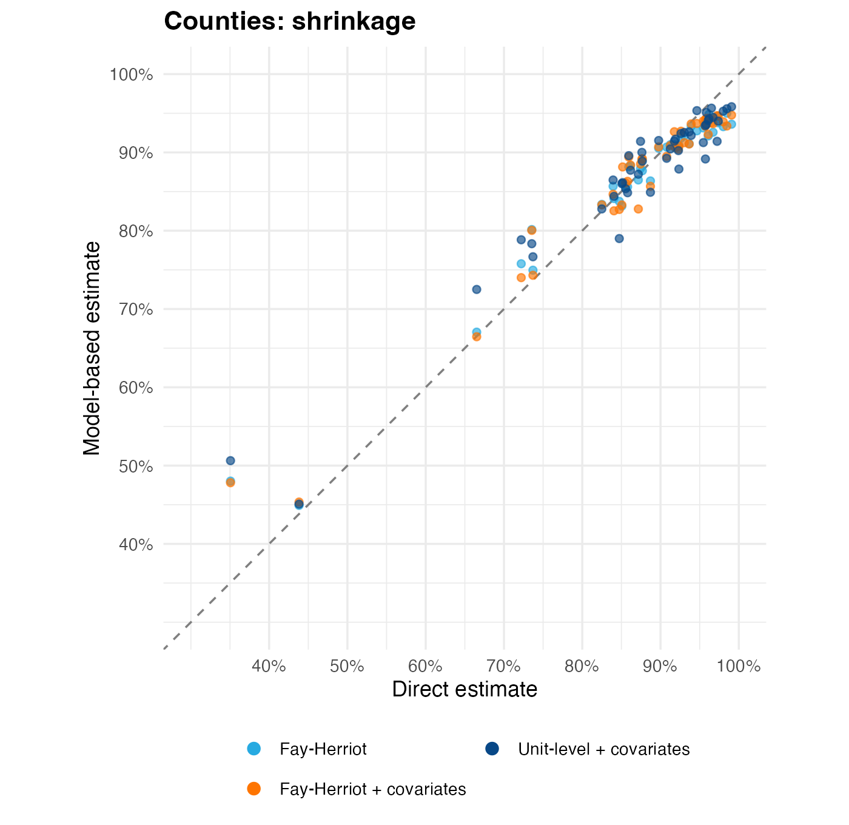
Q5 · Shrinkage
Shrinkage at county level is moderate; covariates reduce it slightly
Model-based estimate against direct estimate, county level
Model | Slope vs direct | Variance retained | Mean |shift| (pp) | SE ratio
Fay-Herriot | 0.81 | 0.68 | 2.1 | 1.02
Fay-Herriot + covariates | 0.82 | 0.70 | 2.2 | 1.00
Unit-level | 0.76 | 0.62 | 2.7 | 0.95
Unit-level + covariates | 0.77 | 0.64 | 2.6 | 0.95
■ Reading: a slope of 1 means no shrinkage; values below 1 show estimates pulled to the mean.
■ Covariates raise the retained variance from 0.68 to 0.70 (Fay-Herriot): less blanket shrinkage because education explains part of the spread.
Penta3 coverage, Kenya DHS 2022 | CEMA SAE short course
18

Slide 19
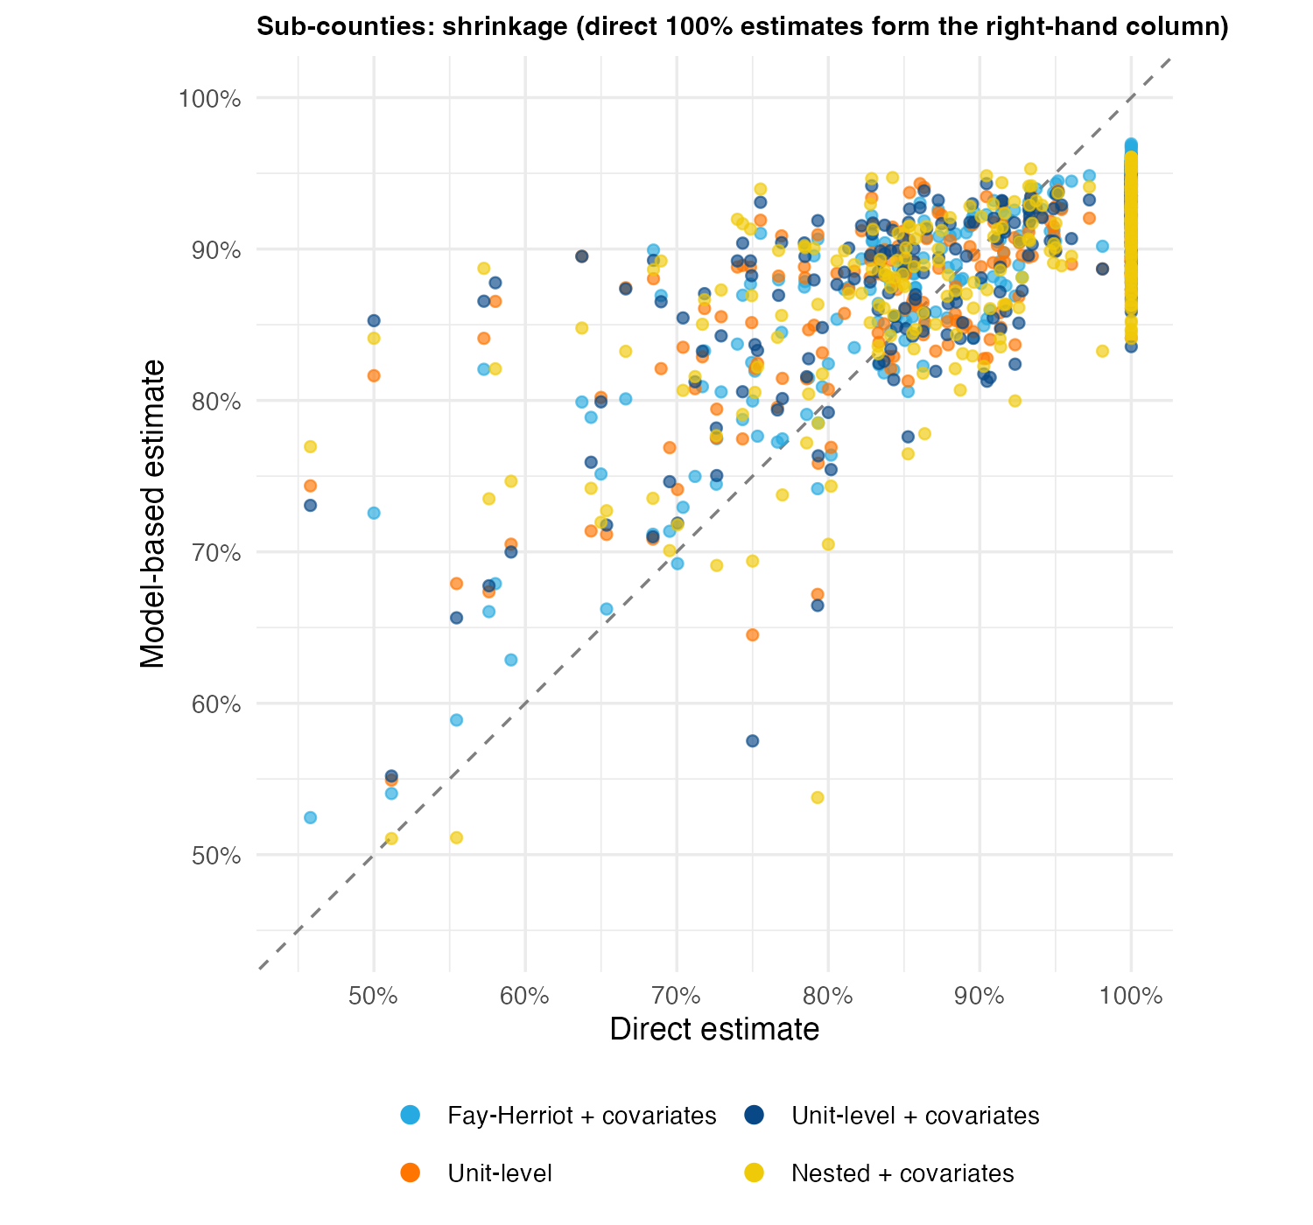
Q5 · Shrinkage
Shrinkage is strong at sub-county level (about 5 clusters per area)
Model-based estimate against direct estimate (sub-counties with a direct estimate)
Model | Slope | Variance retained | Mean |shift| (pp)
Fay-Herriot | 0.54 | 0.39 | 5.6
Fay-Herriot + covariates | 0.54 | 0.39 | 5.7
Unit-level | 0.46 | 0.32 | 7.6
Unit-level + covariates | 0.46 | 0.34 | 7.6
Unit-level nested | 0.50 | 0.42 | 7.6
Unit-level nested + covariates | 0.50 | 0.41 | 7.8
■ Unit-level estimates retain 32% of the direct variance; Fay-Herriot with the same covariates retains 39%.
■ Sparse direct estimates (often 100%) are replaced by model values, which accounts for much of the shift.
Penta3 coverage, Kenya DHS 2022 | CEMA SAE short course
19

Slide 20
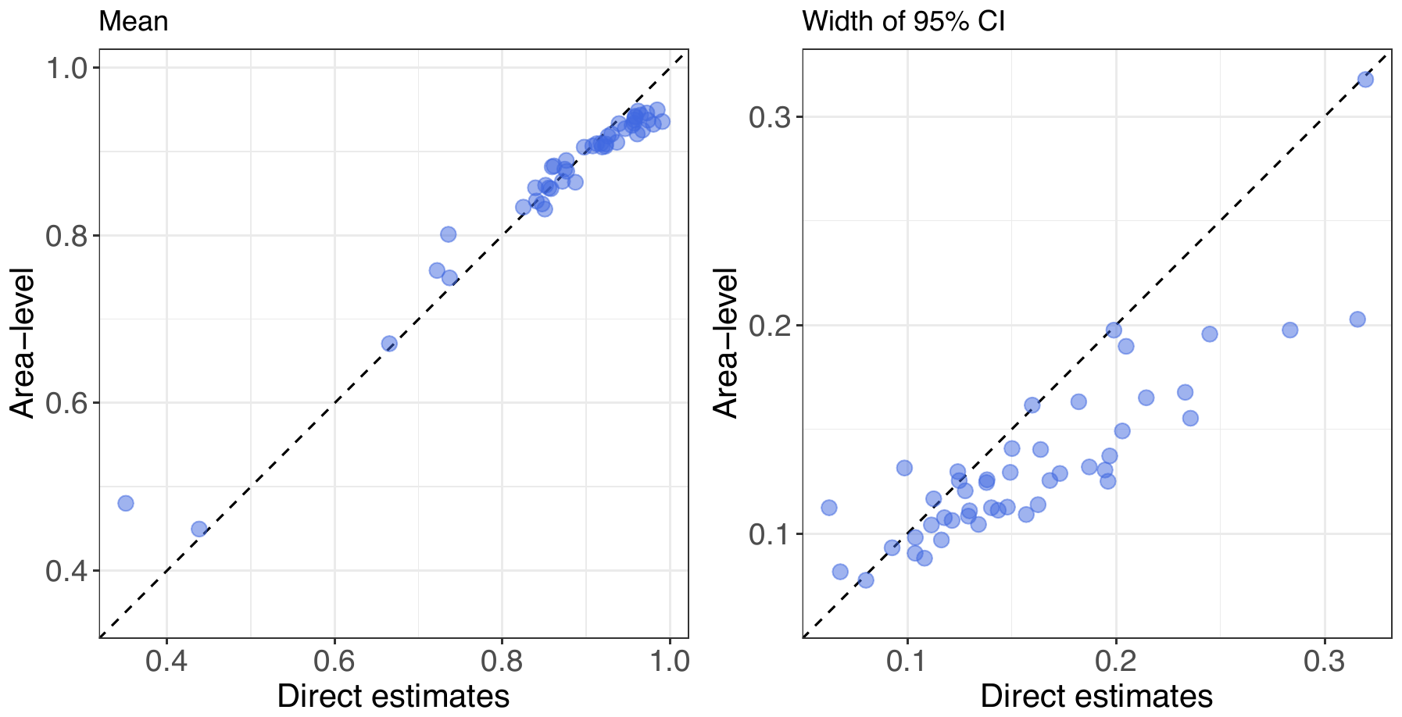
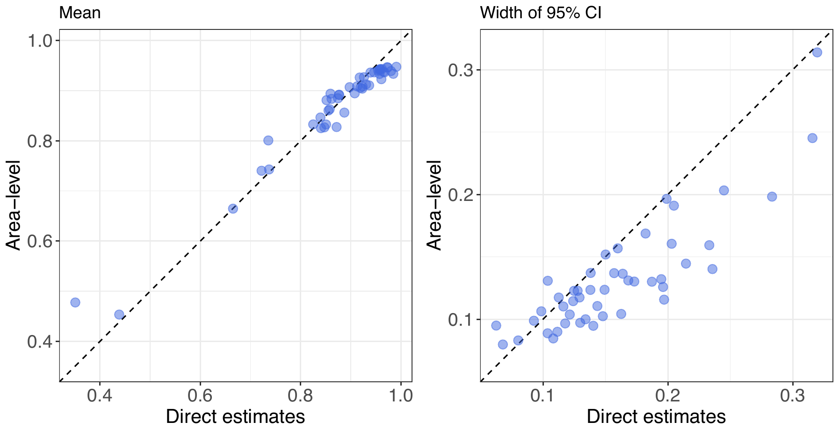
Q5 · Shrinkage
App scatter, county Fay-Herriot: means nearly identical, interval widths shift slightly
Model-based against direct estimate, county level (dashed line = no change)
Shiny app: without covariates
Shiny app: with covariates
■ Means: both versions pull low direct values towards the middle (Garissa 0.35 to 0.48); the shrinkage slope is 0.81 without and 0.82 with covariates.
■ Widths: almost all counties sit below the line, so smoothing narrows intervals; the Samburu point moves up with covariates (0.20 to 0.25).
■ Reading: covariates changed local estimates but did not change the general picture.
Penta3 coverage, Kenya DHS 2022 | CEMA SAE short course
20

Slide 21
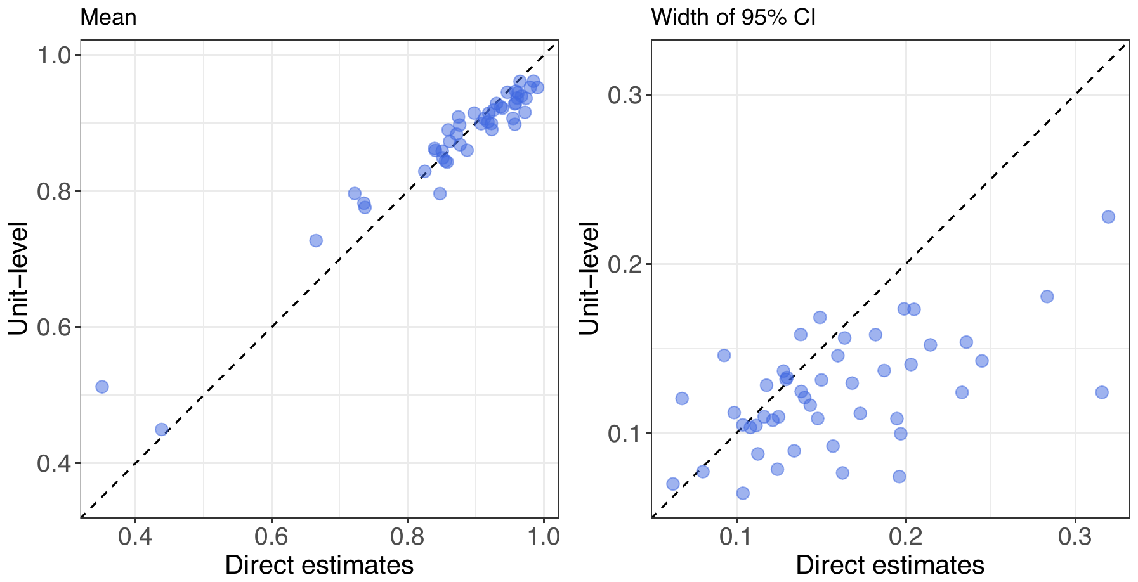

Q5 · Shrinkage
App scatter, county unit-level: stronger narrowing, same means
Model-based against direct estimate, county level (dashed line = no change)
Shiny app: without covariates
Shiny app: with covariates
■ Means: same pattern as Fay-Herriot; slope 0.76 without and 0.77 with covariates.
■ Widths: intervals are narrower than Fay-Herriot for nearly every county, and the two panels are hard to tell apart.
■ Reading: the unit-level model shrinks more because it relies on cluster counts and the spatial structure.
Penta3 coverage, Kenya DHS 2022 | CEMA SAE short course
21

Slide 22
Q6 · Nested models
Nested models did not help: worse fit and wider intervals
Unit-level model with a county IID effect plus sub-county BYM2
Family | Structure | Covariates | WAIC | Mean SD (pp) | Mean CV
Fay-Herriot | BYM2 only | All four | 743 | 4.49 | 0.51
Fay-Herriot | Nested | All four | 754 | 4.29 | 0.49
Fay-Herriot | BYM2 only | None | 738 | 4.54 | 0.51
Fay-Herriot | Nested | None | 749 | 4.37 | 0.50
Unit-level | BYM2 only | All four | 1791 | 4.88 | 0.51
Unit-level | Nested | All four | 1869 | 6.53 | 1.41
Unit-level | BYM2 only | None | 1784 | 5.15 | 0.52
Unit-level | Nested | None | 1813 | 5.36 | 0.98
■ Why it was tried: a county effect can reduce over-shrinkage of unit-level estimates towards a single global mean.
■ What happened: unit-level WAIC rose from 1784 to 1813 (1869 with covariates) and the mean CV almost doubled, because the county term absorbs most of the spatial signal (sub-county spatial precision rises from 1.9 to 34.8) and leaves little for sparse sub-counties.
■ Take-away: retain the single-level BYM2 unit-level model; revisit nesting with more clusters per county or informative priors.
Penta3 coverage, Kenya DHS 2022 | CEMA SAE short course
22

Slide 23
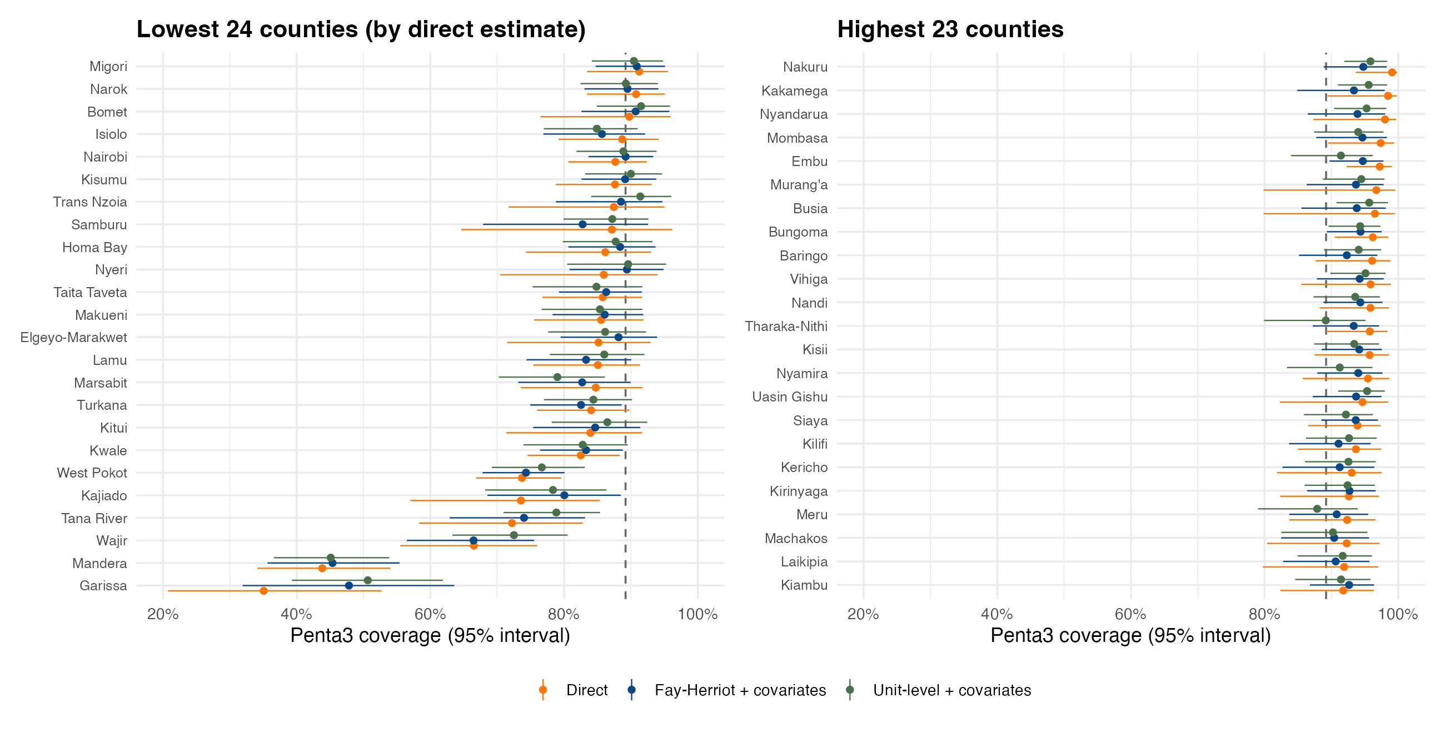
Q7 · Direct vs area-level vs unit-level
Model-based estimates agree on ranking and narrow the intervals
County estimates with 95% intervals, ordered by direct estimate; dashed line is the national 89.2%
■ Largest shifts: Garissa (+13.0 pp), Kajiado (+6.6 pp), Nakuru (-5.5 pp), Nyandarua (-4.7 pp)
■ Interval width: direct intervals are on average 1.2 times wider than Fay-Herriot with covariates.
■ Unit-level vs Fay-Herriot: mean absolute difference 1.67 pp; both lead to the same county ranking (rank correlation 0.91).
■ Direct estimates can reach 100% with wide intervals and should not be ranked without smoothing.
Penta3 coverage, Kenya DHS 2022 | CEMA SAE short course
23

Slide 24
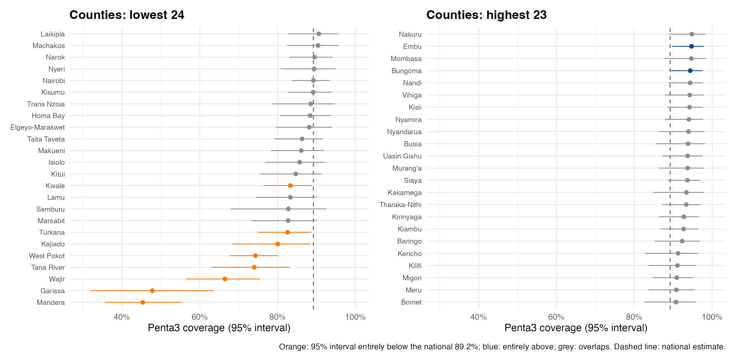
Q8 · Rankings
County ranking: low coverage stands out in the north-east and east
Fay-Herriot with covariates; colour shows whether the 95% interval excludes the national estimate
■ Clearly below national (8): Mandera, Garissa, Wajir, Tana River, West Pokot, Kajiado, Turkana, Kwale.
■ Clearly above national (2): Embu, Bungoma.
■ Most counties overlap the national value, so only the extremes are statistically distinguishable.
Penta3 coverage, Kenya DHS 2022 | CEMA SAE short course
24

Slide 25
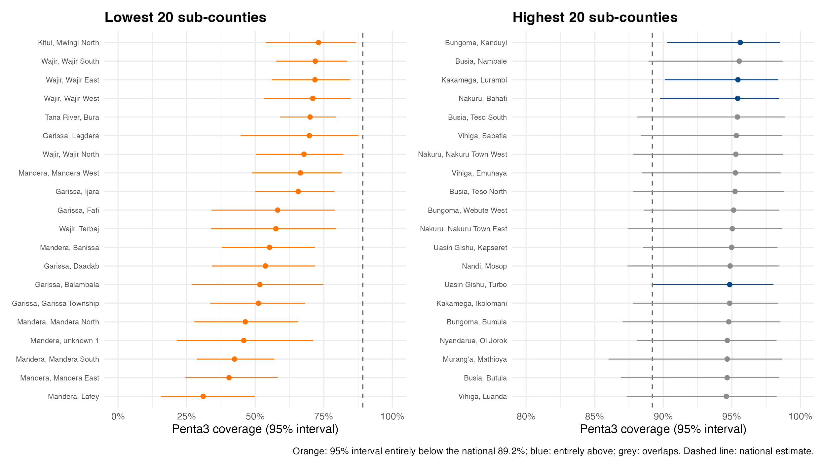
Q8 · Rankings
Sub-county ranking: 26 clearly below national, mostly in Mandera, Garissa, Wajir
Unit-level with covariates; 20 lowest and 20 highest shown
■ Lowest estimates: Mandera / Lafey; Mandera / Mandera East; Mandera / Mandera South; Mandera / unknown 1; Mandera / Mandera North
■ Intervals entirely below national: 26 sub-counties; entirely above: 4.
■ Interpretation: wide intervals (CV about 0.5) mean most sub-county ranks are uncertain; use them for targeting only with the intervals.
Penta3 coverage, Kenya DHS 2022 | CEMA SAE short course
25

Slide 26
Q9 · Suggestions and bugs
Suggestions for the app and issues encountered
■ Report covariate effects. The with-covariates PDF shows maps and scatters only; add coefficients with credible intervals, WAIC and explained spatial variance.
■ Show differences. Add maps of the change in mean and CI width with versus without covariates.
■ Fay-Herriot WAIC. fhModel() does not request WAIC, so it was recomputed by refitting the stored INLA call; return it in the model object.
■ Admin-2 Fay-Herriot fails without a variance fix. Direct estimates of 100% give infinite logits and a singular matrix; var.fix = TRUE is needed, with a warning.
■ Plot arguments. prevMap() needs value.to.plot = "mean" for directEST objects although the column is direct.est.
■ Covariate templates. Placeholders such as “unknown 7” and blank cells; flag missing covariate values before fitting. A grey polygon in the exceedance map needs explaining.
■ Feature requests. multi-covariate comparison table, collinearity warning, nested versus non-nested side by side, shrinkage plots that include the covariate model.
■ Reproducibility. Save the cluster-level input with the model object; here it was recovered from the INLA data.
Penta3 coverage, Kenya DHS 2022 | CEMA SAE short course
26

Slide 27
Summary
Conclusions
■ App and SUMMER. The app with covariates matches the SUMMER fit with all four covariates, so the app maps show the same small precision gain.
■ Variation. County coverage spans 45%–95% and sub-county 31%–96%; the north and north-east are lowest.
■ Reasons. Education and facility use track coverage across areas; access difficulty is negatively related, but the covariates overlap.
■ Covariates. Education is the one consistently clear covariate (facility delivery only at county level, one at a time); adding education tightens precision by roughly 3% (county) to 7% (sub-county) but does not improve WAIC.
■ Missing sub-counties. Model estimates are plausible and close to county averages, with wide intervals.
■ Shrinkage. Moderate at county level, strong at sub-county level; covariates reduce it a little.
■ Nested models. Did not help in this application.
■ Rankings. Only the extremes differ credibly from the national level; report intervals alongside ranks.
Penta3 coverage, Kenya DHS 2022 | CEMA SAE short course
27

