Slide 1
Do area-level covariates sharpen small-area estimates of Penta3 coverage?
Direct, Fay-Herriot and unit-level estimates for Kenyan counties and sub-counties, DHS 2022
CEMA SAE short course | Hands-on project | SUMMER / surveyPrev

Slide 2
Context: 89% receive Penta3 nationally, but local gaps are hidden
89.2%
Item | Value
Clusters | 1,448
Children 12–23 months | 3,679
Vaccinated (events) | 3,148
Counties (admin 1) | 47
Sub-counties (admin 2) | 300
Areas with no sample | 0 counties; 8 sub-counties (2.67%)
of children aged 12–23 months had received DPT3 / Penta3 (DHS final report 89.2%; DHS app 89.18%)
■ Question set. How large is the geographic variation, why do areas differ, and do covariates add information beyond the survey?
■ Approach. Three estimators at two levels, each fitted without and with four area-level covariates, all in SUMMER / surveyPrev.
Penta3 coverage, Kenya DHS 2022 | CEMA SAE short course
2

Slide 3
Method: three estimators, two admin levels, with and without covariates
Estimator | SUMMER function | What it uses | Covariates
Direct | directEST() | Design-weighted survey estimate per area; no borrowing | Not applicable
Fay-Herriot (area-level) | fhModel() | Direct logit estimates with known variance + BYM2 spatial smoothing | Fixed effects on the logit scale
Unit-level (cluster) | clusterModel() | Cluster counts, beta-binomial likelihood + BYM2; nested variant adds a county effect | Fixed effects on the logit scale
■ Covariates. Mean years of education, 4+ ANC visits, difficulty accessing a facility and facility delivery, supplied per county and sub-county and standardised (effects are per 1 SD).
■ Direct estimates are unchanged by covariates; only the smoothed models can use them.
■ Validation. Refitting the intercept-only models reproduced the saved DHS-app results (direct: identical; Fay-Herriot and unit-level: correlation 1.000).
■ Model choice. Covariate sets compared by WAIC, covariate effects with 95% credible intervals, precision (posterior SD, CV) and the spatial variance explained.
Penta3 coverage, Kenya DHS 2022 | CEMA SAE short course
3

Slide 4
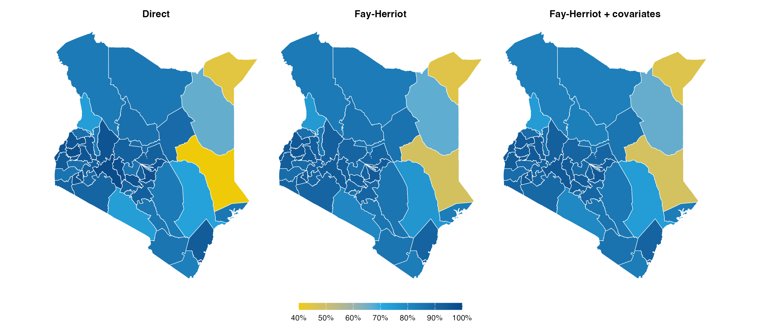
County level: coverage ranges from 45% to 95%
Direct, Fay-Herriot, and Fay-Herriot with covariates (same colour scale)
■ Lowest: Mandera, Garissa, Wajir, Tana River
■ Highest: Nakuru, Embu, Mombasa, Bungoma
■ 12 of 47 counties have a smoothed estimate below 85%.
■ Pattern: low coverage is concentrated in the north-east and east; the highest estimates are in Nakuru, Embu, Mombasa, Bungoma.
Penta3 coverage, Kenya DHS 2022 | CEMA SAE short course
4

Slide 5
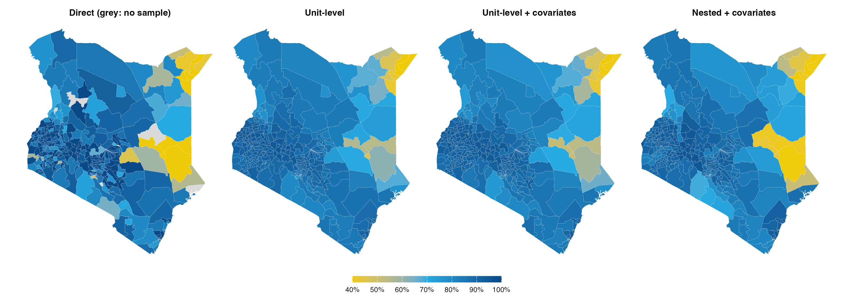
Sub-county level: the range widens to 31%–96%
Direct (design-based), unit-level, unit-level with covariates, and nested with covariates
■ 30 sub-counties fall below 80% and 7 are at or above 95% (unit-level, no covariates).
■ Lowest: Mandera / Lafey; Mandera / Mandera East; Mandera / Mandera South; Mandera / Mandera North
■ Direct map has gaps: 8 sub-counties are unsampled and 99 more have 100% or zero-variance direct estimates.
Penta3 coverage, Kenya DHS 2022 | CEMA SAE short course
5

Slide 6
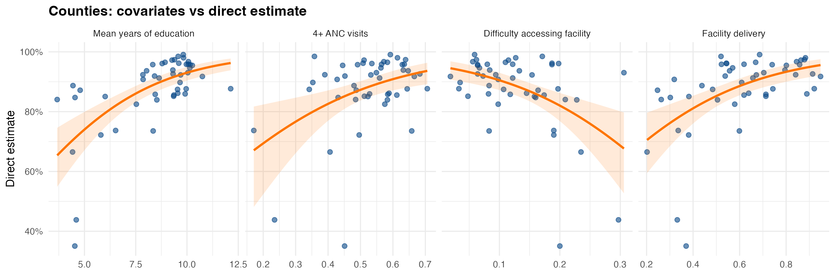
Why counties differ: education is the covariate most aligned with coverage
County direct estimates against each covariate (z-scores)
■ Strongest: Mean years of education (r = 0.62, R² = 0.38). Weakest: 4+ ANC visits (r = 0.35).
■ Plausible mechanism: caregiver education and facility use raise the chance a child completes the three-dose schedule; poor facility access lowers it.
■ Caution: county covariates are area averages and the association is ecological; it does not show that education causes higher coverage.
Penta3 coverage, Kenya DHS 2022 | CEMA SAE short course
6

Slide 7
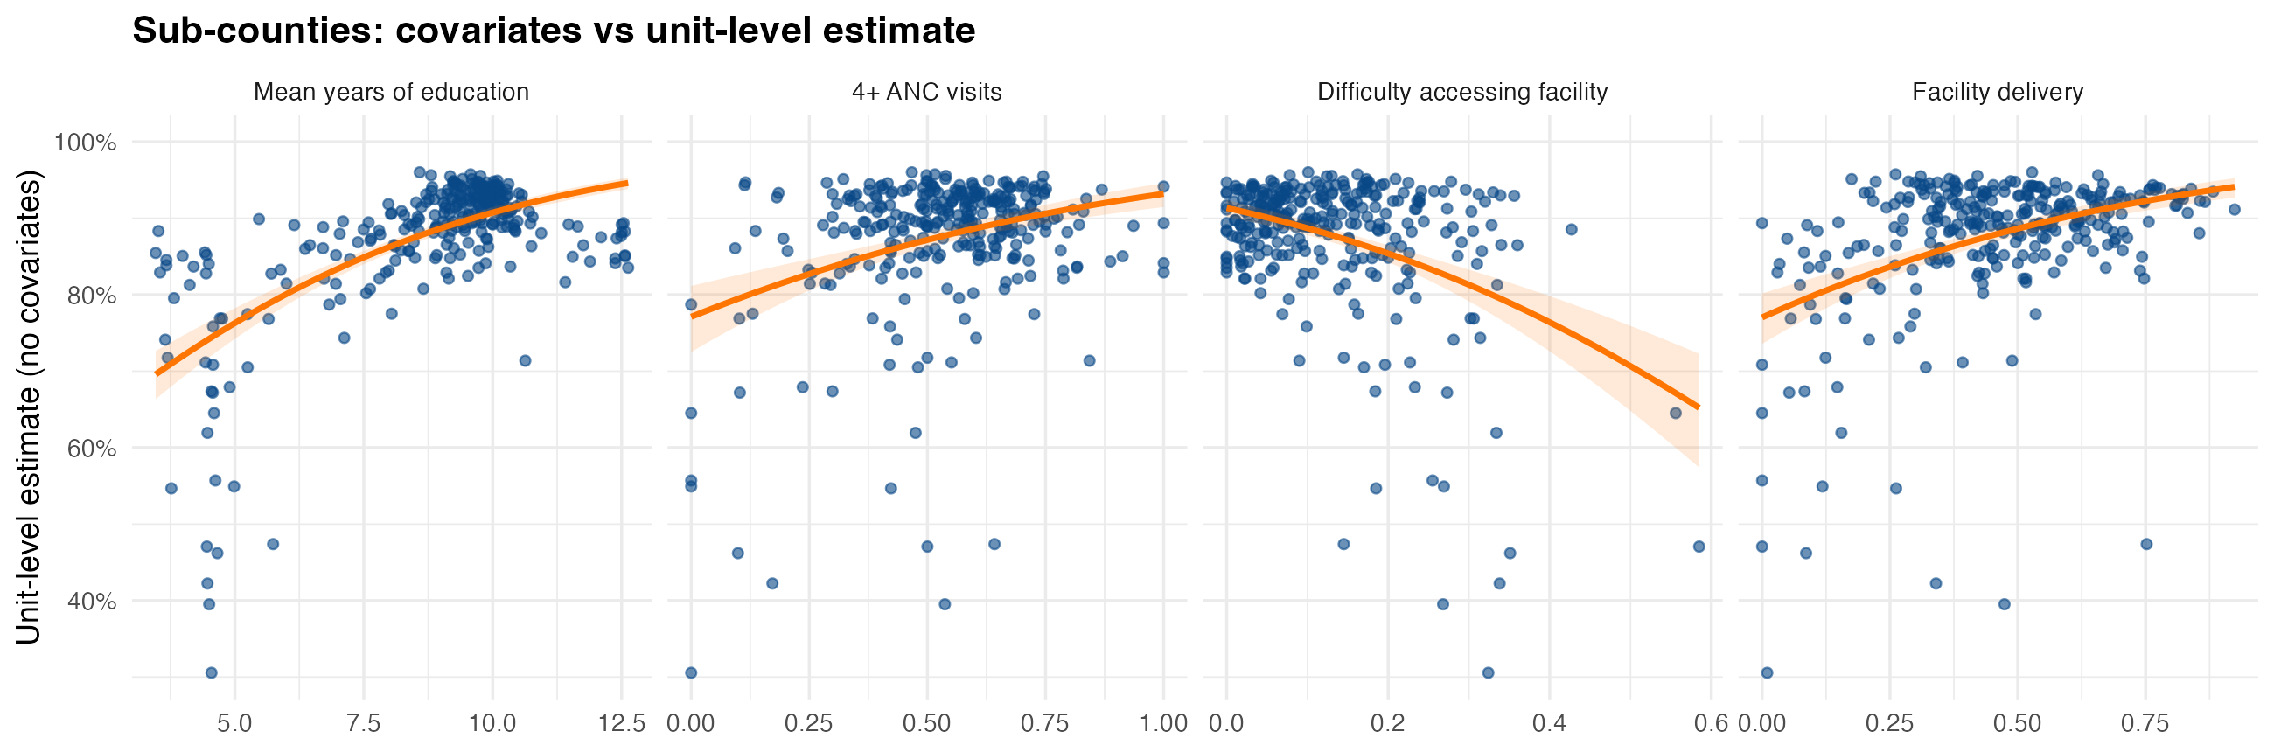
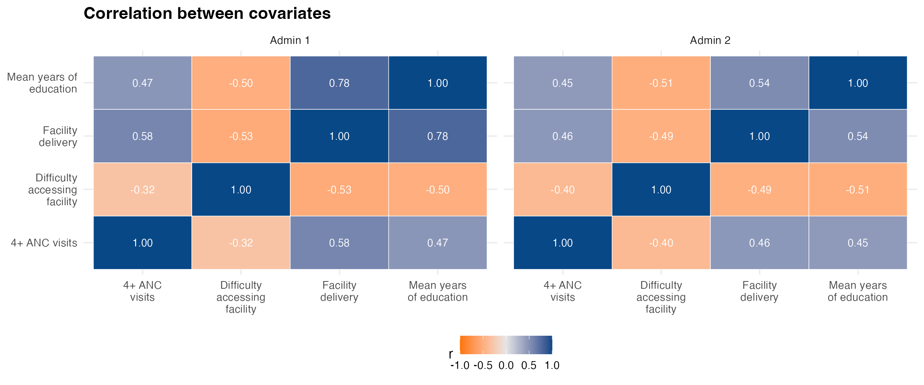
Sub-counties: same direction, much weaker association than counties
Unit-level estimates against each covariate; correlations among covariates
■ Weaker at sub-county level: education r = 0.21 (193 sub-counties with a usable direct estimate) versus r = 0.62 for counties.
■ Overlap: covariate pairs correlate up to r = 0.78 at county level (education and facility delivery), so effects are partly shared when entered together.
■ Missing values: 4 sub-counties lacked covariate values (Machakos / unknown 7; Nairobi / Dagoretti South; Nairobi / Embakasi Central; Turkana / unknown 2); county means of the remaining sub-counties were used.
Penta3 coverage, Kenya DHS 2022 | CEMA SAE short course
7

Slide 8
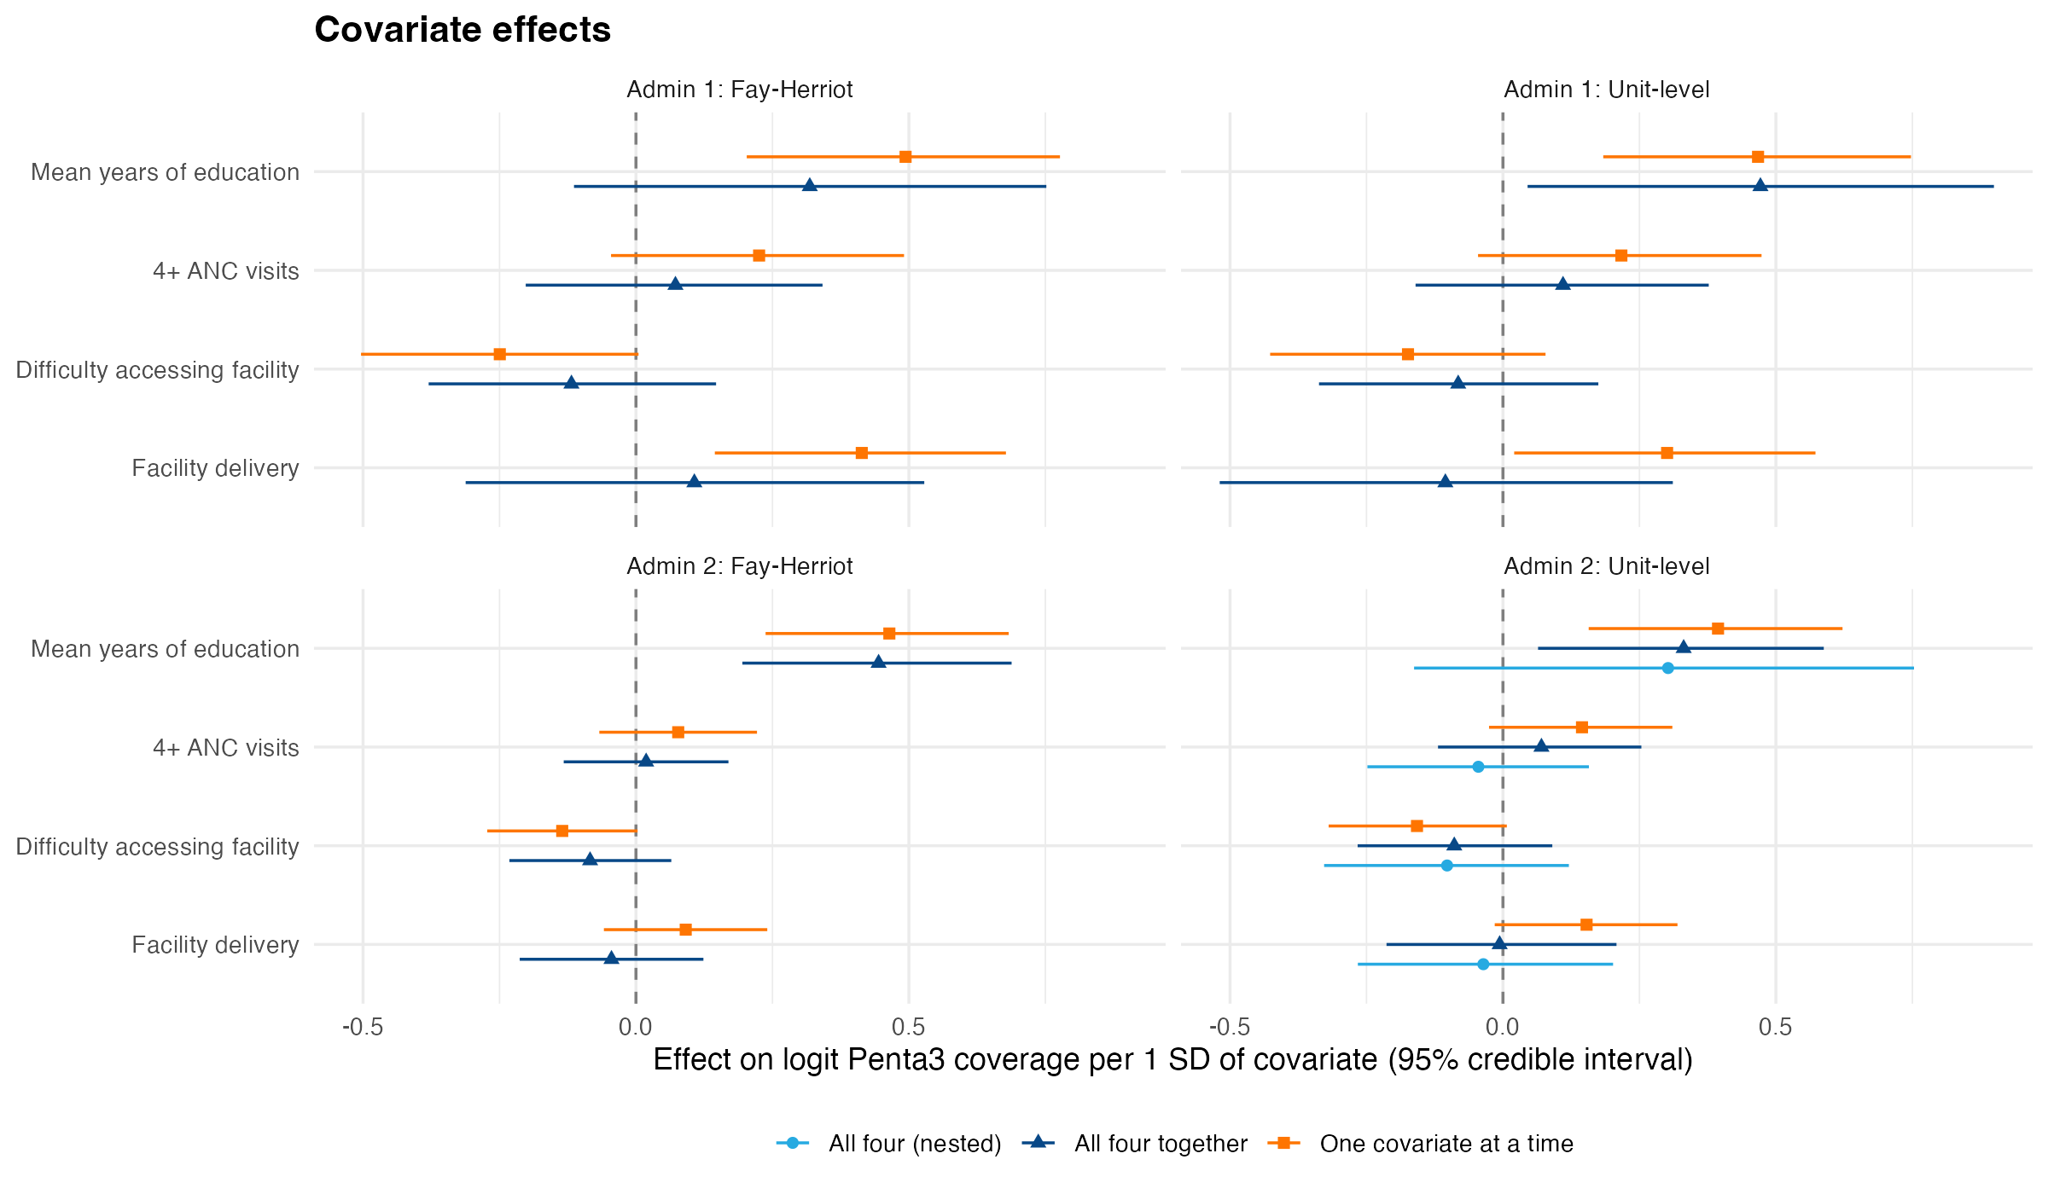
Only education has a clear effect; it fades when all four enter together
Posterior mean and 95% credible interval, effect on logit coverage per 1 SD
■ Education alone: +0.49 logits per SD at county level (Fay-Herriot, 95% CrI 0.20 to 0.78) and +0.39 at sub-county level (unit-level, 0.16 to 0.62).
■ All four together: education stays positive in the unit-level models but intervals widen; ANC, access and facility delivery are consistently weak.
■ Direction is as expected: access difficulty is negative, the others positive.
Penta3 coverage, Kenya DHS 2022 | CEMA SAE short course
8

Slide 9
Covariates add little: slightly tighter estimates, no WAIC gain
Lower WAIC is better; ΔWAIC is relative to the model without covariates
Model | ΔWAIC | Mean SD (pp) | Mean CV
Fay-Herriot, county: none | +0.0 | 3.44 | 0.35
+ education | -0.3 | 3.34 | 0.34
+ all four | +2.1 | 3.42 | 0.35
Unit-level, county: none | +0.0 | 3.19 | 0.33
+ education | -0.2 | 3.09 | 0.32
+ all four | +2.1 | 3.17 | 0.33
Fay-Herriot, sub-county: none | +0.0 | 4.54 | 0.51
+ all four | +4.4 | 4.49 | 0.51
Unit-level, sub-county: none | +0.0 | 5.15 | 0.52
+ education | +3.8 | 4.78 | 0.50
+ all four | +6.6 | 4.88 | 0.51
■ Precision: education trims the mean county SD from 3.44 to 3.34 pp (Fay-Herriot) and the sub-county SD from 5.15 to 4.78 pp (unit-level).
■ Information: the county spatial variance falls from 0.45 to 0.33 once all four covariates are included, so they explain part of the between-county differences.
■ Model fit: county WAIC changes are small (-0.3 for education, +2.1 for all four, Fay-Herriot) and sub-county WAIC is worse (+3.8 and +6.6, unit-level), so the evidence for adding covariates is weak.
■ Recommendation: keep education as a single covariate where a modest precision gain is wanted; do not add all four.
Penta3 coverage, Kenya DHS 2022 | CEMA SAE short course
9

Slide 10
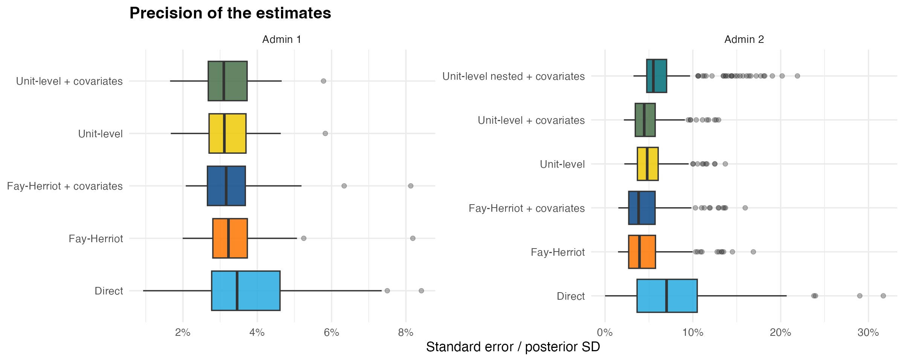
Precision: model-based beats direct; covariates add a small gain
■ Median county SD: direct 3.46 pp, Fay-Herriot 3.22 pp, with covariates 3.16 pp.
■ Median sub-county SD: direct 7.01 pp (usable areas only), unit-level 4.80 pp, with covariates 4.46 pp.
Penta3 coverage, Kenya DHS 2022 | CEMA SAE short course
10

Slide 11
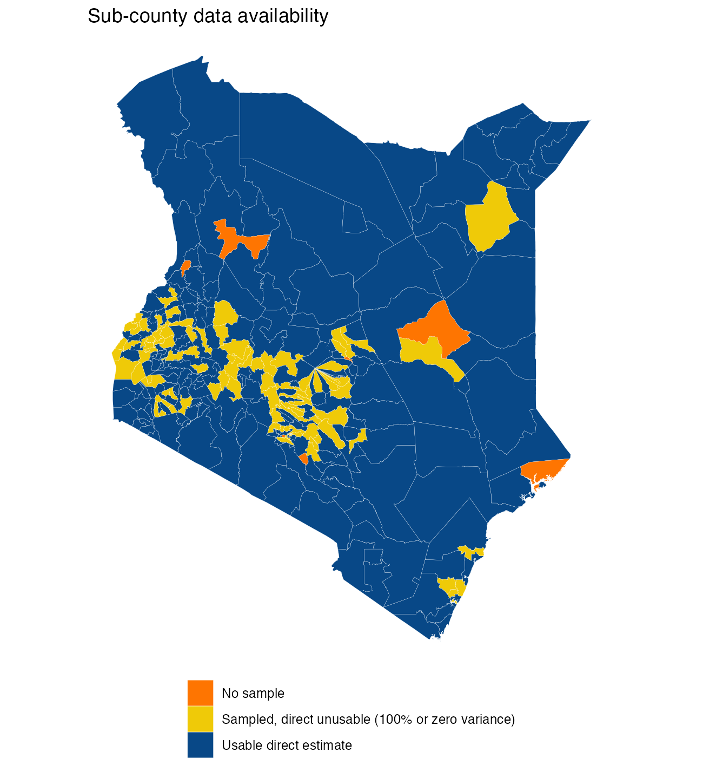
Unsampled sub-counties: plausible estimates that rest on neighbours
8 of 300 sub-counties had no sampled cluster
Sub-county | Fay-Herriot | Unit-level | Unit-level + cov. | 95% interval (unit + cov.) | County mean (sampled areas)
Garissa / Lagdera | 74% | 72% | 70% | 45%–88% | 58%
Lamu / Lamu East | 73% | 77% | 77% | 46%–95% | 86%
Machakos / unknown 7 | 86% | 85% | 83% | 63%–95% | 89%
Meru / unknown 5 | 89% | 86% | 85% | 67%–95% | 86%
Nairobi / Dagoretti North | 86% | 85% | 89% | 72%–97% | 86%
Nairobi / Embakasi North | 91% | 88% | 91% | 77%–97% | 86%
Turkana / unknown 2 | 84% | 85% | 80% | 59%–93% | 84%
West Pokot / unknown 3 | 77% | 79% | 79% | 54%–94% | 79%
■ Sensible: most estimates sit close to the county average with wide intervals (SD 5–13 pp).
■ Check: covariates move some estimates visibly (Turkana / unknown 2 85% to 80%; Nairobi / Dagoretti North 85% to 89%), and the nested model gives an implausible 41% for Garissa / Lagdera.
■ Use with care: report these with their intervals and flag them as covariate- and neighbour-driven.
Penta3 coverage, Kenya DHS 2022 | CEMA SAE short course
11

Slide 12
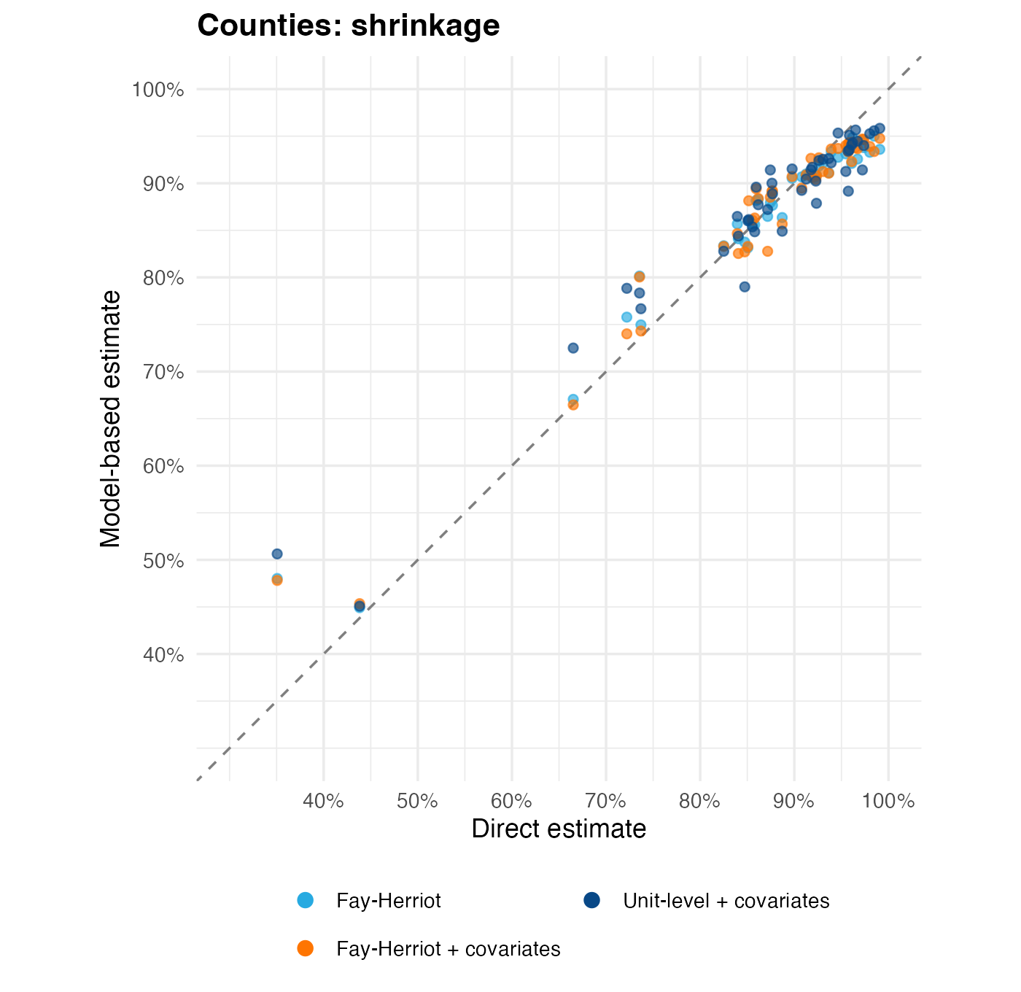
Shrinkage at county level is moderate; covariates reduce it slightly
Model-based estimate against direct estimate, county level
Model | Slope vs direct | Variance retained | Mean |shift| (pp) | SE ratio
Fay-Herriot | 0.81 | 0.68 | 2.1 | 1.02
Fay-Herriot + covariates | 0.82 | 0.70 | 2.2 | 1.00
Unit-level | 0.76 | 0.62 | 2.7 | 0.95
Unit-level + covariates | 0.77 | 0.64 | 2.6 | 0.95
■ Reading: a slope of 1 means no shrinkage; values below 1 show estimates pulled to the mean.
■ Covariates raise the retained variance from 0.68 to 0.70 (Fay-Herriot): less blanket shrinkage because education explains part of the spread.
Penta3 coverage, Kenya DHS 2022 | CEMA SAE short course
12

Slide 13
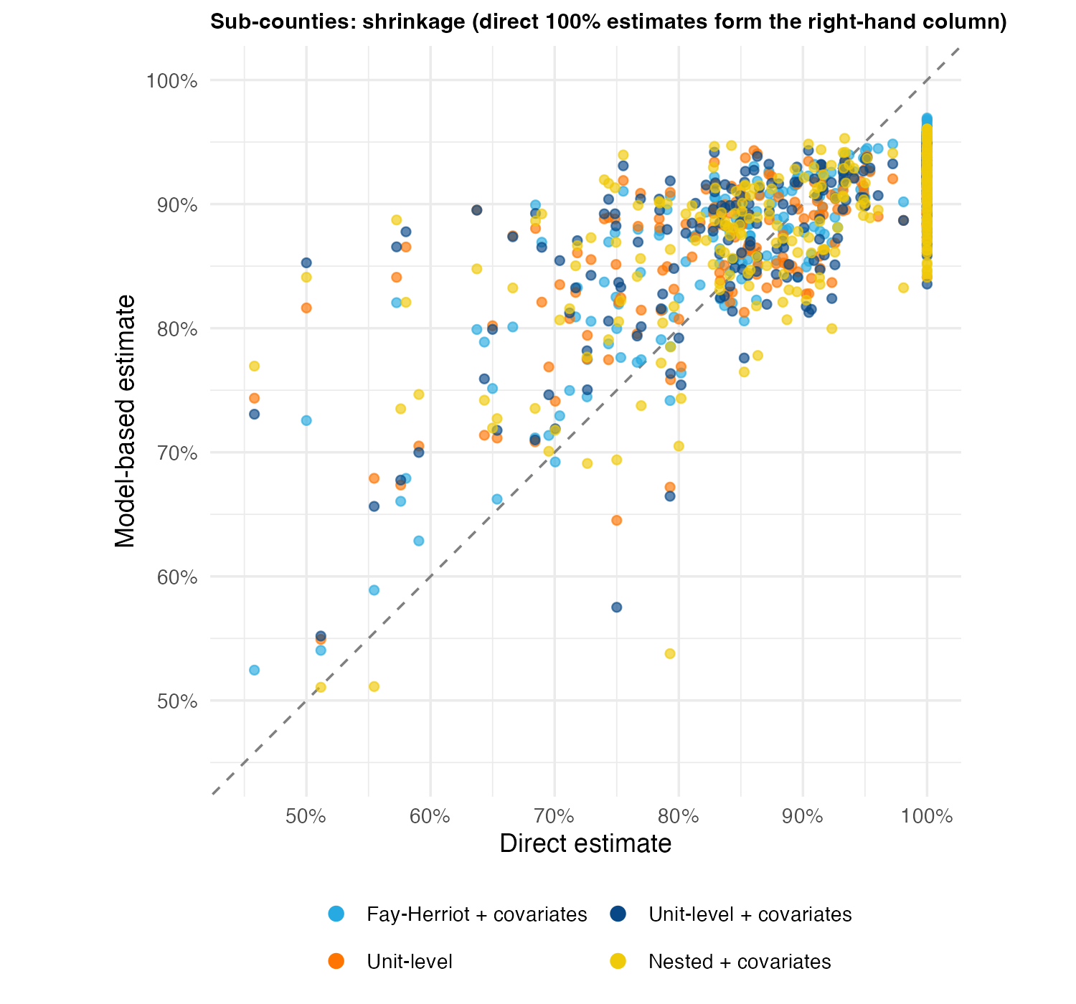
Shrinkage is strong at sub-county level (about 5 clusters per area)
Model-based estimate against direct estimate (sub-counties with a direct estimate)
Model | Slope | Variance retained | Mean |shift| (pp)
Fay-Herriot | 0.54 | 0.39 | 5.6
Fay-Herriot + covariates | 0.54 | 0.39 | 5.7
Unit-level | 0.46 | 0.32 | 7.6
Unit-level + covariates | 0.46 | 0.34 | 7.6
Unit-level nested | 0.50 | 0.42 | 7.6
Unit-level nested + covariates | 0.50 | 0.41 | 7.8
■ Unit-level estimates retain 32% of the direct variance; Fay-Herriot with the same covariates retains 39%.
■ Sparse direct estimates (often 100%) are replaced by model values, which accounts for much of the shift.
Penta3 coverage, Kenya DHS 2022 | CEMA SAE short course
13

Slide 14
Nested models did not help: worse fit and wider intervals
Unit-level model with a county IID effect plus sub-county BYM2
Family | Structure | Covariates | WAIC | Mean SD (pp) | Mean CV
Fay-Herriot | BYM2 only | All four | 743 | 4.49 | 0.51
Fay-Herriot | Nested | All four | 754 | 4.29 | 0.49
Fay-Herriot | BYM2 only | None | 738 | 4.54 | 0.51
Fay-Herriot | Nested | None | 749 | 4.37 | 0.50
Unit-level | BYM2 only | All four | 1791 | 4.88 | 0.51
Unit-level | Nested | All four | 1869 | 6.53 | 1.41
Unit-level | BYM2 only | None | 1784 | 5.15 | 0.52
Unit-level | Nested | None | 1813 | 5.36 | 0.98
■ Why it was tried: a county effect can reduce over-shrinkage of unit-level estimates towards a single global mean.
■ What happened: unit-level WAIC rose from 1784 to 1813 (1869 with covariates) and the mean CV almost doubled, because the county term absorbs most of the spatial signal (sub-county spatial precision rises from 1.9 to 34.8) and leaves little for sparse sub-counties.
■ Take-away: retain the single-level BYM2 unit-level model; revisit nesting with more clusters per county or informative priors.
Penta3 coverage, Kenya DHS 2022 | CEMA SAE short course
14

Slide 15
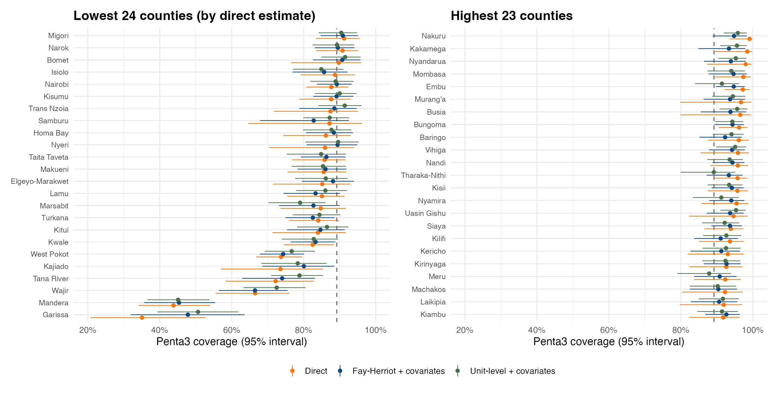
Model-based estimates agree on ranking and narrow the intervals
County estimates with 95% intervals, ordered by direct estimate; dashed line is the national 89.2%
■ Largest shifts: Garissa (+13.0 pp), Kajiado (+6.6 pp), Nakuru (-5.5 pp), Nyandarua (-4.7 pp)
■ Interval width: direct intervals are on average 1.2 times wider than Fay-Herriot with covariates.
■ Unit-level vs Fay-Herriot: mean absolute difference 1.67 pp; both lead to the same county ranking (rank correlation 0.91).
■ Direct estimates can reach 100% with wide intervals and should not be ranked without smoothing.
Penta3 coverage, Kenya DHS 2022 | CEMA SAE short course
15

Slide 16
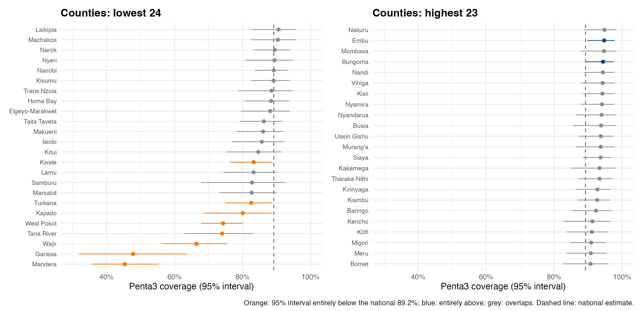
County ranking: low coverage stands out in the north-east and east
Fay-Herriot with covariates; colour shows whether the 95% interval excludes the national estimate
■ Clearly below national (8): Mandera, Garissa, Wajir, Tana River, West Pokot, Kajiado, Turkana, Kwale.
■ Clearly above national (2): Embu, Bungoma.
■ Most counties overlap the national value, so only the extremes are statistically distinguishable.
Penta3 coverage, Kenya DHS 2022 | CEMA SAE short course
16

Slide 17
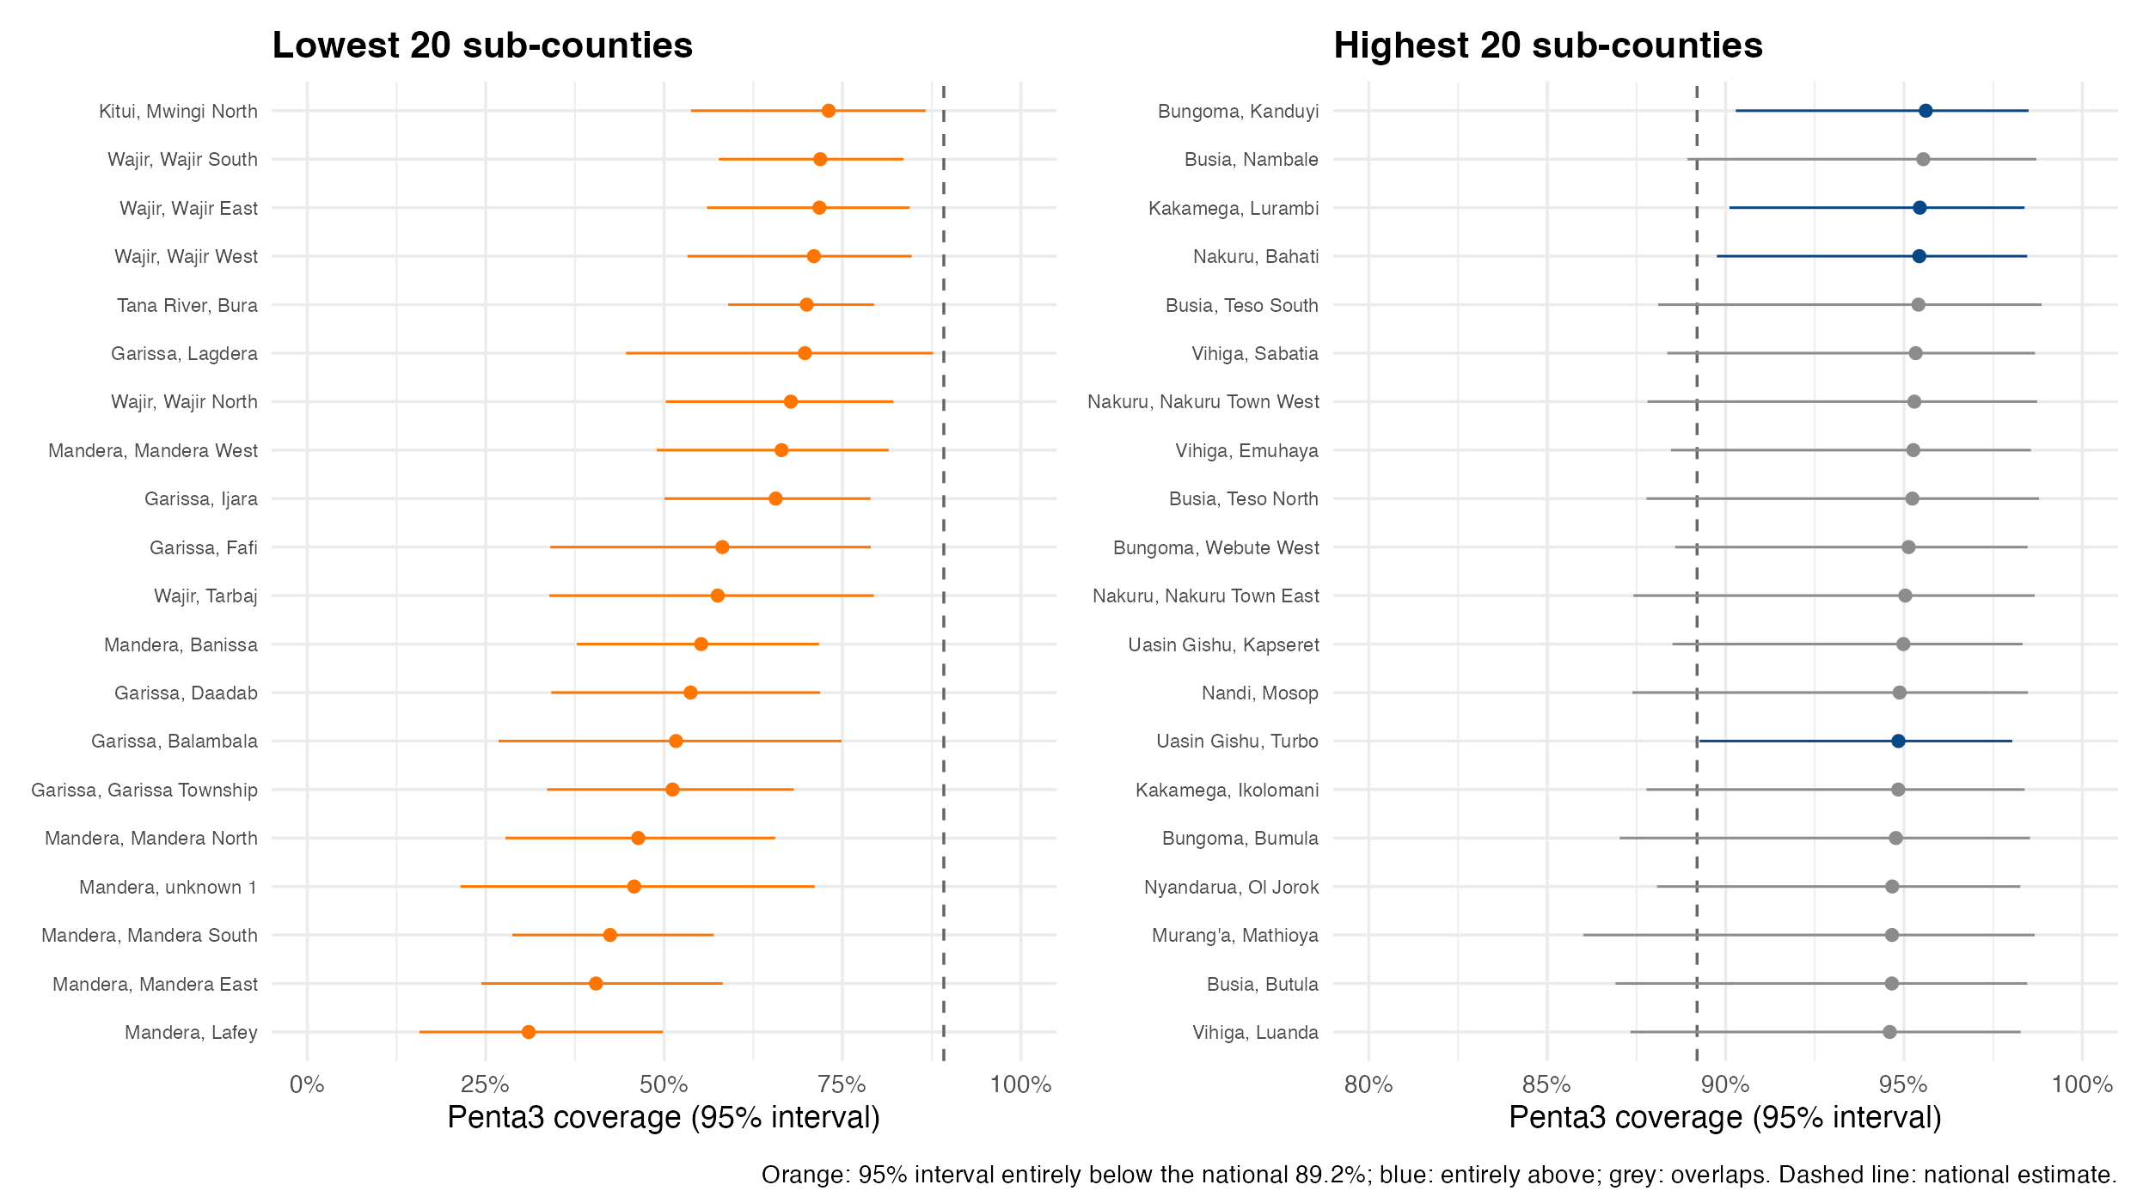
Sub-county ranking: 26 clearly below national, mostly in Mandera, Garissa, Wajir
Unit-level with covariates; 20 lowest and 20 highest shown
■ Lowest estimates: Mandera / Lafey; Mandera / Mandera East; Mandera / Mandera South; Mandera / unknown 1; Mandera / Mandera North
■ Intervals entirely below national: 26 sub-counties; entirely above: 4.
■ Interpretation: wide intervals (CV about 0.5) mean most sub-county ranks are uncertain; use them for targeting only with the intervals.
Penta3 coverage, Kenya DHS 2022 | CEMA SAE short course
17

Slide 18
Suggestions for the app and issues encountered
■ Covariate guidance. Show WAIC / DIC and the explained spatial variance next to the covariate effects, so users can judge benefit directly.
■ Fay-Herriot WAIC. fhModel() does not request WAIC, so it had to be recomputed by refitting the stored INLA call; return it in the model object.
■ Admin-2 Fay-Herriot fails without a variance fix. Direct estimates of 100% give infinite logits and a singular matrix; var.fix = TRUE is needed and should be the default with a warning.
■ Plot arguments are inconsistent. prevMap() needs value.to.plot = "mean" for directEST objects although the column is direct.est.
■ Covariate names. Templates contain placeholders such as “unknown 7” and blank cells; the app should flag missing covariate values before fitting.
■ Feature requests. multi-covariate comparison table, collinearity warning, side-by-side nested vs non-nested results, and shrinkage plots that include the covariate model.
■ Reproducibility. Allow saving the cluster-level input with the model object; here it had to be recovered from the INLA data.
Penta3 coverage, Kenya DHS 2022 | CEMA SAE short course
18

Slide 19
Conclusions
■ Variation. County coverage spans 45%–95% and sub-county 31%–96%; the north and north-east are lowest.
■ Reasons. Education and facility use track coverage across areas; access difficulty is negatively related, but the covariates overlap.
■ Covariates. Education is the only covariate with a clear effect; adding it tightens precision by roughly 3% (county) to 7% (sub-county) but does not improve WAIC.
■ Missing sub-counties. Model estimates are plausible and close to county averages, with wide intervals.
■ Shrinkage. Moderate at county level, strong at sub-county level; covariates reduce it a little.
■ Nested models. Did not help in this application.
■ Rankings. Only the extremes differ credibly from the national level; report intervals alongside ranks.
Penta3 coverage, Kenya DHS 2022 | CEMA SAE short course
19

