Slide 2
Using Git to Manage Your SAS® Code
Danny Zimmerman
Danny Zimmerman is a senior software developer on the SAS® Studio team and has worked at SAS since 2011. Danny has been working on SAS Studio since the beginning of the project. Most recently, Danny has been implementing a set of data step functions to execute Git operations to allow SAS Studio to create a Git UI.

Slide 3
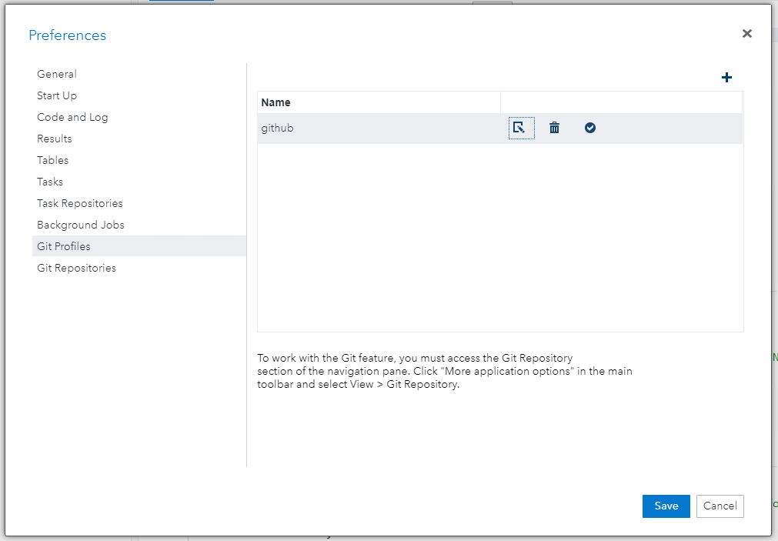
Creating a Git Profile

Slide 4
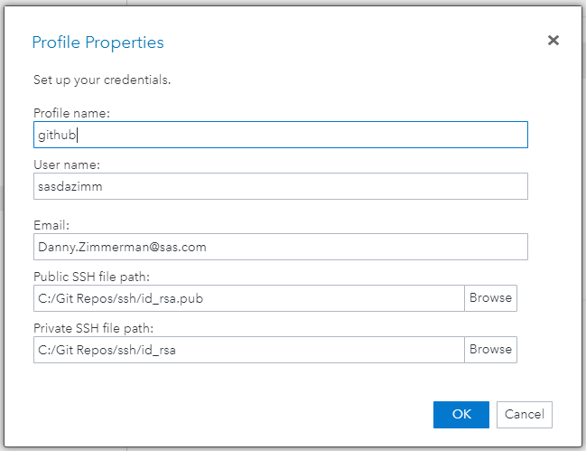
Creating a Git Profile

Slide 5
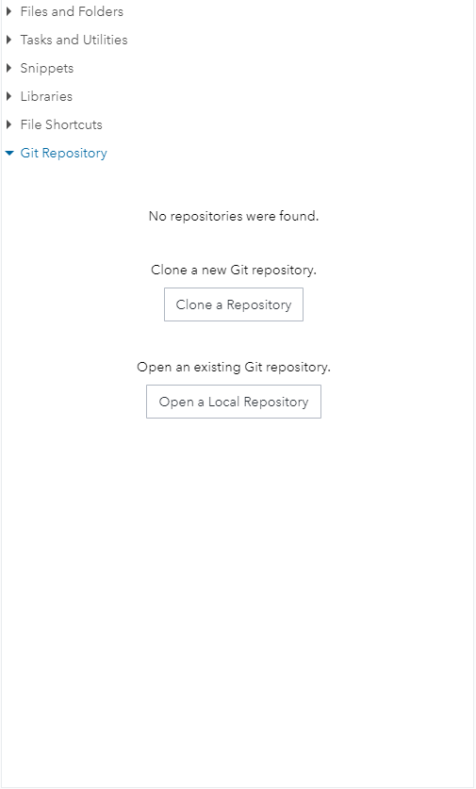
Git Repository Navigation Pane

Slide 6
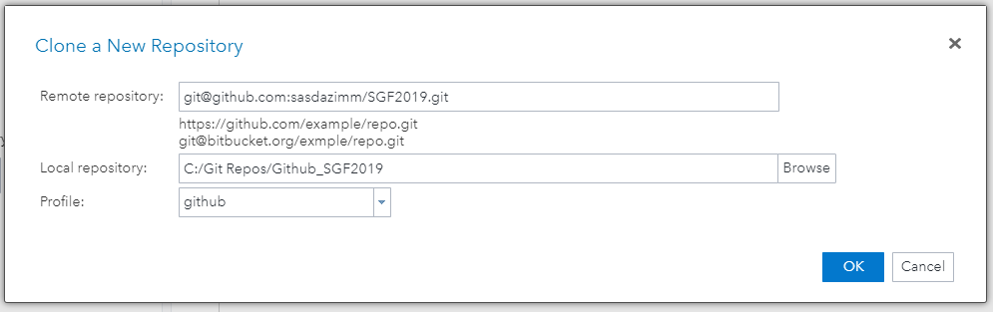
Cloning a Remote Repository

Slide 7
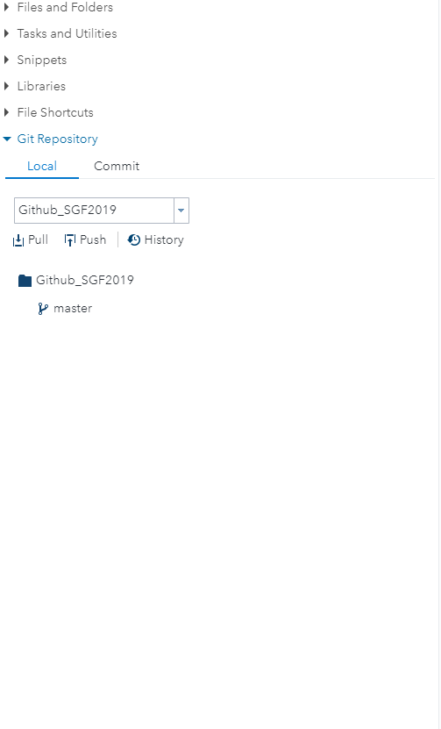
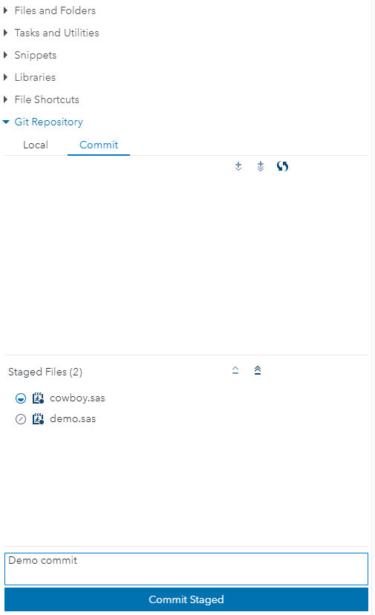
Git Repository Navigation Pane
Local Tab and Commit Tab

Slide 8
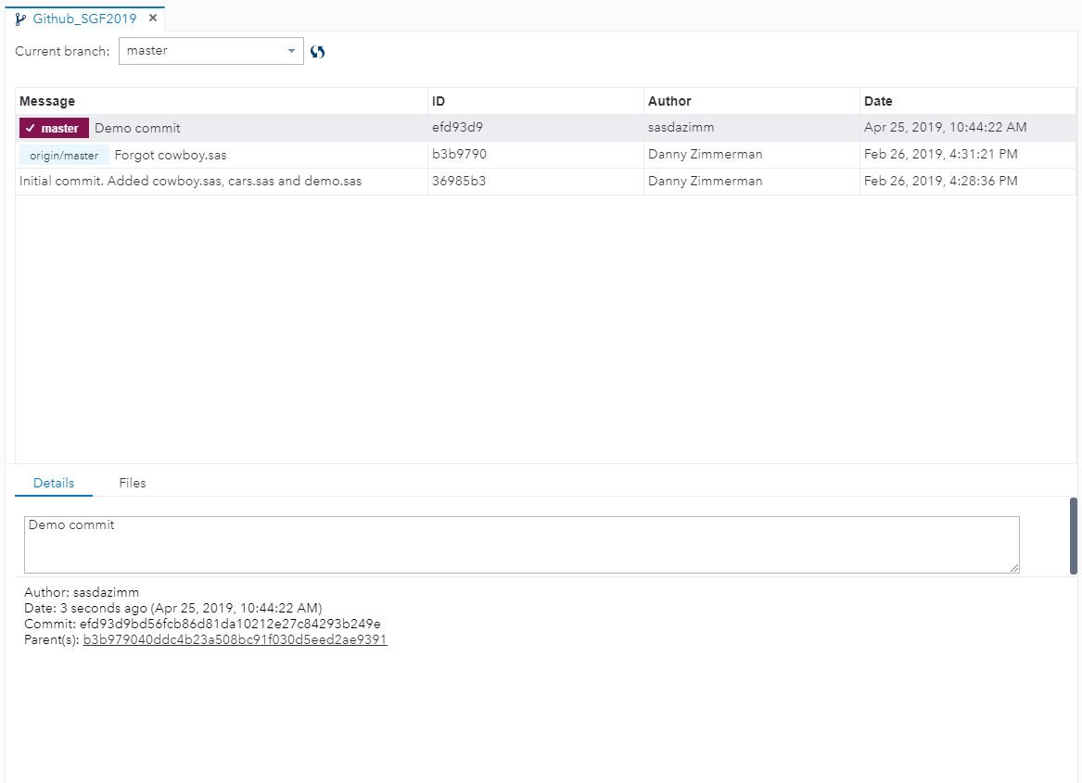
Repository History

Slide 9
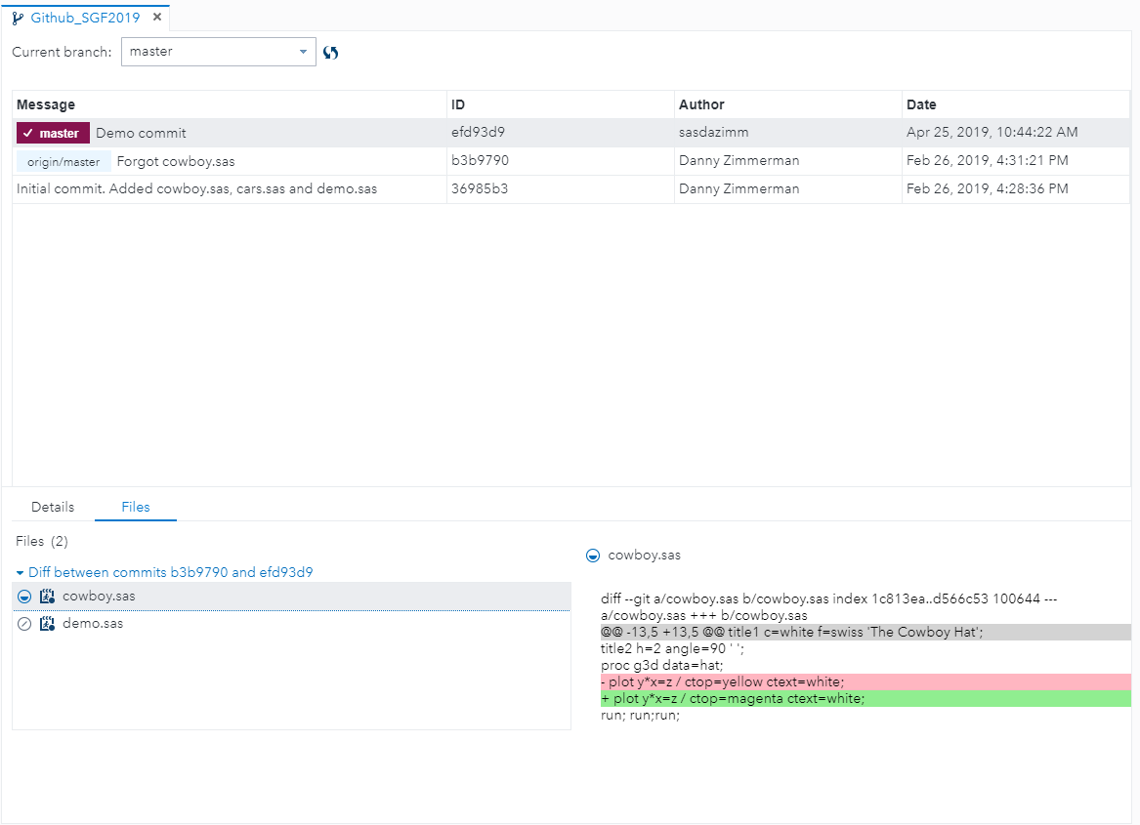
Repository History with File Differences

Slide 10
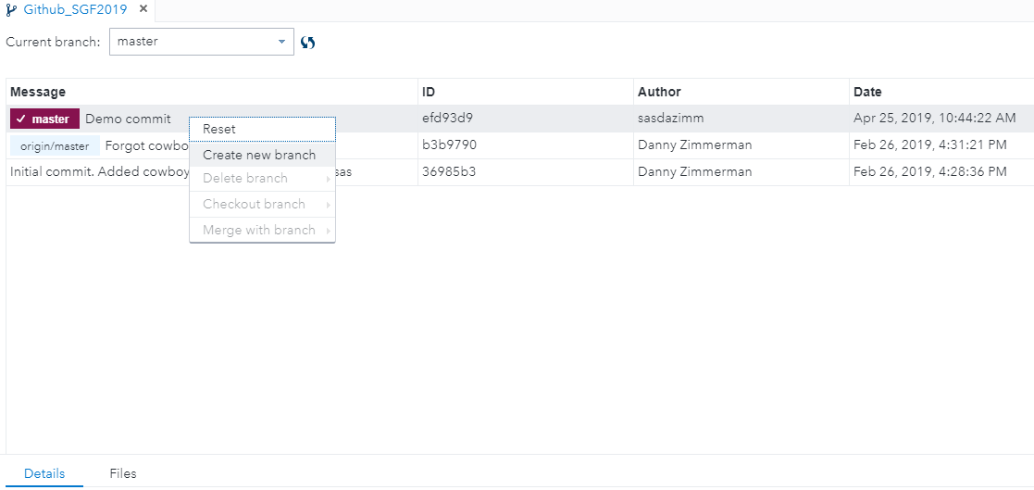
Branching
Creating a new branch

Slide 11
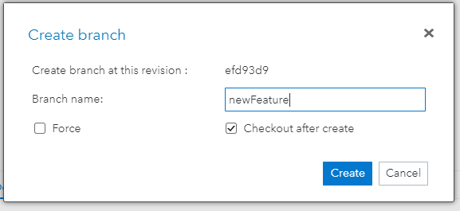
Branching
Create Branch

Slide 12
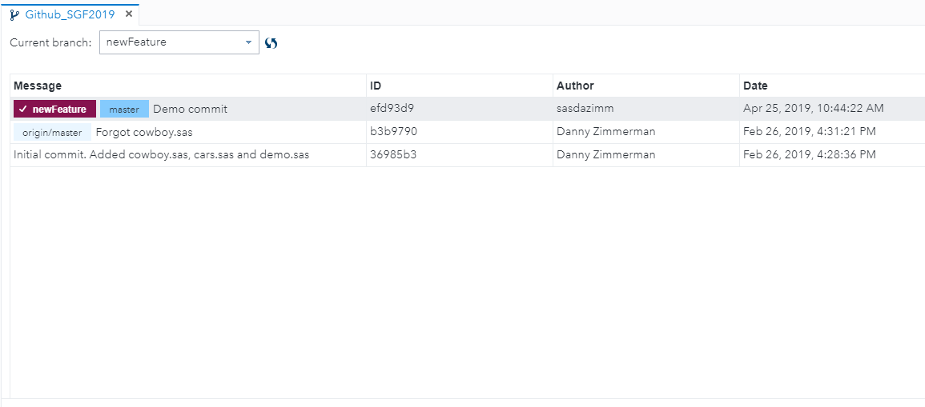
Branching
Check out branch

Slide 13
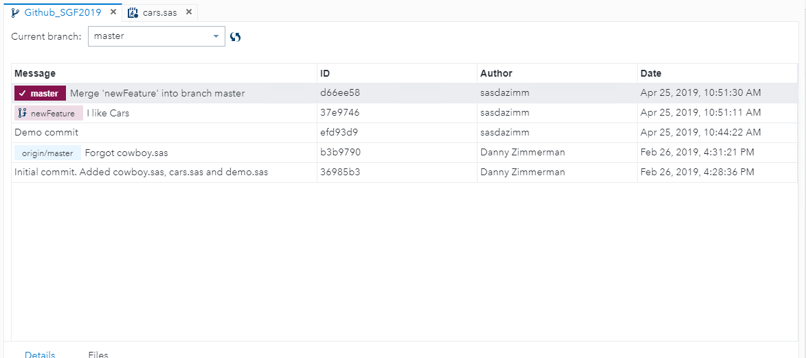
Branching
Merge Branch

Slide 14
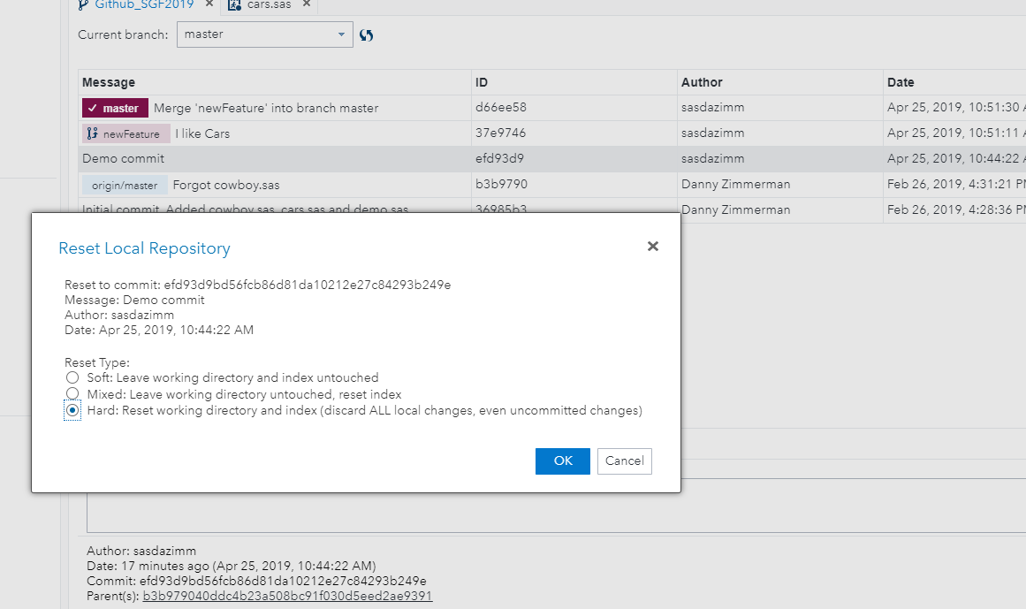
Reset Repository

Slide 15
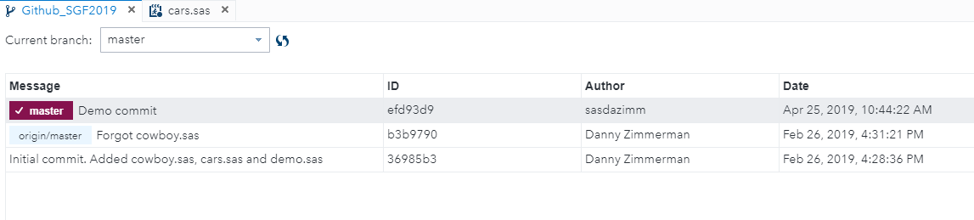
Reset Repository

Slide 16
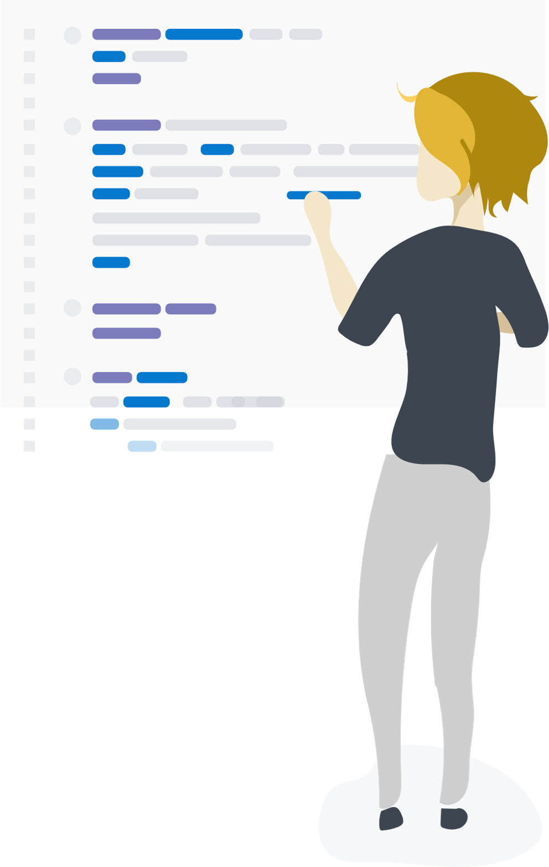
Questions?

Slide 17
Thank you!
Contact Information Danny.Zimmerman@sas.com
Reminder: Complete your session survey in the conference mobile app.

Slide 18


