Slide 1
SAS® Functions to Drive Source Control with Git

Slide 2
Danny Zimmerman
Danny Zimmerman is a senior software developer on the SAS® Studio team and has worked at SAS since 2011. Danny has been working on SAS Studio since the beginning of the project. Most recently, Danny has been implementing a set of data step functions to execute Git operations to allow SAS Studio to create a Git UI.

Slide 3
Today’s Agenda
What is Git?
Why were the functions developed?
Interacting with the remote repository
Staging and Committing Files
Repository Status, History and File Differences
Branching
What’s Next?
Conclusion
Questions

Slide 4
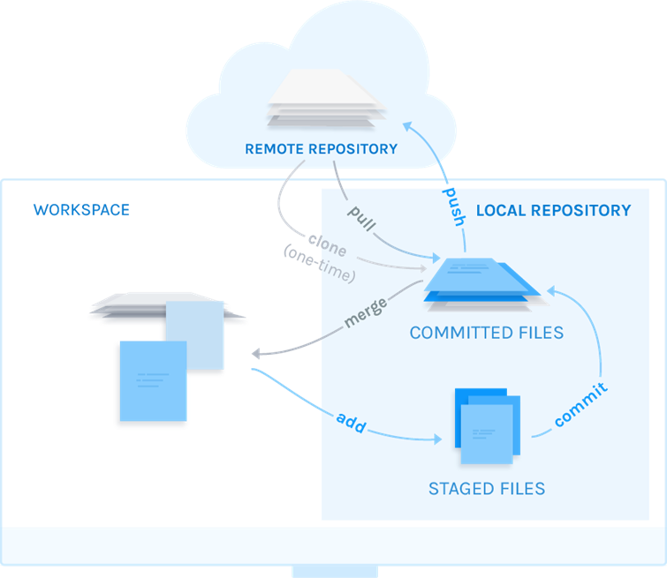
What is Git?
Git is an ‘open source distributed version control system’.
Git consists of two types of repositories:
Local repository on your computer for your direct use.
Remote repository hosted on a server or a service such as GitHub.

Slide 5
Why were the SAS Git functions developed?
Version Control adds tremendous value
User requests for version control in SAS Studio
Overcome SAS Studio hosted solution obstacle

Slide 6

Solutions Provided
Our solution was to build Git support into the SAS platform
Load a 3rd party Git library (Libgit2) into SAS and created a Git API
24 Git functions released with 9.4m6
Each function has the prefix of GITFN_

Slide 7
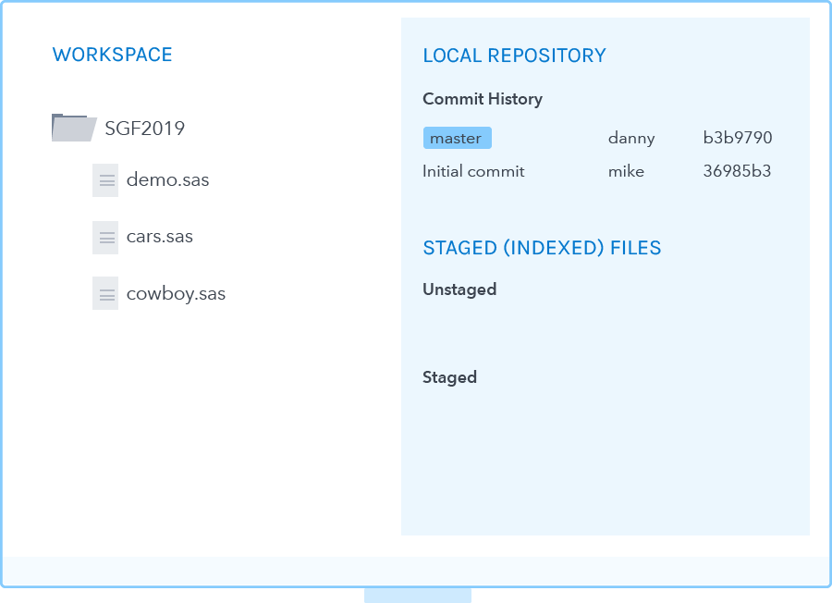
Interacting with the Remote Repository
The 9.4m6 release includes 3 Git functions to interact with the Remote repository:
GITFN_CLONE
Copies the remote repository to your computer and creates a local repository
GITFN_PULL
Fetches any changes from the remote repository and merges them into your local repository
GITFN_PUSH
Pushes the changes you’ve committed to the local repository to the remote repository
Each function supports HTTPS and SSH network protocols.

Slide 8
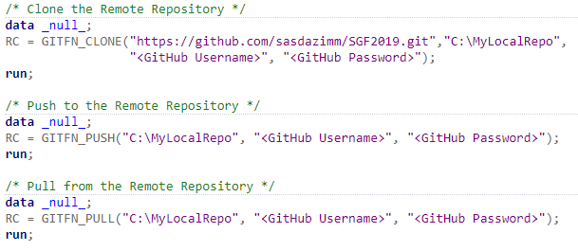
Interacting with the Remote Repository
HTTPS Code Examples

Slide 9
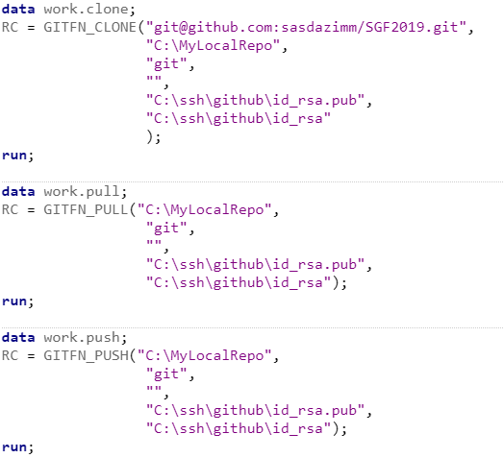
Interacting with the Remote Repository
SSH Examples

Slide 10
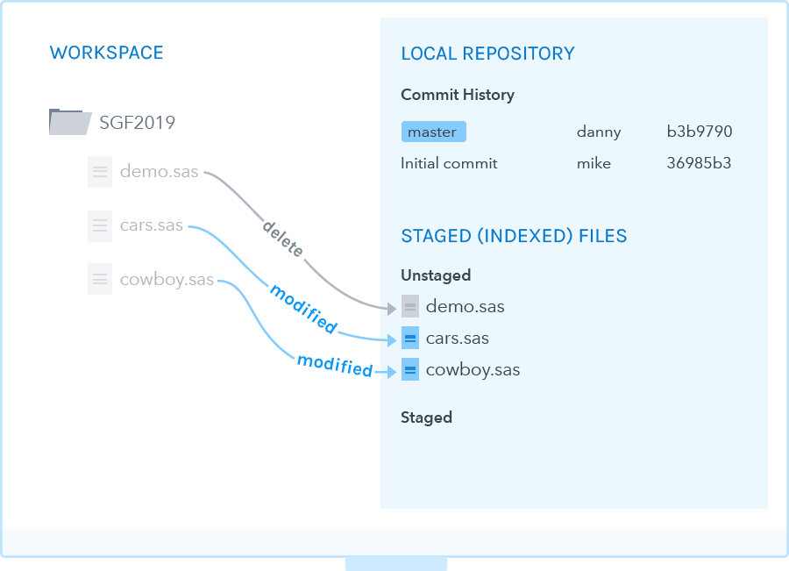
Staging and Committing Files
To share and version files, you need to commit new and changed files to the local repository.
GITFN_IDX_ADD
Stages 1 to N number of files
GITFN_IDX_REMOVE
Un-stages 1 to N number of files
GITFN_COMMIT
Commits all staged files to the local repository

Slide 11
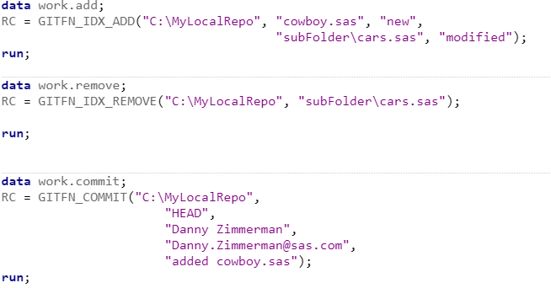
Staging and Committing Files

Slide 12
Repository Status, History and File Differences
There are 3 sets of functions to obtain the Repository status, commit history and file differences.
Each set consists of 3 functions:
Function that generates the data and stores it in memory and returns the count of objects generated
Function to access the generated data
Function to free the memory when you’re done

Slide 13
Repository Status
The repository status tells you what files have been modified and if they are staged for commit.
GITFN_STATUS
Generates the status data and returns the count of objects generated
GITFN_STATUS_GET
Function to access the data
GITFN_STATUSFREE
Clears the data from memory

Slide 14
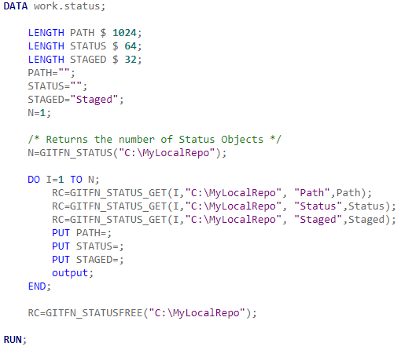

Repository Status

Slide 15
Repository History
The repository history contains the list of commits.
GITFN_COMMIT_LOG
Generates the commit history data and returns the count of objects generated
GITFN_COMMIT_GET
Function to access the data
GITFN_COMMITFREE
Clears the data from memory

Slide 16
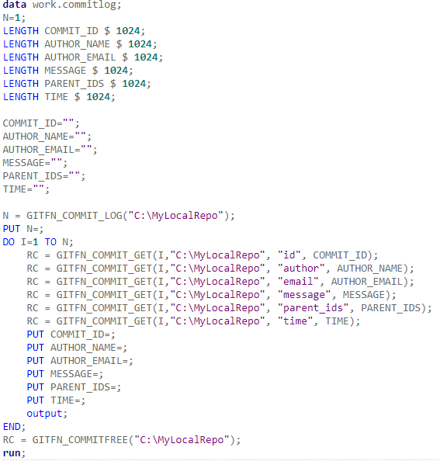
Repository History

Slide 17
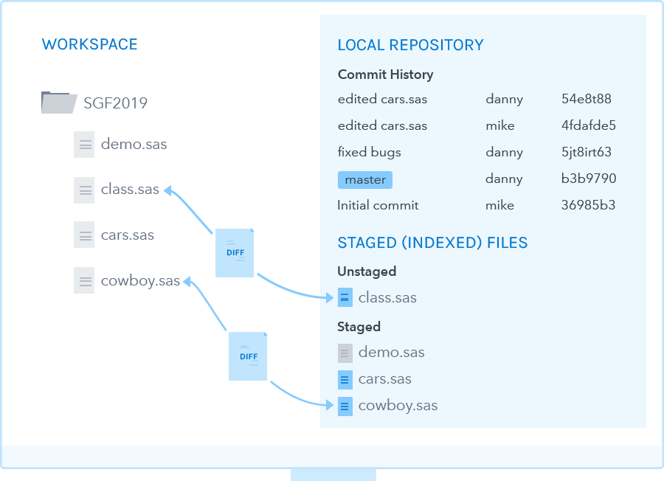
File Differences
The commit IDs from the repository history will allow you to generate the file difference information between two commits.
GITFN_DIFF
Generates the file diff data and returns the count of objects generated
GITFN_DIFF_GET
Function to access the data
GITFN_DIFF_FREE
Clears the data from memory

Slide 18
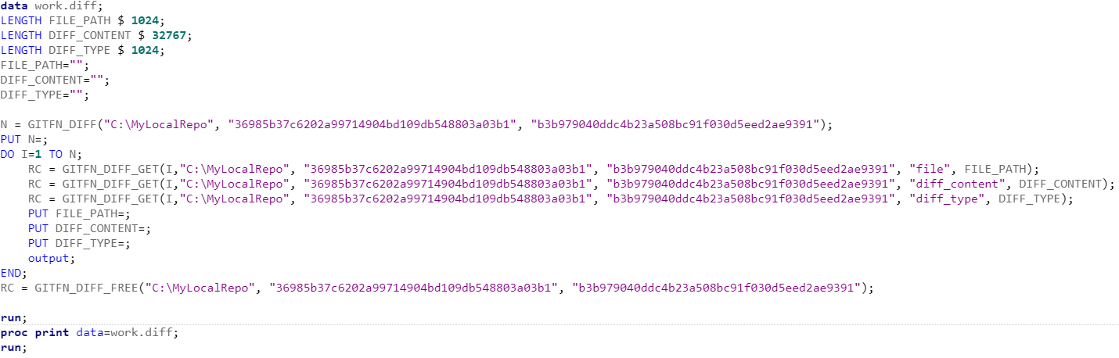
File Differences

Slide 19
Branching
4 branching functions were included in 9.4m6.
GITFN_NEW_BRANCH
Creates a new branch
GITFN_DEL_BRANCH
Deletes a branch
GITFN_CO_BRANCH
Checks out a branch
GITFN_MRG_BRANCH
Merges a branch into the current branch

Slide 20
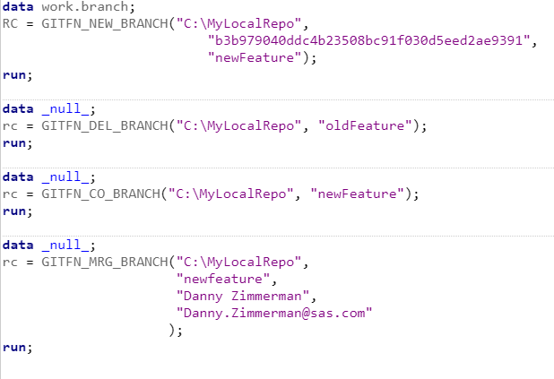
Branching

Slide 21
What’s Next?
Enhancements to the existing functions and 10 additional functions including fetch, rebase, and stash.
Refactored function names to provide more informative function names. Each function begins with prefix of GIT_
SAS Studio 5.2 Git Interface built on top of the new and enhanced functions.

Slide 22
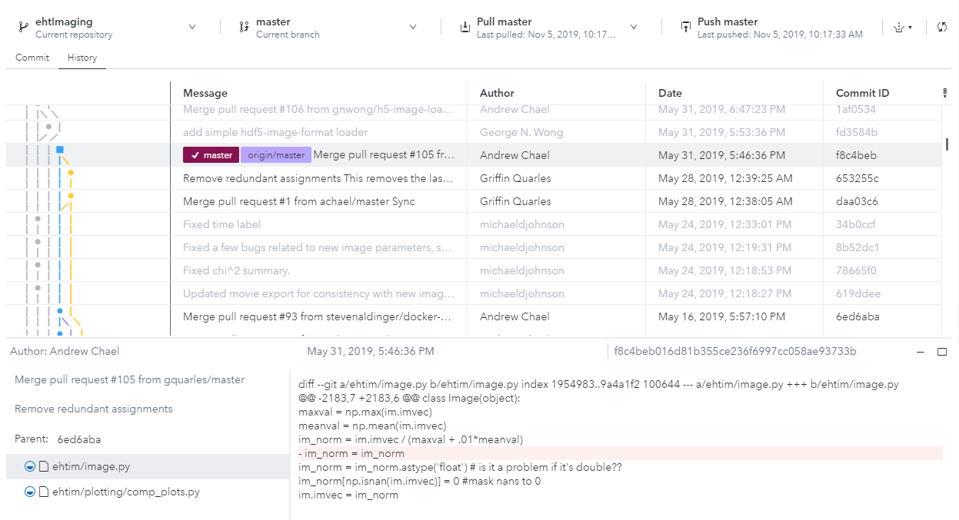
SAS Studio 5.2 Git Interface

Slide 23
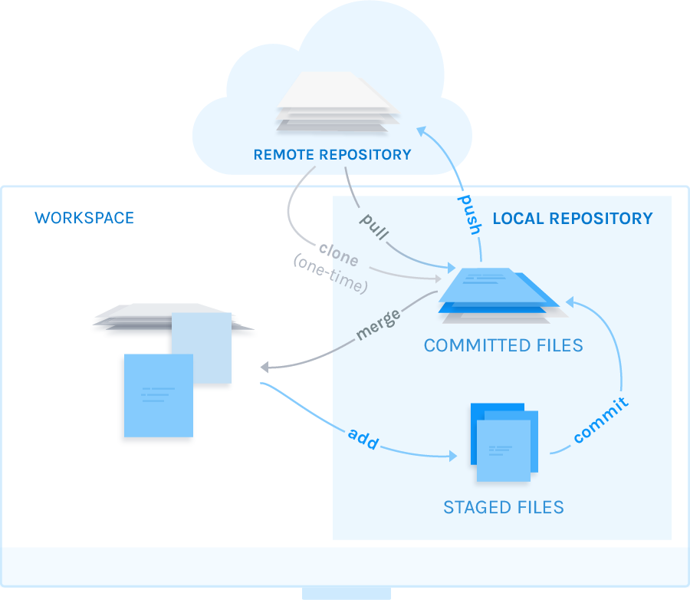
Conclusion
Today we talked about:
Git and the value of version control
The implementation of the functions was driven by SAS Studio
Highlighted functions which interact with the remote repository, stage and commit files, obtain the history and file differences, and branching
Talked about the upcoming releases of SAS Studio, and new and enhanced Git Functions

Slide 24

Questions?

Slide 25
Presentation and Example Files
data _null_;
RC = GITFN_CLONE("https://github.com/SASStudioDev/NewJerseySUG.git",
"<Directory to clone to>");
run;

Slide 26
Thank you!
Contact Information Danny.Zimmerman@sas.com

