Slide 1
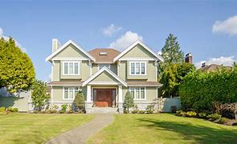

HOUSE PRICE PREDICTION MODEL (MACHINE LEARNING BASED PYTHON PROJECT)
FINAL YEAR PROJECT
Imca-5th year
Department of computer application
Techno india university ,west bengal

Slide 2

CERTIFICATE
This is to certify that this project . "HOUSE PRICE PREDICTION MODEL". in "AI&ML BASED PYTHON PROJECT".in the year 2022 is a bonafide record of work done at "TECHNO INDIA UNIVERSITY, WESTBENGAL" by the following Students
Id | Name
171001091010 | SASWATA DHAR
171001091001 | SAYANI SENGUPTA
171001091004 | SUBHAJIT DAS
171001091002 | ADITI DAS
171001102259 | ANAITA BANERJEE
Under our guidance and supervision and submitted in partial fulfillment of then requirements of the FINAL YEAR PROJECT-2022.

Slide 3

Acknowledgement
We would like to express our deep gratitude to Professor AB Choudhury(HOD)
and Professor Tapas Kumar Mitra, our project supervisors Lecturer
Soumyadeep Das, for their patient guidance, enthusiastic encouragement and
useful critiques of this project work.
We would also like to thank Lec. Soumyadeep Das, for his advice and assistance
in keeping my progress on schedule. Our grateful thanks are also extended to
other professor for their help in doing the Meteorological data analysis, helped
us in this AI&ML project.
I would also like to extend our thanks to laboratory assistance of the computer
application department for their help in this project work.
Finally, I wish to thank our parents for their support
and encouragement throughout our study.

Slide 4

content
Sl No | CHAPTER
1. 2. 3. 4. 5 6. 7. 8. | Introduction Related work Tools and technology Material and method Architecture Project building Pros and cons Future scope

Slide 5

introduction
What is a house price model?
Why demand of house price is so day by day?
Factor of house price model
Prediction vary day by day
Challenges for data scientist
This model build by which method?

Slide 6

RELATED WORK
By the decade of 1990, the increasing popularity of the Internet made it suitable for hosting advertisements which previously were published in newspapers and magazines. As of today, there is a huge number of property advertisements in the Web and exploiting knowledge from them is a topic which is observed in the recent ML literature [Wu and Brynjolfsson 2015, Sirignano et al. 2016]. Due to the large amounts of data from these advertisements, deep learning approaches seem to perform feature extraction for housing prices prediction with good performance [Poursaeed et al. 2018]. Statistical models have been a common approach to analyze and predict property prices for a long time. In [Fik et al. 2003] a study to explain the housing prices variation was conducted by analyzing the influence of location features on the property prices. [Goodman and Thibodeau 2003] employed hierarchical linear models.

Slide 7

Tools and Technology
We use deep learning and python to build this
Model
Python gives us enormous amount of library to build ml model.
Here we use jupyter notebook as our idle
Here we use sklearn, pandas, numpy module to bulid our model
Here we use supervised learning and batch learning method to build our model

Slide 8

Material and Method
Data set we used to take our csv data and manipulate here.
We used missing attribute to manipulate our missing data
We use impute mean/median for missing value function to fill our missing value
We use random forest regression method to build our model
To check performance measure of RF we use RMSE (ROOT-MEAN-SQUARE-ERROR

Slide 9

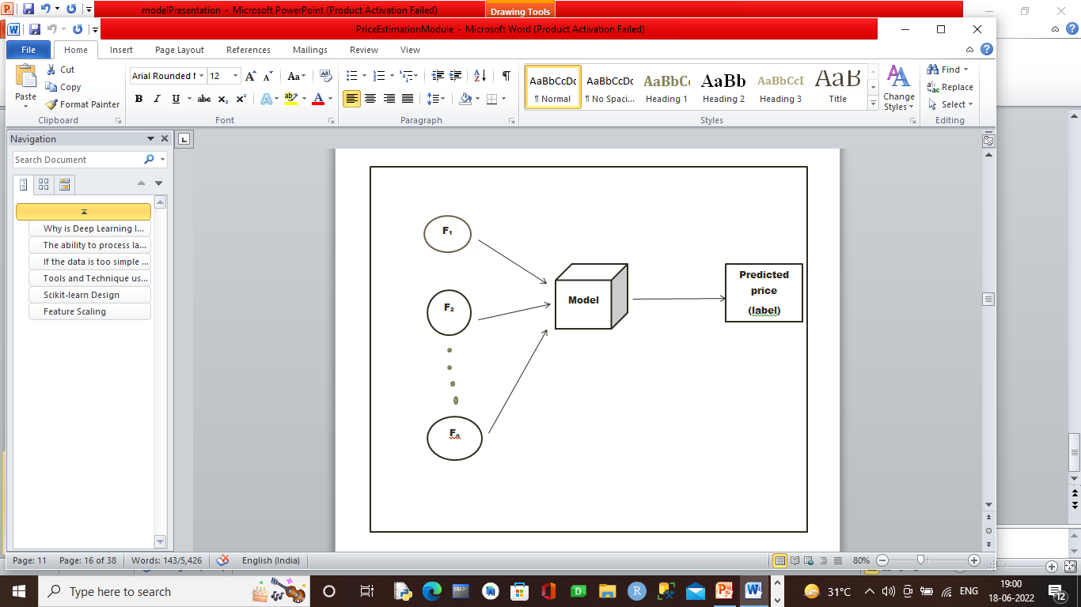
Model architecture
Here F₁ ,F₂ ……. F_{n} are the Feature by which we train our model we find the label I,e predicted price.

Slide 10

Project building
Importing all module
Importing data to dataset
Screening the data
Histogram of the data
Find coefficient correlation of the data
Divided data into training and testing data set
Finding missing attribute of data

Slide 11

Resolving missing attribute with impute mean/median for missing value
Finding best regression method to train our model
To find this we use RMSE.
Create a Pipeline to train our model
Dump our to use it out side
Check our model with test dataset to find error percentage

Slide 12

Pros and cons
Pros
This model is build under Random forest regression so the at least lowest amount of error comes out from the model with correct price.
All the assumption of this model is correct and
Taken in the presence of expert. So there may be no problem of wrong model
As all the assumption is correct so this model doesn’t undergoes into classification method.
This model is train in such a way that if new feature come with a Varity of other dataset then we can easily train the model again.

Slide 13

Cons
Though the model train with correct dataset
But there is a problem in missing value where we make impurity and median value in the missing attribute value place so there might be a problem in given wrong error(As we diagnosed before that the model give rmse error be 0.0 but actually it gives error 2 )
Model is under batch learning so if new feature comes than we have to train our model again
We try our model with three regression technique. But if we train our model with other than may be we find least error and may be our model behave better manner.

Slide 14

Future work
Predicting housing prices from online advertisements is a task which requires insight into the data combined with powerful ML algorithms. In this work, we applied two different methods for this task, and combined them into a final prediction. We provided a strong baseline to overcome, as our final ensemble hit a score 1.64183….. of RMSE. The two architectures (enriched RF and KISS) separately also presented good results and can be used as baselines for data enrichment, stacking models, or configuring RNNs. The Enriched RF works well with numeric features, as it can derive rules not only depending on the value of an attribute but also on its presence or absence. However, it cannot handle raw image or text data. KISS, on the other hand, can represent all kinds of data through the embedding layers. But it did not handle numeric attributes as well as the random forest, and had to rely on more data types to edge it out. Combining the two methods yielded the best result, combining the different strengths of each approach. As future work, feature selection algorithms can also be employed to leverage the training speed for the models. Another technique which we aim to apply on this dataset is weak supervised learning with pseudo-labeling to increase the number of training data instances for deep learning.

