Slide 1
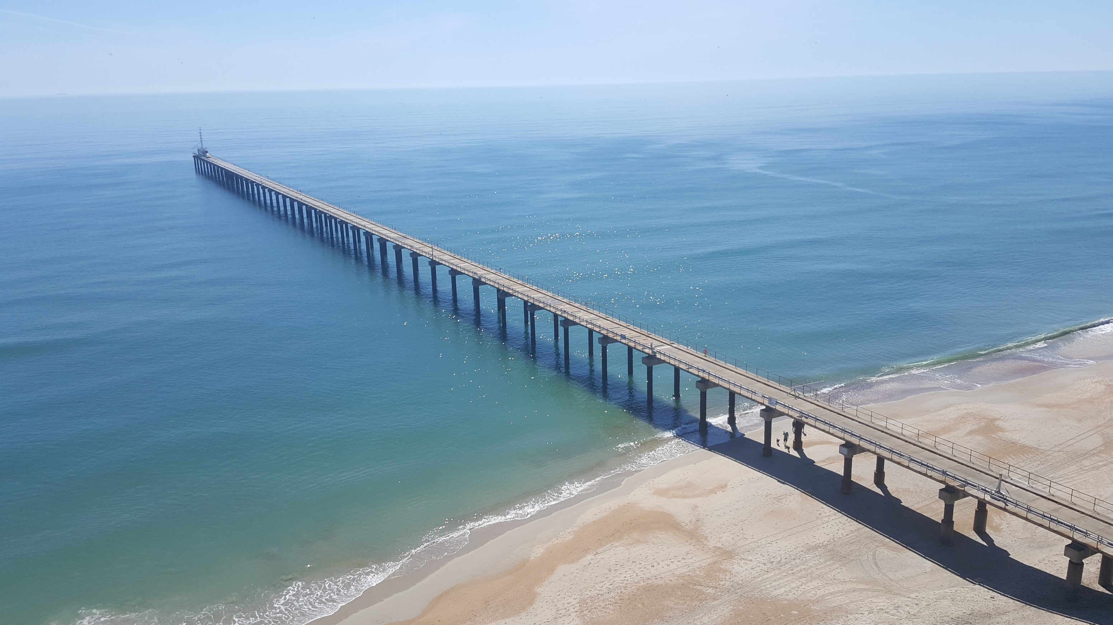
DUNEX 2021 Main Experiment

Slide 2
= File
DUNEXMainExp Directory Structure
= Folder
DUNEXMainExp
microSWIFT_data
document_templates
analysis
tools
README.md
DUNEXMainExp_Metadata.xlsx
dunex-venv-requirements.txt

