Slide 1
Probabilistic Load
Forecasting Using
Foundational Model
Lag-LLAMA
Group-2

Slide 2
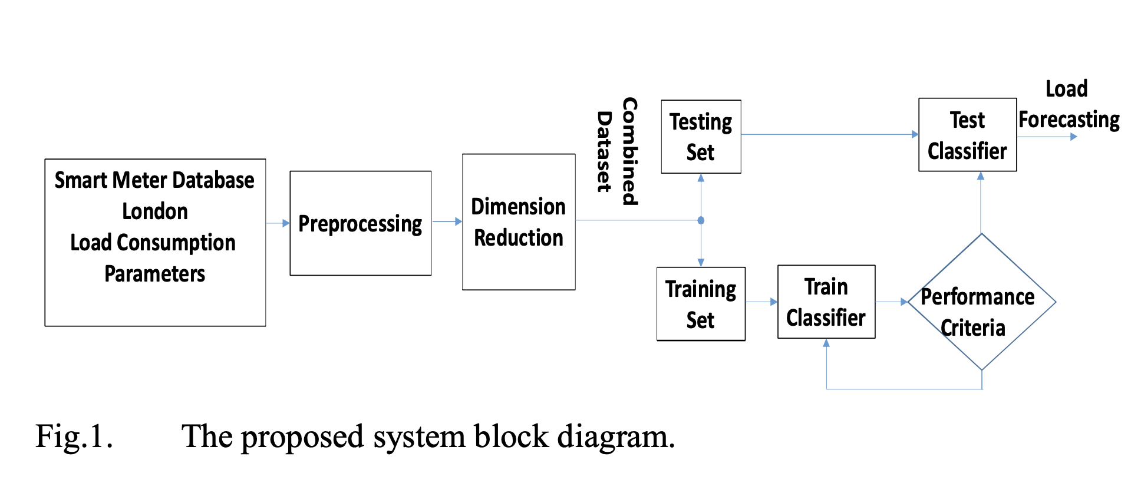
Literature Survey
Machine Learning Based Short-Term Load Forecasting for Smart Meter Energy Consumption Data in London Households
https://ieeexplore.ieee.org/document/9501104

Slide 3
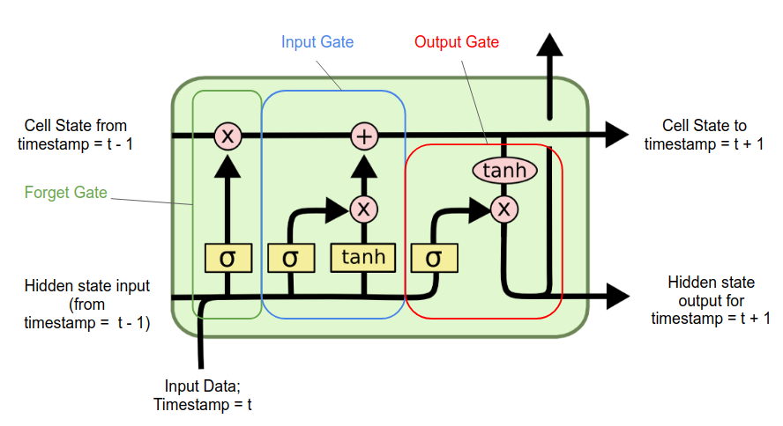
Literature Survey
Short-term Load Forecasting on Smart Meter via Deep Learning
https://ieeexplore.ieee.org/abstract/document/9000185

Slide 4
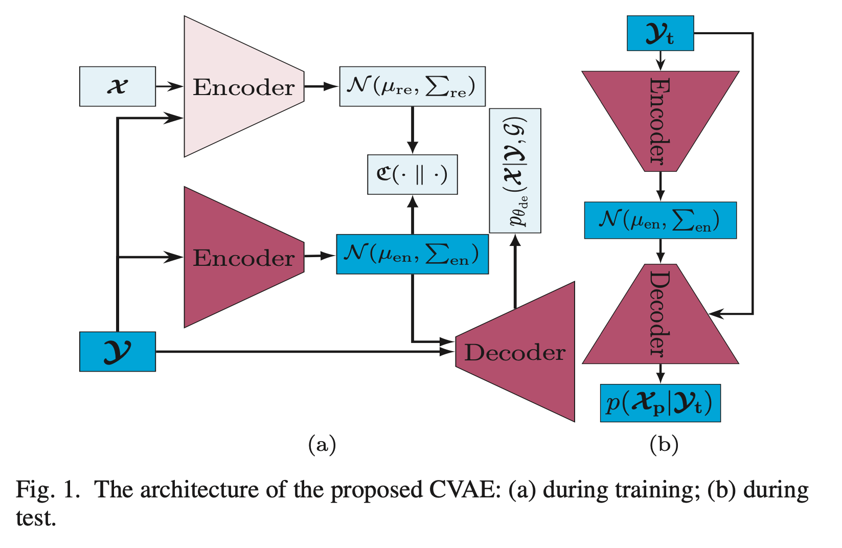
Literature Survey
Probabilistic Individual Short-Term Load Forecasting Using Conditional Variational Autoencoder
https://ieeexplore.ieee.org/abstract/document/10252364

Slide 5
Why are we using foundational models like Lag-Lamma?
Lag-Llama: Towards Foundation Models for Probabilistic Time Series Forecasting
A foundation model is a machine learning model that is trained on broad data such that it can be applied across a wide range of use cases.Foundation models have transformed artificial intelligence (AI), powering prominent generative AI applications like ChatGPT.
Lag-Llama is the first open-source foundation model for time series forecasting
https://arxiv.org/abs/2310.08278

Slide 6
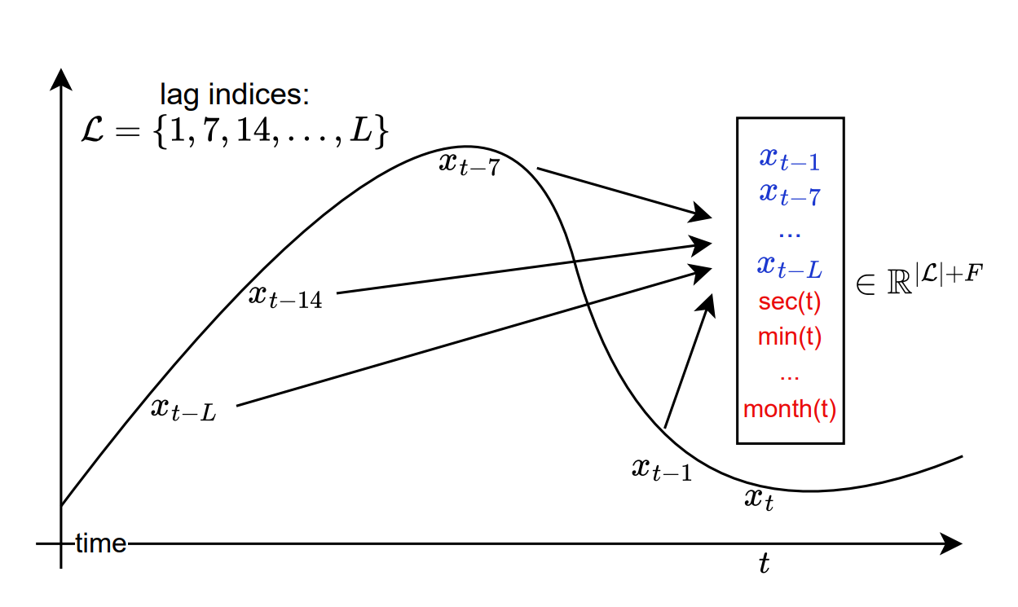
Tokenization: Lag Features
For a time series, we depict the tokenization at the timestep t of the value x_{t} which contains lag features constructed using an example set of lag indices L, where each value in the vector is from the past of x_{t} (in blue), and F possible temporal covariates (date-time features) constructed from timestamp t (red).

Slide 7
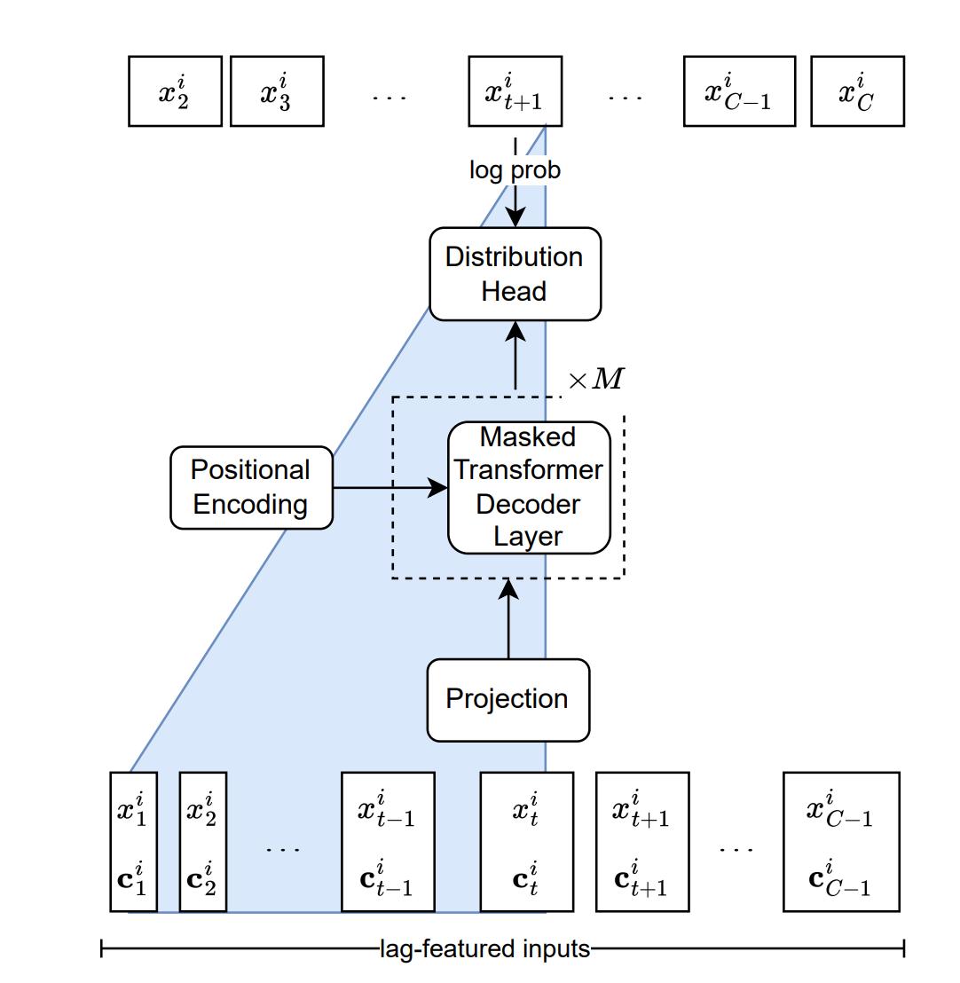



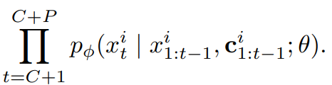
The Lag-Llama architecture-2.85million parameter model
P = no. of future values
ϕ represents the parameters of a parametric distribution.
C = sub-sample fixed context window size
θ =neural network parameters

Slide 8
Training
27 time series datasets from several sources across six different semantically grouped domains such as energy, transportation, economics, nature, air quality and cloud operations; each dataset has a different set of characteristics, such as prediction lengths, number of series, lengths of each series, and frequencies were used to train the model.
Pretraining corpus comprises a total of 7, 965 different univariate time series, each of different lengths, when put together, comprising a total of around 352 million data windows (tokens) for the model to train on.
They used a single Nvidia Tesla-P100 GPU with 12 GB of memory, 4 CPU cores, and 24 GB of RAM for training.

Slide 9
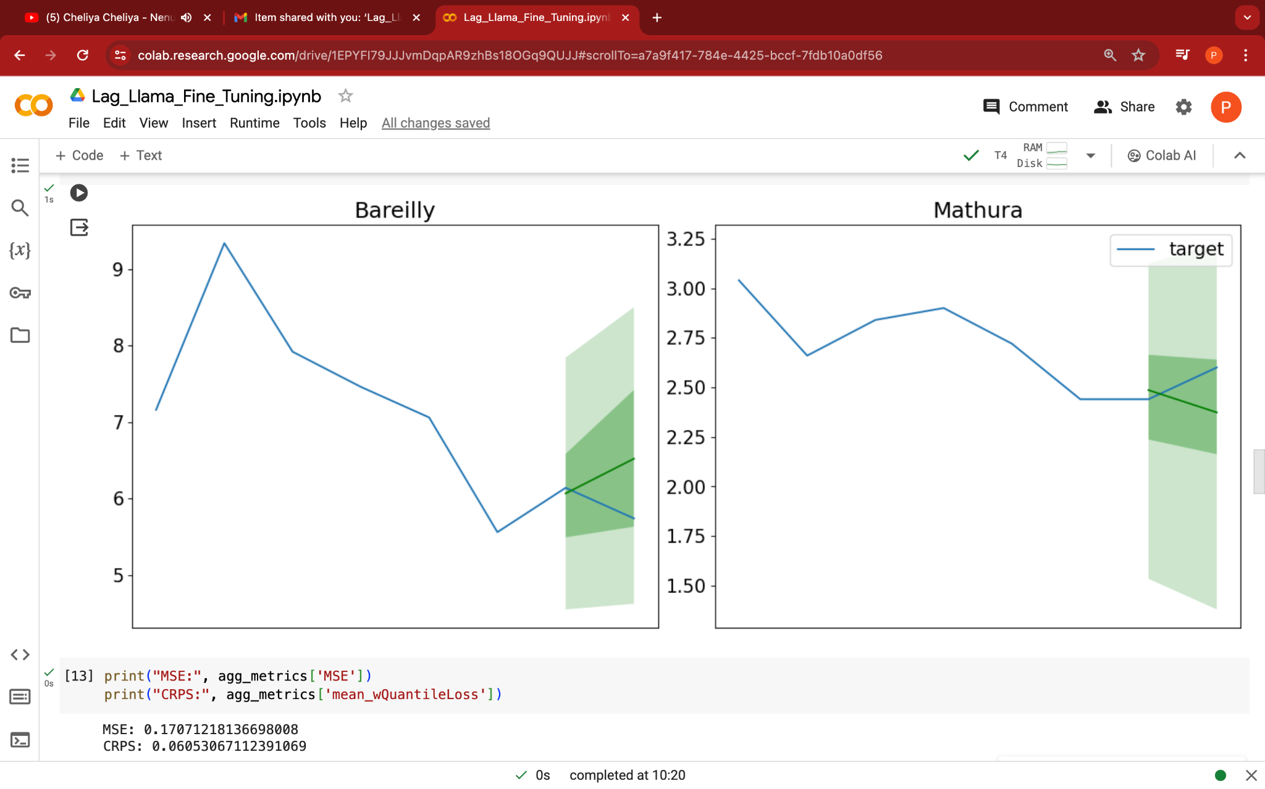
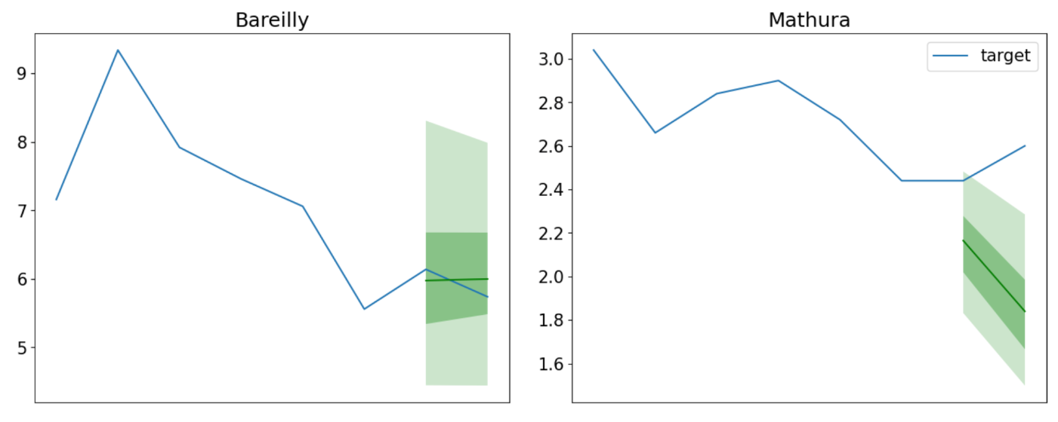
Zero shot vs Fine-tuning Results (2 points):
Zero Shot
1 point = 9 min
Fine-tuned

Slide 10
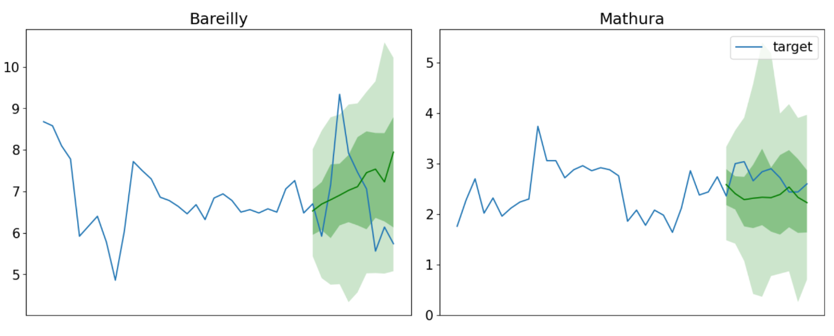
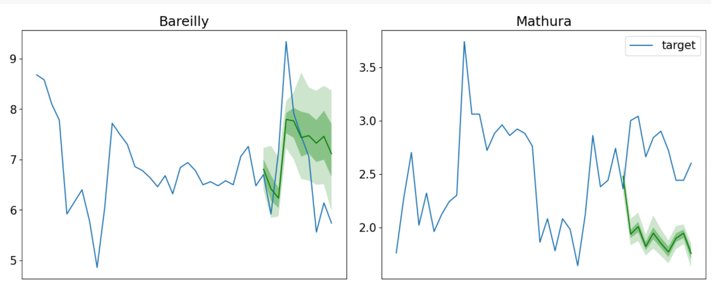
Zero shot vs Fine-tuning Results (10 points):
Zero Shot
1 point = 9 min
Fine-tuned

Slide 11
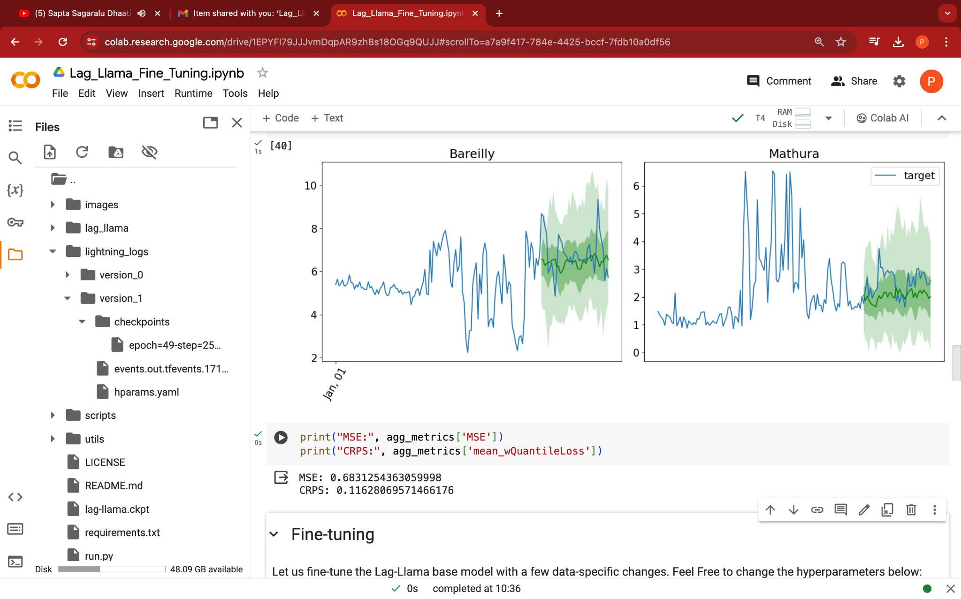
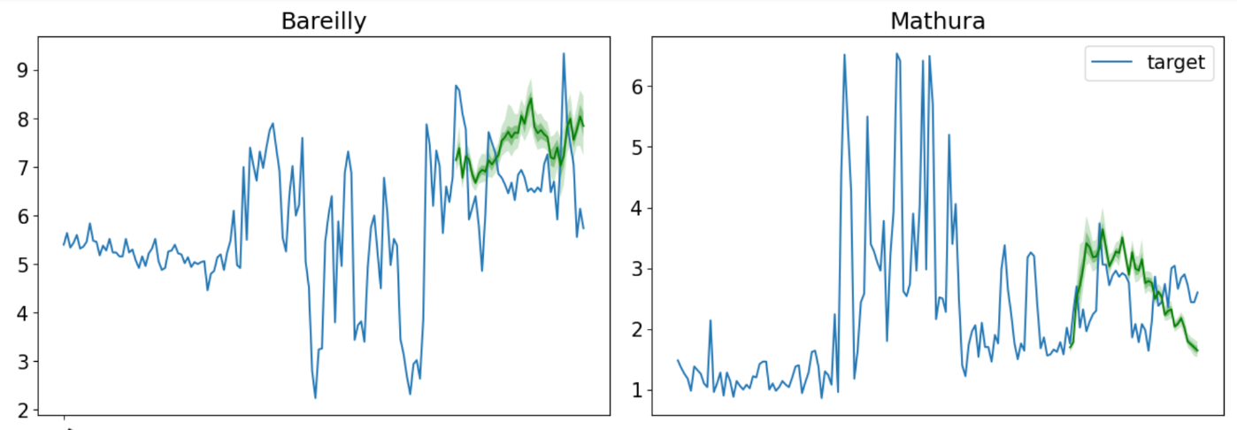
Zero shot vs Fine-tuning Results (40points):
Zero Shot
1 point = 9 min
Fine-tuned

Slide 12
Error Metrics
Prediction length(9min) | Finetuneing | MSE | CRPS
x2 | Zero-shot | 0.1707 | 0.0605
x10 | Zero-shot | 0.8879 | 0.1175
x40 | Zero-shot | 0.6831 | 0.1162
x2 | Fine-tuned | 0.1868 | 0.0825
x10 | Fine-tuned | 0.8969 | 0.1522
x40 | Fine-tuned | 0.9866 | 0.1655

Slide 13
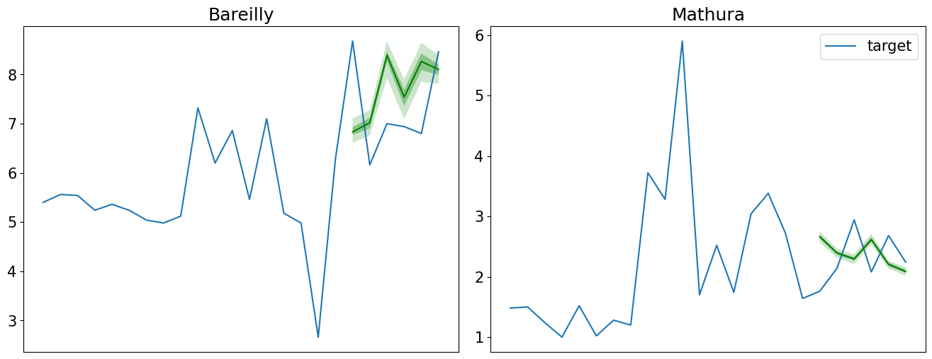
6 point prediction for hourly data:(Fine tuned)
MSE: 0.8643
CRPS: 0.1535
1 point = 1hour
So we can say that, When the interval of the data and the prediction length is comparable to the input data time framework, we get better results.

Slide 14
Limitations and Future Work:
We've noted that fine-tuning the models leads to a decline in model performance and reduces the variance of the predicted load distribution. Therefore, future efforts could focus on exploring improved fine-tuning methods, possibly enhancing the loss function to boost prediction accuracy.

