Slide 1
BLUESTOCK FINTECH
Mutual Fund Analytics Platform
Comprehensive 7-Day Capstone Presentation Deck

Slide 2
1. Problem & Objectives
• Mutual fund investors face fragmented data across fund houses and benchmarks.
• Difficulty analyzing risk-adjusted returns (Sharpe, Sortino, Alpha, Beta).
• Objective: Build an end-to-end analytics platform from raw datasets to interactive dashboards.
• Implement automated ETL, star schema database, risk analytics, and fund recommendation.

Slide 3
2. Data Sources & Authenticity
• Integrated 10 core mutual fund datasets (87,000+ total records).
• Anchored to public data: Fund master, NAV history, AUM, SIP growth, portfolio holdings.
• Investor transaction data synthetically generated for privacy compliance.
• Data quality validation ensures 0 missing NAVs and standardized schemas.

Slide 4
3. System Architecture
• Data Ingestion: Raw CSV extraction & Live NAV API fetcher (`mfapi.in`).
• Data Cleaning: Standardization, duplicate removal, forward-filling NAVs.
• Data Storage: SQLite Star Schema DB (`dim_fund`, `dim_date`, 8 fact tables).
• Analytics & BI: Python (`Pandas`, `NumPy`, `SciPy`), Streamlit Dashboard, ReportLab PDF.

Slide 5
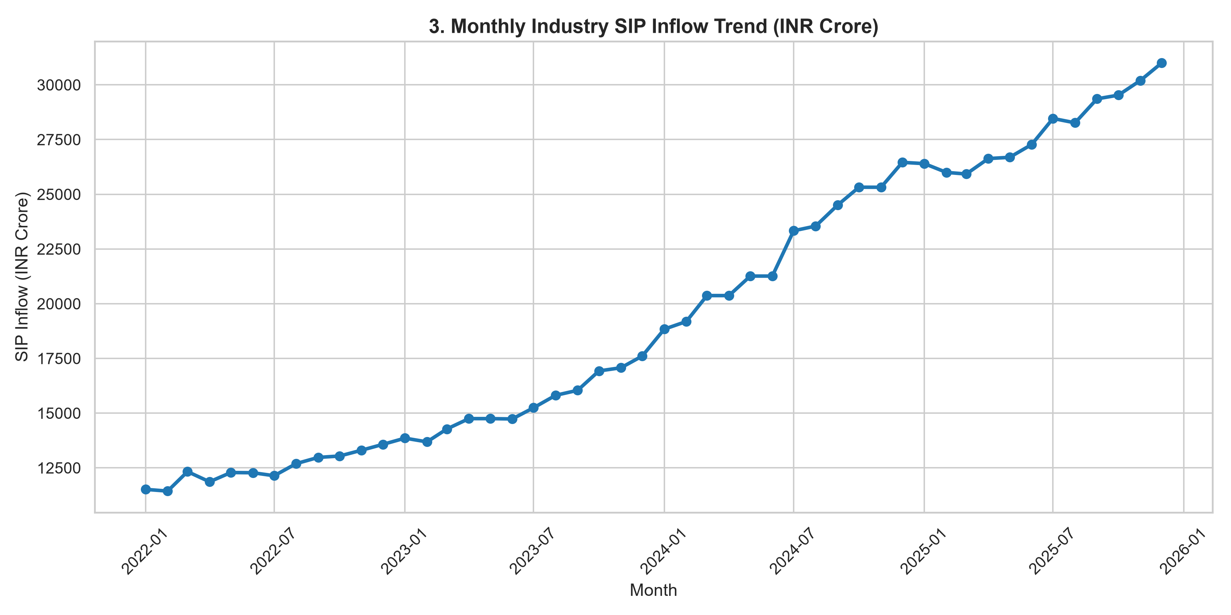
4. EDA Highlights
• Industry AUM exceeds ₹45 Lakh Crore.
• Monthly SIP inflows show constant positive trajectory exceeding ₹19,000 Cr.
• Folio count growth driven primarily by retail equity investments.
• Top 5 fund houses dominate over 65% of total industry AUM.

Slide 6
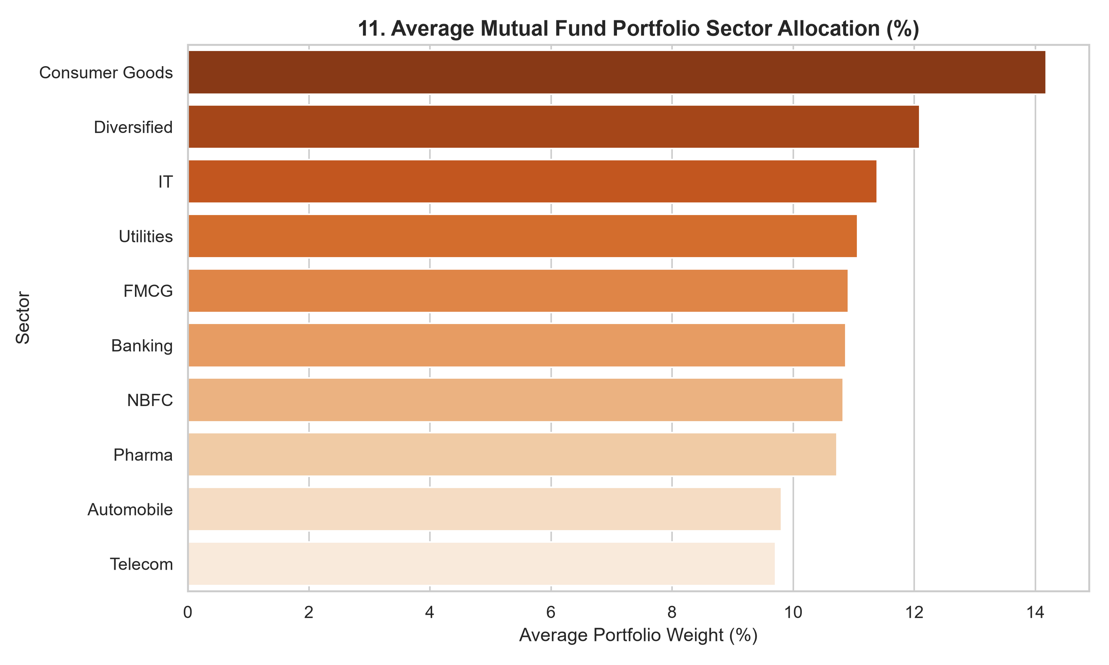
5. Category & Sector Insights
• Equity & Small Cap funds yielded highest 3-Year CAGR returns (18% - 24%).
• Banking, Financial Services, IT, and Oil & Gas represent top sector holdings.
• Sector Concentration HHI indicates well-diversified portfolios across major funds.

Slide 7
6. Performance Analytics & Scorecard
• Calculated 1Yr, 3Yr CAGR, 5Yr CAGR, Sharpe, and Sortino ratios.
• Developed Composite Fund Scorecard (0-100 score).
• Weights: 30% 3Yr Return, 25% Sharpe, 20% Alpha, 15% Expense Ratio (inv), 10% Max DD (inv).
• Identified top-performing funds across equity, debt, and hybrid categories.

Slide 8
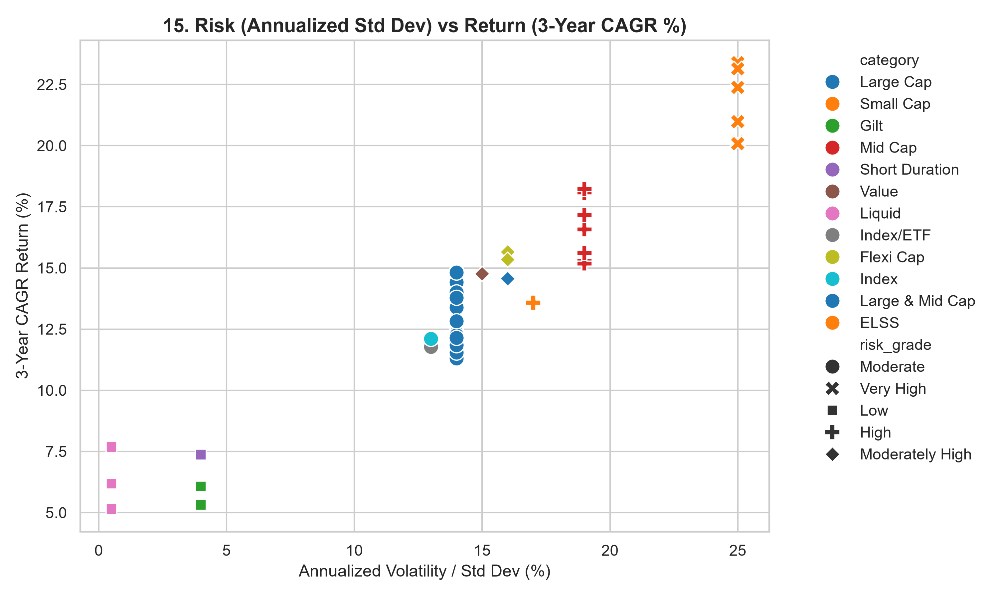
7. Risk & Benchmark Analysis
• Annualized Volatility (Std Dev) ranges from 11% to 22%.
• Historical 95% VaR ranges between 1.1% and 2.4% daily.
• Alpha analysis shows top funds outperforming Nifty 100 benchmark by +2.4% to +6.8%.
• Maximum Drawdown analysis highlights resilience during market pullbacks.

Slide 9
8. Interactive Streamlit Dashboard
• Developed 4-page interactive Streamlit web dashboard (`dashboard/app.py`).
• Page 1: Industry Overview & Macro KPIs.
• Page 2: Fund Performance, Risk Scatter & Composite Scorecard.
• Page 3: Investor Analytics & Geographic Splits.
• Page 4: SIP & Market Trends with Benchmark Index comparisons.

Slide 10
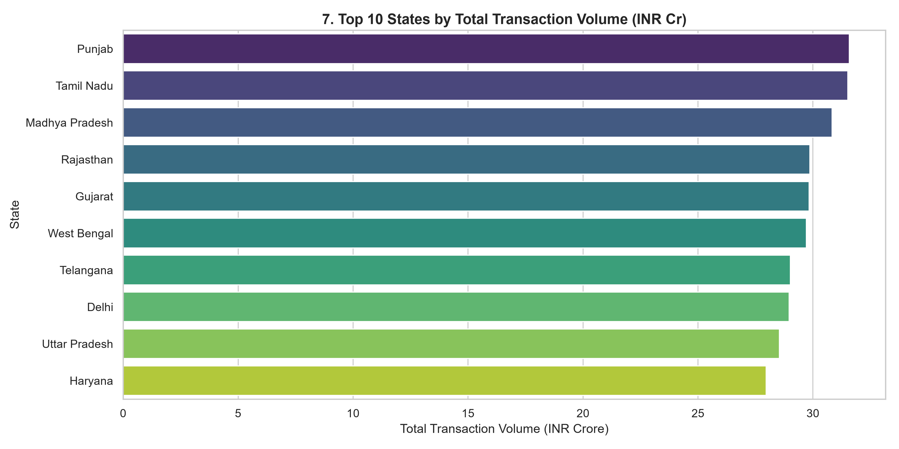
9. Investor Demographics & Behaviors
• T30 cities account for 62% of investment volume; B30 locations expanding rapidly.
• Investors aged 26-35 lead new monthly SIP account creation.
• SIP continuity analysis flagged at-risk investors with transaction gap > 35 days.
• Investor cohort retention remains strong at 78% for recent 2022-2024 cohorts.

Slide 11
10. Key Findings & Strategic Recommendations
1. Promote High-Sharpe, low-cost Direct plan schemes to retail investors.
2. Expand digital distribution in B30 cities to accelerate retail growth.
3. Deploy automated SIP gap notifications to minimize investor drop-offs.
4. Leverage transparent rule-based recommendation model for investor guidance.

Slide 12
11. Conclusion & Deliverables
• Completed submission-ready 7-Day Mutual Fund Analytics Platform.
• Integrated ETL pipelines, SQLite star schema DB, Python analytics, Streamlit dashboard.
• Generated automated 24-section PDF Final Report and PowerPoint deck.
• Thank you! Questions & Discussion.

