Slide 1
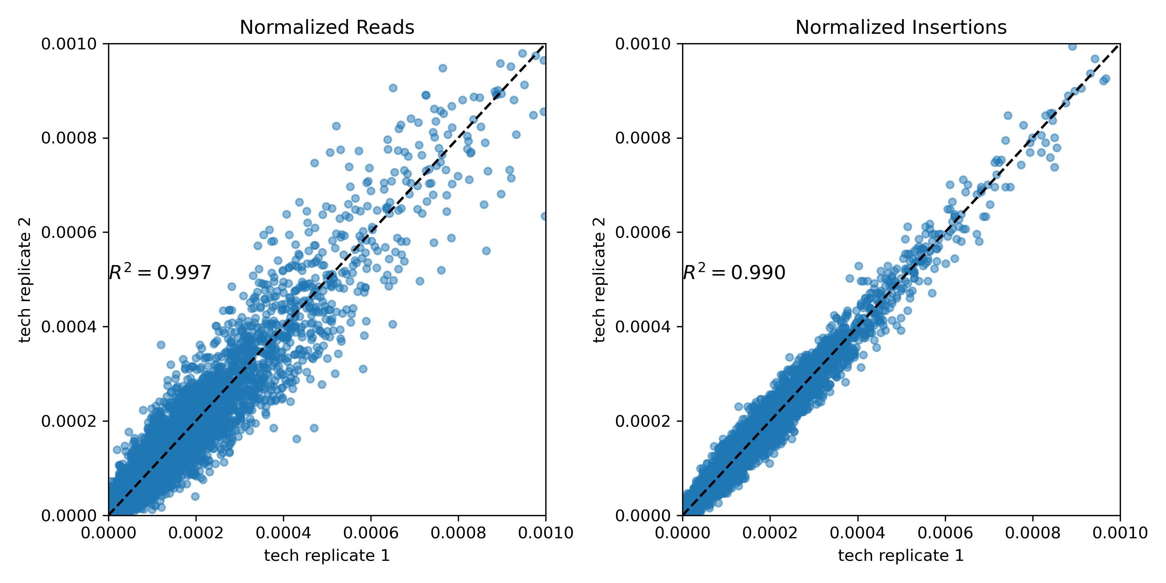
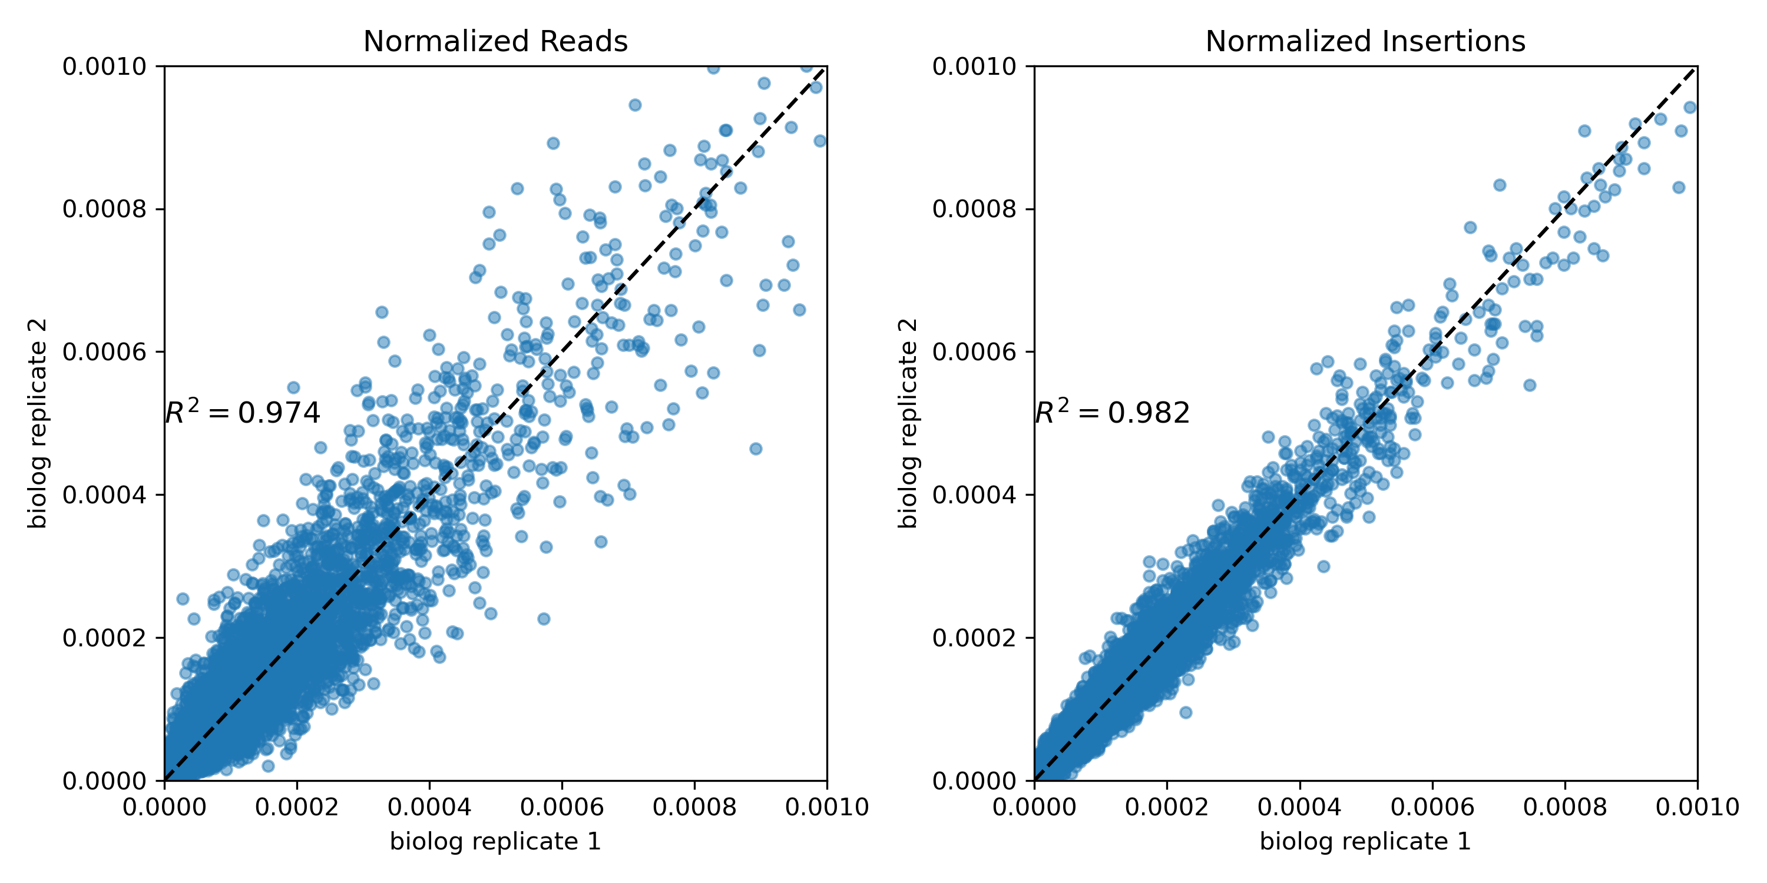
Libraries comparison
Data from each gene from wild type libraries, normalized by the sum of all the reads or insertions respectively (technical replicates- separated before PCR)- from pergene files
Data from each gene from dnrp1 libraries (biological replicates- they are from different glycerol stocks) – from pergene files

Slide 2
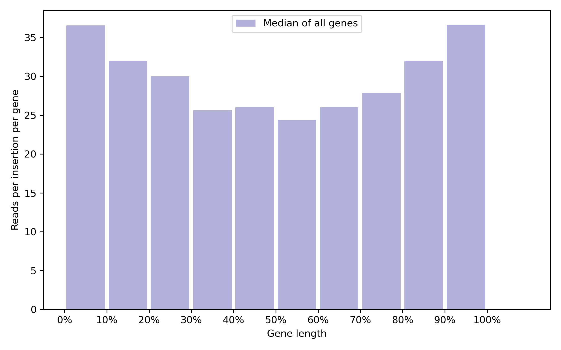
Bias of transposon insertions to the start and the end of genes
Procedure
Take the data from every gene from the wild type background, resulted from merging both technical replicates datasets.
Take every insertion location of every gene and distributed along percentages of the gene length. For instance, if the gene length is divided in 10 equal pieces, then it is computed the total read counts that fall in each segment , divided by the number of insertions on those segments. We ended up in a matrix where each row is a gene and each column is a segment.
Then take the median of all segments from all genes,and plot that. Why the median? To avoid outliers like the ADE2 and URA3 genes.
Interpretation:
The first 10 and last 90% of the gene are generally enriched by more transposons than the middle part. It is wise to discard them when analyzing the fitness effects because, those insertions presumably dont lead to the gene knockout.

Slide 3
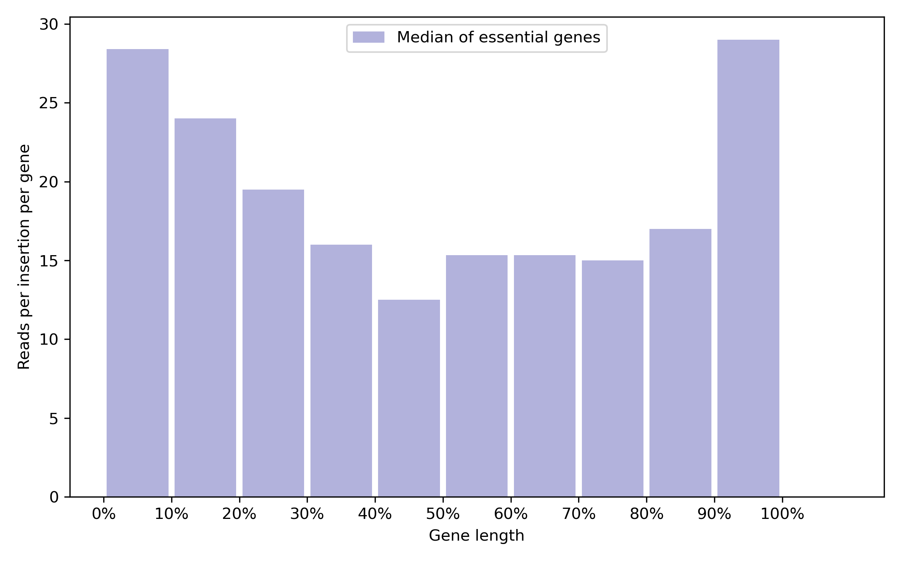
Bias of transposon insertions to the start and the end of essential genes

Slide 4
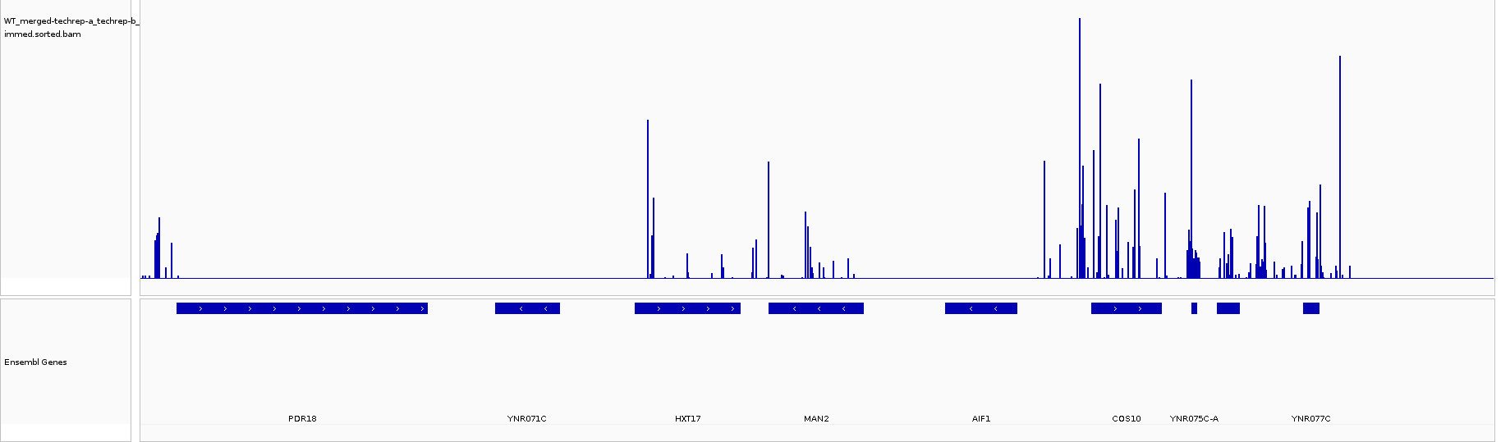
Look for genes with little information
A
20kb- windows size
B
Upstream flanking
downstream flanking
Gene X
If the # of insertions from A to B is less than half of the expected
insertion density in the chromosome for that windows size, then gene X is discarded for
the analysis of the fitness.
Low flanking regions

Slide 5
Insertion density as a function of the distance to centromeres
I neglect the higher insertion density in
pericentromeric regions, therefore I am
artificially inflating the actual
insertion density
in regions far from centromeres.
Insertion density
average
I
I/2
Poor flanked genes
0
Distance to centromeres

