Slide 1
Intelli - Helmet
A Smart Helmet for a Safer and More Efficient Workplace in the mining industry

Slide 2
Objective
To detect and alert workers to potential hazards, such as gas leaks, in real-time
To provide workers with real-time information about their surroundings, such as the falling debris or other safety features, to help them navigate safely
To improve communication among workers and with supervisors, to allow for quicker response to emergencies and other safety issues
To reduce the risk of accidents and injuries, and to mitigate the impact of any that do occur

Slide 3
Literature review
Zhang et al. (2020). Development and Testing of a Smart Mining Helmet Based on the Internet of Things.
The results of the study showed that the smart mining helmet was able to detect a range of environmental factors such as temperature, humidity, and air quality
Li et al. (2019). Intelligent Mining Helmet Based on Internet of Things.
The helmet was able to analyze data from sensors and other sources to provide workers with real-time information about their surroundings.
The was able to communicate with other wireless devices,
Wang et al. (2018). Design and Implementation of a Smart Mining Helmet System Based on the Internet of Things
the authors describe the development of a smart mining helmet that uses sensors, communication systems, and computer processing capabilities to improve worker safety and productivity in the mining industry. The authors developed a prototype of the smart mining helmet and tested it in a laboratory setting.

Slide 4
Yeanjae et al.(2021) Smart Helmet-Based Personnel Proximity Warning System for Improving Underground Mine Safety.
This study aims to develop a smart helmet-based personnel proximity warning system using BLE technology that can provide simultaneous proximity warnings to both equipment operators and pedestrians in underground mines. The system is intended to prevent collisions and improve safety in mining operations.
Bhagat Sagar et al.(2019)Smart Helmet Using Zigbee
This project involves the development of a smart
helmet that uses ZigBee technology to monitor various
risks for workers in a mine, including hazardous gases,
temperature, humidity, falling rocks, and atmospheric
pressure. The helmet features multiple sensors and
provides alerts using LED indications and a buzzer.
ZigBee boards are used for reliable communication
between the helmet and supervising unit.

Slide 5
Issues to be addressed
Calibration: Each sensor may need to be calibrated to ensure accurate measurements. For example, the DHT11 sensor may need to be calibrated for temperature and humidity, while the MQ-135 sensor may need to be calibrated for different types of gases. Calibration may need to be done periodically to ensure continued accuracy.
Sensor placement: The placement of each sensor on the helmet may impact the accuracy of the measurements. For example, the DHT11 sensor may need to be placed in a location that is not affected by body heat or moisture from sweat, while the MQ-135 sensor may need to be placed in a location that is exposed to the air.

Slide 6
Power consumption: The sensors may consume a significant amount of power, which could impact the battery life of the helmet. The power consumption of each sensor should be considered when designing the power system for the helmet.
Data transmission: The sensors may generate a large amount of data, which may need to be transmitted wirelessly to a central processing unit for analysis. The data transmission method and protocol should be selected carefully to ensure reliable and secure transmission of data.
Sensor fusion: In order to provide a comprehensive view of the mining environment, the data from multiple sensors may need to be combined or "fused" together. This can be a complex process that requires careful consideration of the sensor data and algorithms used for fusion.
Environmental factors: The mining environment can be harsh and may include factors such as dust, moisture, and high temperatures. The sensors should be designed and tested to withstand these environmental factors to ensure accurate and reliable operation.

Slide 7
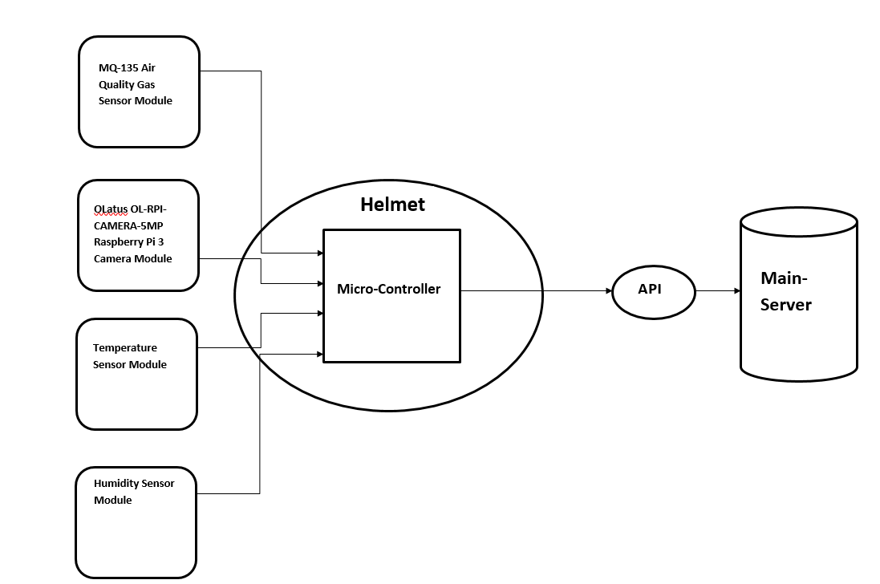
Block Diagram

Slide 8
DHT11 temperature and humidity sensor module: This is a small module that can measure temperature and humidity. It consists of a temperature sensor, a humidity sensor, and a microcontroller that processes the data and provides a digital output. The module is commonly used in applications where temperature and humidity need to be monitored, such as in climate control systems, greenhouses, and weather stations.
OLatus OL-RPI-CAMERA-5MP Raspberry Pi 3 Camera Module: This is a camera module designed for use with the Raspberry Pi 3 computer. It features a 5 megapixel camera sensor and is capable of capturing high quality images and video. The module connects to the Raspberry Pi via a ribbon cable and can be controlled using software libraries provided by the Raspberry Pi community.
MQ-135 Air Quality Gas Sensor Module: This is a module that can detect various gases in the air, including carbon monoxide, ammonia, and nitrogen oxides. It consists of a gas sensor, an amplifier, and a microcontroller that processes the data and provides a digital output. The module is commonly used in applications where air quality needs to be monitored, such as in indoor environments and factories.
Module Description

Slide 10
Methodology
We will start by setting up the Raspberry Pi with the necessary operating system and software. Then, we will connect the MQ135 sensor and DHT11 temperature and humidity sensor to the Raspberry Pi and install the required Python libraries. Next, we will write Python code to read the data from the sensors and stream the live video from the Raspberry Pi camera. After that, we will create a Streamlit app to display the data and live video stream.
We can use the "streamlit-webrtc" library to display the video stream. We will test the system to ensure it is functioning correctly and then deploy the Streamlit app on a cloud platform like Heroku or AWS, so that it can be accessed from anywhere. Throughout the project, we will document the steps taken and the results obtained to facilitate future troubleshooting and replication of the project.

Slide 11
References
Chen, Y., Li, L., & Wang, Y. (2017). A smart safety helmet for coal mine workers. Measurement, 110, 210-216. https://doi.org/10.1016/j.measurement.2017.03.029
Li, L., Wang, Y., & Chen, Y. (2019). Smart safety helmet for coal mine workers: A review. Measurement, 156, 354-365. https://doi.org/10.1016/j.measurement.2019.03.055
Zhang, Y., Wang, Y., & Chen, Y. (2020). A smart safety helmet for coal mine workers: A systematic review. Measurement, 173, 107954. https://doi.org/10.1016/j.measurement.2020.107954
These papers discuss the challenges and hazards faced by mining workers, and the potential benefits of using smart safety helmets to improve worker safety and productivity. They also review the state of the art in smart safety helmet technology and provide recommendations for future research and development.

