Slide 1
CUSTOMER RETENTION
ANALYTICS DASHBOARD
Using Python • SQL • Power BI
3,900 Customers | $233K Revenue | 4 Segments | Feature Engineering & BI Analytics
3,900
$233K
$59.76
1,518
Total Customers
Total Revenue
Avg Purchase
Avg CVS
By SATHVIK N
Notes:
Title slide. Mention this is an end-to-end customer analytics project combining Python preprocessing and feature engineering, SQL querying, EDA, and Power BI dashboarding.

Slide 2
BUSINESS PROBLEM
Why Customer Retention Matters
Key Retention Dimensions Analysed
Acquiring a new customer costs 5–7× more than retaining an existing one.
High-Value Customers
Promo Dependency
Identify Platinum & Gold tier customers generating maximum revenue.
Detect customers who buy only with discounts vs organic buyers.
A 5% increase in customer retention can grow profits by 25–95%.
High-value customers contribute disproportionately to total revenue.
Loyalty Levels
Customer Segments
Understanding purchase behaviour enables targeted, cost-effective marketing.
Quantify purchase frequency, subscription and engagement scores.
Classify into VIP Loyalist, Growth, Bargain Hunter, Low Engagement.
Data-driven segmentation drives personalised retention strategies.
Notes:
The core business problem: understanding which customers to retain, how to engage them, and what strategies to use per segment.

Slide 3
DATASET OVERVIEW
3,900
30
4
100%
Total Records
Total Features
Product Categories
No Missing Values
Customer Attributes
Purchase Information
Behaviour & Loyalty
Customer ID
Age
Gender
Location
Purchase Amount (USD)
Item Purchased
Category
Season
Frequency of Purchases
Previous Purchases
Subscription Status
Review Rating
Payment & Discounts
Engineered Features
Payment Method
Discount Applied
Promo Code Used
Shipping Type
Loyalty Score
Loyalty Band
Customer Value Score
Customer Segment
Notes:
The dataset contains 3,900 customer records across 30 features covering demographics, purchases, behaviour, payment preferences and derived analytics fields.

Slide 4
DATA CLEANING & PREPARATION
01
Missing Value Treatment
02
Data Consistency Validation
03
Feature Normalisation
Review Rating: median imputation applied
No null values in core transactional fields
Post-imputation: zero missing values across all 30 columns
Frequency labels standardised: Bi-Weekly → Fortnightly, Every 3 Months → Quarterly
Categorical fields validated for unique value integrity
Numeric range checks on Age, Purchase Amount, Review Rating
MinMaxScaler applied to: Previous Purchases, Frequency Score, Review Rating
Normalised fields (suffix _N) used in composite scoring formulas
Ensures equal weight contribution across different scales
04
Data Transformation
05
Pipeline for SQL & Power BI
Frequency of Purchases mapped to numeric score (1–5 scale)
Subscription Status encoded as binary (0/1)
Discount Applied and Promo Code Used encoded as binary flags
Processed CSV exported to customer_features.csv (3,900 × 30)
SQLite database created from processed file for query analysis
Power BI connected to the same CSV as the single source of truth
Notes:
Data cleaning was minimal due to high dataset quality. Key steps included median imputation for ratings, label standardisation for frequency fields, and MinMax normalisation before composite scoring.

Slide 5
FEATURE ENGINEERING
7 analytical features engineered from raw transactional data to enable customer segmentation and retention modelling
Feature Name | # | Purpose / Method | Business Meaning
Frequency Score | 1 | Maps purchase frequency text → numeric (1–5 scale). Weekly=5, Fortnightly=4, Monthly=3, Quarterly=2, Annually=1. | Enables numeric comparison of purchase engagement across all customers.
Loyalty Score V1 | 2 | Composite: 0.4×PrevPurchases_N + 0.4×FreqScore_N + 0.2×ReviewRating_N. MinMax normalised inputs. | Ranks customers by historical loyalty behaviour on a 0–1 scale.
Loyalty Band | 3 | pd.qcut(Loyalty Score V1, q=4) → Low / Medium / High / Very High. Equal-frequency quartile split. | Segmentation label for loyalty tier — used in dashboards and SQL.
Promo Dependency Level | 4 | Binary flag: Promo Code Used == 'Yes' → High, else → Low. Derived from single behavioural field. | Identifies customers who purchase only with promotions — key for campaign targeting.
Customer Value Score | 5 | Purchase Amount (USD) × Previous Purchases. Captures both spend magnitude and repeat behaviour. | Monetary lifetime proxy — higher score = higher business value contribution.
Value Tier | 6 | pd.qcut(Customer Value Score, q=4) → Bronze / Silver / Gold / Platinum labels. | Tiered classification for loyalty programme design and reward allocation.
Customer Segment | 7 | Rule-based: Platinum → VIP Loyalist; High Promo → Bargain Hunter; Gold/Silver → Growth; else → Low Engagement. | Primary segment for tailored retention strategy (4 actionable groups).
Notes:
7 core features engineered: Frequency Score, Loyalty Score V1, Loyalty Band, Promo Dependency Level, Customer Value Score, Value Tier, and Customer Segment.

Slide 6
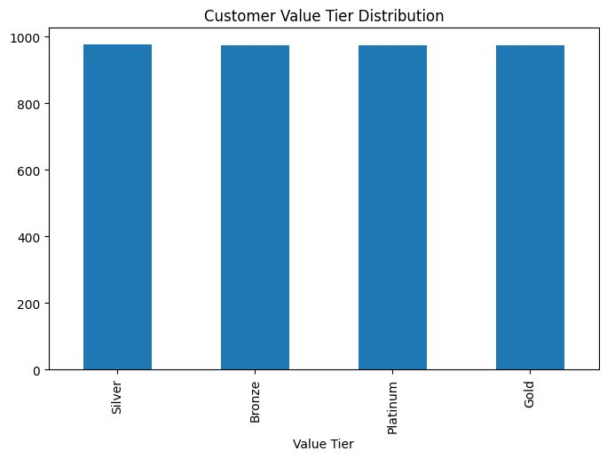
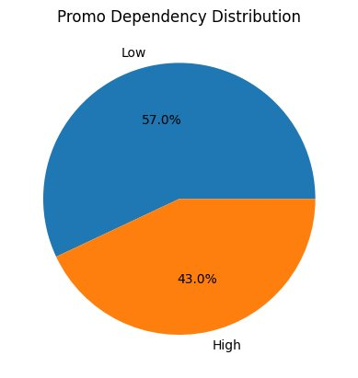

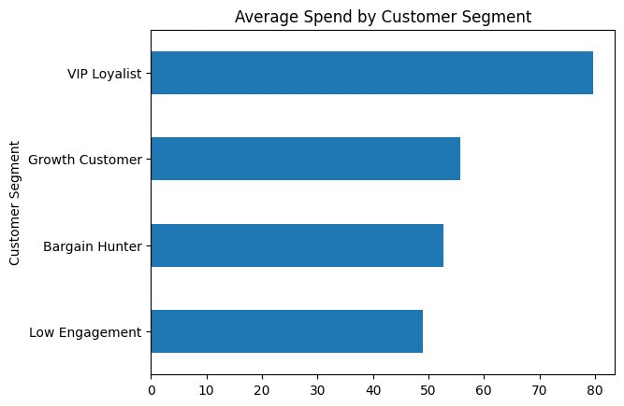
EXPLORATORY DATA ANALYSIS
Value Tier Distribution: All 4 tiers (~975 each) confirm balanced qcut segmentation. Even split enables unbiased tier-specific campaigns.
Promo Dependency: 57% of customers are Low dependency (organic buyers), 43% are High (promo-driven). Majority do not require discounts to purchase.
Loyalty Band Distribution: ~692 customers per band (Low/Medium/High/Very High). Equal quartile split confirms no extreme loyalty skew in the dataset.
Avg Spend by Segment: VIP Loyalists spend $79.66 avg vs Low Engagement at $49.05. Clear 60% revenue gap between best and worst-performing segments.
Notes:
EDA confirms: even tier distribution, majority non-promo-dependent customers, and a clear VIP spending premium. These charts directly inform retention strategy design.

Slide 7
SQL-BASED BUSINESS ANALYSIS
Business Questions Answered Through SQL
SQL Query Results & Insights
Q: Customer Segment Distribution
Metric | Value | Insight
Bargain Hunter | 1,268 | Largest segment (32.5%)
VIP Loyalist Avg Spend | $79.66 | Highest spender of all segments
Clothing Revenue | $104,264 | Top revenue category (44.7%)
Accessories Revenue | $74,200 | Second largest category (31.8%)
Low Promo Dependency | 2,223 | 57% of customers buy organically
Total Customers | 3,900 | Across all 4 loyalty bands
SELECT "Customer Segment", COUNT(*) AS Customer_Count
FROM customer_features
GROUP BY "Customer Segment"
Q: Revenue by Category
SELECT Category,
SUM("Purchase Amount (USD)") AS Revenue
FROM customer_features
GROUP BY Category ORDER BY Revenue DESC
Q: Avg Spend per Segment
SELECT "Customer Segment",
ROUND(AVG("Purchase Amount (USD)"),2) AS Avg_Spend
FROM customer_features
GROUP BY "Customer Segment"
ORDER BY Avg_Spend DESC
Notes:
SQLite was used for structured business queries. 12 queries executed covering: total counts, revenue aggregations, segment distributions, average spend, and loyalty band counts.

Slide 8
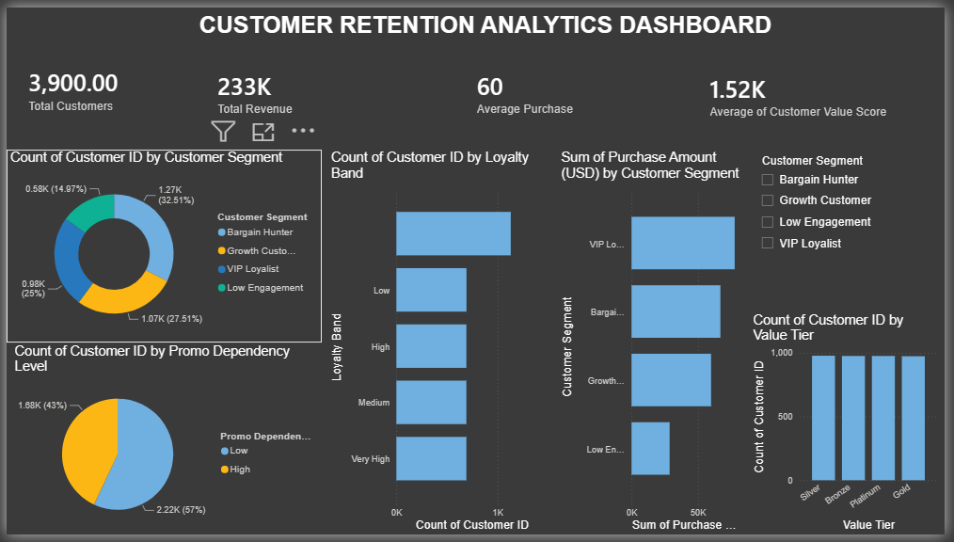
POWER BI DASHBOARD
KPI Cards
Total Customers 3.9K, Revenue $233K, Avg Purchase $60, Avg CVS 1.52K
Segment Analysis
Donut chart: Bargain Hunter 32.5%, Growth 27.5%, VIP 25%, Low Eng 15%
Loyalty Distribution
Horizontal bars: uniform spread across Low / Medium / High / Very High
Promo Dependency
Pie: 57% Low dependency, 43% High — organic buyers dominate
Value Tier
Bar chart: ~975 customers per tier (Silver / Bronze / Platinum / Gold)
Notes:
Power BI dashboard consolidates all KPIs on a single page with slicers for Customer Segment filtering. Charts are interactive and update when segments are selected.

Slide 9
KEY INSIGHTS
Evidence-based findings from dataset analysis, SQL queries, EDA and Power BI
01
Bargain Hunters Dominate
02
VIP Loyalists Drive Premium Revenue
With 1,268 customers (32.5%), Bargain Hunters are the largest segment — driven by promo code usage rather than organic loyalty. This signals over-dependence on discount-led acquisition.
VIP Loyalists average $79.66 per purchase — 62% more than Low Engagement customers. They represent the highest ROI group for retention investment despite being only 25% of the base.
03
Organic Buyers Majority
04
Clothing Category Leads Revenue
57% of customers (2,223) show Low promo dependency, indicating a strong base of purchase-intent-driven buyers who do not require discount incentives — a healthier revenue foundation.
Clothing contributes $104,264 (44.7%) of total revenue, followed by Accessories at $74,200 (31.8%). Category-specific campaigns in Clothing & Accessories offer highest revenue upside.
05
Balanced Loyalty Distribution
06
Customer Value Score Skew
~692 customers per loyalty band (Low/Medium/High/Very High) shows no extreme skew. This signals opportunity across all tiers — not just top-end retention but also nurturing mid-tier.
CVS ranges from 21 to 5,000 (mean 1,518, std 1,117) — high variance confirms that a small Platinum tier generates disproportionate value. Top quartile (≥2,212) deserves premium treatment.
Notes:
6 key insights synthesised from the full analytical pipeline. Highlights: Bargain Hunters dominate count; VIP Loyalists dominate value; Clothing leads revenue; organic buyers are the majority.

Slide 10
CUSTOMER RETENTION PLAYBOOK
VIP Loyalist | 975 customers (25%)
Growth Customer | 1,073 customers (27.5%)
Goal: Retain & deepen relationship
Goal: Upgrade to VIP tier
Exclusive rewards programme with tiered benefits
Early access to new product launches
Premium membership with free expedited shipping
Dedicated account manager for top 100 CVS customers
Anniversary/birthday personalised offers
Cross-sell: Clothing + Accessories bundle campaigns
Upsell: Upgrade from Silver to Gold tier incentives
Loyalty nurturing: Points multiplier months
Subscription status push for non-subscribers
Category-based personalised recommendations
Bargain Hunter | 1,268 customers (32.5%)
Low Engagement | 584 customers (15%)
Goal: Reduce promo dependency
Goal: Reactivate or exit gracefully
Personalised seasonal discount campaigns (not blanket)
Promo fatigue reduction: offer value-adds instead of % off
Gamified loyalty points to shift from discount to reward
Flash sales targeted to specific purchase history
A/B test organic vs promo messaging response rates
Win-back email series: 'We miss you' personalised
Re-engagement with their top browsed categories
Special one-time 20% offer to reactivate purchases
Survey to understand drop-off reasons
Exit intent analysis to prevent further churn
Notes:
Four distinct playbooks: VIP retention through exclusivity, Growth customers through upsell programmes, Bargain Hunters through promo reduction strategies, Low Engagement through win-back campaigns.

Slide 11
EXECUTIVE SUMMARY & CONCLUSION
Dataset Analysis
Feature Engineering
3,900 records, 30 features — clean data with zero missing values post-imputation. Covers demographics, purchase behaviour, payment preferences and subscription status.
7 analytical features engineered: Frequency Score, Loyalty Score, Loyalty Band, Promo Dependency Level, Customer Value Score, Value Tier and Customer Segment.
SQL Insights
Dashboard Findings
12 SQL queries validated all EDA findings. Bargain Hunters lead in count (1,268); Clothing leads in revenue ($104K); VIP Loyalists lead in spend ($79.66 avg).
Power BI KPIs: $233K total revenue, $59.76 avg purchase, 1,518 avg CVS. Interactive slicers allow segment-level drill-down for marketing teams.
Future Scope
Churn Prediction
CLV Prediction
Recommender System
Real-Time Analytics
ML models (XGBoost, LightGBM) to predict 30/60/90-day churn probability per customer.
Customer Lifetime Value regression to quantify long-term revenue contribution per segment.
Collaborative filtering for personalised product recommendations from purchase history.
Streaming pipeline (Kafka + Power BI) for live KPI monitoring and instant segment alerts.
Notes:
Conclusion: The project successfully built an end-to-end customer analytics pipeline. Key business recommendations include exclusive programmes for VIPs, upsell for Growth customers, promo reduction for Bargain Hunters, and win-back for Low Engagement.

