Slide 1

Primary Key (not null + unique )
In the relational model, a table shall not contain duplicate rows, because that would create ambiguity in retrieval. To ensure uniqueness, each table should have a column (or a set of columns), called primary key, that uniquely identifies every record of the table. For example, an unique number customerID can be used as the primary key for the customers table; productid for products table; bookid for books table. A primary key is called a simple key if it is a single column; it is called a composite key if it is made up of several columns. Most RDBMSs build an index on the primary key to facilitate fast search. The primary key is often used to relate to other tables.
Foreign Key
A foreign key of a child table is used to reference the parent table. Foreign key constraint can be imposed to ensure so-called referential integrity .values in the child table must be valid values in the parent table. We define the foreign key when defining the child table, which references a parent table

Slide 2
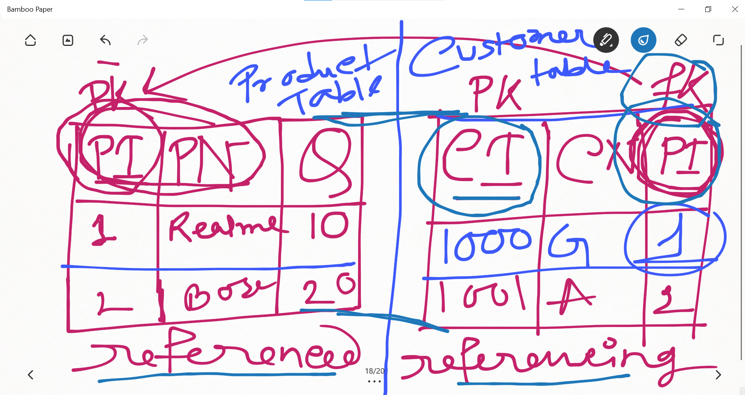

Slide 3
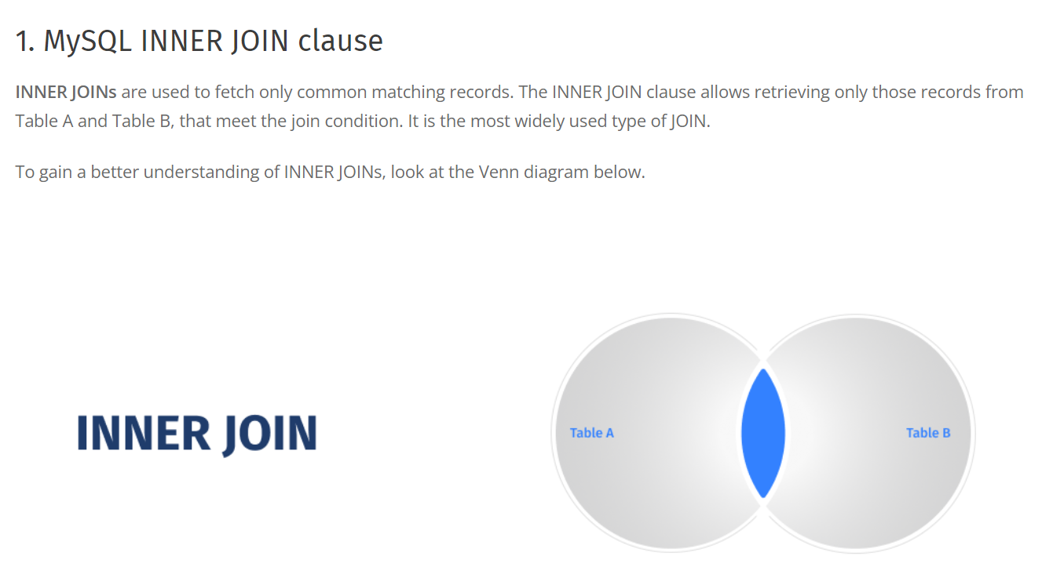

Slide 4


Slide 5
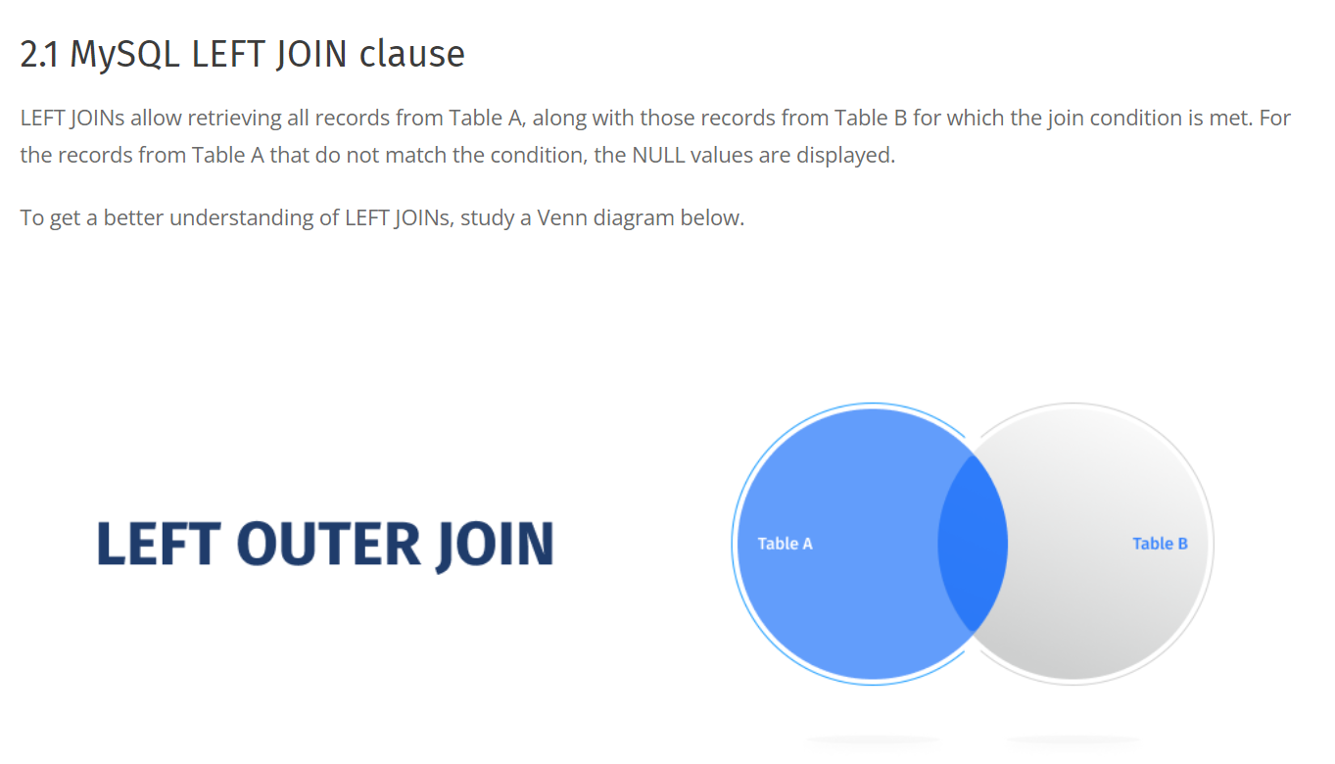

Slide 6
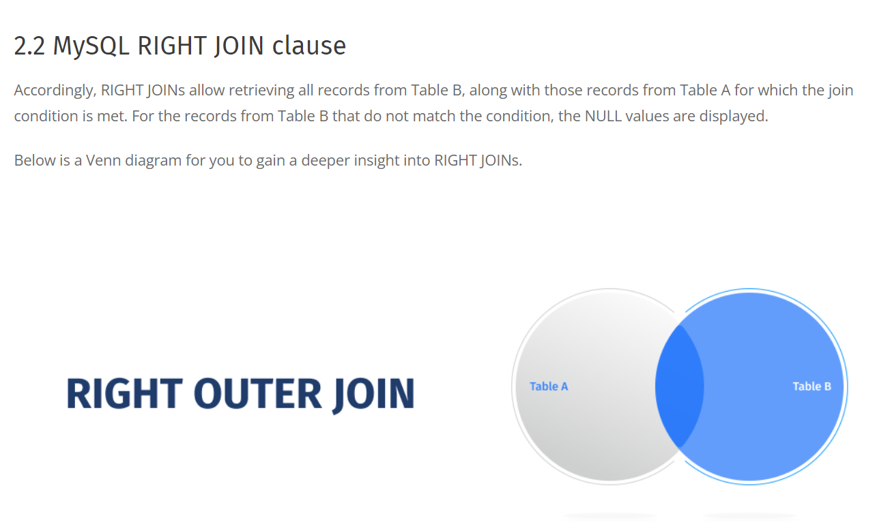

Slide 7
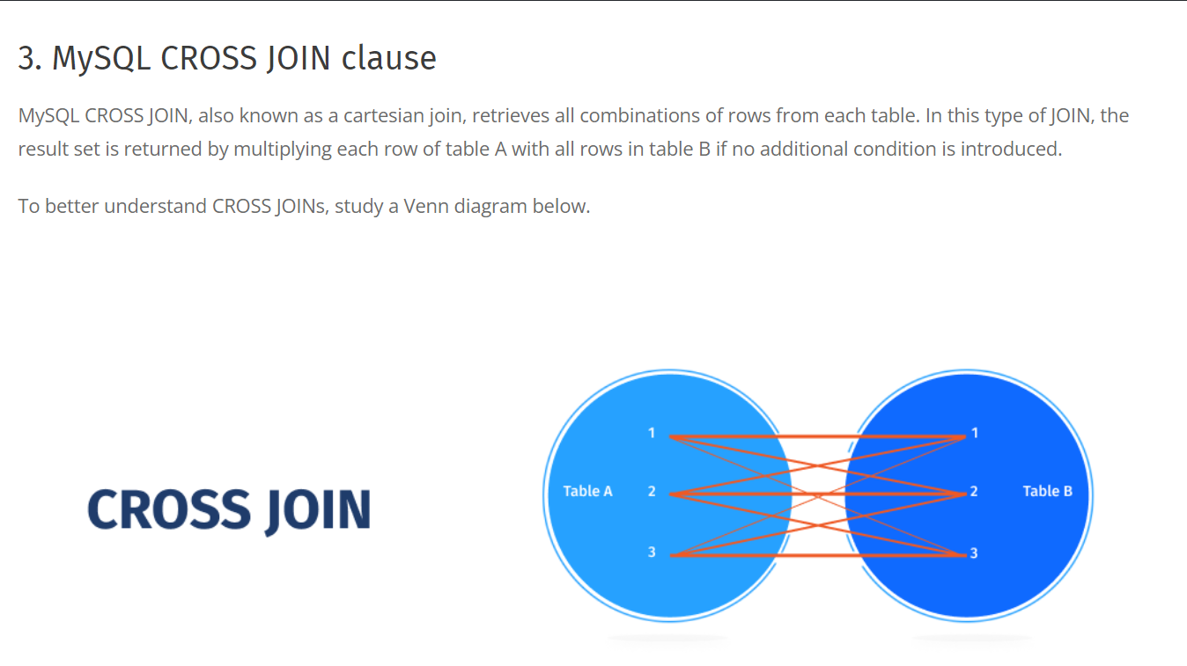

Slide 8
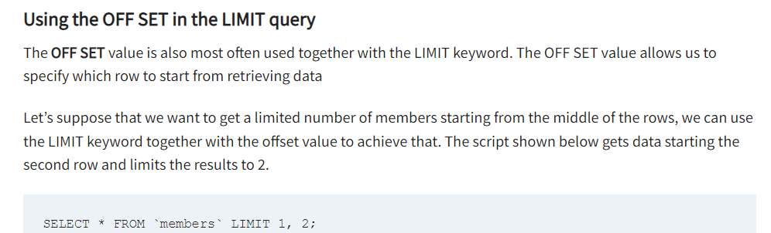
Note that here OFFSET = 1 Hence row#2 is returned & Limit = 2, Hence only 2 records are returned

