Slide 1
Attributes
Tuple~row~record
Fields ~ attribute
Simple Attribute – can’t be divided futher (fname, lname )
Composite attribute- collection of simple attributes(name)
Single valued – only one value can be assigned (age)
Multivalued – more than one value can be assigned(phone no)
Stored attribute- that can be stored (DOB)
Derived attribute – that can be derived from the stored (age)
Complex – both composite & multivalued (address)

Slide 2

Normalization
Data in Database is stored in terms of enormous quantity. Retrieving certain data will be a tedious task if the data is not organized correctly. With the help of Normalization, we can organize this data and also reduce the redundant data.
In brief, normalization is a way of organizing the data in the database. Normalization entails organizing the columns and tables of a database to ensure that their dependencies are properly enforced by database integrity constraints.
It usually divides a large table into smaller ones, so it is more efficient. In 1970 the First Normal Form was defined by Edgar F Codd and eventually, other Normal Forms were defined.

Slide 3
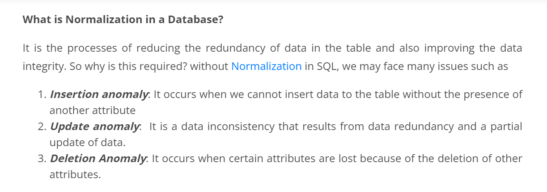
Anomalies

Slide 4
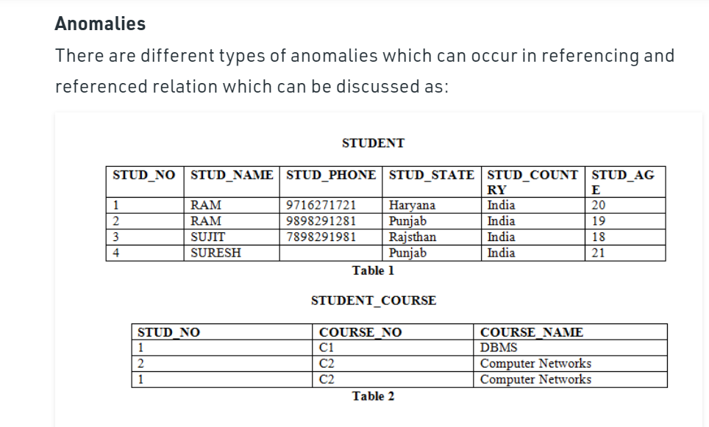

Slide 5

Insertion anomaly: If a tuple is inserted in referencing relation and referencing attribute value is not present in referenced attribute, it will not allow inserting in referencing relation. For Example, If we try to insert a record in STUDENT_COURSE with STUD_NO =7, it will not allow.
Deletion and Updation anomaly: If a tuple is deleted or updated from referenced relation and referenced attribute value is used by referencing attribute in referencing relation, it will not allow deleting the tuple from referenced relation. For Example, If we try to delete a record from STUDENT with STUD_NO =1, it will not allow. To avoid this, following can be used in query:
ON DELETE/UPDATE SET NULL: If a tuple is deleted or updated from referenced relation and referenced attribute value is used by referencing attribute in referencing relation, it will delete/update the tuple from referenced relation and set the value of referencing attribute to NULL.
ON DELETE/UPDATE CASCADE: If a tuple is deleted or updated from referenced relation and referenced attribute value is used by referencing attribute in referencing relation, it will delete/update the tuple from referenced relation and referencing relation as well.

Slide 6
Normalization
Normalization is the process of organizing the data in the database.
Normalization is used to minimize the redundancy from a relation or set of relations. It is also used to eliminate the undesirable characteristics like Insertion, Update and Deletion Anomalies.
Normalization divides the larger table into the smaller table and links them using relationship.
The normal form is used to reduce redundancy from the database table.

Slide 7
1NF
In this Normal Form, we tackle the problem of atomicity. Here atomicity means values in the table should not be further divided. In simple terms, a single cell cannot hold multiple values. If a table contains a composite or multi-valued attribute, it violates the First Normal Form.

Slide 8
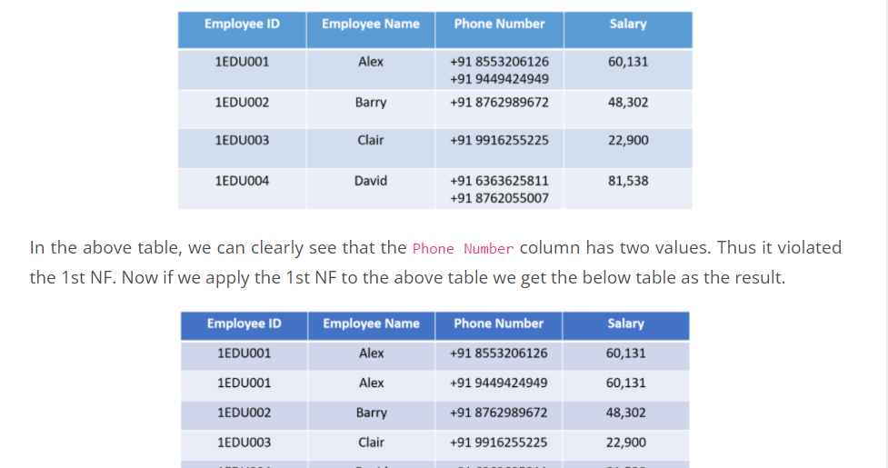
By this, we have achieved atomicity and also each and every column have unique values.

Slide 9
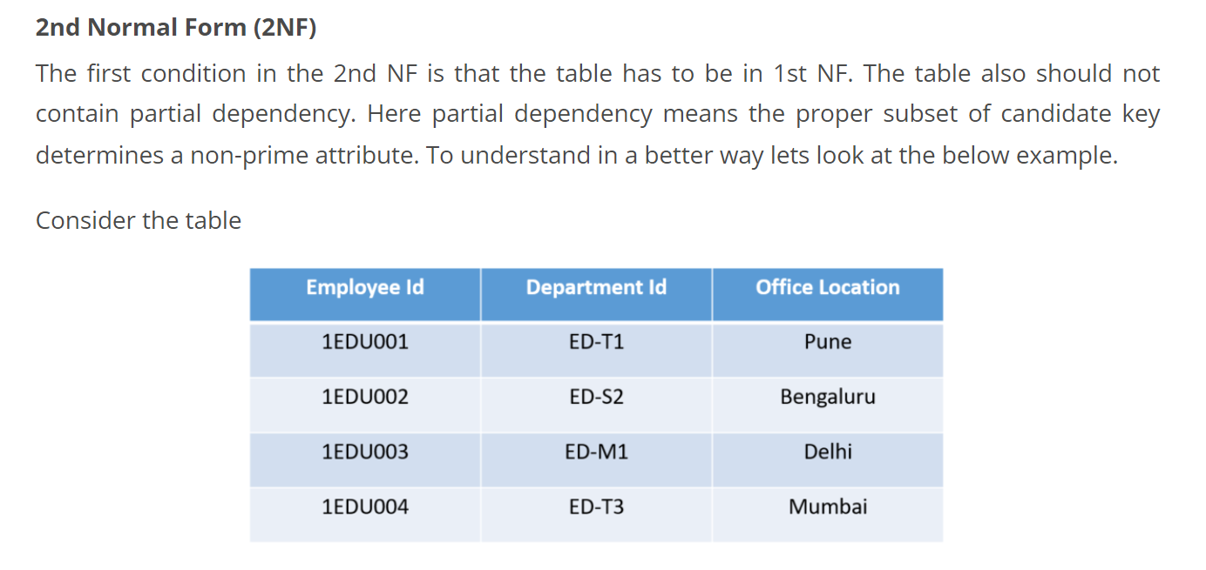

Slide 10
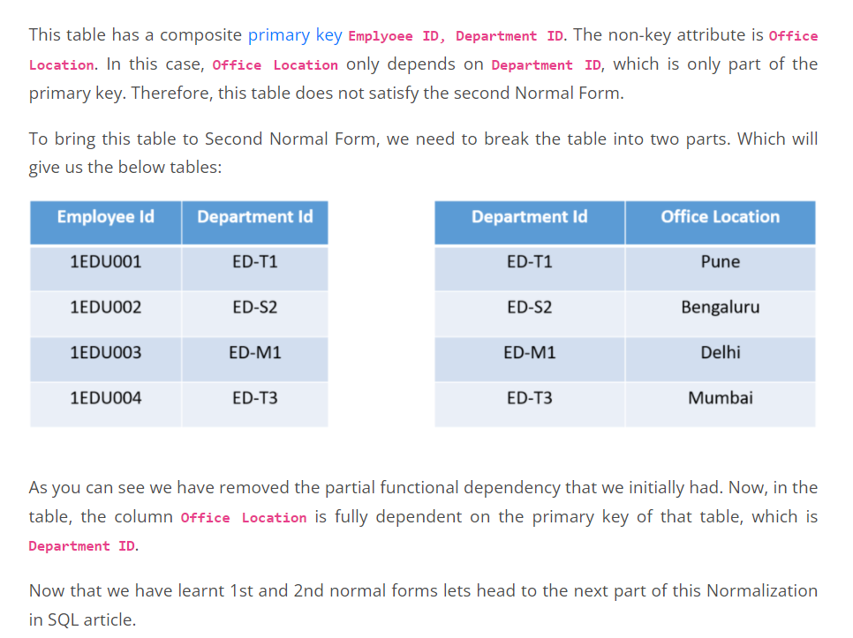

Slide 11
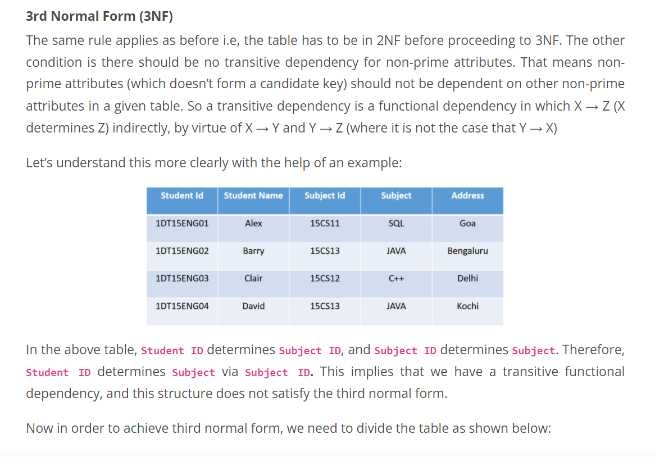

Slide 12
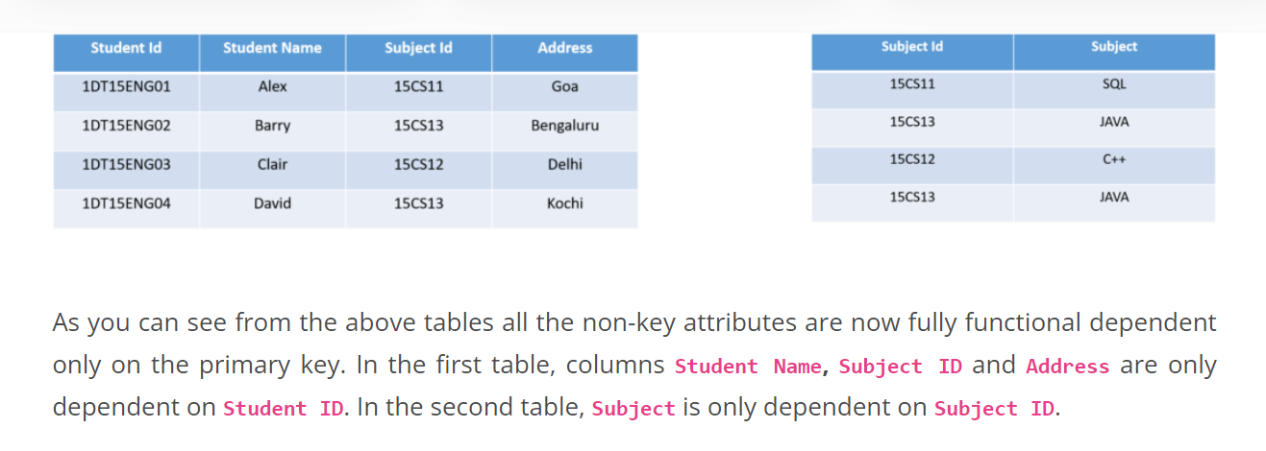

Slide 13
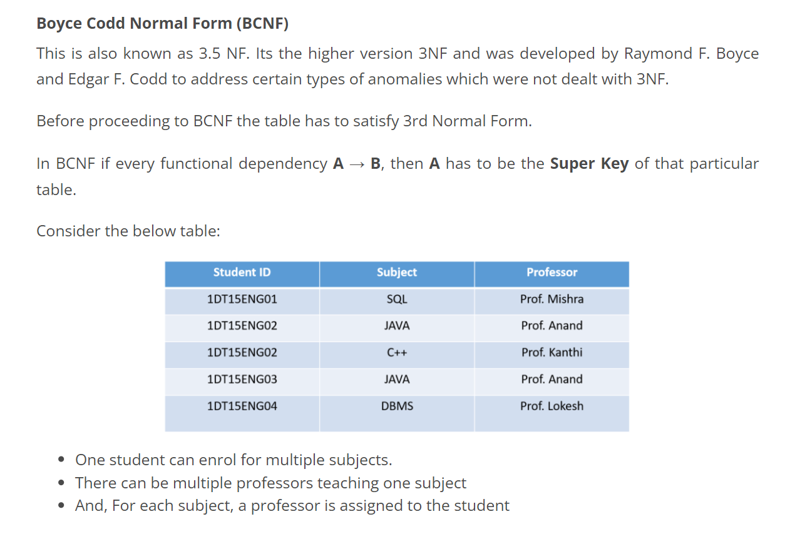

Slide 14
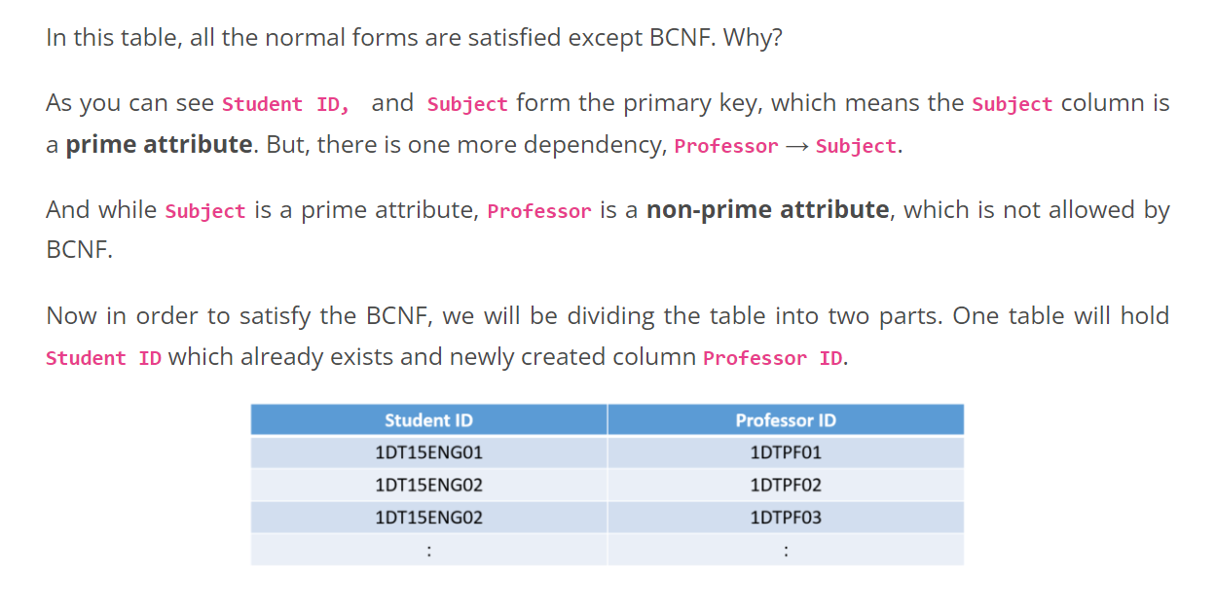

Slide 15
