Slide 1


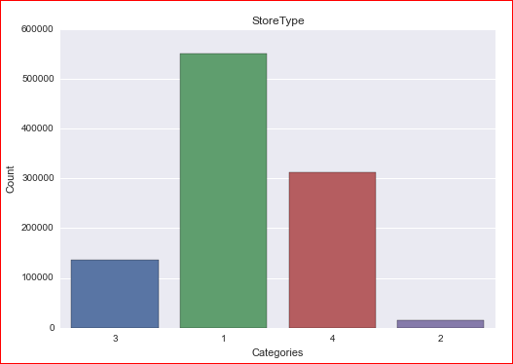
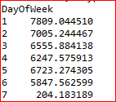
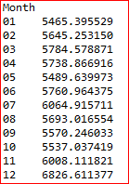


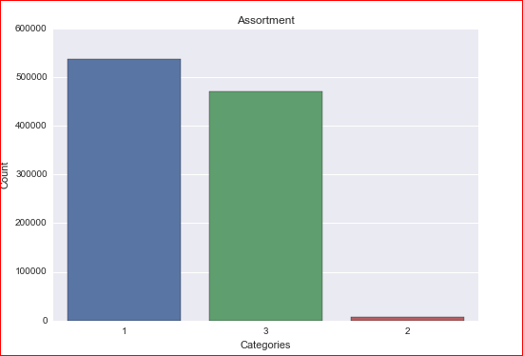
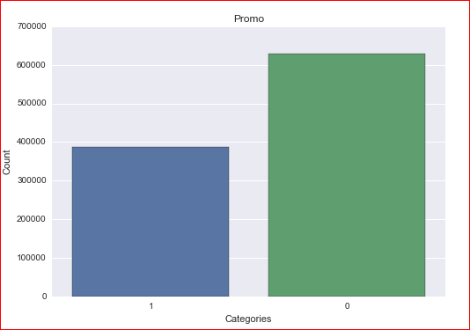
Rossmann Stores Sales Prediction
Raj Nikhil Choul, Subramaniam Ganesh Kumar, Subramanian Vellaiyan, Venu Guntupalli
Business Intelligence & Analytics
Introduction:
Rossmann operates over 3,000 drug stores in 7 European countries.
Managers art wants to predict the sales for 6 weeks in the 1,155 stores located across Germany.
The main aim is to build an automated robust model that predicts sales for the managers.
Data Set:
The dataset was downloaded from kaggle website.
The dataset consist of test (historical data without sales), train (historical data with sales) and store (consists of master information for the stores).
Train dataset has 9 columns and the store dataset has 9 columns
Data Transformation:
The columns StateHoliday , StoreType, Assortment and PromoInterval, originally nominal variables were transformed to a dichotomous categorical variable.
After the transformation the categorical variables were feature engineered into new variables for the model.
Original StateHoliday Variable was removed and four new binary variables (SateHoliday0, StateHolidayA, StateHolidayB, StateHolidayC) were added to the model.
The column Date was transformed into months and weeks. Each month and week were created as a separate binary columns.
The missing values in the columns such as PromoInterval, which means that there are no promotions in the store currently were filled with 0s.
Model:
The target variable ,sales, is a continuous variable.
We used OLS regression , Random Forest and CART to build the model to predict the sales from August-1-2015 to September-17-2015.
Linear models:
Initially , linear models were built for the prediction.
OLS, Ridgecv and Bayesian models were implemented.
It is worthy to note that Bayesian has the least error with 0.40
CART:
We used all the featured engineered variables.
Store, Year Ids that were irrelevant to the model were removed form the model.
The CART had an error value 0f 0.19. This can be attributed to the featured engineering since it created many relevant decision rules based on the variables.
Ensemble:
We used two methods : Gradient Boosting and Random Forest.
Comparatively Random Forest performed better among the two.
Random Forest Had an accuracy of 0.1757 with 10 Estimators and an accuracy of 0.1751 with 25 estimators
Methodology:
The train and the store data sets were merged using left join to form a master data set.
The join was based on the store id which uniquely identifies each store.
Each store’s individual data such as Store type, Assortment , Competition, Promotion etc. were mapped to each transaction in the training and test data sets.
Exploratory Data Analysis :
Store type 2 has the maximum average sales among the store types.
It is also interesting to note that the store type 2 has the least number of stores
Day 1 has the maximum average sales among the Day types and 7 has the least.
Months overall have same average except for spikes in July, November and December
Assortment type2 has the maximum average sales but implemented in fewer stores than 1 and 3
When there is a promotion the average salary goes up as expected
Conclusion:
We noted that the variable Open determines that sale of the store.
Store type B together with Day 7 of Week is important for determining the sales of the store.
Promotion and the competition distance influences the sales of the stores.
http://www.stevens.edu/howe/academics/graduate/business-intelligence-analytics

