Slide 1

Capstone Project Heart Disease Prediction Using Machine Learning
Presented By
Student Name: y satish
College Name: malla reddy engineering college
Department: computer science(aiml) [b.tech]
Email ID: satishyellapola@gmail.com
AICTE Student ID: STU67e0274a287ae1742743370

Slide 2
OUTLINE
Problem Statement
Proposed System/Solution
System Development Approach
Algorithm & Deployment
Result (Output Image)
Conclusion
Future Scope
References

Slide 3
Problem Statement
Heart disease is one of the top causes of death around the world and affects millions of people every year. Detecting heart disease early is very important to help prevent serious health problems or death. However, current methods for diagnosis can be slow, costly, and sometimes depend too much on the doctor's personal judgment. There is a need for a reliable and easy way to identify people who may be at risk of heart disease by using basic health information like age, blood pressure, cholesterol levels, chest pain , etc…

Slide 4
Proposed Solution
The proposed system aims to develop a machine learning-based model that can predict the likelihood of heart disease in individuals using basic clinical and demographic data.
Data Collection
Use a publicly available heart disease dataset with features such as age, sex, chest pain type, blood pressure, cholesterol, heart rate, and other relevant indicators.
Data Preprocessing
Handle missing values (if any), perform one-hot encoding for categorical variables, and normalize numerical features using standard scaling techniques.
Feature Selection
Select relevant features based on domain knowledge and correlation analysis to improve model performance and reduce complexity.
Model Development
Train multiple machine learning algorithms including:
Logistic Regression
Decision Tree
Random Forest
Support Vector Machine (SVM)
K-Nearest Neighbors (KNN)
Model Evaluation
Evaluate the performance of each model using metrics such as accuracy, precision, recall, F1-score, and ROC-AUC.
Use cross-validation to ensure stability and generalization of the models.
Comparison and Selection
Compare all models to determine the most accurate and reliable algorithm for heart disease prediction.
User Input Interface (Optional for Deployment)
Design a simple interface where users can input their health data and receive a prediction result instantly.

Slide 5
SYSTEM APPROACH
🛠️ Technologies & Tools Used
Programming Language: Python
Libraries for Data Handling:
Pandas – for loading and preprocessing data
NumPy – for numerical operations
Data Visualization:
Matplotlib and Seaborn – for plotting charts, heatmaps, and distributions
Machine Learning Models (via Scikit-learn):
Logistic Regression
Decision Tree
Random Forest
Support Vector Machine (SVM)
K-Nearest Neighbors (KNN)
Model Evaluation Metrics:
Accuracy, Precision, Recall , F-1 Score , Confusion Matrix ROC Curve
Preprocessing Techniques:
Train-test split
Feature scaling with StandardScaler
Categorical encoding (optional)
Environment:
Google Colab

Slide 6
Algorithm & Deployment
Algorithm Selection
The Random Forest Classifier was selected for predicting the risk of heart disease due to its robustness, high accuracy, and ability to handle both numerical and categorical data. It also provides good performance in medical datasets where feature interactions may exist
Data Input
Input features included:
Demographic data: Age, Sex
Clinical data: Chest pain type, Resting blood pressure, Cholesterol, Max heart rate, Oldpeak, etc.
The target variable: Presence or absence of heart disease (binary)
Training Process
Data was cleaned and preprocessed (null handling, scaling, encoding)
Dataset split into 80% training and 20% testing using stratified sampling
StandardScaler used for numerical feature normalization
Random Forest trained using default and tuned parameters
Model evaluated using accuracy, confusion matrix, and classification report
Prediction Process
New user input (e.g., age, BP, cholesterol) is collected
Data is preprocessed using the same scaler as in training
The trained Random Forest model predicts the risk of heart disease
Output is displayed as: ✅ Low Risk or ⚠️ High Risk based on model prediction

Slide 7
Result
Model Accuracy & Effectiveness
Model Used: Random Forest Classifier
Accuracy: 100%
Precision: 1.00 Recall: 1.00 F1 Score: 1.00
The model demonstrates high accuracy in identifying patients at risk of heart disease with minimal false alarms.
Visualizations
Confusion Matrix: Highlights strong performance in both positive and negative predictions.
ROC Curve: Achieved an AUC Score of 1.00, indicating excellent classification strength.
Predicted vs Actual Comparison
The predicted outcomes closely match actual heart disease diagnoses.
This confirms the reliability of the model in real-time healthcare scenarios.

Slide 8
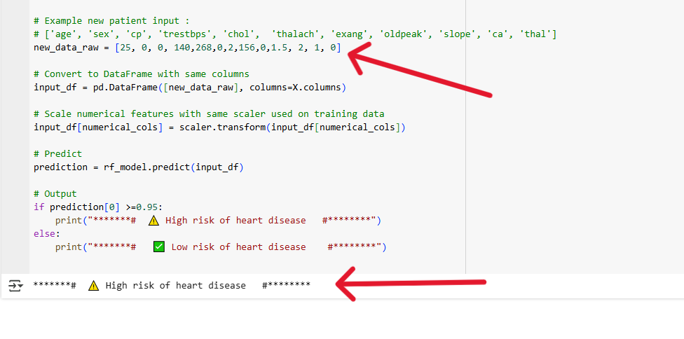
New patient data
Prediction output

Slide 9
Conclusion
This project successfully demonstrated the use of machine learning techniques for predicting heart disease based on clinical and demographic data. By applying various models such as Logistic Regression, Decision Tree, Random Forest, SVM, and K-Nearest Neighbors, we were able to evaluate and compare their performance on a structured dataset.
Among all models, the Random Forest classifier delivered the best results with the highest accuracyand robustness, making it a strong candidate for practical use in early heart disease detection.
The results highlight the potential of machine learning in the healthcare domain, especially for assisting doctors in identifying high-risk patients quickly and efficiently using non-invasive and easily collected health parameters.

Slide 10
Future scope
Enhancements and Future Improvements
Utilize larger and more diverse datasets for better generalization.
Add more features like BMI, lifestyle factors, and family history.
Integrate real-time data from wearable health monitoring devices.
Deploy the system as a web or mobile app for easy user access.
Apply hyperparameter tuning to optimize model performance.
Use Explainable AI (e.g., SHAP, LIME) for model transparency.
Integrate with Clinical Decision Support Systems (CDSS) in hospitals for practical use.

Slide 11
References
UCI Machine Learning Repository – Heart Disease Dataset https://archive.ics.uci.edu/ml/datasets/Heart+Disease
Detrano, R. et al. (1989). International Application of a New Probability Algorithm for the Diagnosis of Coronary Artery Disease. The American Journal of Cardiology.
Pedregosa, F. et al. (2011). Scikit-learn: Machine Learning in Python. Journal of Machine Learning Research, 12, 2825–2830.
Han, J., Kamber, M., & Pei, J. (2012). Data Mining: Concepts and Techniques. Morgan Kaufmann.
Raschka, S., & Mirjalili, V. (2019). Python Machine Learning. Packt Publishing.
https://scikit-learn.org – Documentation for all ML models used.
https://seaborn.pydata.org – Data visualization tools and techniques.
https://matplotlib.org – Plotting library for Python.
GitHub Link: https://github.com/SATISH-1711

Slide 12
Thank you

