Slide 1
Pneumonia Detection
Team
Subhankar Paul
Kunal Patil
Srinivas Dama
Manesh Nambiar

Slide 2
Problem Statement
. Pneumonia is an infection in one or both lungs.Bacteria,viruses,and fungi cause it.
. Usually it is diagnosed by using chest X-rays(CXRs)
What problem we are going to address?
. Highly trained specialists are required to review CXRs
. Clinicians are faced with reading high volumes of images every shift
Solution:
. Build an algorithm to automatically locate lung opacities on chest X-rays
What we are going to achieve?
. Assist physicians to make better clinical decisions or even replace human judgement in certain functional areas of healthcare (eg radiology)

Slide 3
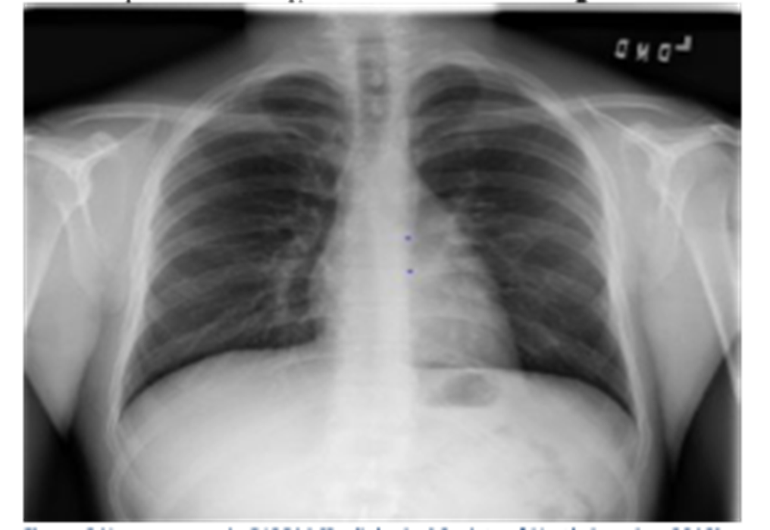
Pneumonia
. Inflammatory condition of the lung affecting primarily the small air sacs known as alveoli
. Illness affecting approximately 450 million people a year
. Yearly 4 million deaths(7% of total deaths)
. In adjacent images, Air indicated by black color,bones are the white color, tissues and fluids are grey
Pneumonia DICOM | Non-pneumonia DICOM

Slide 4
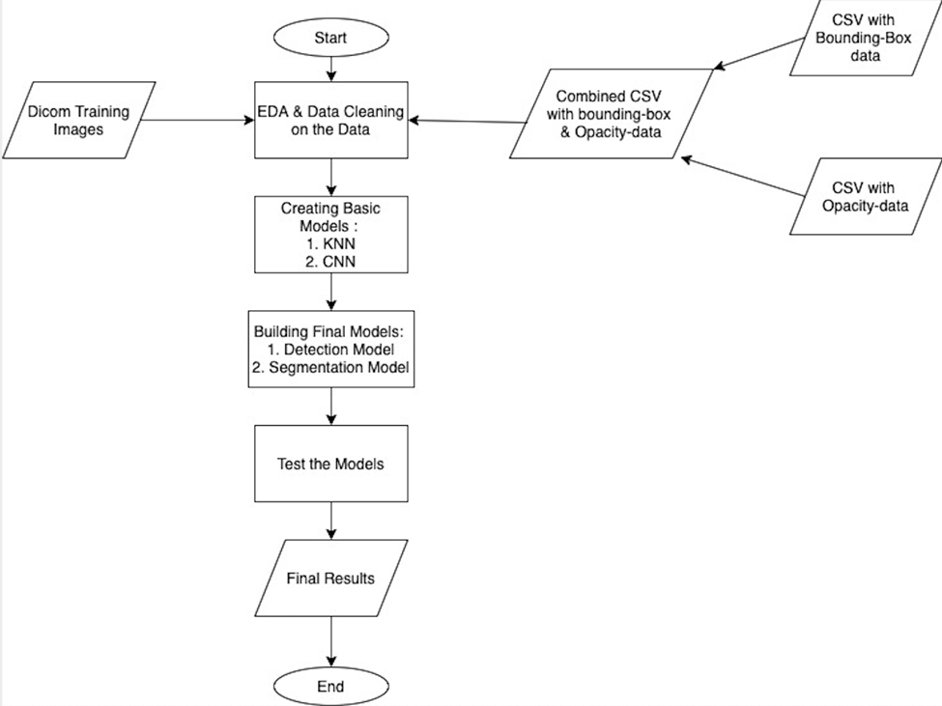
EDA

Slide 5
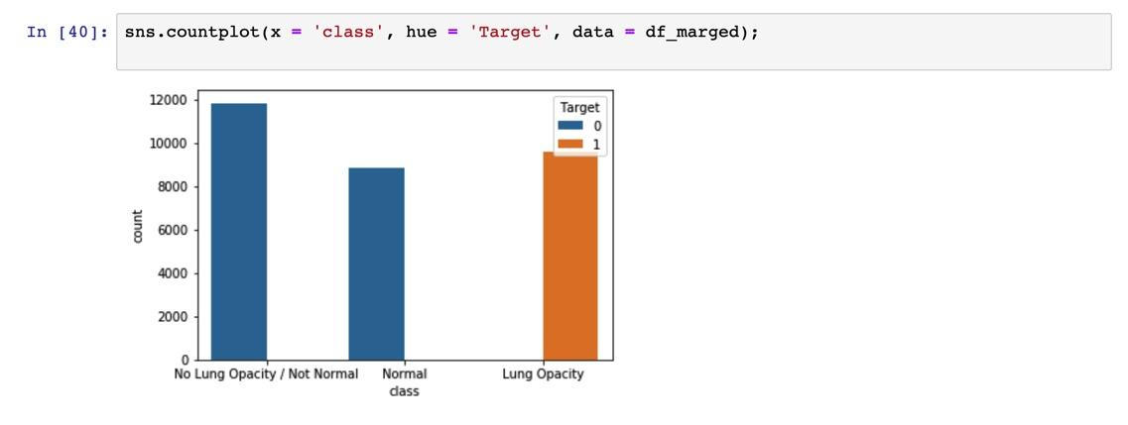

EDA..(univariate analysis)

Slide 6
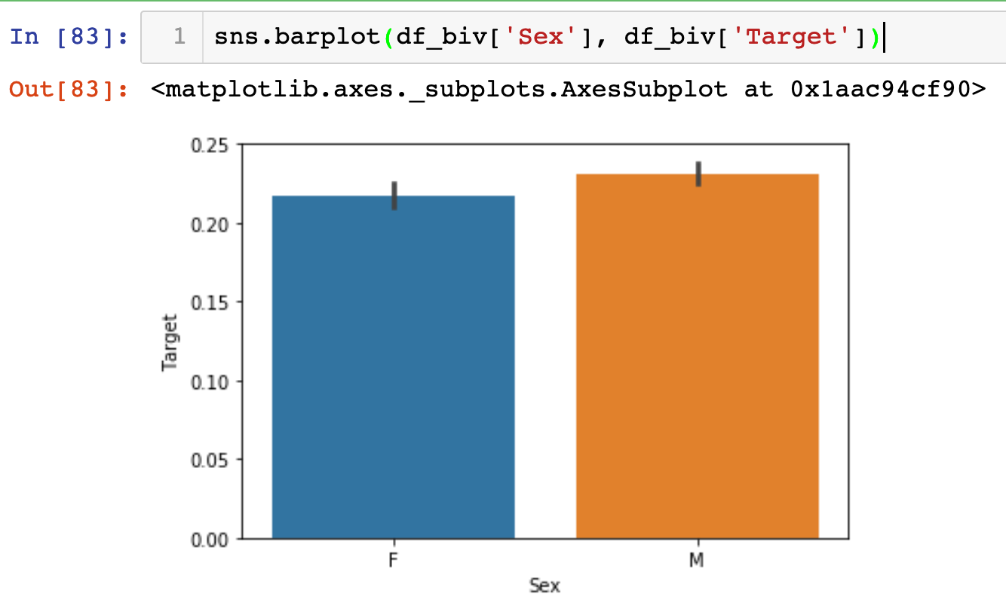
EDA..(Bivariate Analysis)

Slide 7
Model Building
Machine learning Model
Neural network model
KNN model is used to build a classification model which can be used predict if the patient has pneumonia or not
KNN model was built by resizing the image 100x100 array of pixels
Achieved score of 78% in predicting the presence of pneumonia
Tried with different models
Unet is the final model selected.

Slide 8
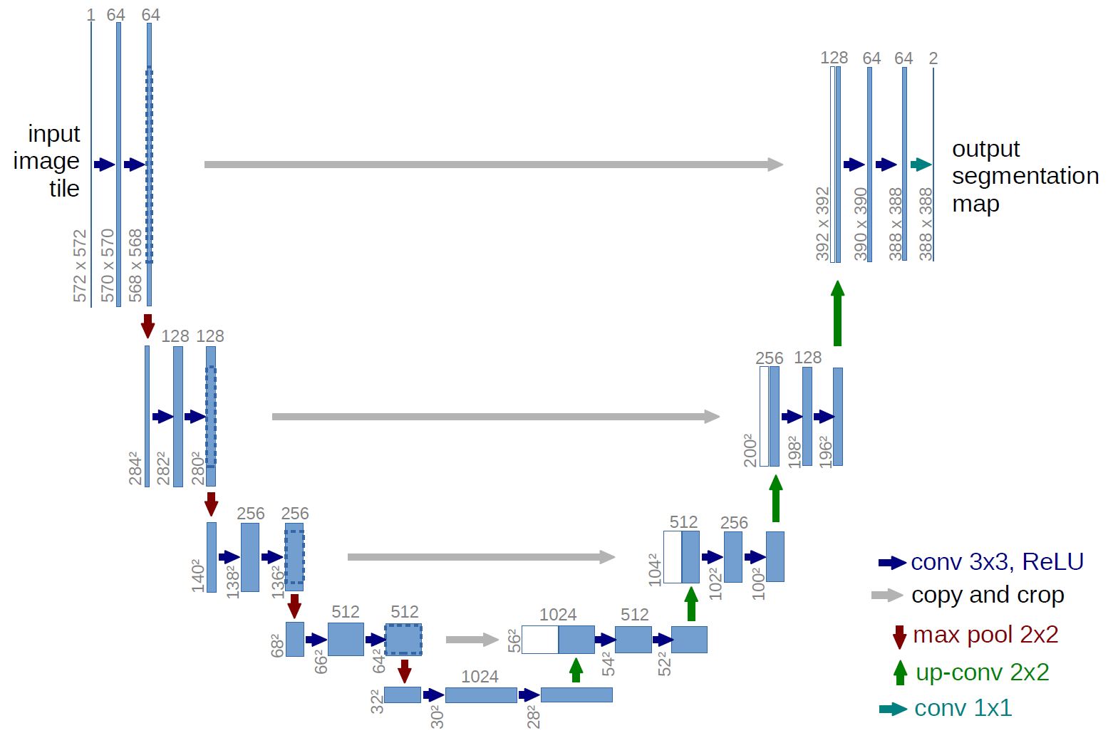
Unet architecture
. The architecture looks like a ‘U’ which justifies its name
. Consistes of 3 sections namely The contraction, The bottleneck, and the expansion section
.

Slide 9
Thank you…
References
America, R. S. (2018, August 27). Retrieved from RSNA Pneumonia Detection
Challenge: https://www.kaggle.com/c/rsna-pneumonia-detection-challenge
Colaboratory. (2017). Retrieved from https://colab.research.google.com
Karpathy, A. (2018). CS231n: Convolutional Neural Networks for Visual Recognition. Retrieved from http://cs231n.stanford.edu/

