Slide 1




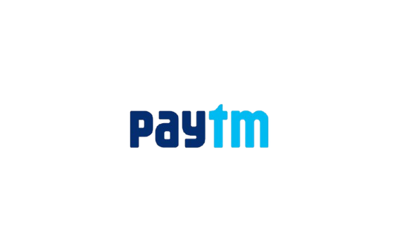








MANIPAL
  ACADEMY OF HIGHER EDUCATION
  Institution of Embrace Diamant in the University
HackSprint
24-Hour Hackathon
17-18
VENUE DETAILS
Manipal Academy of Higher Education (MAHE)
SATURDAY
OCTOBER
09 A.M. Onwards
TEAM NAME: JUGAAD CODERS
TEAM MEMBERS: SATVIK PANDEY (LEADER) | PARTHAV U | VEDANT J
TRACK NO: 1 , PS 21 : FINTECH & COMMERCE
REGISTER NOW
Team Size
1-4 Members
ORGANIZED BY:
MANIPAL
  ACADEMY OF HIGHER EDUCATION
  Institution of Embrace Diamant in the University

Slide 2
Solution
STOCKOUT FIREWALL — AI procurement & fulfillment resilience network for India's small merchants
THE PROBLEM
OUR SOLUTION: ONE BASKET, ONE RESILIENT PLAN
WHAT MAKES US DIFFERENT
• Merchant = manual supply-chain coordinator: one wholesaler for rice, one for oil, one for biscuits
• Supplier runs out, changes price or delivers late: needs 100 kg, only 40 kg exists
• Result: many calls, split orders, 3 deliveries, 3 payments
• Shortage found only after stock is low = lost sales
• Speak or type the full need on WhatsApp / voice in Hindi, Kannada, Tamil, Telugu, Bengali or code-mixed speech
• AI builds a structured basket; optimizer picks suppliers on price, reliability, MOQ, location, terms, delivery
• Supplier fails? Backup activated, route re-optimized automatically
• One confirmation · one payment · one fulfillment
Existing tools
Find → Order → Receive
Stockout Firewall
Understand → Predict → Source → Optimize → Consolidate → Monitor → Failover → Re-optimize → Fulfill
Udaan, Jumbotail, ONDC, PANTR digitize ordering; we continuously re-solve allocation when reality changes.
“When one supplier fails, the merchant shouldn't.”
Innovation: dynamic procurement & fulfillment resilience, like cloud failover, but for fragmented wholesale supply. Not just another ordering app.
3m 18s
1.2
96→91→95%
₹680
procurement time
trips per order
fulfillment confidence
saved on test basket

Slide 3
Tech Stack & Architecture
Design principle: LLM understands & calls tools · Database gives facts · Optimizer decides · Rules authorize · Payment executes
MERCHANT
WhatsApp / Voice · natural speech in any Indian language
TECH STACK
Frontend
React / Next.js
Backend
FastAPI
INDIC LANGUAGE LAYER
Sarvam ASR → code-mix detect → intent → SKU / brand / pack normalization → structured basket
Database
PostgreSQL
Events / cache
Redis
AI / language
Sarvam APIs + LLM
AI ORCHESTRATOR (single agent, tool-calling)
Intent → policy check → deterministic tool → audit log. LLM never decides price, stock or payment.
Optimization
Google OR-Tools / CP-SAT
ML
LightGBM / XGBoost
INTELLIGENCE & OPTIMIZATION
Supplier Intelligence (stock, price, MOQ, reliability) · Procurement Optimizer (landed cost, risk, failover, cash) · Fulfillment Optimizer (milk-run, capacity, windows)
Maps
Google Maps / Mapbox
Messaging
WhatsApp Business API / simulator
Payments
UPI sandbox (Razorpay test)
EXECUTION
Merchant approval → UPI payment → supplier orders → pickup / delivery → monitoring → replan
Deploy
Docker + cloud
Agent tools: get_inventory · optimize_basket · optimize_route · replan_order — every action policy-checked and audit-logged.

Slide 4
Optimization & Failover Engine
Optimization, not prompting: minimize total landed cost, then keep the plan alive when suppliers fail
TOTAL LANDED-COST OPTIMIZER
SUPPLIER FAILOVER: THE CENTRE OF THE SYSTEM
Minimize: product + delivery + delay penalty + failure risk + supplier-count penalty + liquidity cost
Subject to: stock, MOQ, budget, vehicle capacity, time windows, supplier hours, merchant policy
Reliability-aware: ₹2/kg cheaper can cost more after delay + failure risk
Cash-aware: immediate vs 7-day terms
Need
100 kg rice
A confirms
100 kg
A has only
40 kg
Shortfall
60 kg
B 40 kg
+ D 20 kg
Route
re-optimized
Cheapest
₹18,050
Risk: HIGH
Balanced
₹18,420
Risk: LOW
Fastest
₹18,760
1 hour earlier
No restart for the merchant. If nobody can fill the basket, the system says so: “80/100 kg available; substitute or 2 h delay?” It never hallucinates fulfillment.
DELIVERY OPTIMIZATION (OR-TOOLS) + FULFILLMENT CONFIDENCE
• Direct, consolidated milk-run, or multiple deliveries: chosen per order
• Live re-planning when a supplier is delayed
• Test data: 3 deliveries ₹19,100 → 1 route ₹18,420 (₹680 saved)
96%
Plan
91%
A fails
95%
Backup live

Slide 5
Data Flow Diagram
Event-driven order lifecycle with a failure loop at every stage
ORDER_​CREATED
ORDER_​PARSED
SUPPLIERS_​DISCOVERED
ALLOCATION_​GENERATED
DELIVERY_​PLAN
MERCHANT_​APPROVAL
PAYMENT_​CONFIRMED
SUPPLIER_​CONFIRMED
PICKUP
DELIVERY
COMPLETED
FAILURE LOOP
shortfall · rejection · delay at any stage
SUPPLIER_​SHORTFALL
REPLAN
NEW_​SUPPLIER_​SELECTED
ROUTE_​REOPTIMIZED
MERCHANT_​UPDATED
CORE DATA MODEL
GUARDRAILS: CONTROLLED AGENTIC COMMERCE
Merchant
Product
Supplier
Intent → policy check → tool → audit log
Merchant-set limits: budget, price tolerance, minimum reliability, auto-failover ON, auto-substitution OFF
Every decision explainable: reliability, distance, terms, landed-cost gap
SupplierInventory
Order / OrderItem
Allocation
DeliveryPlan
SupplierEvent
Payment

Slide 6
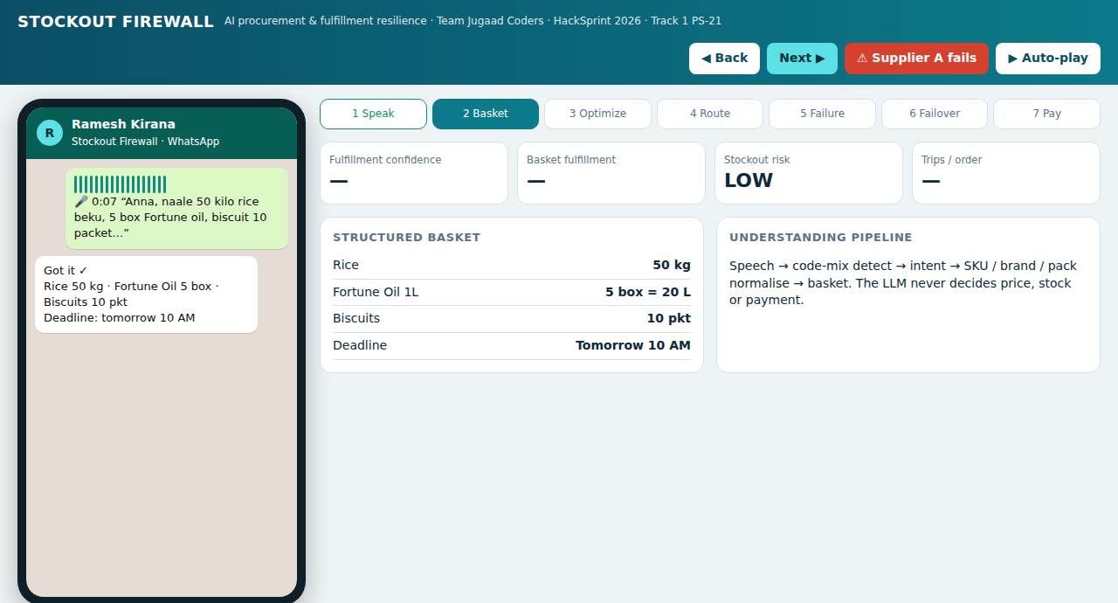
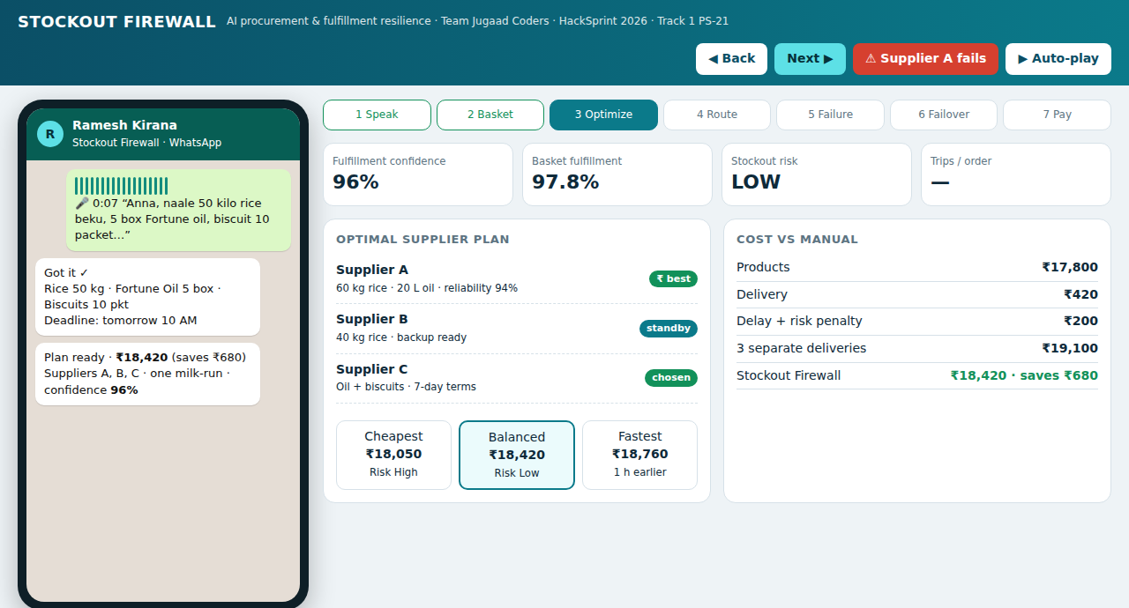
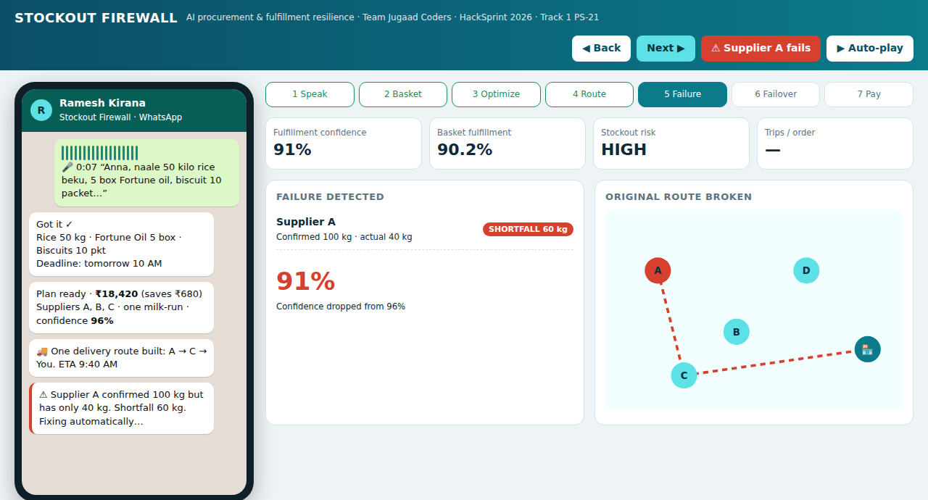
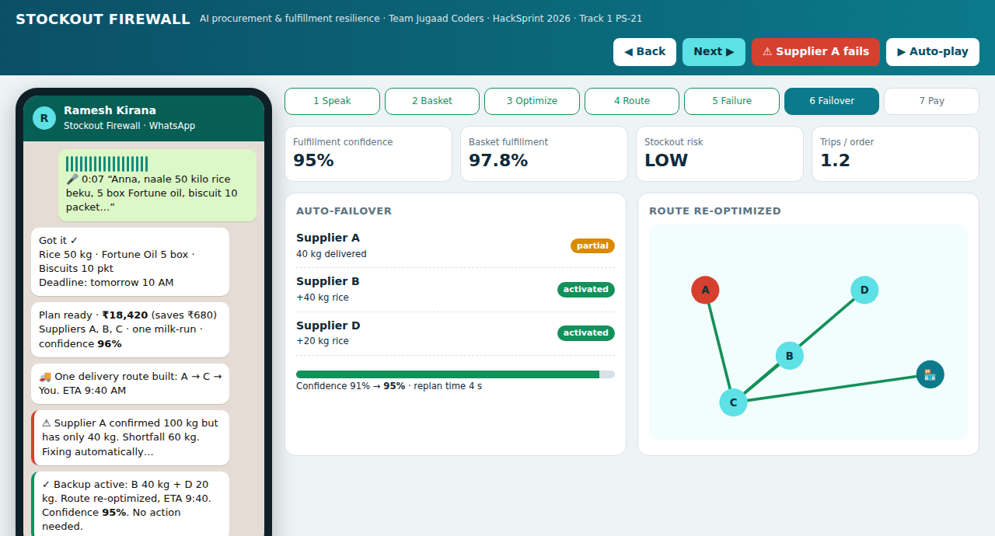
Screenshot of Your Project
Real prototype UI: WhatsApp merchant app + control tower. Suppliers, stock and payments are simulated; optimizer and AI calls are real.
LIVE DEMO
Interactive prototype: click through voice → plan → failure → recovery.
▶Watch Live Demo
1 · Voice order → parsed basket
2 · Optimal plan: ₹19,100 → ₹18,420
DEMO VIDEO (3 MIN)
3-min captioned walkthrough: voice order to failover to payment.
🎬 WATCH DEMO VIDEO
3 · Supplier A fails: shortfall 60 kg
4 · Auto-failover + route re-optimized
Control tower: fulfillment 97.8% · stockout risk LOW · 1.2 trips/order · reliability 94% · procurement 3m 18s

Slide 7
Others
Targets below are pilot hypotheses to be measured, not achieved results
50–70%
less procurement time
>95%
basket fulfillment
20–30%
fewer stockout lost sales
15–30%
fewer fragmented trips
3–8%
lower landed cost
BUSINESS MODEL & PILOT
EVALUATION
DIFFERENTIATION
• Transaction fee on fulfilled orders
• Subscription: predictive stockout, analytics, policies
• Logistics margin; later regulated financing partners
• Pilot: 1 micro-market · 20 merchants · 10–20 suppliers · 3–5 km
Baselines: nearest, cheapest, single-supplier, manual / random
Metrics: cost, distance, deliveries, fulfillment, deadline success, failure-recovery time
Ours: joint procurement + routing → lowest landed cost, fewest trips, automatic recovery
Udaan, Jumbotail, ONDC, PANTR digitize find → order → deliver.
We continuously re-solve allocation and fulfillment as conditions change.
Next: predictive stockout, collective procurement, “supply-chain weather forecast”
ROADMAP
One micro-market
Bengaluru clusters
City supplier graph
Multi-city network
Demand intelligence
Team Jugaad Coders · Satvik Pandey · Parthav U · Vedant J | Track 1 · PS-21 | Full Technical Documentation (PDF) available

