Slide 1

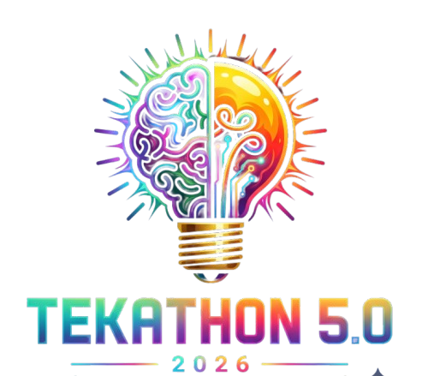
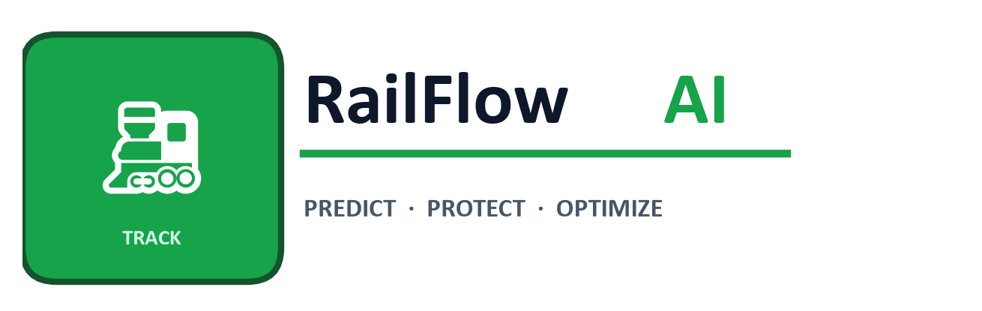
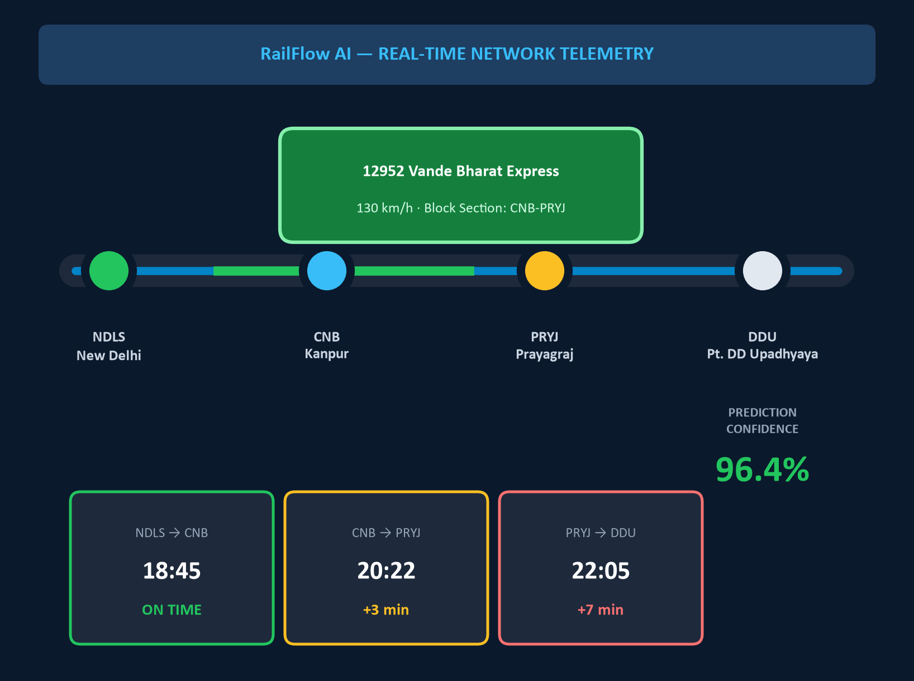


TEKATHON-5.0- 2026
Problem Statement ID – 26028
Problem Statement Title – Dynamic Forecast of Expected Time of Arrival (ETA) for Coaching Trains
Theme – Smart Automation
PS Category – Software
Ministry – Ministry of Railways / Indian Railways
Team Name – HelloWorldWarriors

Slide 2
RailFlow AI | Real-Time Locomotive GPS → Track Graph AI → Dynamic ETA & Platform Protector
PROPOSED SOLUTION
• Live GPS + signal aspects + track congestion fused into spatial railway graph
• Dynamic ETA recalculation every 30 seconds based on live track reality
• Probabilistic arrival bounds: e.g. 18:45 ± 4 mins at high confidence
• Synchronized feed to Passenger App, Station Master & Section Controller
HOW IT SOLVES THE PROBLEM
• Today (NTES): static formula — Schedule + Delay − Slack. No track awareness.
• Fails during cascading delays, slow preceding trains, junction congestion
• Prediction error: drastically reduced from ~30 mins to < 4 mins
• Anticipates priority overtakes & signal halts before they happen
INNOVATION & UNIQUENESS
• "Why is my train late?" — plain-language delay attribution for passengers
• Platform Clash Protector: 60-min warning when 2 trains target same platform
• Dispatcher “What-If” Simulator: test routing decisions before executing
• Zero extra hardware — uses existing ISRO NavIC / CRIS RTIS GPS devices
OUR TECHNICAL EDGE
Spatial Track Graph + Multi-Factor LightGBM ML + Real-Time Platform Clash Resolver Static NTES and standard tracking apps deliver none of these three capabilities.

Slide 3
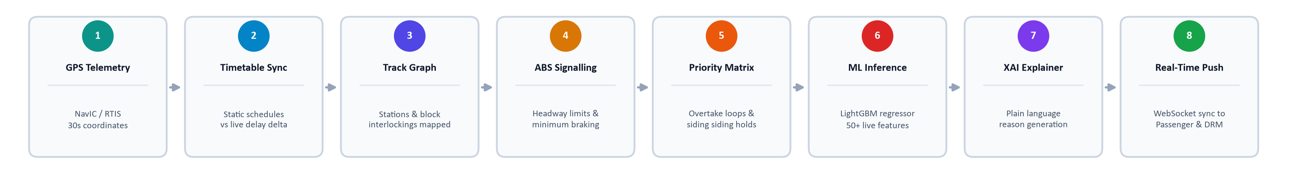
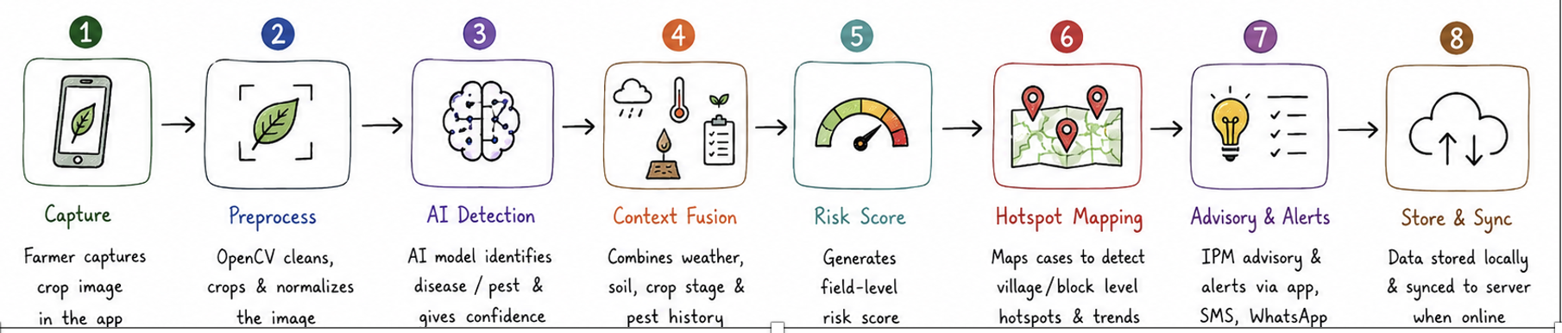
TECHNICAL APPROACH
TECH STACK React.js / TailwindCSS · Python + FastAPI (Async) · WebSockets · LightGBM Regressor · NetworkX (Spatial Graph) · PostgreSQL + PostGIS · Open-Meteo Free Weather API
1 Ingest & Telemetry
ISRO NavIC / CRIS RTIS locomotive GPS stream (30s) + Open-Meteo live weather + TSR caution orders
2 Spatial Track Graph
NetworkX directed railway graph — Stations = Nodes, Block Sections = Weighted Edges
3 Kinematics & Headway
Rake traction physics (WAP-7, LHB) + Automatic Block Signaling block-headway constraints
6 Alerts & Dashboards
Sub-second WebSocket push to Passenger App, Station Master screen & DRM Control Room
5 LightGBM ETA Engine
Multi-horizon delay regression with probabilistic bounds (±4 min) using 50+ live features
4 Priority & Overtakes
Detects trailing Rajdhani / Vande Bharat and pre-calculates loop-line siding wait times
Steps 1–5 process 10,000+ trains with sub-15ms latency — entire pipeline runs on free open-source stack

Slide 4
FEASIBILITY AND VIABILITY
Zero Extra Capex
100% software overlay — plugs directly into existing CRIS RTIS / ISRO NavIC GPS infrastructure
10,000+ trains / 17 Zones
Async microservices handle nationwide real-time operations in under 20ms per section
Proven ML Approach
Gradient Boosted Trees (LightGBM) are industry-standard for real-time tabular dispatch
RISKS & MITIGATION
Risk / Challenge | Mitigation Strategy
GPS signal lost in tunnels or remote hill sections | Physics-based Dead-Reckoning: uses last known speed, track gradient & block signal timers until GPS resumes.
Sudden track block, accident or emergency signal failure | Sub-second spatial graph recalculation; delay vectors propagate instantly across all connected trains & lines.
Peak telemetry burst during festival rush (Diwali / Chhath Puja) | In-memory stream buffering (Redis / SQLite) absorbs massive concurrent GPS packets with zero packet loss.
Passenger confusion over unexplained multi-hour delays | Explainable AI (XAI / SHAP) translates delay root-cause into plain Hindi / English for every passenger.

Slide 5
IMPACT AND BENEFITS
85%+
reduction in arrival prediction error (MAE: ~28 mins → < 4 mins)
1.3 Billion
annual passenger journeys protected from platform anxiety & missed connections
< 15 ms
real-time dynamic ETA prediction latency per train section update
Passengers: real arrival range in plain words + delay reason | Station Masters & Controllers: 60-min platform clash alert + What-If dispatch simulator
OPERATIONAL
• Prevents junction platform gridlocks
• Synchronizes rake cleaning, watering & crew changeover
ECONOMIC
• Cuts idle traction power waste from unnecessary stoppages
• Reduces crew overtime costs & turnaround time
SOCIAL
• Restores commuter trust in railway punctuality
• Eliminates dangerous overcrowding from wrong-platform rushes

Slide 6
RESEARCH AND REFERENCES
Source | What it evidences
Smart India Hackathon 2026 — PS 26028, Ministry of Railways (sih.gov.in) | Official problem definition: dynamic ETA forecasting for coaching trains on Indian Railways.
CRIS & ISRO RTIS Technical Whitepapers | Locomotive GPS telemetry infrastructure (GSAT/NavIC) already deployed across Indian Railways.
Spatio-Temporal Graph Neural Networks — IEEE & Springer Research | Railway network delay propagation modeling and block headway graph theoretical foundations.
Indian Railways National Rail Plan (NRP 2030) | High-Density Network (HDN) corridor punctuality benchmarks & operational dispatch targets.
OPEN DATA & STANDARDS USED
data.gov.in Official Railway Timetables · OpenStreetMap Overpass Rail API · Open-Meteo Free Weather API · CRIS COA Train Running Protocols
https://sih.gov.in/sih2026PS — Smart India Hackathon Official Problem Portal (PS 26028)
https://data.gov.in/catalog/indian-railways-train-time-table — National Open Data Portal Timetable
https://overpass-api.de — OpenStreetMap Railway Network & Geometry Infrastructure API
https://open-meteo.com — High-Resolution Free Weather Forecast & Visibility API
https://ieeexplore.ieee.org/document/10458943/ — IEEE Graph Neural Networks for Railway Delays
https://arxiv.org/abs/1604.03169 — LightGBM Fast Gradient Boosted Decision Tree System
https://shap.readthedocs.io — SHAP Framework for Machine Learning Explainability (XAI)

