Slide 1

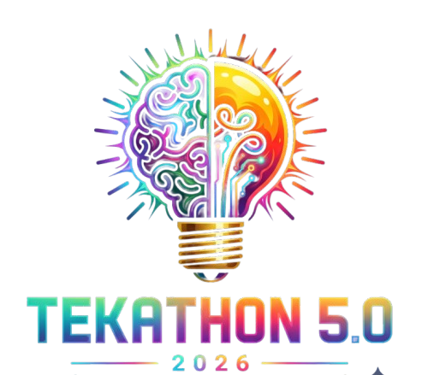

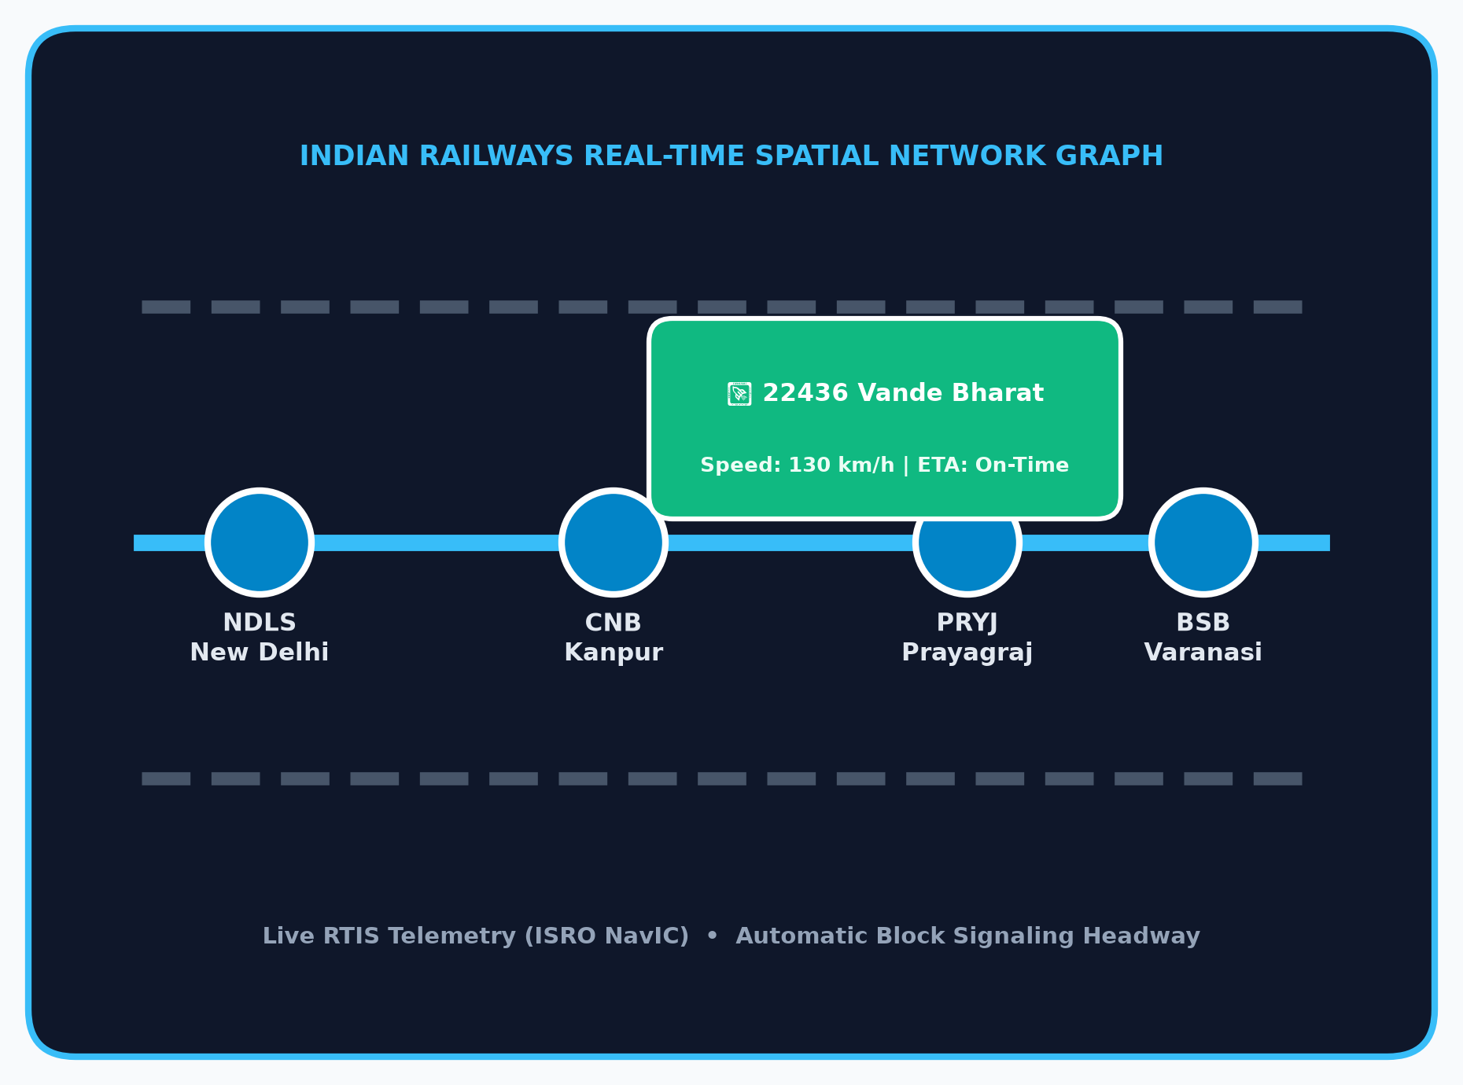


TEKATHON-5.0- 2026
Problem Statement ID – 26028
Problem Statement Title – Dynamic Forecast of Expected Time of Arrival (ETA) for Coaching Trains
Theme – Smart Automation
PS Category – Software
Ministry – Ministry of Railways / Indian Railways
Team Name – HelloWorldWarriors

Slide 2
RailFlow AI | Real-Time Locomotive GPS → Graph AI Engine → Dynamic ETA & Platform Protector
RailFlow AI | Real-Time Locomotive GPS → Graph AI Engine → Dynamic ETA & Platform Protector
PROPOSED SOLUTION
• Live GPS + Signal + Track traffic fused into live network graph
• Dynamic ETA recalculation every 30s based on track reality
• Probabilistic arrival range (e.g. 18:45 ± 4 mins, 94% CI)
• Multi-stakeholder sync: Passenger, Station Master & Controller
HOW IT SOLVES THE PROBLEM
• Today: blind static schedule math (Timetable + Delay - Slack)
• Fails during cascading delays, slow trains & junction congestion
• Arrival prediction error: 28 mins → < 4 mins
• Anticipates overtakes & signal halts before they happen
INNOVATION & UNIQUENESS
• "Why is my train late?" Explained: clear plain-text reasons
• Platform Clash Protector: 60m warning for platform overlaps
• Dispatcher What-If Simulator: test routing to prevent gridlock
• Zero Extra Hardware: uses existing ISRO NavIC / RTIS GPS
OUR TECHNICAL EDGE
Spatial Track Graph + Multi-Factor LightGBM ML + Platform Clash Auto-Resolver Static NTES and basic tracking apps deliver none of these three.

Slide 3
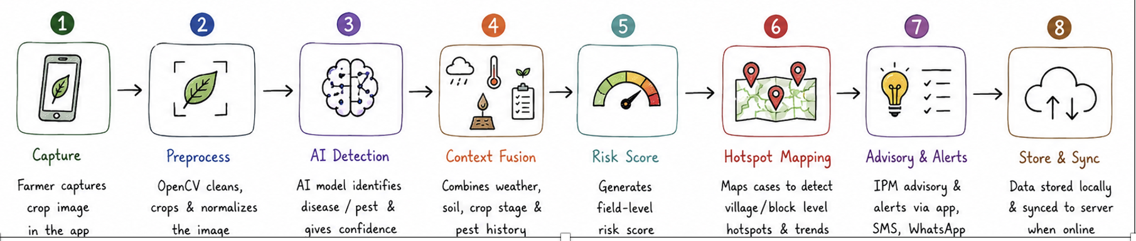
TECHNICAL APPROACH
TECH STACK React.js / TailwindCSS · Python + FastAPI (Async) · WebSockets · LightGBM Regressor · NetworkX (Spatial Graph) · PostgreSQL + PostGIS · Open-Meteo Free Weather API
1 Ingest & Telemetry
RTIS GPS (ISRO NavIC) 30s stream + Open-Meteo Weather + TSR Caution Orders
2 Spatial Track Graph
NetworkX Directed Railway Graph — Stations as Nodes, Block Sections as Edges
3 Kinematics & Headway Engine
Rake traction curves (WAP-7, LHB) + Automatic Block Signaling headway
6 Alerts & Controller Dashboard
WebSocket stream to Passenger App, Station Master & DRM Control Center
5 LightGBM Dynamic ETA Engine
Multi-horizon delay regression with probabilistic confidence bounds (±4 min)
4 Priority & Overtake Modeling
Detects trailing Vande Bharat/Rajdhani & anticipates loop-line siding halts
Steps 1–5 process over 10,000 trains with sub-15ms latency per section update

Slide 4
FEASIBILITY AND VIABILITY
Zero extra Capex
100% software; plugs directly into existing CRIS RTIS (ISRO NavIC) GPS
10,000+ trains / 17 Zones
Async microservices handle nationwide operations in under 20ms
Proven ML method
Gradient Boosted Trees (LightGBM) are industry-standard for real-time dispatch
RISKS & MITIGATION
Risk / Challenge | Mitigation
GPS signal lost in tunnels / mountain sections | Physics-based Dead-Reckoning using track gradient, speed & block signal timers
Sudden track maintenance block or emergency halt | Sub-second spatial graph recalculation; delay vectors instantly propagate across lines
Peak telemetry burst during festival rush (Diwali/Chhath) | In-memory stream buffering (Redis / SQLite) absorbs concurrent packets with zero loss
Passenger confusion over unexplained delays | Explainable AI (XAI) transparently translates delay root causes into plain human language

Slide 5
IMPACT AND BENEFITS
85%+
reduction in ETA prediction error (MAE drops from ~28 mins to < 4 mins)
1.3 Billion
annual passenger journeys protected from platform anxiety & missed connections
< 15 ms
real-time dynamic prediction latency per train section update
Passengers: diagnosis of delays in plain words + real arrival range | Station Masters & Controllers: live platform clash alerts + "What-If" simulator
OPERATIONAL
• Prevents junction platform gridlocks
• Synchronizes rake cleaning, watering & crew changeover
ECONOMIC
• Cuts idle diesel/electric power waste from unnecessary halts
• Reduces crew overtime & turnaround costs
SOCIAL
• Restores commuter trust in railway punctuality
• Eliminates dangerous station platform overcrowding

Slide 6
RESEARCH AND REFERENCES
Source | What it evidences
Smart India Hackathon 2026 — PS 26028, Ministry of Railways | Official problem definition, scope, and coaching train requirements
CRIS & ISRO RTIS Technical Whitepapers | Locomotive GPS telemetry infrastructure (GSAT/NavIC) in Indian Railways
Spatio-Temporal Graph Neural Networks (ST-GCN) Research | Railway network delay propagation and block headway modeling foundations
Indian Railways National Rail Plan (NRP 2030) | High-Density Network (HDN) line utilization and punctuality benchmarks
OPEN DATA & STANDARDS USED
data.gov.in Official Railway Timetables · OpenStreetMap Overpass Rail API · Open-Meteo Weather API · CRIS COA Protocols
http://ieeexplore.ieee.org/document/10458943/
http://ieeexplore.ieee.org/document/10883358/
http://arxiv.org/abs/1604.03169
https://link.springer.com/article/10.1186/s13007-023-01122-x
https://www.nature.com/articles/s41598-025-18613-7
https://academic.oup.com/jipm/article/12/1/16/6245490
https://pmc.ncbi.nlm.nih.gov/articles/PMC1647291/

