Slide 1

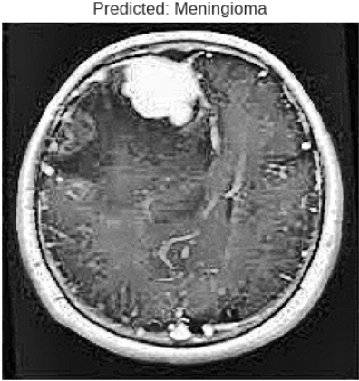
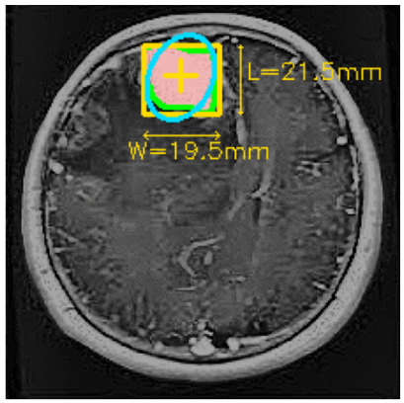
Proposed Multimodel Explainable AI Techniques for Brain Tumor Classification
AKSHAT VASHISTH, MANIKONDA SATYA VARDHAN, MUPPASANI SHRUTHIKKA
Dr. MILAN KUMAR DHOLEY
Proposed Methodology
Introduction
Brain tumor classification is a critical task in medical imaging that plays a vital role in early diagnosis and effective treatment planning. MRI scans are widely used for detecting brain abnormalities; however, manual analysis by radiologists can be time-consuming and prone to variability. With the advancement of deep learning, automated systems have been developed to improve accuracy and efficiency in tumor classification. This project focuses on developing a robust brain tumor classification system using advanced models such as EfficientNetB0, DenseNet121, and ProtoPNet. In addition to classification, the system incorporates tumor localization using image processing techniques to provide visual insights into affected regions. The proposed approach aims to enhance diagnostic accuracy, improve interpretability, and assist medical professionals in making faster and more reliable decisions.
The proposed methodology follows a structured pipeline for brain tumor classification and localization of the MRI images. The input images are fed into advanced deep learning models such as EfficientNetB0 and DenseNet121 for feature extraction and classification using transfer learning, while ProtoPNet model is used to provide interpretability of predictions. A voting-based ensemble approach is applied to combine the outputs of all models and improve overall accuracy and reliability. Finally, tumor localization is performed using traditional OpenCV-based image processing techniques, including thresholding and contour detection, to identify and highlight tumor regions within the MRI images.
Results and Discussion
Literature Review
INDIVIDUAL MODEL PREDICTION
EfficientNet: Glioma (65.21%)
DenseNet: Meningioma (98.92%)
ProtoPNet: Meningioma (89.26%)
FINAL ENSEMBLE RESULT
Prediction: Meningioma
Confidence: 98.92%
Model Used: DenseNet
The Tumor Localization of the
MRI scan image is this
[1] S. Majdi, "Brain tumor classification using DenseNet and EfficientNet: A comparative study," Comput. Methods Programs Biomed., IEEE vol. 237, p. 107567, 2024.
[2] M. J. Islam and Y. Zhang, "Brain tumor classification using MRI images and deep learning techniques," PLOS ONE, IEEE vol. 19, no. 5, p. e0301234, 2024.
[3] A. Iqbal et al., “Enhancing brain tumour multi-classification using EfficientNet-B0 architecture,” Information, arXiv vol. 15, no. 8, 2024.
[4] Y. Chen, J. Li, and C.-J. Hsieh, "This looks like that: Deep learning with prototypes," in Proc. NeurIPS, 2019, pp. 13963–13974.
[5] M. Tan and Q. Le, "EfficientNet: Rethinking model scaling for convolutional neural networks," arXiv preprint arXiv:1905.11946, 2019.
Testing & Validation
1. EfficientNetB0 achieved 90.74% accuracy with 90.93% precision and 90.47% recall during training and during testing it achieved an accuracy of 87.26%.
2. DenseNet121 achieved 80.95% accuracy with 82.78% precision and 78.87% recall during training, and during testing it achieved an accuracy of 83.51%.
3. ProtoPNet achieved 93.55% accuracy with 93.59% precision and 93.55% recall during training, and during testing it achieved an accuracy of 85.67%.
Research Gaps
1. The existing system relies on single-model classification and lacks ensemble learning for improved accuracy.
2. The existing approach lacks interpretability and do not explain which image regions influence predictions.
3. The existing system does not provide tumor localization after classification.
Project Objectives
References
1.To develop an accurate deep learning model for multi-class brain tumor classification using MRI images.
2.To integrate multiple models (EfficientNetB0, DenseNet121, ProtoPNet) to improve performance and reliability.
3.To provide tumor localization and interpretability using image processing and explainable AI techniques.
[1] A. Iqbal et al., “Enhancing brain tumour multi-classification using EfficientNet-B0 architecture,” Information, IEEE vol. 15, no. 8, 2024.
[2] M. J. Islam and Y. Zhang, "Brain tumor classification using MRI images and deep learning techniques," PLOS ONE, arXiv vol. 19, no. 5, p. e0301234, 2024.
Department of Artificial Intelligence and Data Science, GSCSE, Visakhapatnam

