Slide 1

Capstone Project – Final: Review – 1 on
Brain Tumor Detection and Classification Using Multi-model Deep Learning Algorithms
Presented by the Batch No. : 15
Akshat Vashisth VU22CSEN0300234
MANIKONDA SATYA VARDHAN VU22CSEN0300205
Shruthika VU22CSEN0300300
Under the Guidance of
Dr. Milan Kumar Dholey
Department of Computer Science and Engineering
GITAM School of CSE, GITAM (Deemed to be University),
Visakhapatnam.

Slide 2
CONTENTS
Recap of Capstone Project Introduction Review-2
  Problem Statement
  Objectives and Project Workflow
  Feedback from Guide/Reviewers and actions taken after Review–2
2. Methodology/Algorithms
3. Status of Implementation
4. Conclusion
5. References

Slide 3
Problem Statement
Brain tumors require early and accurate diagnosis, but manual MRI analysis is time-consuming and subjective. While deep learning shows promise for automated detection, the "black-box" nature of these models hinders clinical adoption, as healthcare professionals require interpretable systems to trust AI-driven diagnoses.
This project develops an interpretable automated brain tumor classification system addressing three key challenges: (1) class imbalance using DDPM-based synthetic data generation, (2) accurate detection through EfficientNetB0 and DenseNet121 architectures for binary and multi-class tumor classification, and (3) clinical transparency via ante-hoc explainability with integrated attention mechanisms that reveal feature importance in real-time without additional computation.
By embedding explainability directly into the model architecture, this framework provides transparent, auditable predictions essential for responsible AI deployment in healthcare

Slide 4
Objectives
To develop an automated MRI-based brain tumor detection and classification system using deep learning techniques.
To enhance dataset quality and address class imbalance if any using synthetic data generation methods.
To implement and compare the performance of EfficientNetB0 and DenseNet121 models for tumor detection and classification.
To propose a multi-model deep learning framework that improves model robustness, generalization, and diagnostic reliability.
To validate the proposed system using performance evaluation metrics such as accuracy, precision, recall, F1-score, and confusion matrix analysis.

Slide 5
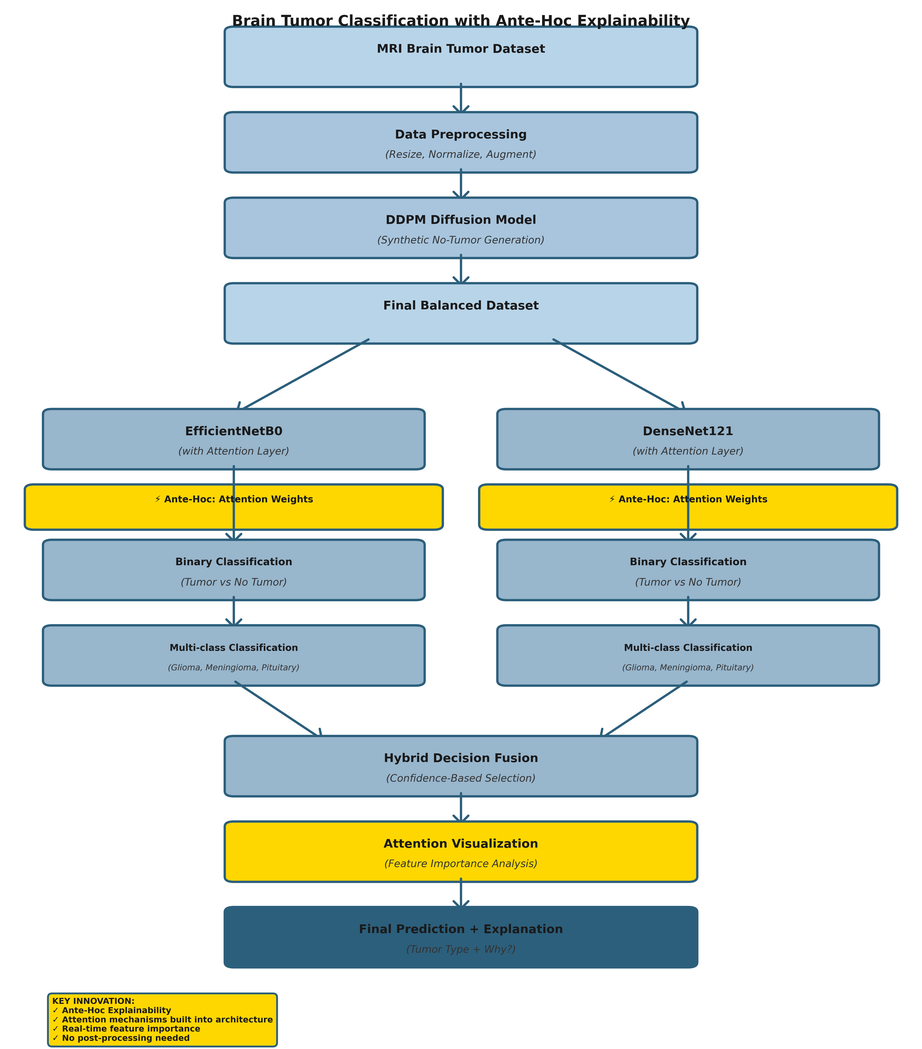
Design Strategy
Project Workflow

Slide 6
Feedback from Guide/Reviewers and actions taken after Review–2
Feedback from Guide/Reviewers
1. The PSO optimizer is very slow in execution for large data set.
2. The initially proposed hybrid model feel wrong as the definition of hybrid model is combination of 2 architectures not results from one passing to another.
3. Clarification was requested on how PSO optimization models can process raw image data directly.
Actions taken
Conducted a detailed analysis of various CNN architectures and selected EfficientNet and DenseNet based on their superior performance and accuracy in medical imaging classification tasks.
Studied and clarified the difference between hybrid models, multi-model approaches.
Implemented and evaluated PSO and Genetic Algorithm (GA) optimization approaches; however, experimental results showed lower classification accuracy and higher computational complexity. Therefore, these methods were not included in the final implementation.

Slide 7
Methodology
The proposed system follows a structured methodology integrating multiple learning techniques to achieve accurate brain tumor detection and classification
1. Dataset Preparation: MRI brain tumor images were collected from kaggle containing tumor and non-tumor classes. The dataset includes multiple tumor types such as glioma, meningioma, and pituitary tumors. The dataset was divided into training, validation, and testing subsets to ensure proper model evaluation and generalization.
2. Data Preprocessing: The collected MRI images were preprocessed to ensure uniformity and improve model performance. The preprocessing includes image resizing, and data augumentation.
3. Synthetic Data Generation using DDPM: To address any class imbalance and improve dataset diversity, a Denoising Diffusion Probabilistic Model (DDPM) was implemented. The DDPM model was trained using no-tumor MRI images to learn the distribution of normal brain structures. After training, the model generated synthetic no-tumor MRI images, which were added to the original dataset to improve class balance and enhance model generalization capability.
4. Model Development:
a) EfficientNetB0: It was used due to its high accuracy and computational efficiency. The pre-trained ImageNet weights were used for feature extraction, followed by custom fully connected layers for classification. Fine-tuning was performed to improve performance on medical imaging data.

Slide 8
Methodology
b) DenseNet121: It was implemented due to its dense connectivity architecture, which improves gradient flow and feature reuse. Similar to EfficientNet, transfer learning was applied using pre-trained weights, followed by custom classification layers.
5. Model Training: Both models were trained using the prepared dataset with Adam optimizer, appropriate loss functions (Binary Crossentropy / Categorical Crossentropy), early stopping and learning rate scheduling for optimized training
6. Model Evaluation: The trained models were evaluated using standard classification metrics like Accuracy, Precision, Recall, F1-score, Confusion matrix.
7. Multi-Model Decision Framework: A multi-model framework was implemented where predictions from EfficientNet and DenseNet models were combined using confidence-based decision selection. The model providing higher confidence probability for a prediction was selected as the final output, improving classification reliability.

Slide 9
Algorithm (s)
The proposed hybrid framework employs the following algorithms at different stages of the system:
Denoising Diffusion Probabilistic Model (DDPM): Applied for synthetic image generation by progressively learning and reversing noise patterns to augment the no‑tumor class and balance the dataset.
EfficientNetB0: Utilized for feature extraction and classification using transfer learning, providing high accuracy with fewer parameters and computational efficiency.
DenseNet121: Employed as an additional deep learning classifier to leverage dense feature reuse and improve learning of subtle tumor patterns.

Slide 10
Algorithm (s)
Algorithm 1: Brain Tumor Classification with Ante-Hoc Explainability
Load MRI brain tumor dataset
Preprocess dataset
a) Resize images to 224 × 224
b) Normalize pixel values
c) Apply data augmentation
Train DDPM model using no-tumor MRI images
Generate synthetic no-tumor MRI images using trained DDPM
Combine original dataset and synthetic dataset
Build EfficientNetB0 model with integrated Attention Layer
a) Load pretrained EfficientNetB0 backbone
b) Add Global Average Pooling layer
c) Insert custom Attention Layer (Ante-Hoc component)
d) Add Dense layers for classification
Train EfficientNetB0 using prepared dataset
Simultaneously learn classification and feature importance weights
Fine-tune the EfficientNetB0 model
Build DenseNet121 model with integrated Attention Layer
a) Load pretrained DenseNet121 backbone
b) Add Global Average Pooling layer
c) Insert custom Attention Layer (Ante-Hoc component)
d) Add Dense layers for classification
Train DenseNet121 using prepared dataset
Simultaneously learn classification and feature importance weights
Randomly pick a MRI image I:
11.1 Preprocess input image
11.2 Predict class probability using EfficientNetB0 → P_E
11.3 Extract attention weights from EfficientNetB0 → A_E
11.4 Predict class probability using DenseNet121 → P_D
11.5 Extract attention weights from DenseNet121 → A_D
Compare confidence scores:
If max(P_E) > max(P_D)
Final Prediction ← EfficientNet Output
Explanation ← Attention weights A_E
Else
Final Prediction ← DenseNet Output
Explanation ← Attention weights A_D
Visualize attention weights:
Display feature importance distribution
Show which features contributed to prediction
Return Final Prediction and Explanation
End

Slide 11
Status of Implementation
The proposed hybrid framework has been successfully implemented and tested using the following tools and components:
Programming Environment
  Python programming language
  Jupyter Notebook / Google Colab / Kaggle environment
Libraries and Packages Used
  NumPy, Pandas – Data handling and numerical operations
  OpenCV (cv2), PIL – Image processing
  Matplotlib, Seaborn – Visualization and analysis
  Scikit‑learn – Evaluation metrics
  TensorFlow & Keras – Deep learning model development
  PyTorch & Diffusers – Implementation of DDPM diffusion model

Slide 12
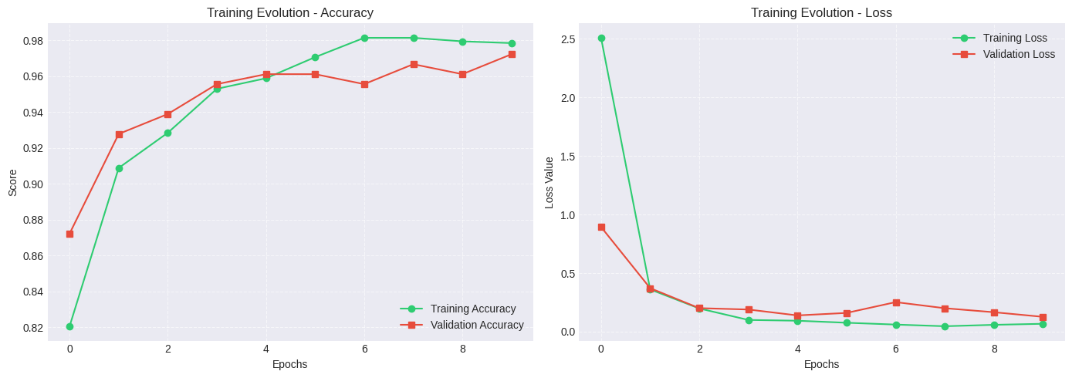
Status of Implementation
BINARY CLASSIFICATION LOSS AND ACCURACY USING EfficientNetB0

Slide 13
Status of Implementation
MULTICLASS CLASSIFICATION LOSS AND ACCURACY USING EfficientNetB0

Slide 14
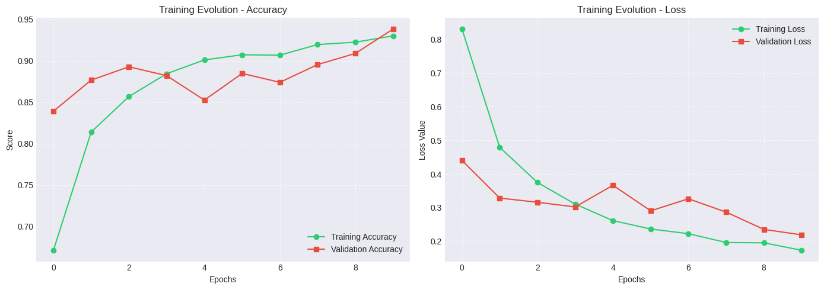
Status of Implementation
MULTICLASS CLASSIFICATION FINE TUNING LOSS AND ACCURACY USING EfficientNetB0

Slide 15
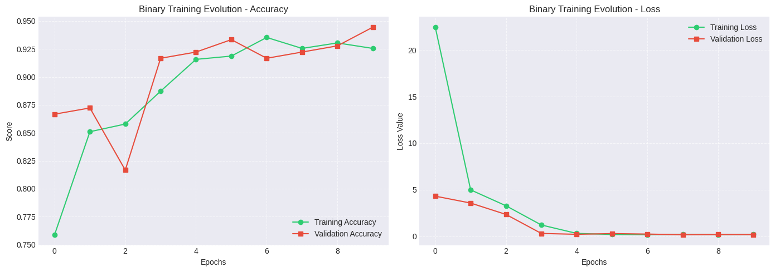
Status of Implementation
BINARY CLASSIFICATION LOSS AND ACCURACY USING DenseNet121

Slide 16
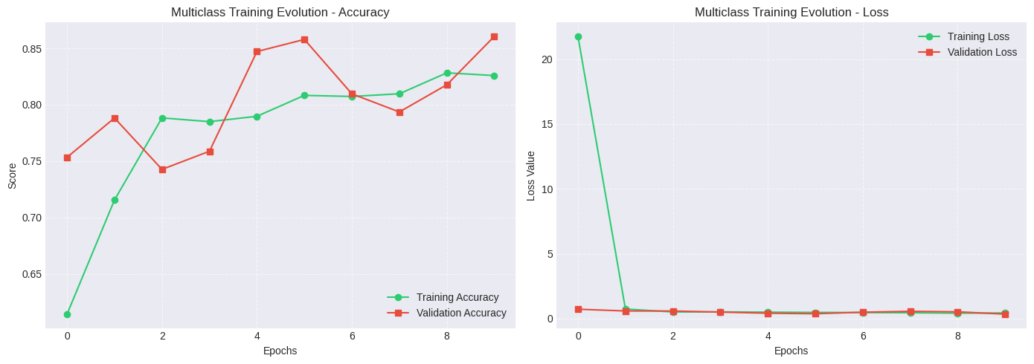
Status of Implementation
MULTICLASS CLASSIFICATION LOSS AND ACCURACY USING DenseNet121

Slide 17
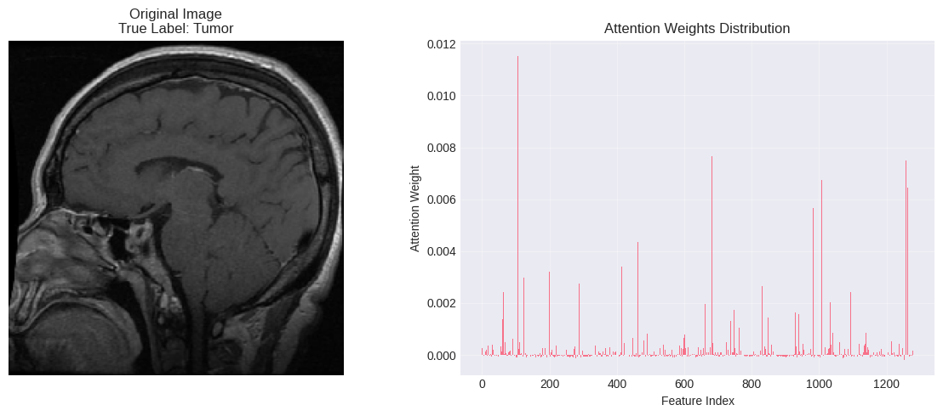
Status of Implementation
Visualize attention for sample images

Slide 18
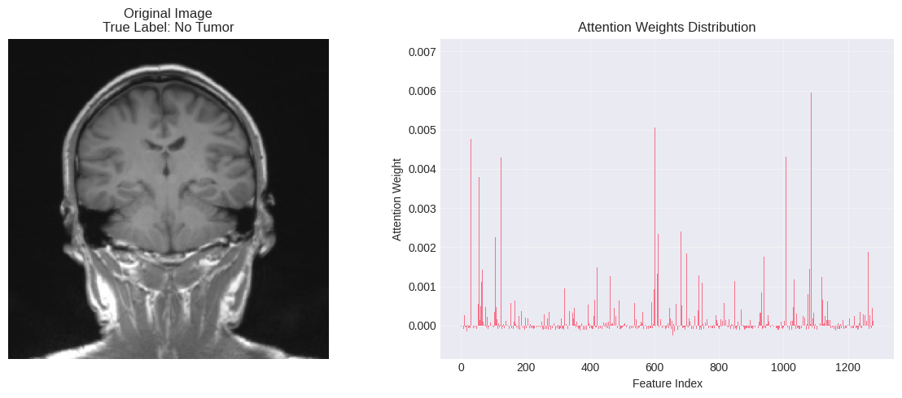
Status of Implementation
Visualize attention for sample images

Slide 19
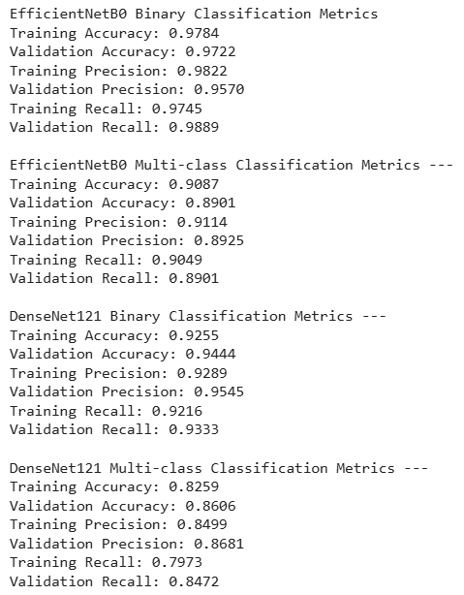
Status of Implementation
ACCURACY, PRECISION, RECALL OF ALL THE MODELS

Slide 20
Conclusion
The project successfully presents a hybrid deep learning framework for automated brain tumor detection and classification using MRI images.
A combination of DDPM‑based data augmentation, and deep learning models (EfficientNetB0 and DenseNet121) was implemented to address data imbalance, redundancy, and classification accuracy.
Experimental results demonstrate that the proposed approach achieves reliable performance with improved generalization and robustness.
Summary of Progress: Dataset preprocessing, clustering, and augmentation stages were completed successfully. Deep learning models were trained, fine‑tuned, and evaluated using standard performance metrics. Comparative analysis between EfficientNet and DenseNet was performed.
Team’s Confidence on Project Completion: The team is confident in the successful completion of the project, as all major components have been implemented, tested, and validated. The system demonstrates stable performance and meets the defined project objectives.
Expected Outcomes / Impact: Provides an accurate and automated diagnostic support system for brain tumor detection. Reduces dependency on manual MRI analysis. Has potential applications in clinical decision support systems and future medical imaging research.

Slide 21
References
[1] M. Tan and Q. Le, “EfficientNet: Rethinking Model Scaling for Convolutional Neural Networks,” Proceedings of the International Conference on Machine Learning (ICML), 2019.
[2] M. S. Madhan, E. N. Rani, K. Santhiya, S. Praveena and S. P. M. D, “Brain Tumor Classification with Optimized EfficientNet Architecture,” Journal of Neonatal Surgery, vol. 14, 2025.
[3] U. Singh, R. Saxena, T. Sharma, S. Ray, P. Mishra, P. Gupta and M. Shukla, “Brain Tumor Segmentation and Detection using EfficientNetB3 Model for MRI Medical Images,” International Journal of Intelligent Systems and Applications in Engineering, vol. 12, 2024.
[4] G. Huang, Z. Liu, L. Van Der Maaten and K. Q. Weinberger, “Densely Connected Convolutional Networks,” IEEE Conference on Computer Vision and Pattern Recognition (CVPR), 2017.
[5] J. Ho, A. Jain and P. Abbeel, “Denoising Diffusion Probabilistic Models,” Advances in Neural Information Processing Systems (NeurIPS), 2020.

