Slide 1

Capstone Project – Final: Review – 2 on
BTAI: Proposed Multimodel Explainable AI Techniques for Brain Tumor Classification
Presented by the Batch No. : 15
AKSHAT VASHISTH VU22CSEN0300234
MANIKONDA SATYA VARDHAN VU22CSEN0300205 MUPPASANI SHRUTHIKKA VU22CSEN0300300
Under the Guidance of
Dr. Milan Kumar Dholey
Assistant Professor
Department of Artificial Intelligence & Data Science
GITAM School of CSE, GITAM (Deemed to be University),
Visakhapatnam, INDIA.

Slide 2
CONTENTS
Recap of Capstone Project Final Review-1
  Problem Statement
  Objectives
  Design Strategy
  Feedback from Guide/Reviewers and actions taken after Capstone Project Final Review–1
Testing & Validation
Results, Analysis & Discussion
Conclusion
References

Slide 3
Problem Statement
Brain tumors require early and accurate diagnosis for effective treatment. While MRI scans are the primary diagnostic tool, manual analysis is often time-consuming and subjective. This project develops a multi-model, confidence-based automated system for brain tumor detection and classification. The proposed framework utilizes a pipeline of advanced deep learning architectures, including EfficientNet and DenseNet, for robust feature extraction and detection. To address the need for transparency in medical diagnosis, the system incorporates a ProtoPNet model, which enables explainable multi-class classification by identifying prototypical parts of the tumor. This hybrid approach ensures both high-accuracy detection and interpretable results for diagnosing Glioma, Meningioma, and Pituitary tumors.

Slide 4
Objectives
To develop an automated system for brain tumor detection and classification from MRI images using deep learning techniques.
To implement multiple CNN-based models (EfficientNet, DenseNet, and ProtoPNet) for accurate and robust multi-class tumor classification.
To design a confidence-based multi-model voting mechanism that selects the most reliable prediction among different models.
To enhance model interpretability using visualization techniques like Grad-CAM, enabling clear identification of tumor regions in MRI scans.
To improve overall model performance and generalization through proper preprocessing, data handling, and evaluation techniques.

Slide 5
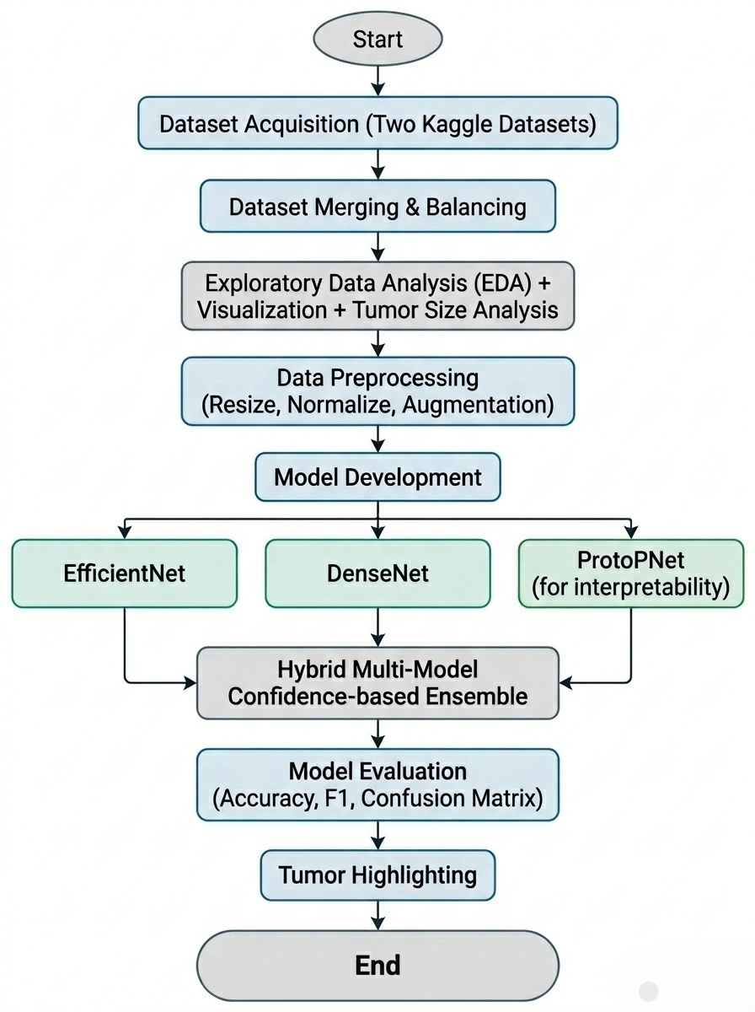
Design Strategy

Slide 6
Feedback from Guide/Reviewers and actions taken after Capstone Project Final Review–1
Feedback from Guide/Reviewers
1. How does the model detect tumors in MRI images?
2. Since the images appear dull, how can the model accurately identify tumors?
3. Why were only EfficientNet and DenseNet models used?
Actions taken
1. Performed detailed data analysis and preprocessing, including cropping, resizing, and contrast enhancement to improve image quality.
2. Implemented a tumor highlighting mechanism using classical image processing techniques (grayscale conversion, thresholding, and contour detection) to visually identify tumor regions.
3. Gained a deeper understanding of EfficientNet and DenseNet architectures and additionally incorporated ProtoPNet for more accurate and interpretable tumor analysis.

Slide 7
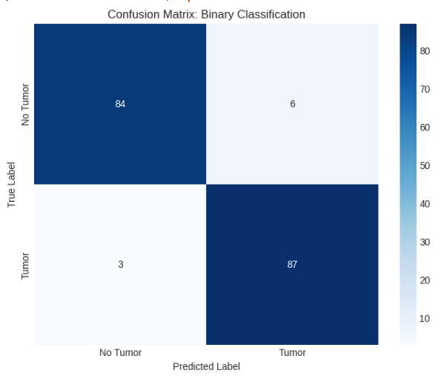
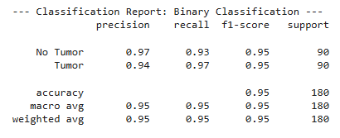
Testing & Validation
EfficientNetB0 Binary Classification Model Outputs

Slide 8
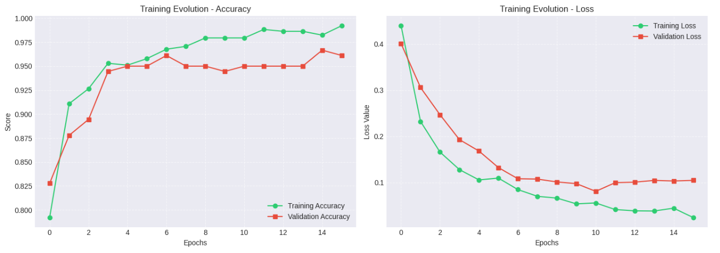
Testing & Validation
EfficientNetB0 Binary Classification Model Outputs

Slide 9
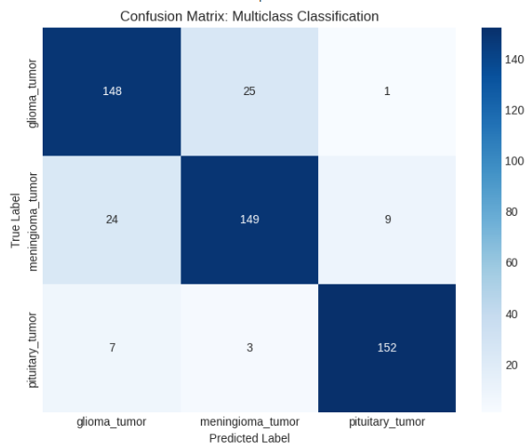
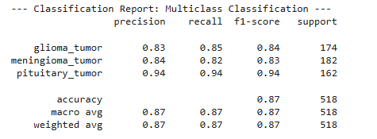
Testing & Validation
EfficientNetB0 Multiclass Classification Model Outputs

Slide 10
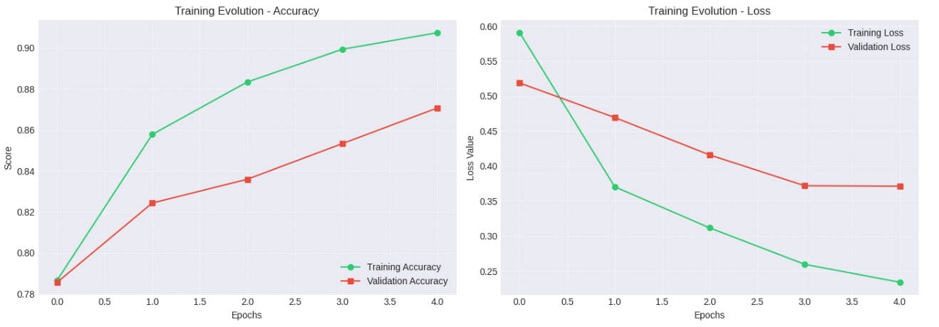
Testing & Validation
EfficientNetB0 Multiclass Classification Model Outputs

Slide 11
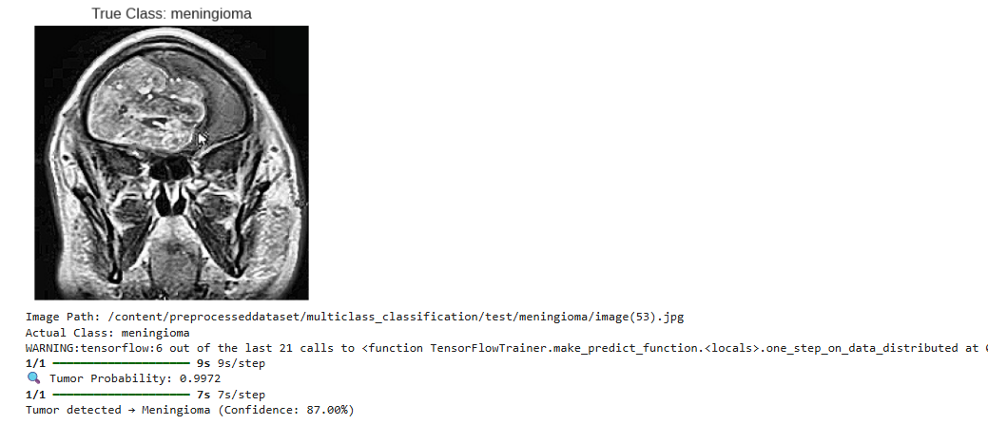
Testing & Validation
EfficientNetB0 Model Outputs

Slide 12
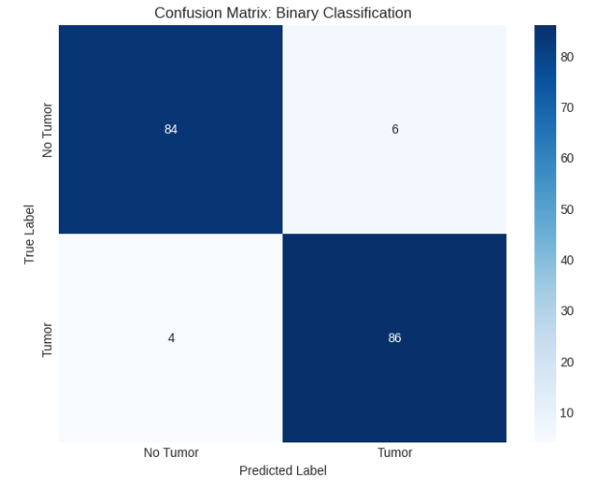
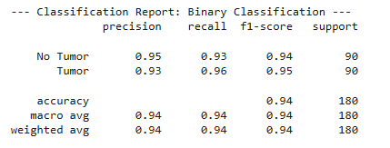
Testing & Validation
DenseNet121 Binary Classification Model Outputs

Slide 13
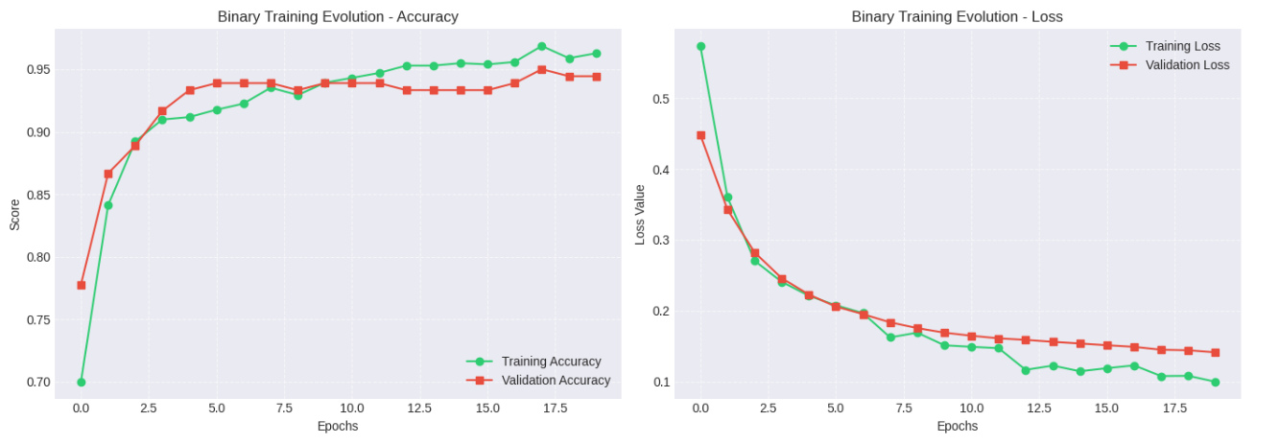
Testing & Validation
DenseNet121 Binary Classification Model Outputs

Slide 14
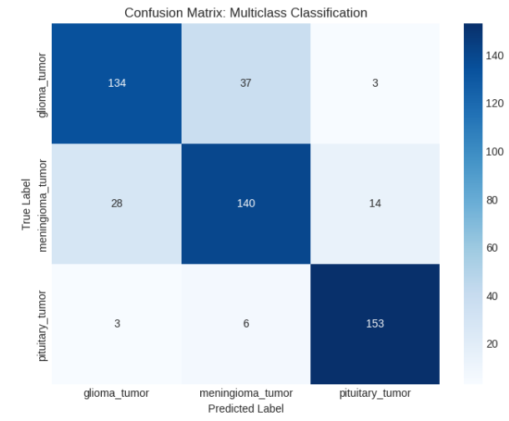
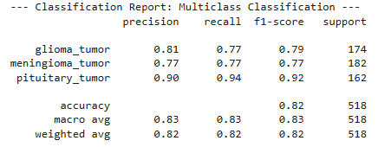
Testing & Validation
DenseNet121 Multiclass Classification Model Outputs

Slide 15
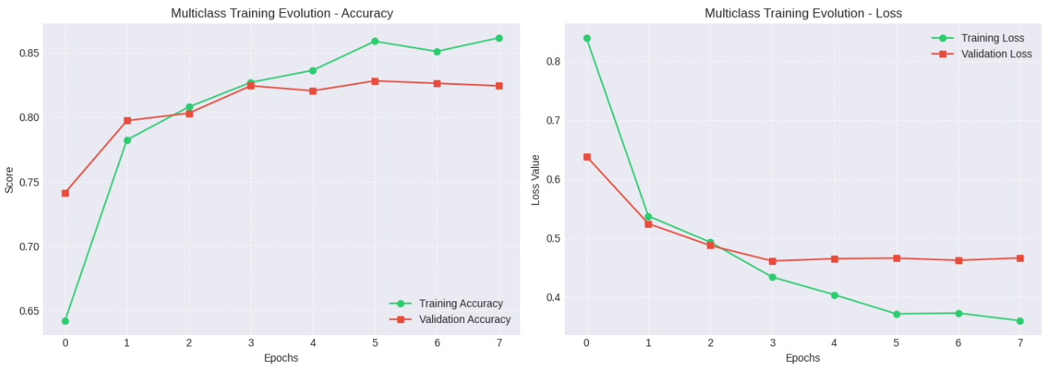
Testing & Validation
DenseNet121 Multiclass Classification Model Outputs

Slide 16
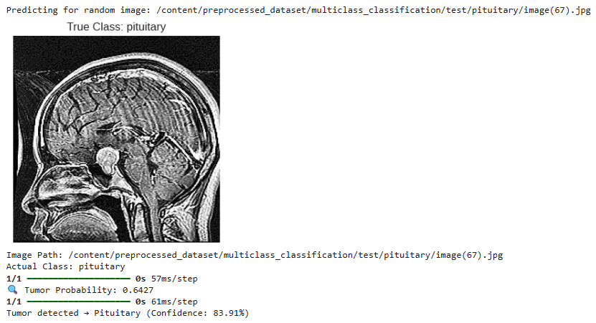
Testing & Validation
DenseNet121 Model Testing

Slide 17
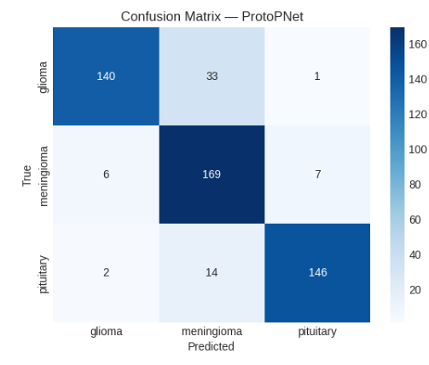
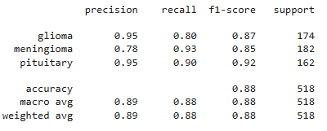
Testing & Validation
ProtoPNet Multiclass Classification Model Outputs

Slide 18
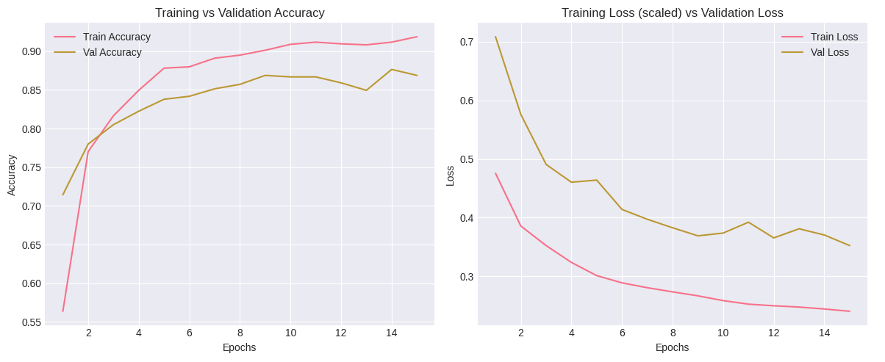
Testing & Validation
ProtoPNet Multiclass Classification Model Outputs

Slide 19
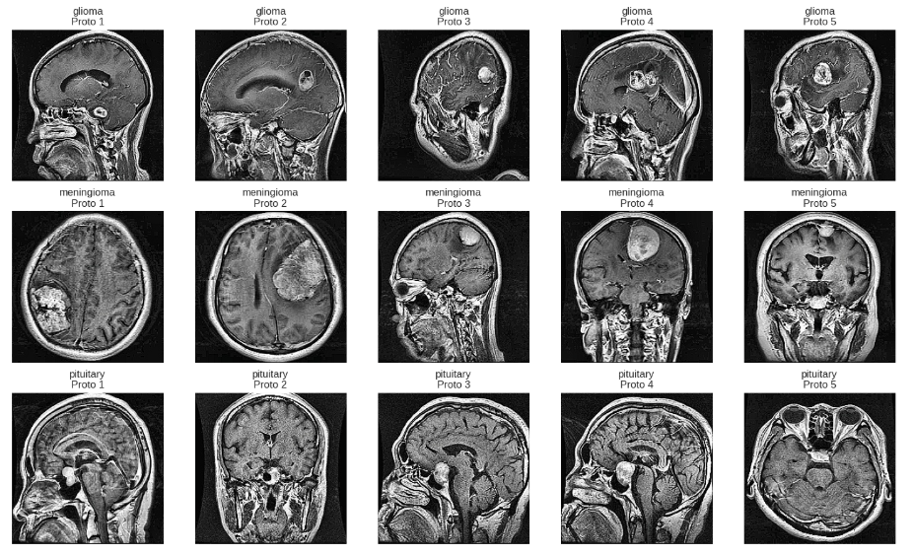
Testing & Validation
ProtoPNet Prototypes

Slide 20
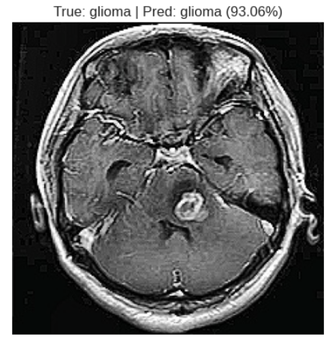
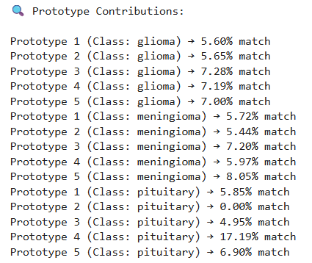
Testing & Validation
ProtoPNet Model Results

Slide 21
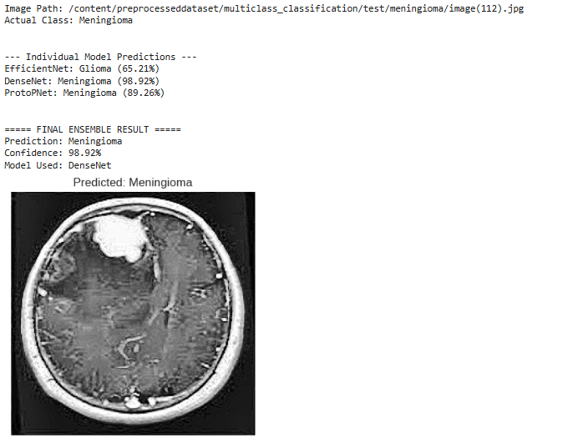
Results, Analysis & Discussion
Tumor Classification Analysis

Slide 22
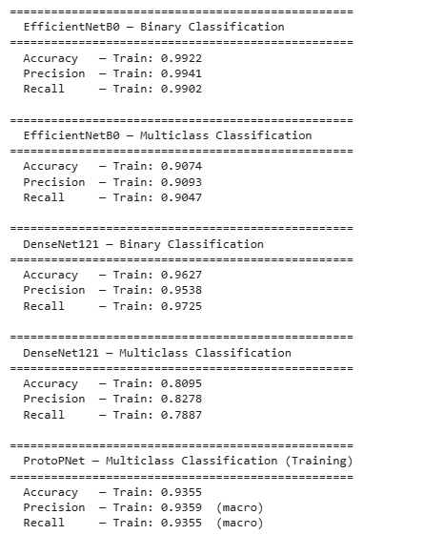
Results, Analysis & Discussion
Training Results

Slide 23
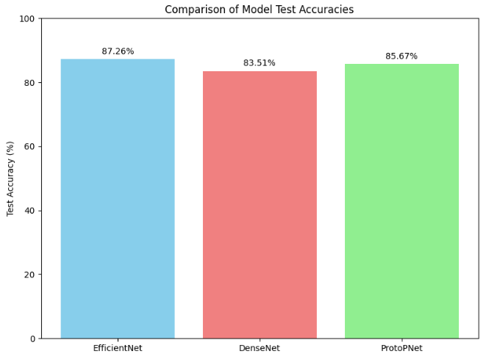
Results, Analysis & Discussion
Testing Results

Slide 24
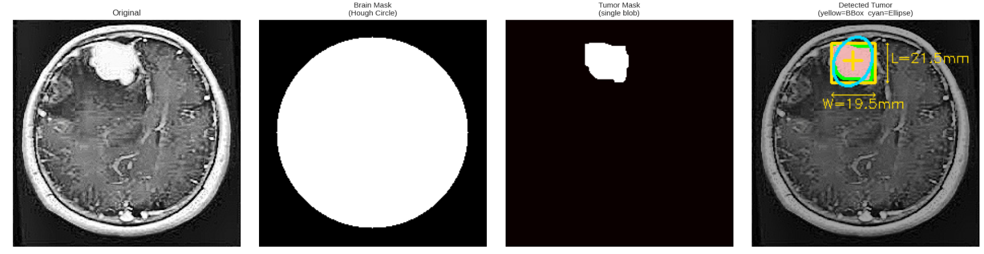
Results, Analysis & Discussion
Tumor Localization Result

Slide 25
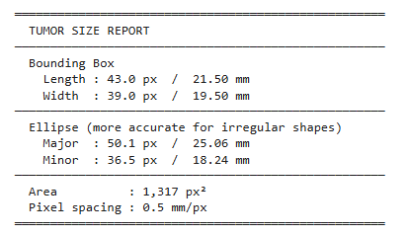
Results, Analysis & Discussion
Tumor Analysis Report

Slide 26
Conclusion
Summary of the Project
Developed an automated system for brain tumor detection and classification using MRI images
Applied preprocessing techniques such as resizing, normalization, and contrast enhancement to improve image quality
Implemented multiple deep learning models: EfficientNet, DenseNet, and ProtoPNet
Designed a confidence-based multi-model voting system to improve prediction reliability
Used OpenCV-based image processing (thresholding and contour detection) to highlight tumor regions in MRI images

Slide 27
Conclusion
Expected Outcomes / Impact
Enables faster and more accurate brain tumor diagnosis compared to manual analysis
Assists doctors by providing decision support with proof of visual explanations
Improves reliability through multi-model prediction instead of a single model
Contributes to early detection, leading to better treatment planning and patient outcomes

Slide 28
References
[1] M. Tan and Q. V. Le, “EfficientNet: Rethinking Model Scaling for Convolutional Neural Networks,” in Proceedings of the 36th International Conference on Machine Learning (ICML), 2019, pp. 6105–6114.
[2] G. Huang, Z. Liu, L. van der Maaten, and K. Q. Weinberger,
“Densely Connected Convolutional Networks,” in Proceedings of the IEEE Conference on Computer Vision and Pattern Recognition (CVPR), 2017, pp. 4700–4708.
[3] C. Chen, O. Li, A. Tao, A. Barnett, C. Rudin, and J. Su,
“This Looks Like That: Deep Learning for Interpretable Image Recognition,”
in Advances in Neural Information Processing Systems (NeurIPS), 2019.
[4] K. Simonyan and A. Zisserman,
“Very Deep Convolutional Networks for Large-Scale Image Recognition,”
arXiv preprint arXiv:1409.1556, 2014.
[5] O. Ronneberger, P. Fischer, and T. Brox,
“U-Net: Convolutional Networks for Biomedical Image Segmentation,”
in International Conference on Medical Image Computing and Computer-Assisted Intervention (MICCAI), 2015, pp. 234–241.

