Slide 1
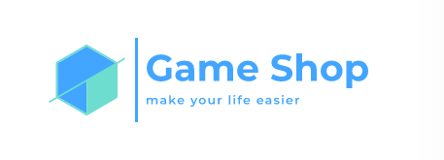
Kaloyan Dinev, 9b
Stanislav Todorov, 9v
Stoyan Kolev, 9a
Borislav Ferdinandov, 9g

Slide 2







Slide 3


Data base
Receipt function
Discount function

Slide 4


