Slide 1

RM

Slide 2
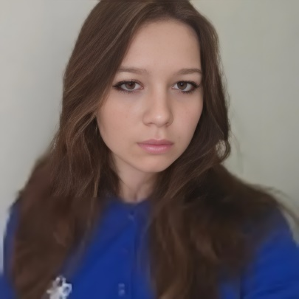
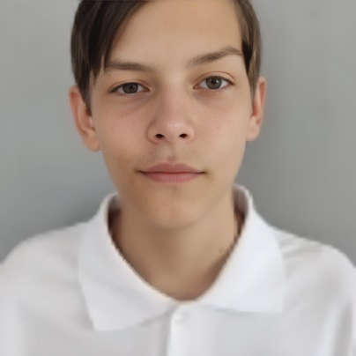
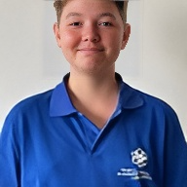
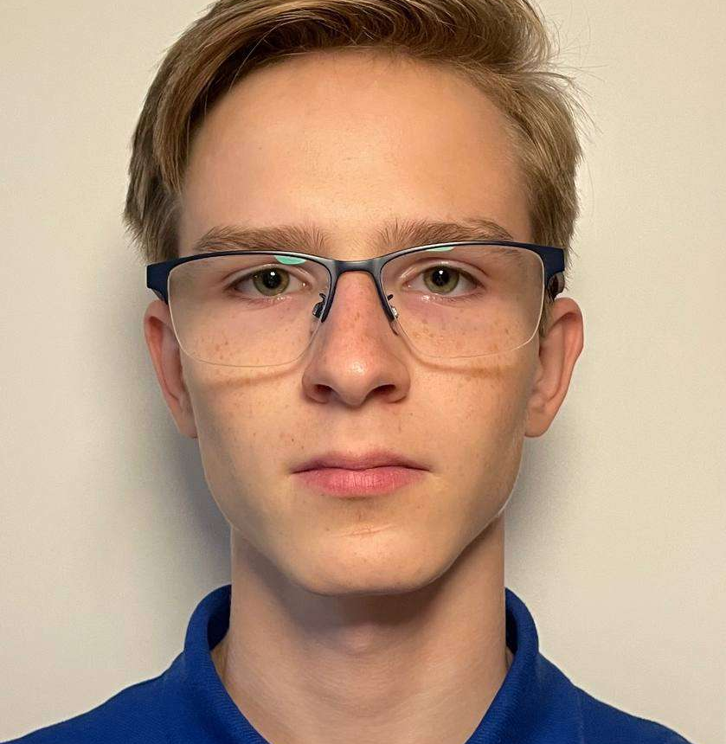
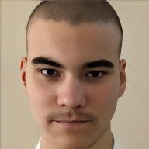
Our Group
Anastasia Gorska
Gregory Kalashnik
Evgeniy Kresnov
Lev Davletov
Sergey Toptunov
Designer
Backend developer
Frontend developer
Documentation
Backend developer
Designer
Presentation
Trainer

Slide 3



Stages
Come up with an idea
Wrote the code
Checked for functionality

Slide 4
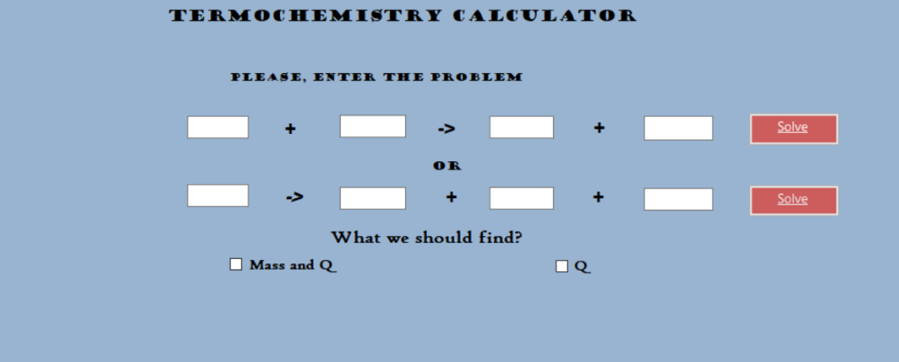
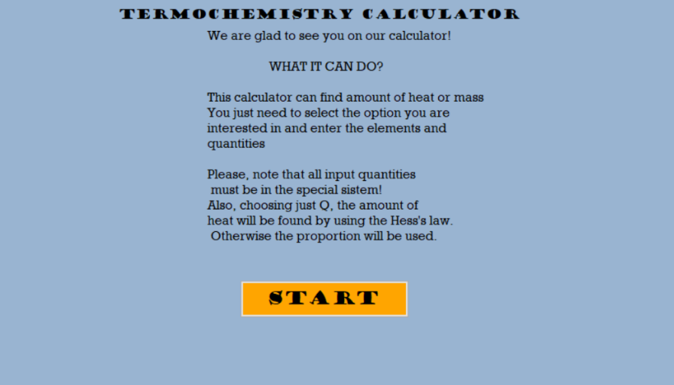
Demo

Slide 5







Used Programs

Slide 6
Let’s get to the program!

