Slide 1
E-Management of Tollgate and Vehicle Tracking System

Slide 2
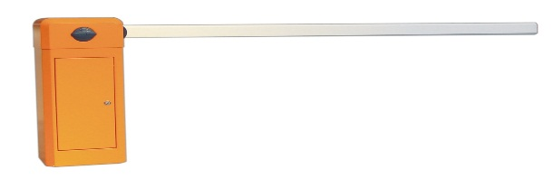
Abstract
The project we proposed “Toll Gate” is a web based application that have complete details of a Toll Gate Company details like Toll gate details, staff details, user details and Fare details of each toll booth and collection details of each toll booth.
The above aim can be established by implementing a layout structure modules and each module can have many sub modules.
Admin is responsible for creating all toll gate details, branch details, staff details, user details and Fare details.
This system is based CMS website Concept. Admin is responsible for giving username and password for user as well as access level. It has user interface module.
User can login through our site and access the service offered by the admin.
The Aim of these project is to keep complete details about fare collection and user details.

Slide 3
Existing System
The Existing system “Toll gate” is an static website and has no CMS technics, that means any change needed to be done on the site is done only through offline with a software’s used to edit a website pages. It has no user interface.
It has information about the toll gate details and fare details
Draw Backs
It has information about toll gates and fare details.
It has no CMS technics inherited within.
Any updation in the website can be done through offline mode.
It has no user interface
It’s a time consuming process.

Slide 4
Proposed System
The Main Aim of the project “Toll gate” is to keep track of a Toll gate booth details, staff details, user details and Fare details of each toll booth and collection details of each toll booth.
Admin is responsible for creating Toll gate booth details, staff details and Fare details .
Admin can update or change all above details through online itself and remaining details like user details, toll booth collection details is maintained by the automation software.
User can registered with the site and access the service offered by the admin.
User will get toll gate pass through our System. It may lead to reduce the access time.

Slide 5
Advantage
It has CMS technics inherited within.
It has admin module and automation software
Any updation on site content can be done through online itself.
It provides attractive and user interface for user visiting the sites.
Users have separate service offered by the admin.
It keeps track toll booth details, user details and collection details of each tool booth.
It keep track on user feedback.
User easy to get gate pass through our System.

Slide 6
Modules
Admin Module
Tollgate Details
Staff details
Update toll fare
User Module
View Profile
Gate pass Booking

Slide 7
Module Description
Admin Module
Admin module will manage tollgate process.it contain following
Tollgate details
Admin will perform add tollgate details, view tollgate details, and also delete tollgate.
That contain Tollgate name,Toll location,postal code,mobile number,email id,Tollgate
images.
Staff details
Admin will perform add,view,delete staff details through our System.
Update toll fare
Admin will update tollgate fare every year depend on tollgate location,year,vehicle
Category.
And also admin update his/her profile by itself through this module.

Slide 8
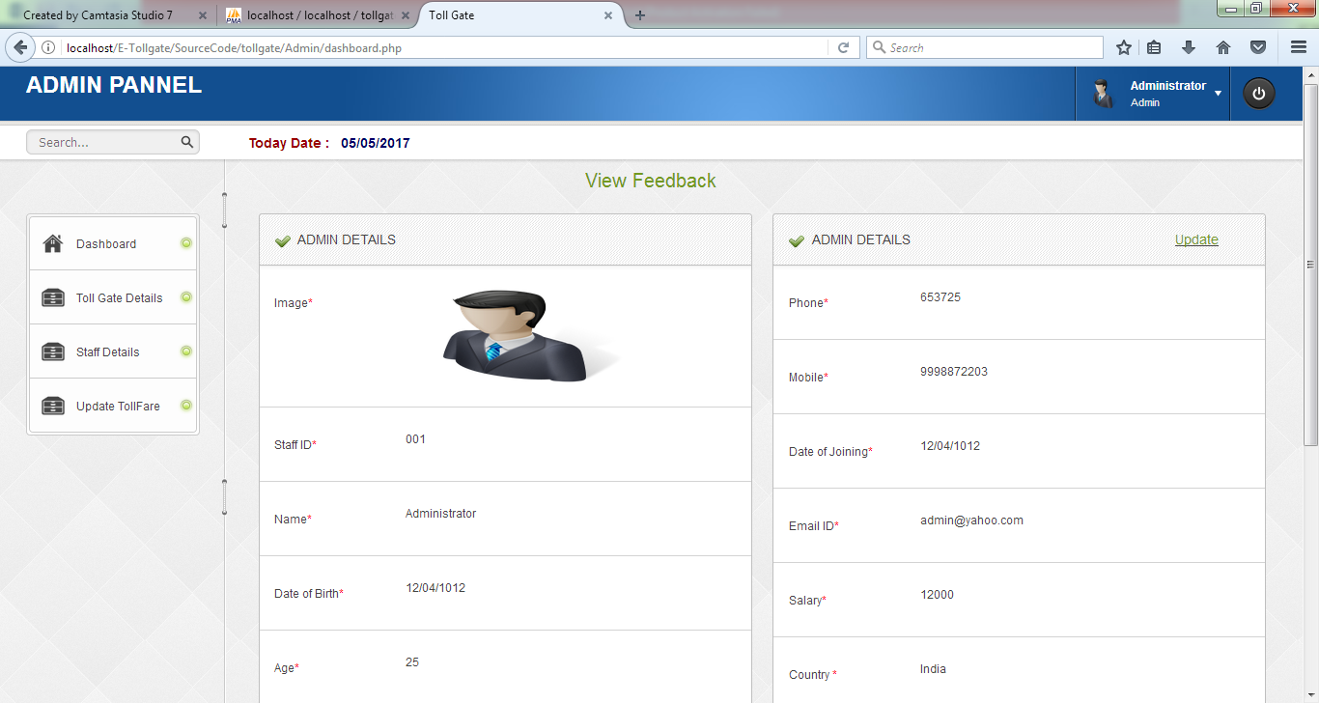

Slide 9
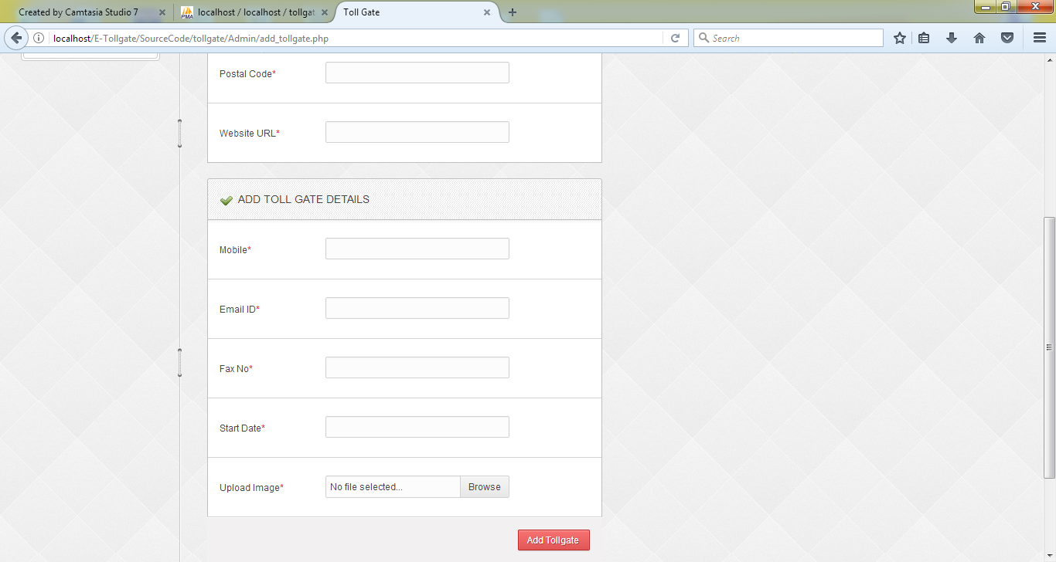

Slide 10
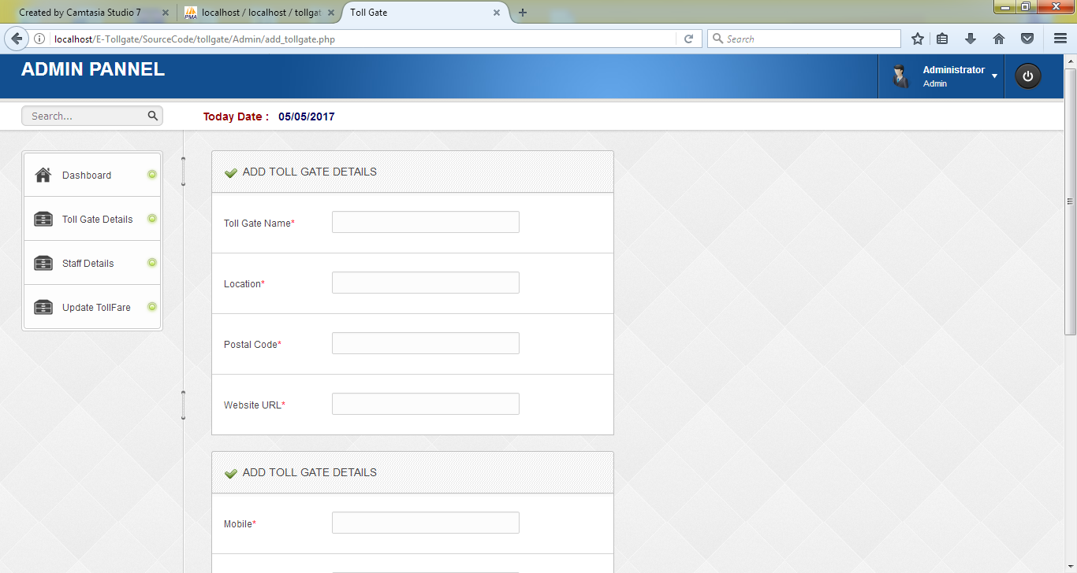

Slide 11
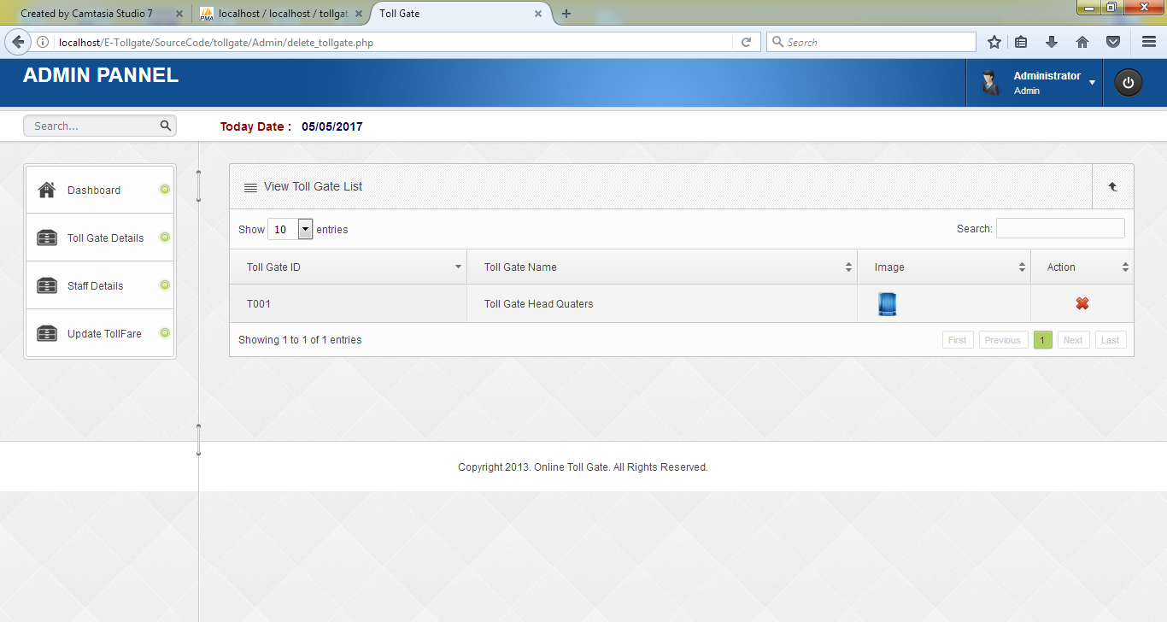

Slide 12
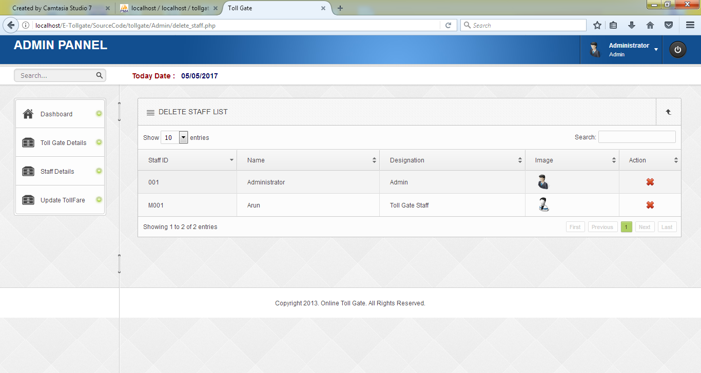

Slide 13
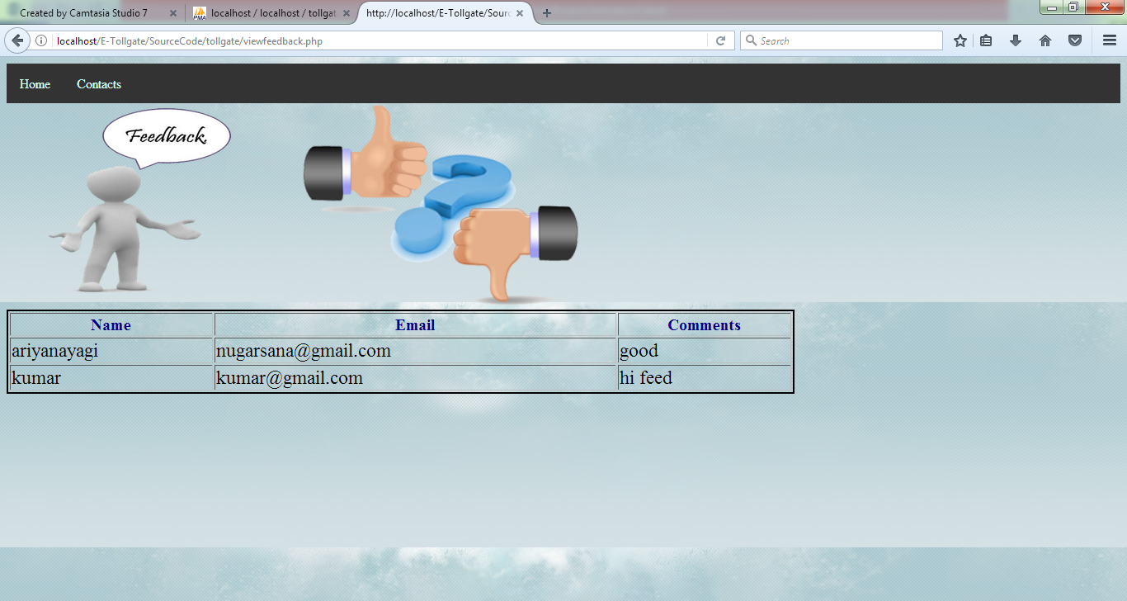

Slide 14
Module Description
User Module
View profile
User will view his/her profile by own itself through authenticated user name, password.
Gate pass Booking
It is our main module.morethan one user will get gate pass through this module.
Gate pass contain Username,vehicle category,vehicle number,location,time,year,date and tollfare details.

Slide 15
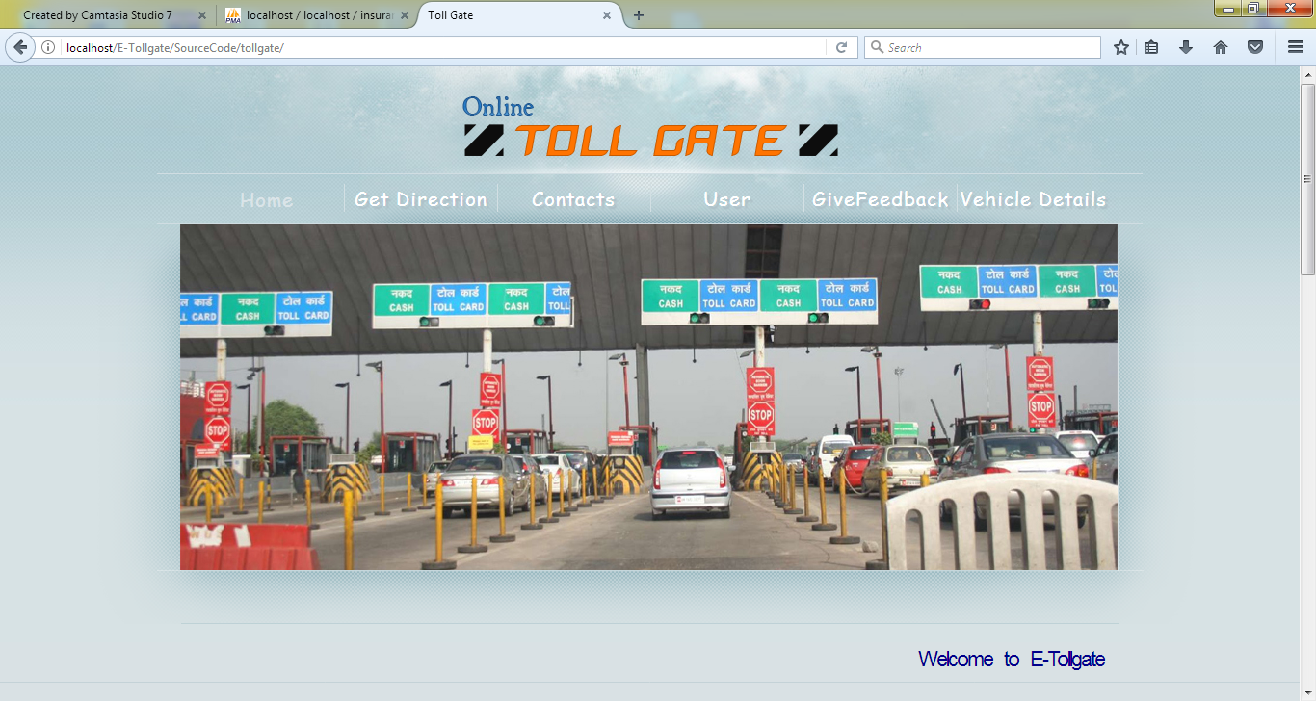

Slide 16
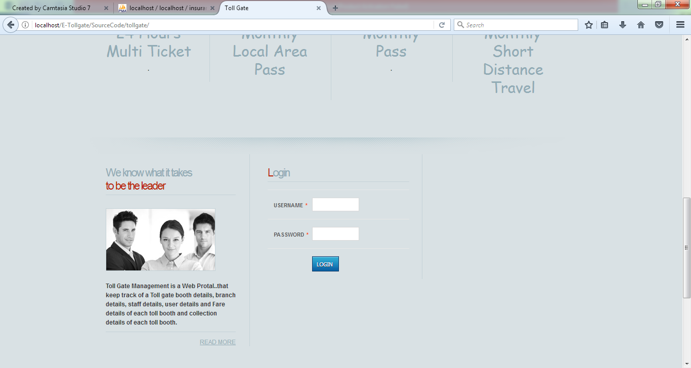

Slide 17
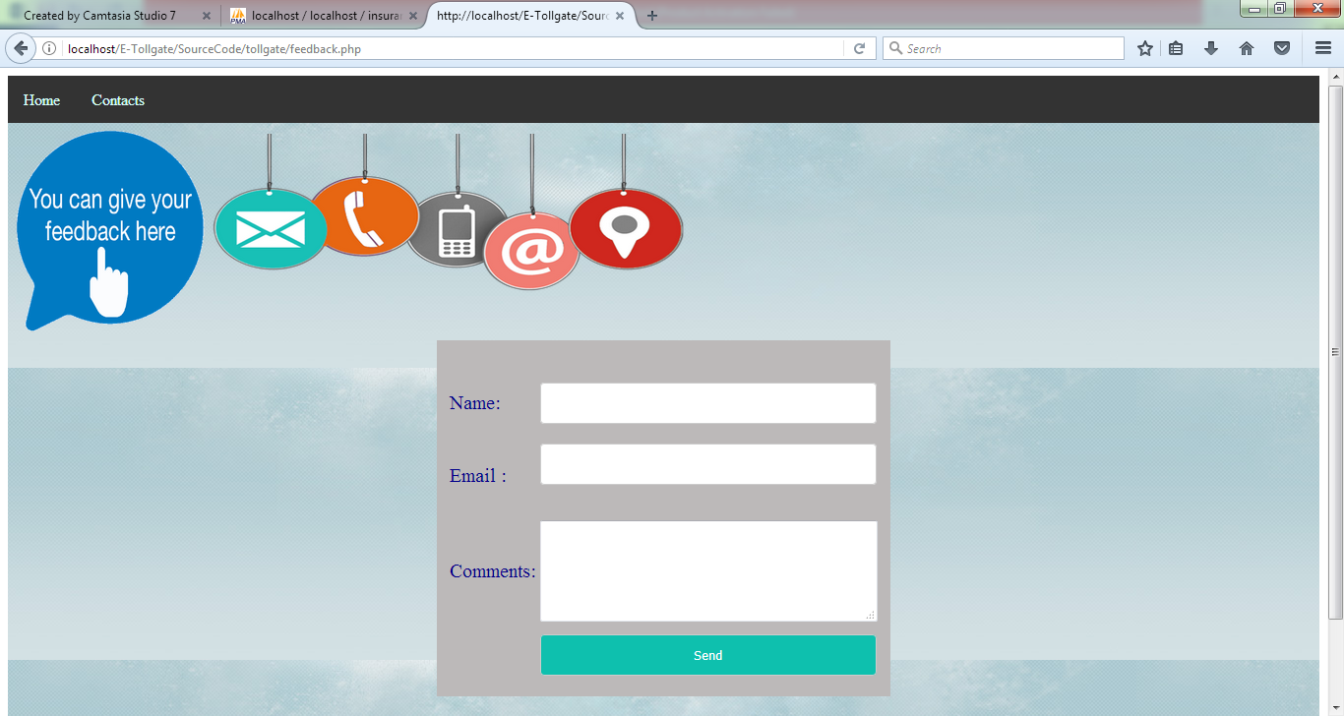

Slide 18
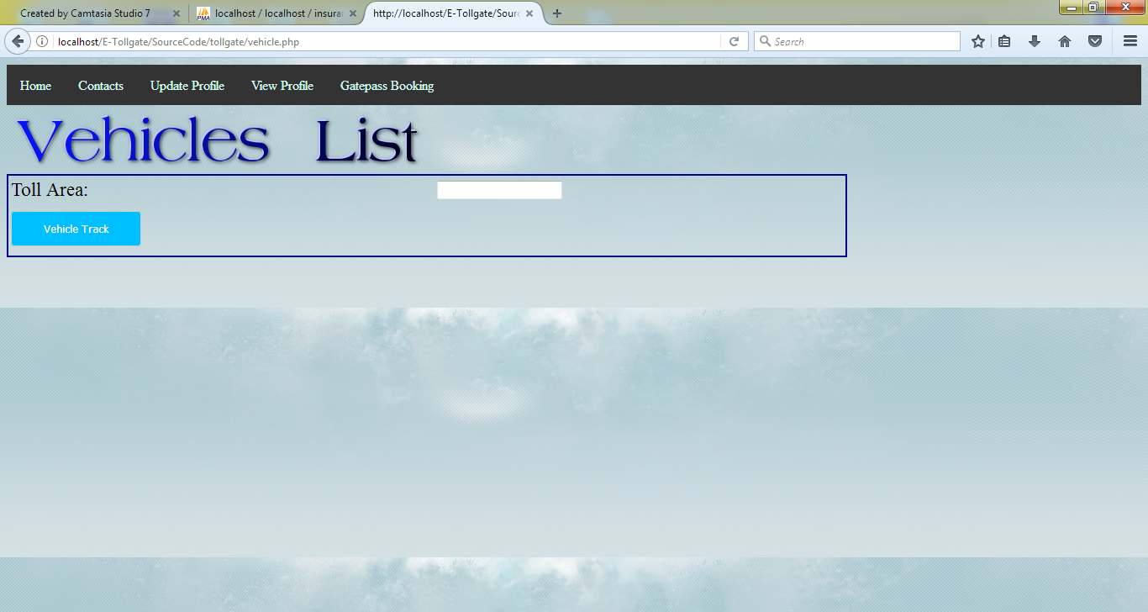

Slide 19
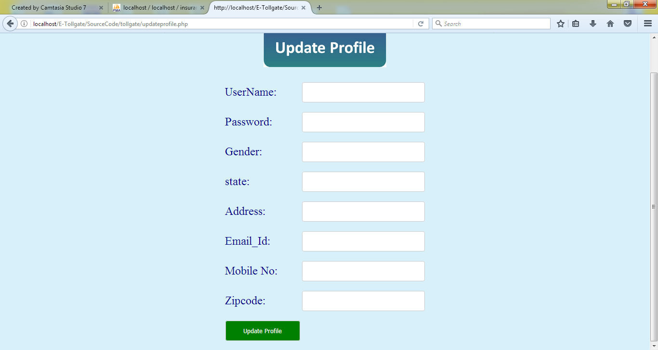

Slide 20
Flow Diagram
User
Admin
Yes
No
Register
Login
Update admin Profile
Login
Add,view,delete
Staff details
View Profile
Add,view,delete Tollgate details
Gate pass Booking
Update Tollfare

Slide 21
Usecase Diagram
Add/delete/view Tollgate details
Add/delete/view staff details
Update tollfare
Update admin profile
Admin
User
View profile
Gatepass Booking

Slide 22
ER Diagram
Add/view/ Delete Staff details
Update Tollfare
View his/her profile
Gatepass booking
Update admin profile
Add/delete Tollgate details
Authentication
User
Admin

Slide 23
Sequence Diagram
Admin
User
Add/view/delete tollgate details
Add/view/delete staff details
Update Tollfare
Update Admin profile
View Profile
Gatepass Booking

Slide 24
Activity Diagram
User
Admin
View profile
Add/delete Tollgate details
Add/delete Staff details
Gatepass Booking
Update Tollfare
Update/view admin profile

Slide 25
System Requirements
Software Requirements
O/S : Windows XP/7.
Language : PHP, HTML, Javascript, CSS
Server : WAMP, XAMP
Data Base : Sql Server

Slide 26
System Requirement
Hardware Requirements
System : Pentium IV 2.4 GHz
Hard Disk : 160 GB
Monitor : 15 VGA color
Mouse : Logitech.
Keyboard : 110 keys enhanced
Ram : 2GB

Slide 27
Literature Survey

Slide 28
Title | Year | Author | Abstract | Merits/Demerits
ONLINE TOLLGATE MANAGEMENT SYSTEM | 2010 | Anuj Gupta and Hariharan Rajagopalan | Toll gates are usually considered an inconvenience by travellers not only for the cost of the toll, but also for the delays at toll booths, toll roads and bridges.. Security systems can also be added, which will further enhance the system. | Merits: Scheduling the meeting in efficient way. • Toll gates are usually considered an inconvenience by travelers not only for the cost of the toll, but also for the delays at toll booths, toll roads and bridges. Demerits: In this system Has Make more error.

Slide 29
Future Enhancement
Graph Report : It provides report in pie , bar , wave graph
Firewall Status on | off : It provide firewall status of a searched web site
Top Ranking for website : It provide top ten website as a result from reports
Email and SMS Service : It provide mail and sms service to user and company registered with the system
Advertisement Services : It allows companies to advertise their products on top ten ranked
web site.

Slide 30
Conclusion
Our System user will get gate pass easily it lead to reduce traffic held on tollgate area and reduce access time for get gate pass.
We can get gate pass from any side in the world through our System
User easy to get gate pass and manage whole by admin.

