Slide 1
HOUSING: PRICE PREDICTION
[ Name: Saunak Mukherjee]
[Institution: DataTrained]
[Flip Robo Technology]

Slide 2
Introduction
Houses are one of the necessary need of each and every person around the globe and therefore housing and real estate
market is one of the markets which is one of the major contributors in the world’s economy. It is a very large market
and there are various companies working in the domain. Data science comes as a very important tool to solve problems
in the domain to help the companies increase their overall revenue, profits, improving their marketing strategies and
focusing on changing trends in house sales and purchases. Predictive modelling, Market mix modelling,
recommendation systems are some of the machine learning techniques used for achieving the business goals for housing
companies. Our problem is related to one such housing company.
A US-based housing company named Surprise Housing has decided to enter the Australian market. The company uses
data analytics to purchase houses at a price below their actual values and flip them at a higher price. For the same
purpose, the company has collected a data set from the sale of houses in Australia.

Slide 3
Overview
We are required to model the price of houses with the available independent variables. This model will then be used
by the management to understand how exactly the prices vary with the variables. They can accordingly manipulate the
strategy of the firm and concentrate on areas of that will yield high returns. Further, the model will be a good way for the
management to understand the pricing dynamics of a new market.

Slide 4

Housing price prediction with machine learning
. House prices which is increase every year, so we have to predict house prices in the future. House Price Prediction can help us to determine the selling price of the House and It can help the customer to arrange the the right time to purchase the house

Slide 5
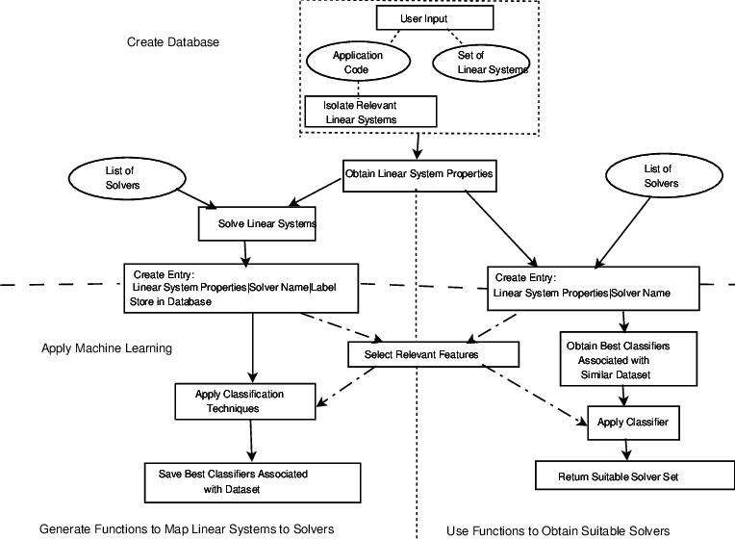
Flow Chart of Machine Learning
Machine Learning is a application of the prediction where the data with the proper application of a sats model. We have done with analysis or the comparison of different machine learning methods. The dataset is split into two different dataset namely training and testing. The dataset which contains multiple parameters that may cause execution time of the algorithm
Which is used is not to be suitable
For multi class analysis.

Slide 6
DATASET
Dataset is a house price prediction dataset
Link of the dataset from github(‘C:\Users\91907\Music\train.csv’) and (‘C:\Users\91907\Music\test.csv’)
There are total 1168 rows and 81 columns I the train dataset and 292 rows and 80 columns is test dataset.
We have used many features to train our machine learning model

Slide 7
Data cleaning
The main aim of the Data cleaning to identify am remove errors or the duplicate data
Those column we have to drop from our dataset which are not important.
The rows which are having null values in any column are dropped from our data set

Slide 8
OUTLYER DETECTION
In simple words , an outlayers is an observation that diverges from an overall pattern
We use many types of outlayer detection techniques such as Z score

Slide 9
ONE HOT ENCODING
This technique is used to covert the categorical variables into numeric values.
Our dataset contains a categorical variable which is “location”
we have used one hot encoding method which is convert them as numeric values

Slide 10
Model Creation
The process of Modeling which is training a ML algorithm to predict the labels from feature.
We have use Linear Regression for training and testing

Slide 11
XGBOOST AND LIGHTGBM
we have used xgboost and lightgbm classifier because its a huge data

Slide 12
K fold Cross Validation
Cross validation is stats method which can used a estimate skill of the ML.
IT is commonly used in applied ml which is compare to select a model.
After applying k-fold cv we found our accuracy more than 85% which is very good

Slide 13
Results and Output
We created a function which is predict house price.
our function is to “predict_price”
We pass the values into our function and it will predict.

Slide 14
Thank you

Slide 18
Questions & Answers
Invite questions from the audience

