Slide 1
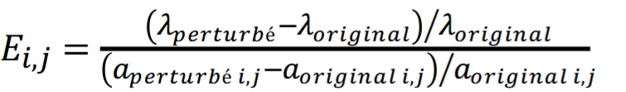
Lambda Rates | Barn owl | WTTB | RTTB | Rat | Pied crow
Owl breeding success | 0,00444468 | 3,958E-08 | 1,7772E-08 | -6,096E-06 | 2,7766E-09
Owl juvenil survival rate | 0,04027114 | 2,1236E-06 | 9,8944E-07 | -0,0002934 | 3,9227E-09
Owl adult survival rate | 0,03294236 | 1,6019E-06 | 7,0996E-07 | -0,0002574 | -1,546E-08
Growth of pied cow | -1,31E-10 | 2,0558E-07 | 9,0664E-08 | -0,0027611 | -
Regulation of pied crow | 1,7562E-10 | -2,531E-08 | -1,047E-08 | 0,00047468 | -0,0645611
Growth of rats | 1,6826E-10 | -1,799E-05 | -8,563E-06 | - | -1,772E-08
Regulation of rat | -2,331E-10 | 0,00092406 | 0,00058491 | -0,007932 | -2,696E-08

Slide 2
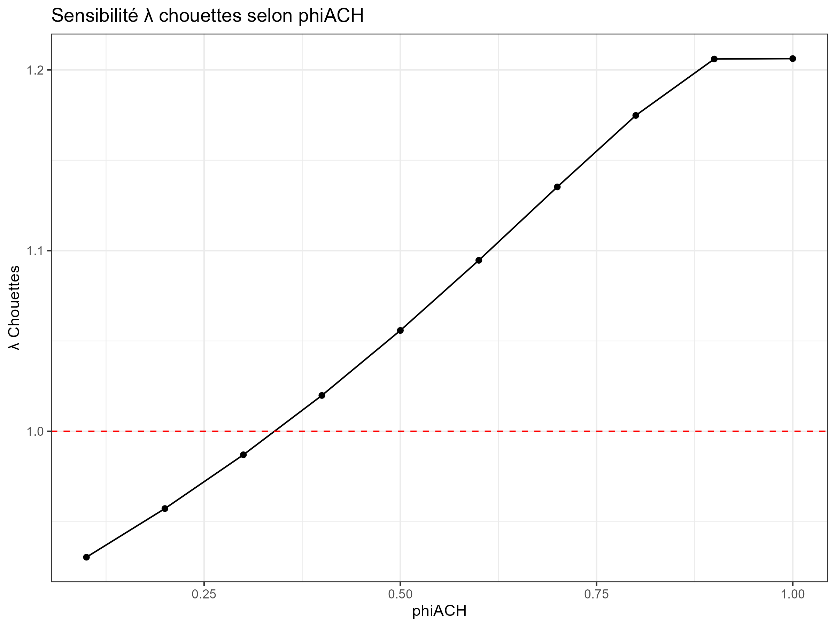
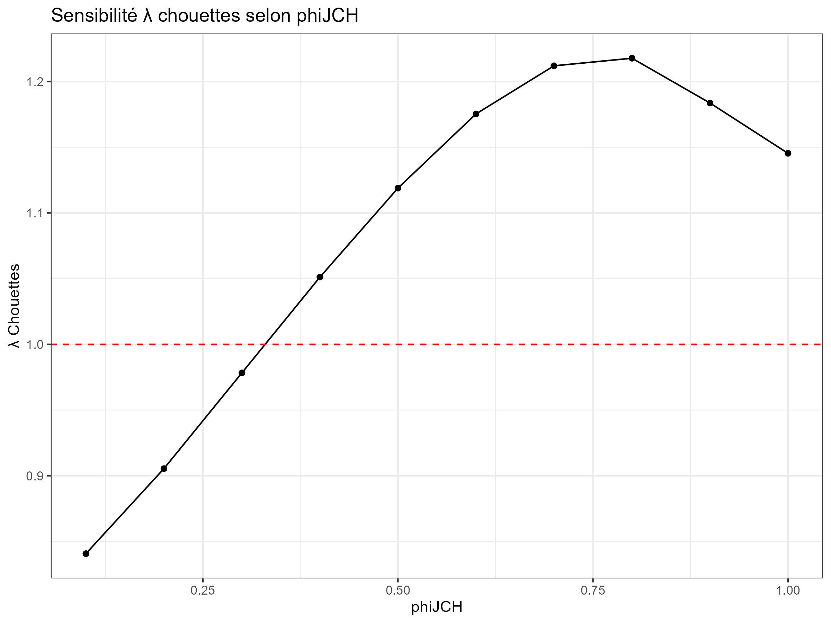

Slide 3
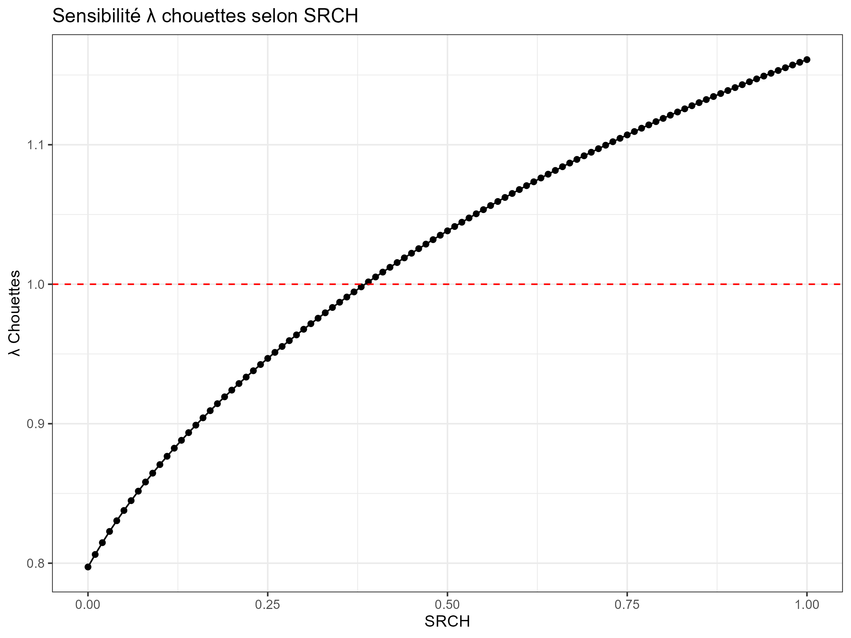
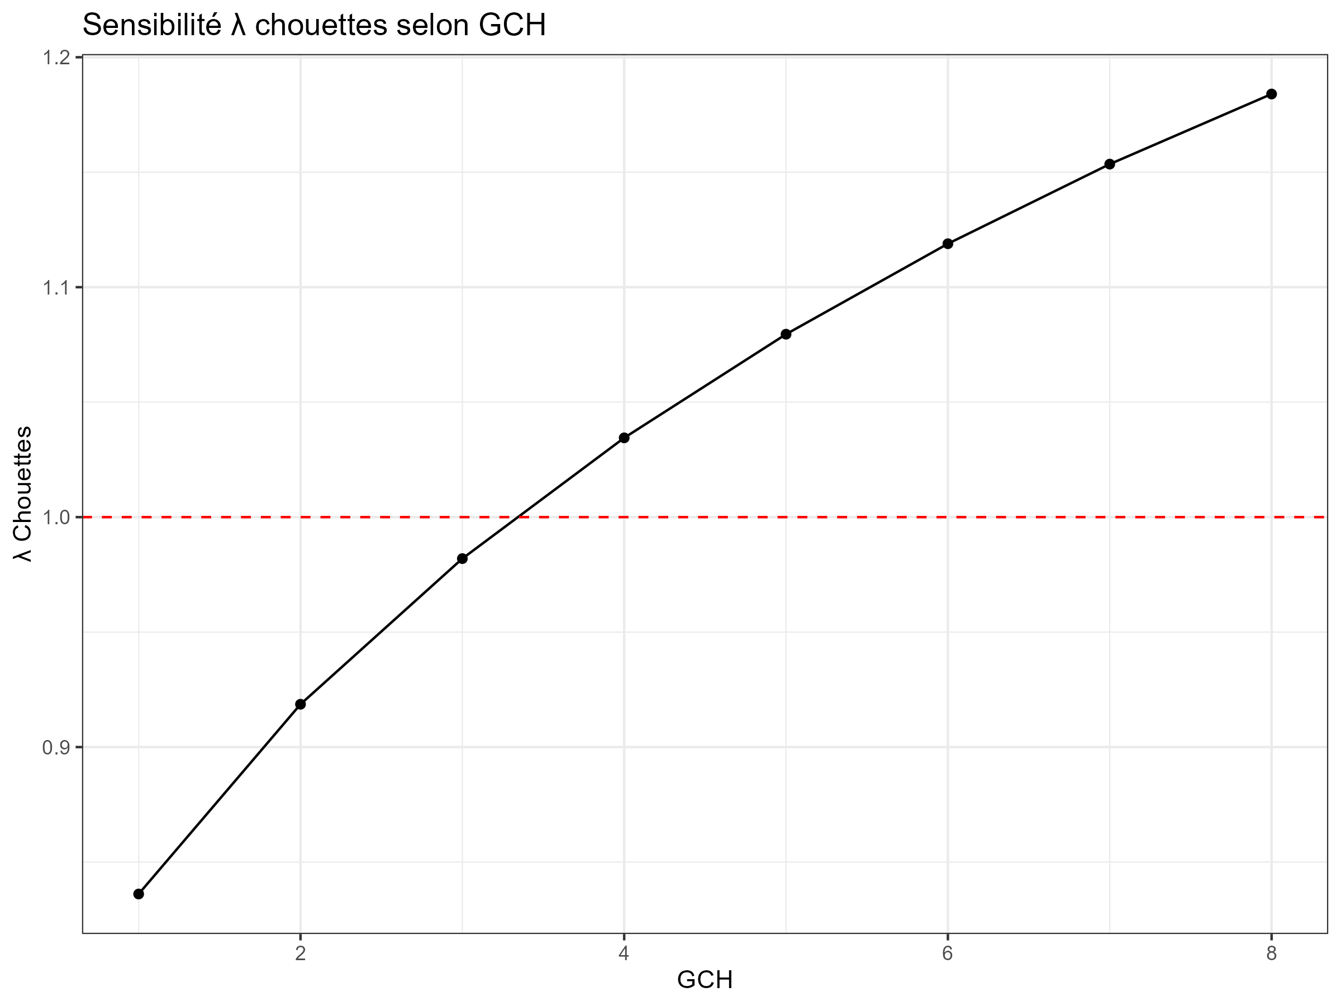

Slide 4
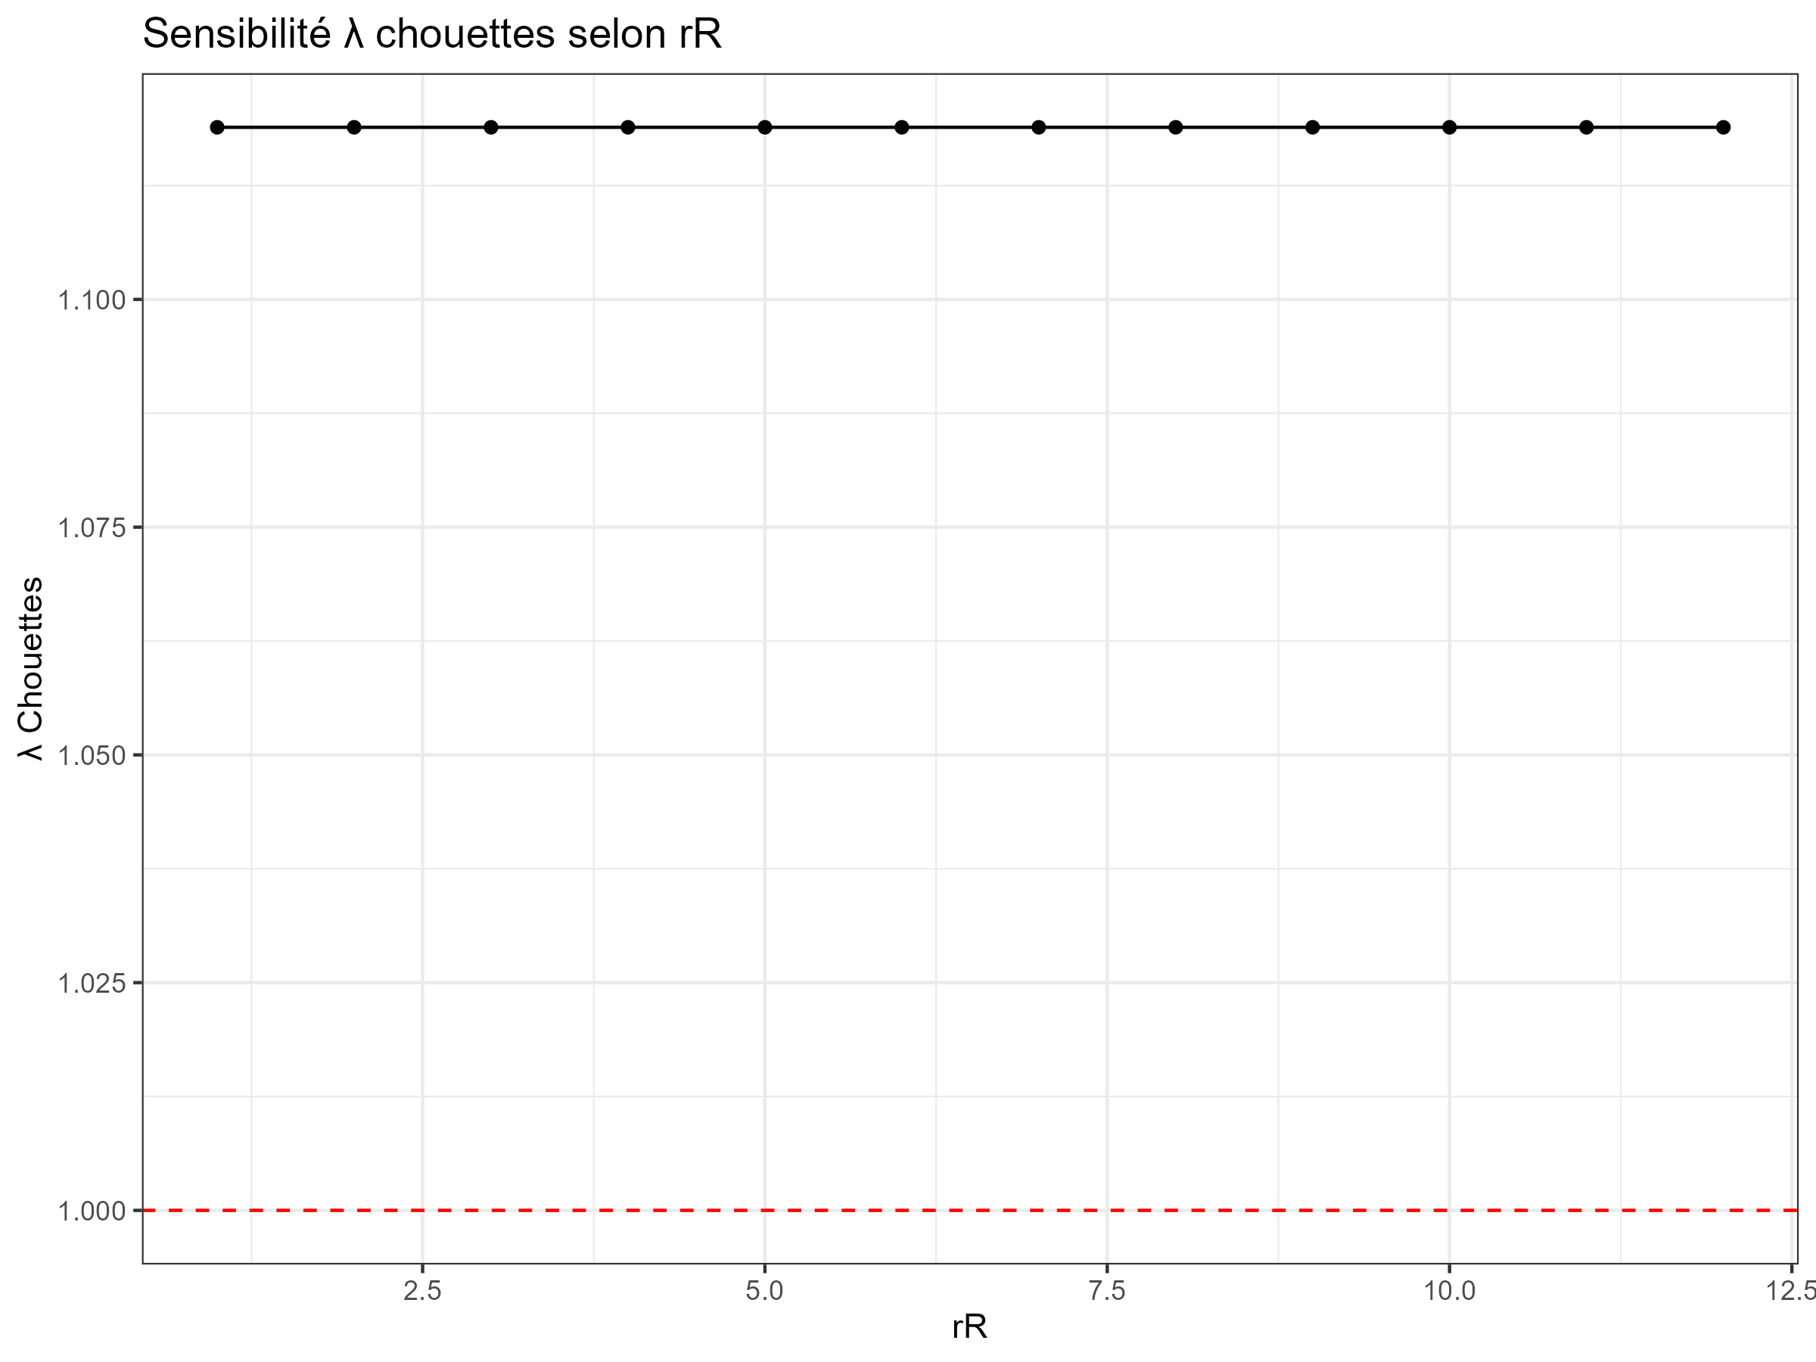
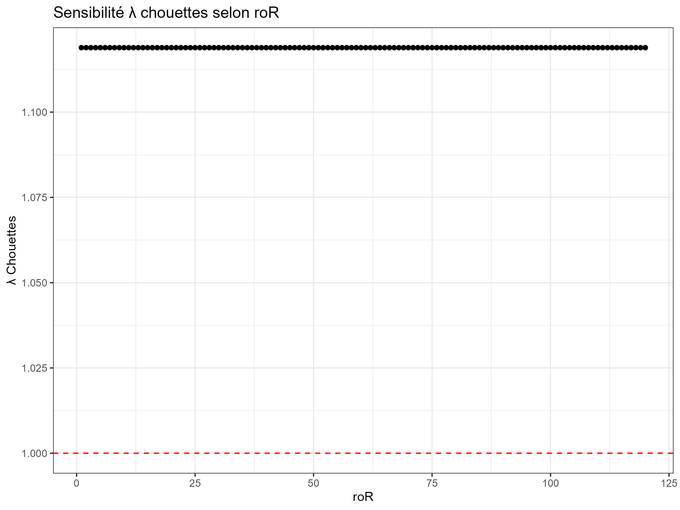

Slide 5
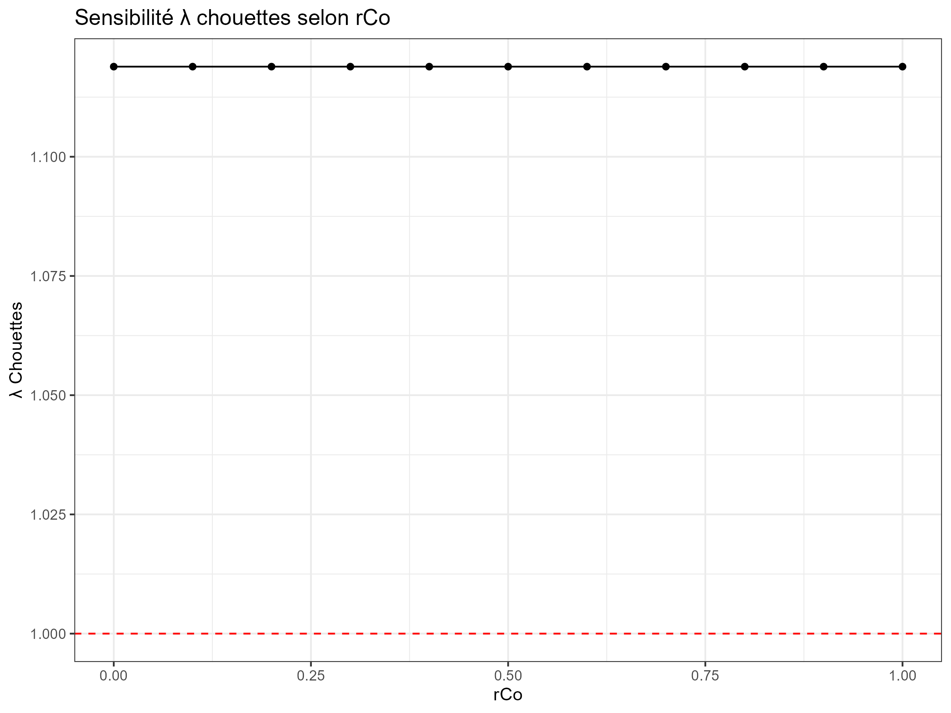
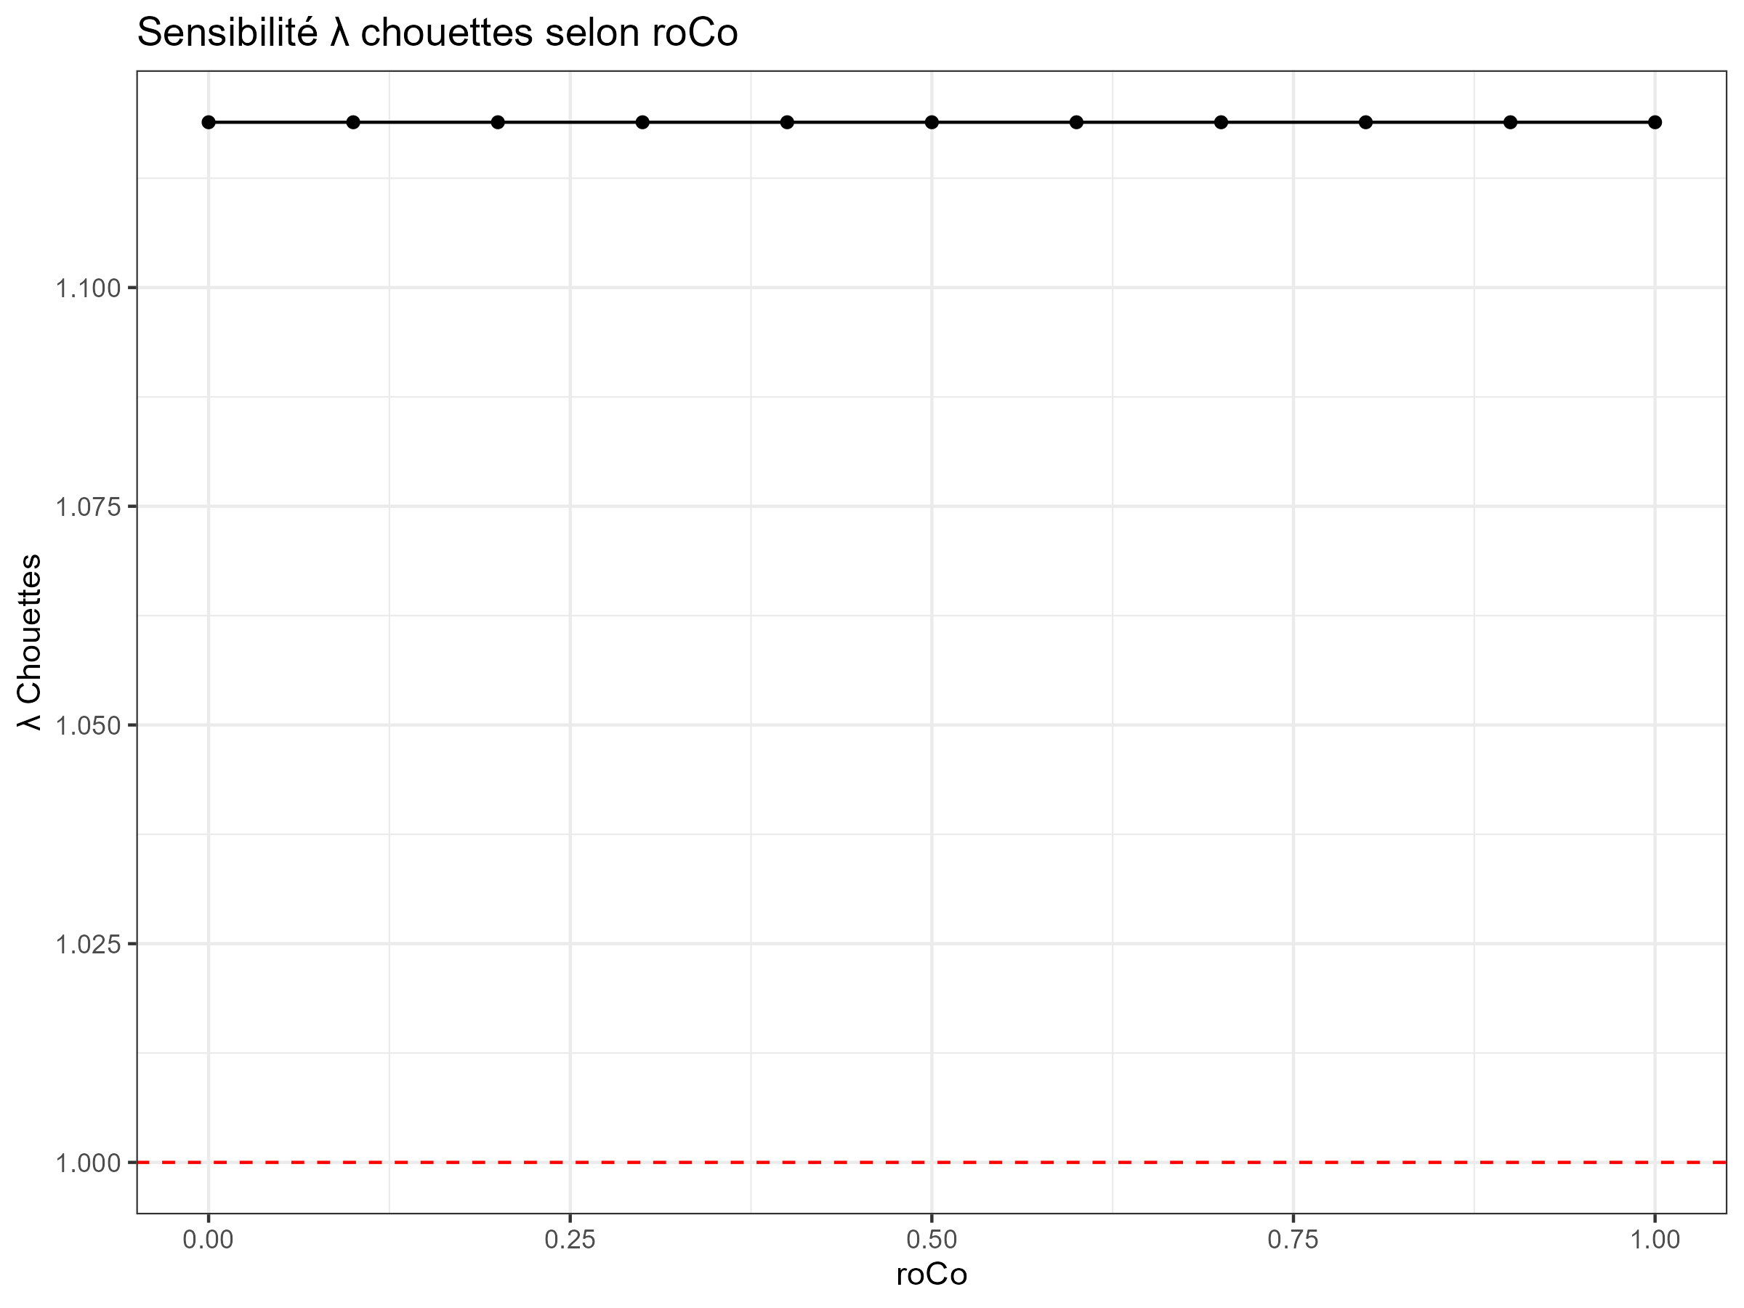

Slide 8
