Slide 1
DentaMind AI: AI-Assisted Dental X-ray Analysis System
Tooth detection, FDI numbering, segmentation, finding classification and validated draft reports for panoramic radiographs, with human review
B.Tech Generative AI MDM Capstone Project · Department of Computer Science and Engineering (AI & ML)
Pimpri Chinchwad College of Engineering, Pune · 2026-27
Group ID: ________ Students: ____________________ (PRN ________)
Guide: Prof. ____________________
Research prototype: not clinically validated, not for diagnosis
Notes:
Introduce the team and the project. DentaMind AI is a research prototype that reads a panoramic dental X-ray, finds and numbers each tooth, outlines it, suggests the closest of four trained findings, flags uncertain regions and drafts a structured report that a qualified person must review. Say clearly at the start that it is not a clinically validated diagnostic tool.

Slide 2
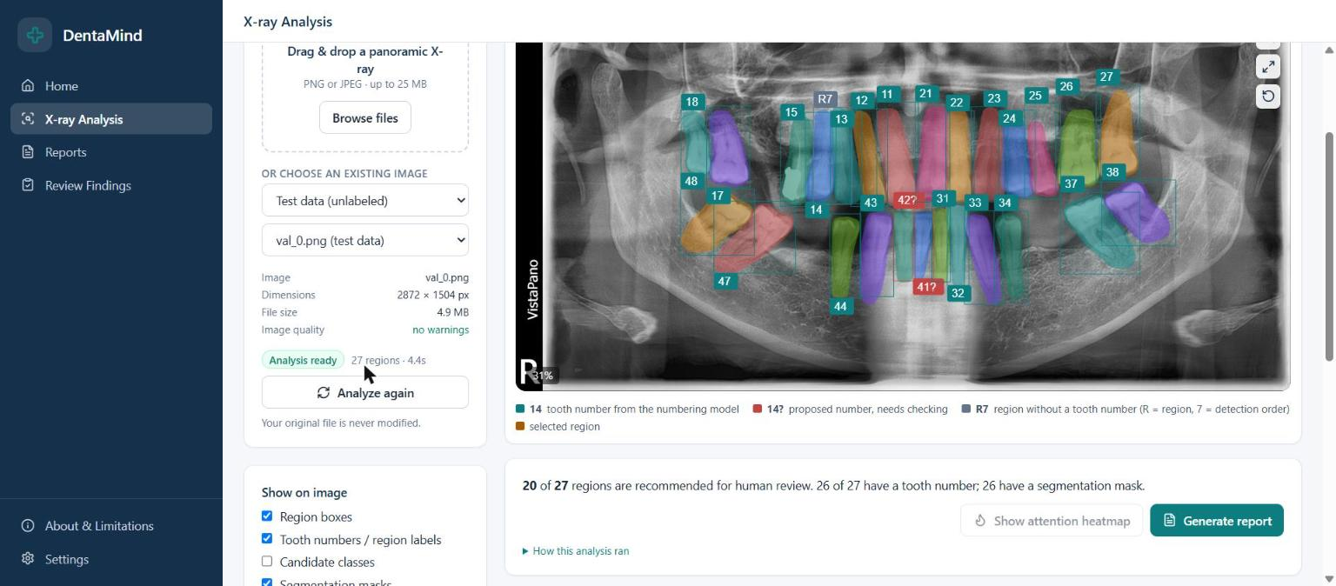
Introduction and motivation
Panoramic radiographs (OPGs) show all teeth in one image and are used for screening and treatment planning
Reading them is time-consuming, and subtle findings such as early caries or small periapical lesions are easy to miss
Deep learning detects and numbers teeth well, but finding-level classification is harder and published systems rarely show their uncertainty
Generative AI can turn structured model output into readable reports, but free text can state things the image does not support
Goal of DentaMind AI: a transparent assistant that shows evidence, flags doubt, and leaves the decision to a person
X-ray Analysis page: 27 regions on DENTEX test image val_0
DentaMind AI · B.Tech Capstone · PCCOE CSE (AI & ML) 2026-27
2 / 22
Notes:
Motivation. Panoramic X-rays are common but reading them is slow and error-prone. Explain that tooth detection is close to solved in the literature, while finding classification is harder. The generative part of our project is report drafting, and the main risk with generated text is unsupported claims, so we built a validator. The screenshot is the real application running on a DENTEX test image.

Slide 3
Problem statement
Build an end-to-end system that, given a panoramic radiograph, locates and numbers each tooth (FDI), outlines it, and suggests the closest of four findings: Caries, Deep Caries, Impacted, Periapical Lesion
Generate a structured, multilingual (English, Hindi, Marathi) draft report that contains only statements supported by the model evidence
Make uncertainty visible and route doubtful regions to a human reviewer
Evaluate honestly: separate validation from test data, avoid data leakage, and never promote a model on test-set results
Constraints: public DENTEX data only (no healthy-tooth labels, no patient IDs), one 4 GB laptop GPU, local deployment
DentaMind AI · B.Tech Capstone · PCCOE CSE (AI & ML) 2026-27
3 / 22
Notes:
Read the problem statement. Point out the constraints, because they explain many design choices: DENTEX labels findings only on affected teeth, so there is no healthy class; there are no patient IDs; and all training ran on an RTX 3050 laptop GPU with 4 GB of memory.

Slide 4
Objectives
O1: Audit and de-duplicate the DENTEX data and build leakage-free train / validation / calibration / test splits
O2: Train tooth detection, FDI numbering, instance segmentation and finding classification models
O3: Combine them in one inference pipeline with flip-TTA uncertainty, review flags and abstention
O4: Generate evidence-grounded draft reports in three languages with an automatic output validator
O5: Provide a web interface for analysis, reports and human review, with an auditable review trail
O6: Evaluate with precision, recall, F1, AP, Dice and calibration; test class-imbalance remedies under a pre-registered rule
DentaMind AI · B.Tech Capstone · PCCOE CSE (AI & ML) 2026-27
4 / 22
Notes:
Six objectives, which map to the chapters of the report. O6 is a research-integrity objective: every improvement had to pass a rule written before the experiment was run.

Slide 5
Literature review
Work | Task | Approach | Gap relevant to us
Lee et al., 2018 [14] | Caries, periapical films | GoogLeNet Inception v3 CNN | Single task; no tooth numbering or report
Tuzoff et al., 2019 [15] | Tooth detection + numbering | Faster R-CNN + CNN classifier | No pathology
Chen et al., 2019 [16] | Detection + numbering, periapical films | Faster R-CNN + rule-based post-processing | No findings or report
Ekert et al., 2019 [17] | Apical lesions, panoramic | Deep CNN | Single finding; no human-review loop
Hamamci et al., 2023 [11], [8] | DENTEX: enumeration + diagnosis | Hierarchical diffusion-based detector | Benchmark scores; no calibrated abstention or reporting
Jing et al., 2018 [5] | Medical report generation | Co-attention + hierarchical LSTM | Free text can be unsupported by evidence
Stephan et al., 2024 [6] | ChatGPT for OPG reports | LLM-assisted reporting study | Reports omitted key diagnostic details
Common pattern: strong single-task accuracy, but little attention to uncertainty, leakage control, or keeping generated text faithful to the evidence.
DentaMind AI · B.Tech Capstone · PCCOE CSE (AI & ML) 2026-27
5 / 22
Notes:
Summarise the literature in one table. Numbers in brackets refer to the reference list in the report. The key message: most dental AI work reports a single task on one split. Few works expose uncertainty or control generated text.

Slide 6
Research gap
Integration: tooth detection, numbering, segmentation and findings are usually studied separately
Uncertainty: closed-set classifiers always output a class, so a system needs abstention and review flags
Faithful generation: LLM reports can omit or invent findings, so output must be checked against the model evidence
Evaluation hygiene: duplicates across DENTEX folders, test-set reuse and selection bias are rarely audited
Imbalance: rare classes (Periapical Lesion is about 7 % of findings) are often reported only through accuracy
DentaMind addresses these with one pipeline, a validator, a review workflow, a leakage audit and pre-registered experiments
DentaMind AI · B.Tech Capstone · PCCOE CSE (AI & ML) 2026-27
6 / 22
Notes:
Explain each gap briefly. The last bullet links each gap to a component of DentaMind. Be careful not to claim we closed the clinical gap: we addressed it at the research-prototype level.

Slide 7
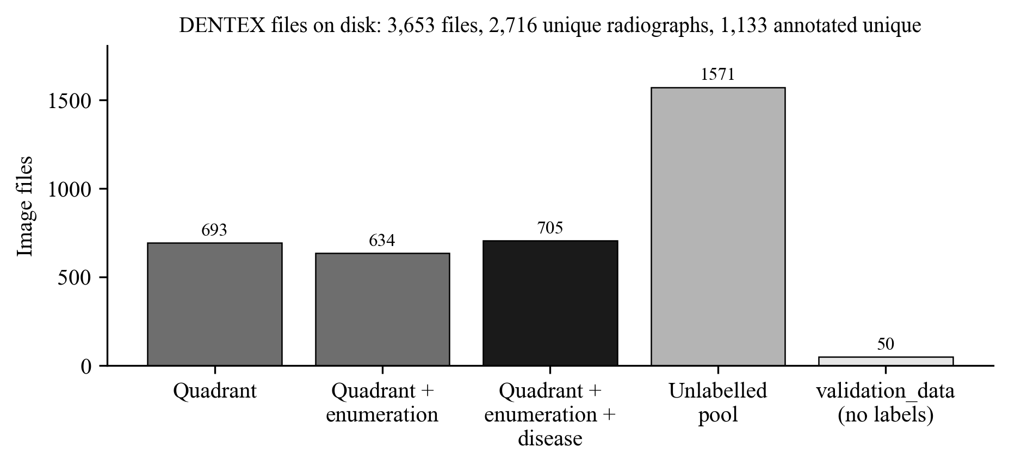
Dataset: DENTEX (MICCAI 2023 challenge)
3,653 PNG files in five folders: 2,716 unique radiographs after pixel-hash de-duplication
1,133 unique annotated radiographs; 1,598 unlabelled files; 50 unlabelled 'validation_data' files used as demo images
Three label levels: quadrant (693), quadrant + enumeration (634, 18,095 tooth polygons), + disease (705, 3,529 findings)
Finding labels: Caries 2,189 · Deep Caries 578 · Impacted 604 · Periapical Lesion 158
No healthy-tooth label and no patient identifier
638 groups of duplicate files exist across folders, so splitting by file name would leak films between train and test.
DentaMind AI · B.Tech Capstone · PCCOE CSE (AI & ML) 2026-27
7 / 22
Notes:
All counts come from Data/reports/dataset_audit.json. Emphasise the duplicate problem: the same film appears in several DENTEX folders, so we split by unique radiograph using pixel hashes. Three validation_data files are copies of test films; they are only used as demo images and are listed as a leakage-check warning.

Slide 8
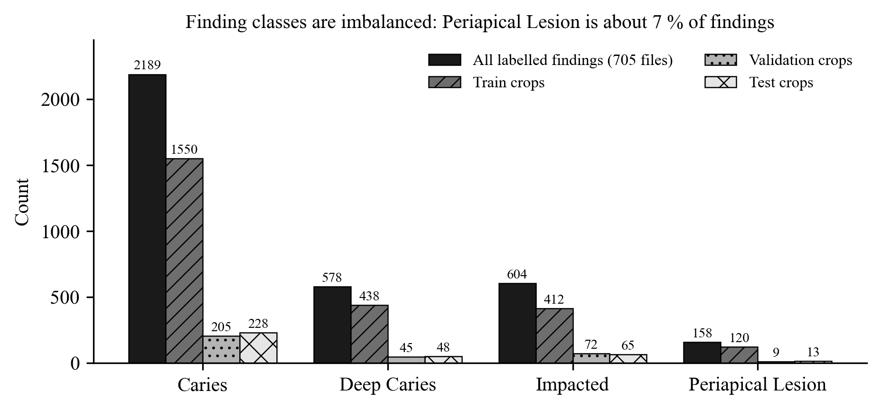
Splits and class imbalance
Duplicate-aware split per unique radiograph: train 794 · validation 113 · calibration 113 · test 113
Classifier crops (train): Caries 1,550 · Deep Caries 438 · Impacted 412 · Periapical Lesion 120
Validation crops: 331 (205 / 45 / 72 / 9); test crops: 354 (228 / 48 / 65 / 13)
Only 9 validation and 13 test Periapical Lesion examples, so rare-class metrics are very noisy
Leakage audit: 18 automated checks, 17 pass, 1 informational warning
DentaMind AI · B.Tech Capstone · PCCOE CSE (AI & ML) 2026-27
8 / 22
Notes:
The calibration split is used only to choose uncertainty thresholds. The test split is used once per checkpoint and recorded in a hash-chained ledger. Stress that with only 9 validation Periapical Lesion examples, one prediction changes recall by 11 percentage points.

Slide 9
Methodology: AI inference pipeline
1 Input radiograph
upload or test image (PNG/JPEG)
2 Pre-processing
load grayscale → 3-channel tensor
3 Tooth detection
Faster R-CNN, score ≥ 0.3
4 FDI numbering
Faster R-CNN, matched at IoU ≥ 0.5
5 Tooth segmentation
Mask R-CNN outline per tooth
6 Tooth crops
box + 10 % padding, 224 px, ImageNet norm.
Per-region output
box, FDI number, outline, closest class + raw score, flags
11 Human review
confirm / correct / reject
10 Draft report
evidence → template (EN/HI/MR) → validator
9 Flags & abstention
entropy ≥ 0.397 → 'no reliable class'
8 Uncertainty
flip-TTA disagreement, normalised entropy
7 Finding classifier
ResNet-50, 4 classes, argmax
Order of operations as implemented in backend/services/pipeline.py. Thresholds: detection score 0.3 (boxes below 0.5 are flagged as weak detections); abstention when normalised entropy ≥ 0.3966, chosen by Youden's J on the calibration split; flip-instability flag when TTA disagreement ≥ 0.0762. The classifier has no healthy class, so every detected tooth receives its closest of four findings; the system therefore presents a candidate for review, never a diagnosis.
DentaMind AI · B.Tech Capstone · PCCOE CSE (AI & ML) 2026-27
9 / 22
Notes:
Walk through the eleven steps. Grey boxes are trained networks. Detection runs first; numbering and segmentation are matched to detected boxes; each tooth is cropped with 10 % padding and classified. Flip test-time augmentation gives an uncertainty estimate. If normalised entropy is at least 0.397, a threshold chosen on the calibration split, the system abstains and shows 'No reliable class candidate'. The report generator only uses the structured evidence.

Slide 10
System architecture
Client (browser)
X-ray Analysis page
upload or pick image, viewer, regions
Reports page
draft report, EN / HI / MR
Review Findings page
decisions and approvals
Storage (local disk)
SQLite database
analyses, reports, reviews
Transport &
API gateway
React 18 + Vite proxy → FastAPI on 127.0.0.1:8000
API token added server-side · token auth · rate limits · input validation
Checkpoints
4 models + sidecars, SHA-256
Application
services
Analysis pipeline service
runs the four models, flags
Report service
template draft + output validator
Review & registry services
revisions, promotion, ledger
DENTEX images
manifest + split file
dentexmodel package
ML core
(PyTorch)
Detection
Faster R-CNN
Numbering
Faster R-CNN, 32 FDI
Segmentation
Mask R-CNN
Classifier
ResNet-50, 4 cls
Uncertainty
flip-TTA, entropy
Evaluation reports
JSON / MD + test ledger
Grey boxes are trained networks; white boxes are ordinary code. Everything runs on one machine and the API listens only on the loopback address. An optional OpenAI-compatible LLM path for report wording exists in code but is not configured, so all drafts in this project come from the deterministic template.
DentaMind AI · B.Tech Capstone · PCCOE CSE (AI & ML) 2026-27
10 / 22
Notes:
Three tiers: a React user interface, a FastAPI service layer, and the dentexmodel machine-learning package, with storage on the right. The API binds only to 127.0.0.1 and needs a token, which the Vite proxy adds on the server side so it is never exposed in the browser. Mention that the LLM path exists in code but is not configured; all drafts shown come from the deterministic template.

Slide 11
Technology stack
Layer | Technology | Role in DentaMind
Models | PyTorch 2.6, torchvision 0.21 (CUDA 12.4) | Faster R-CNN, Mask R-CNN, ResNet-50; training and inference
Backend | Python 3.13, FastAPI 0.143, Uvicorn | REST API, token auth, rate limits, pipeline and report services
Data | NumPy, Pillow, SQLite | Image loading, hashing, crops; analyses, reports and reviews
Frontend | React 18, Vite 5, Tailwind CSS, Recharts | Analysis viewer, reports, review queue, research pages
Reports | Template engine (EN / HI / MR) + validator | Evidence-grounded drafts; optional LLM path not configured
Quality | pytest (233 tests), scripts for leakage and ledger | Regression tests, integrity checks, reproducible evaluation
Hardware | NVIDIA RTX 3050 Laptop GPU, 4 GB | All training, evaluation and inference
DentaMind AI · B.Tech Capstone · PCCOE CSE (AI & ML) 2026-27
11 / 22
Notes:
Versions are taken from the project's virtual environment and package.json. Every model was trained on one 4 GB laptop GPU, which limited batch size: batch 2 for detection, 1 for segmentation, 32 for the classifier.

Slide 12
Implementation: trained models
Model | Architecture | Training data | Schedule
Tooth detection | Faster R-CNN R50-FPN, COCO-pretrained, 1 class | 440 train radiographs (enumeration set) | 12 epochs, batch 2, AdamW 1e-4, best epoch 9
FDI numbering | Faster R-CNN R50-FPN, 32 FDI classes | 440 train radiographs | 16 epochs, batch 2, AdamW 1e-4
Tooth segmentation | Mask R-CNN R50-FPN, polygon masks | 440 train radiographs | 8 epochs, batch 1, AdamW 1e-4
Finding classifier | ResNet-50, ImageNet-pretrained, 224 px crops | 2,520 crops from 476 radiographs | 15 epochs, batch 32, AdamW 3e-4, class weights
Every checkpoint has a JSON sidecar (classes, data counts, history) and a SHA-256 hash; new checkpoints also get a training manifest
Selection always used the validation split (best epoch by mAP or macro-F1); the test split was never used for selection
Reports are drafted from structured evidence and checked by a validator before they are shown
DentaMind AI · B.Tech Capstone · PCCOE CSE (AI & ML) 2026-27
12 / 22
Notes:
All four checkpoints are labelled 'legacy' because they were trained before the provenance manifests existed. We later showed that the production trainer reproduces the deployed classifier bit-for-bit with seed 42.

Slide 13
Training and evaluation workflow
DENTEX archives
3,653 PNG files in 5 folders
Dataset audit
pixel hashing → 2,716 unique films
Duplicate-aware split
1,133 annotated radiographs
Leakage check
18 checks: 17 pass, 1 warning
Train split
794 radiographs
Validation split
113 radiographs
Calibration split
113 radiographs
Test split
113 radiographs, ledger-gated
Training
AdamW, cosine LR, AMP; manifest with data + code hashes
Selection & comparison
best epoch; 5-seed runs; pre-registered rule
Uncertainty thresholds
Youden's J; temperature fit (not applied)
Historical test report
once per checkpoint, hash-chained ledger
All splits are assigned per unique radiograph, so duplicate files never cross splits.
Promotion gate (human decision)
needs a validation report + written justification; recorded with rollback
Never used for model selection, thresholds or promotion
DentaMind AI · B.Tech Capstone · PCCOE CSE (AI & ML) 2026-27
13 / 22
Notes:
Data flows from the archives through the audit and the duplicate-aware split. The leakage checker runs before any training. Validation is for selection, calibration for thresholds, and test is used once per checkpoint through a hash-chained ledger. Promotion to the live system is a human decision that needs a validation report and a written justification, and it can be rolled back.

Slide 14
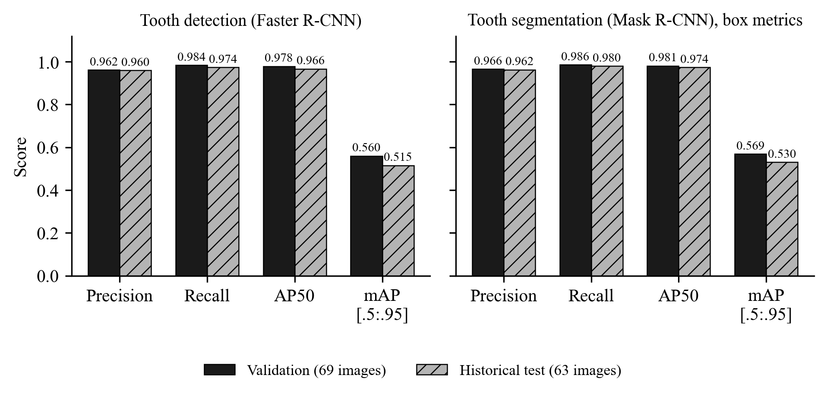
Results: detection and segmentation
Detection, validation: precision 0.962, recall 0.984, AP50 0.978, mAP 0.560
Detection, historical test: precision 0.960, recall 0.974, AP50 0.966, mAP 0.515
Segmentation, historical test: mask AP50 0.974, mean Dice 0.873, mean IoU 0.780 (matched teeth)
Numbering: exact FDI accuracy 93.6 % (validation) and 96.8 % (test) among matched teeth; quadrant accuracy 99.7 % / 99.9 %
  Operating point: score 0.3, IoU 0.5. mAP averages IoU 0.5 to 0.95, so it is lower: box placement is good but not pixel-tight
DentaMind AI · B.Tech Capstone · PCCOE CSE (AI & ML) 2026-27
14 / 22
Notes:
Validation numbers come from the validation split, which was also used for model selection, so they are slightly optimistic. Test numbers are historical: the test split was evaluated once per checkpoint and is now recorded as used. Tooth localisation is strong. The gap between AP50 and mAP means boxes overlap well but are not tight at strict IoU thresholds.

Slide 15
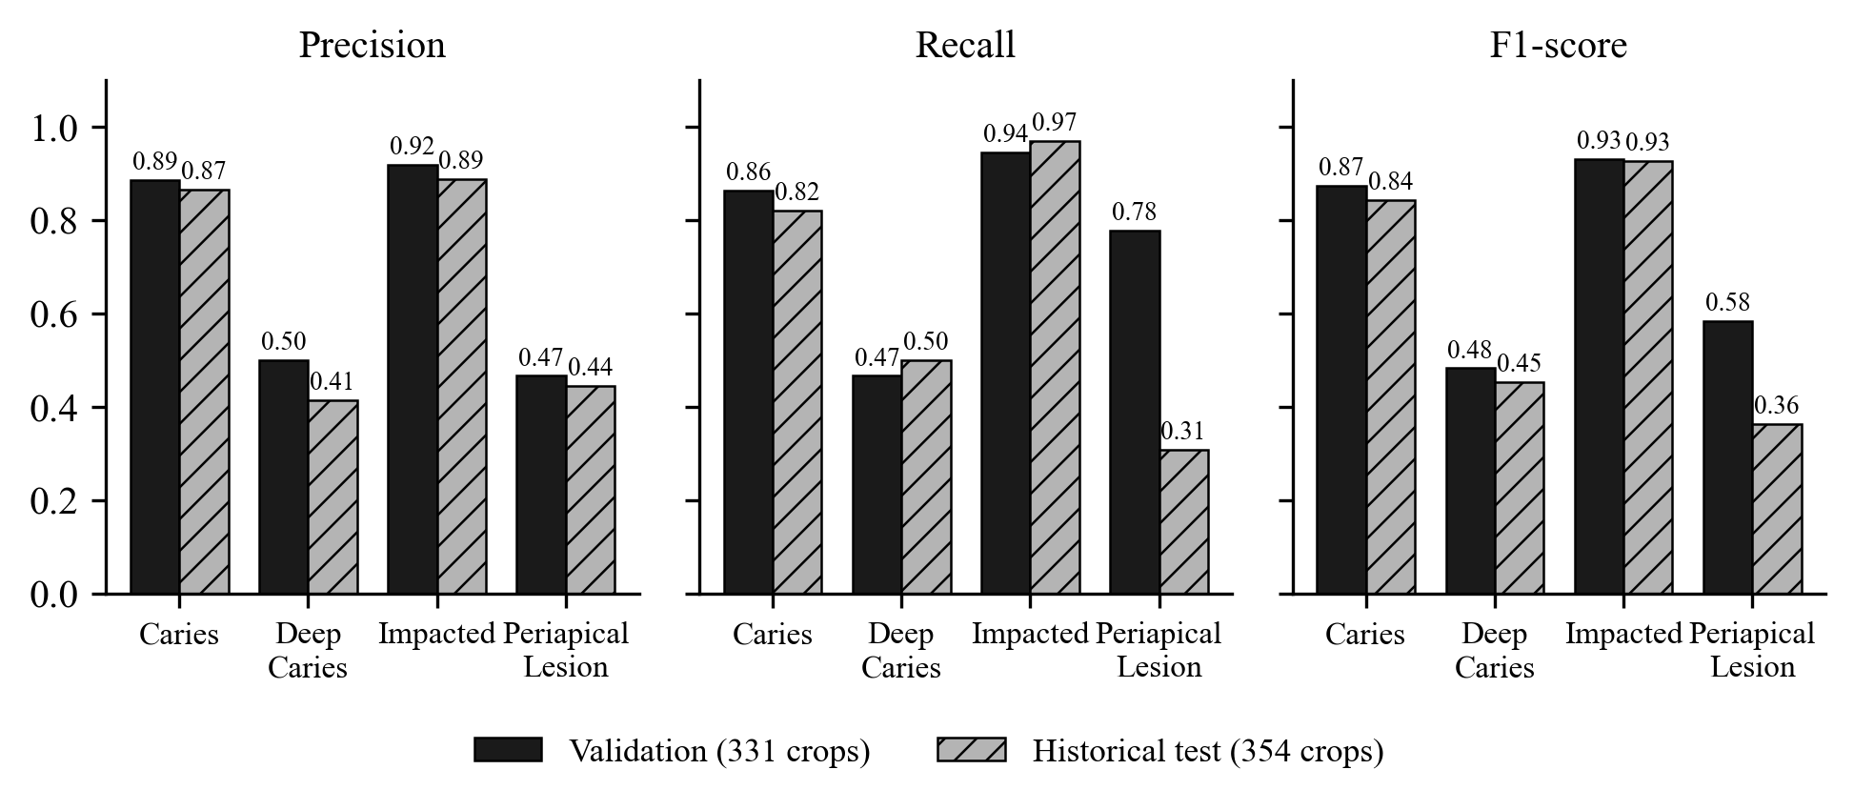
Results: finding classification (ground-truth boxes)
Split | Accuracy | Macro precision | Macro recall | Macro F1 | Crops
Validation | 0.825 | 0.693 | 0.763 | 0.718 | 331
Historical test | 0.785 | 0.653 | 0.649 | 0.646 | 354
Strong: Impacted (F1 0.93 / 0.93) and Caries (0.87 / 0.84)
Weak: Deep Caries (0.48 / 0.45), often confused with Caries
Periapical Lesion: F1 0.58 on 9 validation crops, 0.36 on 13 test crops
Test macro ROC-AUC 0.910
Accuracy hides the rare classes: macro-F1 weights all four findings equally and is our primary metric.
DentaMind AI · B.Tech Capstone · PCCOE CSE (AI & ML) 2026-27
15 / 22
Notes:
Values are validation / historical test. Explain why macro-F1 is lower than accuracy: Caries dominates, so accuracy mostly measures Caries. Deep Caries and Caries form a continuum of depth and the labels are hard to separate. Periapical Lesion has very few examples, so its scores have wide uncertainty.

Slide 16
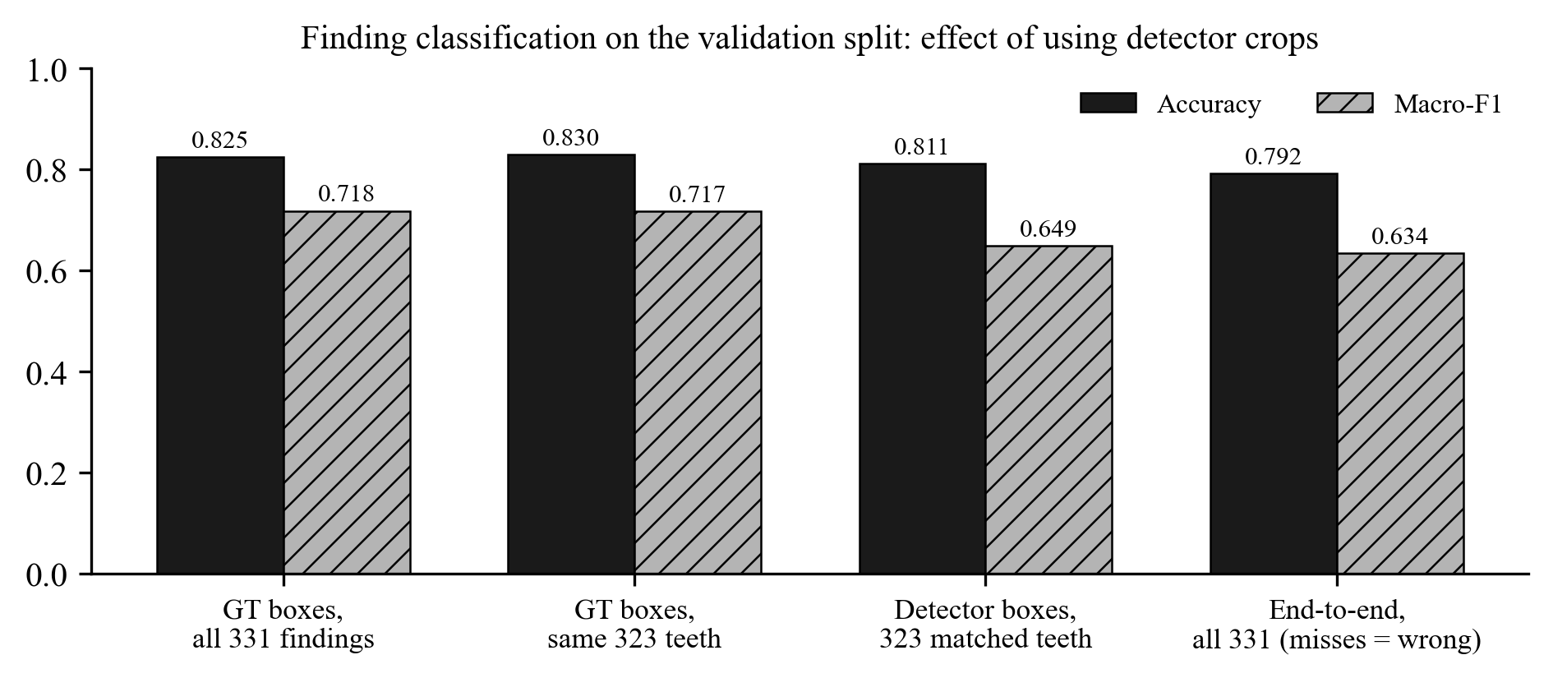
Results: ground-truth boxes vs detector boxes (validation)
Same 323 teeth: ground-truth crops give accuracy 0.830 and macro-F1 0.717; detector crops give 0.811 and 0.649
End-to-end over all 331 findings (misses count as wrong): accuracy 0.792, macro-F1 0.634
Detector on 24 fully annotated images: 716 of 719 teeth found, 17 false positives (P 0.977, R 0.996)
Crop sensitivity: about 10 % of predictions change even when detector and ground-truth boxes overlap at IoU above 0.9
1,580 of 1,903 detected teeth have no finding label but still receive a class (no healthy class)
DentaMind AI · B.Tech Capstone · PCCOE CSE (AI & ML) 2026-27
16 / 22
Notes:
This is the most honest view of the deployed system: classification on the detector's own crops. The drop in macro-F1 is mostly on the rare classes: Deep Caries end-to-end recall 0.33 and Periapical Lesion 4 of 9. Errors decompose into 248 correct with both box types, 41 wrong with both, 20 correct only with ground-truth boxes, 14 correct only with detector boxes, and 8 unmatched.

Slide 17
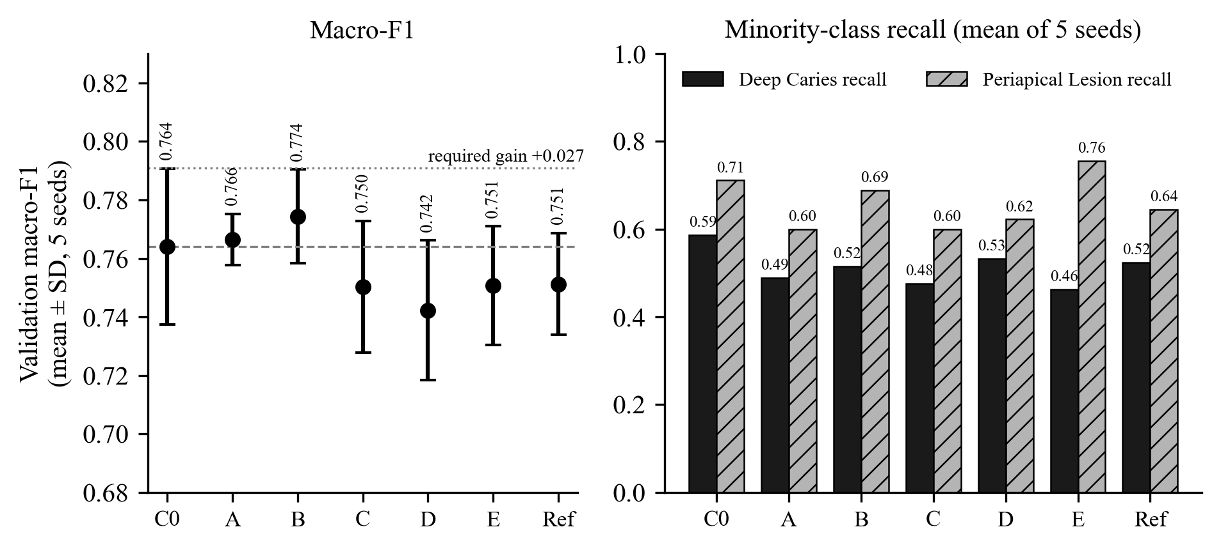
Class-imbalance experiments
Pre-registered rule: paired macro-F1 gain above 0.027 in at least 4 of 5 seeds, without lowering minority recall
A weighted sampler +0.002 (2/5) · B oversampling +0.010 (3/5) · C focal loss -0.014 (0/5)
D sqrt weights -0.022 (1/5) · E minority-only augmentation -0.013 (1/5)
No variant passed: A to D gained precision but lost Deep Caries and Periapical Lesion recall; E lost Deep Caries recall in 5/5 seeds
Threshold tuning: +0.023 in-sample, but -0.005 under cross-fitting, so argmax was kept
Not promoted: no gain beyond seed-to-seed noise (SD 0.027), and the minority classes became worse.
DentaMind AI · B.Tech Capstone · PCCOE CSE (AI & ML) 2026-27
17 / 22
Notes:
All runs used the validation split, five seeds (42 to 46), and changed one factor at a time against the inverse-frequency-weighted baseline C0. The baseline re-run reproduced C0 bit-for-bit, so the comparison is deterministic. Validation was used for both epoch selection and reporting, which gives every method the same optimistic bias. The crop-jitter candidate and the training-recipe comparison also failed their pre-registered rules.

Slide 18
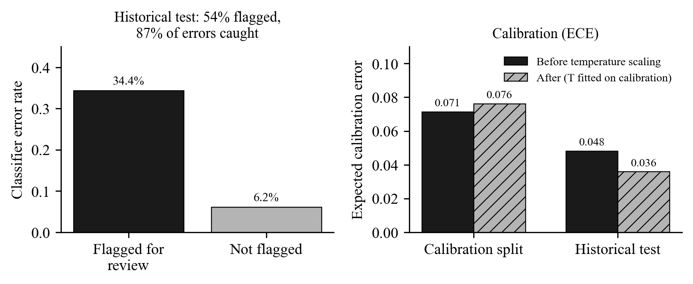
Uncertainty, abstention and recipe study
Flip-TTA plus normalised entropy; review threshold 0.397 chosen by Youden's J on the calibration split
Historical test: 54 % of crops flagged; they contain 87 % of the errors (error rate 34 % flagged vs 6 % not flagged)
ECE 0.048 on test; temperature T = 0.95 (fitted on calibration) is reported but not applied
Recipe study: the production trainer reproduces the deployed classifier bit-for-bit (seed 42); its five seeds give detector-crop macro-F1 0.722 ± 0.045, and the deployed run is the weakest (0.651)
The alternative recipe (0.724 ± 0.015) did not pass the rule either (10 of 25 cross pairs), so nothing was promoted
DentaMind AI · B.Tech Capstone · PCCOE CSE (AI & ML) 2026-27
18 / 22
Notes:
Uncertainty works as a triage signal: flagged crops are about five times more likely to be wrong. The cost is that more than half of all crops are flagged, which is high for a clinical workflow. The recipe study found that seed variation alone gives a 0.125 spread in detector-crop macro-F1, which is larger than any imbalance remedy we tried.

Slide 19
Human-review workflow
Needs review
abstained, weak detection, unstable, unnumbered
yes
Any flag?
Reviewer decision
confirm · correct class · reject · set tooth number · mark unassigned · specialist review · unusable image
AI output per region
box, FDI number, closest class + score, flags
No flag
shown in the table, still open to review
no
Review record (SQLite)
revisioned; previous output kept; reviewer + self-declared role
The AI never finalises a finding. Every region stays editable, approvals need a second person, and reviewed images only become training data after the leakage rules are checked.
Report draft marked 'reviewed'
the clinician stays responsible for any diagnosis
Approval by a second person
approved or rejected; identical resubmission refused
Candidate model
validation report → human promotion gate
Training-eligibility check
only unassigned images, never a copy of a labelled film
DentaMind AI · B.Tech Capstone · PCCOE CSE (AI & ML) 2026-27
19 / 22
Notes:
The system never finalises a finding. Each region can be confirmed, corrected or rejected, and every decision is a new revision that keeps the previous output. A second person approves or rejects. Approved reviews only become training data if the image is unassigned and is not a copy of any labelled film, which prevents leakage into validation or test.

Slide 20
Limitations
No healthy class: every detected tooth receives one of four findings; on test image val_0, 18 of 27 regions abstained
Rare classes: Deep Caries recall 0.33 and Periapical Lesion 4/9 end-to-end on validation; tiny support makes these estimates unstable
Crop sensitivity: small box shifts change about 10 % of predictions; the detector-box classifier is weaker than the ground-truth-box classifier
No independent external validation: one public dataset, no patient IDs (patient-level separation unproven), no other scanners or sites
The test split was used historically; thresholds and the LLM path are provisional; Hindi and Marathi text was not reviewed by dental professionals
Not clinically validated, not a medical device, not for diagnosis
DentaMind AI · B.Tech Capstone · PCCOE CSE (AI & ML) 2026-27
20 / 22
Notes:
Be direct about limitations; examiners value this. The missing healthy class is the biggest one: it explains the high abstention rate and why the classifier output is called a 'closest class'. We have no external dataset, so we cannot say how the system generalises to other clinics or machines.

Slide 21
Conclusion and future work
Built a working local system: detection (validation recall 0.984), numbering (93.6 % exact), segmentation (test Dice 0.873) and a four-class finding classifier
Classification is the weak link (validation macro-F1 0.718; 0.634 end-to-end), and we report this openly instead of tuning on the test split
Reports are generated only from evidence and checked by a validator; humans stay in control through review and approval
Future: add healthy and 'other' labels (open-set), collect more Periapical Lesion and Deep Caries cases, and train on detector-style crops
Future: external multi-centre validation with patient-level splits, a reader study with dentists, and a validated LLM wording layer
Future: calibrated probabilities, tooth-level heatmaps, and DICOM / PACS integration
DentaMind AI · B.Tech Capstone · PCCOE CSE (AI & ML) 2026-27
21 / 22
Notes:
Conclude with what works and what does not. The integrity tooling (leakage audit, ledger, pre-registered rules) is a reusable contribution even though the imbalance remedies did not help. Future work should start with data, especially healthy teeth and more rare-class examples, before trying more algorithms.

Slide 22
Key references and thank you
[11] I. E. Hamamci et al., DENTEX benchmark, arXiv:2305.19112, 2023
[8] I. E. Hamamci et al., Diffusion-based hierarchical multi-label object detection, MICCAI 2023, LNCS 14225
[18] S. Ren et al., Faster R-CNN, NeurIPS 2015 · [19] K. He et al., Mask R-CNN, ICCV 2017 · [20] K. He et al., ResNet, CVPR 2016
[26] C. Guo et al., On calibration of modern neural networks, ICML 2017
[27] G. Wang et al., Test-time augmentation uncertainty, Neurocomputing 335, 2019
[12] S. Kaufman et al., Leakage in data mining, ACM TKDD 6(4), 2012
Full IEEE reference list: Project Report, References chapter
Thank you. Questions?
DentaMind AI · B.Tech Capstone · PCCOE CSE (AI & ML) 2026-27
22 / 22
Notes:
Show the main references. The numbering matches the project report. Invite questions. If asked about clinical use, repeat that this is a research prototype that has not been clinically validated.

