Slide 1

SESSION 2026–2027
EduIdentityAI: Student Authentication, Record & Guidance System
PRESENTED BY:
SAURABH SINGH
SARVENDRA SINGH
SAMARTH
SAKSHAR JAIN
Roll numbers: to be added
UNDER SUPERVISION OF:
Faculty Supervisor Name
Designation to be confirmed
CSE (AIML)
G.L. Bajaj Institute of Technology & Management

Slide 2
INTRODUCTION OF THE PROJECT
A connected academic identity and support portal
EduIdentityAI brings sign-in, academic records, policy lookup and traceable activity into one web application. The current repository is a prototype foundation, not a fully validated production identity service.
IDENTITY & ACCESS
ACADEMIC RECORDS
GUIDANCE & TRACEABILITY
Registration, password hashing, JWT sessions, role checks and an institutional approval state.
Student create/read/update/delete routes and explainable rules based on CGPA, attendance and backlogs.
Policy-query endpoint, chat/notices, per-user work logs, WebSocket telemetry and health/metrics routes.
IMPORTANT SCOPE NOTE
The portal includes student, faculty and admin selectors. Face/voice/OCR checks and APAAR/DigiLocker responses are simulated or sandboxed; the current policy retriever uses keyword overlap, not a verified dense-embedding/LLM pipeline.

Slide 3
LITERATURE SURVEY (12 SELECTED STUDIES)
STUDY / YEAR | CORE IDEA / METHOD | PROJECT RELEVANCE / GAP
[1] Jain, Ross & Prabhakar (2004) An Introduction to Biometric Recognition | Reviews biometric traits, identity matching, error trade-offs and privacy concerns. | Supports identity-verification design; requires real evaluation data and privacy safeguards.
[2] Ross & Jain (2003) Information Fusion in Biometrics | Explains fusion of multiple biometric matchers to reduce weaknesses of single traits. | Motivates face/voice/OCR fusion; project scores are simulated rather than measured.
[3] Phillips et al. (2000) Evaluating Biometric Systems | Defines systematic methods for assessing face, voice and other biometric systems. | Use FAR/FRR, quality and spoofing tests; no genuine accuracy benchmark was reproduced.
[4] Ferraiolo & Kuhn (1992) Role-Based Access Controls | Foundational model for assigning permissions through organizational roles. | Project contains role guards; complete endpoint authorization still needs review.
[5] Romero & Ventura (2010) Educational Data Mining: State of the Art | Surveys analytical methods for extracting insight from educational data. | Supports a future validated student-risk model; current guidance is threshold-based.
[6] Macfadyen & Dawson (2010) LMS Early-Warning System | Studies online learning activity indicators related to academic outcomes. | Early intervention is promising but needs real student data and outcome validation.
[7] Papamitsiou & Economides (2014) Learning Analytics & EDM in Practice | Reviews empirical studies of learning analytics and educational data mining. | Guidance should be evidence-led, interpretable and designed with privacy in mind.
[8] Karpukhin et al. (2020) Dense Passage Retrieval | Uses a trained dual-encoder to retrieve semantically relevant passages for QA. | Potential upgrade path; current `vector_store.py` implements keyword-overlap scoring.
[9] Lewis et al. (2020) Retrieval-Augmented Generation | Combines document retrieval with language generation for knowledge-intensive tasks. | Current query route returns matched KB content; it does not run a live RAG generator.
[10] Roslan & Chen (2022) EDM for Student Prediction | Reviews student-performance prediction studies and common data-mining methods. | Suggests benchmarking predictions; current system has no trained performance model.
[11] Alwarthan (2022) Predicting Higher-Ed Performance | Systematic review of data-mining approaches to higher-education performance. | CGPA/attendance/backlog rules are explainable baselines, not ML predictions.
[12] Rustemi et al. (2023) Academic Certificate Verification | Reviews blockchain-based academic certificate systems, benefits and adoption gaps. | Credential verification remains sandboxed; blockchain is future scope, not implemented.

Slide 4
EXISTING SYSTEM / RELATED WORK
Baseline: separate identity, record and advising workflows
FRAGMENTED PORTALS
MANUAL CHECKS
GENERIC GUIDANCE
LIMITED AUDITABILITY
Authentication, records, notices and advising may live in different systems or teams.
Document checks and repeated data entry can delay verification and create stale copies.
Static FAQs or unstructured advising make it harder to tie help to attendance and backlogs.
Local logs or disconnected activity trails complicate session continuity and review.
PROJECT BASELINE
A FastAPI web API, SQLAlchemy data models, a Lit/Alpine.js portal, a small local policy knowledge base and per-user activity logs. EduIdentityAI integrates these patterns while leaving external identity verification and AI claims explicitly unvalidated.

Slide 5
MOTIVATION
Why unify these workflows?
01 TRUST
02 EARLIER SUPPORT
03 TRACEABILITY
Keep identity, role and record access in a common workflow; surface where approval or verification is still pending.
Turn attendance, CGPA and backlog fields into clear next-step messages that students and mentors can discuss.
Preserve user-scoped work snapshots and expose live service signals for troubleshooting and review.
Design principle: demonstrate an integrated student-services prototype without confusing simulation, policy heuristics or future integrations with proven production capability.

Slide 6
PROBLEM STATEMENT
How can an academic portal bring identity checks, student records and actionable guidance into one maintainable workflow—while clearly separating verified data from simulated integrations?
IDENTITY CONFIDENCE
RECORD CONTINUITY
GUIDANCE QUALITY
Role access and multi-step sign-in require consistent authorization, safe secrets and verifiable credential checks.
Academic fields, mentor communications and session activity need dependable storage and carefully scoped access.
Rule-based recommendations and keyword retrieval need evaluation for correctness, fairness and usefulness.
Core challenge: integrate the workflows, then validate security, advice quality and service behaviour before real student deployment.

Slide 7
OBJECTIVES
01 ACCESS CONTROL
Implement sign-in, password hashing, JWT sessions and role-based guards.
Next: secure configuration, route-wide authorization tests and production OTP delivery.
02 CENTRAL RECORDS
Provide student record CRUD and a shared relational data model.
Next: validate data quality, audit critical changes and enforce privacy-by-role.
03 GUIDANCE
Generate readable recommendations from CGPA, attendance and backlog fields; answer sample policy queries.
Next: retrieve from authoritative policy sources and evaluate relevance.
04 OPERATIONS
Record per-user activity, expose WebSocket telemetry and service metrics.
Next: harden retention, cloud upload and monitoring controls.
Scope status: 4 prototype objectives represented in code; live biometric, official credential and model-validation work remains.

Slide 8
PROPOSED METHODOLOGY
01
02
03
04
05
MAP NEEDS
MODEL DATA
BUILD API + UI
ADD SERVICES
VALIDATE
Roles, identity fields, academic records and student support questions.
SQLAlchemy entities, schemas, SQLite default and PostgreSQL option.
FastAPI routers with Lit/Alpine.js portal calling REST endpoints.
Rules-based guidance, keyword KB lookup, work logs and WebSocket stream.
Run tests, inspect endpoints and label real vs simulated behaviour.
Validation finding: the supplied automated test suite currently stops at import time because `Text` is undefined in `backend/models/student.py`; no test cases execute until this is fixed.

Slide 9
DESCRIPTION OF PROJECT (IN FORM OF DIAGRAM)
CURRENT PROTOTYPE ARCHITECTURE
SERVICE MODULES
PERSISTENCE / SIGNALS
Authentication & RBAC
• SQLAlchemy → SQLite / PostgreSQL
USER ROLES
WEB PORTAL
FASTAPI
Student
Faculty
Admin
Lit + Alpine.js
REST + WebSocket
Student records
• sample_students.json knowledge base
Guidance + policy query
• Per-user JSON / JSONL logs
Chat / notices / work logs
• /health · /metrics · audit stream
SIMULATED / FUTURE ADAPTERS: biometric models · official APAAR/DigiLocker API · live cloud bucket sync
BASE WORK
MODIFICATIONS
EXPECTED RESULT
CONCLUSION
Basic portal + student database
Guidance, role checks and activity logs
More coherent academic workflow
Prototype; security and integrations need validation

Slide 10
HARDWARE & SOFTWARE REQUIREMENTS
HARDWARE / RUNTIME
SOFTWARE STACK
• Modern dual-core CPU (Core i5 / Ryzen 5 class or equivalent)
• 8 GB RAM baseline; 16 GB recommended for development tools
• ~10 GB free SSD space for source, dependencies and sample data
• Current simulated biometric pipeline does not require a GPU
• GPU / accelerator only for future real neural inference
• Windows / Linux / macOS; Python 3.10+ (repository targets Python 3.13)
• FastAPI, SQLAlchemy, Pydantic, Alembic, python-jose / Passlib
• Node.js 18+ and npm/Vite; Lit and Alpine.js frontend
• SQLite by default; PostgreSQL 15 defined in container setup
• A modern browser; Docker Compose is optional for supporting services
Note: hardware figures are practical development guidance, not a measured production sizing study.

Slide 11
PROJECT DETAILS (DESCRIPTION OF VARIOUS MODULES)
MODULE 1 | AUTHENTICATION & ACCESS
Registration / login, password hashing, JWT session tokens, role guards and institutional approval state. OTP is currently stored in memory; the math challenge is implemented in the frontend flow.
MODULE 2 | ACADEMIC RECORDS
Student CRUD through FastAPI + SQLAlchemy, student profile fields, and guidance rules based on attendance, CGPA and active backlogs.
MODULE 3 | GUIDANCE & OPERATIONS
Keyword-based policy lookup, URL heuristic checks, mentor/community messaging, notices, user-scoped activity logs, WebSocket telemetry and Prometheus endpoints.
Cross-cutting: SQLAlchemy models · SQLite/PostgreSQL configuration · sample knowledge base · local file storage

Slide 12
PROJECT DETAILS (DESCRIPTION OF VARIOUS MODULES)
AUTHENTICATION
STUDENT RECORDS
GUIDANCE / KB
JWT-based login; password hashing; role dependencies. OTP storage is in-process, not a persistent verification service.
REST routes for listing, creating, updating and deleting records. Write paths use role checks; read-path permissions need a full security audit.
Attendance threshold (75%), CGPA bands and backlog messages. Policy lookup uses a local JSON knowledge base and simple keyword overlap.
BIOMETRICS / IDs
MESSAGING / LOGS
Face, voice and OCR return random confidence values; APAAR checks ID length; DigiLocker response is fixed sandbox data.
Mentor chat, community groups, notices, per-user last-work / login history / activity stream, WebSocket and metrics endpoints.
Project claim discipline: simulated adapters are shown as simulated; real services must be integrated and evaluated separately.

Slide 13
RESULT ANALYSIS AND DISCUSSION
AREA | EVIDENCE IN REPOSITORY | REVIEW OUTCOME
Application architecture | FastAPI routes + Lit/Alpine.js portal + SQLAlchemy models are present in the repository. | Source artifacts present; runtime startup needs a blocker fix.
Student record logic | CRUD routes and threshold-based advice for attendance / CGPA / backlogs are implemented in code. | Logic found; full integration tests could not run.
Policy query | `vector_store.py` scores lexical keyword overlap against `sample_students.json`. | Prototype retrieval only; no dense-model relevance result verified.
Biometric / credential checks | Biometric confidence is randomized; APAAR and DigiLocker routes return sandbox/stub results. | Simulation only; no real identity verification or accuracy result.
Automated validation | `backend/tests/test_api.py` is included, but pytest fails during import. | Blocker: `NameError: Text is not defined` in `backend/models/student.py`; 0 tests executed.
No independently reproducible latency, biometric-accuracy or RAG-precision benchmark was established in this review.

Slide 14
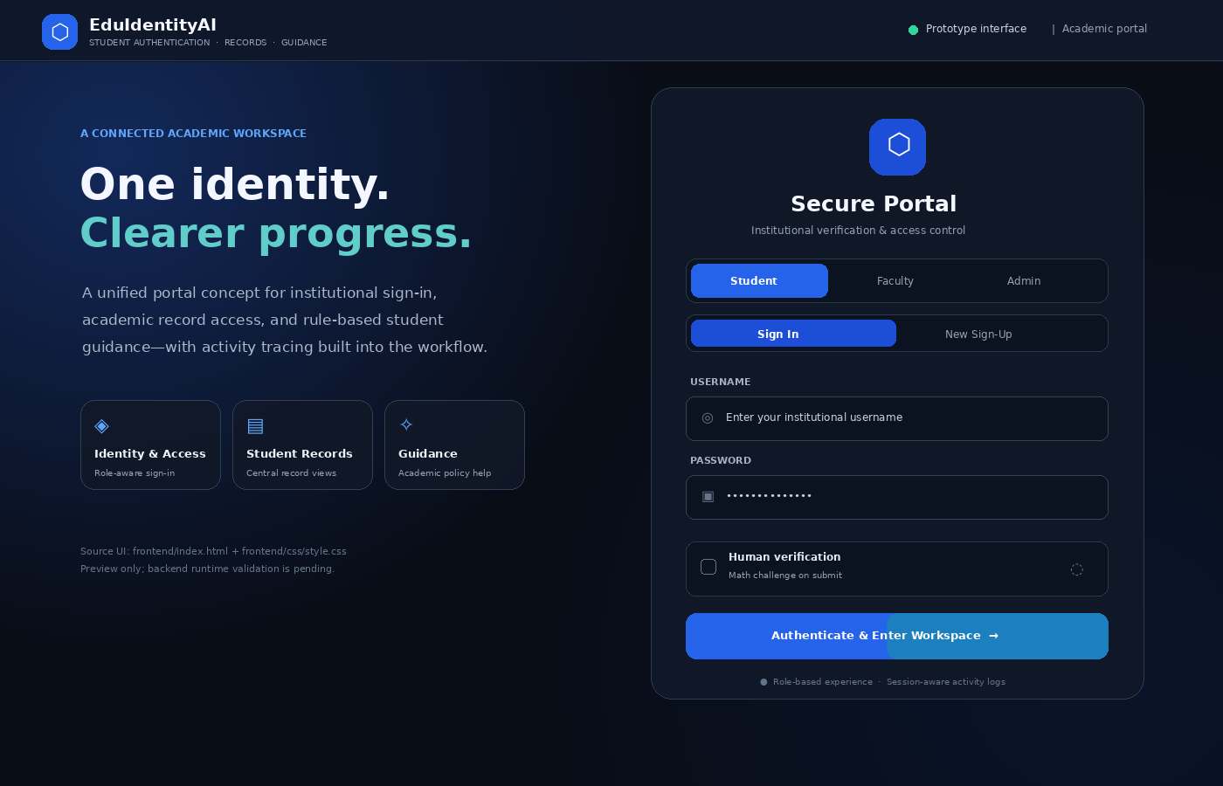
SCREENSHOTS OF RESULT (PROTOTYPE UI PREVIEW)
VISIBLE IN THE FRONTEND
• Student / faculty / admin role selector
• Sign-in and new sign-up views
• Math challenge flow in frontend JavaScript
• Workspace sections for records, guidance and communities
RUNTIME VALIDATION
The screenshot is a source-inspired UI preview, not a live authenticated session. Backend startup is currently blocked by the missing `Text` import.
Portal mock preview based on `frontend/index.html` and `frontend/css/style.css`.

Slide 15
CONCLUSION & FUTURE SCOPE
CONCLUSION
EduIdentityAI demonstrates a modular path for connecting sign-in, academic record management, explainable rules-based guidance and activity tracing in a single educational portal.
PRIORITY FUTURE WORK
01
Fix startup + validation
Import `Text`, rerun automated tests, add CI and endpoint-level tests.
02
Harden access & privacy
Externalize secrets, narrow CORS, review public reads, token policy, OTP limits and log retention.
03
Replace simulations
Integrate real biometric inference and authorized national credential APIs; measure FAR/FRR.
04
Upgrade guidance
Add embedding retrieval / grounded generation, policy freshness and relevance evaluation.
05
Production operations
Implement live cloud object upload, backups, observability, load testing and role governance.

Slide 16
REFERENCES
BIOMETRICS, SECURITY & EARLY WARNING
LEARNING ANALYTICS, RETRIEVAL & CREDENTIALS
[1] Jain, A. K., Ross, A., & Prabhakar, S. (2004). An introduction to biometric recognition. IEEE Transactions on Circuits and Systems for Video Technology, 14(1), 4–20. https://doi.org/10.1109/TCSVT.2003.818349
[2] Ross, A., & Jain, A. (2003). Information fusion in biometrics. Pattern Recognition Letters, 24(13), 2115–2125. https://doi.org/10.1016/S0167-8655(03)00079-5
[3] Phillips, P. J., Martin, A., Wilson, C. L., & Przybocki, M. (2000). Introduction to evaluating biometric systems (NIST IR 6384). National Institute of Standards and Technology. https://www.nist.gov/publications/introduction-evaluating-biometric-systems-0
[4] Ferraiolo, D. F., & Kuhn, D. R. (1992). Role-based access controls. Proceedings of the 15th National Computer Security Conference. NIST. https://www.nist.gov/publications/role-based-access-controls
[5] Romero, C., & Ventura, S. (2010). Educational data mining: A review of the state of the art. IEEE Transactions on Systems, Man, and Cybernetics, Part C, 40(6), 601–618. https://doi.org/10.1109/TSMCC.2010.2053532
[6] Macfadyen, L. P., & Dawson, S. (2010). Mining LMS data to develop an “early warning system” for educators: A proof of concept. Computers & Education, 54(2), 588–599. https://doi.org/10.1016/j.compedu.2009.09.008
[7] Papamitsiou, Z., & Economides, A. A. (2014). Learning analytics and educational data mining in practice: A systematic literature review of empirical evidence. Educational Technology & Society, 17(4), 49–64. https://eric.ed.gov/?id=EJ1045537
[8] Karpukhin, V., et al. (2020). Dense passage retrieval for open-domain question answering. Proceedings of EMNLP 2020, 6769–6781. https://doi.org/10.18653/v1/2020.emnlp-main.550
[9] Lewis, P., et al. (2020). Retrieval-augmented generation for knowledge-intensive NLP tasks. Advances in Neural Information Processing Systems, 33. https://arxiv.org/abs/2005.11401
[10] Roslan, M. H., & Chen, C. J. (2022). Educational data mining for student performance prediction: A systematic literature review (2015–2021). International Journal of Emerging Technologies in Learning, 17(5), 147–179. https://doi.org/10.3991/ijet.v17i05.27685
[11] Alwarthan, S. A. (2022). Predicting student academic performance at higher education using data mining: A systematic review. Applied Computational Intelligence and Soft Computing, 2022, Article 8924028. https://doi.org/10.1155/2022/8924028
[12] Rustemi, A., Dalipi, F., Atanasovski, V., & Risteski, A. (2023). A systematic literature review on blockchain-based systems for academic certificate verification. IEEE Access, 11, 64679–64696. https://doi.org/10.1109/ACCESS.2023.3289598

Slide 17
PUBLICATION DETAILS
CONFERENCE DATE
Not supplied / not verified
CONFERENCE NAME
Not supplied / not verified
PROPOSED PAPER TITLE
EduIdentityAI: Student Authentication, Record & Guidance System
PAPER STATUS
Submission / acceptance status was not evidenced in the supplied project archive. Update this slide only when official details are available.

Slide 18
Thank You
Questions & Discussion
EduIdentityAI | G.L. Bajaj Institute of Technology & Management

