Slide 1
MIT Virtual Source Model 2.0.0
Model By Prof. Shaloo Rakheja and Dimitri Antoniadis
By
Saurav Thakur

Slide 2
Acknowledgements
Mentor- Prof. Shaloo Rakheja, Electrical and Computer Engineering, New York University, who has been highly supportive throughout the project and cleared my doubts over the technical background
Pranav Kumar, Btech EE, final year at IIT Kanpur, has been a great support and was actively involved with me.
Nanohub-U course on “Fundamentals of Nanotransistors” by prof. Mark Lundstrom is an excellently designed course. It was a great course and did help me to understand the physics involved in the transistor at this scale.
Wikipedia has been the fastest source to get information on any terminology or other doubts.

Slide 3
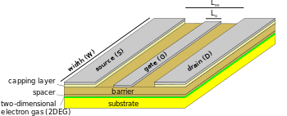



HEMT Devices
High Electron Mobility Transistors
HEMT is a heterojunction device which has high current carrying capacity
2 different materials with dissimilar energy band gaps form a junction
Due to heterojunction we have abrupt change in Energy band at the junction and it goes even below the fermi level hence it has large number of available electrons
Image source-Wikipedia.org
$$E_{c1}$$
$$E_{c2}$$
$$E_{F}$$

Slide 4
ETSOI Devices
Extremely thin silicon on insulator devices have extremely thin channel length and has 2 gates
Due to small size we have to consider the sub-bands too as electrons can exists only in quantum states which can be calculated with quantum mechanics if we know the potential well
Gate
Silicon
Oxide layer

Slide 5
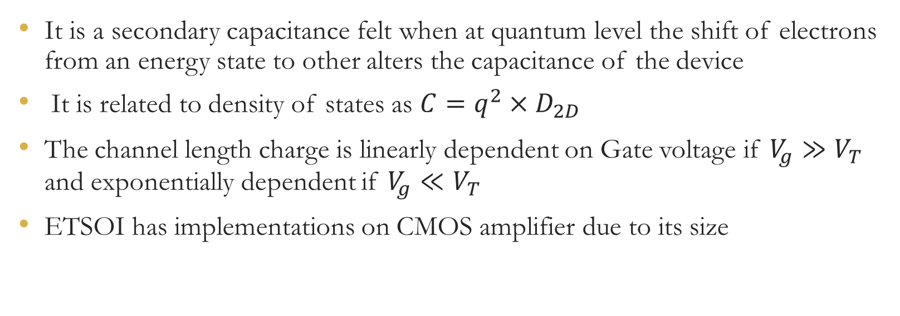
It is a secondary capacitance felt when at quantum level the shift of electrons from an energy state to other alters the capacitance of the device
It is related to density of states as $C=q^{2}×D_{2D}$
The channel length charge is linearly dependent on Gate voltage if $V_{g}≫V_{T}$ and exponentially dependent if $V_{g}≪V_{T}$
ETSOI has implementations on CMOS amplifier due to its size

Slide 6
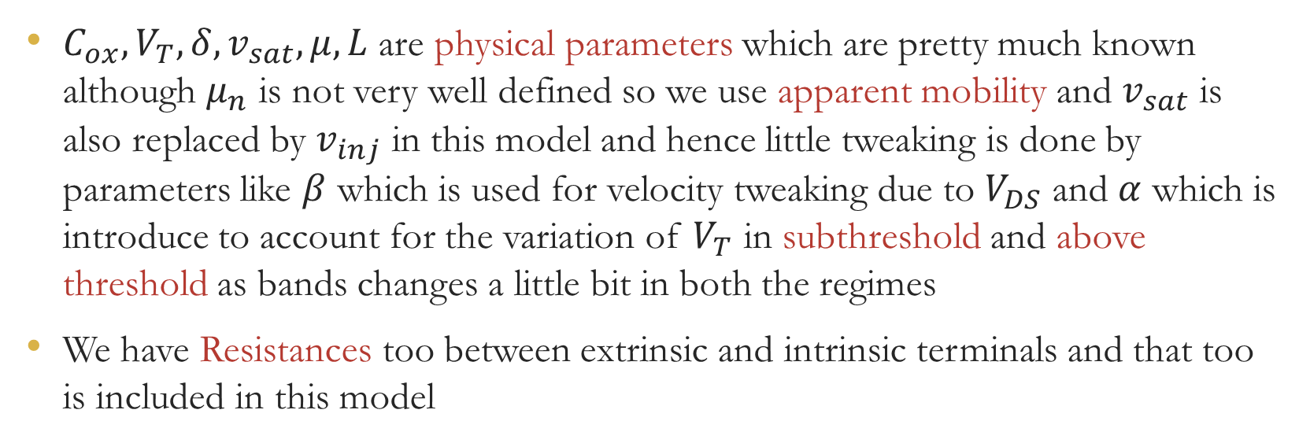
Parameters on which MIT VS model depends
$C_{ox},V_{T}, δ,v_{sat},μ, L$ are physical parameters which are pretty much known although $μ_{n}$ is not very well defined so we use apparent mobility and $v_{sat}$ is also replaced by $v_{inj}$ in this model and hence little tweaking is done by parameters like $β$ which is used for velocity tweaking due to $V_{DS}$ and $α$ which is introduce to account for the variation of $V_{T}$ in subthreshold and above threshold as bands changes a little bit in both the regimes
We have Resistances too between extrinsic and intrinsic terminals and that too is included in this model

Slide 7
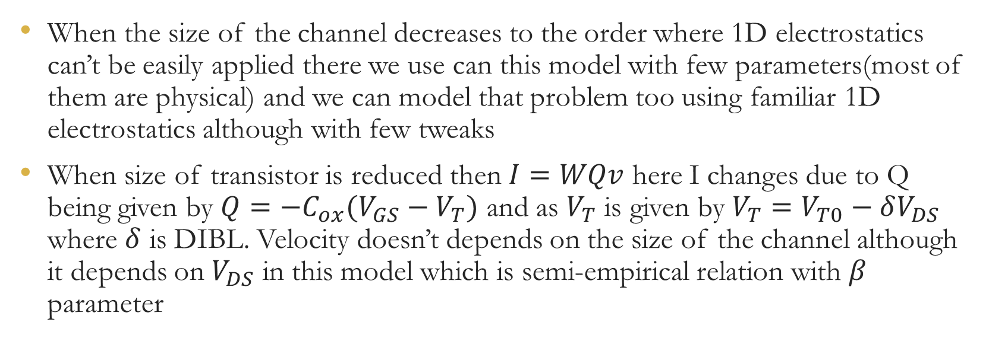
Description of Charge model of MVS
When the size of the channel decreases to the order where 1D electrostatics can’t be easily applied there we use can this model with few parameters(most of them are physical) and we can model that problem too using familiar 1D electrostatics although with few tweaks
When size of transistor is reduced then $I=WQv$ here I changes due to Q being given by $Q=−C_{ox}(V_{GS}−V_{T})$ and as $V_{T}$ is given by $V_{T}=V_{T0}−δV_{DS}$ where $δ$ is DIBL. Velocity doesn’t depends on the size of the channel although it depends on $V_{DS}$ in this model which is semi-empirical relation with $β$ parameter

Slide 8
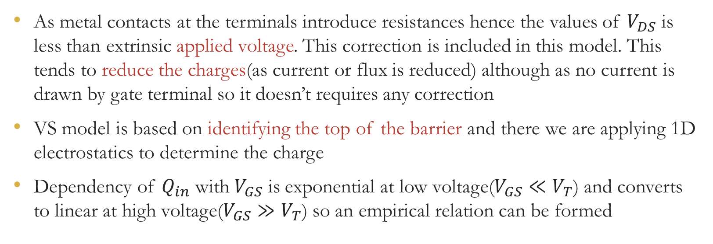
Description of Charge model of MVS
As metal contacts at the terminals introduce resistances hence the values of $V_{DS}$ is less than extrinsic applied voltage. This correction is included in this model. This tends to reduce the charges(as current or flux is reduced) although as no current is drawn by gate terminal so it doesn’t requires any correction
VS model is based on identifying the top of the barrier and there we are applying 1D electrostatics to determine the charge
Dependency of $Q_{in}$ with $V_{GS}$ is exponential at low voltage($V_{GS}≪V_{T}$) and converts to linear at high voltage($V_{GS}≫V_{T}$) so an empirical relation can be formed

Slide 9
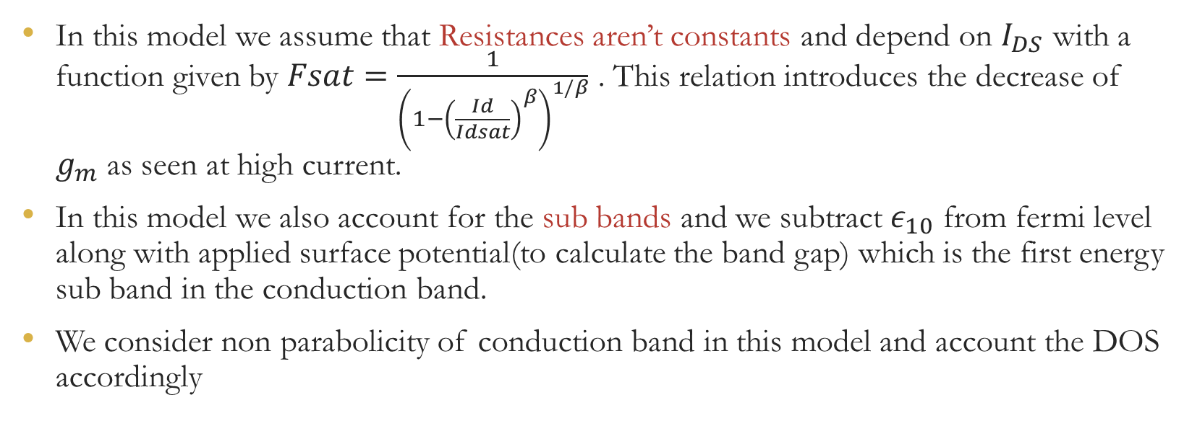
MVS Model 2.0.0
In this model we assume that Resistances aren’t constants and depend on $I_{DS}$ with a function given by $Fsat=\frac{1}{{\left(1−{\left(\frac{Id}{Idsat}\right)}^{β}\right)}^{1/β}}$ . This relation introduces the decrease of $g_{m}$ as seen at high current.
In this model we also account for the sub bands and we subtract $ε_{10}$ from fermi level along with applied surface potential(to calculate the band gap) which is the first energy sub band in the conduction band.
We consider non parabolicity of conduction band in this model and account the DOS accordingly

Slide 10
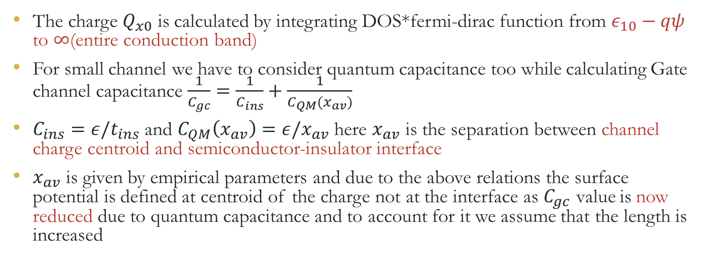
MVS Model 2.0.0
The charge $Q_{x0}$ is calculated by integrating DOS*fermi-dirac function from $ε_{10}−qψ$ to $∞$(entire conduction band)
For small channel we have to consider quantum capacitance too while calculating Gate channel capacitance $\frac{1}{C_{gc}}=\frac{1}{C_{ins}}+\frac{1}{C_{QM}(x_{av})}$
$C_{ins}=ε/t_{ins}$ and $C_{QM}\left(x_{av}\right)=ε/x_{av}$ here $x_{av}$ is the separation between channel charge centroid and semiconductor-insulator interface
$x_{av}$ is given by empirical parameters and due to the above relations the surface potential is defined at centroid of the charge not at the interface as $C_{gc}$ value is now reduced due to quantum capacitance and to account for it we assume that the length is increased

Slide 11
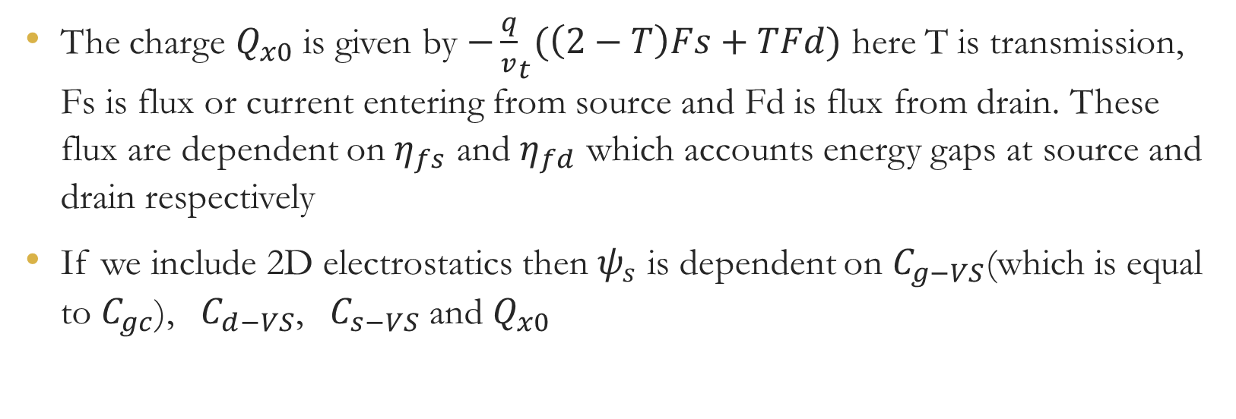
MVS Model 2.0.0
The charge $Q_{x0}$ is given by ${−\frac{q}{v}}_{t}(\left(2−T\right)Fs+TFd)$ here T is transmission, Fs is flux or current entering from source and Fd is flux from drain. These flux are dependent on $η_{fs}$ and $η_{fd}$ which accounts energy gaps at source and drain respectively
If we include 2D electrostatics then $ψ_{s}$ is dependent on $C_{g−VS}$(which is equal to $C_{gc}$), $C_{d−VS}$, $C_{s−VS}$ and $Q_{x0}$

Slide 12
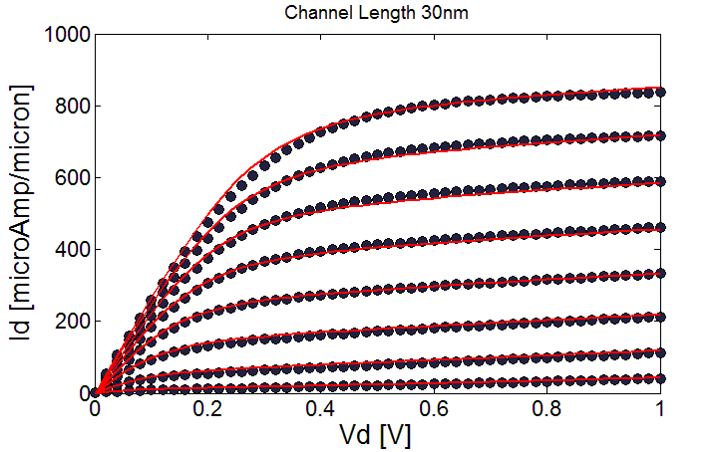
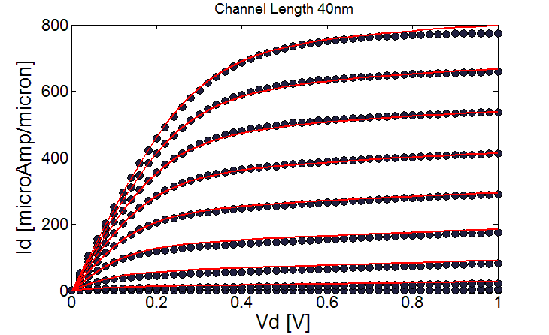
ET-SOI Plots of Id vs Vd
Increase in channel length results in decrease in current for same Vds and Vgs due to decrease in transmission but saturation current isn’t much dependent on Vd

Slide 13
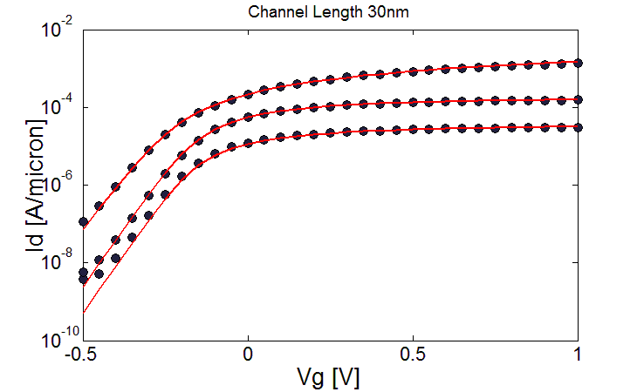
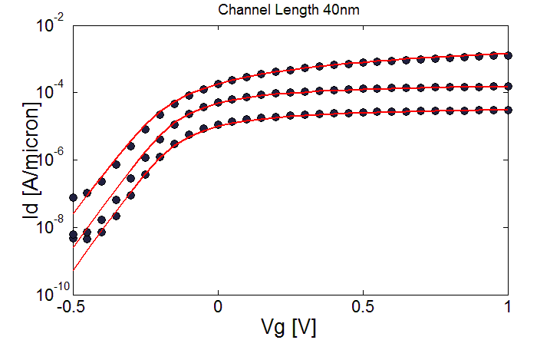
ET-SOI Plots of Id vs Vg
DIBL and subthreshold swing is lowered at higher channel length

Slide 14
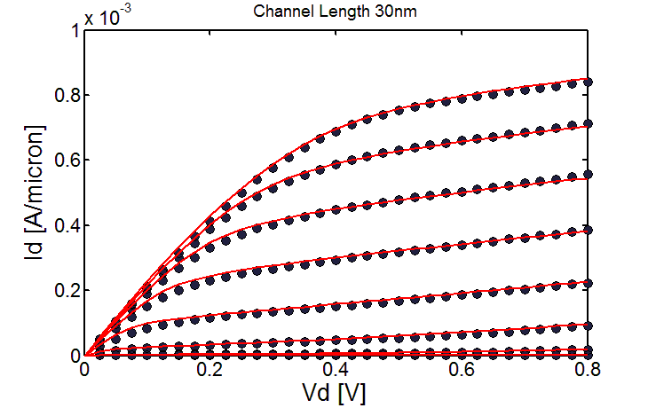
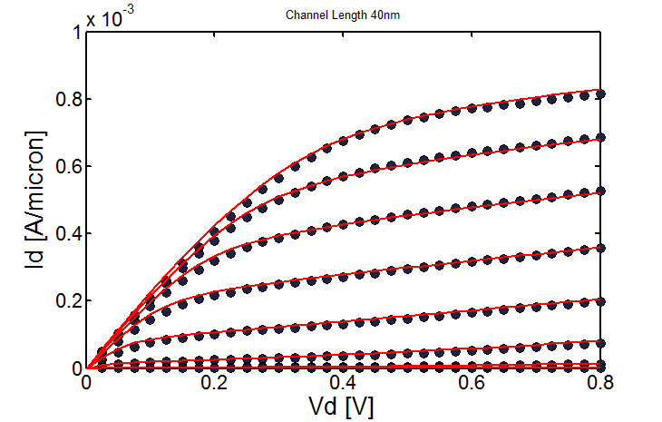
HEMT Plots of Vd vs Id
Increase in channel length results in decrease in current for same Vds and Vgs due to decrease in transmission and saturation current is dependent on Vd although this effect too decreases with increase in channel length

Slide 15
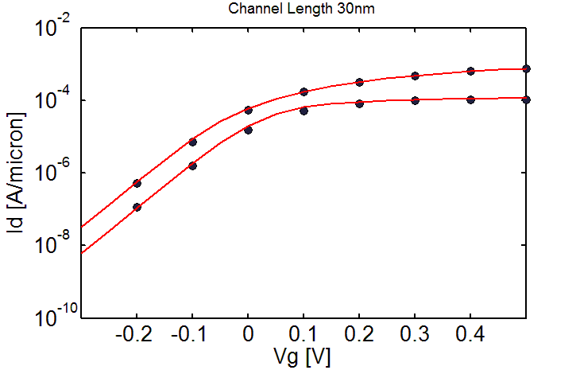

HEMT Plots of Vg vs Id
Decrease in DIBL can be observed

Slide 16
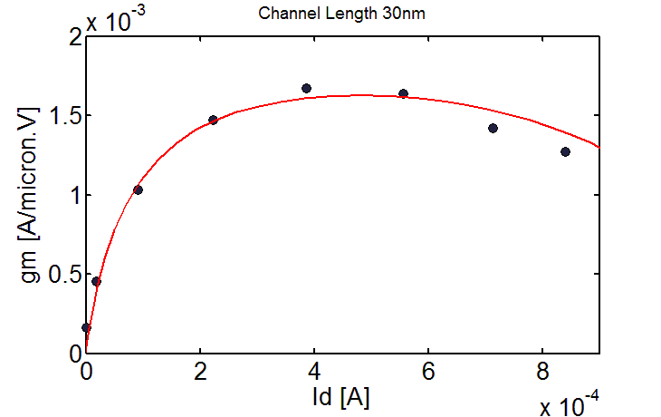
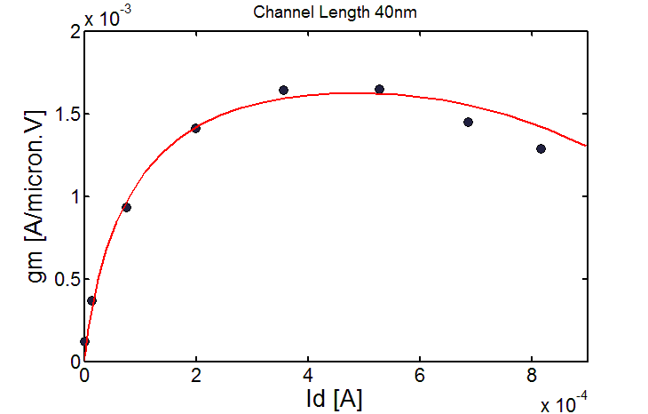
HEMT Plots of Gm vs Id
First the conductivity increases as the current increases before reaching saturation
We see a drop after the saturation of mobility as we have considered series resistances to be current dependent which increases with it and hence at higher current we see this unusual drop

Slide 17
THANK YOU

