Slide 1

Active Measurements for Path Performance Diagnosis with DisNETPerf, a Distributed Internet Paths Performance Analyzer
Sarah Wassermann

Slide 2

Motivations
Internet-scale services are provisioned from geo-distributed servers
QoE issues occur due to internal load balancing policies¹
Performance-measuring tools are very important for ISPs
Previously proposed approach relies on IP spoofing and IP Record-route Option²
CDN
We need a tool allowing to measure path performance without security concerns
¹P. Casas, A. D’Alconzo, P. Fiadino, A. Bär, A. Finamore, and T. Zseby,
“When YouTube does not work. analysis of QoE-relevant degradation in Google CDN traffic,”
IEEE Transactions on Network and Service Management, vol. 11, no. 4, pp. 441–457,
December 2014.
² E. Katz-Bassett, H. Madhyastha, V. Adhikari, C. Scott, J. Sherry, P. van Wesep,
A. Krishnamurthy, and T. Anderson, “Reverse traceroute,”
USENIX Symposium on Networked Systems Design and Implementations (NSDI), June 2010.

Slide 3
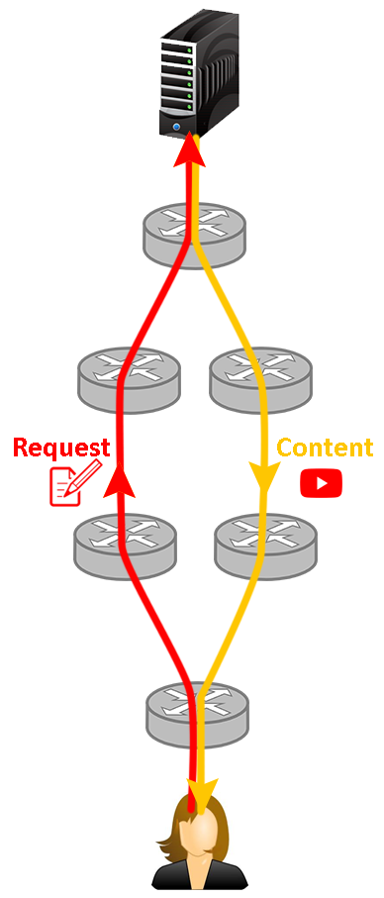
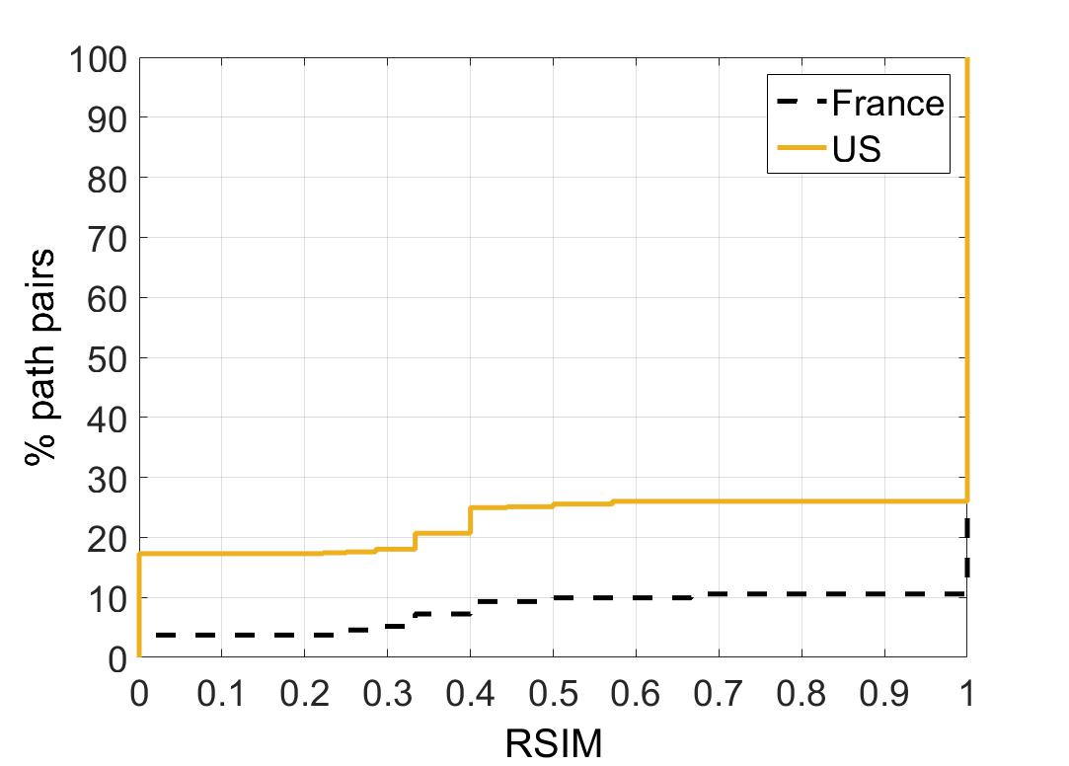
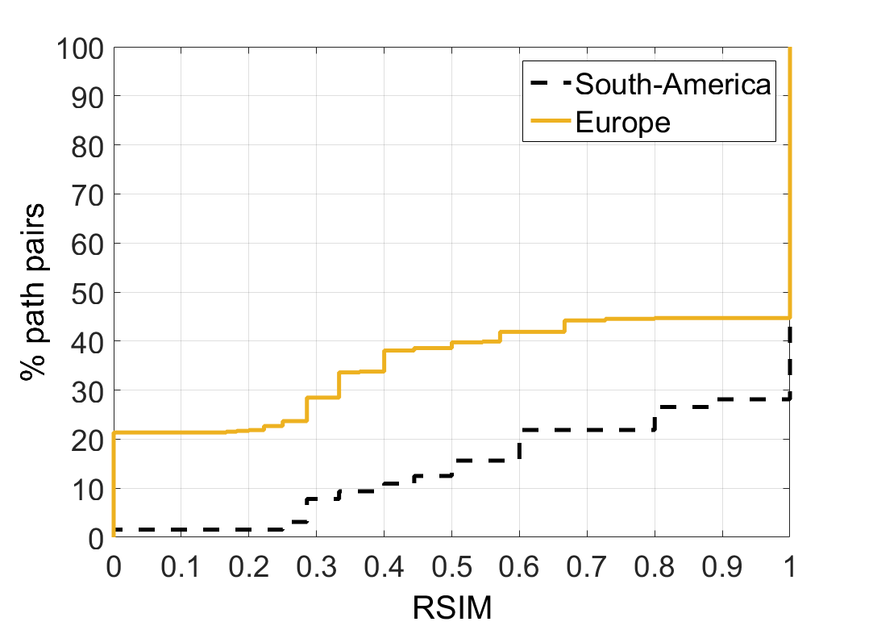
Motivations
“Plague” of traceroute: path asymmetry
We evaluate path asymmetry at the AS level using RIPE Atlas boxes
We use the RSIM index as path-similarity metric: ratio between # common links and # total links
Even at the AS level, path asymmetry is notorious!

Slide 4
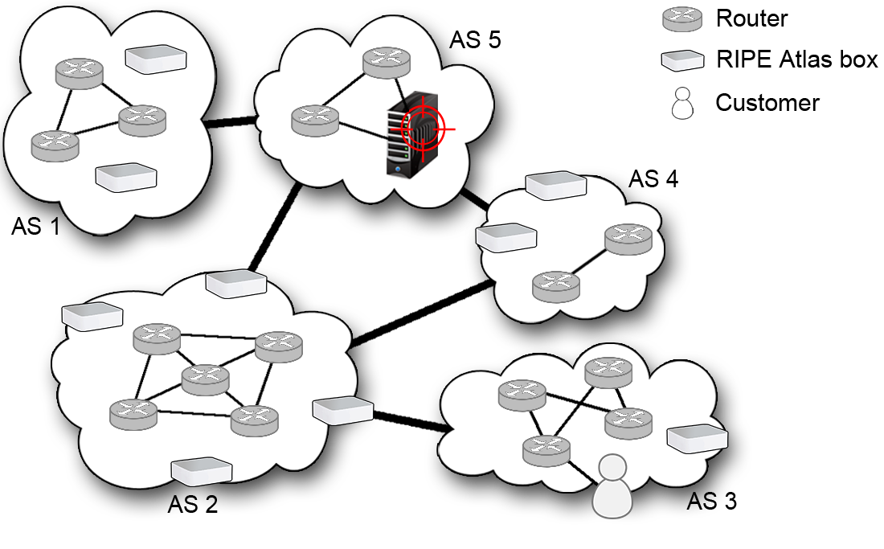
Introducing DisNETPerf
Given server IP_{s} and client IP_{d}, locate closest probe w.r.t. IP_{s} with address IP_{c}
We use a combined topology- and delay-based distance to select IP_{c}
Run traceroute measurements from IP_{c} to IP_{d}
Collect data for troubleshooting purposes
IP_{s}
IP_{c}
IP_{d}

Slide 5
DisNETPerf – Probe selection Smallest latency (SL) approach
Launch ping measurements from candidate probes to IP_{s}
IP_{c} = probe with min RTT
IP_{s}
IP_{c}

Slide 6
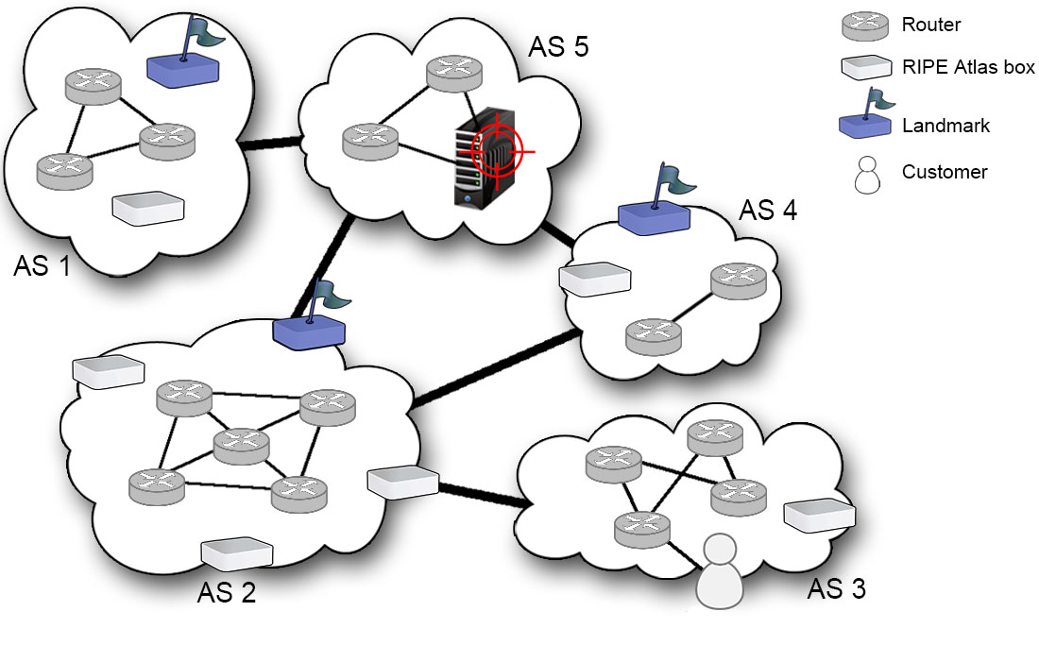
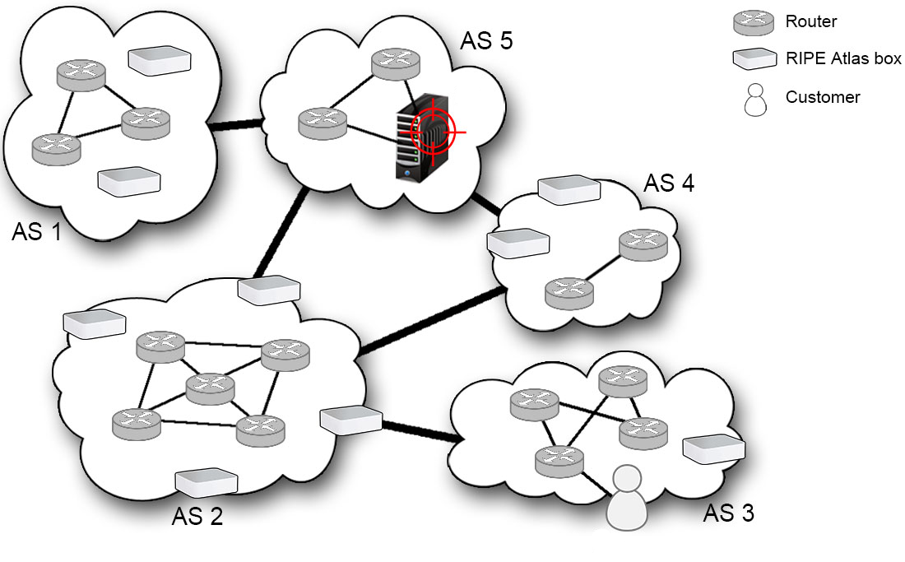
DisNETPerf – Probe selection Landmark (LM) approach
From candidate probes, randomly choose landmarks
From landmarks, ping IP_{s} and remaining candidate probes
Build a feature vector for each pinged IP containing min RTT from each landmark to IP
IP_{s}
IP_{c}
IP_{c} = probe whose feature vector is most similar to the one of IP_{s}

Slide 7
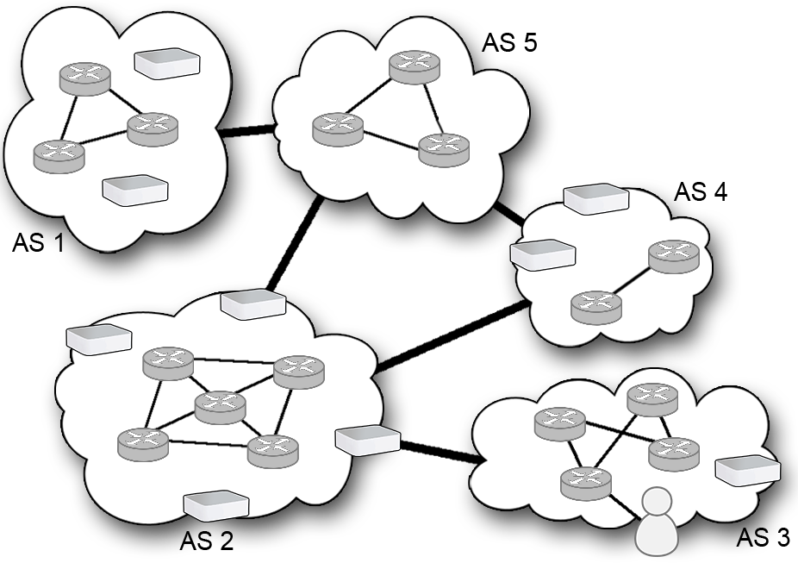
DisNETPerf – Evaluation
We consider links at the AS-, PoP-, and IP-level
IP2AS mapping through Maxmind
IP2PoP mapping trough iPlane’s database
Neighbour-AS lookup through CAIDA’s relationship database
We randomly select 300 RIPE Atlas probes as target servers (IP_{si}) and one single destination (IP_{d})
4-step analysis:
We compare the (IP_{si} → IP_{d}) vs. (IP_{c} → IP_{d}) paths using RSIM ratio
We analyse the RSIM difference between (IP_{c} → IP_{d}) and (best probe → IP_{d}) in case IP_{c} is not optimal
We check the number of probes with highest RSIM
We analyse the delay between the candidate probes and IP_{si}
IP_{si}
IP_{si}
IP_{c}
IP_{si}
IP_{d}

Slide 8
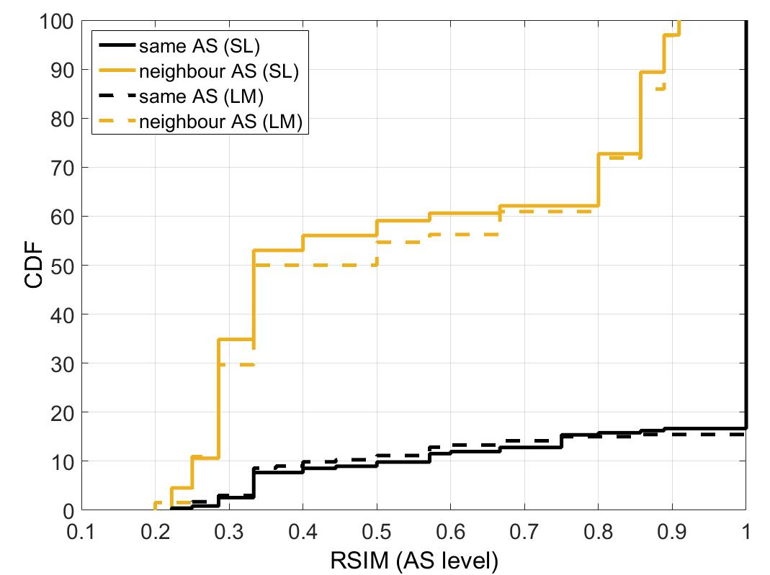
DisNETPerf – Evaluation
Nearly optimal results in the co-located scenario

Slide 9
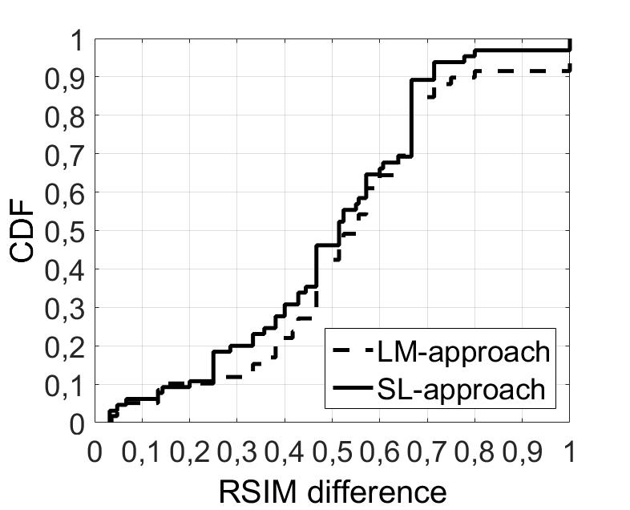
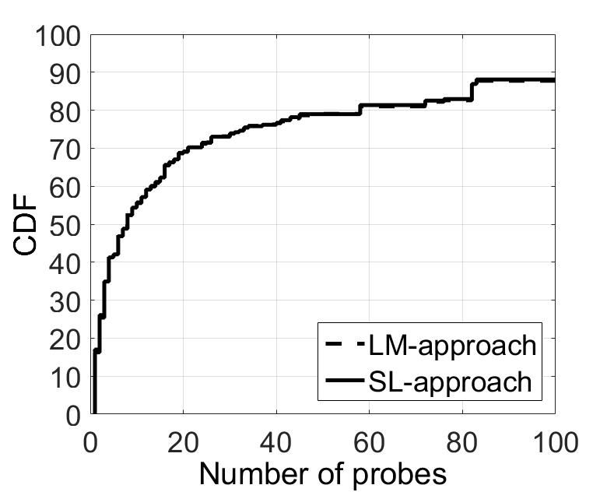
DisNETPerf – Evaluation
IP_{c} vs. best probe
# probes with highest RSIM
AS level

Slide 10
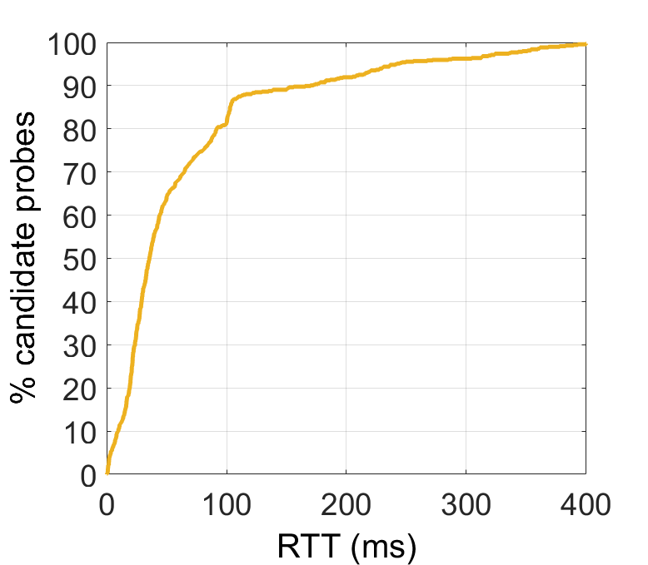
DisNETPerf – Evaluation

Slide 11
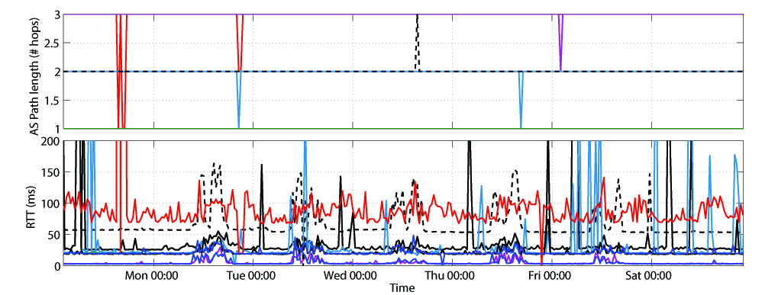
Example Analysis with DisNETPerf
We monitored 50 Google servers for one week with DisNETPerf
The measured RTTs show high variability for some AS paths, potentially leading to significant performance degradation
Correlation between variation of RTT and variation of # traversed ASes

Slide 12

Conclusions
We introduced DisNETPerf, a Distributed Internet Paths Performance Analyzer
Smallest-latency and landmark approaches yield very similar results
Probes elected by both approaches correspond often to paths most similar to the ground truth
Reverse path can be measured with very high accuracy in certain scenarios
We obtained the best results at the AS level, which is the most important one for our purpose
DisNETPerf is freely available on GitHub: https://github.com/SAWassermann/DisNETPerf

Slide 13

Future work
Test other probe-selection methods (for ex. RSD – Gürsun et al., IMC 2012)
Deep comparison between DisNETPerf and Reverse Traceroute
Deploy DisNETPerf in a real large-scale network

Slide 14
References
Towards DisNETPerf: a Distributed Internet Paths Performance Analyzer S. Wassermann, P. Casas, B. Donnet, Proceedings of the ACM CoNEXT Student Workshop, 2015
On the Analysis of Internet Paths with DisNETPerf, a Distributed Paths Performance Analyzer S. Wassermann, P. Casas, B. Donnet, G. Leduc, M. Mellia, Proceedings of the IEEE Workshop on Network Measurements (WNM), 2016
Unveiling Network and Service Performance Degradation in the Wild with mPlane P. Casas, P. Fiadino, S. Wassermann, S. Traverso, A. D'Alconzo, E. Tego, F. Matera, M. Mellia, IEEE Communications Magazine, Network Testing Series, vol. 54 (3), pp. 71-79, 2016
Reverse Traceroute with DisNETPerf, a Distributed Internet Paths Performance Analyzer S. Wassermann, P. Casas, Proceedings of the Demonstrations of the 41th Annual IEEE Conference on Local Computer Networks (LCN-Demos), 2016
Distributed Internet Paths Performance Analysis through Machine Learning S. Wassermann, P. Casas, Proceedings of the Demonstrations of the Network Traffic Measurement and Analysis Conference (TMA), 2018

Slide 15

Thanks for listening!

