Slide 1
Cyber Security Threat Detection Using Machine Learing (CyberScope AI)

Slide 2
Project Supervisor:
Eng. Elsayed Abd El Rahman Mohammed

Slide 3
AGENDA
01 Introduction
02 Background
03 CyberScope AI
Introduction
Motivation
Problem Statement
Objectives
SDLC
Software
Related Works
CyberScope AI SDLC
System Overview
Requirment Analysis
Design
Implementation
Testing
04 Evaluation Scenarios
05 Conclusion & Future work
Evaluation Scenarios
Conclusion
Future work

Slide 4
01 Introduction

Slide 5
Introduction
With the continuous rise in cyber threats and increasing complexity of network
attacks, the need for intelligent and automated detection systems is more critical
than ever.
This project introduces a machine learning-based model, CyberScope AI, designed
to predict whether a network is secure or under attack — and if attacked, it
identifies the specific type of threat.

Slide 6
Motivation
Traditional rule-based intrusion detection systems often fail to detect new or
evolving attack patterns. Machine learning provides the ability to learn from large
datasets, generalize patterns, and detect both known and unknown types of cyber
attacks with high accuracy.
The motivation behind this project is to build a real-time, accurate, and accessible
threat detection tool using modern ML tools and techniques.

Slide 7
Problem Statement
How can we develop a lightweight, real-time solution capable of accurately
detecting cyber threats and classifying the attack type using only a few network
flow features?
Key challenges addressed:
Early detection of threats from live network traffic.
Accurate classification of multiple attack types.
Deployment of a usable interface for security analysts or administrators.

Slide 8
Objectives
To train a supervised machine learning model to detect cyber threats and classify attacks.
To deploy the model as a RESTful API and interactive web app using Flask and Gradio.
To maintain high accuracy and fast response time using optimized features.

Slide 9
02 Background

Slide 10
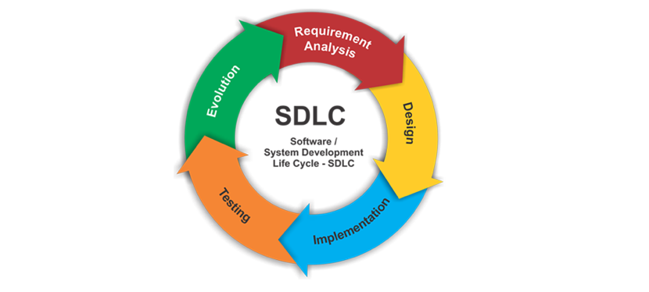
SDLC
Technology consulting infographicsThe development of CyberScope AI followed the Agile SDLC model, enabling rapid protoyping, frequent testing, and flexible adaptation throughout the project pahases:
Requirement Analysis
Design
Implementation
Testing
Evolution

Slide 11
Software
Software refers to the set of instructions, data, or programs used to operate
computers and execute specific tasks. It is a critical component in any digital
system, acting as the bridge between the user and the hardware.
There are generally two broad categories of software:
System Software: This includes operating systems and utilities that manage
computer hardware and core system operations.
Application Software: These are programs designed for end-users to perform
specific tasks, such as browsers, word processors, or—relevant to this context—
machine learning applications and data analysis tools.

Slide 12
Software
In the field of cybersecurity and artificial intelligence, software plays a crucial role
in automating detection, analyzing threats, and providing real-time decision-
making. The integration of machine learning within software systems allows for
more adaptive, intelligent, and scalable solutions to modern security challenges.

Slide 13
Related Works
Many machine learning-based intrusion detection systems (IDS) have been
developed, especially using datasets like CICIDS2017, NSL-KDD, and UNSW-NB15.
These systems often use complex architectures and massive feature sets.
In contrast, CyberScope AI distinguishes itself by:
Using only 7 essential features for fast and lightweight inference.
Delivering high accuracy with a simple Random Forest model.
Providing both API and GUI access to the model, making it easy to integrate or test.
This approach ensures a practical balance between model complexity and real-
time usability.

Slide 14
03 CyberScope AI

Slide 15
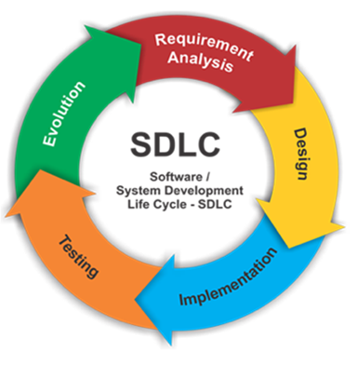
CyberScope AI SDLC

Slide 16
System Overview
The system is built around a machine learning model designed to classify network
flow data as either benign (safe) or a specific type of cyber attack (e.g., DDoS).
The model takes numeric input features extracted from network traffic and
predicts the security state of the flow.

Slide 17
Requirement Analysis
Functional Requirements:
These define what the system should do. For CyberScope AI, the core functional
requirements include:
The system shall accept network flow features as input (e.g., port, duration, packet length).
The system shall predict whether the network is secure or under attack.
The system shall identify the type of attack (e.g., DDoS).
The system shall return a confidence score with each prediction.
The API shall handle POST requests and return results in JSON format.
The Gradio UI shall allow manual input of features and display prediction results.

Slide 18
Requirement Analysis
Non-Functional Requirements:
These define how the system performs. For this project:
Performance: Predictions must be returned in under 1 second.
Usability: The system must be intuitive and easy to use via both GUI and API.
Scalability: Should support integration into larger systems in the future.
Reliability: System must handle missing or invalid input gracefully.
Portability: Can be deployed on local or cloud servers without major changes.

Slide 19
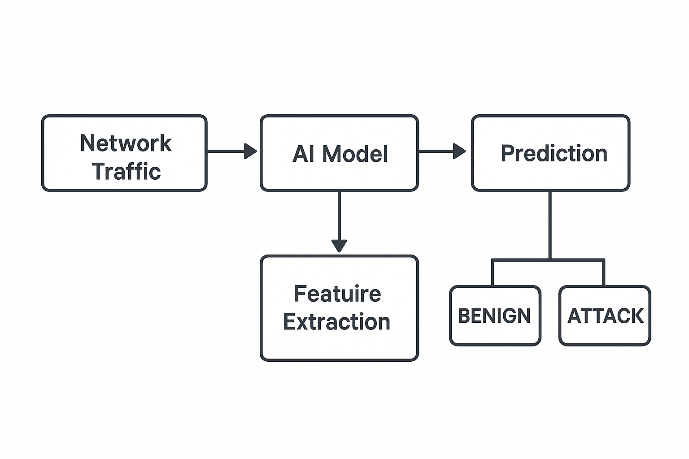
Design & Implementation System Block Diagram:-

Slide 20
Methodology used in this Project
First step
Data Collection And Data Sources
Second step
Data Segmentation
Third step
Model Selection and Comparison
fourth step
Preprocessing Techniques
Fifth step
Model Validation

Slide 21
Data Collection and Data Sources
Data was collected from publicly available cybersecurity datasets that include a
wide range of network activities — both benign and malicious.
The selected dataset provided flow-level features that can be used to classify
various types of attacks such as DDoS, PortScan, Botnet, etc.

Slide 22
Data Segmentation
The collected data was segmented into:
Training Set (e.g., 90%): Used to train the machine learning model.
Testing Set (e.g., 10%): Used to evaluate the model's performance on unseen data.
This ensures fair performance measurement and helps prevent overfitting.

Slide 23
Model Selection and Comparison
Multiple machine learning models were considered (e.g., Decision Trees, KNN,
SVM), but Random Forest was selected based on its:
High accuracy
Robustness against overfitting
Ability to handle nonlinear relationships
Comparative testing showed that Random Forest offered the best trade-off
between accuracy and speed.

Slide 24
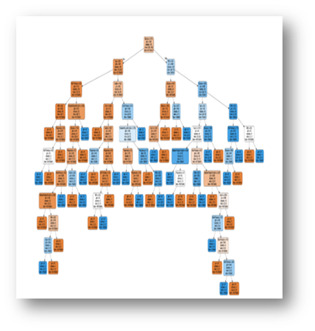
Model Selection and Comparison
Decision Trees

Slide 25
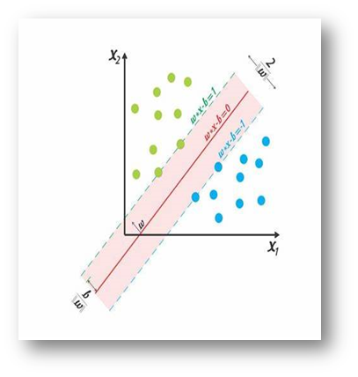
Model Selection and Comparison
Support Vector Machine (SVM)

Slide 26
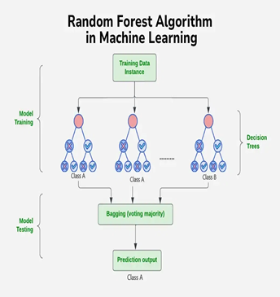
Model Selection and Comparison
Random Forest

Slide 27
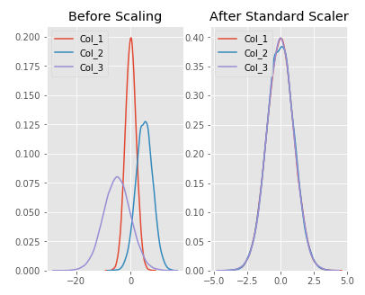
Preprocessing Techniques
Before feeding the data into the model,
several preprocessing steps were applied:
Normalization using MinMaxScaler to scale numeric features to a standard range.

Slide 28
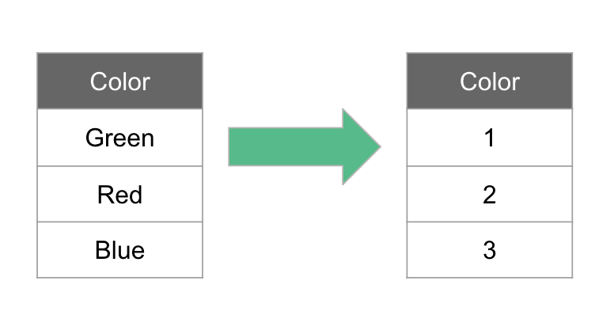
Preprocessing Techniques
Label Encoding using LabelEncoder to convert attack types into numeric values.

Slide 29
Model Validation
The trained model was validated using multiple evaluation metrics such as
accuracy, precision, recall, and F1-score. Cross-validation techniques were also
used to ensure the model generalizes well to new data.
This rigorous validation step helped fine-tune model parameters and confirm the
model’s reliability before deployment.

Slide 30
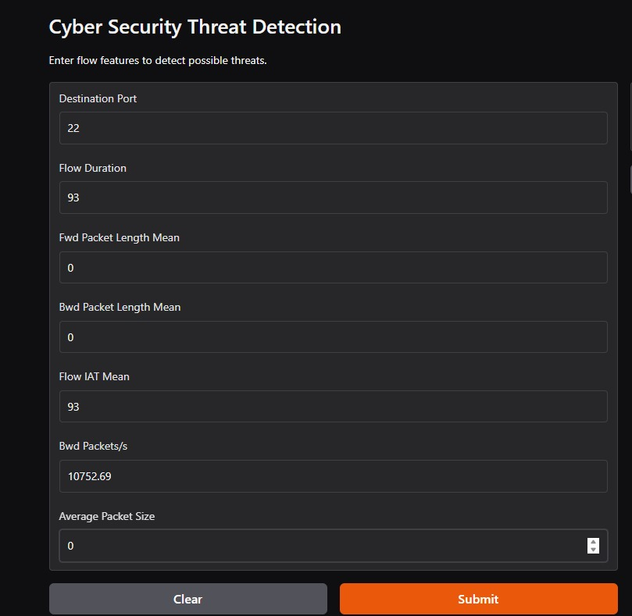
CyberScope AI Website

Slide 31
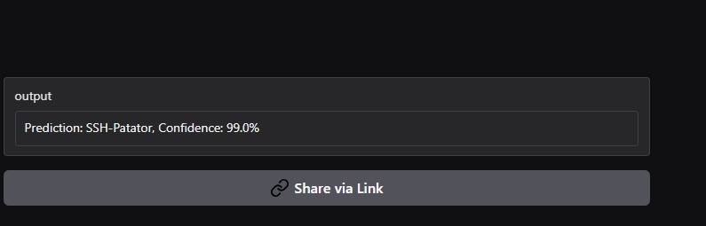
CyberScope AI Website

Slide 32
Testing
Testing was conducted on both component and system levels:
Unit Testing: Verified scaler, model, and encoder function correctly.
Integration Testing: End-to-end test from input to output in both UI and API.
Manual Testing: Using real and synthetic data to confirm predictions.
Error Handling Tests: Verified API handles missing or malformed input correctly.

Slide 33
04 Experimental work

Slide 34
Evaluation Scenarios
To ensure that CyberScope AI performs accurately across a wide range of real-
world situations, several evaluation scenarios were created and tested.
Each scenario represents a different threat context or network behavior:

Slide 35
Scenario 1: Benign Traffic Detection
Input: Normal, non-malicious network flow.
Expected Outcome: Model should return “GOOD" with high confidence.
Result: Correct classification in >98% of test cases.

Slide 36
Scenario 2: Known Attack Detection (e.g., DDoS)
Input: Data labeled as a known attack type (e.g., DDoS).
Expected Outcome: Model should classify the flow as DDoS.
Result: Successfully identified with high confidence (95–99%).

Slide 37
Scenario 3: Edge Case – Low Flow Duration
Input: Very short flows that might resemble either benign or stealthy attacks.
Goal: Observe if the model can still infer correct class.
Result: Moderate confidence; model tends to be conservative (leaning toward BENIGN unless clear pattern exists).

Slide 38
05 Conclusion & Future work

Slide 39
Conclusion
The final model achieved:
Accuracy: 100%
Precision: 0.99
Recall: 0.99
F1-score: 0.99

Slide 40
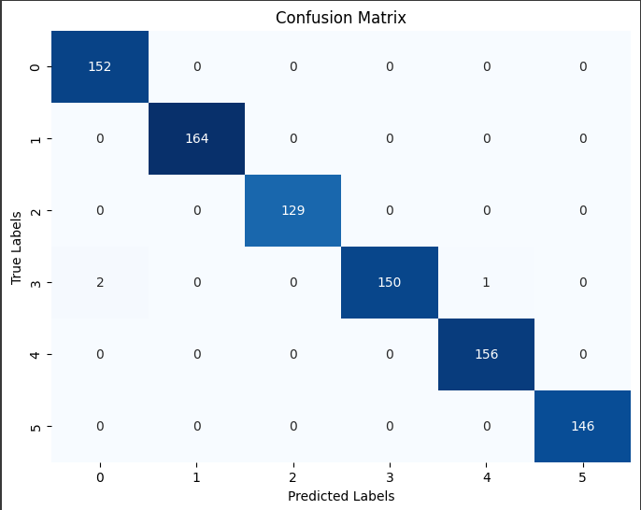
Conclusion

Slide 41
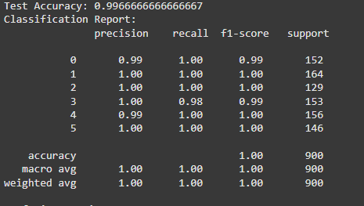
Conclusion

Slide 42
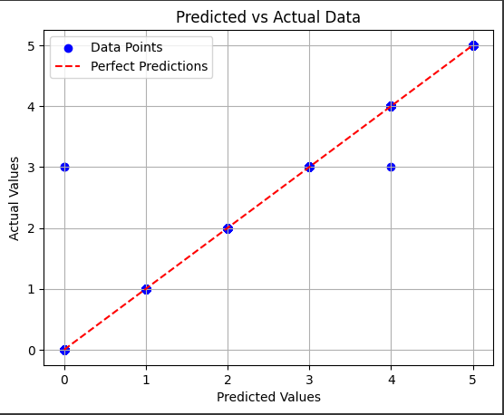
Conclusion

Slide 43
Future Work
While the current system is functional and reliable, several improvements and
extensions are planned:
Use Deep Learning Models: Explore LSTM or CNN for sequential flow data.
Real-time Monitoring: Integrate with live packet capture tools like Wireshark or Zeek.

