Slide 1
Module -6
Java Script

Slide 2
Introduction to Java Script.
Java Script is a dynamic computer programming language.
It is used to handle the client side scripting that handling the browser.
Java script can communicate with the server either in synchronous or in asynchronous mode.
Java script programming language is similar to Java programming language. It is not expected to know java programming lanaguage to understand Java script.

Slide 3
Features of java script.
Java script can modify the html element data using innerHTML property.
Java Script can modify the HTML element styles as done in css.
One of the major advantage of Java script is to validate the forms before sending data to the server.

Slide 4
Java script variables.
Java Script variables are declared using var keyword.
data types in Java script are:
  Numeric --> var num= 10;
  String --> var name=”charan”;
  Boolean --> var type=true;
  Null. --> var x = null;
  Undefined. --> var y = undefined. This says no data type is defined at this moment but later on any data type can be assigned to it.
  Object. --> var dt = new Date();

Slide 5
Java script variables.
<!DOCTYPE html>
<html>
<body>
<p id="num"/>
<p id="str"/>
<script>
var balance = 3000.54; --> Float data type is assigned.
var person = "Charan"; --> String data type is assigned to the variable person.
document.getElementById("num").innerHTML = balance;
document.getElementById("str").innerHTML = person;
</script>
</body>
</html>
Java script code should be written in <script> </script> tags.
Document.getElementById(“num”) will get the object named num which is a paragraph and its content is replaced by the variable balance using innerHTML property.
Same is applicable to string data also.

Slide 6
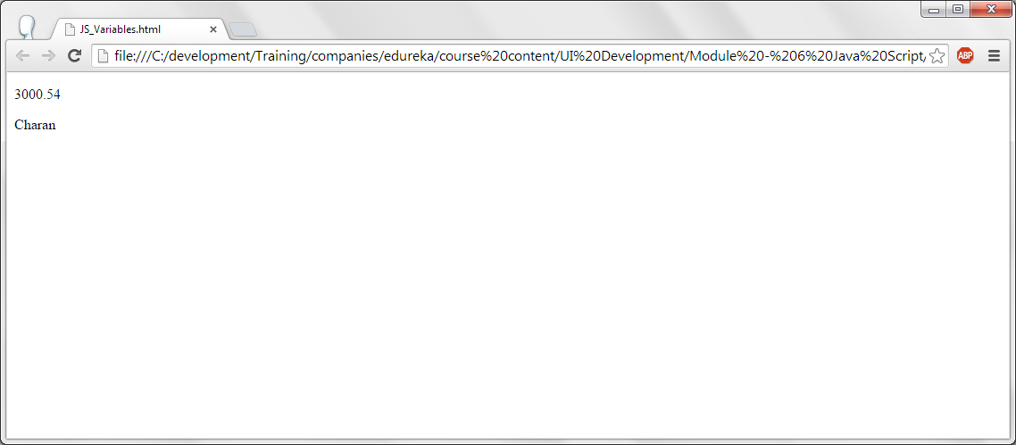
Java script variables.

Slide 7
Java Script Variables.
<!DOCTYPE html>
<html>
<body>
<script>
var x = 5, y = 20; --> Two variables are declared and values are assigned.
var z = x + y; --> variable x and y are added and result is stored in the variable z.
var result = "Result is " + z; --> String “Result is added to the value 25 and is stored in the result variable.
alert (result);
</script>
</body>
</html>
Alert () is a function to display the string in a message box. In this code an alert box is displays with the value of result variable.

Slide 8
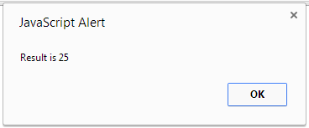
Java Script Variables - output.

Slide 9
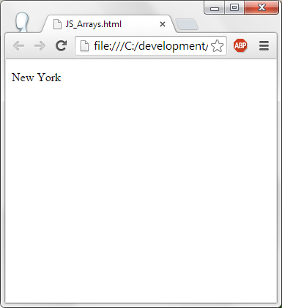
JS - Arrays.
<!DOCTYPE html>
<html>
<body>
<p id="city"></p>
<script>
var cities = ["New York","San Francisco","New Jersy"];
document.getElementById("city").innerHTML = cities[0];
</script>
</body>
</html>
Cities array is declared and New York, San Francisco and New Jersy is assigned.
Paragraph with id “city” content is changed to the first element of the array, that is New York.

Slide 10
JS - Objects.
<!DOCTYPE html>
<html>
<body>
<p id="bank_account"></p>
<script>
var bank = {
Name : "Charan Kumar",
act_no : 12345,
age : 35,
act_type : "SB"
};
document.getElementById("bank_account").innerHTML =
bank.Name + "'s account number is " + bank.act_no;
</script>
</body>
</html>
Bank is the object created with the variables of Name, Account number, age and account type. This is in JSON format. JSON Stands for Java Script Object Notation.
Object variable can be accessed using object name and “.” and the variable name.

Slide 11
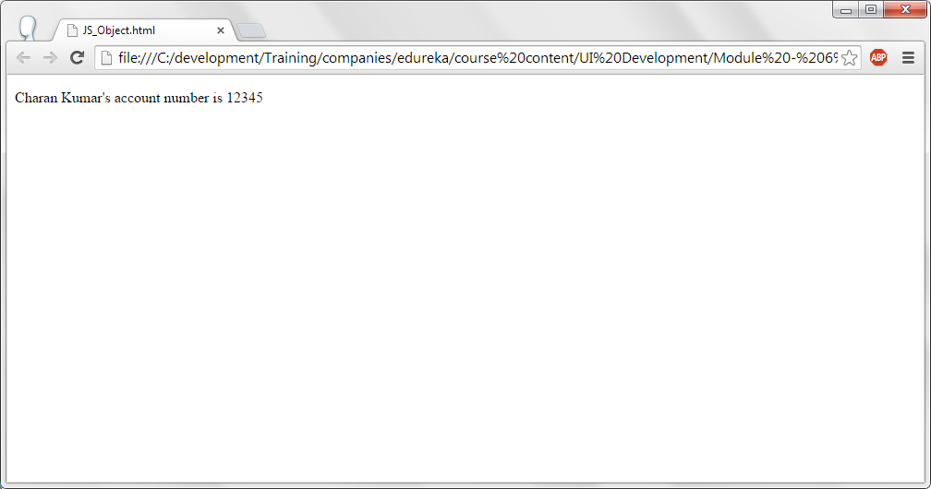
JS – Objects - Output.

Slide 12
JS – Functions.
A function is a block of code to perform some operation or action.
A function is called when it is invoked.
Function can have optional arguments.
Advatages of functions are code reusability. Once the function is written, it is called many times so that no code repitition.
With functions, modularity can be increased.

Slide 13
JS – Functions.
Functions in Java script can be declared as given below:
  function name_of_the_function (arguments)
  {
  Statement – 1;
  Statement – 2;
  }

Slide 14
JS – Functions.
<!DOCTYPE html>
<html>
<body>
<p>This example has a squre function which takes an argument and returns its squre.</p>
<p id="sqr"></p>
<script>
function square(a ) --> This is the function named square and it takes an argument and returns its square.
{
return a * a;
}
document.getElementById("sqr").innerHTML = square(5); --> Square method is called with 5 as the data which returns 25 as 5 square is 25.
</script>
</body>
</html>

Slide 15
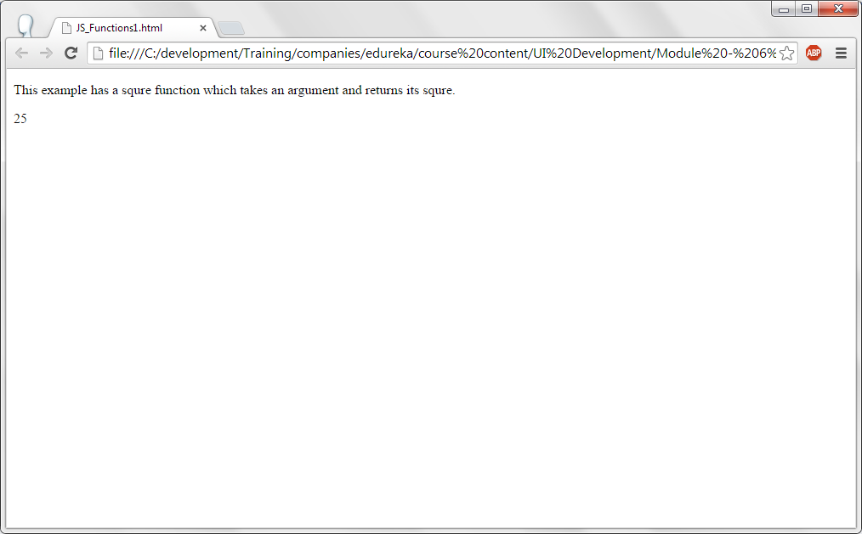
JS – Functions - Output.

Slide 16
JS – Functions.
<!DOCTYPE html>
<html>
<body>
<p>This example has a function which takes 1000 as basic, 500 as hra, 500 as da and 600 as the deductions and returns the total salary. Final salary is 1000 + 500 + 500 - 600 </p>
<p> Computed salary is : </p>
<p id="salary"></p>
<script>
function ComputeSalary(basic, hra, da, deductions ) {
var gross_salary = basic + hra + da;
var total_salary = gross_salary - deductions;
return total_salary;
}
document.getElementById("salary").innerHTML = ComputeSalary(1000, 500, 500, 600);
</script>
</body>
</html>
Here the ComputeSalary function takes basic, hra, da and deductions as the arguments and computes the final salary is returned. The returned value is updated with one of the paragraph content whose id is salary.

Slide 17
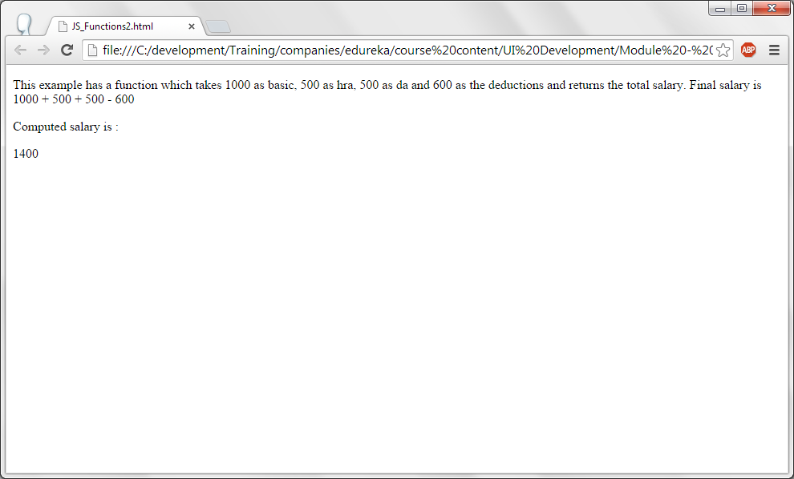
JS – Functions - output.

Slide 18
JS-Events.
For some particular actions events are generated. For example, on click of a button, it generates onclick event. Some action can be taken when onclick event is generated.
Some more events are:
  onchange --> After changing the HTML element.
  onclick --> User clicked on an HTML element.
  onmouseover --> User has moved the mouse on HTML element.
  onmouseout --> User has moved the mouse away from HTML element.
  onkeydown --> User has pressed a key down.
  onload --> After the page is completely loaded.

Slide 19
JS-Events.
<!DOCTYPE html>
<html>
<body>
<p>Click on the button to display current date.</p>
<button onclick="displayDate()">Date</button>
<script>
function displayDate() {
document.getElementById("display").innerHTML = Date();
}
</script>
<p id="display"></p>
</body>
</html>
On click of button generated onclick event. Onclick of the event it exeuctes displayDate() function. In the displayDate() function display paragraph will get updated with the current date.
What this program does is : On click of the button current date and time is displayed.

Slide 20
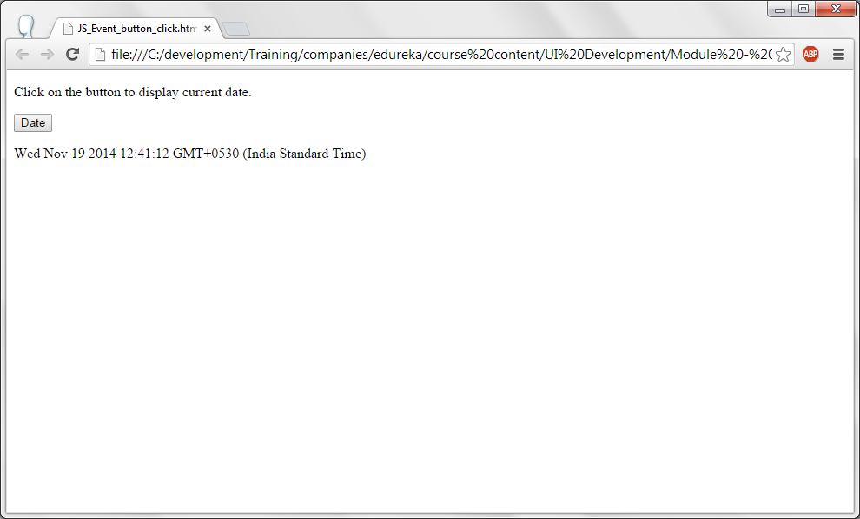
JS-Events - Output.

Slide 21
JS Objects.
In real life, objects has attributes and behavior. For example: If we consider a car then attributes of the car are:
  Name : BMW
  Model : BMW- 7 series.
  Cost : x dollars.
  Features : High speed, built in GPS etc.
Some fo the behavior or methods of the car are:
  Start() --> Starts the car.
  Stop() --> Stops the car.
  Run_wiper() --> Runs the wiper to clean the glass.
  Carry_Lugguage() --> Carries luggage in the car etc.,

Slide 22
JS Objects.
<!DOCTYPE html>
<html>
<body>
<h1> Car details </h1>
<p id="car_details"></p>
<script>
var car = {
Name : "BMW",
model : "BMW 7 series",
cost : "1 million dollars"
};
document.getElementById("car_details").innerHTML =
"Name of the car is : " + car.Name + "<br/>" + "Model is : " + car.model + "<br/>" + "Cost of the car is " + car.cost;
</script>
</body>
</html>
This code defines an object by name car and fill in the data for all the attributes and displays the value for the attributes.

Slide 23
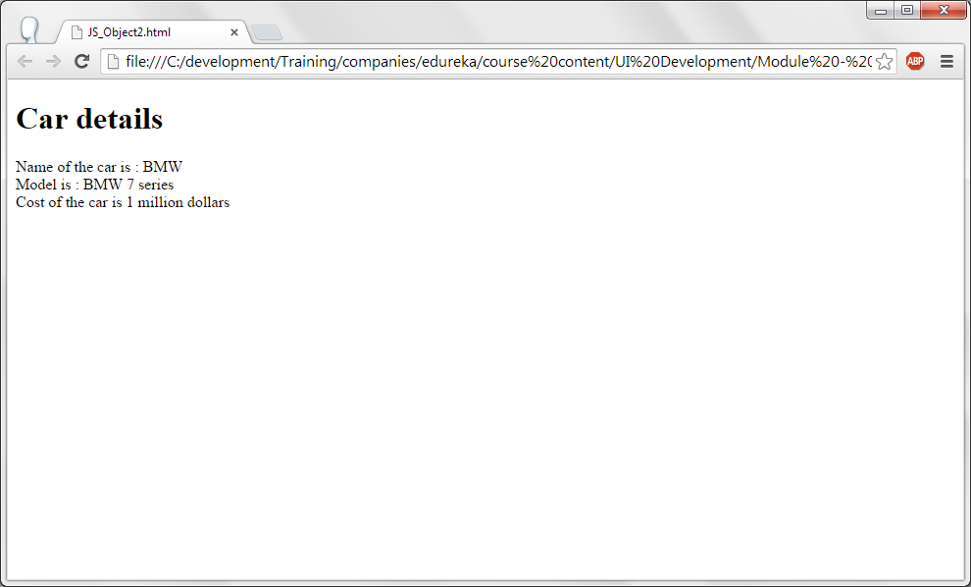
JS Objects.

Slide 24
JS – Strings.
Strings are set of characters. As specified before a string in js can be defined using var keyword. Strings are placed in double quotes.
  var str = “I am java script”;
Some of the string functions are:
  charAt() --> Retur ns the character at the given position.
  concat() --> Adds two strings.
  Replace() --> Used to replace a string with another.
  Substr() --> Obtiains the substring from the given string.

Slide 25
JS – Strings.
<!DOCTYPE html>
<html>
<body>
<p> Length of the string is : </p>
<p id="strlen"></p>
<script>
var str="I am learning java script";
document.getElementById("strlen").innerHTML = str.length;
</script>
</body>
</html>
Length attribute will returns the length of the string. In this example, string length of the string “I am learning java script” is updated for the paragraph strlen.

Slide 26
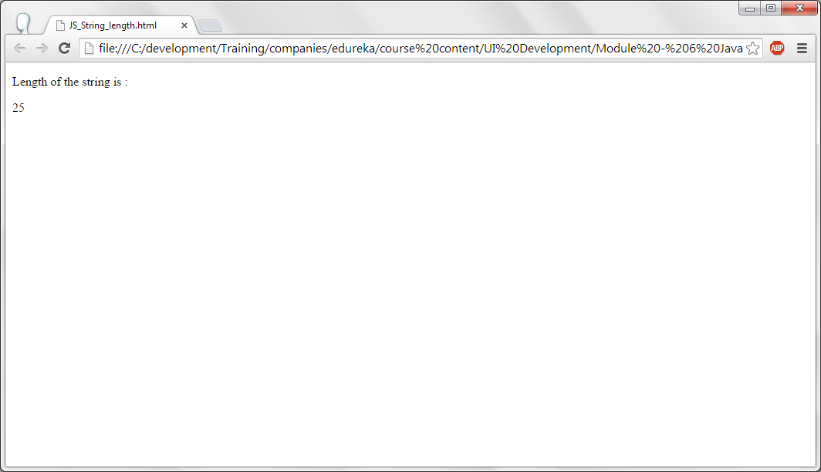
JS – Strings - output.

Slide 27
JS – Strings.
<!DOCTYPE html>
<html>
<body>
<p> Length of the string is : </p>
<p id="strlen"></p>
<script>
var str="I am learning java script";
document.getElementById("strlen").innerHTML = str.length;
var str1 = str.charAt(2);
var str2 = str.concat (" From Charan");
alert ("Concatenated string is : " + str2);
var str3 =str2.replace ("charan", "John");
alert ("Replaced string is : " + str3);
var str4 = str2.substr (13, 12);
alert ("Substring is : " + str4);
</script>
</body>
</html>

Slide 28
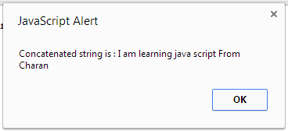
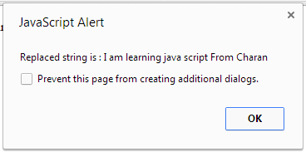
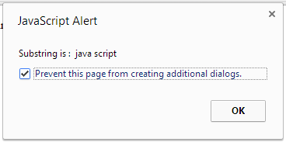
JS – Strings - output.

Slide 29
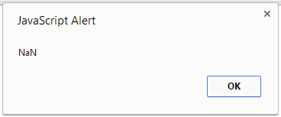
JS - Numbers
In java script, numbers can be written with or without decimal points. As stated earlier, var is used to define numbers.
  var num1 = 20;
  var num2 = 300.20;
NaN stands Not a Number. When number and string operation are performed in an expression Nan Will be written.
var x = 100, y;
var str = "test";
y = x /str;
alert (y);
This msg will be displayed.

Slide 30
JS - Number
<!DOCTYPE html>
<html>
<body>
<p>The toString() method converts a number to a string.</p>
<p id="demo"></p>
<script>
var x = 123;
var str = x.toString(); --> Converts the given number to a string.
str = str + " is the number converted to a string...";
alert (str);
</script>
</body>
</html>

Slide 31
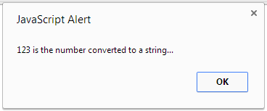
JS – Number – output.

Slide 32
JS - Number
<!DOCTYPE html>
<html>
<body>
<p>The toString() method converts a number to a string.</p>
<p id="demo"></p>
<p id="fixed_num"/>
<p id="precision_num"/>
<script>
var x = 123.3456;
document.getElementById("fixed_num").innerHTML = "Fixed numbers using toFixed() :<br/> " + x.toFixed(0) + "<br/>" + x.toFixed(1) + "<br/>" + x.toFixed(2);
var y = 19.256;
document.getElementById("precision_num").innerHTML = "Total number of numbers using toPrecision() : <br/> " + y.toPrecision() + "<br/>" + y.toPrecision(2) + "<br/>" + y.toPrecision(3)+ "<br/>" + y.toPrecision(4);
var str = "200.234";
var num = parseInt(str);
alert ("parseInt() parses the number in a string : " + num);
var str = "200.3245";
var num1 = parseFloat(str);
alert ("parseFloat() parses the floating number in a string : " + num1 );
</script>
</body>
</html>

Slide 33
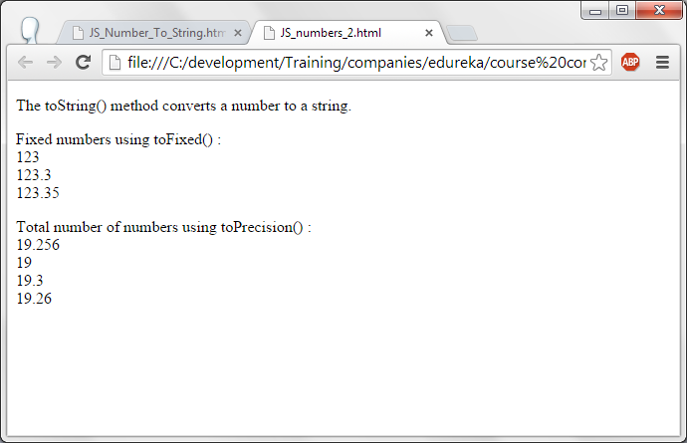
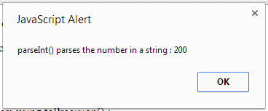
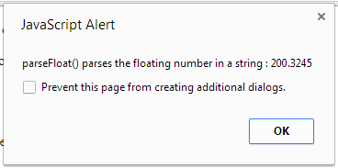
JS – Number - output

Slide 34
JS Numbers.
toFixed() returns a string with the specified number of decimals.
toPrecision() returns a string, with the number written in the specified length.
parseInt() parses a string and returns the number of it.
parseFloat() parses a floating data in a string.

Slide 35
JS Operations.
Following operations can be performed in Java Script.
  + --> Addition
  - --> Subtraction.
  * --> Multiplication.
  / --> Division.
  % --> Modules --> Which gives the remainder.
  ++ --> Incriment the variable by one unit.
  -- --> Decrements the variable by one unit.
  +=, -=, *=, /=, %= --> Expressions.

Slide 36
JS-Operations.
<!DOCTYPE html>
<html>
<body>
<p>Perfoming the operations of Java script</p>
<button onclick="Ops()">Operations</button>
<p id="result"></p>
<script>
function Ops() {
var x = 5;
var y = 20;
var z1 = x + y;
var z2 = x - y;
var z3 = x * y;
var z4 = x / y;
var z5 = 21 % x;
var z6 = ++x; --> pre-increment --> x is incremented and then assigned to z6.
var z7 = x++; --> Post increment --> x value is assigned to z7 and incremented.
var z8 = --x;

Slide 37
JS-Operations.
y += 5;
y -= 10;
document.getElementById("result").innerHTML = z1 + "<br/>"+
z2 + "<br/>"+
z3 + "<br/>"+
z4 + "<br/>"+
z5 + "<br/>"+
z6 + "<br/>"+
z8 + "<br/>"+
y + "<br/>";
}
</script>
</body>
</html>

Slide 38
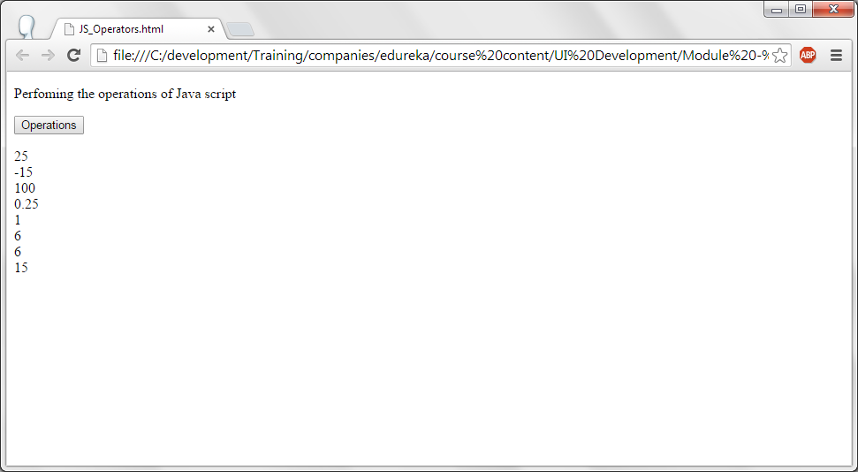
JS-Operations - output.

Slide 39
JS – Maths.
Some fo the functions of Maths are:
1. random () --> Returns the random number.
2. max() --> Returns the maximum of the list.
3. min() --> Returns the minimum of the list.
4. round() --> Rounds the given number to the nearest integer.
5. ceil () --> Ceil value (nearest up value) of the number.
6. floor() --> Returns the floor value (nearest down value) of the number.

Slide 40
JS – Maths.
<!DOCTYPE html>
<html>
<body>
<p>Perfoming the Maths operations of Java script</p>
<input onclick="Math_ops()" type="button" value = "Maths Operations"/>
<p id="maths"></p>
<script>
function Math_ops()
{
var random_num = Math.random() * 10;
var min_num = Math.min (100,200,5,400, 35);
var max_num = Math.max (100,200,5,400, 35);
var round_num = Math.round (47.36);
var ciel_num = Math.ceil (4.2);
var floor_num = Math.floor (4.2);
document.getElementById("maths").innerHTML = "Random number between 0 to 10 : " + random_num + "<br/>" +
"Minimum of 100, 200, 5, 400 & 35 is "+ min_num + "<br/>" +
"Maximum of 100, 200, 5, 400 & 35 is "+ max_num + "<br/>" +
"Rounded value of 47.66 is " + round_num + "<br/>" +
"Ceiling value of 4.2 is " + ciel_num + "<br/>" +
"Floor value of 4.2 is " + floor_num + "<br/>";
}
</script></body></html>

Slide 41
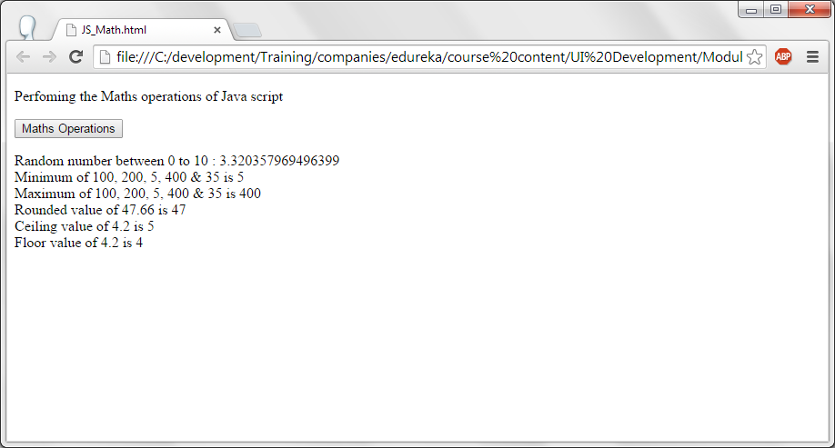
JS – Maths.

Slide 42
JS - Date
<!DOCTYPE html>
<html>
<body>
<p>Date operations</p>
<input onclick="Date_ops()" type="button" value = "Date Operations"/>
<p id="dates"></p>
<script>
function Date_ops()
{
var dt = new Date(); --> Data object is created.
var date = dt.getDate(); --> Gets the day of the month.
var day = dt.getDay(); --> Gets the day of the week.
var month = dt.getMonth()+1; --> Return the month (0 - 11)
var year = dt.getFullYear(); --> Returns the year of the given date.
document.getElementById("dates").innerHTML = "Current date and time is : " + dt + "<br/>" +
"Day of the date is : " + date +"<br/>" +
"Day of the week is : " + day + "<br/>" +
"Month of the date is : " + month + "<br/>" +
"year of the date is : " + year + "<br/>" ;
}
</script> </body> </html>

Slide 43
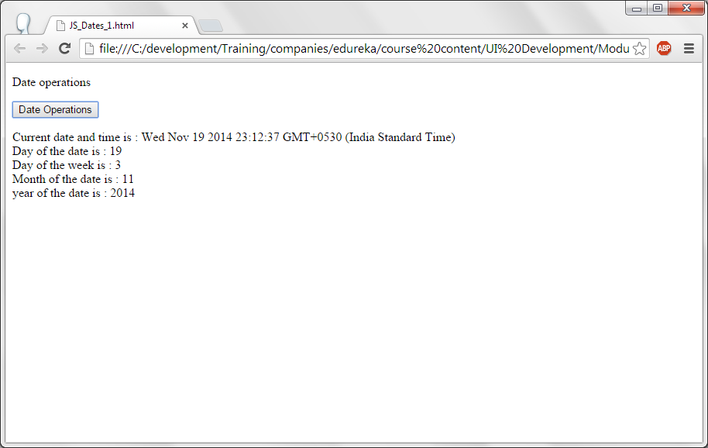
JS - Date

Slide 44
JS-Arrays
<!DOCTYPE html>
<html>
<body>
<p>Loop through the array and display the result...</p>
<button onclick="ArrayDisplay()">Click on me</button>
<p id="ArrDispl"></p>
<script>
function ArrayDisplay() {
var index;
var text = "<ul>";
var cities = ["San Francisco", "New York", "New Jersey", "Dallas"];
for (index = 0; index < cities.length; index++) {
text += "<li>" + cities[index] + "</li>";
}
text += "</ul>";
document.getElementById("ArrDispl").innerHTML = text;
}
</script>
</body>
</html>

Slide 45
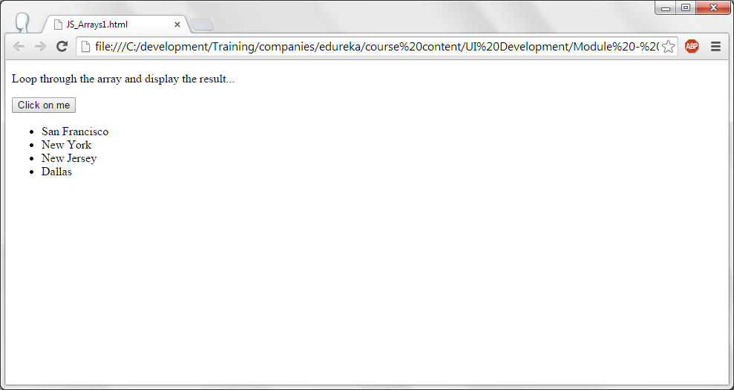
JS-Arrays

Slide 46
JS-Arrays
An array name cities is declared and the list of array elements are given.
Length property is used to find the maximum number of elements in the array. Hence, cities.length.
All the elements of the array is looped through and added as line items in un-ordered list.
Generated list is updated for paragraph ArrDispl.

Slide 47
JS-Arrays
<!DOCTYPE html><html><body>
<p>Loop through the array and display the result...</p>
<button onclick="ArrayDisplay()">Click on me</button>
<p> Array is sorted </p>
<p id="ArrDispl"></p>
<p> Reversed the elements of the array </p>
<p id="Rev_ArrDispl"></p>
<script>
function ArrayDisplay() {
var index;
var text = "<ul>";
var cities = ["San Francisco", "New York", "New Jersey", "Dallas"];
cities.sort(); --> Sorts the array elements.
for (index = 0; index < cities.length; index++) {
text += "<li>" + cities[index] + "</li>";
}
text += "</ul>";
document.getElementById("ArrDispl").innerHTML = text;
cities.reverse(); --> Reverses the array Elements.
text = "<ul>";
for (index = 0; index < cities.length; index++) {
text += "<li>" + cities[index] + "</li>";
}
text += "</ul>";
document.getElementById("Rev_ArrDispl").innerHTML = text;
}</script></body></html>

Slide 48
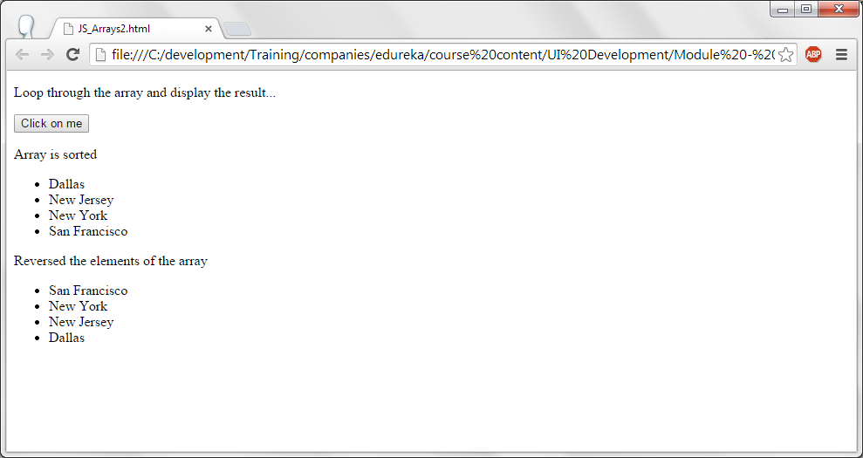
JS – Arrays.

Slide 49
JS - Boolean
Boolean is a data type. It can store either true or false.
When any condition is evaluated, it returns boolean value as either true or false.

Slide 50
JS - Boolean
<!DOCTYPE html>
<html>
<body>
<p>Evaluates the condition (9 > 5) and (5 > 9) returns the boolean value</p>
<button onclick="BooleanDisplay()">Click on me!</button>
<p id="bool"></p>
<p id="bool1"></p>
<script>
function BooleanDisplay() {
document.getElementById("bool").innerHTML = Boolean(9 > 5);
document.getElementById("bool1").innerHTML = Boolean(5 > 9);
}
</script>
</body>
</html>

Slide 51
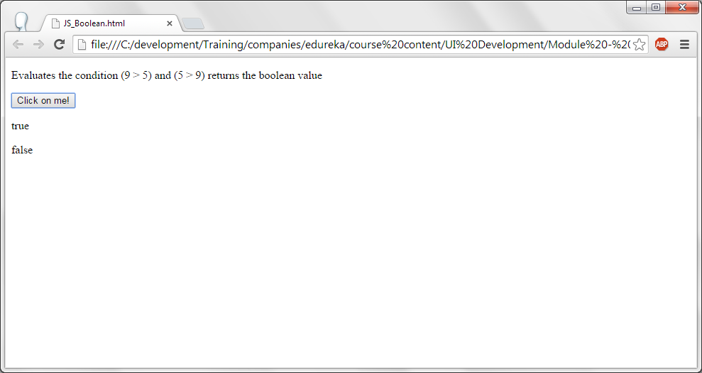
JS – Boolean - Output

Slide 52
JS – Comparison.
Following relational operators can be used for comparisons.
  == --> Equals to
  === --> Comparing with the same type.
  != --> Not equals to.
  !== --> Not equals to with the same type.
  < --> Less than.
  <= --> Less than or equal to.
  > --> Greater than.
  >= --> Greater than or equal to.
Logical operators are:
  && --> And operations. True if both the conditions are satisfied.
  || --> Or operation. Returns true if either condition is satisfied.
  ! --> Not operator. Negates the boolean value from true to false and false to true.

Slide 53
Js – if condition.
If condition is used to check the condition is true or false. Based on the result, corresponding action is taken.
Syntax of the if condition is
If (condition)
{
st-1;
st-2;
}
Else condition can able be added to the if condition. If the condition is not satisfied then statements in the else condition will be executed.
Braces should be placed if more than one statement to be executed. This rule applies to both if and else condition too.

Slide 54
Js – if condition.
<!DOCTYPE html>
<html>
<body>
<p>Checks the age and returns the voting status</p>
<button onclick="VotingStatus()">Click here</button>
<p id="vote"></p>
<script>
function VotingStatus() {
var age = prompt ("Enter your age :"); --> Displays a dialog box and asks for the age.
if (age >= 18) {
status = "You are eligible for voting...Happy voting!";
} else {
status = "Sorry, you are not eligible for voting..";
}
document.getElementById("vote").innerHTML = status;
}
</script>
</body>
</html>

Slide 55
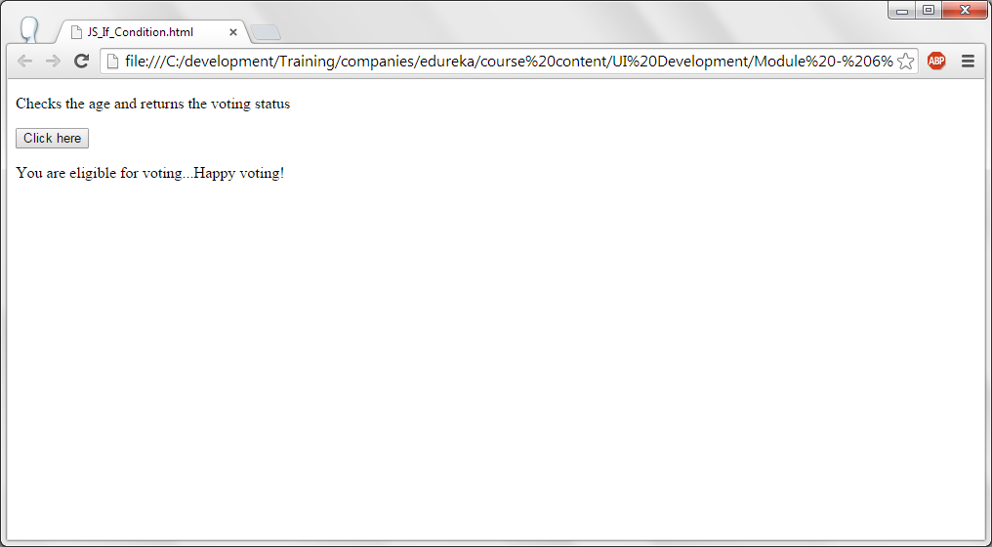
Js – if condition.

Slide 56
JS – Switch.
Rather than using serveral if conditions, switch is used. Syntax is switch is:
  switch (value){
  case value: st-1; st-2 break;
  case value: st-1; st-2 break;
  deafult : st-1; st-2;}
Data given in the switch statement is evaluated with each case. If the case matches then the statements inside that block is executed. If the value does not match with any case then default code block is executed.

Slide 57
JS – Switch.
<!DOCTYPE html><html><body>
<p>This program displays day of the week</p>
<button onclick="DayOfWeek()">Click on me!</button>
<p id="dow"></p>
<script>
function DayOfWeek() {
var dt = new Date();
var DayOfWeek = dt.getDay();
var day;
switch (DayOfWeek) {
case 0:
day = "Sunday"; break;
case 1:
day = "Monday"; break;
case 2:
day = "Tuesday"; break;
case 3:
day = "Wednesday"; break;
case 4:
day = "Thursday"; break;
case 5:
day = "Friday"; break;
case 6:
day = "Saturday"; break;
}
document.getElementById("dow").innerHTML = "Today is " + day;
}
</script></body></html>

Slide 58
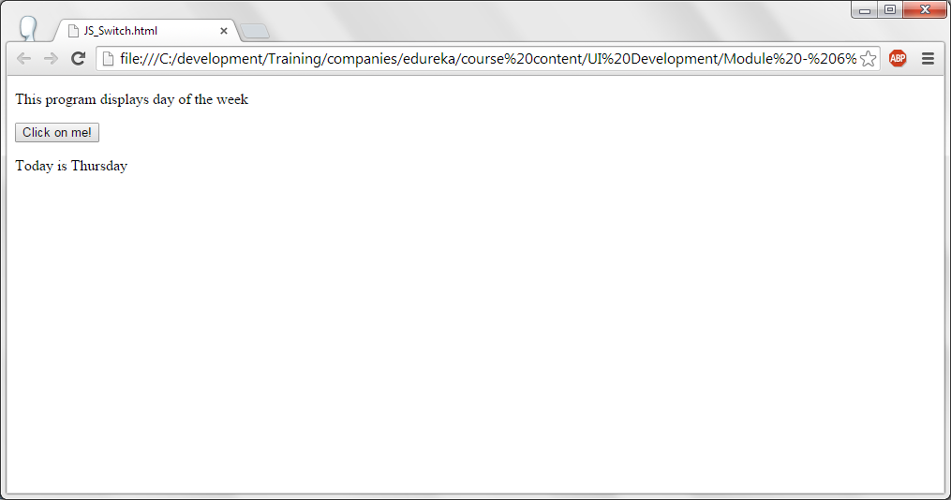
JS – Switch - Output.

Slide 59
Thank you!

