Slide 1
Module – 7
Java Script – Part II

Slide 2
Topics covered in this module are:
• JS Breaks
• JS Errors
• JS RegExp
• JS Hoisting
• JS Strict Mode
• JS Conventions
• JS Performance
• JS Reserved Words
• JS JSON
• Object Prototypes
• Function Parameters
• DOM Methods
• DOM Elements
• DOM HTML
• DOM CSS

Slide 3
JS – break.
<!DOCTYPE html>
<html>
<body>
<p>Break breaks the loop. A Loop is running from 10 to 20. Using break statement
loop is stopped after looping variable is 16 </p>
<button onclick="BreakFunction()">Click on Me</button>
<p id="brk"></p>
<script>
function BreakFunction() {
var text = ""
var i;
for (i = 10; i < 20; i++) {
if (i > 16) {break;} --> If the value of i is greater than 16 then control comes out of the loop with break statement.
text += "The number is " + i + "<br>";
}
document.getElementById("brk").innerHTML = text;
}
</script>
</body>
</html>

Slide 4
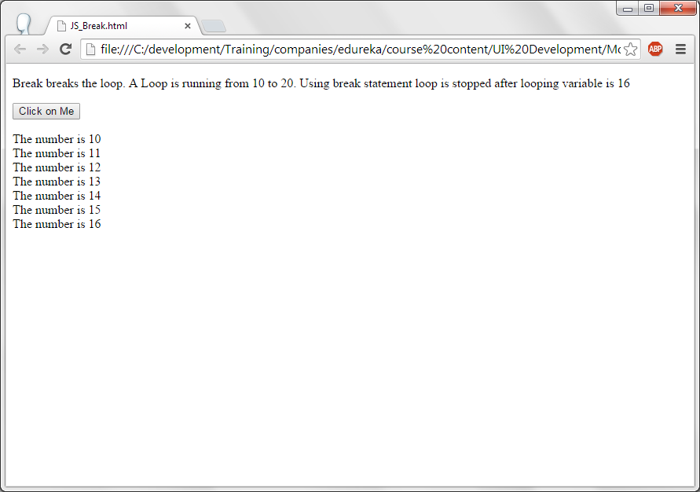
JS-Break output.

Slide 5
JS-Error
try..catch..finally blocks are used for error handling in Java script.
All the statements should be placed in try block. If there is any error control goes to catch block. Error message will be placed in err object and will be sent to the catch block as argument. Message property of err object will specify the error in the try block.
Finally block is executed at the end. Whether the succesful execution of the code or unsuccessful execution of the code finally block is executed.
Throw statement is used to throw an error message which can be caught in the catch block. Throw can be used when there is a logical error and developer wants to throw an error.

Slide 6
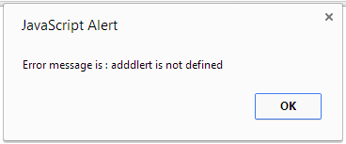
JS-Error-try..catch.
<!DOCTYPE html>
<html>
<body>
<script>
try {
adddlert("Hope you are learning java script...");
}
catch(err) {
alert("Error message is : " + err.message);
}
</script>
</body>
</html>
In the code, adddlert () is used instead alert, since it is not a valid function control goes to catch block and err.message contains the error and this error message displayed in alert box.

Slide 7
JS-Error-try..catch
<!DOCTYPE html>
<html>
<body>
<p>Please enter a number between 100 to 200</p>
<input id="data" type="text">
<button type="button" onclick="TestData()">Click on me</button>
<p id="error_msg"></p>
<script>
function TestData() {
var error_msg, data;
error_msg = document.getElementById("error_msg");
error_msg.innerHTML = "";
data = document.getElementById("data").value;
try {
if(data == "") throw "Given input is empty";
if(isNaN(data)) throw "Given input is not a number";
if(data > 200) throw "Given number is too high. Please enter between 100 to 200";
if(data < 100) throw "Given number is too low. Please enter between 100 to 200";
alert ("Congratulations...Correct data is entered: "+data);
}
catch(err) {
error_msg.innerHTML = err;
}
finally
{
alert ("In the finally block...");
}
}
</script>
</body>
</html>

Slide 8
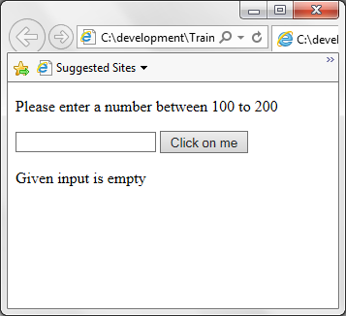
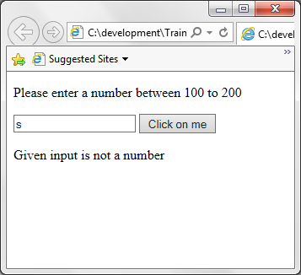
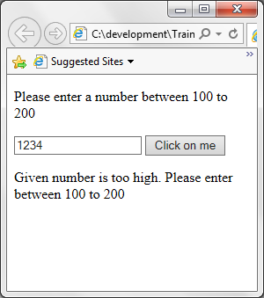
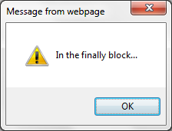
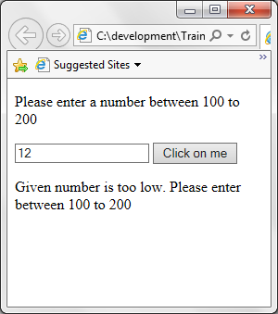
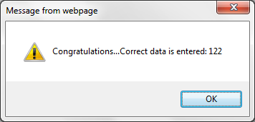
JS-Error-try..catch..finally output.

Slide 9
JS-Error-try..catch
In the TestData() function, Entered data in the text box is obtained and stored into the variable data.
If no data is eneted error message “Given number is empty is thrown”. Similary based on the give input corresponding error message is thrown.
This error message is displayed in the paragraph having the id error_msg.
If the user entered the data between 100 to 200 then an alert message is displayed as “Congratulations...You entered correct data”.
At the end finally block executed. In both the cases i.e,. successful execution of the code and unsuccessful execution of the code finally block is executed.

Slide 10
JS – Regular expression.
<!DOCTYPE html>
<html>
<body>
<p>Search for the string in case insensitive way...</p>
<button onclick="SearchString()">Try it</button>
<p id="display"></p>
<script>
function SearchString() {
var str = "I am learning Java Script";
var n = str.search(/java/i);
document.getElementById("display").innerHTML = "String is located at the location : " + n;
}
</script>
</body>
</html>

Slide 11
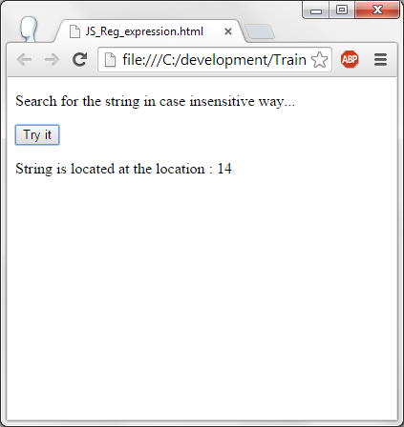
JS – Regular expression.

Slide 12
JS – Hoisting (Variable).
variable declarations (and declarations in general) are processed before any code is executed, declaring a variable anywhere in the code is equivalent to declaring it at the top. This also means that a variable can appear to be used before it's declared. This behavior is called "hoisting", as it appears that the variable declaration is moved to the top of the function or global code.
A variable can be intialized in the beginning and can be declared later on is known as hoisting. This is not the correct way of executing the code. This can be avoided using strict mode which will be explained in the next topic.

Slide 13
JS – Regular expression.
Regular expression is a pattern to be matched in the string and returns whether the pattern is available or not.
Regular expression modifiers
  i – case insensitive
  g – global pattern matching.
  m – matches multiple lines.
Some more modifiers are:
  [xyz] – Finds any character given in the brackets.
  [0-9] – Finds any number between 0 to 9.
In the code, java is searched in the string “I am learning java Script” using /i option of regular expression and its position is displayed as 14 as 14th position Java is found.

Slide 14
JS – Hoisting (Variable).
<!DOCTYPE html>
<html>
<body>
<p id="info"></p>
<script>
int_data = 15; //Assing 15 to int_data but the variable declaration is defined at the end.
elem = document.getElementById("info"); // Find an element
elem.innerHTML = "int_data content in hoisting mode is: " + int_data; // Display int_data in the element
var int_data, elem; // Declare int_data
</script>
</body>
</html>
Variable int_data is assigned to 15 without declaring it. This variable is declared at the end of the script tag. This is hoisting.
Object of info is obtained and stored in elem variable and it is updated with the int_data.

Slide 15
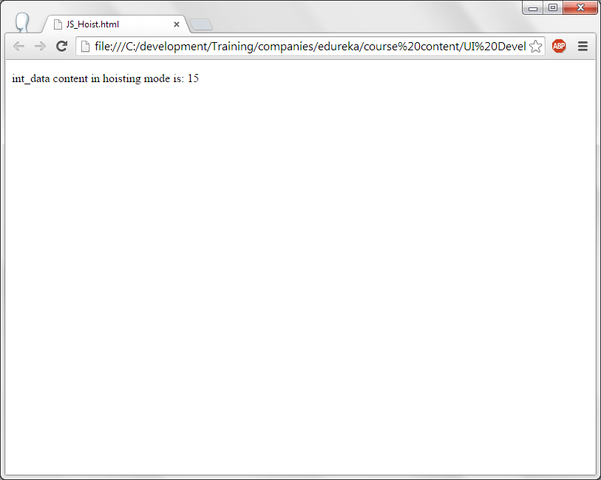
JS – Hoisting (Variable).

Slide 16
JS – Strict mode.
Strict mode can be enabled by using “use strict”;
With strict mode, hoisting is not possible. That is initialize the variable without declaring it.
“use strict”; should be the first line of the script or the function to take the effect else script works in hoisting mode.
Defining the duplicate variables declaration is an error in strict mode.

Slide 17
JS – Strict mode.
<!DOCTYPE html>
<html>
<body>
<p>"use strict"; is used for strict type declaration rather than hositing...</p>
<p> Remove "use script" and check the output... </p>
<script>
"use strict"; //Strict mode is defined here. Without variable declaration, variable cant be assigned data.
y= 600; // This will cause an error.
CallFunction(); // This will also cause an error.
function CallFunction()
{
alert ("Inside a function");
x = 500;
alert (x);
alert (y);
}
</script>
</body>
</html>

Slide 18
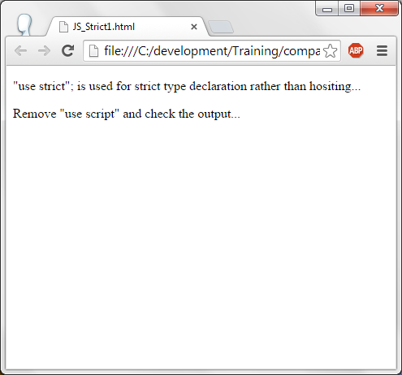
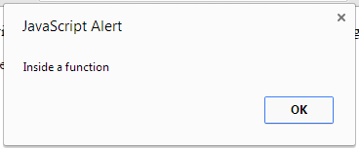
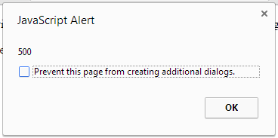
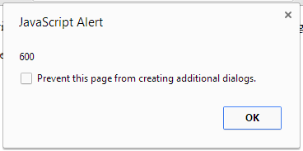
JS – Non Strict mode.
JS – Strict mode.

Slide 19
JS – Strict mode.
The first line of script is “Use strict”; This will enable the strict mode rather than hoisting mode. i.e., variable cant use initialized or used without declaring them.
Variable y is initialize without declaring it. This is an error in strict mode.
CallFunction() is called without defining it, this is also an error in strict mode.
Variable x is initialized with 500 in the function CallFunction() without declaring it, this is also an error in strict mode.
Values of x and y variables are displayed in alert box. Since errors are there, there is no display in the output of the program.
Please try removing the “Use strict”; and run the same program to see the output.
In alert box, “prevent the page from seeing additional dialogs” will be displayed by chrome if the alerts is generated with in a second. This is browser specific.

Slide 20
JS- Strict mode.
<!DOCTYPE html>
<html>
<body>
<p>"use strict"; is used in the function. Strict mode is applicable only to the function....</p>
<p> This should be first line of the script or the function to get the effect.. </p>
<p> Remove "use script" and check the output... </p>
<script>
y= 600; // This will not cause an error.
alert (y);
CallFunction();
function CallFunction()
{
"use strict";
alert ("Inside a function");
x = 500;
alert (x);
alert (y);
}
</script>
</body>
</html>

Slide 21
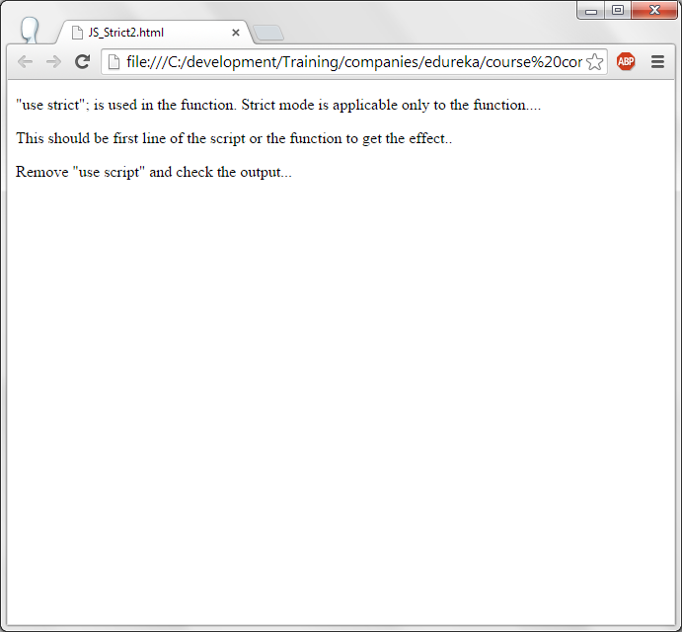
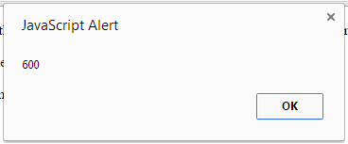
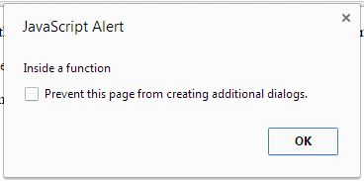
JS- Strict mode.

Slide 22
JS- Strict mode.
Variable y is initialized to 600 and displayed its value in alert box. Since it is in hoisting mode, there is no issue.
Strict mode is defnined in the function CallFunction(). An alert box is displayed and variable x is initialized without declaring it, hence this is an error in strict mode. Next 2 alert boxes will not be displayed.

Slide 23
JS – Best practices / Conventions.
Avoid global variables – Declare them only when necessary. The reason being, once the global variable is declared then the memory allocated for that variable will be there till the program ends. It is always better to use a local variable (variable inside a function) so that once the control executes the functions and comes out then memory allocated for the local variable is released.
Always use local variable – Variable declared inside a function are called as local variable. It must declared using var keyword. If not then they are considered as global variables.
All the variables declare on top – To avoid the confusion and redeclarion, it is always better to declare all the variable in the beginning of the section or in the beginning of the function.
Do not declare numbers, string and booleans as objects : There are two types of data. One is primitive data type and another is objects of the same primitve data type. It is better use primitive data type rather than objective type to increase the performance of the system.

Slide 24
JS – Best practices / Conventions.
Primitive data type can be declared as given below:
  var str = “charan”
The same can be declared as objects as given below:
  var str = new String (“charan”);
Use === rather than == as it compares the data with the data type too.
//y= (0 == ""); // true
//y = (1 == "1"); // true
//y = (1 == true); // true
//y = (0 === ""); // false
//y = (1 === "1"); // false
//y = (1 === true); // false

Slide 25
JS - Performance
Reduce activity in loops : If certain statements are not required to be as part of loops then place them outside the loop. With every statement in the loop cpu will execute them and it takes the cpu cycles. If the statements placed outside the loop then the performance of the project goes up. For example :- Initializing a varialbe need not be in the loop all the time. It can be declared outside the loop.
Reduce the DOM access : DOM stands for Document Object model. Some of the functions like getElementById() returns the object of the element. Rather than using it every time, once the getElementById() can be used and its object can be stored in a variable and that variable can be used as many times as required.

Slide 26
JS - Performance
Every time DOM is used, it searches in the tree and obtains the address. Searching every time can be costly in terms of performance.
Avoid declaring varaibles and objects un-necessarily : For example :
  Var full_name = first_name + last_name;
  Document.getElementById(“test”).innerHTML = full_name
can be used as
  Document.getElementById(“test”).innerHTML = first_name + last_name;

Slide 27
JS - Performance
Define the script at the end : Place the script at the end of the body as let the page first gets loaded and bevdisplayed and then the script gets loaded. Otherwise time is consumed to load the scripts and then page is displayed. User will see a delay in seeing the webpage which is not right from web page development.

Slide 28
JS – Reserved words. Please do not use these reserve words as variables or as functions.
abstract, arguments, boolean, break, byte,
case , catch, char, class*, const,
continue, debugger, default, delete, do,
double, else, enum*, eval, export,
extends, false, final, finally, float,
for, function, goto, if, implements,
import, in, instanceof, int interface,
let long, native, new, null,
package, private, protected, public, return,
short, static, super, switch, synchronized,
this, throw, throws, transient, true,
try, typeof, var, void, volatile,
while, with, yield .

Slide 29
JS – JSON.
JSON stands for Java Script Object Notation.
Like XML JSON is also another format for storing data.
Many applications uses JSON as the format for exchanging the data between the applications.
Using parse() meethod json data can be loaded in an object format in Java Script.
JSON data can be placed in a file. This file should have the extension of .json.

Slide 30
JS – JSON.
<!DOCTYPE html>
<html>
<body>
<h2>Create Object from JSON String</h2>
<p id="json_data"></p>
<script>
var text = '{"bank":[' +
'{"ActNumber":"SB101","Name":"Doe","Address":"California" },' +
'{"ActNumber":"SB102","Name":"Divya","Address":"Bangalore" },' +
'{"ActNumber":"SB103","Name":"Jones","Address":"New York" }]}';
obj = JSON.parse(text);
document.getElementById("json_data").innerHTML =
obj.bank[1].ActNumber + " " + obj.bank[1].Name+ " " + obj.bank[1].Address;
</script>
</body>
</html>
Bank account details are stored in bank variable which is stored in text JSON object.
JSON.parse(text) reads the JSON data and stores in an object obj.
Account Number, Name and Address from JSON object is printed in the paragraph which has the id json_data.

Slide 31
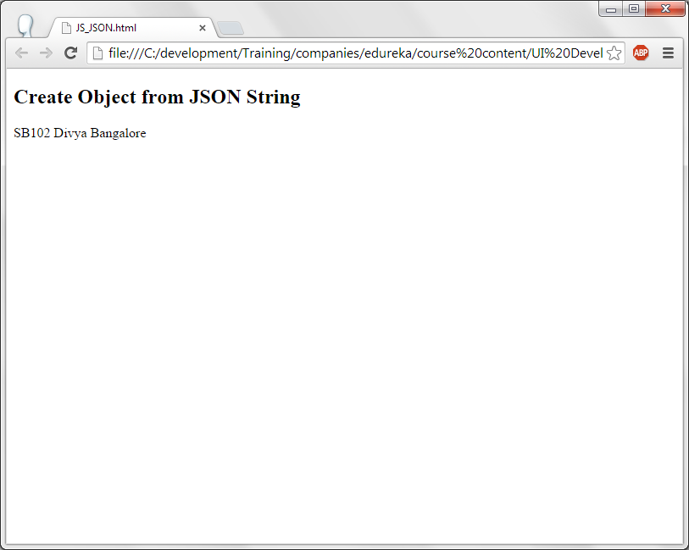
JS – JSON.

Slide 32
JS - Functions
<!DOCTYPE html>
<html>
<body>
<p> Function is defined as part of the attribute </p>
<p id="attr_function"></p>
<script>
var person = {
firstName: "Charan",
lastName : "kumar",
id : 3456,
fullName : function() {
return this.firstName + " " + this.lastName;
}
};
document.getElementById("attr_function").innerHTML = person.fullName();
</script>
</body>
</html>

Slide 33
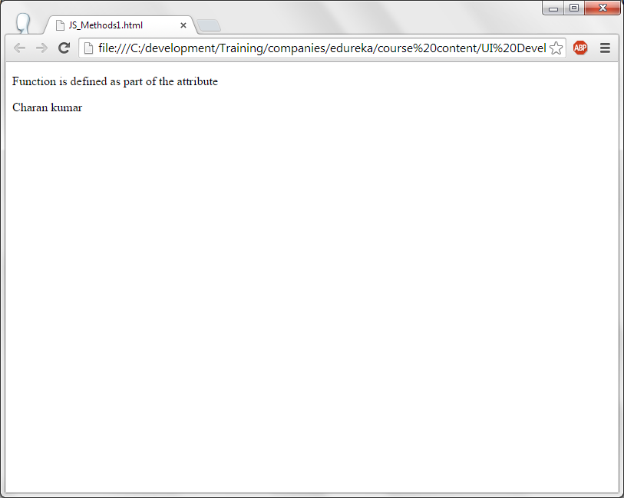
JS - Functions

Slide 34
JS - Functions
A variable is declared by name person.
First name, last name, id are the attributes defined and assigned a value.
For the attribute fullname, a function is defined which adds the value of first name and last name and this value is returned.
Paragraph with the id attr_function content is updated by calling a object.attribute function as person.fullname().

Slide 35
JS – Object Prototype
Every java script object has a prototype and prototype is also an object.
All the java script objects get their properties and methods from their prototyped objects.
All the objects like Date, Array, RegExpr etc., are derived from Object.prototype.

Slide 36
JS – this pointer.
<!DOCTYPE html>
<html>
<body>
<p id="account1"></p>
<p id="account2"></p>
<script>
function BankAccount(AcctNumber, first, last, TypeOfAcct) {
this.AcctNumber = AcctNumber;
this.firstName = first;
this.lastName = last;
this.TypeOfAcct = TypeOfAcct;
this.ChequeFacility = true;
}
var act1 = new BankAccount(101,"Charan", "Kumar", "SB");
var act2 = new BankAccount(102,"Daisy", "Dan", "RD");
document.getElementById("account1").innerHTML = act1.firstName + " is holding " + act1.TypeOfAcct + " Account number : "
+act1.AcctNumber + " Having cheque facility : " + act1.ChequeFacility;
document.getElementById("account2").innerHTML = act2.firstName + " is holding " + act2.TypeOfAcct + " Account number: "+act2.AcctNumber + " Having cheque facility : " + act2.ChequeFacility;
</script></body></html>

Slide 37
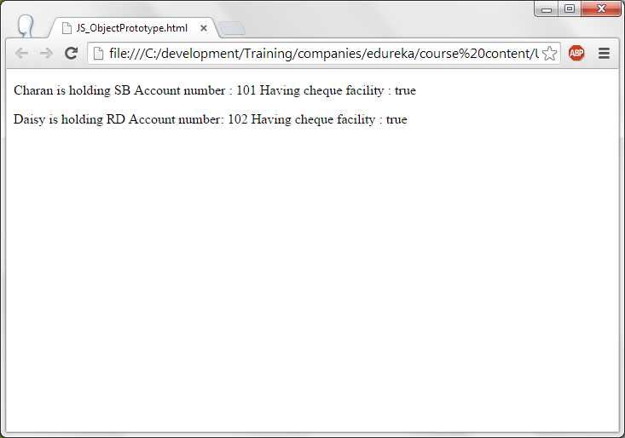
JS – this pointer.

Slide 38
JS – this pointer.
Two paragraphs account1 and account2 are defined.
A function by name BankAccount which receives the arguments Accout number, first name, last name and Type of account.
this pointer points to the current object.
this pointer attribute is defined and the received argument is assigned to it.
Two accounts are created with the names given.
These account objects information is displayed in the HTML paragraphs with id account1 and account2 .

Slide 39
JS- Function as variable name
<!DOCTYPE html>
<html>
<body>
<p>A function is assigned to a variable and variable name can be used as a function</p>
<p id="sqr_para"></p>
<p id="mul_para"></p>
<script>
var sqr = function (a) {return a * a};
var multiply = function (a, b) {return a * b};
document.getElementById("sqr_para").innerHTML = "Square of 25 is " + sqr(25);
document.getElementById("mul_para").innerHTML = "Multiply of 16 x 4 is : " + multiply(16, 4);
</script>
</body>
</html>

Slide 40
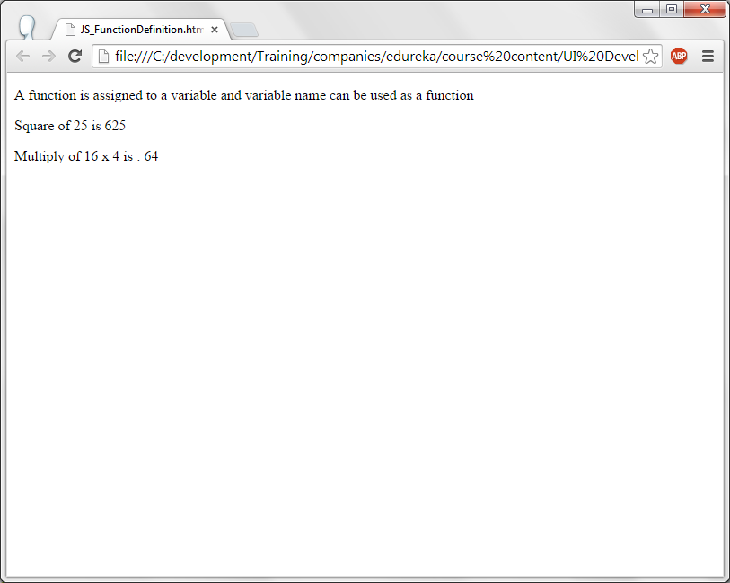
JS- Function as variable name

Slide 41
JS- Function as variable name
Two functions are defined and assigned to a variable sqr and multiply.
The function which is assigned to sqr variable returns the square of the given number.
The function which is assigned to multiply variable will multiply the received arguments and returns them.
These functions are called by the variables assigned to them. They are sqr (25) and multiply (16,4).

Slide 42
JS – Function arguments.
<!DOCTYPE html>
<html>
<body>
<p>Find sum and average of the data : (1, 123, 500, 115, 44, 88)</p>
<p id="sum"></p>
<p id="Average"></p>
<script>
function SumAndAverage() {
var i, sum = 0;
for(i = 0; i < arguments.length; i++) {
sum += arguments[i];
}
document.getElementById("sum").innerHTML = "Sum is : "+sum;
document.getElementById("Average").innerHTML = "Average is : "+sum / arguments.length;
}
SumAndAverage(1, 123, 500, 115, 44, 88);
</script>
</body>
</html>

Slide 43
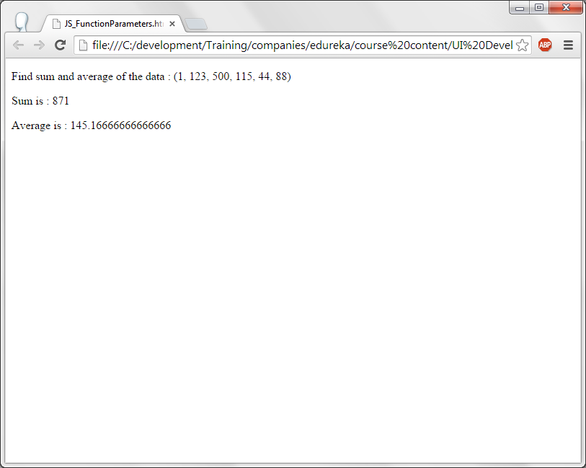
JS – Function arguments.

Slide 44
JS – Function arguments.
Two paragraphs with Ids sum and average are defined.
Function SumAndAverage() is defined. In this function a loop is iterated for all the elements passed to the function. Number of arguments can be found by arguments.length attribute. In the loop sum of all the elements are added.
Sum and Average paragraph is updated with the sum and average value.
At the end SumAndAverage() function is called with the data.
Note : arguments for the function need not be passed in the paranthesis of the function. They can be passed while calling a function and can be accessed by using arguments property.

Slide 45
JS – Function closures.
A closure is an inner function that has access to the outer function’s variables
<!DOCTYPE html>
<html>
<body>
<p>Counter example...With every click of a button value of the counter gets incremented</p>
<p> They are called closures </p>
<button type="button" onclick="MyCounter()">Counter</button>
<p id="value">0</p>
<script>
var add = (function () {
var counter = 0;
return function () {return counter += 1;}
})();
function MyCounter(){
document.getElementById("value").innerHTML = add();
}
</script></body></html>

Slide 46
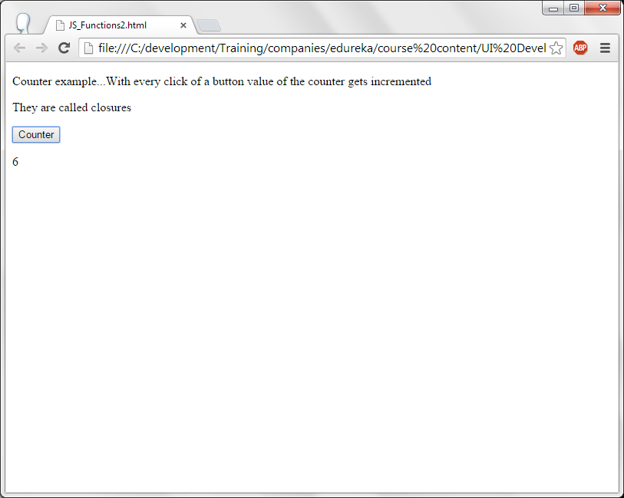
JS – Function closures.

Slide 47
JS – Function closures.
A counter button is displayed. On click of this button, MyCounter() method is invoked.
In MyCounter() function, paragraph with id value is updated by calling add() function .
In add() function, counter variable is initialized to 0 and it calls another inner function which incriments the value of counter by one more unit and returns it. Hence with every click of the button counter, value of counter gets incremented and displayed.

Slide 48
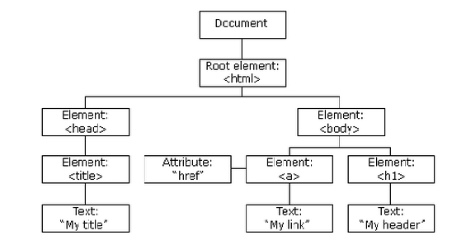
DOM
DOM stands for Document Object Model,
HTML elements are constructed as a tree and it is accessed using DOM. This is called as HTML DOM.
Tree structure looks like this:

Slide 49
DOM – Elements and Methods.
<!DOCTYPE html>
<html>
<body>
<p> This is a paragraph in p tag</p>
<p id="test"> 5345 </p>
<p class="generic"> This is a class paragraph with class name generic </p>
<script>
document.getElementById("test").innerHTML = 6700;
var x = document.getElementsByTagName("p");
alert (x[0].innerHTML);
var y = document.getElementsByClassName("generic");
alert (y[0].innerHTML);
</script>
</body>
</html>

Slide 50
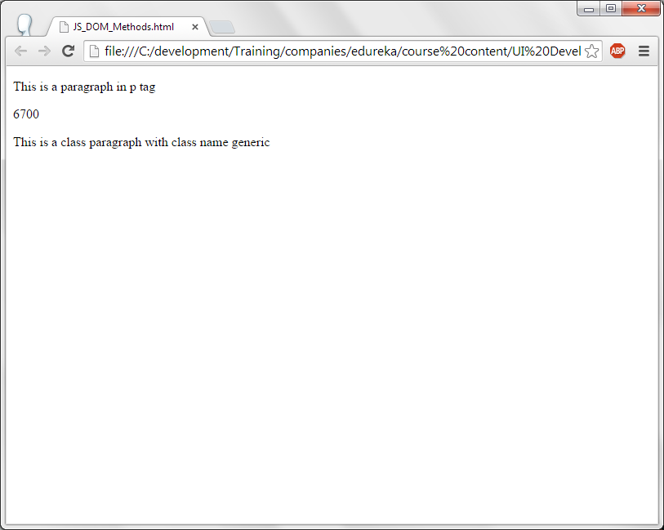
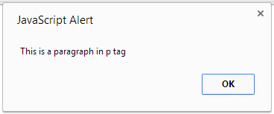
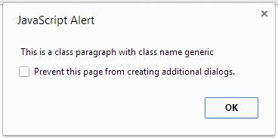
DOM – Elements and Methods.

Slide 51
DOM – Elements and Methods.
Three paragraphs are defined. First paragraph displays a simple message “This is a paragraph in p tag”. Second paragraph with id “test” displays the content 5345. Third paragraph has a class “generic” displays the message “This is a class paragraph with class name generic”.
getElementById() is used to change the value of paragraph with id “test” to 6700.
getElementsByTagName() with tag name “p” retuns all the elements with the tag <p>. This is assigned to a variable x. First element of the x can be accessed using x[0]. This element is displayed in the alert box.
In the same manner getElementsByClassName(“generic”) is used to access the elements of the paragraph with a class name “generic” and displays its first element in the alert box.

Slide 52
JS - DOM Elements
<!DOCTYPE html>
<html>
<body>
<form id="form1" >
First name: <input type="text" name="first_name" value="John"><br>
Last name: <input type="text" name="last_name" value="Donavan"><br><br>
<input type="submit" value="Submit">
</form>
<p>Click "Click On Me" to display the value of each element in the form.</p>
<button onclick="FormDataDisplay()">Click On Me</button>
<p id="DisplayInfo"></p>
<script>
function FormDataDisplay() {
var data = document.getElementById("form1");
var text = "";
var i;
for (i = 0; i < data.length ;i++) {
text += data.elements[i].value + "<br>";
}
document.getElementById("DisplayInfo").innerHTML = text;
}
</script></body></html>

Slide 53
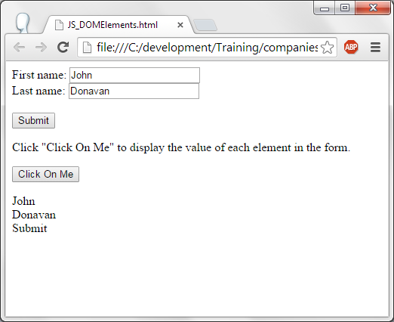
JS - DOM Elements
All the elements of the form is obtained using getElementById() and it is displayed.

Slide 54
JS – DOM - HTML
<!DOCTYPE html><html><body>
<img id="image1" src="roses.jpg" width="160" height="120">
<p> On click on the button, image is changed.. </p>
<input type="submit" onclick="ChangePicture()"value="Click on me"/>
<input type="submit" onclick="ChangeBack()"value="Change Back"/>
<script>
function ChangePicture()
{
document.getElementById("image1").src = "single_flower.jpg";
}
function ChangeBack()
{
document.getElementById("image1").src = "roses.jpg";
}
</script></body></html>
GetElementById().innerHTML will change the HTML element content and .src will change the source image.

Slide 55
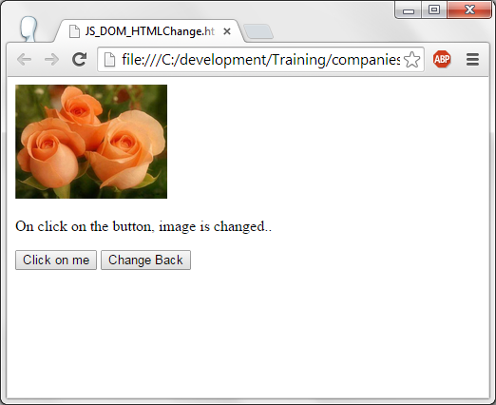
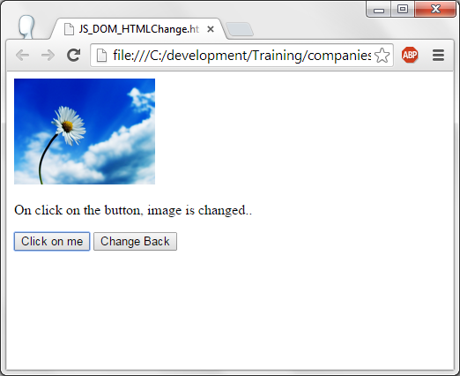
JS – DOM – HTML - Output

Slide 56
JS – DOM - CSS
<!DOCTYPE html>
<html>
<body>
<h1 id="header">This is a header...Changes its color on click of the button...</h1>
<button type="button"
onclick="document.getElementById('header').style.color = 'red'">
Click</button>
</body>
</html>
Header “This is header...etc.,” is displayed. This header has the id “header”.
A button is displayed and on click of this button, header color is changed from black to red. .style.color property of DOM is used to change the color of the header.

Slide 57
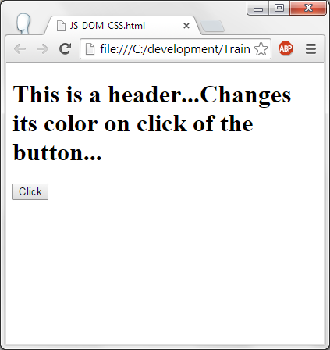
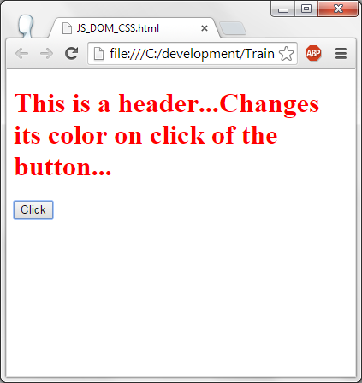
JS – DOM - CSS

Slide 58
Thank you!

