Slide 1
Module – 8
Java Script - III

Slide 2
Content to be covered.
DOM Events
DOM EventListener
DOM Navigation
DOM Nodes
JS Browser BOM
JS Window
JS Screen
JS Location
JS History
JS Navigator
JS Popup Alert
JS Timing
JS Cookies

Slide 3
DOM Events
<!DOCTYPE html>
<html><head></head>
<body>
<p>Click on the button to display todya's date and time...</p>
<button id="btn">Click on me</button>
<p id="DateInfo"></p>
<script>
document.getElementById("btn").onclick = function(){Display()};
function Display() {
document.getElementById("DateInfo").innerHTML = new Date();
}
</script></body></html>
A button with id btn is displayed. On click on this button, it calls a function and inside that function another function Display() is called. Display function will update the DateInfo paragraph with the current Date.

Slide 4
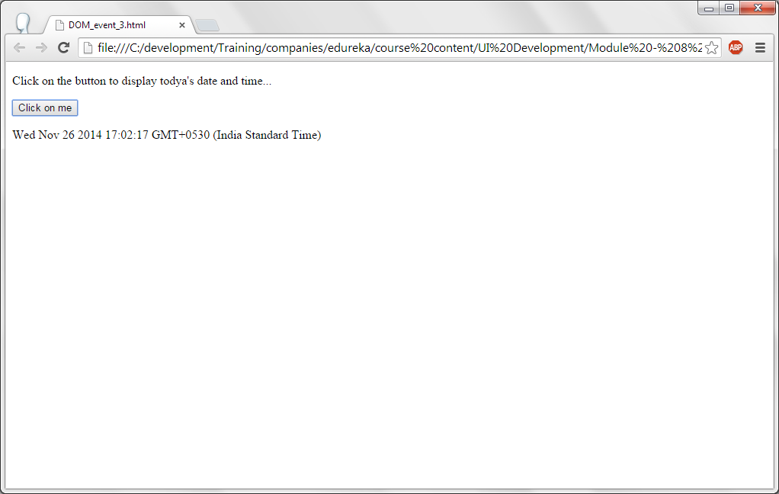
DOM Events

Slide 5
DOM Events
<!DOCTYPE html>
<html>
<body onload="DisplayAlert()">
<h1> This is the header </h1>
<script>
function DisplayAlert() {
alert ("Alert box is displayed when the page is loaded...");
}
</script>
</body>
</html>
onload event occurs when the web page is completely loaded including HMLT, CSS, images etc. onload of the web page DisplayAlert() method is called. In this method, an alert box is displayed...

Slide 6
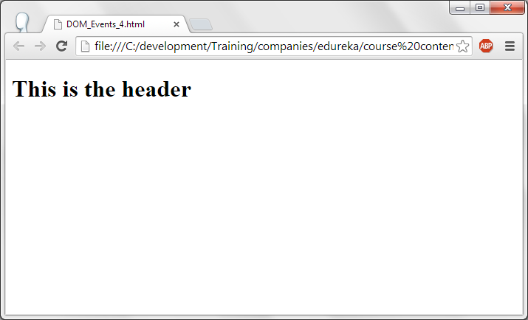
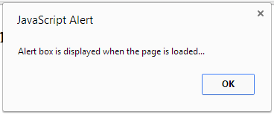
DOM Events

Slide 7
DOM – Event listener.
An event listener is attaching a method to an element of a HTML when a specific event is generated for that element. For example, when a button is clicked a method is attached to it.
Advantage of event listeners is, not only one method many methods can be attached as event listeners.

Slide 8
DOM – Event listener.
<!DOCTYPE html>
<html>
<body>
<p>addEventListener() is attached when a button is clicked...</p>
<button id="btn">Click</button>
<script>
document.getElementById("btn").addEventListener("click", addEvntLstner_function);
function addEvntLstner_function() {
alert ("Hurray! addEventListener is attached when a button is clicked..");
}
</script>
</body>
</html>
Event Listener addEvntLstner_function is added when a button with id “btn” is clicked.
In the attached function, an alert box is displayed.

Slide 9
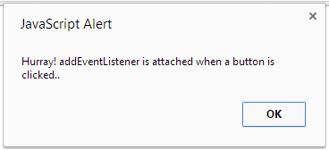
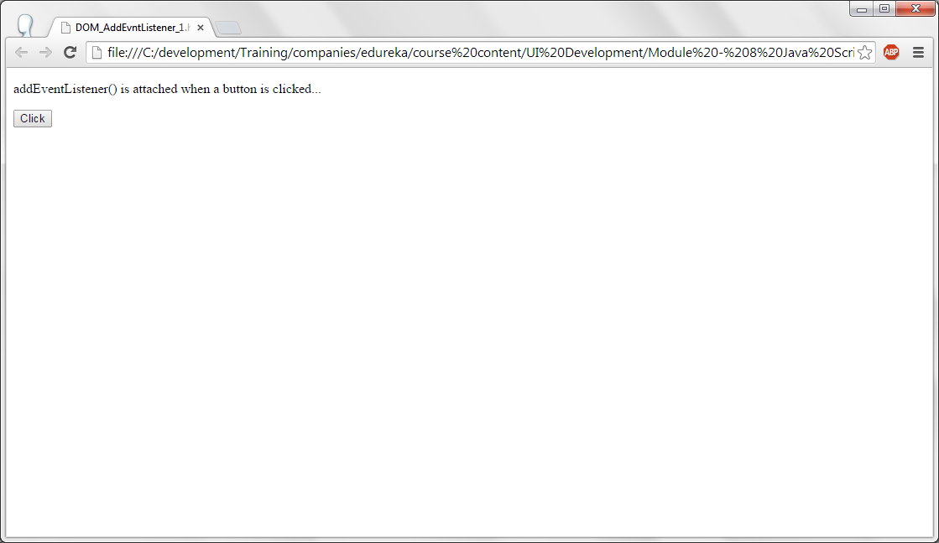
DOM – Event listener.

Slide 10
DOM – Event listener.
<!DOCTYPE html>
<html>
<body>
<p>Using addEventListeners, many events are added to a button</p>
<button id="Btn">Click on me!</button>
<p id="information"></p>
<script>
var x = document.getElementById("Btn");
x.addEventListener("mouseover", MouseOverInfo);
x.addEventListener("click", ClickInfo);
x.addEventListener("mouseout", MouseOutInfo);
function MouseOverInfo() {
document.getElementById("information").innerHTML += "Mouse is over the button!<br><br>";
}
function ClickInfo() {
document.getElementById("information").innerHTML += "You clicked on a button!<br><br>";
}
function MouseOutInfo() {
document.getElementById("information").innerHTML += "You moved mouse out of the button!<br><br>a";
}
</script>
</body>
</html>

Slide 11
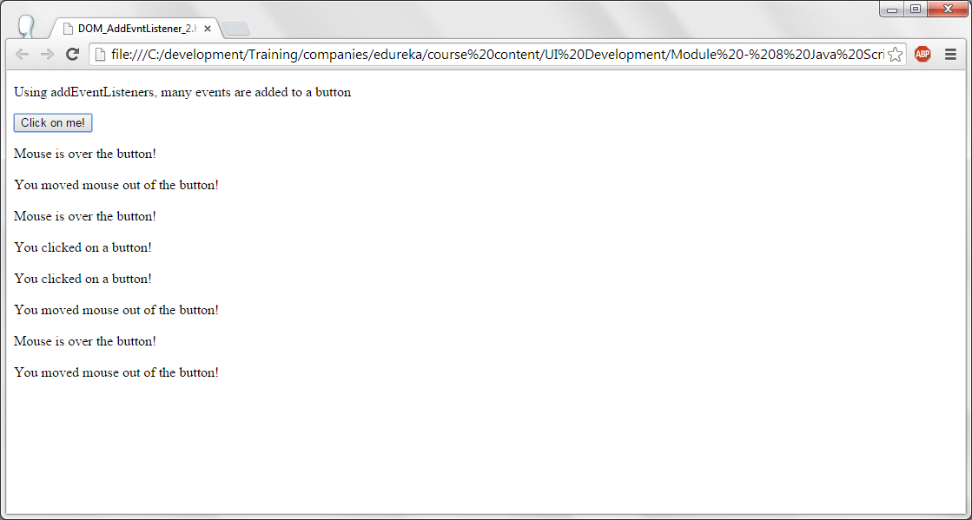
DOM – Event listener.

Slide 12
DOM – Event listener.
Description about the program is displayed as a paragraph.
A button is displayed with id Btn and the caption of the button is Click on me!.
A paragraph with the id “information” is created.
For the button 3 event listeners are added. They are mouseover, mouseout and click. When the mouse is moved on the button, when the mouse cursor is moved out of the button and the button is clicked on. On all these events corresponding methods are called.
In the corresponding methods, paragraph content with id “information” is appended with the event listener function, such as mouseover, mouseout and clicked.

Slide 13
DOM – Event listener.
<!DOCTYPE html><html><head><style>
#box {
background-color: #660099;
border: 1px solid;
padding: 50px;
color:white;
}</style></head>
<body>
<div id="box">Move the mouse inside the box to see the random numbers and click on the button to remove the mousemove handler </p>
<button onclick="removeHandler()" id="Btn">Remove Handler</button>
</div>
<p id="data"></p>
<script>
document.getElementById("box").addEventListener("mousemove", DisplayRandom);
function DisplayRandom() {
document.getElementById("data").innerHTML = Math.random()*100;
}
function removeHandler() {
document.getElementById("box").removeEventListener("mousemove", DisplayRandom);
}
</script></body></html>

Slide 14
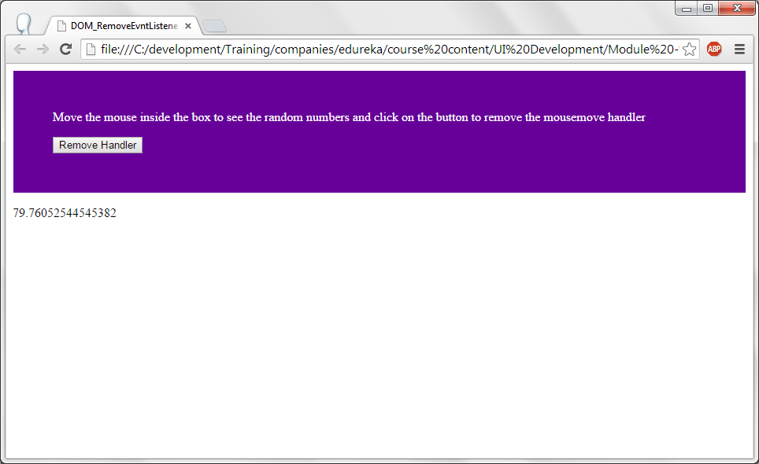
DOM – Event listener.

Slide 15
DOM – Event listener.
Information about the program and a button is displayed in a <div> tag. Style for div is padding is 50px, text color is in white color and background color is specified.
When the mouse is moved in the div box an event is added by calling a function. This function displays the random numbers between 0 to 10.
On the click of Remove Handler button, event handler attached with the div box is removed by using removeEventListener() function.

Slide 16
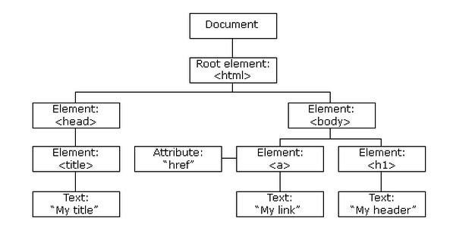
DOM – Navigation.
The whole HTML file is a document node.
Every element in HTML is a element node.
It is like tree format. It will have braches and leaves.

Slide 17
DOM – Navigation.
Following Java script node properties can be used to access the elements of the HTML tree..
  parentNode
  childNodes
  firstChild
  lastChild
  nextSibling
  previousSibling

Slide 18
DOM – Navigation.
<!DOCTYPE html>
<html>
<body>
<h1 id="information">This is the header</h1>
<input type="button" onclick="DisplayInfo()"id="btn" value="click on me" />
<p id="para">Hello World!</p>
<script>
function DisplayInfo()
{
data = document.getElementById("information").firstChild.nodeValue;
document.getElementById("para").innerHTML = data;
}
</script>
</body>
</html>

Slide 19
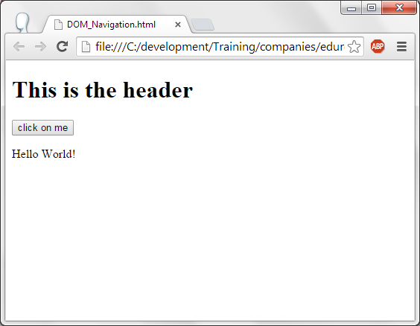
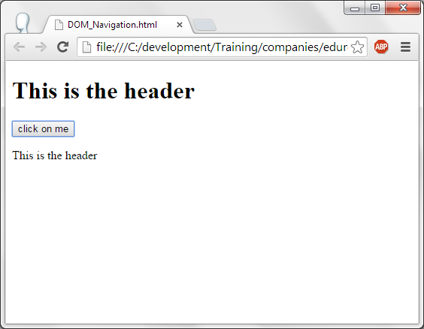
DOM – Navigation.

Slide 20
DOM – Navigation.
Header with the text “This is the header” with id “information” is displayed.
A button with caption “click on me” with id =”btn” and onclick of this button DisplayInfo() function is called.
A paragraph with id “para” with text Hello World is displayed.
In the DisplayInfo() function, Header content “This is Header” is copied to a variable and it is copied to a paragraph.

Slide 21
DOM – Nodes.
Using DOM nodes can be added or deleted or replaced.
  appendChild() is used to append a node element.
  replaceChild() is used to replace the content of the child node.
  removeChild() is used to remove the node form the list.

Slide 22
DOM – Nodes.
<!DOCTYPE html><html>
<style>
p
{
font-size : 30px;
color : #990033;
background-color : #CCCC66;
}
</style>
<body>
<div id="division">
<p id="p1">This is the first paragraph.</p>
<p id="p2">This is second paragraph.</p>
</div>
<input type="button" onclick="AddText()"id="btn" value="Add Text from DOM" />
<script>
function AddText()
{
var para = document.createElement("p");
var node = document.createTextNode("This is the new paragraph added from DOM function...");
para.appendChild(node);
var div_element = document.getElementById("division");
div_element.appendChild(para);
}</script></body></html>

Slide 23
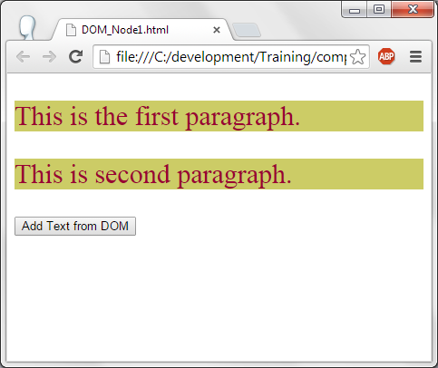
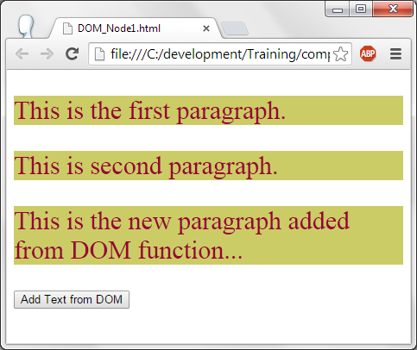
DOM – Nodes.

Slide 24
DOM – Nodes.
Two paragraphs with id p1 and p2 in div is displayed.
On click of the button AddText() function is called.
In the AddText() function, a paragraph is created using DOM function createElement(). A text node is created and added to the paragraph.
Using getElementById() object of div is obtained and the created paragraph is appended to it using appendChild() function.

Slide 25
DOM Nodes.
<!DOCTYPE html>
<html>
<style>
p
{
font-size : 30px;
color : #990033;
background-color : #CCCC66;
}
</style>
<body>
<div id="division">
<p id="p1">This is the first paragraph.</p>
<p id="p2">This is second paragraph.</p>
</div>
<input type="button" onclick="AddText()"id="btn" value="Add Text from DOM" />
<input type="button" onclick="ReplaceText()"id="btn1" value="Replace Text from DOM" />
<script>

Slide 26
DOM Nodes.
<script>
function AddText()
{
var para = document.createElement("p");
var node = document.createTextNode("This is the new paragraph added from DOM function...");
para.appendChild(node);
var div_element = document.getElementById("division");
div_element.appendChild(para);
}
function ReplaceText()
{
var para = document.createElement("p");
var node = document.createTextNode("Text replaced using DOM functions...");
para.appendChild(node);
var parent = document.getElementById("division");
var para_element = document.getElementById("p1");
parent.replaceChild(para, para_element);
}
</script>
</body>
</html>

Slide 27
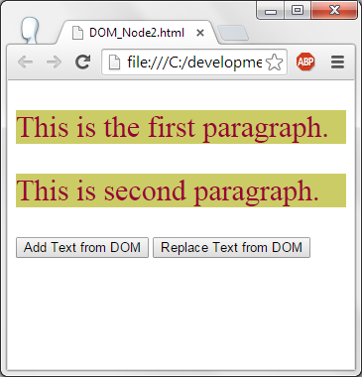
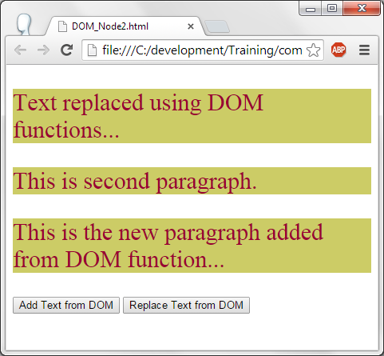
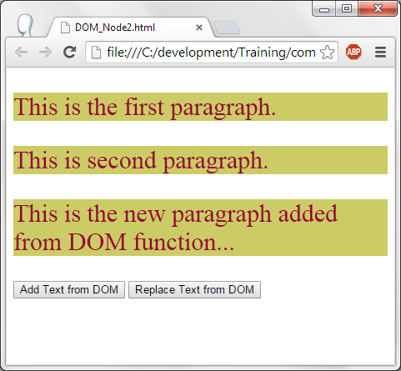
DOM Nodes.

Slide 28
DOM Nodes.
In addition to the previous code, another button is added to replace the paragraph's content.
When “Replace Text from DOM” button is clicked ReplaceText() function is called. In this function, a paragraph and text node is created.
This para is replaced with para with id p1.

Slide 29
BOM
BOM stands for Browser Object Model.
Window object is the object for for browser window.
Document object is the property of the browser window.
Following window functions can be used to perform window operations:
  window.open() --> Opens a new window.
  window.close() --> Closes the current window.
  window.moveTo() --> Moves the window to the given location.
  window.resizeTo() --> Resizes the current window.

Slide 30
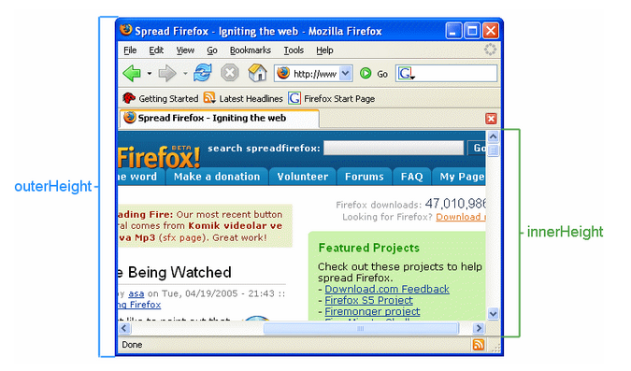
JS - window
Window object has outerHeight, innerHeight and outerWidhth , innerWidth as the properties to get the width and height of the window. Inner property is only the window which is used for display and outer property includes all the elements of the window like menu, toolbar etc.,

Slide 31
JS - Window
<!DOCTYPE html>
<html>
<body>
<p id="inner_info"></p>
<p id="outer_info"></p>
<script>
var inner_width = window.innerWidth;
var inner_height = window.innerHeight;
var outer_width = window.outerWidth;
var outer_height = window.outerHeight;
var outer = document.getElementById("outer_info");
outer.innerHTML = "Browser outer window width: " + outer_width + ", height: " + outer_height + ".";
element = document.getElementById("inner_info");
element.innerHTML = "Browser inner window width: " + inner_width + ", height: " + inner_height + ".";
</script></body></html>
After checking the output of this code, resize the window and check again to see the changes in width and height of the window.

Slide 32
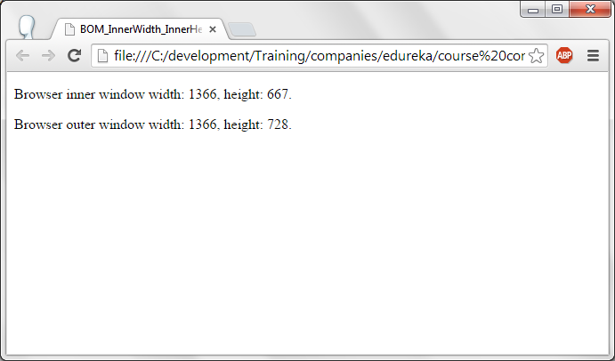
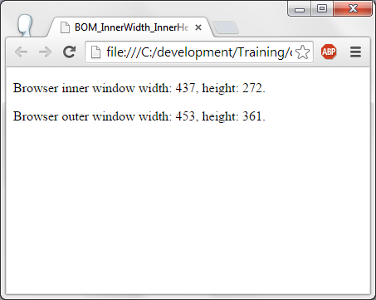
JS - Window

Slide 33
JS – Screen.
<!DOCTYPE html>
<html>
<body>
<p id="max_w_h"></p>
<script>
var width = screen.width;
var height = screen.height;
document.getElementById("max_w_h").innerHTML =
"Screen width is " + width + " Height : " + height;
</script>
</body>
</html>
Screen width specifies monitor screen width in pixels. The same with screen height too.
Window.height returns the height of the window. Screen.height returns the height of monitor.

Slide 34
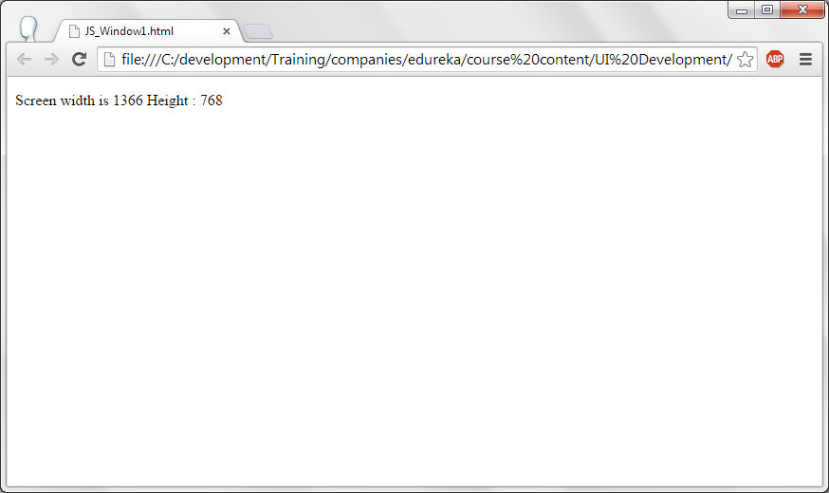
JS – Screen.

Slide 35
JS – Location.
Following are some of the window object properties.
  window.location.href --> Gives the URL of the current web page.
  window.location.host --> Gives the host name as google.com, yahoo.com etc.,
  window.location.pathname --> Gives the path of the URL.
  window.location.protocol --> Gives the protocol used in the web site. It can be http, https, file, ftp etc.,
  window.location.assign --> Opens the URL in the current page.

Slide 36
JS – Location.
<!DOCTYPE html><html><body>
<p>Click the button to display the entire URL of the current page.</p>
<button onclick="LocationInfo()">Location Information</button>
<button onclick="ChangeURL()">Change the website</button>
<p id="info"></p>
<script>
function LocationInfo() {
url = window.location.href;
hostname = window.location.host;
PathName = window.location.pathname;
protocol = window.location.protocol;
document.getElementById("info").innerHTML = "URL : " + url + " <br>" +
"Host name : " + hostname + "<br>" +
"Path name : " + PathName + "<br>" +
"protocol : " + protocol + "<br>" ;
}
function ChangeURL()
{
//Changes the current url to google.com using location.assign().
window.location.assign("http://www.google.com")
}
</script></body></html>

Slide 37
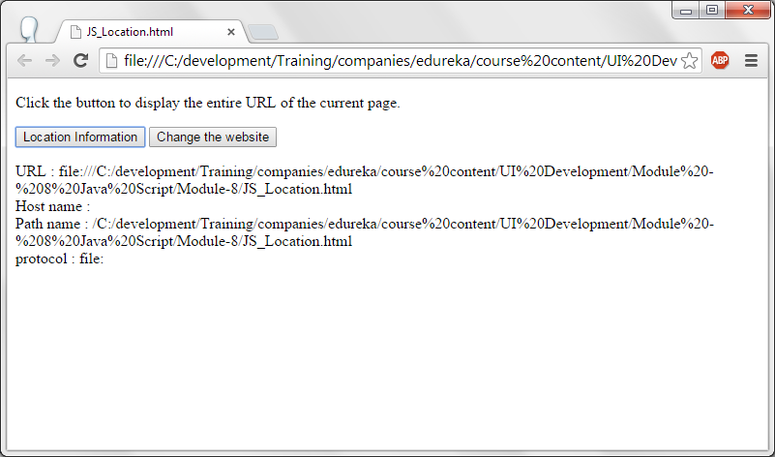
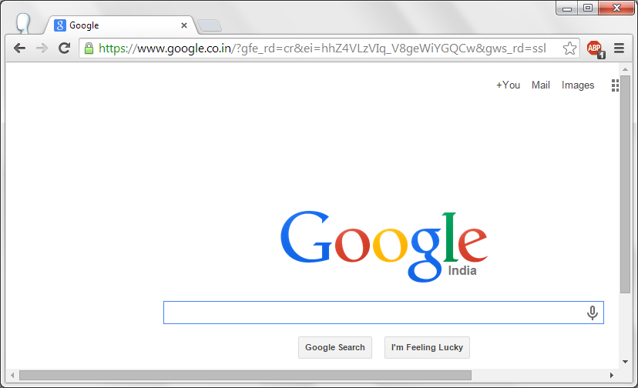
JS – Location.

Slide 38
JS – Location.
Two buttons are displayed. 1) Location Information 2) Change the web site.
On click on Location Information, calls LocationInfo() function. This function displays Url, hostname, pathname and protocol.
On click of change web site button, current page opens google.com using location.assign().

Slide 39
JS – History.
Visited web sites are in the history of the browser.
Java Script has windows.history object to provide the history of the browser.
History.back(), moves the control to the previous visited page. It is same as clicking on the back button on the browser.
History.next(), moves the control to the next page. It is same as clicking on the next button of the browser.

Slide 40
JS – History.
<html>
<head>
<script>
function goBack() {
window.history.back()
}
function goNext() {
window.history.forward()
}
</script>
</head>
<body>
<input type="button" value="Back" onclick="goBack()">
<input type="button" value="Next" onclick="goNext()">
</body>
</html>

Slide 41
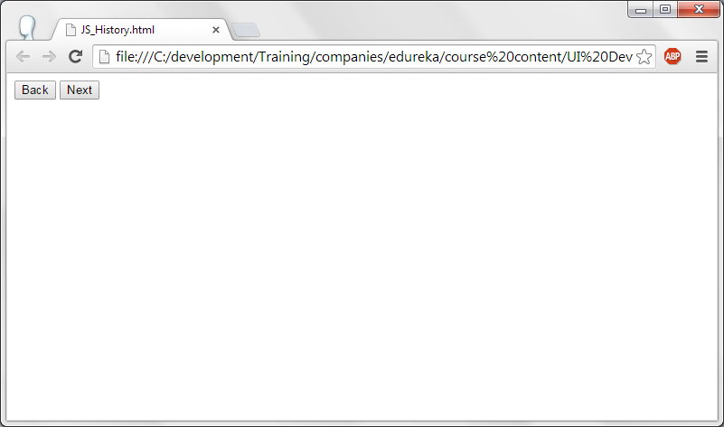
JS – History.

Slide 42
JS – Navigator.
Navigator object is used to obtain the information about the browser.
navigator.cookieEnabled --> Gives whether the cookies are enabled or not.
navigator.platform --> Gives the OS / Platform of the browser. As win32, linux etc.,
navigator.language --> Gives the language of the browser. As English etc.,
navigator.javaEnabled() --> Gives the result as whether Java is enabled in the browser or not to execute java script.

Slide 43
JS – Navigator.
<!DOCTYPE html>
<html>
<body>
<p>Browser Information...</p>
<button onclick="NavigatorInfo()">Click</button>
<p id="data"></p>
<script>
function NavigatorInfo() {
document.getElementById("data").innerHTML =
"Cookies enabled : " + navigator.cookieEnabled + "<BR>" +
"Browser Platform : "+ navigator.platform +"<BR>" +
"Browser english : " + navigator.language + "<BR>" +
"Is Java enabled : " + navigator.javaEnabled();
}
</script>
</body>
</html>

Slide 44
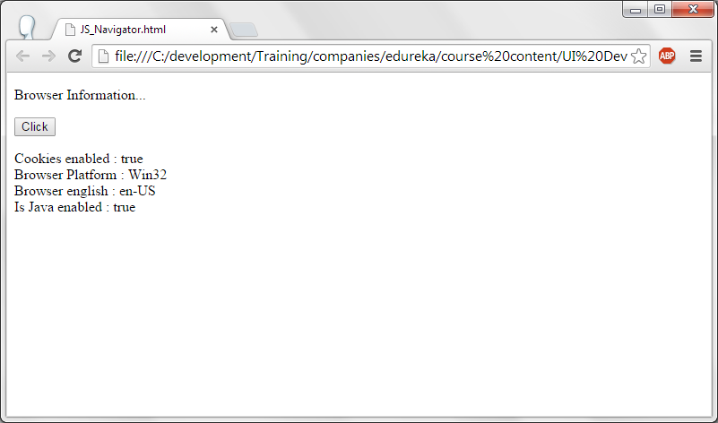
JS – Navigator.

Slide 45
JS – Popup Alert
alert() --> Is used to display the message in the alert box.
confirm() --> This method is used to display a message and displays ok and cancel buttons. User can select any of them to give the decision.
prompt() --> Displays a edit box. Default value can be provided for this edit box. User can enter data in this edit box. On click of ok button, entered data in the edit box can be assigned to a variable.

Slide 46
JS – Popup Alert
<!DOCTYPE html><html><body>
<p>Alert boxes.</p>
<button onclick="ConfirmBox()">ConfirmBox</button>
<button onclick="PromptFunction()">Prompt</button>
<p id="PopupBoxes"></p>
<script>
function ConfirmBox() {
var x;
if (confirm("Press OK or Cancel") == true) {
x = "You pressed OK!";
} else {
x = "You pressed Cancel!";
}
document.getElementById("PopupBoxes").innerHTML = x;
}
function PromptFunction() {
var person = prompt("Please enter your name", "Charan Kumar");
if (person != null) {
document.getElementById("PopupBoxes").innerHTML =
"Hello " + person + "Hope you are doing great!!";
}
}
</script></body></html>

Slide 47
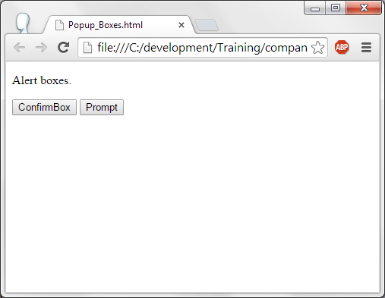
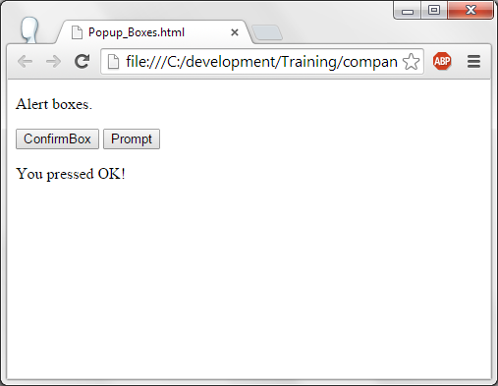
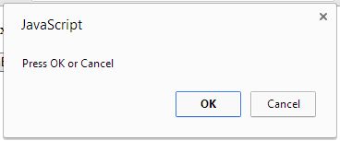
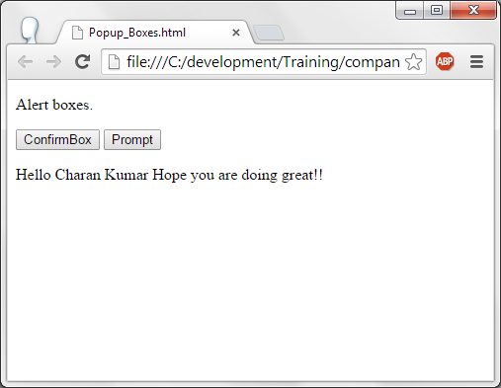
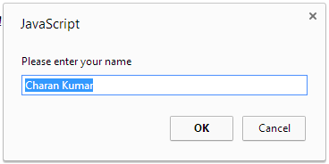

Slide 48
JS - Timer
A function or set of statements can be executed at regular intervals. This is called as timer in programming.
setInterval() function is used to set the timer.
  setInterval ( name of the function, time);
  Name of the function will be executed at regular time intervals as given in the second parameter of this function. Time will take in milli seconds.
clearInterval(variable) --> Stops the timer. When the timer is created using setInterval, timer is assigned to a variable. Which ever the timer we need to stop; that timer variable should be specified in clearInterval() function.

Slide 49
JS - Timer
<!DOCTYPE html>
<html>
<body>
<p>This code will show the time. Click on the stop timer button to stop the time...</p>
<p id="time_para"></p>
<Input type="button" value="Stop time" onclick="clearInterval(time_var)"/>
<script>
var time_var=setInterval(function(){TimerFunc()},1000);
function TimerFunc() {
var d = new Date();
document.getElementById("time_para").innerHTML = d.toLocaleTimeString();
}
</script></body></html>
setInterval is used to set the timer. TimerFunc() will be exeucted for a every 1000ms which is 1 second. In The TimerFunc(), date object is created and current time is obtained from the date object. If this function is executed for every second then the function updates the time for every second. Hence time in hours:minutes:seconds are displayed on browser as in digital watch.

Slide 50
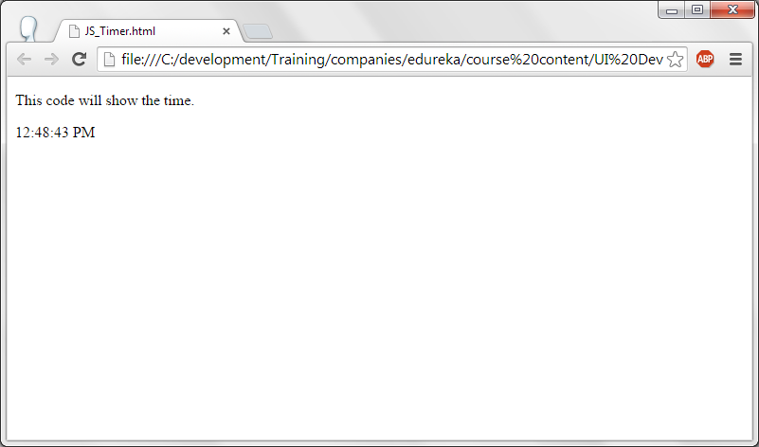
JS - Timer

Slide 51
JS – Timer – stop the timer.
<!DOCTYPE html>
<html>
<body>
<p>This code will show the time. Click on the stop timer button to stop the time...</p>
<p id="time_para"></p>
<Input type="button" value="Stop time" onclick="clearInterval(time_var)"/>
<script>
var time_var=setInterval(function(){TimerFunc()},1000);
function TimerFunc() {
var d = new Date();
document.getElementById("time_para").innerHTML = d.toLocaleTimeString();
}
</script>
</body>
</html>
On click of “Stop time” button, clearInterval() function is exeucted which stops the timer with the id time_var.

Slide 52
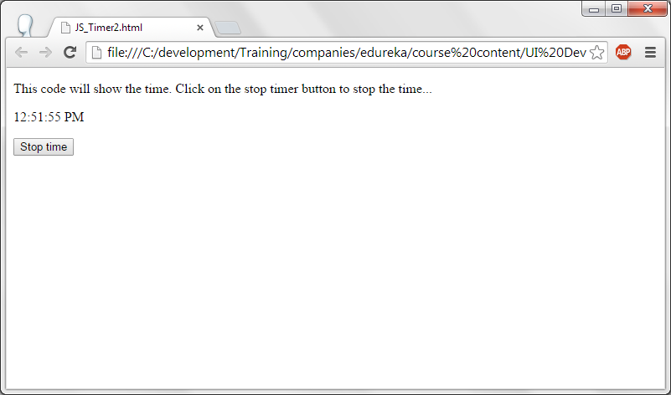
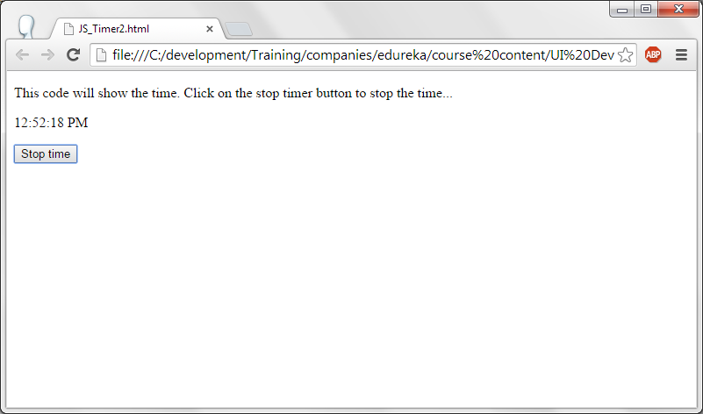
JS – Timer – stop the timer.

Slide 53
JS – Cookies.
Server need to track the information about the client. For this server stores the information about the client on the client browser itself. They are called as Cookies.
documnet.cookie is used to set the cookie in java script. Syntax is:
  Document.cookie = “Cookie name =value; expires= date time “;
  cookie name and its value will be set and this cookie will be available for the given date and time which is given in the expires parameter.

Slide 54
JS - Cookies
<html>
<head>
<script type="text/javascript">
<!--
function WriteCookie()
{
var now = new Date();
now.setMonth( now.getMonth() + 1 );
var cookievalue= document.getElementById("cust").value+";";
var expires = now.toUTCString();
document.cookie="name=" + cookievalue + "expires=" + expires + ";"
alert("Setting Cookies : " + "name=" + cookievalue + "expires="+expires);
}
//-->
</script>
</head>
<body>
<form name="myform" action="">
Enter name: <input type="text" id="cust"/>
<input type="button" value="Set Cookie" onclick="WriteCookie();"/>
</form>
</body>
</html>

Slide 55
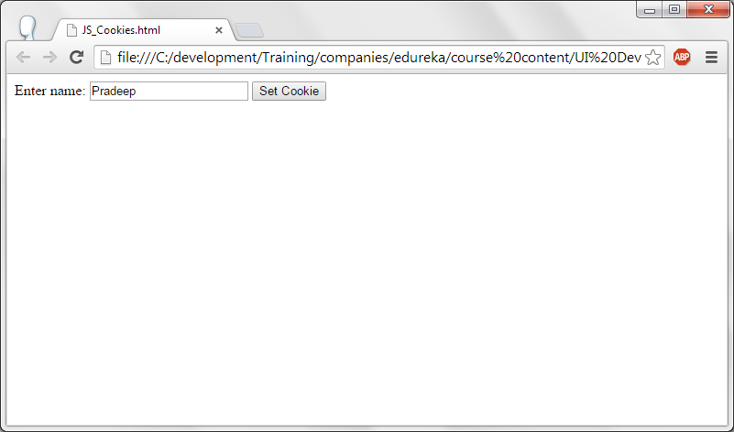
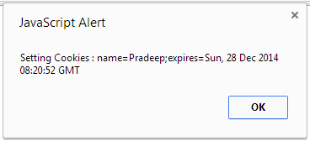
JS – Cookies.

Slide 56
JS - Cookies
A form is created with a edit box and a button with a caption “Set cookie” is displayed. On click of this button, it executes a function WriteCookie().
In WriteCookie() function, date object is created which gets the current date and time and assigned to variable now. Variable “now” date is moved by 1 more moth i.e., to the next month same date and time. Data entered in the edit box is obtained and stored in the variable cookievalue. A cookie has been set with this name and the expiration date and time. At the end an alert box is displayed.

Slide 57
Thank you!

