Slide 1
Mongo

Slide 2
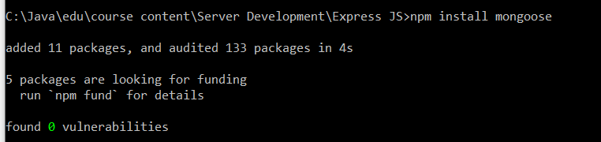
Install Mongoose with express

Slide 3
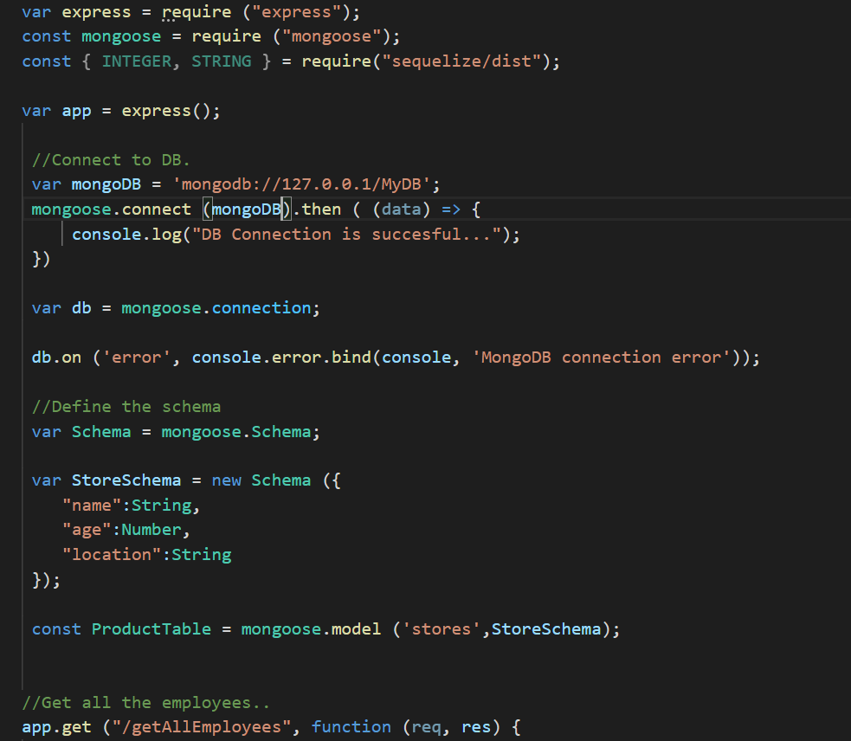
Express-Mongoose CRUD Operations.

Slide 4
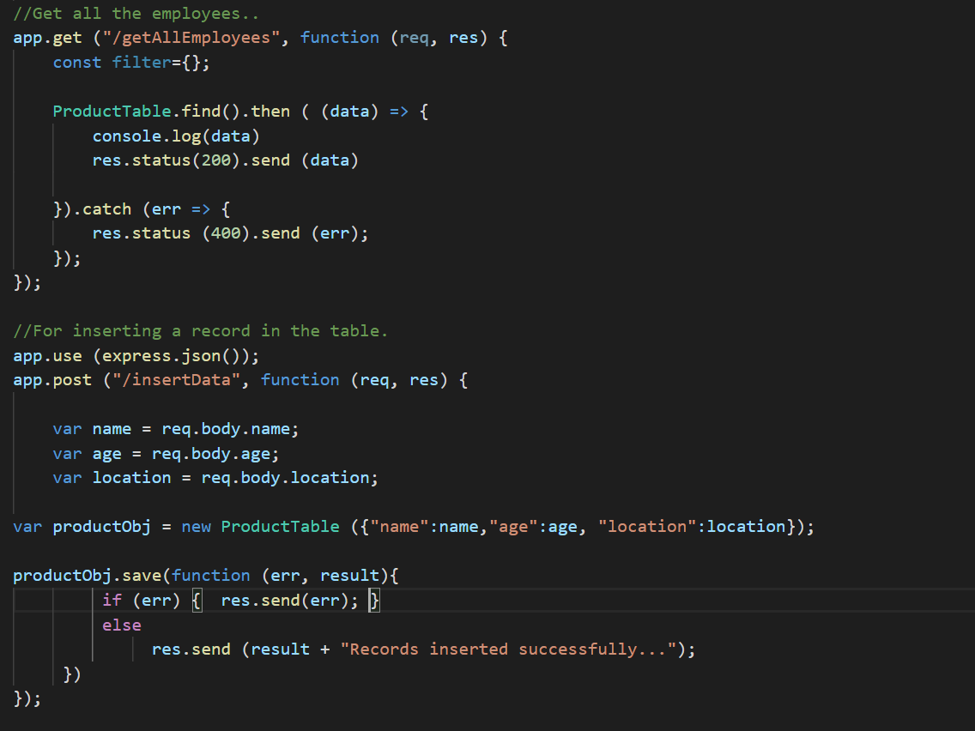

Slide 5
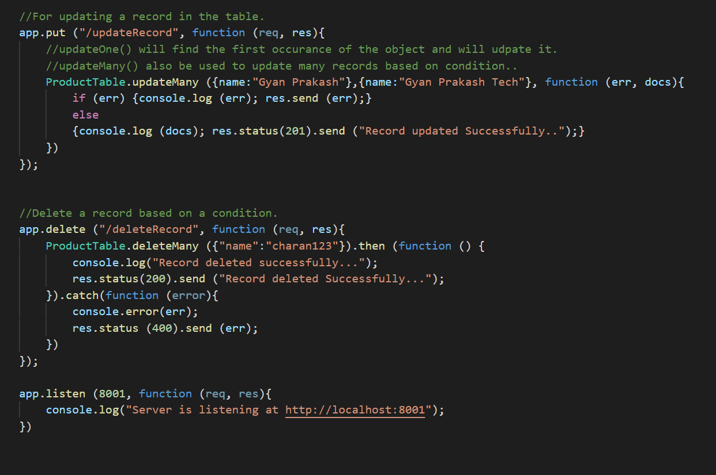

Slide 6
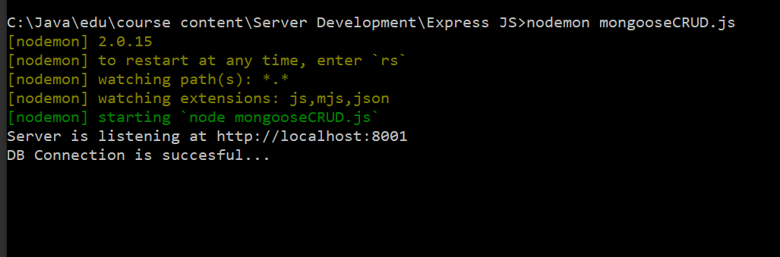
Run express script file.
Start the mongodb server and start the mongo client and test the server from postman.

