Slide 1
RDBMS

Slide 2
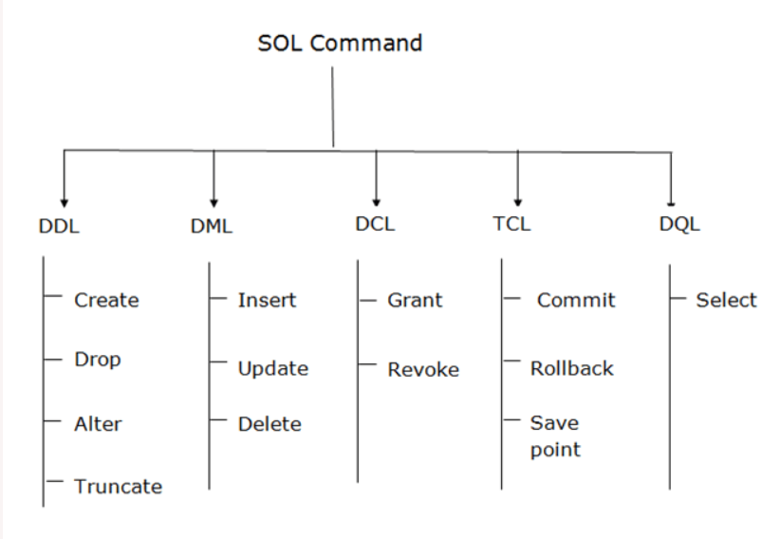
SQL Commands.

Slide 3
Data definition language
MySQL command syntax can be reffered in here:
https://dev.mysql.com/doc/refman/8.0/en/create-table-foreign-keys.html
Create table with Primary Key and Foreign Key.
create table Employee_Primary
(
ID Integer NOT NULL PRIMARY KEY,
NAME VARCHAR(25),
DESIGNATION VARCHAR(25)
);
CREATE TABLE Dapartment_ForeignKey
(
ID INTEGER,
DEPTID INTEGER,
DESCRIPTION VARCHAR(20),
MANAGER VARCHAR(20),
FOREIGN KEY (ID) REFERENCES employee_primary(ID)
);

Slide 4
ALTER TABLE
ALTER TABLE command is used to alter the table structure. A column can be added and can be deleted.
Syntax is ALTER TABLE <TABLE NAME> ADD/DROP COLUMN <TYPE OF COLUMN>
ALTER TABLE EMPLOYEE_PRIMARY ADD COLUMN GENDER VARCHAR(6)
→ Adds GENDER to the table EMPLOYEE_PRIMARY.

Slide 5
TRUNCATE TABLE
TRUNCATE TABLE will delete all the rows from the table.
TRUNCATE TABLE employee;
This command will remove all the rows from the table employee.
Primary Key table rows cant be deleted unless and until Foreign key table rows are deleted first. From our example, we cant use TRUNCATE TABLE EMPLOYEE_PRIMARY as the records are inserted in the DEPARTMENT_ForeignKey table and they both are connected. First ForeignKey table records has to be deleted and then Primary Key table records has to be deleted.
    TRUNCATE TABLE Dapartment_ForeignKey
    TRUNCATE TABLE EMPLOYEE_PRIMARY

Slide 6
DROP TABLE
DROP TABLE drops the table from the databse.
Syntax is :
DROP TABLE <table name>
In terms of referential Integrity, Foreign key table has to be dropped first and then Primary Key table next as if the primary key table or data is dropped then there is no meaning of Foreign key table data.

Slide 7
Data manipulation language
DML has got 3 commands. They are insert, update and delete.
Inserting data into a table can be in the following ways:
    INSERT INTO EMP VALUES (‘CHARAN’, 500000);
    INSERT INTO EMP (NAME, SAL) VALUES (‘KARAN’,50000);
Inserting the data in the primary and foreign key table.
insert into employee_primary values (102, 'Tejas', 'Technical Manager');
INSERT INTO Dapartment_ForeignKey VALUES (100, 1000, 'DEVELOPMENT', 'CHARAN')
INSERT INTO Dapartment_ForeignKey VALUES (101, 1001, 'HR', 'CHARAN')
INSERT INTO Dapartment_ForeignKey VALUES (102, 1002, 'FINANCE', 'CHARAN')

Slide 8
DML:UPDATE COMMAND
Update command is used to update the field data based on a condition. If the condition is not specified, it is applied to all the records.
Syntax : UPDATE <table name> SET field=data WHERE condition.
For example :
UPDATE EMP SET NAME='CHARAN KUMAR' WHERE NAME='CHARAN‘
This command updates name to CHARAN KUMAR when the field name is CHARAN.

Slide 9
DML : DELETE Command.
DELETE command deletes the records of the table. Syntax of the DELETE command is:
DELETE FROM <TABLE NAME> condition.
It can be like this:
DELETE FROM emp WHERE name = ‘RAVI’

Slide 10
Data control language
GRANT and REVOKE are the DCL commands.
GRANT command is used to give the permission for the specified user on the commands.
REVOKE is to remove the permissions for the particular on the specific commands of SQL>

Slide 11
Transaction control language
COMMIT, ROLLBACK and SAVEPOINT are the commands of TCL.
COMMIT commits the transaction.
ROLLBACK revokes the previous command.
SAVEPOINT saves to the current point so that it can be reverted back when required.
Syntax is SAVEPOINTS <save point name>
By default mysql autocommit is true. It has to set to false using the command
set autocommit = 0.
This sets autocommit to false so that TCL commands can be used.

Slide 12
SAVEPOINT
SAVEPOINT savepoint1
Insert into emp values (‘test1’,100);
Insert into emp values (‘test2’,200);
SAVEPOINT savepoint2
Insert into emp values (‘test3’,100);
Insert into emp values (‘test4’,200);
SAVEPOINT savepoint4
Insert into emp values (‘test5’,100);
Insert into emp values (‘test6’,200);
SAVEPOINT savepoint5
At each and every savepoint two records are inserted. This is to test SAVEPOINT.
Transaction can be gone back to previous save point using ROLLBACK TO <save point name>
ROLLBACK TO savepoint4 → Give the select query and check the records in the emp table.
ROLLBCAK to savepoint3 → check the number of records in the table emp.
ROLLBACK TO savepoint2→ check the number of records in the table emp.

Slide 13
Data Query/Retrieval language
Select query is used to fetch the data from the tabel.
Different types of select query.
SELECT * FROM EMP;
SELECT NAME FROM EMP
SELECT * FROM EMP WHERE NAME=‘CHARAN KUMAR’;
SELECT * FROM EMP ORDER BY NAME;
SELECT * FROM EMP ORDER BY NAME DESC,
SELECT * FROM EMP GROUP BY NAME
SELECT * FROM EMP GROUP BY NAME HAVING NAME=‘CHARAN’
SELECT DISTINCT SALARY FROM EMP → DISTINCT REMOVES THE DUPLICATE data from SALARY field.

Slide 14
Views
Views are used to see a portion of table when the user does not want to all the fields or when the table data needs to be filtered in terms of number of rows or in terms of number columns.
Syntax is : CREATE VIEW <VIEW NAME> AS SELECT */FIELD NAMES FROM <TABLE NAME>
CREATE VIEW empView as SELECT NAME FROM EMP;
SELECT * FROM empView

Slide 15
DELETE FROM AND DROP VIEW.
DELETE FROM <VIEW NAME> WHERE <CONDITION>
DELETE FROM empView WHERE NAME='test'
SELECT * FROM empView
Deletes all the records from empView where NAME=‘test’
DROP VIEW empView
SELECT * FROM empView
→ Drops the view from the database.

Slide 16
Synonyms
Synonym is the alternative name given to Table/view and many db components. This is possible in Oracle but is not possible in MySQL.
Syntax is Oracle is :
CREATE SYNONYM MyEmployees FOR test.emp;
SELECT * FROM MyEmployees.
Synonyms are not possible in MySQL. Pls refer the link below:https://stackoverflow.com/questions/15777420/how-to-create-a-synonym-in-mysql

Slide 17
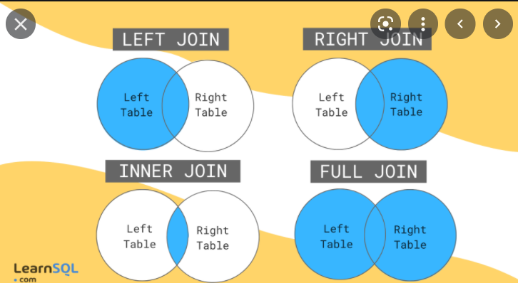
Joins

Slide 18
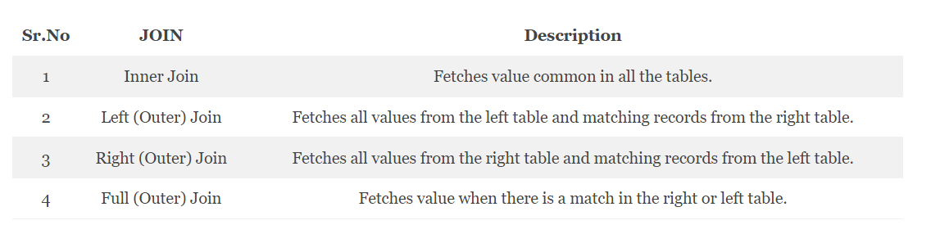
Joins.

Slide 19
Inner Join.
select E.ID, E.NAME, D.DEPTID, D.DESCRIPTION FROM employee_primary E INNER JOIN dapartment_foreignkey D ON E.ID = D.ID
Returns the matching records of both the tables.

Slide 20
LEFT Join
select E.ID, E.NAME, D.DEPTID, D.DESCRIPTION FROM employee_primary E LEFT JOIN dapartment_foreignkey D ON E.ID = D.ID
All the records from the left table and matching records on the right table.

Slide 21
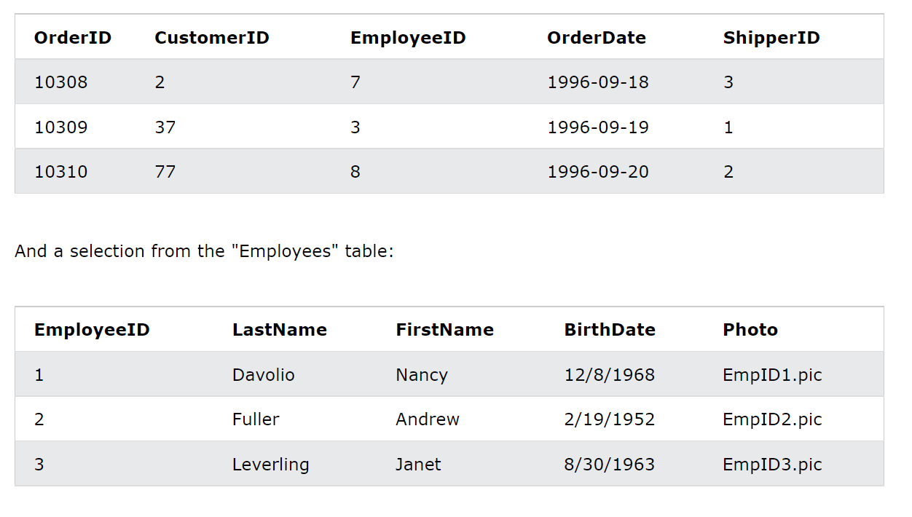
Right Join
Assuming table structure is like this:

Slide 22
Right Join.
SELECT O.ORDERID, O.ORDERDATE, E.EMPLOYEEID, E.NAME FROM ORDERS O RIGHT JOIN EMPLOYEE_ORDERS E ON O.EMPLOYEEID = E.EMPLOYEEID
Fetches all the records from Employee_orders table and its matching records from orders table.

Slide 23
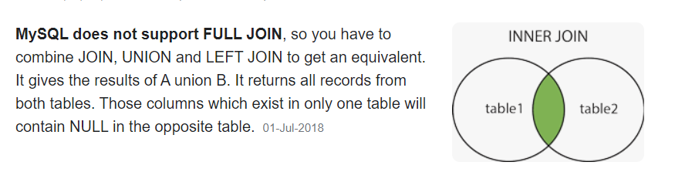
Full Join
MySQL Does not support full Join.

Slide 24
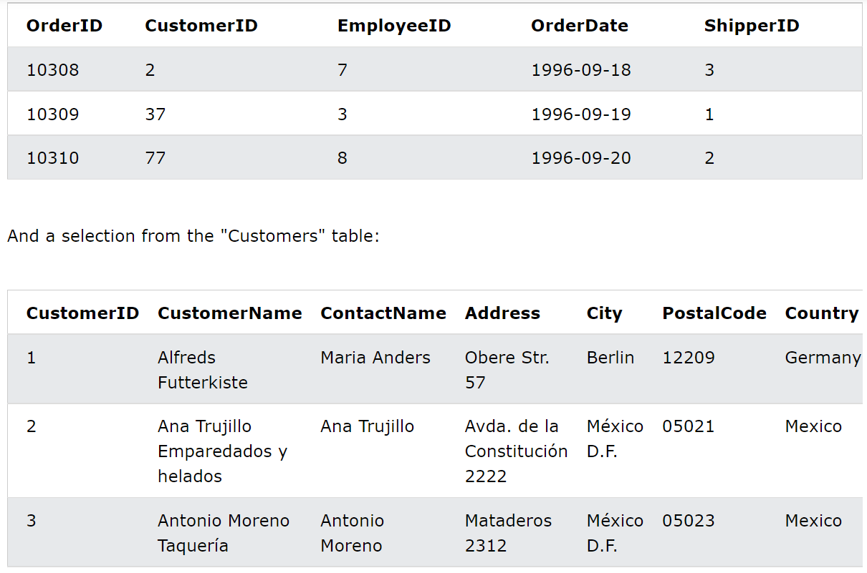
Assignment

Slide 25
Assignment
Inner Join : Display all customer id, customer name, customer city and what the customer has ordered that is order id, order date from the below given table.
Left Join : Display all the customer IDs, Cutomer name, order id of that customer. If the customer did not place any order, result can display NULL. User Left join for this which displays all the records from the left table and matching records on the right table.

Slide 26
Sorting
Select * from emp order by name, dept
Select * from emp order by name asc, salary desc;
Order by sorts in ascending order and desc shows that it sorts in descending order.

Slide 27
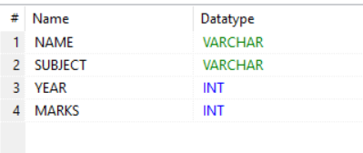
Group by and Having clause
Group by is to display the records based on a group.
A table student_groupby is as below:
SELECT YEAR, COUNT(*) FROM STUDENT_GROUPBY GROUP BY YEAR → Displays numbers of students in each year.
SELECT NAME, SUM(MARKS) FROM STUDENT_GROUPBY GROUP BY NAME → Displays sum of each person’s marks.
SELECT NAME, AVG(MARKS) FROM STUDENT_GROUPBY GROUP BY NAME
This sql command displays average marks taken by each student.

Slide 28
Having clause
Having is used to add a condition to Group by clause.
SELECT NAME, SUM(MARKS) FROM STUDENT_GROUPBY GROUP BY NAME HAVING SUM(MARKS) >50
This sql will display all the records whose sum(marks) are > 50 group by name.

Slide 29
Aggregation function
SUM, COUNT, AVG,MIN AND MAX are aggregate functions.
SELECT MIN(MARKS), MAX(MARKS) FROM STUDENT_GROUPBY
This SQL will display the mininum and maximum marks in the table.

Slide 30
Working with dates
Some of the date functions are
NOW(), DATE(), DAY(), MONTH(), YEAR(), TIME(), HOUR(), MINUTE(), SECOND, DATE_ADD, CURRTIME(),
select birthdate, day(birthdate), month(birthdate),year(birthdate), weekday (birthdate), MONTHNAME (birthdate) from employee_orders
select now(), time(now()), hour(now()), minute(now()), second(now())
SELECT BIRTHDATE, DATE_ADD(BIRTHDATE, INTERVAL 20 DAY), DATE_ADD(BIRTHDATE, INTERVAL 1 MONTH), DATE_ADD(BIRTHDATE, INTERVAL 1 YEAR) FROM EMPLOYEE_ORDERS
Date functions can be seen at : https://dev.mysql.com/doc/refman/8.0/en/date-and-time-functions.html#function_date-add

