Slide 1
🌿
Crop Disease Detection System
Technical Deep Dive & Implementation

Slide 2
System Architecture
Slide 2
Frontend
Backend
Inference Engine
React 18 + Vite + Tailwind CSS
FastAPI + Python
ResNet50 + PyTorch
▸ UploadSection.jsx
▸ POST /predict
▸ ResNet50 weights (DEFAULT)
▸ ResultCard.jsx
▸ GET /health
▸ transforms() preprocessing
▸ DiseaseHistory.jsx
▸ File validation
▸ torch.inference_mode()
▸ AIAdviceSection.jsx
▸ Image decode + transform
▸ softmax + argmax
▸ AudioPlayer.jsx
▸ JSON response builder
▸ heuristic crop mapping
Request / Response Flow
User uploads image → FormData POST /predict → Validate → Decode → Transform → ResNet50 forward pass → Map + Severity → JSON to UI
2 / 15

Slide 3
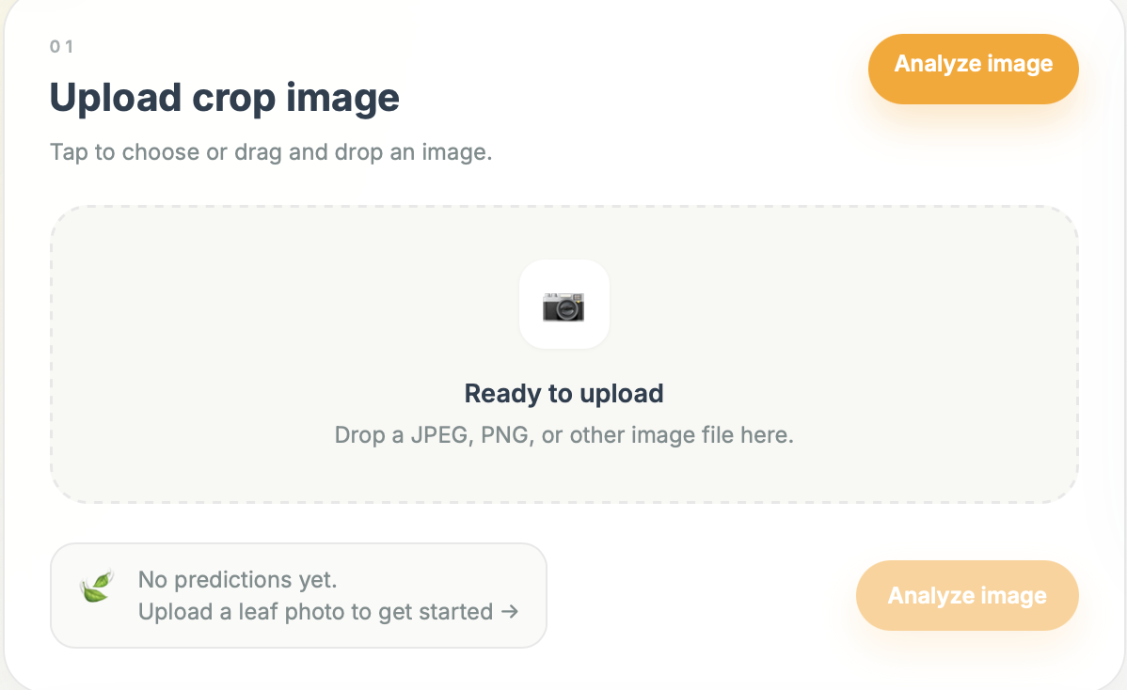
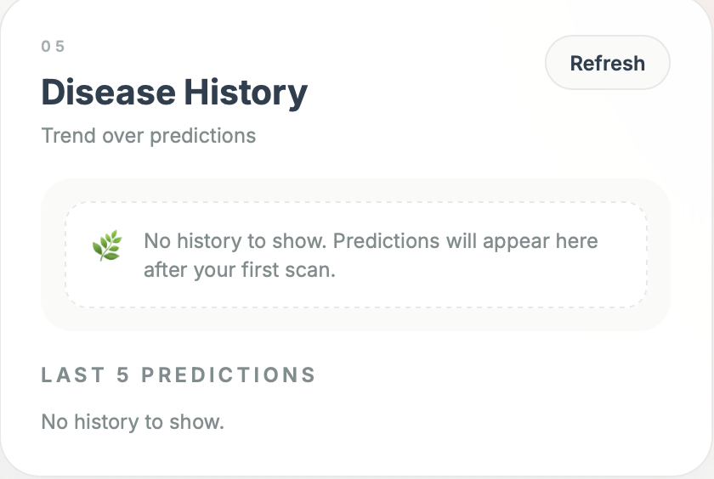
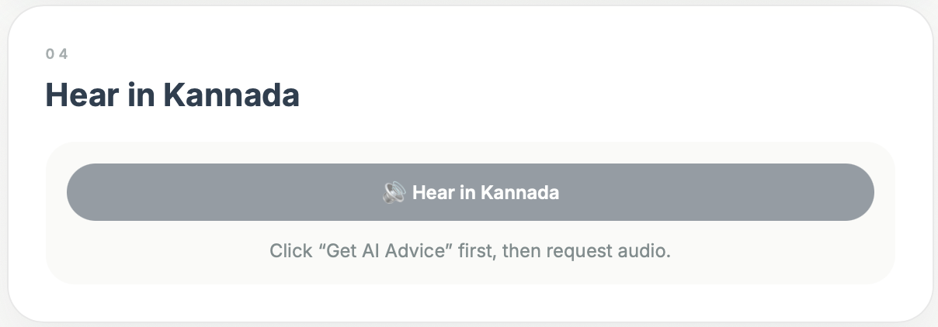
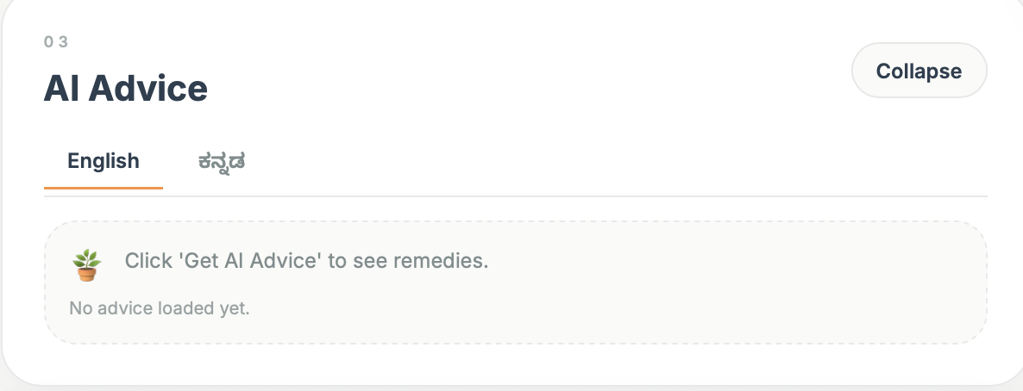
Frontend UI Walkthrough
Slide 3
Prediction Result
Upload UI
AI Advice Section
TTS output
Replace dashed boxes with actual UI screenshots
3 / 15

Slide 4
Frontend → Backend Data Flow
Slide 4
api.js — fetch-based, no axios
Request Payload
// api.js helper export const predictDisease = async (file) => { const formData = new FormData(); formData.append('file', file); const response = await fetch('/predict', { method: 'POST', body: formData // browser sets boundary }); return parseResponse(response); };
▸ Content-Type: multipart/form-data
▸ Field name: file
▸ Body: binary image data
▸ Boundary: set automatically by browser
Response JSON
{
"disease": "Tomato_Early_blight",
"confidence": 0.8923,
"severity": "Moderate",
"crop": "Tomato"
}
Severity Logic
Severe
Moderate
Mild
confidence ≥ 0.85
0.60 ≤ confidence < 0.85
confidence < 0.60
4 / 15

Slide 5
Backend — FastAPI /predict Endpoint
Slide 5
app_backend.py — /predict
Model Loading
@app.post("/predict") async def predict(file: UploadFile = File(...)): if not file.content_type.startswith("image/"): raise HTTPException(400, ...) payload = await file.read() image = Image.open(BytesIO(payload)).convert("RGB") input_tensor = TRANSFORM(image).unsqueeze(0).to(DEVICE) with torch.inference_mode(): logits = MODEL(input_tensor) probs = torch.softmax(logits, dim=1) confidence, pred_idx = torch.max(probs, dim=1) crop, disease = map_prediction_to_domain(label) return { "disease": disease, "confidence": ..., ... }
WEIGHTS = ResNet50_Weights.DEFAULT
TRANSFORM = WEIGHTS.transforms()
MODEL = models.resnet50(weights=WEIGHTS)
.to(DEVICE).eval()
CATEGORIES = WEIGHTS.meta["categories"]
Inference Block
with torch.inference_mode():
logits = MODEL(input_tensor)
probs = torch.softmax(logits, dim=1)
conf, idx = torch.max(probs, dim=1)
5 / 15

Slide 6
Data Preprocessing Pipeline
Slide 6
1
Load Image
2
Resize/Crop
3
To Tensor
PIL.Image.open() → .convert('RGB')
ResNet50 default transforms: 256 → 224×224 center crop
PIL → FloatTensor [C, H, W]
4
Normalize
5
Unsqueeze
6
To Device
ImageNet μ=[0.485,0.456,0.406] σ=[0.229,0.224,0.225]
.unsqueeze(0) → [1, 3, 224, 224] batch dim
.to(DEVICE) → mps / cuda / cpu
WEIGHTS = ResNet50_Weights.DEFAULT
TRANSFORM = WEIGHTS.transforms() # wraps all above steps
6 / 15

Slide 7
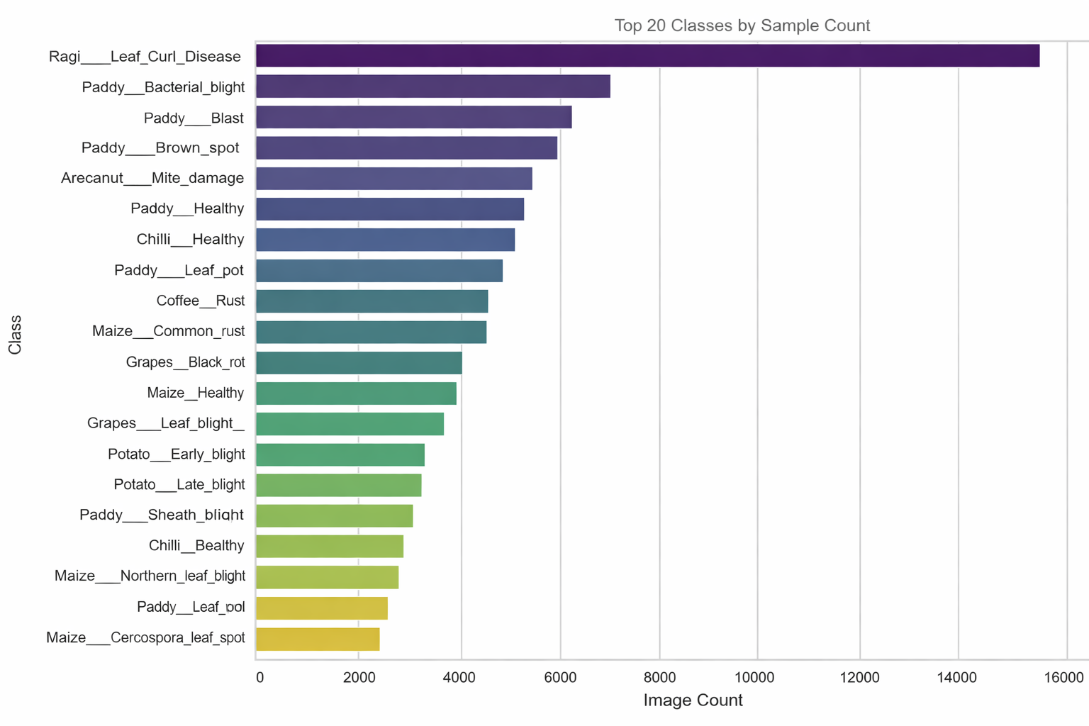
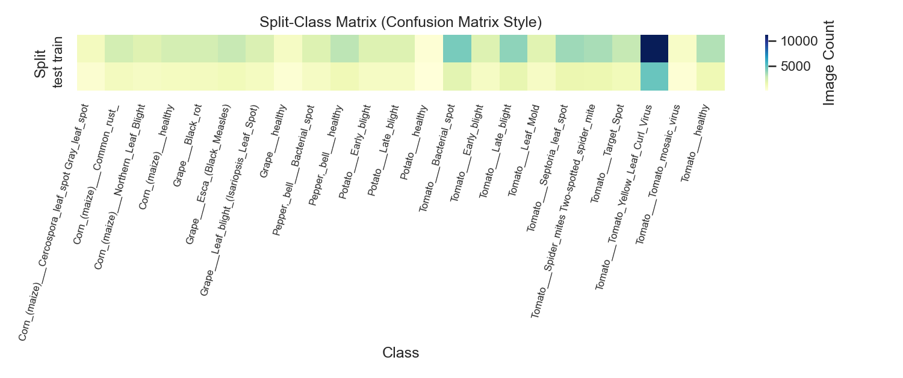
Dataset Statistics & Morphology
Slide 7
92,104
23
64,465
27,639
Total Images
Classes
Train Samples
Test Samples
📷
📷
Class distribution bar chart
(X: disease class, Y: image count)
Train / Test split
pie or bar chart
Corrupted: 0 Duplicate groups: 19 Balancing: None (PoC) Format: RGB → Normalized tensor
7 / 15

Slide 8
Model Architecture Deep Dive — ResNet50
Slide 8
Input
224×224×3
conv1
bn1, relu
maxpool
layer1
(3 blocks)
layer2
(4 blocks)
layer3
(6 blocks)
layer4
(3 blocks)
avgpool
fc(1000)
softmax
top-1 class
Heuristic Mapping — ImageNet label → crop/disease
severity_from_confidence(c)
def map_prediction_to_domain(label: str): lower = label.lower() if "apple" in lower: if "scab" in lower: return "Apple", "Apple_scab" if "rot" in lower: return "Apple", "Apple_Black_rot" return "Apple", "Apple_Healthy" if "tomato" in lower: return "Tomato", "Tomato_Early_blight" if "potato" in lower: return "Potato", "Potato_Early_blight" if "corn" in lower: return "Corn", "Corn_Common_rust" return "Unknown", "Unknown_Disease"
c >= 0.85 → "Severe"
c >= 0.60 → "Moderate"
c < 0.60 → "Mild"
⚠ Confidence is uncalibrated for domain tasks
Supported Crops (mapped)
▸ Ragi
▸ Paddy
▸ Maize
▸ Jowar
▸ Bajra
▸ Sugarcane etc.
8 / 15

Slide 9
Base Model Evaluation — Baseline Results
Slide 9
3,000
76
2,924
20.53%
Samples Evaluated
Correct Predictions
Unknown / Unmapped
Proxy Accuracy
poc1_baseline_model.py — eval loop
with torch.inference_mode(): for images, targets in loader: outputs = model(images) pred_indices = outputs.argmax(dim=1) # map ImageNet label → crop → compare with target label = CATEGORIES[pred_idx] crop, _ = map_prediction_to_domain(label)
⚠ Limitations
▸ Metric is crop-level top-1 proxy via ImageNet → crop mapping, NOT class-level accuracy
▸ Domain fine-tuning on curated disease dataset required for production-grade performance
9 / 15

Slide 10
Complete Data Pipeline Flow
Slide 10
01
02
03
04
05
06
Raw Image Upload
Frontend Validation
POST /predict
Backend Validation
Decode + Transform
ResNet50 Inference
User selects file in browser
File type check before POST
multipart/form-data
content_type + empty payload check
PIL.Image → TRANSFORM tensor
torch.inference_mode()
07
08
09
10
11
Softmax + Confidence
Heuristic Mapping
Severity Calculation
JSON Response
Frontend Renders
probs → max confidence + pred_idx
ImageNet label → crop + disease
confidence threshold bucketing
disease, confidence, severity, crop
ResultCard + HistoryGraph + AIAdvice
Flow confirmed accurate for current PoC implementation
10 / 15

Slide 11
Project File Structure
Slide 11
crop_disease_detetction/
├── src/
│ ├── components/
│ │ ├── ResultCard.jsx
│ │ ├── UploadSection.jsx
│ │ ├── ResultsSection.jsx
│ │ ├── AIAdviceSection.jsx
│ │ ├── DiseaseHistory.jsx
│ │ ├── AudioPlayer.jsx
│ │ ├── Header.jsx
│ │ └── ResponsiveLayout.jsx
│ ├── hooks/
│ ├── utils/
│ └── App.jsx
├── poc_api/
│ └── app_backend.py
├── poc/
│ ├── poc1_baseline_model.py
│ └── poc1_results.txt
├── data/
│ ├── raw/
│ └── karnataka_curated/
├── validate_karnataka_datasets.py
├── download_datasets.py
├── requirements.txt
├── package.json
└── README.md
React Components
API Utilities & Hooks
FastAPI Backend (PoC)
Evaluation Scripts
Dataset Storage
Data Pipeline Scripts
11 / 15

Slide 12
Environment Setup & Dependencies
Slide 12
Frontend (package.json)
Backend (requirements.txt)
react
18.3.1
torch
2.11.0
react-dom
18.3.1
torchvision
0.26.0
recharts
2.13.3
fastapi
≥ 0.135.3
tailwindcss
3.4.17
uvicorn
≥ 0.44.0
vite
5.4.14
python-multipart
≥ 0.0.24
Node (runtime)
[confirm from system]
Python (runtime)
[confirm from system]
Note: axios is NOT used
Also: Pillow, scipy, scikit-learn, pandas, numpy
12 / 15

Slide 13
Known Issues & Limitations
Slide 13
Technical Debt
Performance Bottlenecks
Accuracy Concerns
Next Steps Required
▸ Heuristic label mapping — no domain fine-tuning on curated disease classes
▸ Inference + API latency not yet benchmarked — measure preprocess / model / total separately
▸ 2.53% proxy accuracy — label space mismatch between ImageNet and plant disease classes
▸ Fine-tune ResNet50 (or EfficientNet) on PlantVillage / karnataka_curated dataset
▸ PoC backend: only /health and /predict endpoints active
▸ No request batching — single-image inference per call
▸ Confidence values are NOT calibrated probabilities for domain diseases
▸ Replace heuristic mapping with direct model output per disease class
▸ Frontend flows may need additional endpoints in full deployment
▸ mps backend (Apple Silicon) may behave differently from CUDA in production
▸ Domain-specific fine-tuning and label alignment required for production
▸ Add confusion matrix generation, per-class F1, and calibration metrics
13 / 15

Slide 14

Closing Discussion
Slide 15
Questions?
?
?
Thank you for your attention
15 / 15

