Slide 1

SPI (Serial Peripheral Interfacing)

Slide 2
Module objectives
On the completion of this module, you will learn:
Basics of SPI and serial vs parallel communication.
Different lines for transmission
Different steps of SPI transmission
Pros and cons of SPI vs I2C and UART
SPI using registers in STM32

Slide 3
table of contents
SNo | Topic | Duration | Slide
1. | Introduction to SPI |  | 4
2. | Steps in SPI communication |  | 14
3. | SPI using registers in STM32 |  | 19

Slide 4
INTRODUCTION TO SPI

Slide 5
What is SPI?
SPI or Serial Peripheral Interfacing is a form of interfacing/communication between a single master and one or more slaves.
It provides a way for the microcontroller on an MCU board to communicate with other peripherals such as sensors, display, etc.
SPI communication has the following features:
Feature | Value
Wires used | 4
Maximum speed | Upto 10 Mbps
Synchronous or Asynchronous | Synchronous
Serial or Parallel | Serial
No. of Masters | 1
No. of Slaves | Theoretically unlimited

Slide 6
about SPI
Devices communicating via SPI are in a master-slave relationship.
The master is the controlling device (usually a microcontroller), while the slave (usually a sensor, display, or memory chip) takes instruction from the master.
The simplest configuration of SPI is a single master, single slave system, but one master can control more than one slave (more on this below).

Slide 7
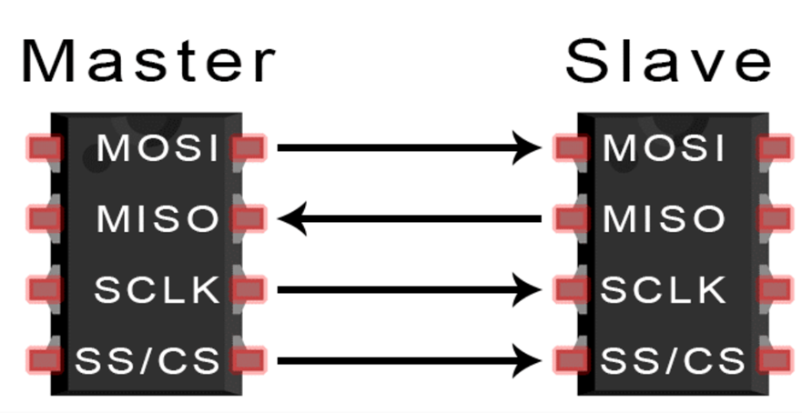
spi wire lines
Any SPI connection involves the following lines:
MOSI (Master Output/Slave Input) – Line for the master to send data to the slave.
MISO (Master Input/Slave Output) – Line for the slave to send data to the master.
SCLK (Clock) – Line for the clock signal.
SS/CS (Slave Select/Chip Select) – Line for the master to select which slave to send data to.

Slide 8
working of spi with clock
THE CLOCK
The clock signal synchronizes the output of data bits from the master to the sampling of bits by the slave.
One bit of data is transferred in each clock cycle, so the speed of data transfer is determined by the frequency of the clock signal. SPI communication is always initiated by the master since the master configures and generates the clock signal.
Any communication protocol where devices share a clock signal is known as synchronous. SPI is a synchronous communication protocol.
In asynchronous methods, they don’t use a clock signal. For example, in UART communication, both sides are set to a pre-configured baud rate that dictates the speed and timing of data transmission.

Slide 9
working of spi with clock
SLAVE SELECT
The master can choose which slave it wants to talk to by setting the slave’s CS/SS line to a low voltage level.
In the idle, non-transmitting state, the slave select line is kept at a high voltage level. Multiple CS/SS pins may be available on the master, which allows for multiple slaves to be wired in parallel.

Slide 10
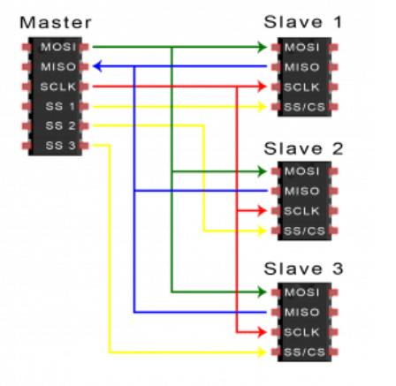
Multiple slave connections
SPI can be set up to operate with a single master and a single slave, and it can be set up with multiple slaves controlled by a single master. There are two ways to connect multiple slaves to the master.
If the master has multiple slave select pins, the slaves can be wired in parallel like this:

Slide 11
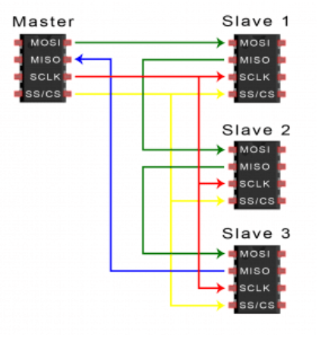
MULTIPLE SLAVE CONNECTIONS
If only one slave select pin is available, the slaves can be daisy-chained like this

Slide 12
ADVANTAGES OF SPI
No start and stop bits, so the data can be streamed continuously without interruption
No complicated slave addressing system like I2C
Higher data transfer rate than I2C (almost twice as fast)
Separate MISO and MOSI lines, so data can be sent and received at the same time

Slide 13
DISADVANTAGES OF SPI
Uses four wires (I2C and UARTs use two)
No acknowledgement that the data has been successfully received (I2C has this)
No form of error checking like the parity bit in UART
Only allows for a single master

Slide 14
spi COMMUNICATION steps

Slide 15
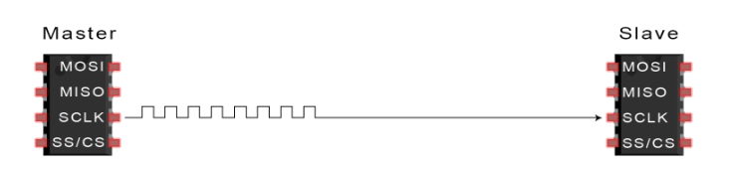
SPI DATA TRANSMISSION STEP 1
The master outputs the clock signal:

Slide 16
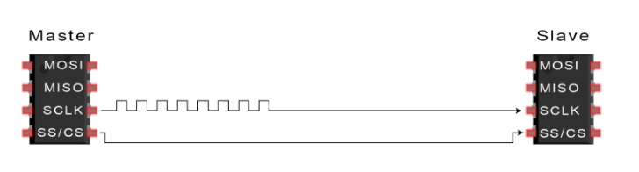
SPI DATA TRANSMISSION STEP 2
The master switches the SS/CS pin to a low voltage state, which activates the slave:

Slide 17
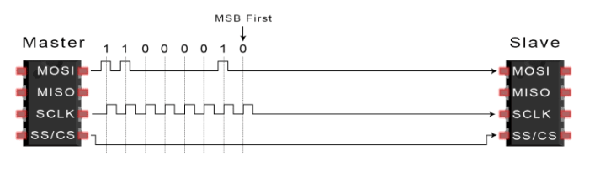
spi data transmission step 3
The master sends the data one bit at a time to the slave along the MOSI line. The slave reads the bits as they are received

Slide 18
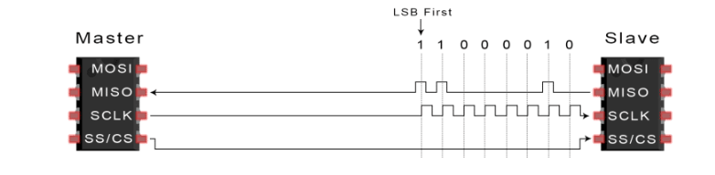
spi data transmission step 4
If a response is needed, the slave returns data one bit at a time to the master along the MISO line. The master reads the bits as they are received:

Slide 19
SPI USING REGISTERS IN STM32

Slide 20
spi CONFIGURATION STEPS
1. Enable SPI 1 clock using the RCC APB2ENR registers as shown below:

Slide 21
spi CONFIGURATION STEPS
The SPI2 or SPI3 clock could also be enabled using the RCC APB1ENR register:

Slide 22
spi CONFIGURATION STEPS
2. Configure the SPI Control Register 1:

Slide 23
spi CONFIGURATION STEPS
Configure the SPI Control Register 2:

Slide 24
SPI TRANSMISSION STEPS
1. Before Transmitting the data, we will wait for the TXE (Transmit Register Empty) bit in the Status Register to set. This indicates that the Transmit Register is empty and we can load the data.

Slide 25
SPI TRANSMISSION STEPS
2. Load the data into the data register:

Slide 26
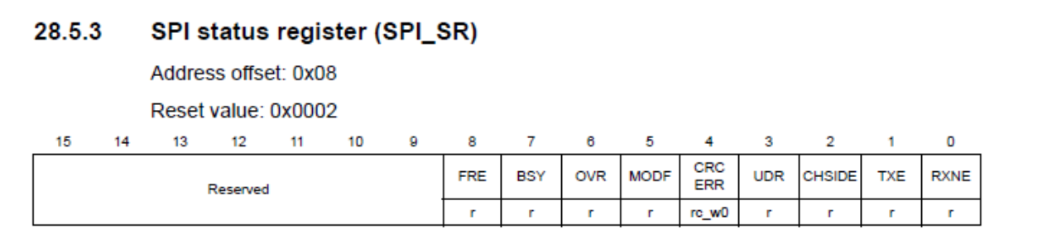
spi transmission steps
2. After transmitting the data, we will wait for the BSY (Busy) bit in the Status Register to reset. This will indicate that the SPI is not busy in communication anymore and we can proceed with other things

Slide 27
SPI RECEIVE STEPS
1. Before receiving the data, we must send some dummy byte to the device. Since the slave device is in the transmission mode, this dummy byte does not change the registers or the data of the registers
2. On receiving the dummy byte, the device transmits one byte of data. This will set the RXNE (Receive Buffer Not Empty) bit in SPI status register(SPI_SR).

Slide 28
SPI RECEIVE STEPS
3. And later we can copy the data from the Data Register into our buffer. This clears the RXNE bit

Slide 29
MCQ

Slide 30
MCQ-1
1) What of the following is NOT true about SPI?
It is synchronous
It provides interfacing to multiple slaves.
It provides interfacing to multiple masters.
It does not include addressing of slaves.

Slide 31
MCQ-2
2) What is the full form of MISO line in SPI?
Minimum input slave output
Minimum input select output
Master input slave output
Master input select output

Slide 32
MCQ-3
3) If a master is connected using SPI to 5 slaves what are the number of minimum and maximum number of wire lines needed for the master?
4 and 4
4 and 8
5 and 7
5 and 8

Slide 33
MCQ-4
4) What is NOT a reason for choosing SPI over I2C or UART?
It is synchronous
It provides interfacing to multiple slaves.
It requires fewer transmission lines than I2C or UART.
It does not include addressing of slaves.

Slide 34
MCQ-5
5) Which of the following registers holds the data that is to be transmitted or received in an SPI communication?
SPI_SR
SPI_DR
SPI_CR1
SPI_CR2

Slide 35
Answer cues
Question No. | Answer | Slide Number
1. | c) It provides interfacing to multiple masters. | 13
2. | c) Master input slave output | 7
3. | b) 4 and 8 | 10, 11
4. | c) It requires fewer transmission lines than I2C or UART. | 13
5 | b) SPI_DR | 25, 28

Slide 36
THANK YOU

