Slide 1
The problem of Stripes in Cuprates
Shruti Agarwal
Under guidance of Prof. Steve Johnston
*To assist in presenting for 3MT

Slide 2
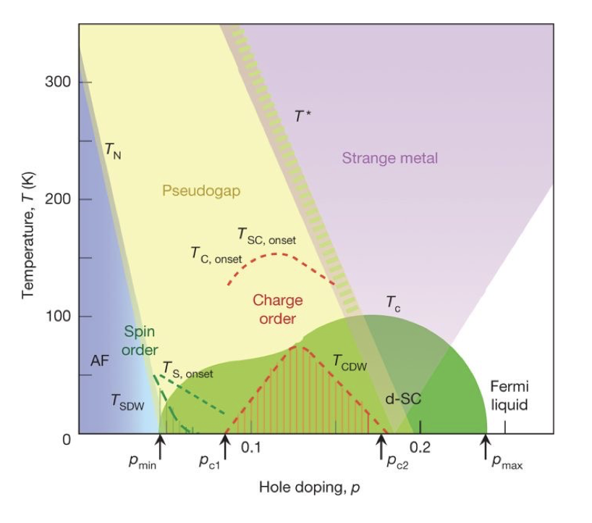
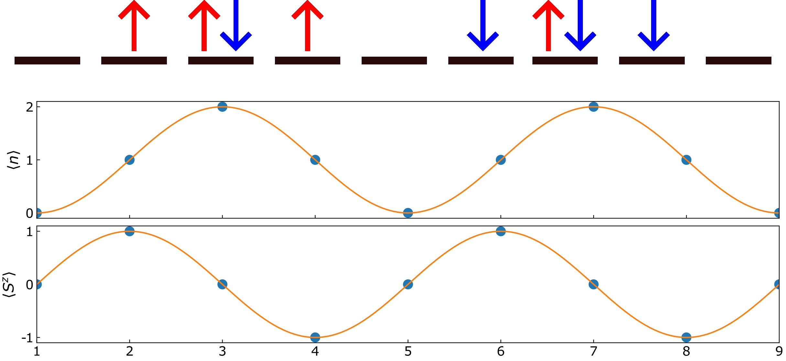
Hubbard Model = Kinetic term + Coulomb Potential
*B. Keimer, Nature 518, 197-186 (2015)
Example of simultaneous charge density wave (CDW) and spin density wave(SDW)

Slide 3
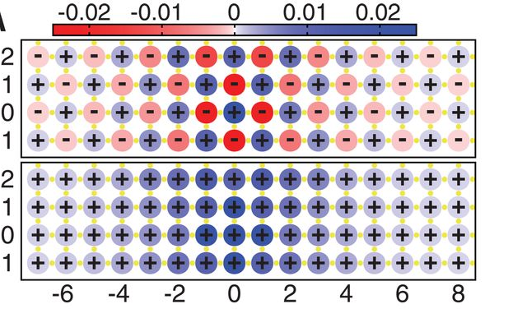
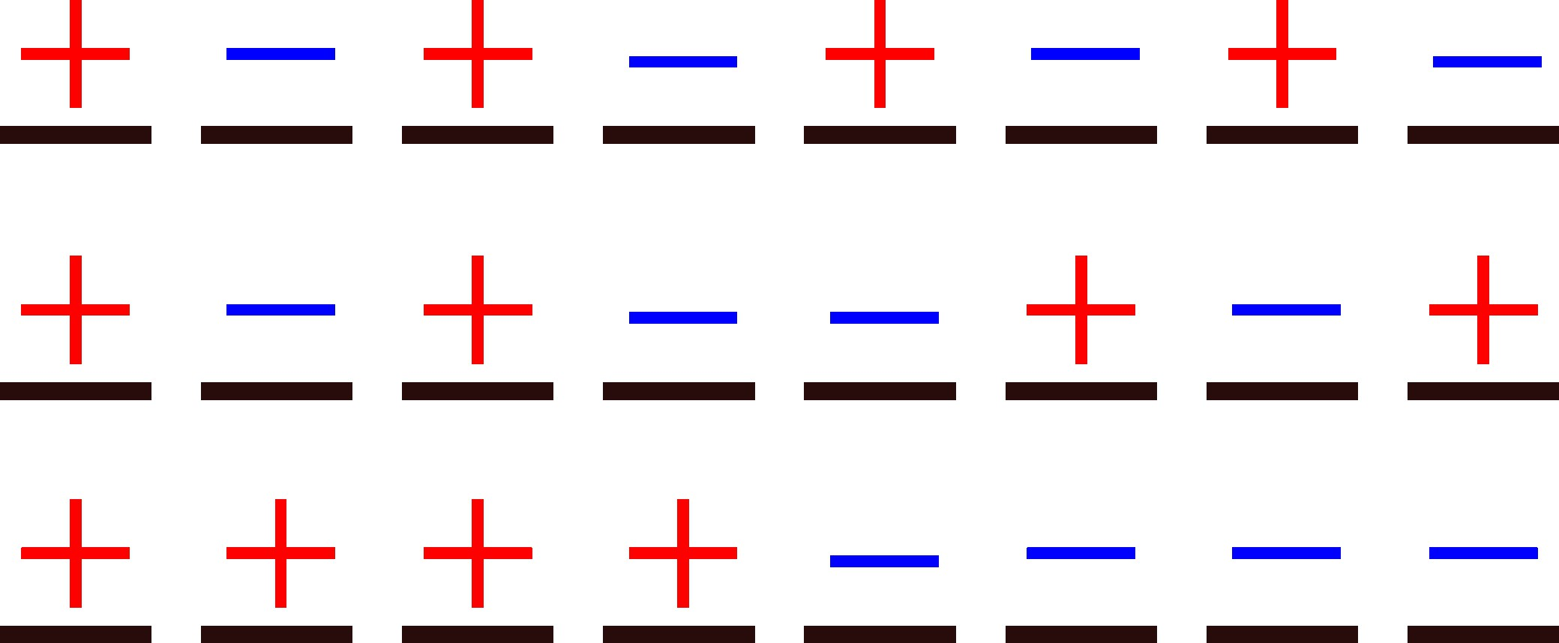
Stripes
Expected correlations for AFM
Actual correlations
AFM correlations

Slide 4
