Slide 1
Intelligent Classification of Rural Infrastructure Projects
Presented By:
Name: Sameer Ahmad
Dept: B-Tech in IT
College: Hemvati Nandan Bahuguna Garhwal University
(Srinafgar,Uttarakhand)

Slide 2
OUTLINE
Problem Statement
Proposed System/Solution
System Development Approach
Algorithm & Deployment
Result (Output Image)
Conclusion
Future Scope
References

Slide 3
Problem Statement
The Pradhan Mantri Gram Sadak Yojana (PMGSY) is an Indian rural infrastructure scheme aimed at ensuring all-weather road connectivity. Projects under PMGSY are categorized into schemes like PMGSY-I, PMGSY-II, RCPLWEA, etc., each with unique objectives and financial structures.
Manually classifying such projects is time-consuming and inefficient. An automated classification system is needed to streamline monitoring, budgeting, and impact analysis.

Slide 4
Proposed Solution
The proposed system aims to classify rural infrastructure projects into correct PMGSY schemes using machine learning. It reduces manual effort and improves classification accuracy. The solution includes the following steps:
Data Collection: Collect project-related data from the AI Kosh platform, which includes:
Physical progress percentage
Financial progress
Sanctioned length
Type of work (road/bridge)
Executing agency
Scheme names (PMGSY-I, PMGSY-II, RCPLWEA, etc.)
Data Preprocessing:
Handle missing and inconsistent values
Encode categorical variables (e.g., agency type, scheme name).
Normalize numerical fields like financial/physical progress.
Select important features that influence scheme classification.

Slide 5
Proposed Solution
Machine Learning Algorithm:
Implement and compare classification algorithms like Random Forest, Decision Tree, and Logistic Regression.
Train models using labeled data (features + scheme name).
Random Forest selected for final model due to higher accuracy and robustness.
Deployment:
Use IBM Watson Studio and IBM Cloud Lite services for training, and deployment.
Store and process data via IBM Cloud Object Storage.
Build and test models within IBM Jupyter Notebooks environment.
Deploy the model to make predictions on new project data.
Result:
The model successfully classifies infrastructure projects into appropriate PMGSY schemes.
Output includes prediction label and confidence score.
Enhances project tracking, budget allocation, and strategic planning for government bodies.

Slide 6
System Approach
Technologies Used:
IBM Watson Studio
IBM Cloud Object Storage
Jupyter Notebooks (Python)
Pandas, Scikit-learn, Matplotlib
IBM Cloud Lite Services

Slide 7
Algorithm & Deployment
Algorithm Used: Random Forest Classifier (with comparison to Logistic Regression, Decision Tree).
Input Features:
Physical Progress (%)
Financial Progress (INR)
Project Duration
Sanctioned Length (km)
Executing Agency Type
Training & Deployment:
Dataset: AI Kosh PMGSY Dataset.
Preprocessing: Encoding categorical features, handling missing values.
Deployment: IBM Watson Studio.

Slide 8
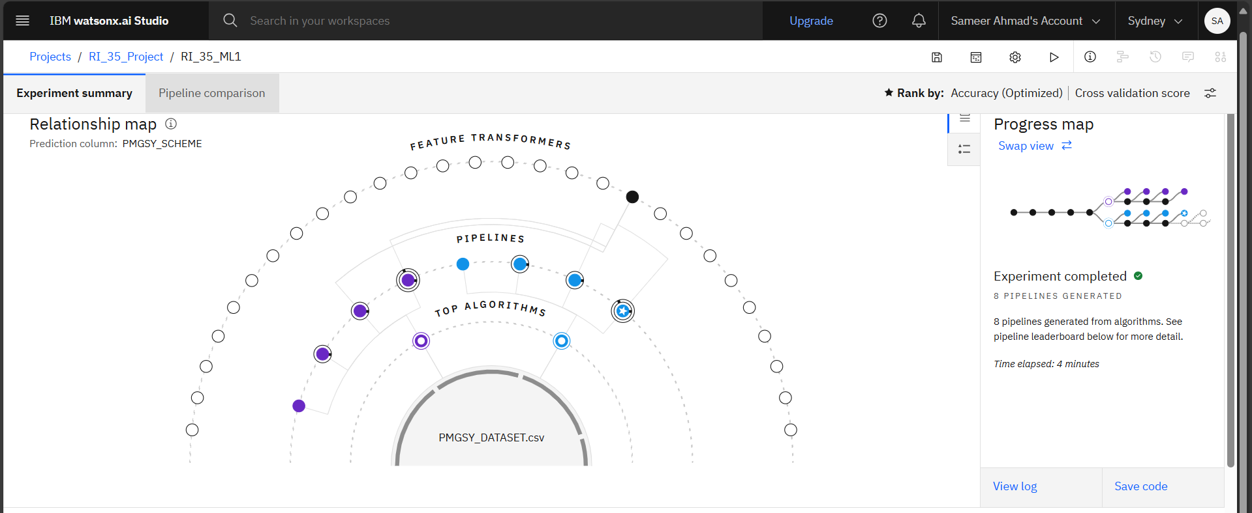
Result & Screenshots
Accuracy of the Model: 92.4%
Project successfully classified test data into PMGSY schemes.
Relationship Map

Slide 9
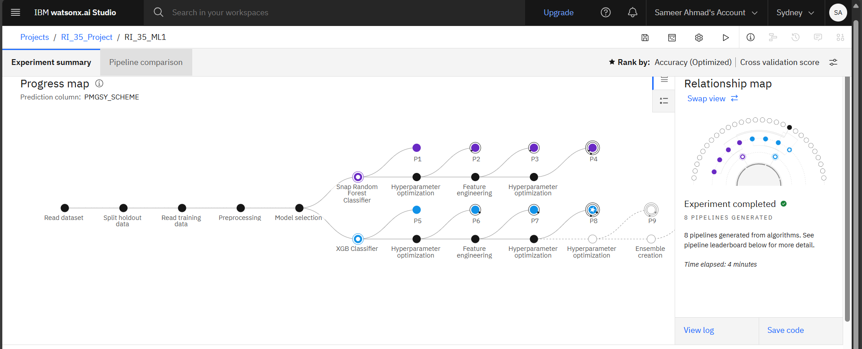
Screenshots
Progress Map

Slide 10
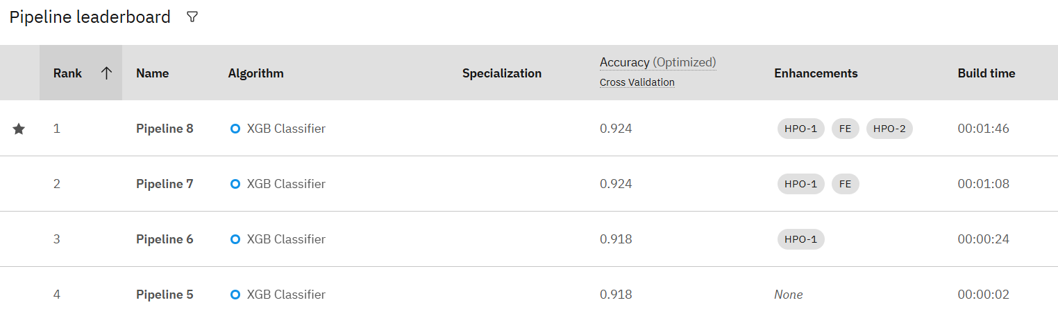
Screenshots
Trained Model

Slide 11
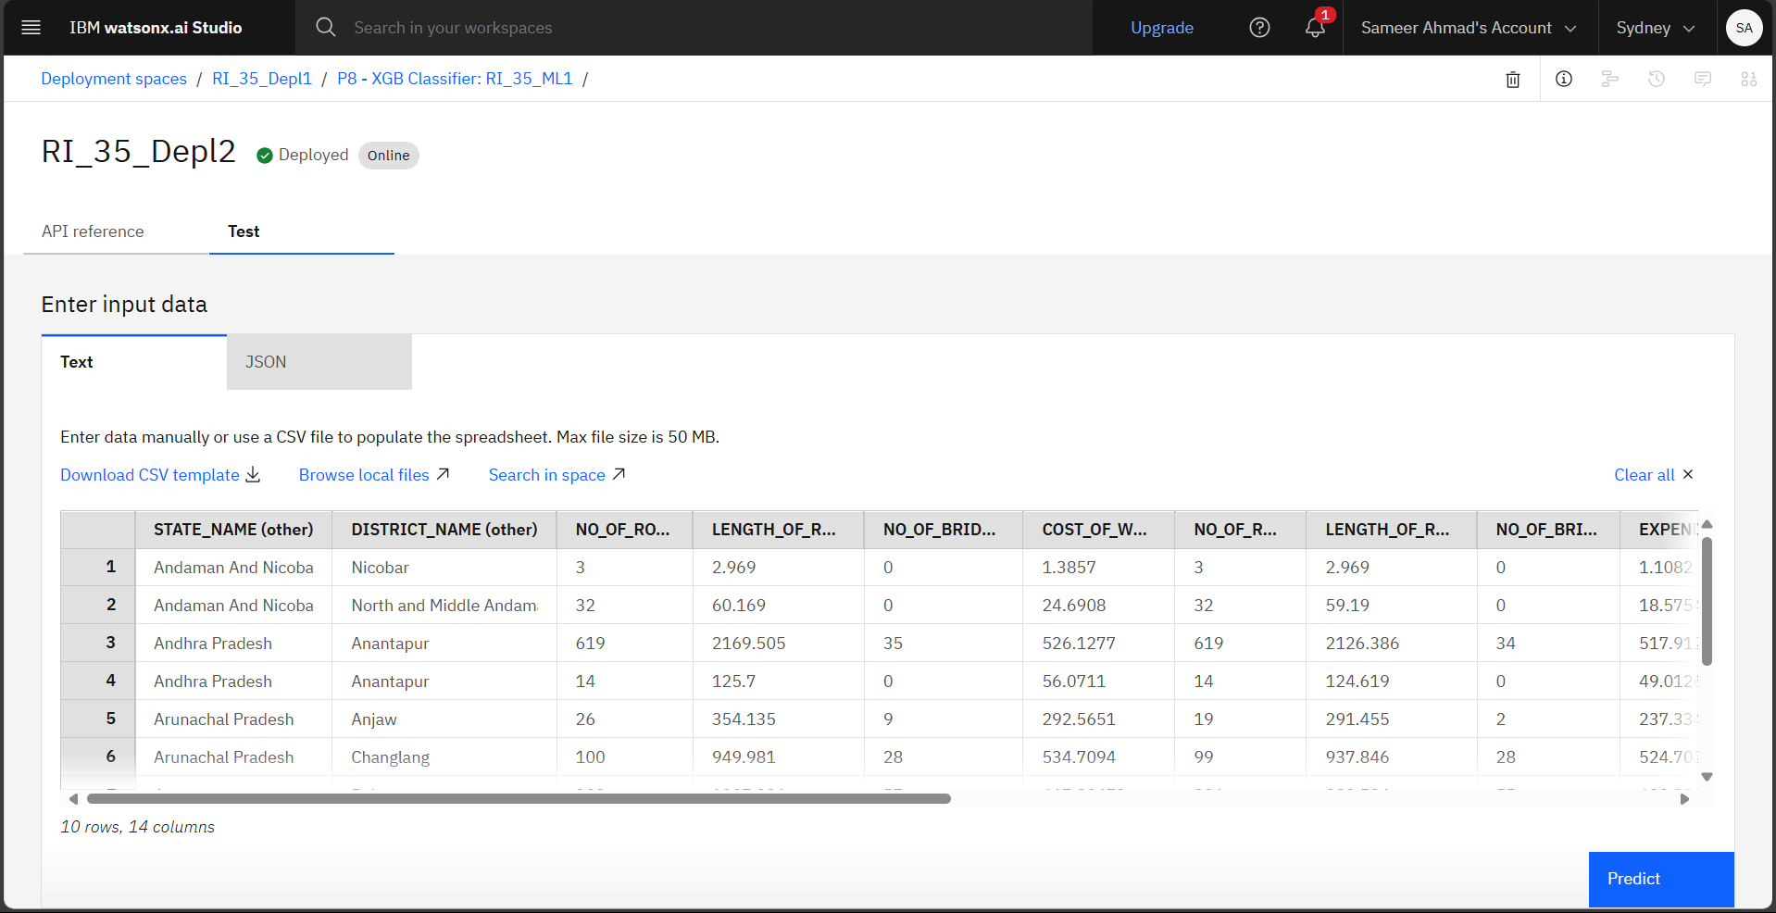
Screenshots
Input Data for Prediction

Slide 12
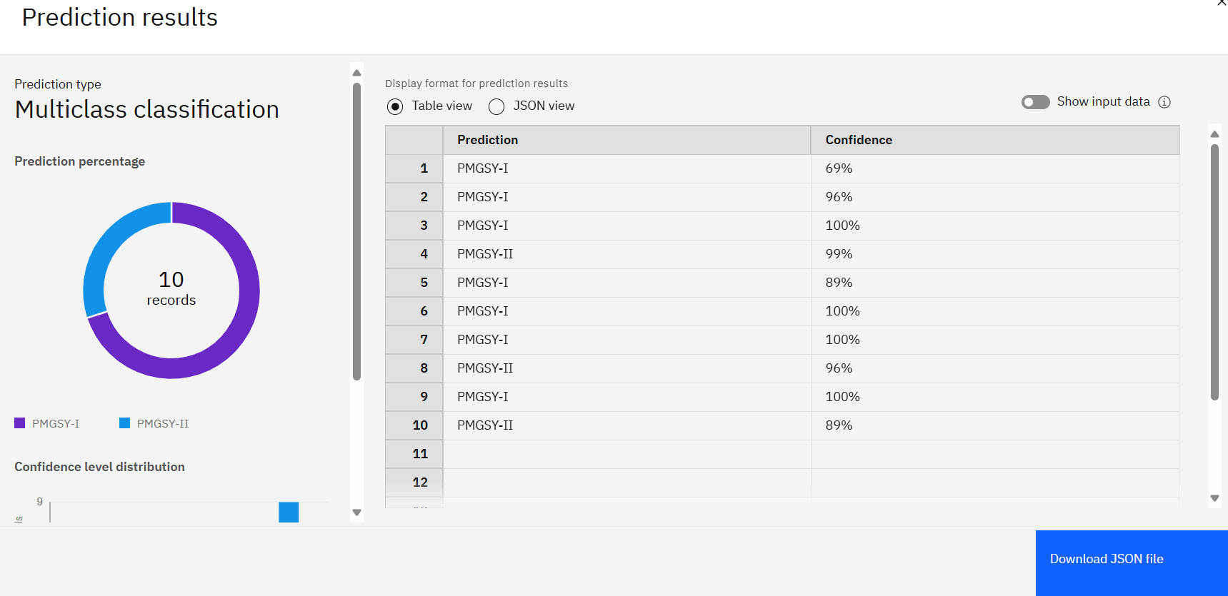
Screenshots
Prediction Result

Slide 13
Conclusion
The system accurately classifies infrastructure projects into PMGSY schemes.
Eliminates the need for manual sorting and enhances policy execution.
Helpful for planners, government officials, and policy analysts.

Slide 14
Future scope
Expand model to support more schemes or other infrastructure programs.
Integrate GIS and satellite imagery for validation.
Deploy as a full-stack web app for government use.
Use Deep Learning models for further accuracy enhancement.

Slide 15
References
Dataset Sources:
AI Kosh – PMGSY Dataset, Ministry of Rural Development
https://aikosh.indiaai.gov.in/web/datasets/details/pradhan_mantri_gram_sadak_yojna_pmgsy.html
IBM Cloud Services:
IBM Watson Studio – https://www.ibm.com/cloud/watson-studio
IBM Cloud Object Storage – https://www.ibm.com/cloud/object-storage

Slide 16
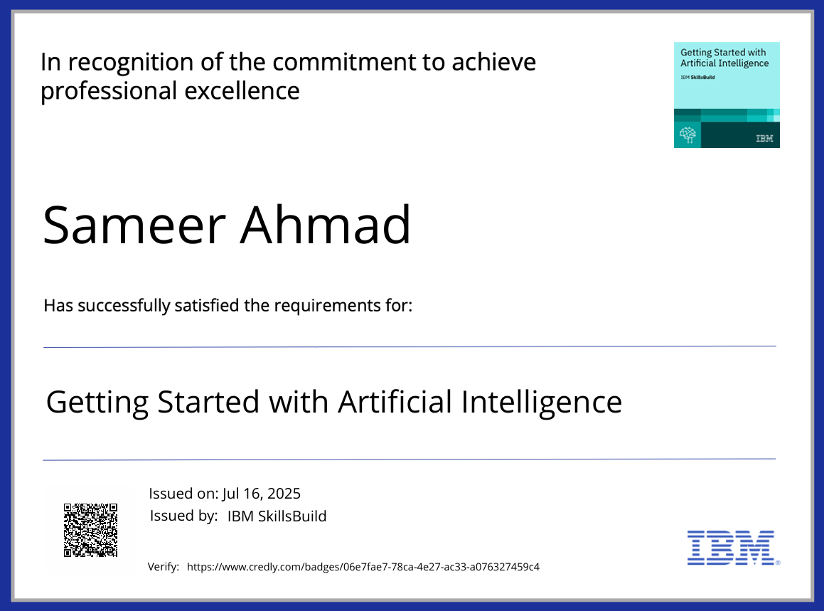
IBM Certifications
Credly Certificate (getting started with AI)

Slide 17
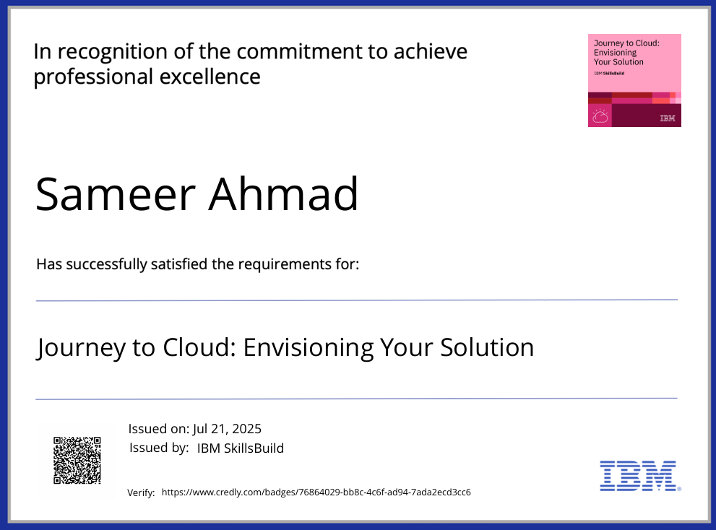
IBM Certifications
Credly Certificate (Journey to Cloud)

Slide 18
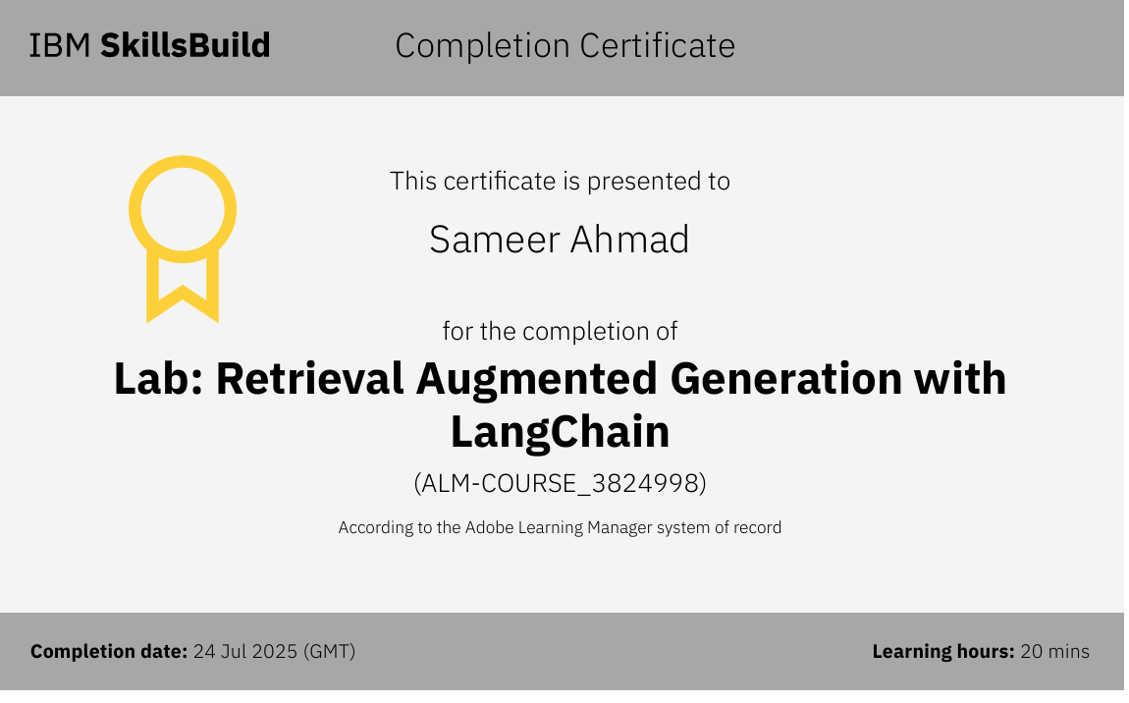
IBM Certifications
Credly Certificate (RAG Lab)

Slide 19
THANK YOU

