Slide 1



IPL
View in Power BI
Last data refresh:
1/6/2023 9:11:23 AM UTC
Downloaded at:
3/4/2023 7:21:25 PM UTC

Slide 2
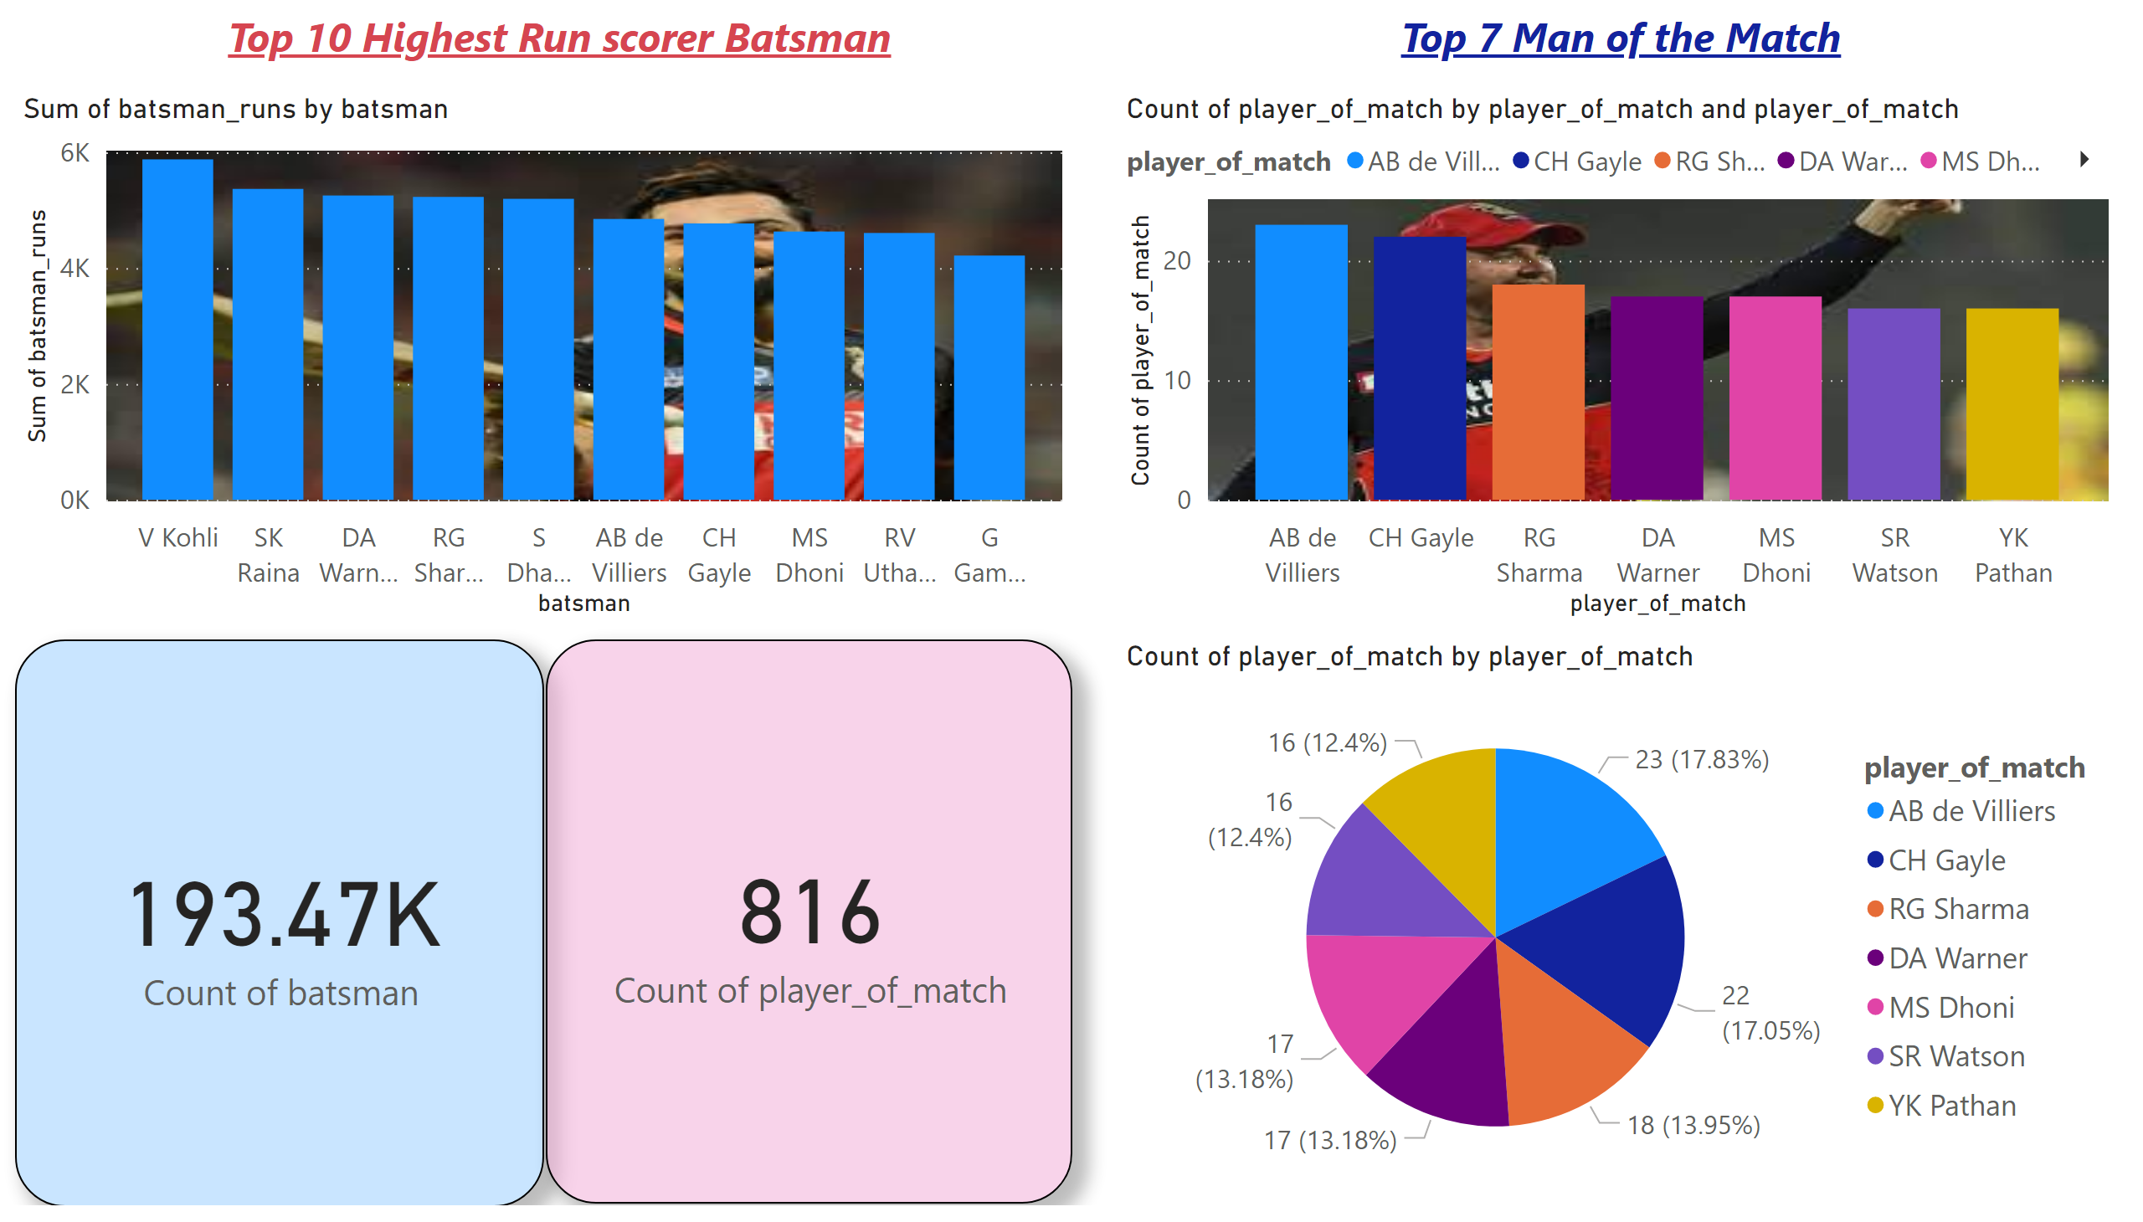
Page 1
Notes:
columnChart
No alt text provided
columnChart
No alt text provided
pieChart
No alt text provided
textbox
No alt text provided
textbox
No alt text provided
card
No alt text provided
card
No alt text provided

Slide 3
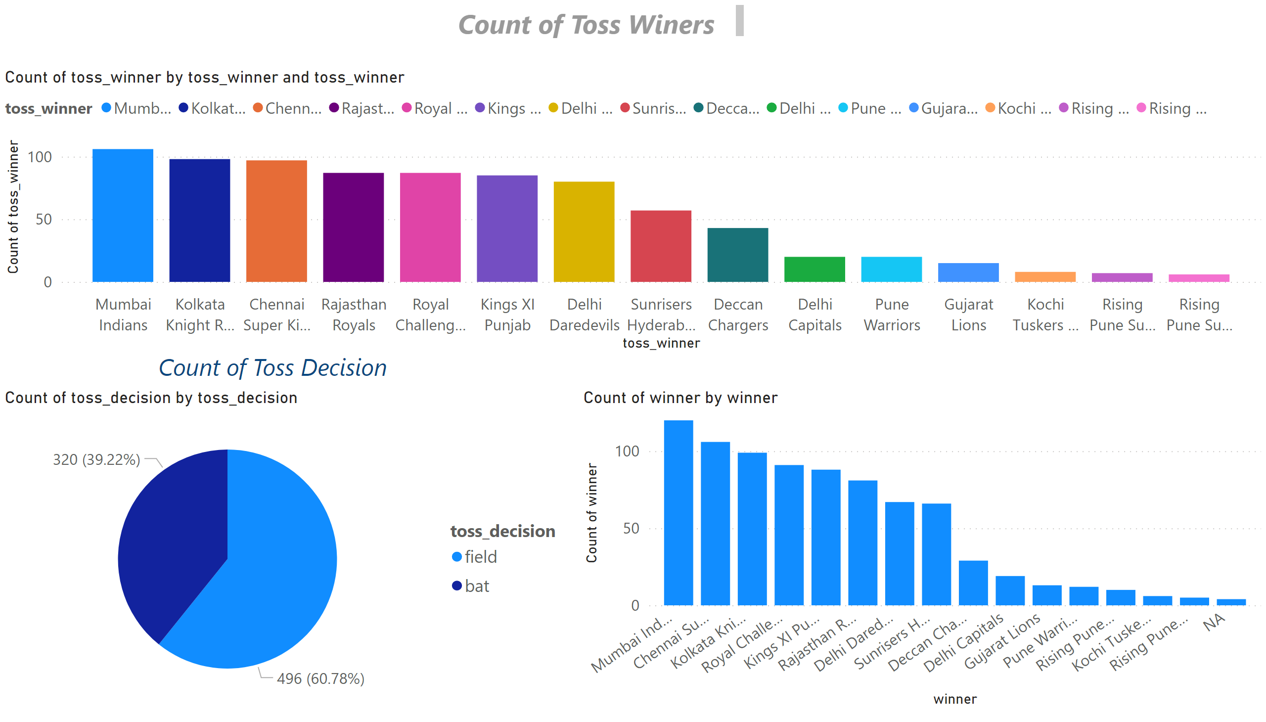
Page 2
Notes:
textbox
No alt text provided
textbox
No alt text provided
clusteredColumnChart
No alt text provided
pieChart
No alt text provided
columnChart
No alt text provided

Slide 4
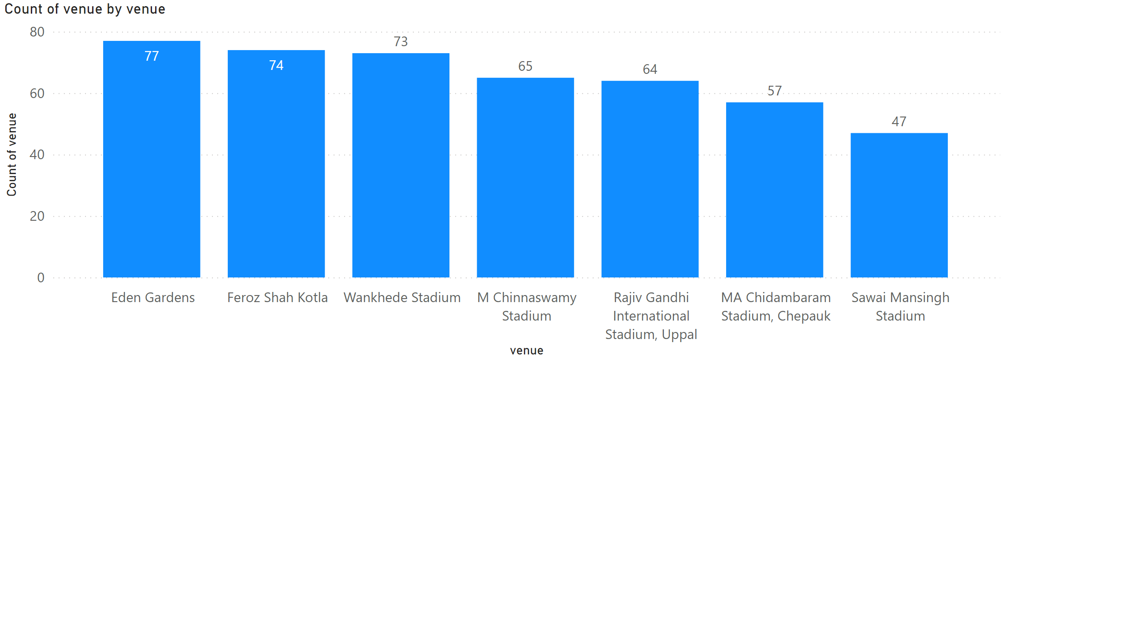
Page 3
Notes:
columnChart
No alt text provided

